Slide 1
Algorithms and Complexities NP-Completeness （Part I)
刘盛云

Slide 2
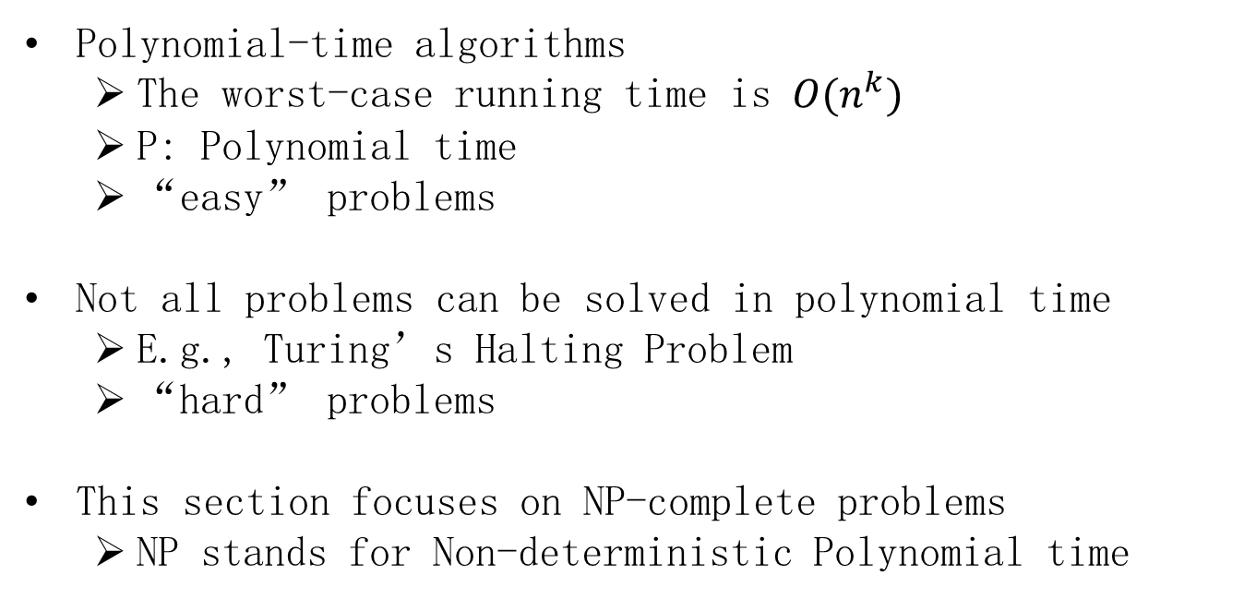
Overview
Polynomial-time algorithms
The worst-case running time is $O(n^{k})$
P: Polynomial time
“easy” problems
Not all problems can be solved in polynomial time
E.g., Turing’s Halting Problem
“hard” problems
This section focuses on NP-complete problems
NP stands for Non-deterministic Polynomial time

Slide 3
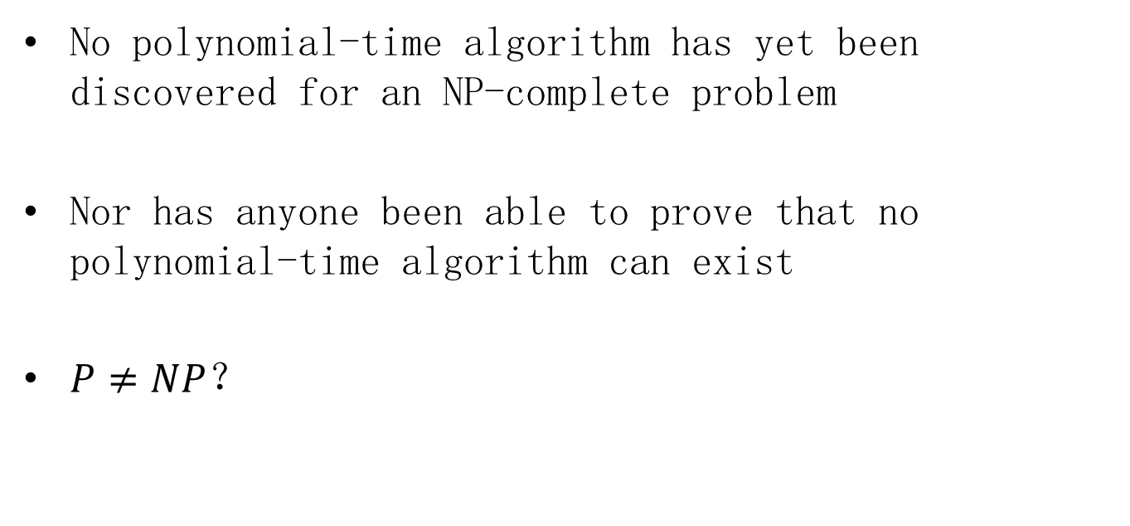
NP-complete problems
No polynomial-time algorithm has yet been discovered for an NP-complete problem
Nor has anyone been able to prove that no polynomial-time algorithm can exist
$P≠NP$？

Slide 4
Examples
P | NP-complete
Shortest path | longest simple path
Euler tour | hamiltonian cycle
2-CNF satisﬁability | 3-CNF satisﬁability
Notes:
Conjunctive Normal Form

Slide 5
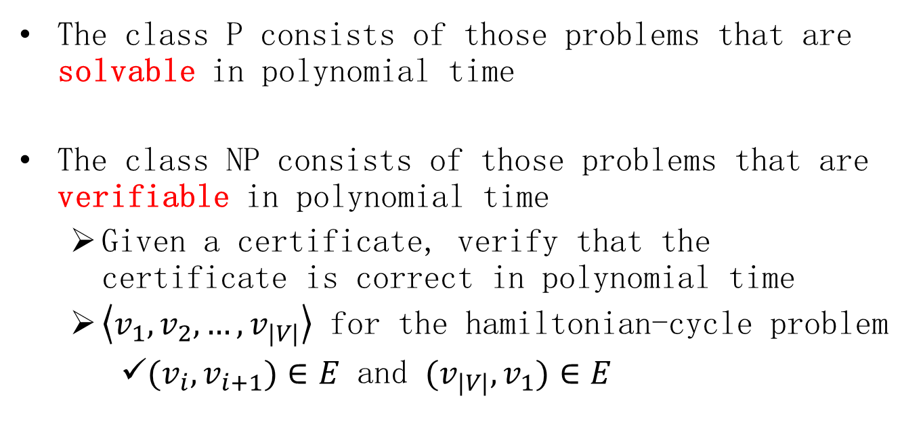
P vs. NP vs. NPC (informal)
The class P consists of those problems that are solvable in polynomial time
The class NP consists of those problems that are verifiable in polynomial time
Given a certificate, verify that the certificate is correct in polynomial time
$\left\langle v_{1},v_{2},…,v_{|V|}\right\rangle$ for the hamiltonian-cycle problem
${(v}_{i},v_{i+1})∈E$ and ${(v}_{|V|},v_{1})∈E$

Slide 6
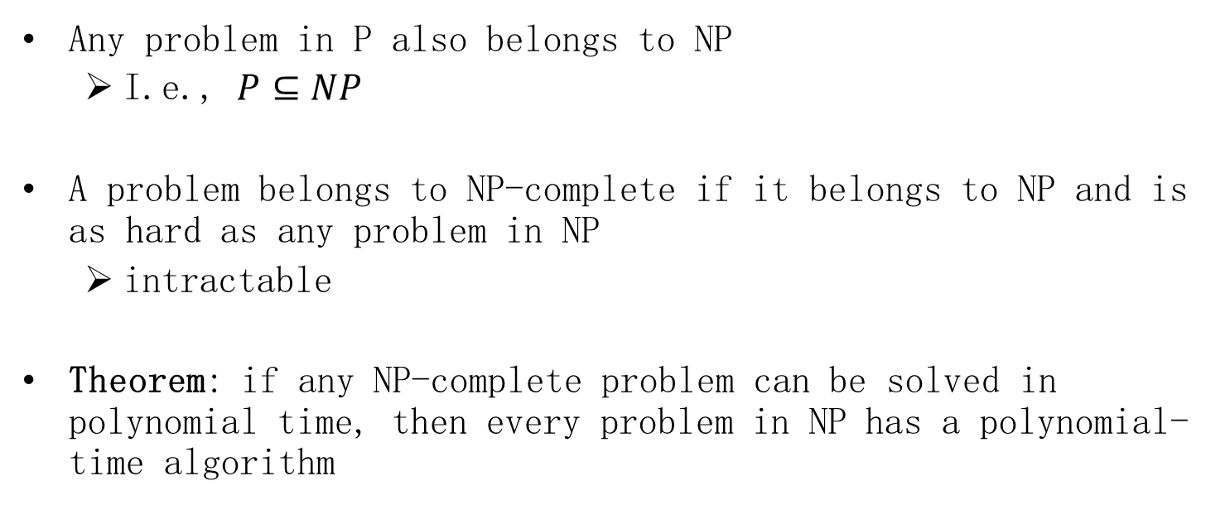
P vs. NP vs. NPC (informal)
Any problem in P also belongs to NP
I.e., $P⊆NP$
A problem belongs to NP-complete if it belongs to NP and is as hard as any problem in NP
intractable
Theorem: if any NP-complete problem can be solved in polynomial time, then every problem in NP has a polynomial-time algorithm

Slide 7
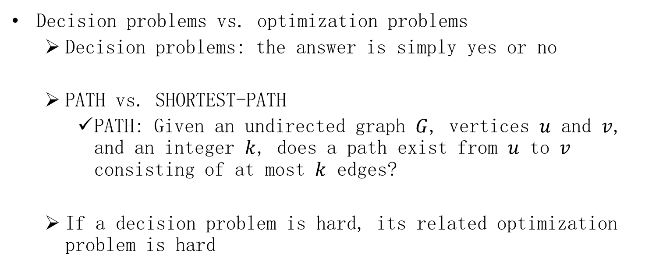
Showing problems to be NP-complete
Decision problems vs. optimization problems
Decision problems: the answer is simply yes or no
PATH vs. SHORTEST-PATH
PATH: Given an undirected graph $G$, vertices $u$ and $v$, and an integer $k$, does a path exist from $u$ to $v$ consisting of at most $k$ edges?
If a decision problem is hard, its related optimization problem is hard
Notes:
given an undirected graph G, vertices u and v, and an integer k , does a path exist from u to v consisting of at most k edges?

Slide 8
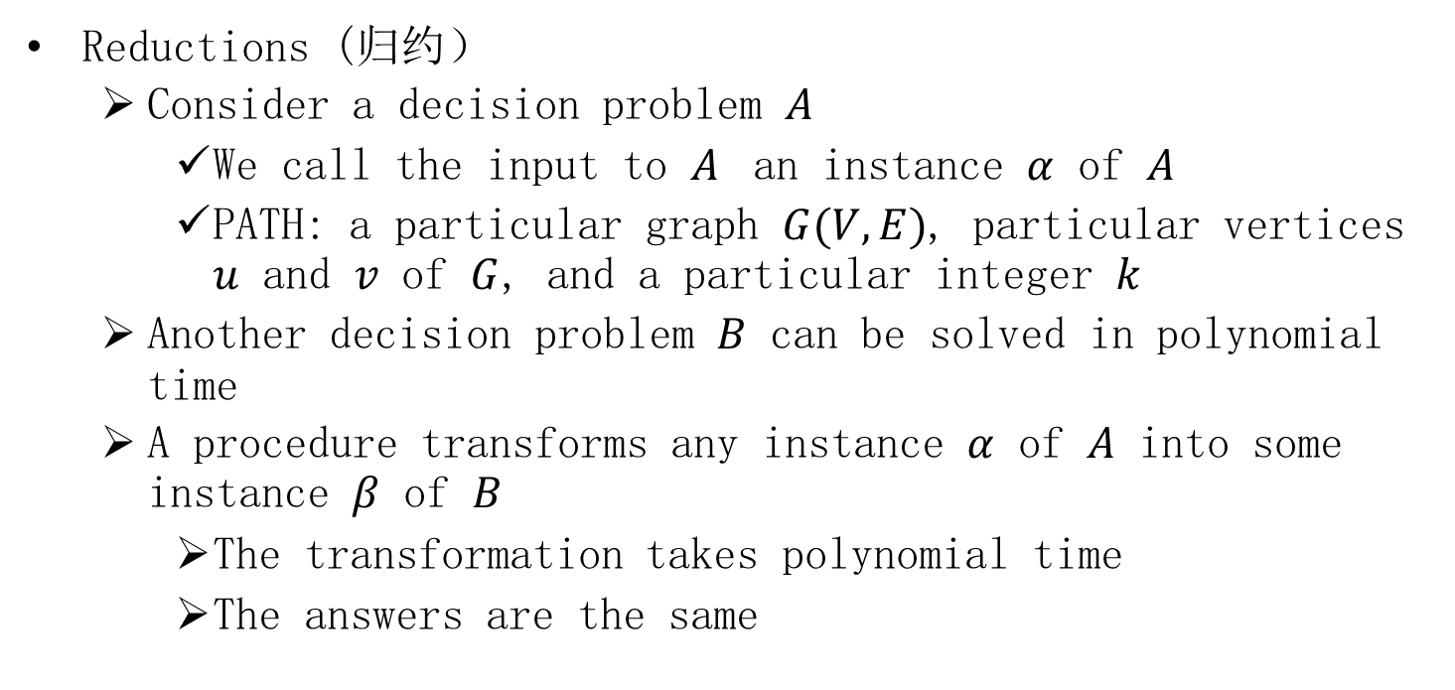
Showing problems to be NP-complete
Reductions (归约）
Consider a decision problem $A$
We call the input to $A$ an instance $α$ of $A$
PATH: a particular graph $G(V,E)$, particular vertices $u$ and $v$ of $G$, and a particular integer $k$
Another decision problem $B$ can be solved in polynomial time
A procedure transforms any instance $α$ of $A$ into some instance $β$ of $B$
The transformation takes polynomial time
The answers are the same

Slide 9
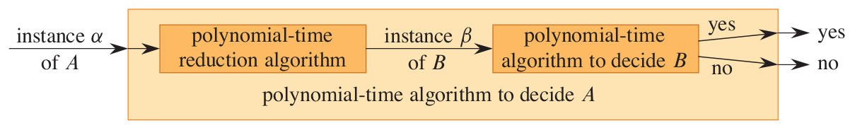
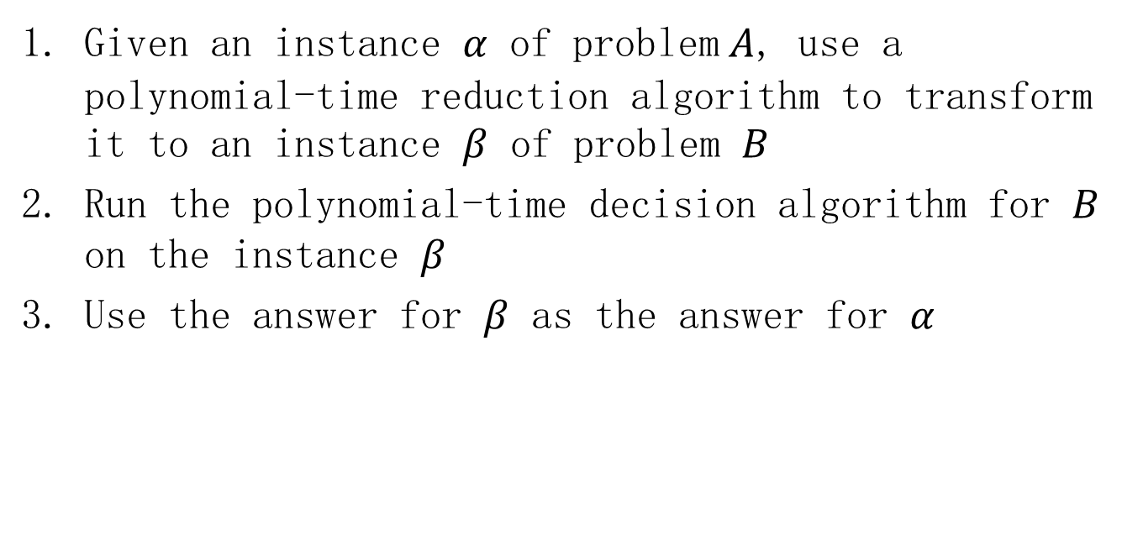
Reductions
Given an instance $α$ of problem$A$, use a polynomial-time reduction algorithm to transform it to an instance $β$ of problem $B$
Run the polynomial-time decision algorithm for $B$ on the instance $β$
Use the answer for $β$ as the answer for $α$

Slide 10
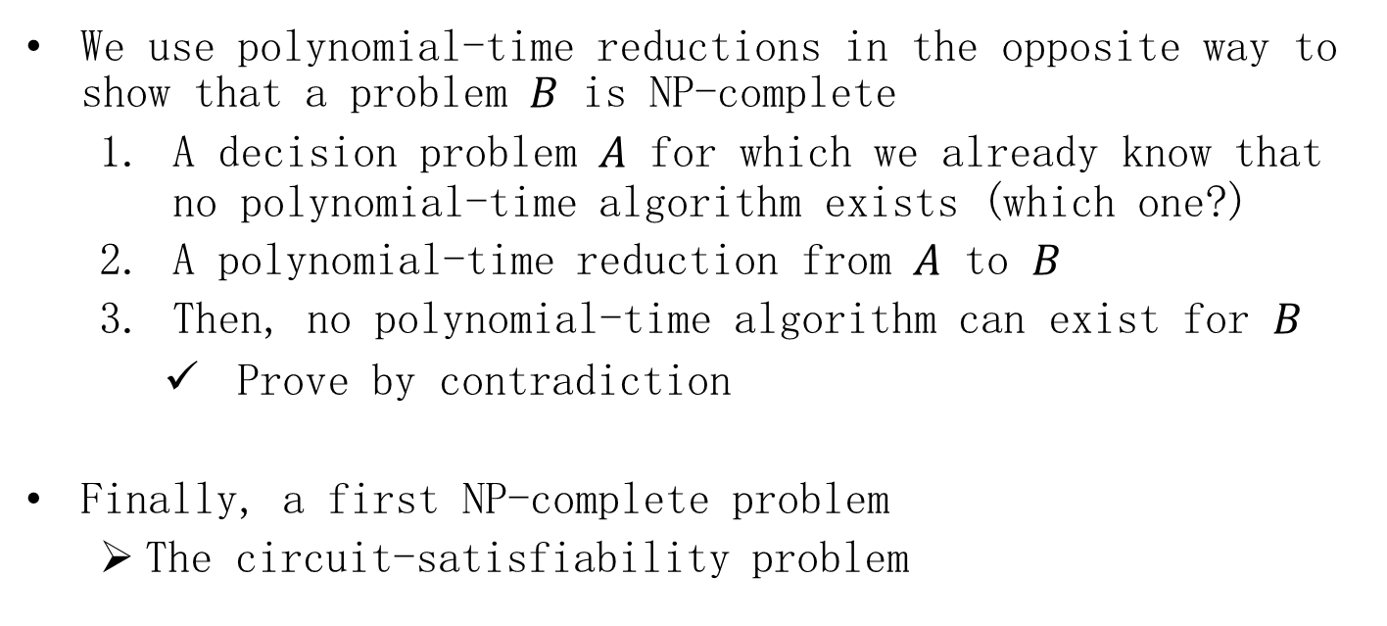
Showing problems to be NP-complete
We use polynomial-time reductions in the opposite way to show that a problem $B$ is NP-complete
A decision problem $A$ for which we already know that no polynomial-time algorithm exists (which one?)
A polynomial-time reduction from $A$ to $B$
Then, no polynomial-time algorithm can exist for $B$
Prove by contradiction
Finally, a first NP-complete problem
The circuit-satisfiability problem

Slide 11
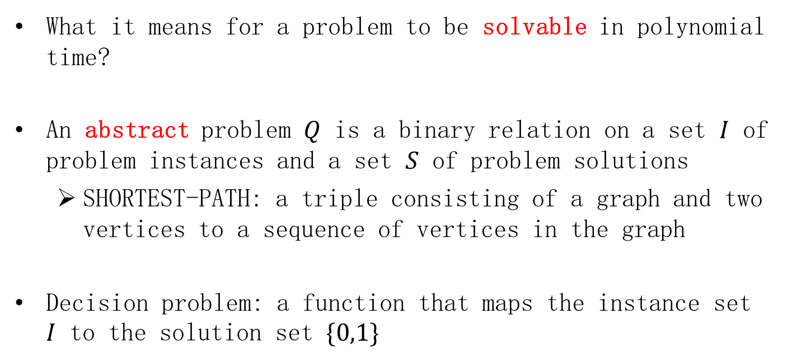
Polynomial time
What it means for a problem to be solvable in polynomial time?
An abstract problem $Q$ is a binary relation on a set $I$ of problem instances and a set $S$ of problem solutions
SHORTEST-PATH: a triple consisting of a graph and two vertices to a sequence of vertices in the graph
Decision problem: a function that maps the instance set $I$ to the solution set $\{0,1\}$

Slide 12
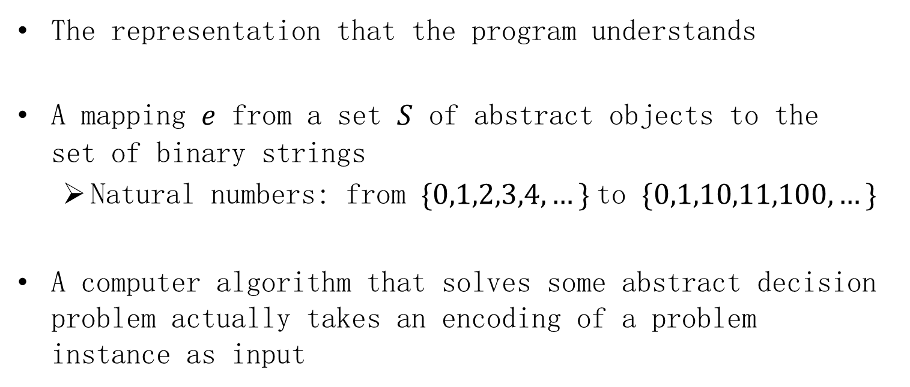
Encodings
The representation that the program understands
A mapping $e$ from a set $S$ of abstract objects to the set of binary strings
Natural numbers: from $\{0,1,2,3,4,…\}$to $\{0,1,10,11,100,…\}$
A computer algorithm that solves some abstract decision problem actually takes an encoding of a problem instance as input

Slide 13
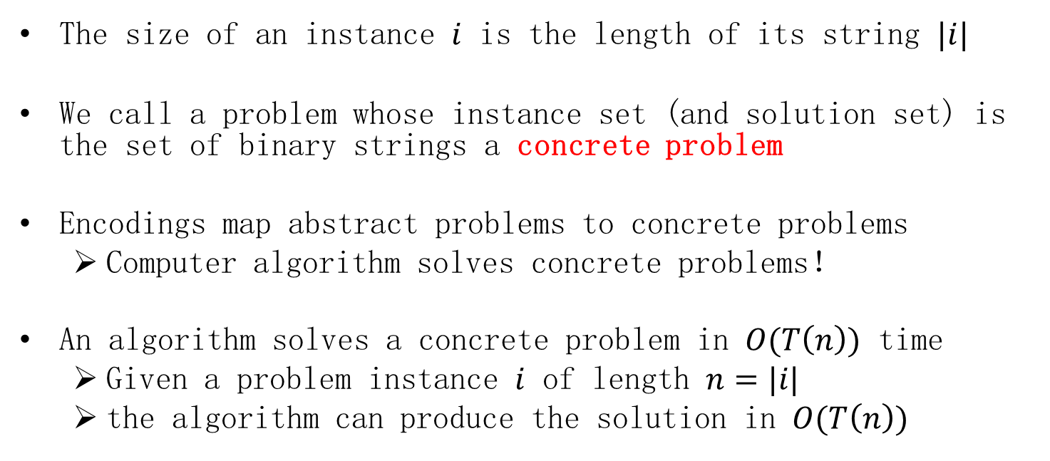
Encodings
The size of an instance $i$ is the length of its string $|i|$
We call a problem whose instance set (and solution set) is the set of binary strings a concrete problem
Encodings map abstract problems to concrete problems
Computer algorithm solves concrete problems！
An algorithm solves a concrete problem in $O(T\left(n\right))$ time
Given a problem instance $i$ of length $n=|i|$
the algorithm can produce the solution in $O(T\left(n\right))$

Slide 14
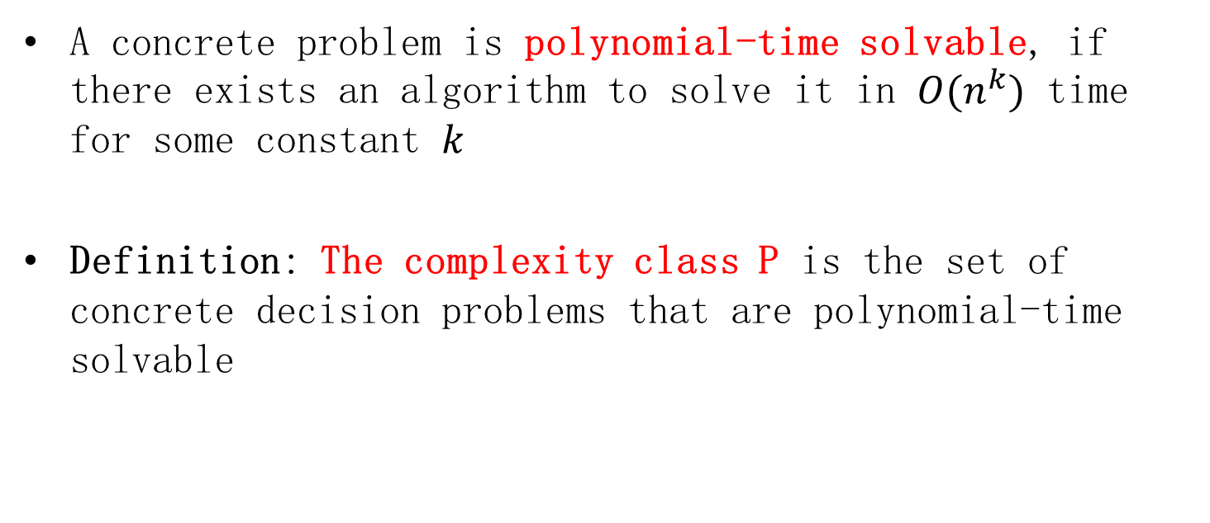
The complexity class P
A concrete problem is polynomial-time solvable, if there exists an algorithm to solve it in $O(n^{k})$ time for some constant $k$
Definition: The complexity class P is the set of concrete decision problems that are polynomial-time solvable

Slide 15
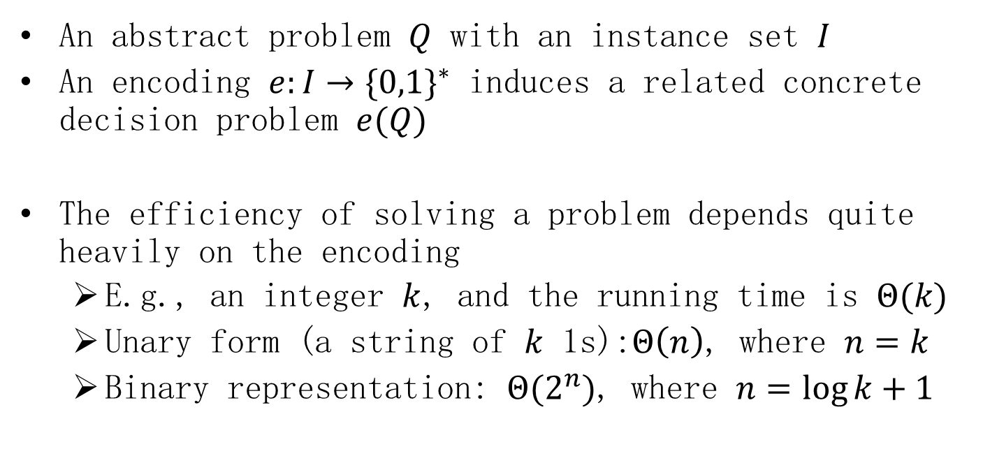
Encodings
An abstract problem $Q$ with an instance set $I$
An encoding $e:I→{\{0,1\}}^{∗}$ induces a related concrete decision problem $e(Q)$
The efficiency of solving a problem depends quite heavily on the encoding
E.g., an integer $k$, and the running time is $Θ(k)$
Unary form (a string of $k$ 1s):$Θ\left(n\right)$, where $n=k$
Binary representation: $Θ(2^{n})$, where $n=\log{k}+1$

Slide 16
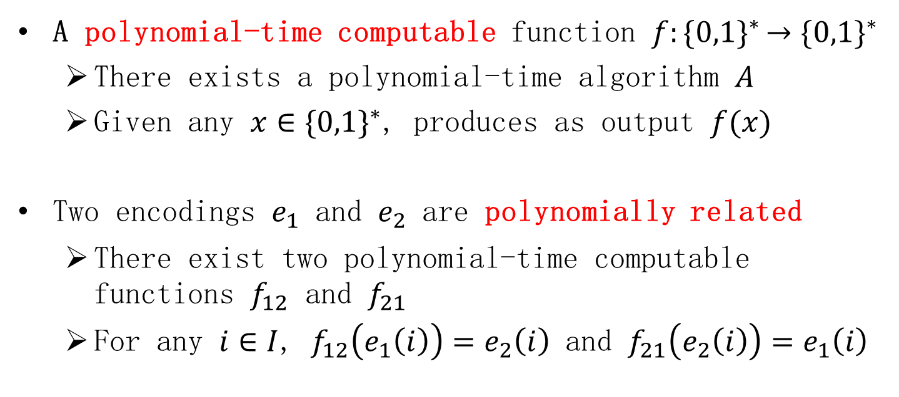
Encodings
A polynomial-time computable function $f{:\{0,1\}}^{∗}→{\{0,1\}}^{∗}$
There exists a polynomial-time algorithm $A$
Given any $x∈{\{0,1\}}^{∗}$, produces as output $f(x)$
Two encodings $e_{1}$ and $e_{2}$ are polynomially related
There exist two polynomial-time computable functions $f_{12}$ and $f_{21}$
For any $i∈I$, $f_{12}\left(e_{1}\left(i\right)\right)=e_{2}\left(i\right)$ and $f_{21}\left(e_{2}\left(i\right)\right)=e_{1}\left(i\right)$

Slide 17

Encodings
Lemma. Let Q be an abstract decision problem on an instance set $I$, and let $e_{1}$ and $e_{2}$ be polynomially related encodings on $I$. Then, $e_{1}\left(Q\right)∈P$ if and only if $e_{2}\left(Q\right)∈P$

Slide 18
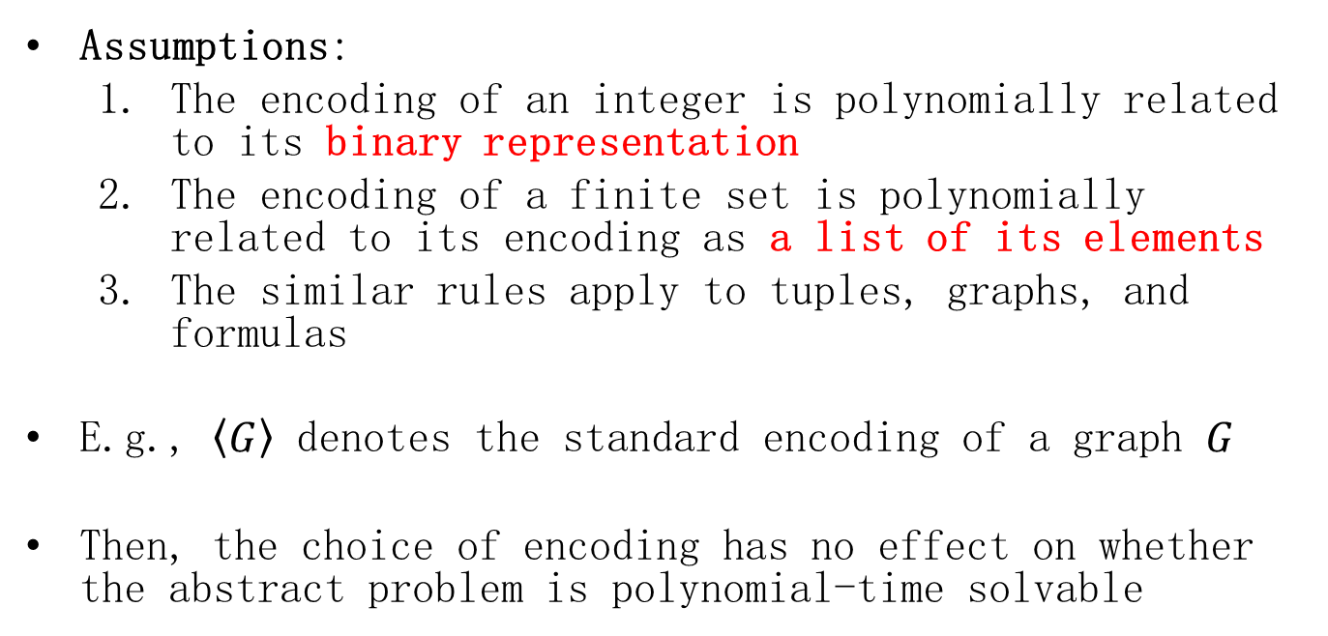
Encodings
Assumptions:
The encoding of an integer is polynomially related to its binary representation
The encoding of a finite set is polynomially related to its encoding as a list of its elements
The similar rules apply to tuples, graphs, and formulas
E.g., $\left\langle G\right\rangle$ denotes the standard encoding of a graph $G$
Then, the choice of encoding has no effect on whether the abstract problem is polynomial-time solvable

Slide 19
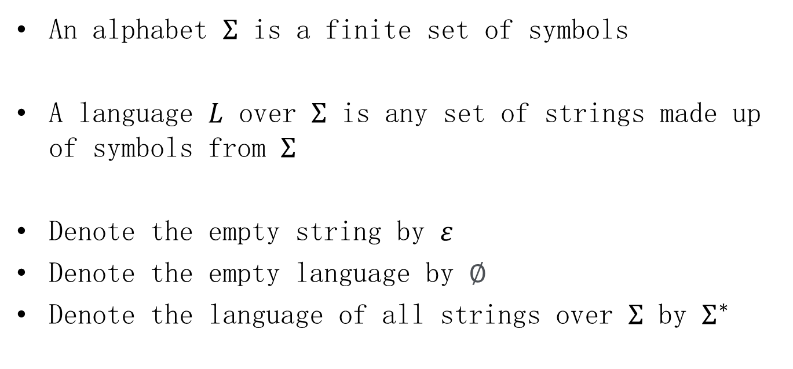
A formal-language framework
An alphabet $Σ$ is a finite set of symbols
A language $L$ over $Σ$ is any set of strings made up of symbols from $Σ$
Denote the empty string by $ε$
Denote the empty language by $∅$
Denote the language of all strings over $Σ$ by $Σ^{∗}$

Slide 20
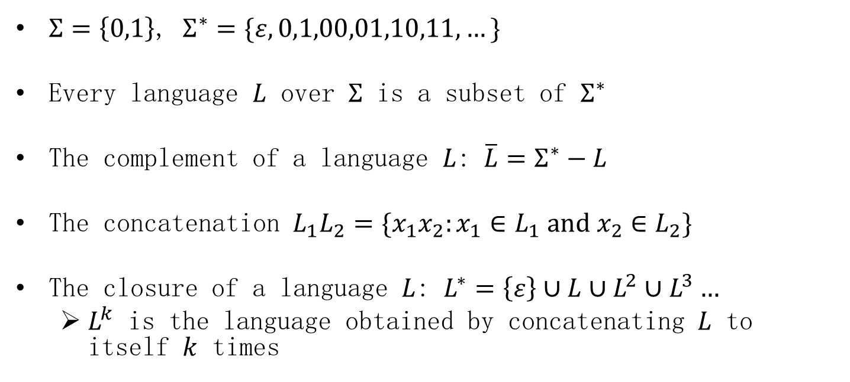
A formal-language framework
$Σ=\left\{0,1\right\}$, $Σ^{∗}=\{ε,0,1,00,01,10,11,…\}$
Every language $L$ over $Σ$ is a subset of $Σ^{∗}$
The complement of a language $L$: $\overline{L}=Σ^{∗}−L$
The concatenation $L_{1}L_{2}=\{x_{1}x_{2}:x_{1}∈L_{1} and x_{2}∈L_{2}\}$
The closure of a language $L$: $L^{∗}=\left\{ε\right\}∪L∪L^{2}∪L^{3}…$
$L^{k}$ is the language obtained by concatenating $L$ to itself $k$ times

Slide 21
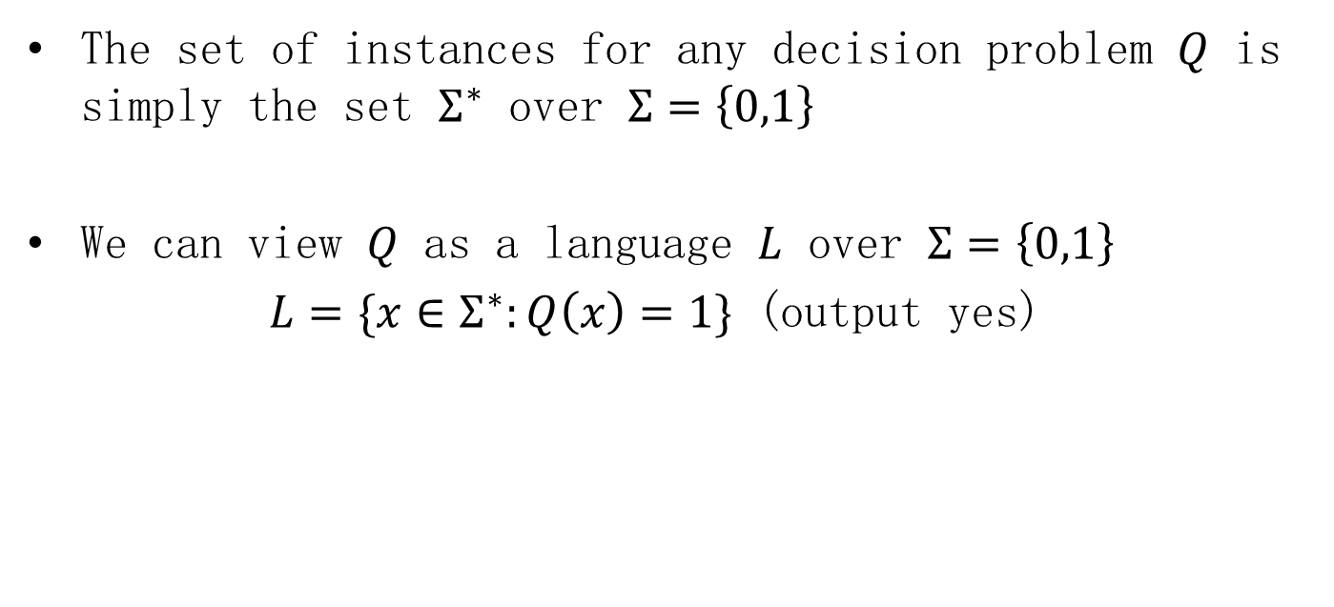
A formal-language framework
The set of instances for any decision problem $Q$ is simply the set $Σ^{∗}$ over $Σ=\left\{0,1\right\}$
We can view $Q$ as a language $L$ over $Σ=\left\{0,1\right\}$
$L=\{x∈Σ^{∗}:Q\left(x\right)=1\}$ (output yes)

Slide 22
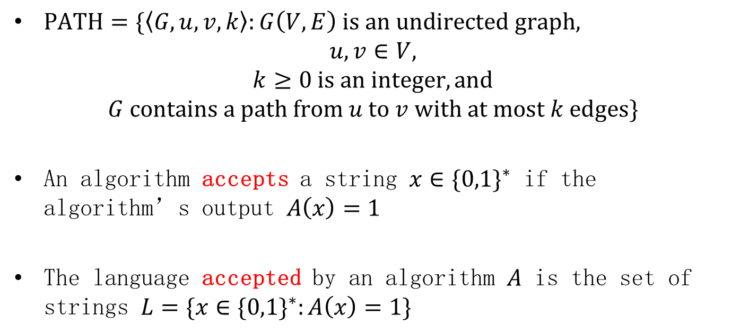
A formal-language framework
$PATH=\{\left\langle G,u,v,k\right\rangle :G\left(V, E\right) is an undirected graph,$
$$u,v∈V,$$
$$k≥0 is an integer, and$$
$$G contains a path from u to v with at most k edges\}$$
An algorithm accepts a string $x∈{\{0,1\}}^{∗}$ if the algorithm’s output $A\left(x\right)=1$
The language accepted by an algorithm $A$ is the set of strings $L=\{x∈{\{0,1\}}^{∗}:A\left(x\right)=1\}$

Slide 23
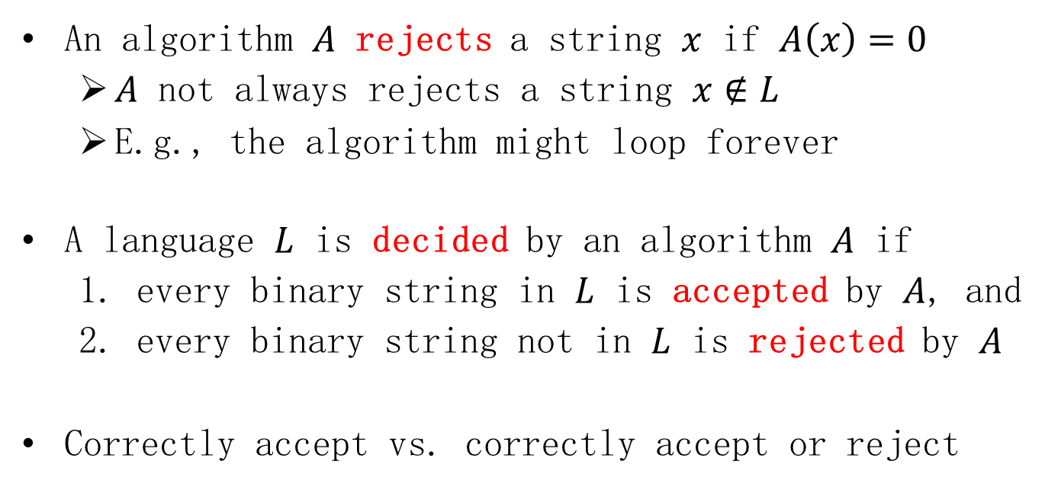
A formal-language framework
An algorithm $A$ rejects a string $x$ if $A\left(x\right)=0$
$A$ not always rejects a string $x∉L$
E.g., the algorithm might loop forever
A language $L$ is decided by an algorithm $A$ if
every binary string in $L$ is accepted by $A$, and
every binary string not in $L$ is rejected by $A$
Correctly accept vs. correctly accept or reject

Slide 24
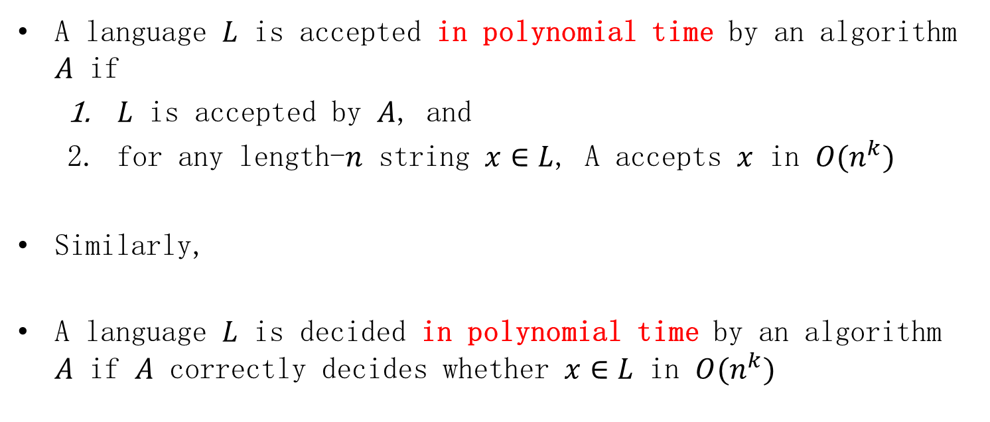
A formal-language framework
A language $L$ is accepted in polynomial time by an algorithm $A$ if
$L$ is accepted by $A$, and
for any length-$n$ string $x∈L$, A accepts $x$ in $O(n^{k})$
Similarly,
A language $L$ is decided in polynomial time by an algorithm $A$ if $A$ correctly decides whether $x∈L$ in $O(n^{k})$

Slide 25
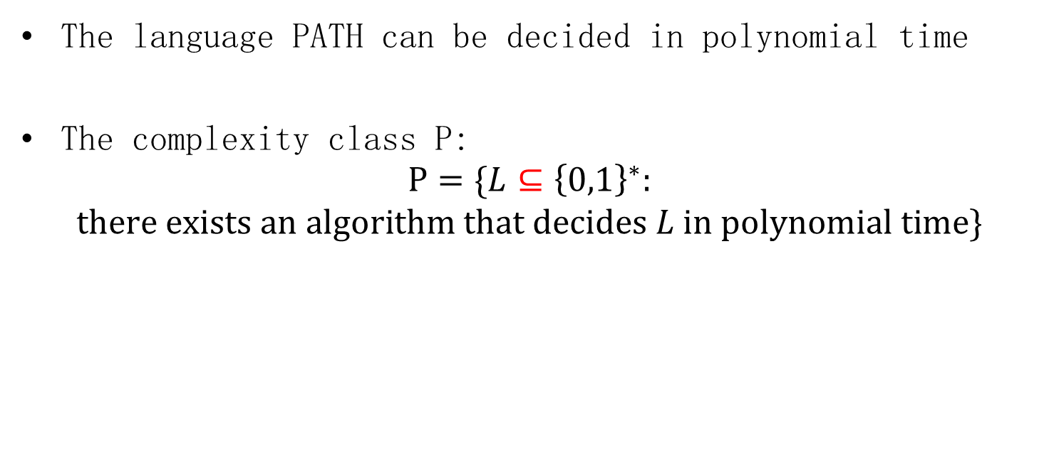
A formal-language framework
The language PATH can be decided in polynomial time
The complexity class P:
$$P=\{L⊆{\left\{0,1\right\}}^{∗}:$$
$$there exists an algorithm that decides L in polynomial time\}$$

