Slide 1
Algorithms and Complexities NP-Completeness （Part II)
刘盛云

Slide 2
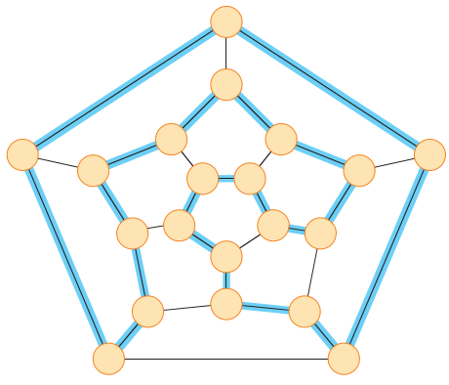
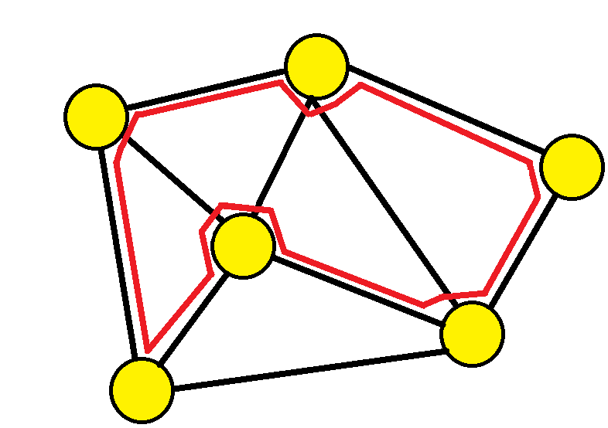

Hamiltonian cycles
A hamiltonian cycle of an undirected graph $G=(V,E)$is a cycle that visits each vertex exactly once

Slide 3
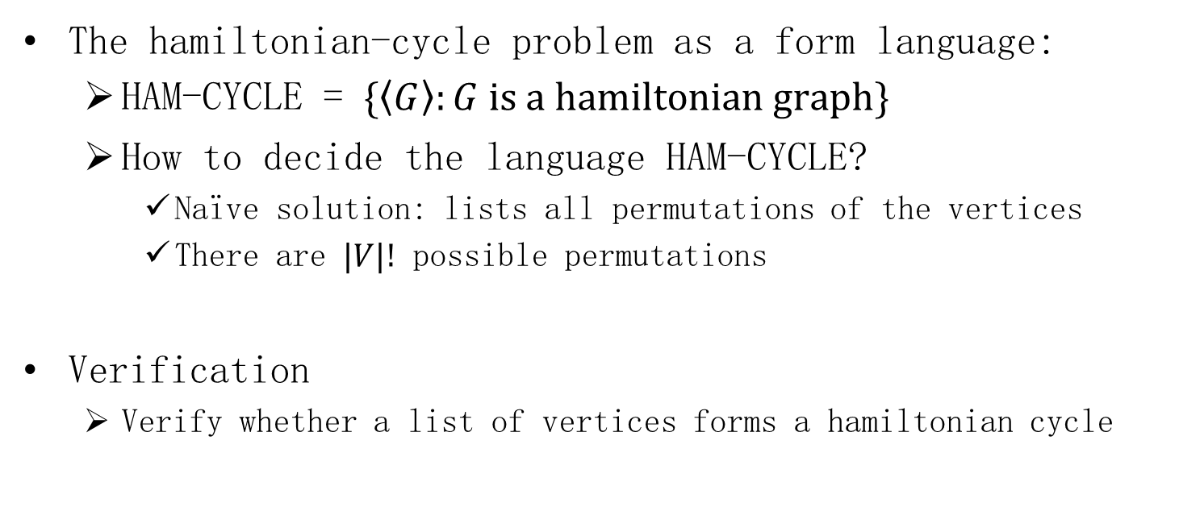
Hamiltonian cycles
The hamiltonian-cycle problem as a form language:
HAM-CYCLE = $\{\left\langle G\right\rangle :G is a hamiltonian graph\}$
How to decide the language HAM-CYCLE?
Naïve solution: lists all permutations of the vertices
There are $|V|!$ possible permutations
Verification
Verify whether a list of vertices forms a hamiltonian cycle

Slide 4
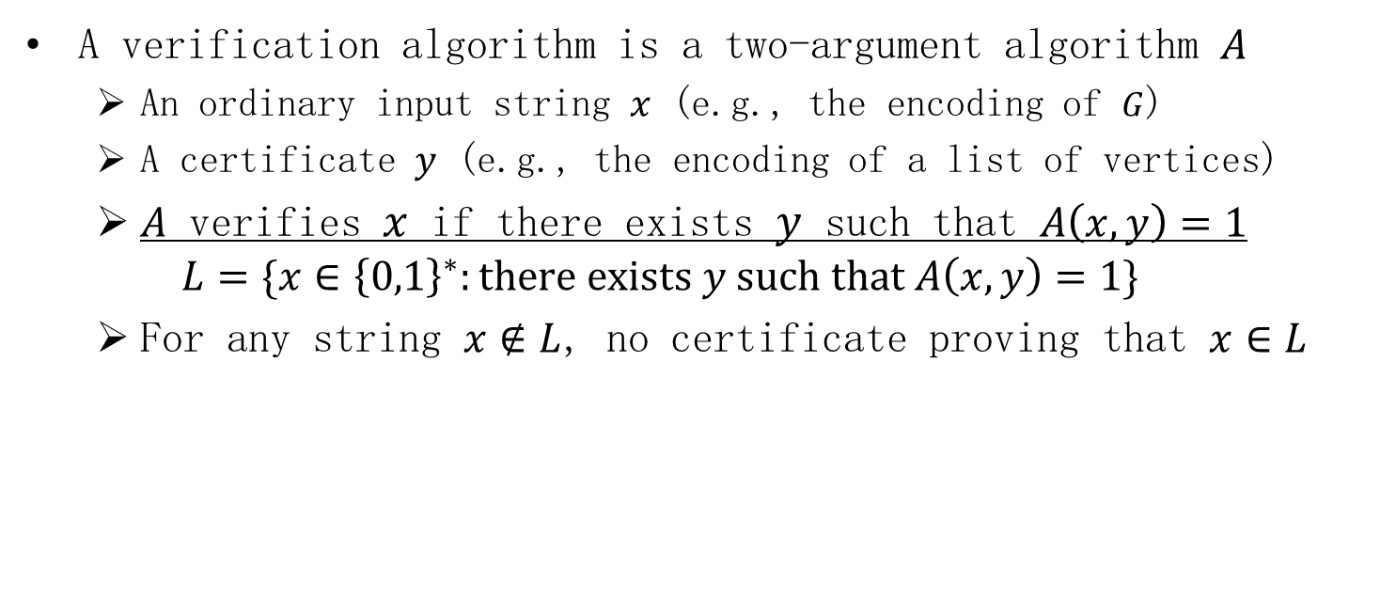
Veriﬁcation algorithm
A verification algorithm is a two-argument algorithm $A$
An ordinary input string $x$ (e.g., the encoding of $G$)
A certificate $y$ (e.g., the encoding of a list of vertices)
$A$ verifies $x$ if there exists $y$ such that $A\left(x,y\right)=1$
$$L=\{x∈{\left\{0,1\right\}}^{∗}:there exists y such that A\left(x,y\right)=1\}$$
For any string $x∉L$, no certificate proving that $x∈L$

Slide 5
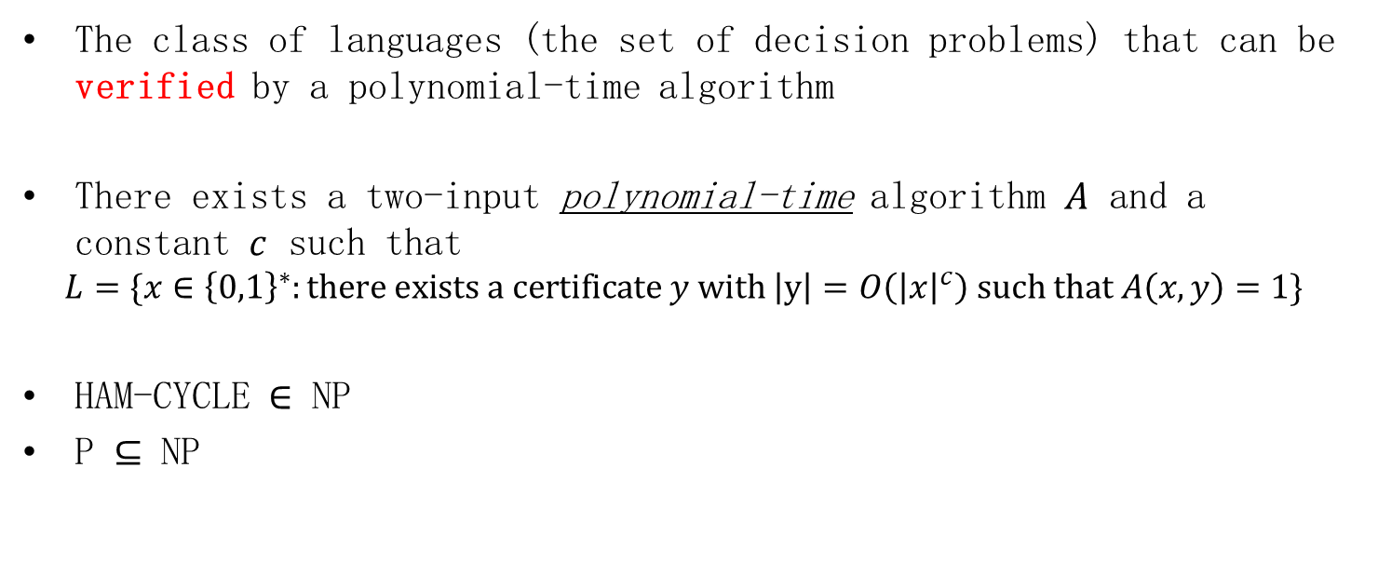
The complexity class NP
The class of languages (the set of decision problems) that can be verified by a polynomial-time algorithm
There exists a two-input polynomial-time algorithm $A$ and a constant $c$ such that
$$L=\{x∈{\left\{0,1\right\}}^{∗}:there exists a certificate y with \left|y\right|=O\left({\left|x\right|}^{c}\right) such that A\left(x,y\right)=1\}$$
HAM-CYCLE $∈$ NP
P $⊆$ NP

Slide 6
P vs. NP
The class P consists of problems that can be solved quickly
The class NP consists of problems for which a solution can be verified quickly

Slide 7
The class of NP-complete problems
If any NP-complete problem can be solved in polynomial time, then every problem in NP has a polynomial-time solution
The “hardest” languages in NP
HAM-CYCLE is an NP-complete problem

Slide 8

Reducibility
Recast one problem $Q$ as a different problem $Q’$
Any instance of $Q$ can be recast as an instance of $Q’$
The solution to the instance of $Q’$ provides a solution to the instance of $Q$
Q is, in a sense, no “harder” to solve than $Q’$

Slide 9
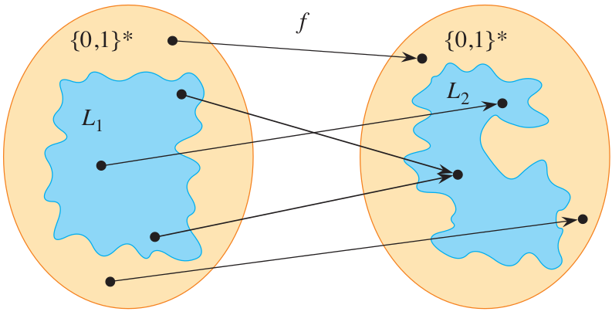
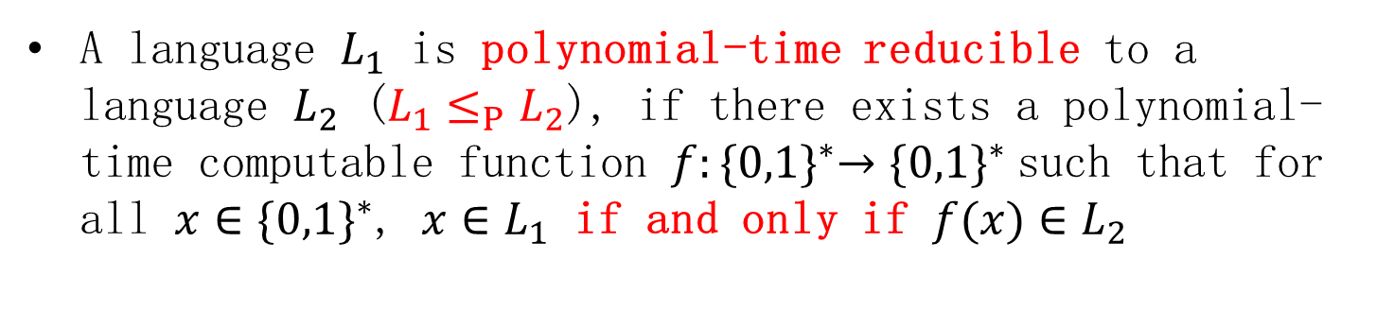

Reducibility: Definition
A language $L_{1}$ is polynomial-time reducible to a language $L_{2}$ (${L_{1}≤}_{P}L_{2}$), if there exists a polynomial-time computable function $f:{\{0,1\}}^{∗}→{\{0,1\}}^{∗}$ such that for all ${x∈\{0,1\}}^{∗}$, $x∈L_{1}$ if and only if $f(x)∈L_{2}$
$F:$ reduction algorithm
$f:$ reduction function

Slide 10
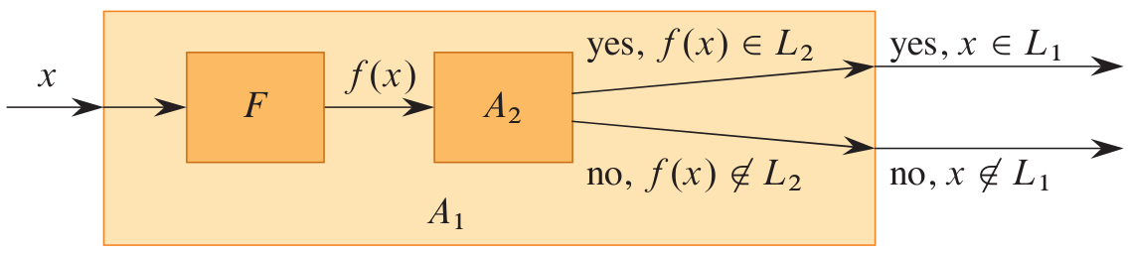

Important lemma
If $L_{1},L_{2}⊆{\left\{0,1\right\}}^{∗}$ are languages such that ${L_{1}≤}_{P}L_{2}$, then $L_{2}∈P$ implies $L_{1}∈P.$

Slide 11
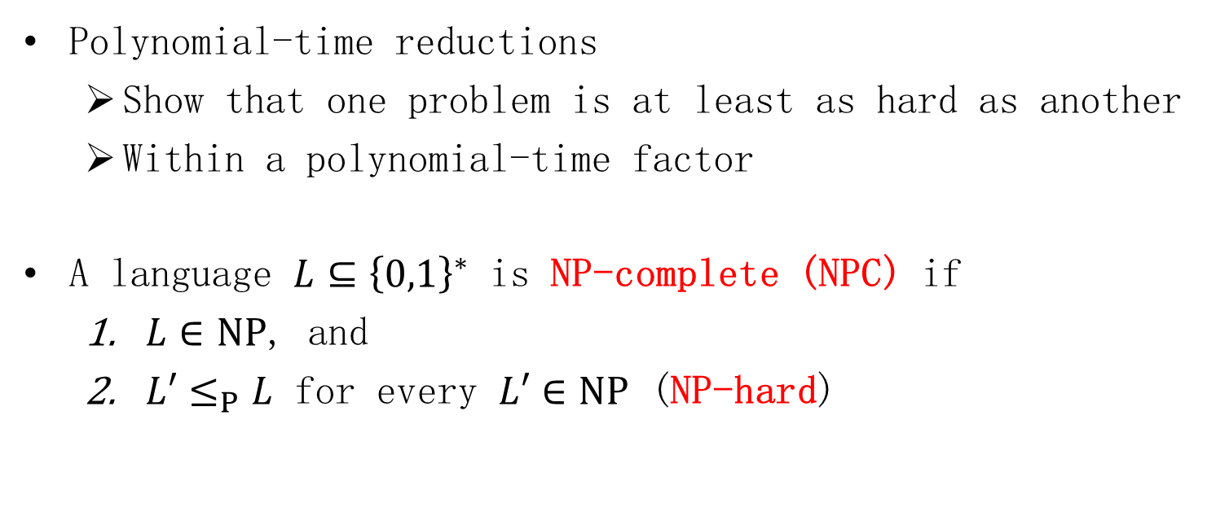
NP-completeness
Polynomial-time reductions
Show that one problem is at least as hard as another
Within a polynomial-time factor
A language $L⊆{\left\{0,1\right\}}^{∗}$ is NP-complete (NPC) if
$L∈NP$, and
${L′≤}_{P}L$ for every $L′∈NP$ (NP-hard)

Slide 12
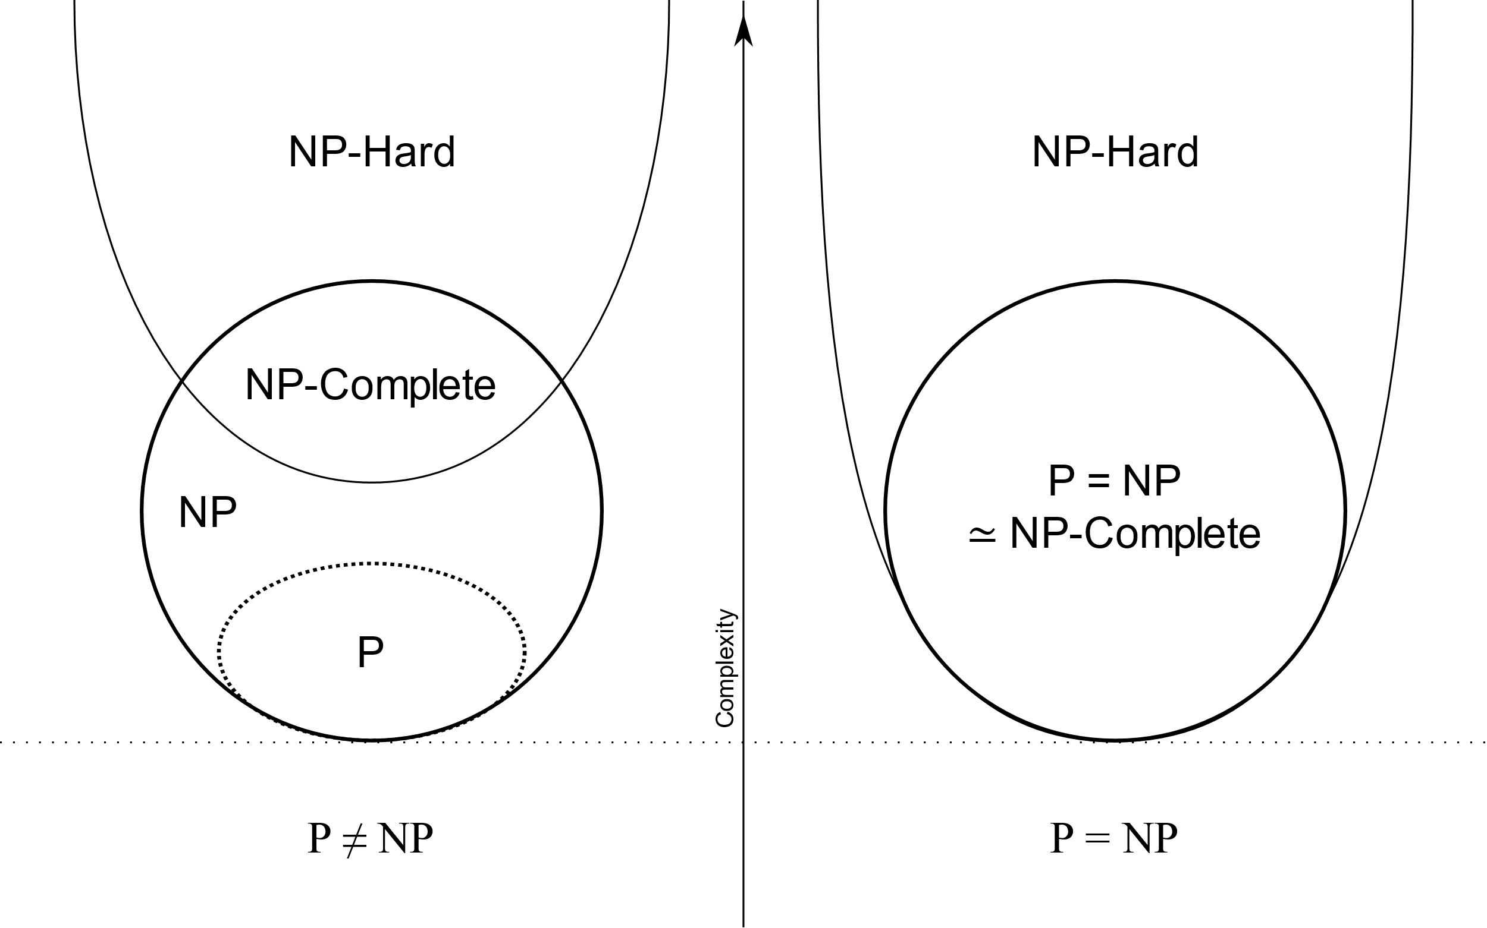
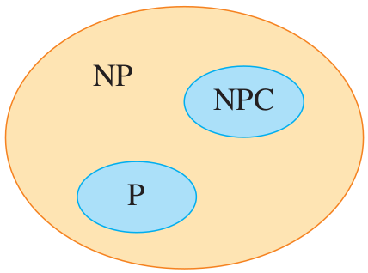
Important theorem
If any NP-complete problem is polynomial-time solvable, then P = NP
If any problem in NP is not polynomial-time solvable, then no NP-complete problem is polynomial-time solvable
The relationship most theoretical computer scientists believe

Slide 13
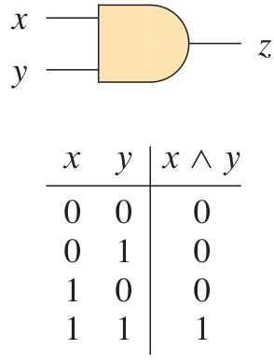
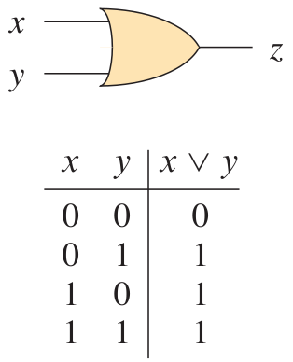
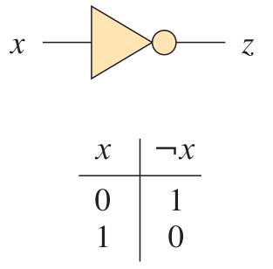
The circuit-satisfiability problem
The NOT gate
The AND gate
The OR gate
A Boolean combinational circuit consists of one or more Boolean combinational gates interconnected by wires

Slide 14
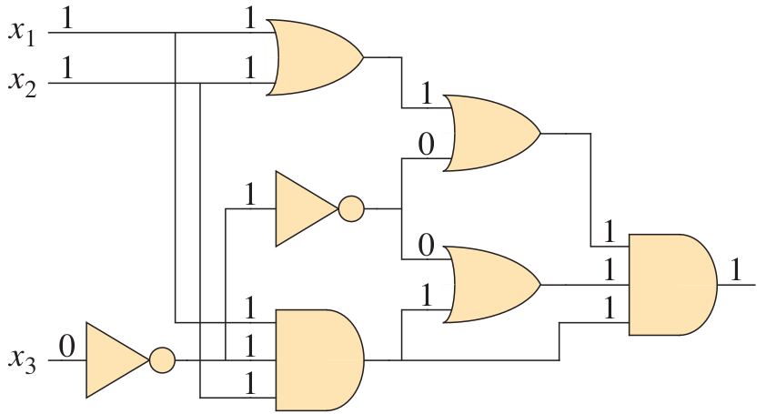
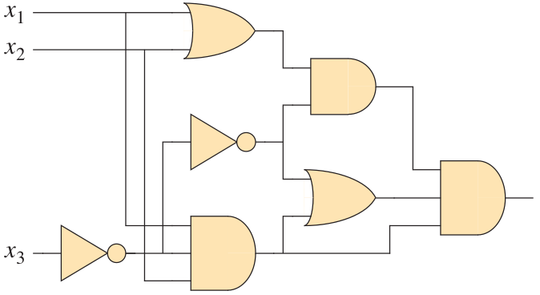
The circuit-satisfiability problem
A 1-output Boolean combinational circuit is satisfiable if it has a satisfying assignment
Naïve solution: check all possible assignments
satisfiable
unsatisfiable

Slide 15
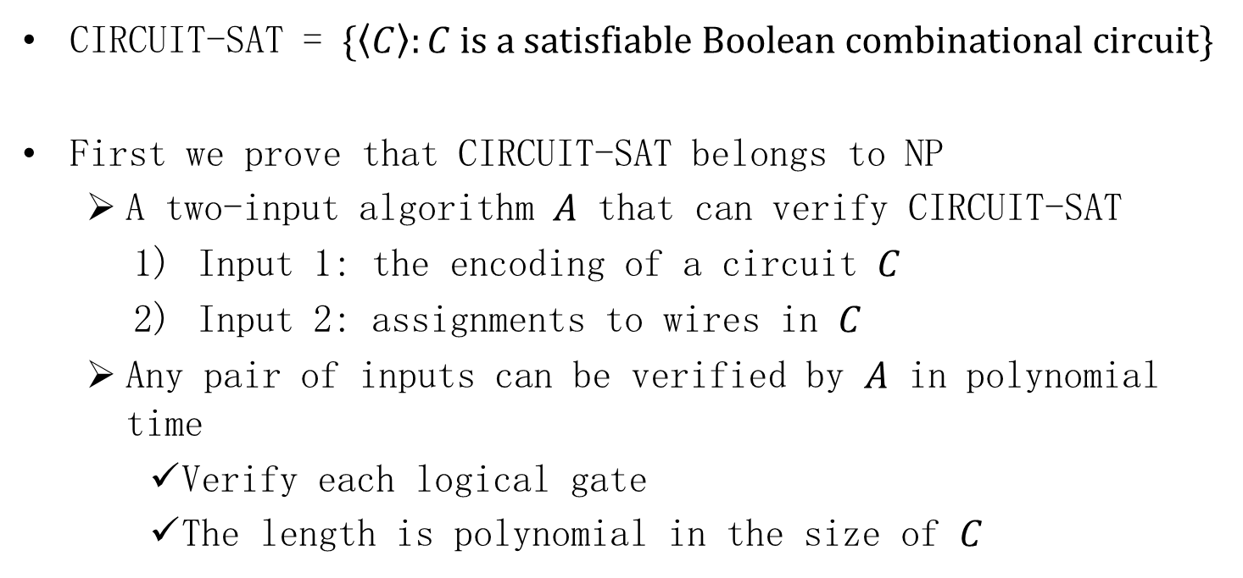
The circuit-satisfiability problem
CIRCUIT-SAT = $\{\left\langle C\right\rangle :C is a satisfiable Boolean combinational circuit\}$
First we prove that CIRCUIT-SAT belongs to NP
A two-input algorithm $A$ that can verify CIRCUIT-SAT
Input 1: the encoding of a circuit $C$
Input 2: assignments to wires in $C$
Any pair of inputs can be verified by $A$ in polynomial time
Verify each logical gate
The length is polynomial in the size of $C$

Slide 16
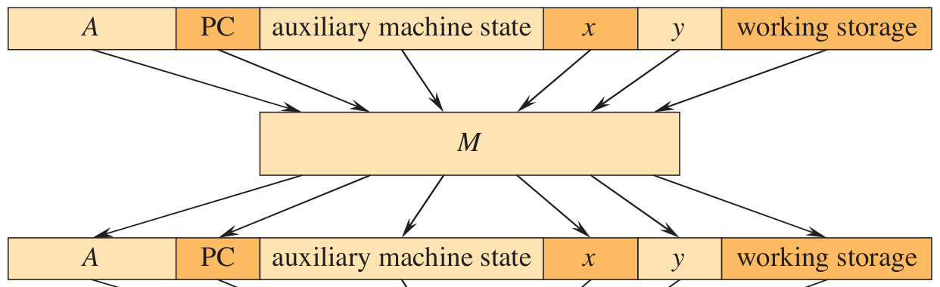
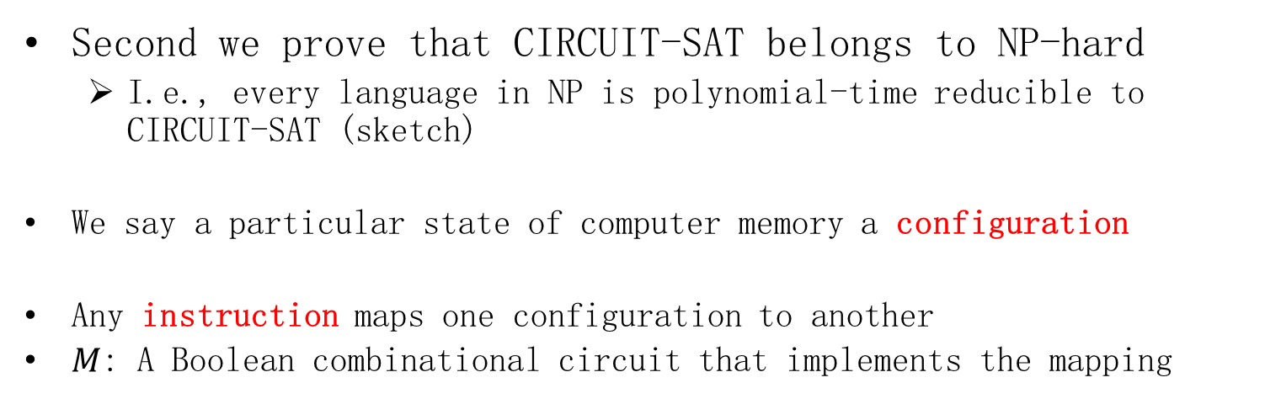
The circuit-satisfiability problem
Second we prove that CIRCUIT-SAT belongs to NP-hard
I.e., every language in NP is polynomial-time reducible to CIRCUIT-SAT (sketch)
We say a particular state of computer memory a configuration
Any instruction maps one configuration to another
$M$: A Boolean combinational circuit that implements the mapping

Slide 17
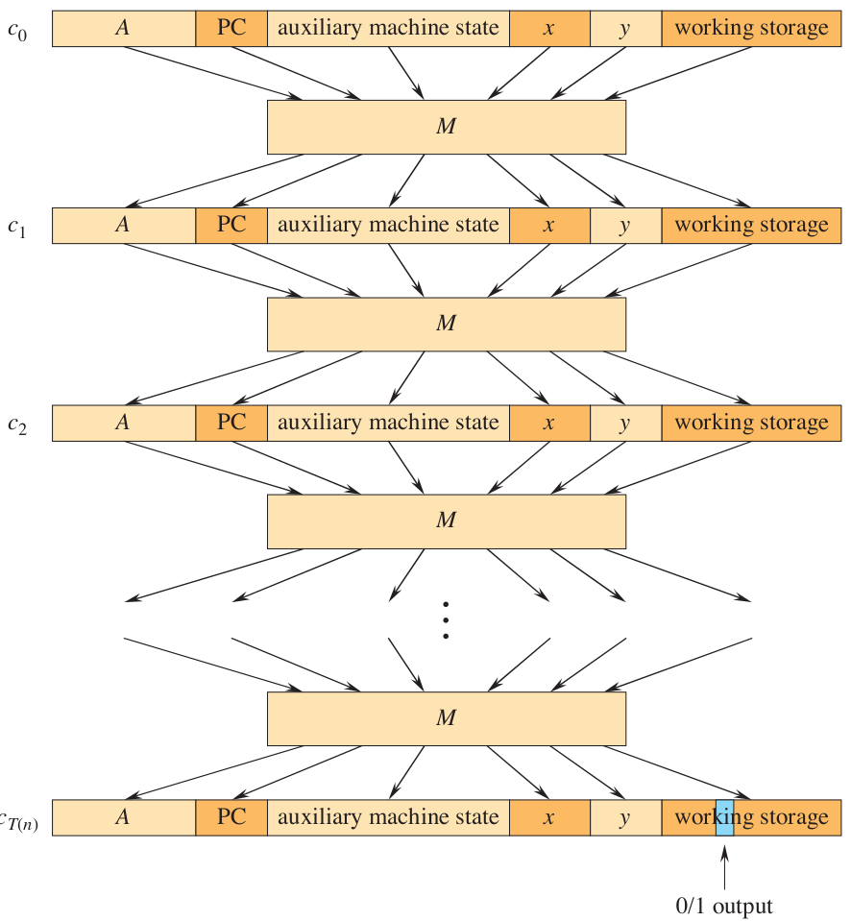
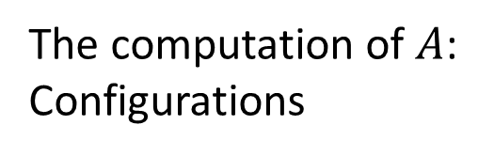
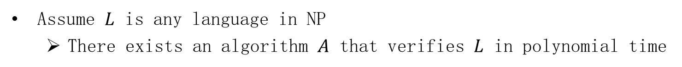
The circuit-satisfiability problem
Assume $L$ is any language in NP
There exists an algorithm $A$ that verifies $L$ in polynomial time
The computation of $A$:
Configurations
A single combinational circuit

Slide 18
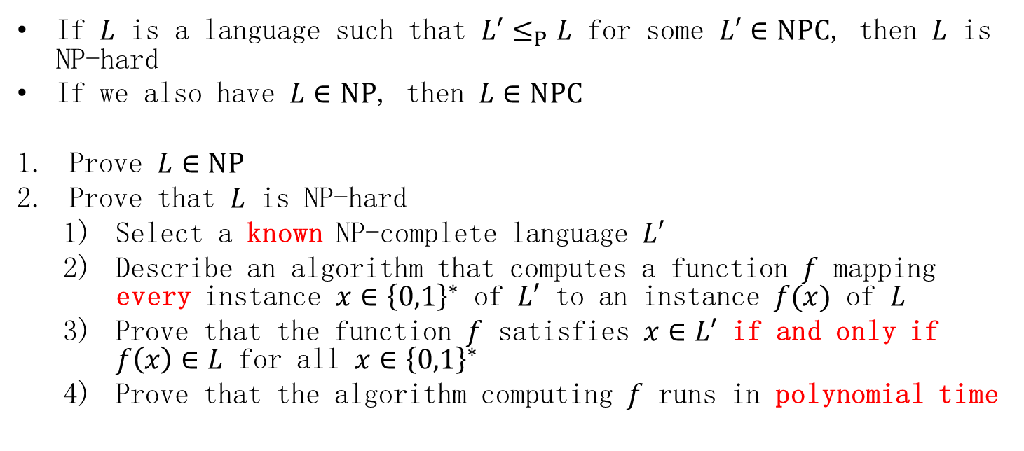
NP-completeness proofs (important)
If $L$ is a language such that ${L′≤}_{P}L$ for some $L′∈NPC$, then $L$ is NP-hard
If we also have $L∈NP$, then $L∈NPC$
Prove $L∈NP$
Prove that $L$ is NP-hard
Select a known NP-complete language $L′$
Describe an algorithm that computes a function $f$ mapping every instance $x∈{\left\{0,1\right\}}^{∗}$ of $L′$ to an instance $f(x)$ of $L$
Prove that the function $f$ satisfies $x∈L′$ if and only if $f\left(x\right)∈L$ for all $x∈{\left\{0,1\right\}}^{∗}$
Prove that the algorithm computing $f$ runs in polynomial time

Slide 19
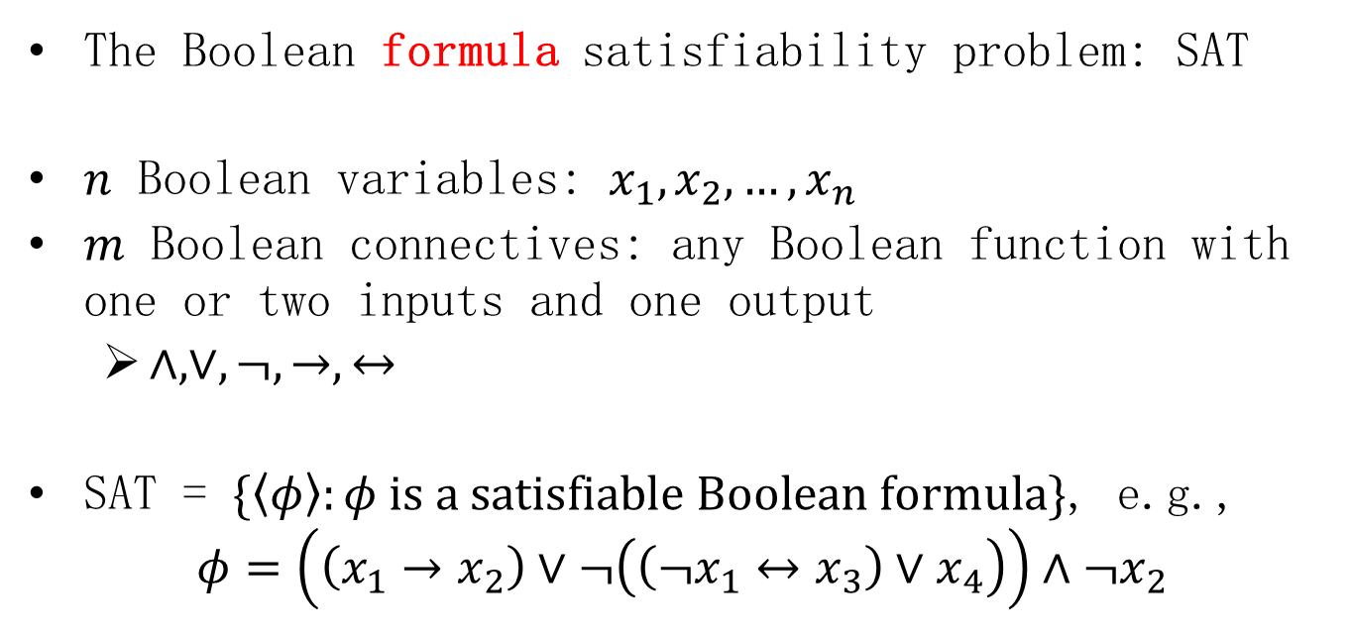

CIRCUIT-SAT $≤_{P}$ SAT
The Boolean formula satisfiability problem: SAT
$n$ Boolean variables: $x_{1},x_{2},…,x_{n}$
$m$ Boolean connectives: any Boolean function with one or two inputs and one output
$∧,∨,¬,→,↔$
SAT = $\{\left\langle φ\right\rangle :φ is a satisfiable Boolean formula\}$, e.g.,
$$φ=\left(\left(x_{1}→x_{2}\right)∨¬\left(\left(¬x_{1}↔x_{3}\right)∨x_{4}\right)\right)∧¬x_{2}$$

Slide 20
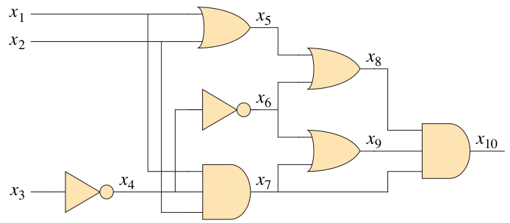
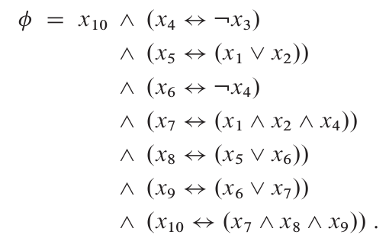
CIRCUIT-SAT $≤_{P}$ SAT
Express each of the gates as a formula (clause)

Slide 21


SAT $≤_{P}$ 3-CNF-SAT
It is (usually) simpler to reduce from a restricted language of Boolean formulas
Conjunctive normal form (CNF) 合取范式
E.g., $(x_{1}∨¬x_{1}∨x_{2})∧(x_{3}∨x_{2}∨x_{4})∧(¬x_{1}∨¬x_{3}∨¬x_{4})$

Slide 22
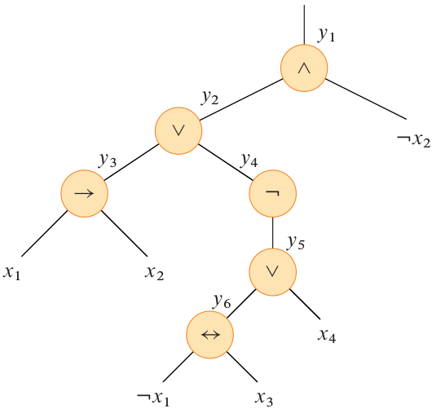
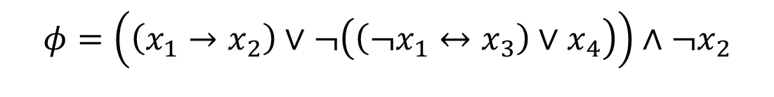

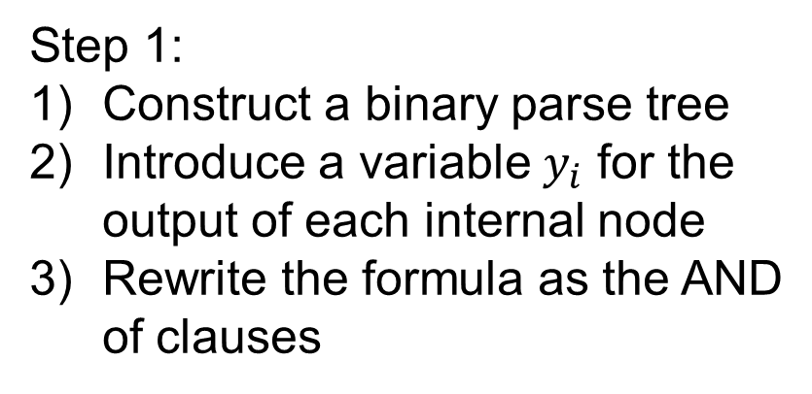
SAT $≤_{P}$ 3-CNF-SAT: Step 1
$$φ=\left(\left(x_{1}→x_{2}\right)∨¬\left(\left(¬x_{1}↔x_{3}\right)∨x_{4}\right)\right)∧¬x_{2}$$
Step 1:
Construct a binary parse tree
Introduce a variable $y_{i}$ for the output of each internal node
Rewrite the formula as the AND of clauses

Slide 23
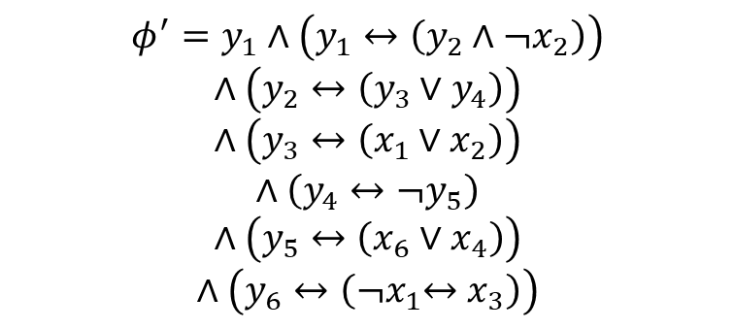
SAT $≤_{P}$ 3-CNF-SAT: Step 1
$$φ^{′}=y_{1}∧\left(y_{1}↔\left(y_{2}∧¬x_{2}\right)\right)$$
$$∧\left(y_{2}↔\left(y_{3}∨y_{4}\right)\right)$$
$$∧\left(y_{3}↔\left(x_{1}∨x_{2}\right)\right)$$
$$∧\left(y_{4}↔¬y_{5}\right)$$
$$∧\left(y_{5}↔\left(x_{6}∨x_{4}\right)\right)$$
$$∧\left(y_{6}↔\left({¬x}_{1}↔x_{3}\right)\right)$$

Slide 24
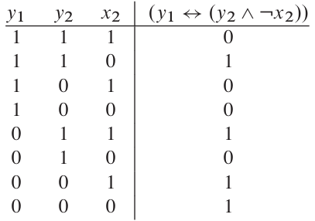

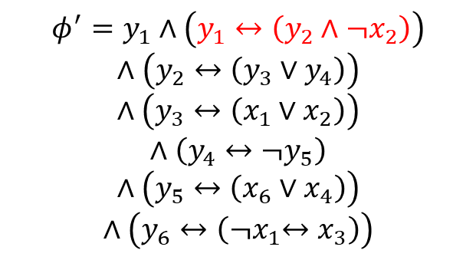
SAT $≤_{P}$ 3-CNF-SAT: Step 2
Step 2: Convert each clause into conjunctive normal form
$$φ^{′}=y_{1}∧\left(y_{1}↔\left(y_{2}∧¬x_{2}\right)\right)$$
$$∧\left(y_{2}↔\left(y_{3}∨y_{4}\right)\right)$$
$$∧\left(y_{3}↔\left(x_{1}∨x_{2}\right)\right)$$
$$∧\left(y_{4}↔¬y_{5}\right)$$
$$∧\left(y_{5}↔\left(x_{6}∨x_{4}\right)\right)$$
$$∧\left(y_{6}↔\left({¬x}_{1}↔x_{3}\right)\right)$$
disjunctive normal form
$$¬φ_{1}^{′}=(y_{1}∧y_{2}∧x_{2})∨(y_{1}∧¬y_{2}∧x_{2})∨(y_{1}∧¬y_{2}∧¬x_{2})∨(¬y_{1}∧y_{2}∧¬x_{2})$$

Slide 25
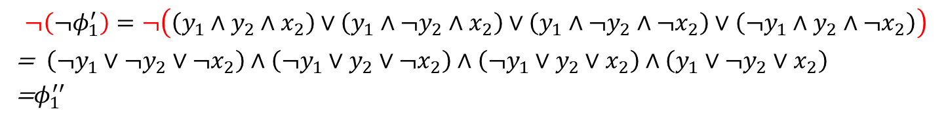
SAT $≤_{P}$ 3-CNF-SAT: Step 2
Step 2: Convert each clause into conjunctive normal form
$$¬\left(¬φ_{1}^{′}\right)=¬\left(\left(y_{1}∧y_{2}∧x_{2}\right)∨\left(y_{1}∧¬y_{2}∧x_{2}\right)∨\left(y_{1}∧¬y_{2}∧¬x_{2}\right)∨\left(¬y_{1}∧y_{2}∧¬x_{2}\right)\right)$$
= $\left(¬y_{1}∨¬y_{2}∨¬x_{2}\right)∧\left(¬y_{1}∨y_{2}∨¬x_{2}\right)∧\left(¬y_{1}∨y_{2}∨x_{2}\right)∧\left(y_{1}∨¬y_{2}∨x_{2}\right)$
=$φ_{1}^{′′}$

Slide 26
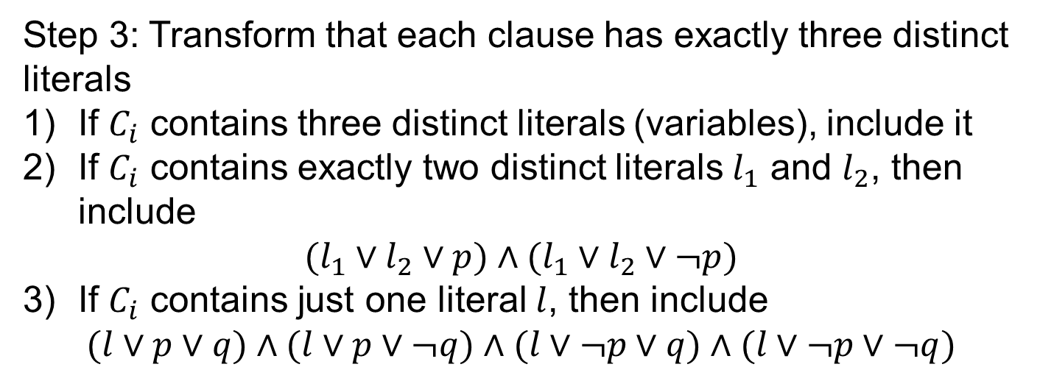

SAT $≤_{P}$ 3-CNF-SAT: Step 3
Step 3: Transform that each clause has exactly three distinct literals
If $C_{i}$ contains three distinct literals (variables), include it
If $C_{i}$ contains exactly two distinct literals $l_{1}$ and $l_{2}$, then include
$$(l_{1}∨l_{2}∨p)∧(l_{1}∨l_{2}∨¬p)$$
If $C_{i}$ contains just one literal $l$, then include
$$(l∨p∨q)∧(l∨p∨¬q)∧(l∨¬p∨q)∧(l∨¬p∨¬q)$$

Slide 27
SAT $≤_{P}$ 3-CNF-SAT
Complexity
Step 1: introduces at most one clause per connective
Step 2: introduce at most eight clauses for each clause
Step 3: introduces at most four clauses for each clause

Slide 28
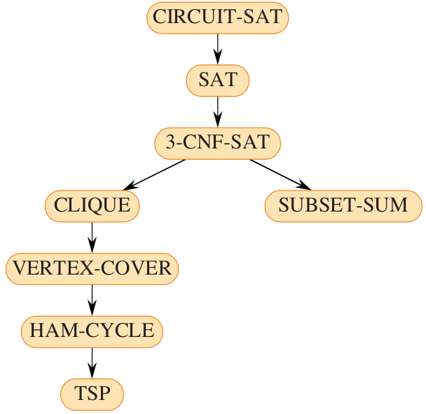
More NP-complete problems

Slide 29
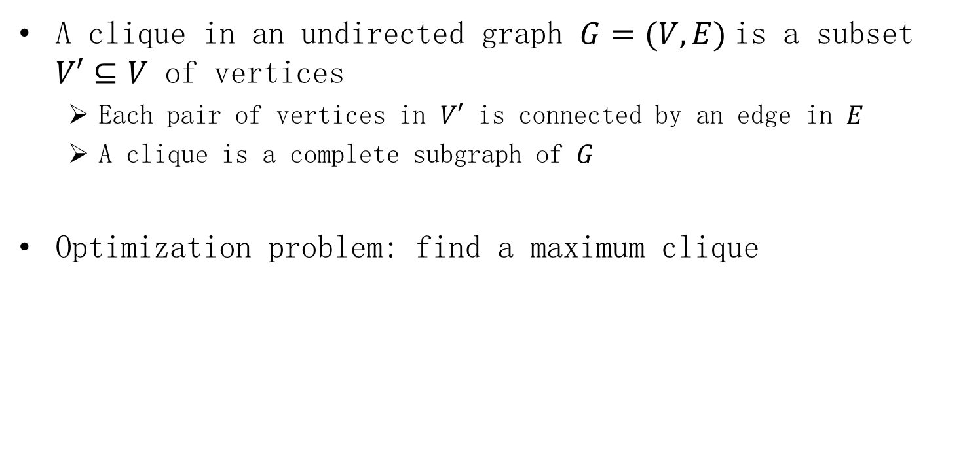
The clique problem
A clique in an undirected graph $G=(V,E)$is a subset $V′⊆V$ of vertices
Each pair of vertices in $V′$ is connected by an edge in $E$
A clique is a complete subgraph of $G$
Optimization problem: find a maximum clique

Slide 30
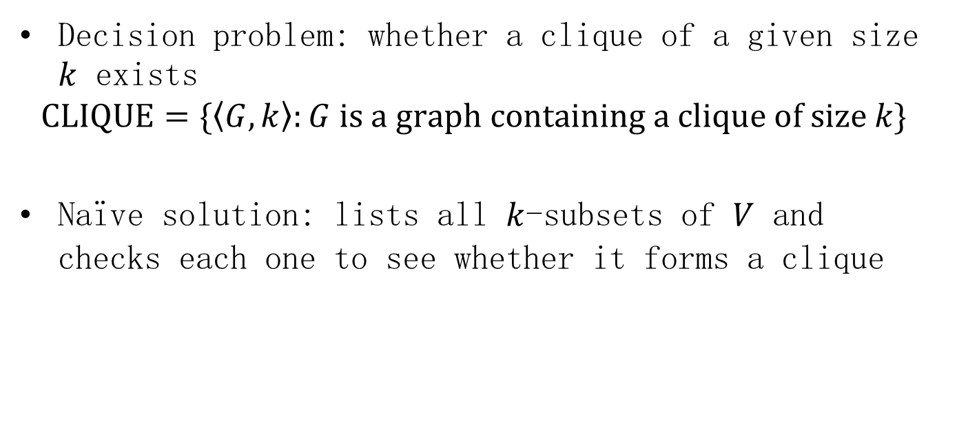
The clique problem
Decision problem: whether a clique of a given size $k$ exists
$$CLIQUE=\{\left\langle G,k\right\rangle :G is a graph containing a clique of size k\}$$
Naïve solution: lists all $k$-subsets of $V$ and checks each one to see whether it forms a clique

Slide 31
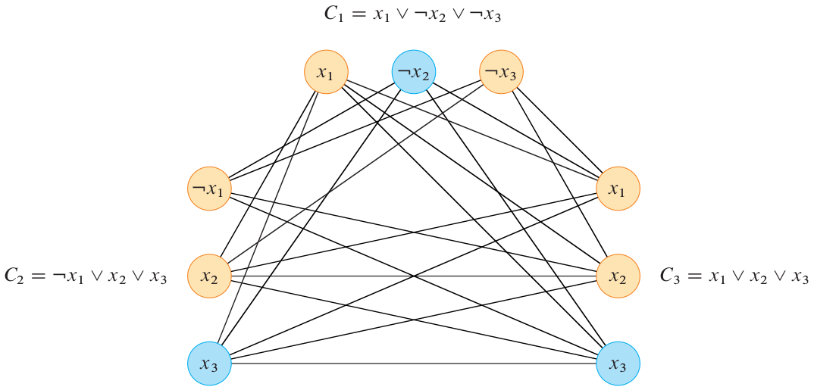

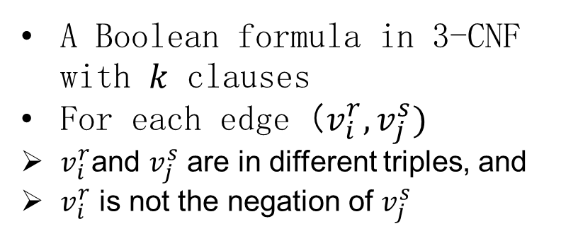
3-CNF-SAT $≤_{P}$ CLIQUE
A Boolean formula in 3-CNF with $k$ clauses
For each edge $（v_{i}^{r},v_{j}^{s})$
$v_{i}^{r}$and $v_{j}^{s}$ are in different triples, and
$v_{i}^{r}$ is not the negation of $v_{j}^{s}$
$$φ=(x_{1}∨¬x_{1}∨x_{2})∧(x_{3}∨x_{2}∨x_{4})∧(¬x_{1}∨¬x_{3}∨¬x_{4})$$

Slide 32
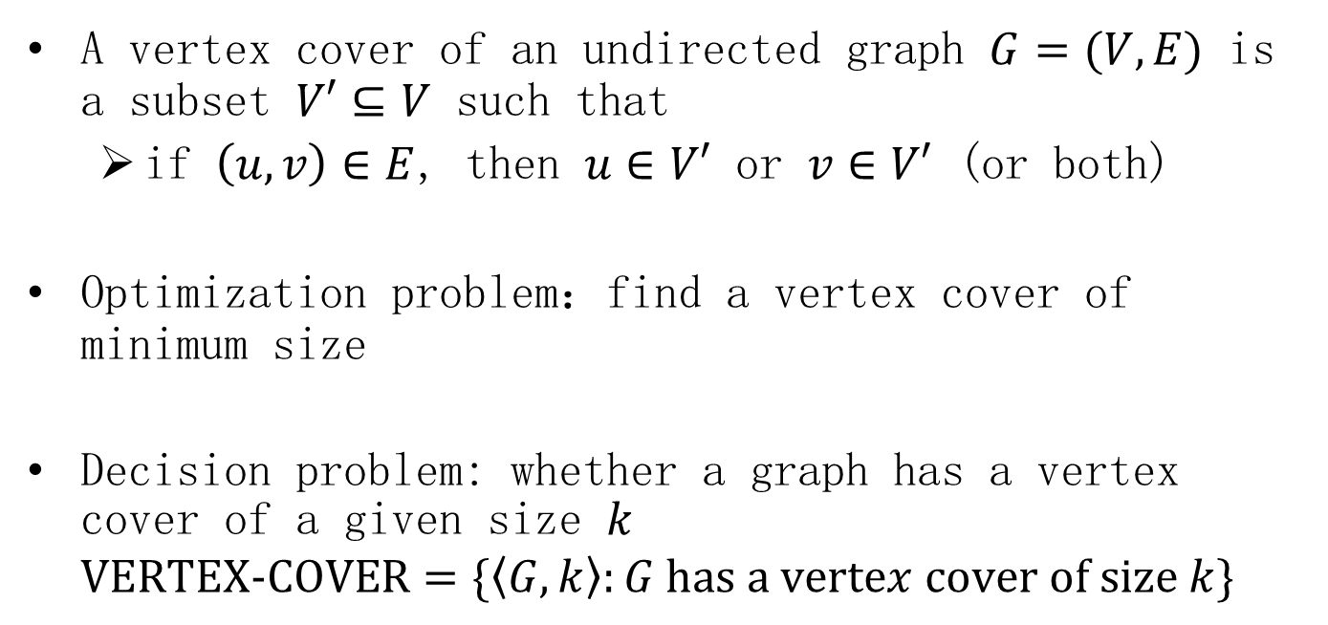
The vertex-cover problem
A vertex cover of an undirected graph $G=(V,E)$ is a subset $V′⊆V$ such that
if $\left(u,v\right)∈E$, then $u∈V′$ or $v∈V′$ (or both)
Optimization problem：find a vertex cover of minimum size
Decision problem: whether a graph has a vertex cover of a given size $k$
$$VERTEX−COVER=\{\left\langle G,k\right\rangle :G has a vertex cover of size k\}$$

Slide 33
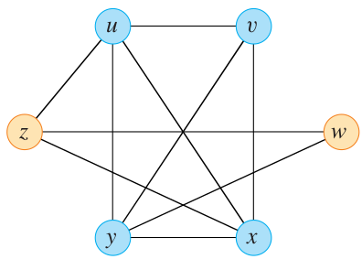
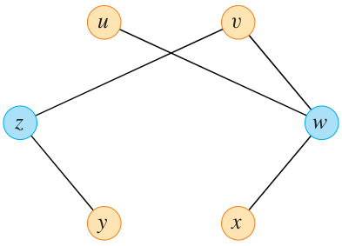




CLIQUE $≤_{P}$ VERTEX-COVER
Given an undirected graph $G=\left(V,E\right)$, the complement of $G$ is a graph $\overline{G}=(V,\overline{E})$, where
$$\overline{E}=\{\left(u,v\right):u,v∈V,u≠v,and \left(u,v\right)∉E\}$$
Polynomial time
$$G$$
$$\overline{G}$$

Slide 34



CLIQUE $≤_{P}$ VERTEX-COVER
The graph $G$ contains a clique of size $k$ if and only if the graph $\overline{G}$ has a vertex cover of size $\left|V\right|−k$
Assume $G$ contains a clique $V′$ of size $|V^{′}|$
Let $\left(u,v\right)$ be any edge in $\overline{E}$, then $\left(u,v\right)∉E$ and $u or v∉V′$
Either $u or v∈V−V′$, i.e., $\left(u,v\right)$ is covered by $V−V′$
$$G$$
$$\overline{G}$$

Slide 35
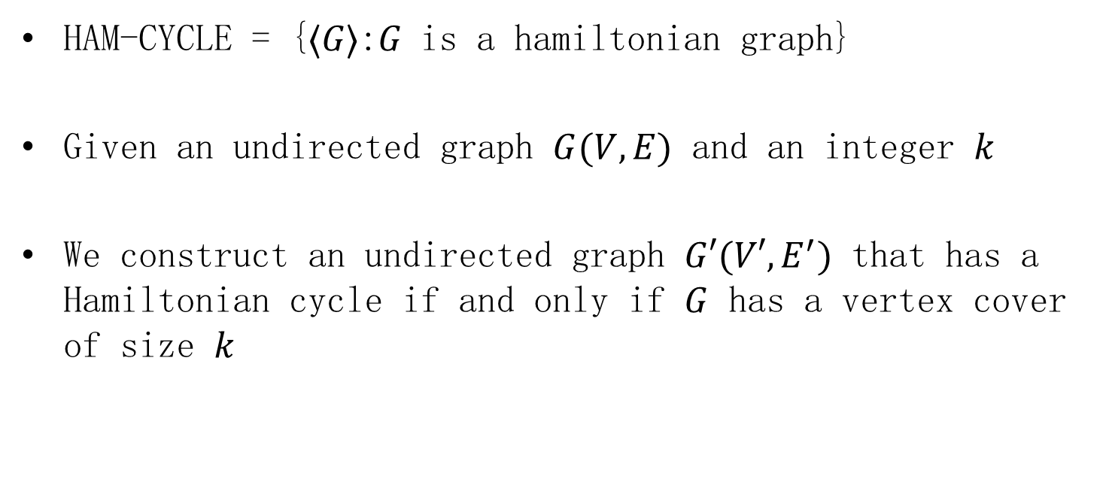

VERTEX-COVER $≤_{P}$ HAM-CYCLE
HAM-CYCLE = {⟨𝐺⟩:𝐺 is a hamiltonian graph}
Given an undirected graph $G(V,E)$ and an integer $k$
We construct an undirected graph $G′(V′,E^{′})$ that has a Hamiltonian cycle if and only if $G$ has a vertex cover of size $k$

Slide 36







VERTEX-COVER $≤_{P}$ HAM-CYCLE
Given an undirected graph $G(V,E)$
For each edge $\left(u,v\right)∈E$, $G′$ contains a copy of a gadget (subgraph)
Any hamiltonian cycle must traverse the edges of each gadget in one of the three ways
(1)
(2)
(3)

Slide 37




VERTEX-COVER $≤_{P}$ HAM-CYCLE
For $w,x,y,z$
Connecting $\left[u,u^{\left(i\right)},6\right] and \left[u,u^{\left(i+1\right)},1\right],1≤i≤degree\left(u\right)−1$
Connecting $\left[u,u^{\left(1\right)},1\right] and \left[u,u^{\left(degree\left(u\right)\right)},6\right]$ to each of the $k$ selector vertices
(1)
(3)
(4)
(2)
(1)
(2)
(3)
(4)

Slide 38

VERTEX-COVER $≤_{P}$ HAM-CYCLE
Suppose that $G(V,E)$ has a vertex cover $V^{∗}⊆V$
$V^{∗}=\{u_{1},u_{2},…,u_{k}\}$
The cycle starts at $s_{1}$
Visits all gadgets corresponding to edges incident on $u_{1}$

Slide 39

VERTEX-COVER $≤_{P}$ HAM-CYCLE
Suppose that $G(V,E)$ has a vertex cover $V^{∗}⊆V$
Then visits $s_{2}$, visits all gadgets corresponding to edges incident on $u_{2}$, and so on
Until it returns to $s_{1}$

Slide 40

VERTEX-COVER $≤_{P}$ HAM-CYCLE
Suppose that $G′(V′,E^{′})$ contains a hamiltonian cycle $C⊆E′$
Then, $V^{∗}=\{u∈V:\left(s_{j},\left[u,u^{\left(1\right)},1\right]\right)∈C for some 1≤j≤k\}$

Slide 41

VERTEX-COVER $≤_{P}$ HAM-CYCLE: Complexity
The total number of vertices
$$\left|V^{′}\right|=12\left|E\right|+k$$
The total number of edges
$$\left|E^{′}\right|=14\left|E\right|+\sum_{u∈V}{(degree\left(u\right)−1)}+2k\left|V\right|$$
$$=14\left|E\right|+\left(2\left|E\right|−\left|V\right|\right)+2k\left|V\right|$$
$$=16\left|E\right|+\left(2k−1\right)|V|$$

Slide 42



HAM-CYCLE $≤_{P}$ TSP
Traveling-salesperson problem
There is a nonnegative cost $c(i,j)$ for each edge
Optimization problem
The total cost is minimum
Decision problem
Whether the total cost is at most $k$

Slide 43

HAM-CYCLE $≤_{P}$ TSP
Construct $G′(V,E′)$,
$$c\left(i,j\right)=\left\{\begin{matrix}0 & if \left(i,j\right)∈E \\ 1 & otherwise\end{matrix}\right.$$
Graph $G$ contains a hamiltonian cycle if and only if graph $G′$ has a tour of cost at most 0

Slide 44

Homework
34.5-1 The subgraph-isomorphism problem takes two undirected graphs $G_{1}$ and $G_{2}$, and asks whether $G_{1}$ is isomorphic to a subgraph of $G_{2}$. Show that the subgraph-isomorphism problem is NP-complete.

Slide 45

Homework
34.5-2 Given an integer $m×n$ matrix $A$ and an integer $m$-vector $b$, the 0-1 integer-programming problem asks whether there exists an integer $n$-vector $x$with elements in the set $\{0,1\}$ such that $Ax≤b$. Prove that 0-1 integer programming is NP-complete. (Hint: Reduce from 3-CNF-SAT.)

