Slide 1
Algorithms and Complexities DisAlg: broadcast
刘盛云

Slide 2
Outline
Last course
Distributed Computation
Abstracting Processes
Abstracting Communication
Timing Assumptions
Abstracting time

Slide 3
Outline
This course
Reliable broadcast primitives
Quorum
Majority-Ack Uniform Reliable Broadcast
Causal-order broadcast primitives

Slide 4
Broadcast abstractions
Broadcast: an information dissemination method
When more than two processes need to operate in a coordinated manner
E.g., shared register, consensus, multi-party computation
A process sends a message within a group of processes Π, such that
processes in Π agree on the messages they deliver

Slide 5

Broadcast abstractions
Π
s
Message m
This course: Best-effort broadcast -> regular broadcast -> uniform broadcast

Slide 6
Best-effort broadcast
Name: BestEffortBroadcast, instance beb.
Request: < beb, Broadcast | m >: Broadcasts a message m to all processes.
Indication: < beb, Deliver | p, m >: Delivers a message m broadcast by process p.
Properties:
BEB1. Validity: If a correct process broadcasts a message m, then every correct process eventually delivers m.
BEB2. No duplication: No message is delivered more than once.
BEB3. No creation: If a process delivers a message m with sender s, then m was previously broadcast by process s.

Slide 7
bebBroadcast
bebDeliver
bebBroadcast
p1
m
p2
bebDeliver
m
bebDeliver
p3

Slide 8
bebBroadcast
bebDeliver
crash
bebBroadcast
bebBroadcast
p1
m
m1
bebDeliver
p2
bebDeliver
m
m1
p3
bebDeliver

Slide 9
Basic broadcast
Implements: BestEffortBroadcast, instance beb.
Uses: PerfectPointToPointLinks, instance pl.
upon event < beb, Broadcast | m > do
forall q ∈ Π do
trigger < pl, Send | q, m >;
upon event < pl, Deliver | p, m > do
trigger < beb, Deliver | p, m >;

Slide 10
Correctness and performance
The no creation and no duplication properties follow directly from the corresponding properties of perfect links.
Validity is derived from the reliable delivery property and the fact that the sender sends the message to every other process.
Complexity. A single communication step, O(N) messages.

Slide 11
(Regular) Reliable Broadcast
Name: ReliableBroadcast, instance rb.
Request: < rb, Broadcast | m >: Broadcasts a message m to all processes.
Indication: < rb, Deliver | p, m >: Delivers a message m broadcast by process p.
Properties:
RB1–RB3: Same as properties BEB1–BEB3 in best-effort broadcast.
RB4. Agreement: If a message m is delivered by some correct process, then m is eventually delivered by every correct process.

Slide 12
rbBroadcast?
rbDeliver
crash
rbBroadcast
rbBroadcast
p1
m
m1
rbDeliver
p2
rbDeliver
m
m1
p3
rbDeliver

Slide 13
rbBroadcast
rbDeliver
crash
rbBroadcast
rbBroadcast
p1
m
m1
rbDeliver
p2
rbDeliver
m
m1
p3
rbDeliver
rbDeliver

Slide 14
rbBroadcast
rbDeliver
crash
rbBroadcast
rbBroadcast
p1
m
m1
p2
rbDeliver
m
p3
rbDeliver

Slide 15
rbBroadcast
rbDeliver
crash
rbBroadcast
rbBroadcast
p1
m
m1
rbDeliver
p2
rbDeliver
m
m1
p3
rbDeliver

Slide 16
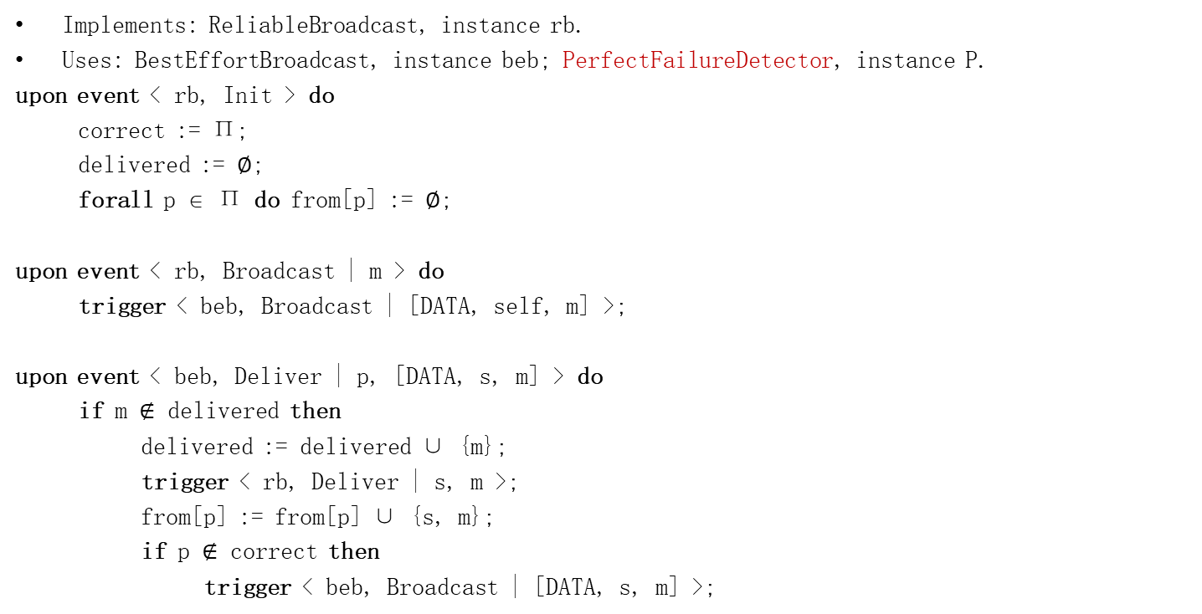
Lazy Reliable Broadcast
Implements: ReliableBroadcast, instance rb.
Uses: BestEffortBroadcast, instance beb; PerfectFailureDetector, instance P.
upon event < rb, Init > do
correct := Π;
delivered := ∅;
forall p ∈ Π do from[p] := ∅;
upon event < rb, Broadcast | m > do
trigger < beb, Broadcast | [DATA, self, m] >;
upon event < beb, Deliver | p, [DATA, s, m] > do
if m $∉$ delivered then
delivered := delivered ∪ {m};
trigger < rb, Deliver | s, m >;
from[p] := from[p] ∪ {s, m};
if p $∉$ correct then
trigger < beb, Broadcast | [DATA, s, m] >;
upon event < P, Crash | p > do
correct := correct \ {p};
forall {s, m} ∈ from[p] do
trigger < beb, Broadcast | [DATA, s, m] >;

Slide 17
Lazy Reliable Broadcast
Complexity
Best case: if the initial sender does not crash
a single communication step and O(N) messages
Worst case: if the processes crash in sequence
O(N) steps and O(N²) messages

Slide 18
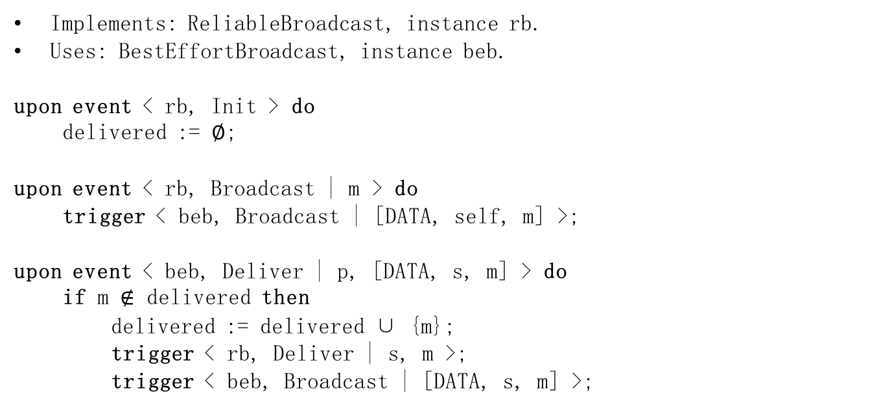
Eager Reliable Broadcast
Implements: ReliableBroadcast, instance rb.
Uses: BestEffortBroadcast, instance beb.
upon event < rb, Init > do
delivered := ∅;
upon event < rb, Broadcast | m > do
trigger < beb, Broadcast | [DATA, self, m] >;
upon event < beb, Deliver | p, [DATA, s, m] > do
if m $∉$ delivered then
delivered := delivered ∪ {m};
trigger < rb, Deliver | s, m >;
trigger < beb, Broadcast | [DATA, s, m] >;

Slide 19
Eager Reliable Broadcast
Performance.
Best case
A single communication step and O(N²) messages
Worst case: the processes crash in sequence
O(N) steps and O(N²) messages

Slide 20
(Regular) Reliable Broadcast
rbDeliver
crash
rbBroadcast
rbBroadcast
p1
m1
m
m1
rbDeliver
bebBroadcast
p2
rbDeliver
m1
m
m1
rbDeliver
p3
rbDeliver

Slide 21
Uniform reliable broadcast
Name: UniformReliableBroadcast, instance urb.
Request: < urb, Broadcast | m >: Broadcasts a message m to all processes.
Indication: < urb, Deliver | p, m >: Delivers a message m broadcast by process p.
Properties:
URB1–URB3: Same as properties RB1–RB3 in (regular) reliable broadcast.
URB4: Uniform agreement: If a message m is delivered by some process (whether correct or faulty), then m is eventually delivered by every correct process.

Slide 22
urbBroadcast?
urbDeliver
crash
urbBroadcast
urbBroadcast
p1
m
m1
urbDeliver
p2
urbDeliver
m
m1
p3
urbDeliver

Slide 23
urbBroadcast
urbDeliver
crash
urbBroadcast
urbBroadcast
p1
m
m1
p2
urbDeliver
m
m1
p3
urbDeliver

Slide 24
urbBroadcast
urbDeliver
crash
urbBroadcast
urbBroadcast
p1
m
m1
urbDeliver
p2
urbDeliver
m
m1
p3
urbDeliver
urbDeliver

Slide 25
All-Ack Uniform Reliable Broadcast
Implements: UniformReliableBroadcast, instance urb.
Uses: BestEffortBroadcast, instance beb; PerfectFailureDetector, instance P.
upon event < urb, Init > do
delivered := ∅;
pending := ∅;
correct := Π;
forall m do ack[m] := ∅;
upon event < urb, Broadcast | m > do
pending := pending ∪ {(self, m)};
trigger < beb, Broadcast | [DATA, self, m] >;

Slide 26
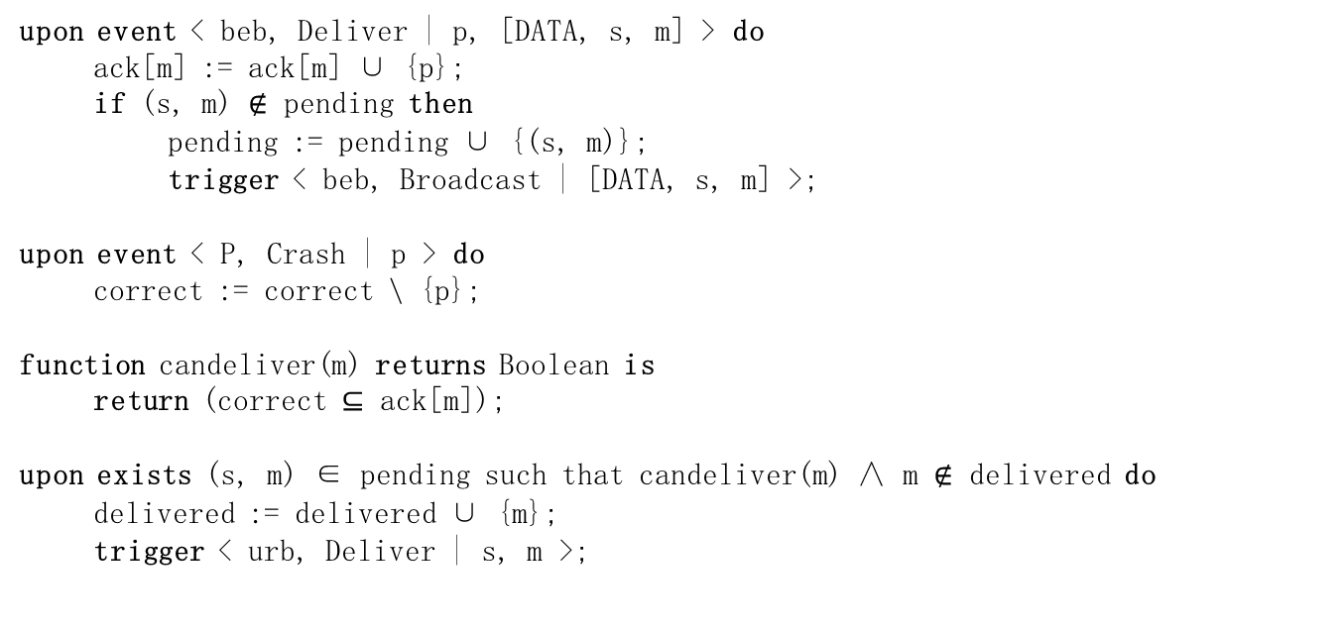
All-Ack Uniform Reliable Broadcast
upon event < beb, Deliver | p, [DATA, s, m] > do
ack[m] := ack[m] ∪ {p};
if (s, m) $∉$ pending then
pending := pending ∪ {(s, m)};
trigger < beb, Broadcast | [DATA, s, m] >;
upon event < P, Crash | p > do
correct := correct \ {p};
function candeliver(m) returns Boolean is
return (correct ⊆ ack[m]);
upon exists (s, m) ∈ pending such that candeliver(m) ∧ m $∉$ delivered do
delivered := delivered ∪ {m};
trigger < urb, Deliver | s, m >;

Slide 27
All-Ack Uniform Reliable Broadcast
bebBroadcast
urbDeliver
p1
m
m
urbDeliver
p2
m
m
urbDeliver
p3

Slide 28
All-Ack Uniform Reliable Broadcast
bebBroadcast
FD suspicion
urbDeliver
p1
m
m
m
p2
m
m
p3
urbDeliver

Slide 29
All-Ack Uniform Reliable Broadcast
Complexity.
Best case
two communication steps and O(N²) messages
Worst case
O(N) steps and O(N²) messages

Slide 30
Exercises
Exercise 1.
Can we devise an uniform reliable broadcast algorithm using eventually perfect failure detector?
If so, give the algorithm
Otherwise, give the reason

Slide 31
Outline
This course
Reliable broadcast primitives
Quorum
Majority-Ack Uniform Reliable Broadcast
Causal-order broadcast primitives
高能预警！
高能预警！
高能预警！
开始了！ 开始了！ 核能预警！
核能预警！

Slide 32
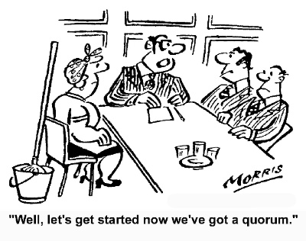
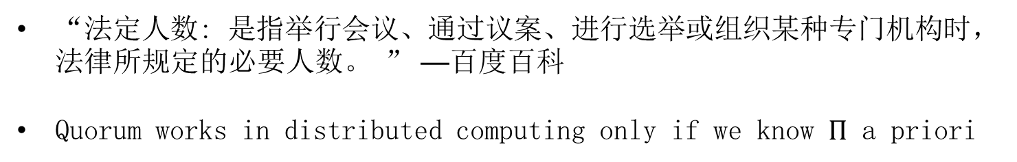
Quorum
“A quorum is the minimum number of members of a deliberative assembly necessary to conduct the business of that group.” —Wiki
Derived from Latin quorum: “of whom”
“法定人数: 是指举行会议、通过议案、进行选举或组织某种专门机构时，法律所规定的必要人数。 ” —百度百科
Quorum works in distributed computing only if we know $Π$ a priori

Slide 33
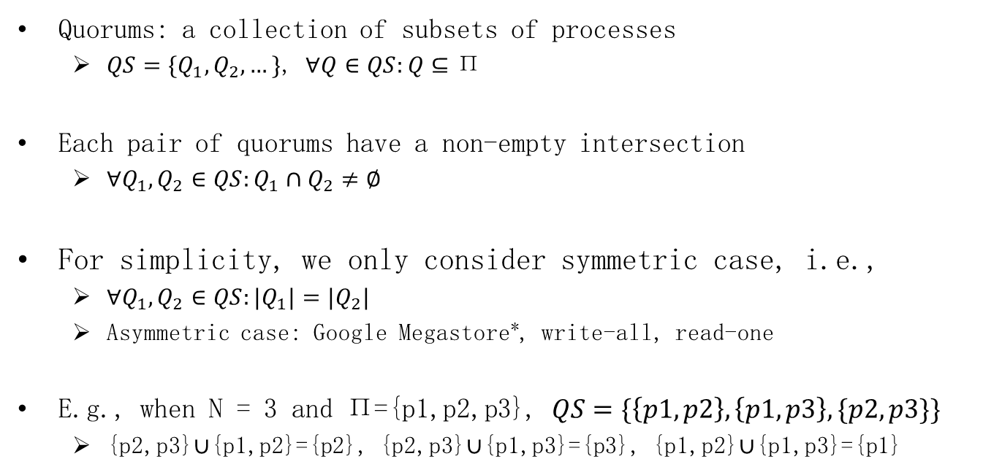
Quorum system in distributed computing
Quorums: a collection of subsets of processes
$QS=\{Q_{1},Q_{2},…\}$, $∀Q∈QS:Q⊆\text{Π}$
Each pair of quorums have a non-empty intersection
$∀Q_{1},Q_{2}∈QS:Q_{1}∩Q_{2}≠∅$
For simplicity, we only consider symmetric case, i.e.,
$∀Q_{1},Q_{2}∈QS:{|Q}_{1}|=|Q_{2}|$
Asymmetric case: Google Megastore*, write-all, read-one
E.g., when N = 3 and $\text{Π}\text{=\{}\text{p}\text{1,}\text{p}\text{2,}\text{p}\text{3\}}$, $QS=\{\left\{p1,p2\right\},\left\{p1,p3\right\},\{p2,p3\}\}$
{p2,p3}$∪${p1,p2}={p2}, {p2,p3}$∪${p1,p3}={p3}, {p1,p2}$∪${p1,p3}={p1}
* Jason Baker et al. Megastore: Providing Scalable, Highly Available Storage for Interactive Services. Proceedings of the Conference on Innovative Data system Research (CIDR) (2011), pp. 223-234.

Slide 34



Symmetric quorum system
Quorum is a key abstraction for ensuring consistency (safety)
Any quorum can make progress despite failures of other processes
p1
p1
p1
p2
p1
p2
p3
p2
p3
p3
p2
Step1:
transfer(A, B, 100)
Step2:
transfer(B, C, 100)
Step3:
transfer(C, D, 100)
quorum = $\{p2,p3\}$
quorum = $\left\{p1,p2\right\}$
quorum = $\left\{p1,p3\right\}$

Slide 35
Safety and liveness
Safety: a quorum must be any majority of processes
Otherwise, split-brain problem may occur
Liveness: even if a minority of processes fail, there is always a quorum that contains only correct processes
Thus can proceed, i.e., ensuring liveness
Account: A = 100
p1
p3
transfer(A, B, 100)
transfer(A, C, 100)
p2
p4

Slide 36

Safety and liveness: combined
Assume there are $f$ crash faults
Liveness: $N−f$ processes can make progress (quorum size)
Safety:
$2\left(N−f\right)>N⇒$ // any two quorums intersect in one correct process
$N>2f⇒$
$N≥2f+1$

Slide 37
Outline
This course
Reliable broadcast primitives
Quorum
Majority-Ack Uniform Reliable Broadcast
Causal-order broadcast primitives

Slide 38
Uniform reliable broadcast
Name: UniformReliableBroadcast, instance urb.
Request: < urb, Broadcast | m >: Broadcasts a message m to all processes.
Indication: < urb, Deliver | p, m >: Delivers a message m broadcast by process p.
Properties:
URB1. Validity: If a correct process broadcasts a message m, then every correct process eventually delivers m.
URB2. No duplication: No message is delivered more than once.
URB3. No creation: If a process delivers a message m with sender s, then m was previously broadcast by process s.
URB4: Uniform agreement: If a message m is delivered by some process (whether correct or faulty), then m is eventually delivered by every correct process.

Slide 39
Uniform reliable broadcast
Can we implement urb without Perfect failure detector?
Assume a majority of correct processes, i.e., N > 2f
Using quorum

Slide 40
Majority-Ack Uniform Reliable Broadcast
Implements: UniformReliableBroadcast, instance urb.
Uses: BestEffortBroadcast, instance beb.
upon event < urb, Init > do
delivered := ∅;
pending := ∅;
forall m do ack[m] := ∅;
upon event < urb, Broadcast | m > do
pending := pending ∪ {(self, m)};
trigger < beb, Broadcast | [DATA, self, m] >;

Slide 41
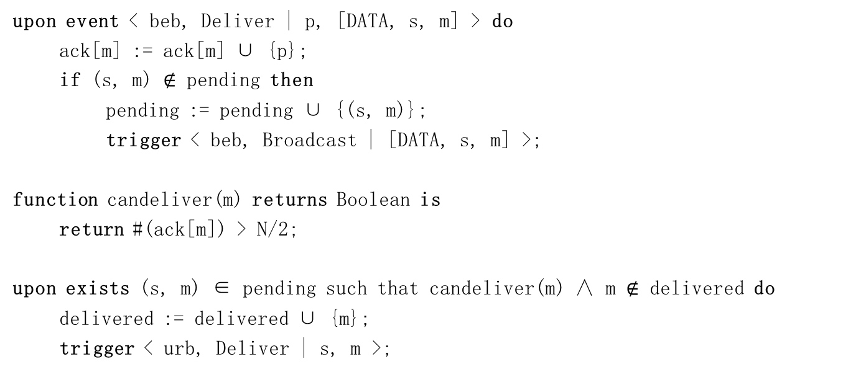
Majority-Ack Uniform Reliable Broadcast
upon event < beb, Deliver | p, [DATA, s, m] > do
ack[m] := ack[m] ∪ {p};
if (s, m) $∉$ pending then
pending := pending ∪ {(s, m)};
trigger < beb, Broadcast | [DATA, s, m] >;
function candeliver(m) returns Boolean is
return #(ack[m]) > N/2;
upon exists (s, m) ∈ pending such that candeliver(m) ∧ m $∉$ delivered do
delivered := delivered ∪ {m};
trigger < urb, Deliver | s, m >;
a majority of correct processes

Slide 42
Majority-Ack Uniform Reliable Broadcast
bebBroadcast
urbDeliver
p1
m
m
urbDeliver
p2
m
m
urbDeliver
p3

Slide 43
Correctness
Validity: if the sender is correct, then
Every correct process delivers a DATA message
Every correct process broadcasts a DATA message
Every correct process delivers more than N/2 DATA messages
Since a majority of processes are correct
No duplication, no creation
Straightforward

Slide 44
Correctness
Uniform agreement
Assume N = 2f + 1
Suppose a correct process p1 somehow urb-delivers m
p1 must have received at least f + 1 DATA messages for m
At least one of these are from correct process
DATA message of this correct process is also delivered by the rest f correct processes,
which then broadcast DATA messages
Every correct process urb-delivers m
Since f + 1 correct processes have sent a DATA message

Slide 45
Majority-Ack Uniform Reliable Broadcast
Complexity.
Best case
two communication steps and O(N²) messages
Worst case
O(N) steps and O(N²) messages

Slide 46
Outline
This course
Reliable broadcast primitives
Quorum
Majority-Ack Uniform Reliable Broadcast
Causal-order broadcast primitives

Slide 47
Why causal order?
Two messages broadcast by the same process might not be delivered in order
A message m1 that causes a message m2 might be delivered by some process after m2
Example
A comment on Facebook appears before the photo?
Might happen even with (uniform) reliable broadcast
Causal broadcast alleviates the need for the application to deal with such dependencies

Slide 48
Applications requiring causal relationship
Payment services
A: 100 -> 0
B: 0 -> 100
transfer(A, B, 100)
p1
B: 100 -> 0
C: 0 -> 100
transfer(B, C, 100)
p2
Causality is violated!
p3
B: 0 -> -100?

Slide 49


Applications requiring causal relationship
Social networks
upload a picture
p1
thumb!
p2
Causality is violated!
p3
Thumb for nothing?

Slide 50
Happened-before relationship [Lam78]
In an asynchronous distributed system
Event a “happened before” event b (we write a → b) iff
Local order:
both a and b occur at the same process p, and
event a precedes b according to p's local clock, OR
Communication order:
a is a send event containing message m, whereas
b is a receive event for m, OR
Transitivity:
there is event c, such that a → c and c → b
If a → b and b → a:
a and b are concurrent events (we write a || b)

Slide 51
Happened-before with local clocks?
1
2
3
4
p1
1
2
3
4
p2
1
2
3
p3

Slide 52
Happened-before
Can we simulate a global clock?
Local clocks won't do it
Logical clocks (Lamport's clocks)
Vector clocks

Slide 53
Logical clocks
Each process p maintains its own event counter cnt(p)
p increments cnt(p) with every step
p includes cnt(p) in every message it sends
upon q receives a message from p
cnt(q) := max(cnt(q), cnt(p)) + 1

Slide 54
Logical clocks
Logical clocks: if a → b then lc(a) < lc(b)
Issue: same logical time for different events
1
2
3
6
p1
2
4
5
6
p2
p3
1
2
3

Slide 55
Logical clocks
Logical clocks enforce partial order among events
Concurrent events may have the same or different logical time
Enforcing total order
Use process IDs as tiebreakers

Slide 56
Logical clocks
1.1
2.1
3.1
6.1
p1
2.2
4.2
5.2
6.2
p2
p3
1.3
2.3
3.3

Slide 57
Still some issues?
Logical clocks cannot convey causal relation
i.e., lc(a) < lc(b) does not imply a → b
Solution
Vector clocks

Slide 58
Vector clocks
Each process pi maintains a vector of counters
Initially, VC_{i}[j] = 0, for every j ∈ 1..n
pi increments VC_{i}[i] with every step
pi includes VC_{i}[] in every message it sends
Upon pj receives a message from pi
VC_{j}[k] := max(VC_{j}[k], VC_{i}[k]), for every k
VC_{j}[j] := VC_{j}[j] + 1

Slide 59
Vector clocks (vc)
(1,0,0)
(2,0,0)
(3,0,0)
(4,3,3)
p1
(1,1,0)
(1,2,3)
(2,4,3)
p2
(1,3,3)
p3
(0,0,1)
(0,0,2)
(0,0,3)

Slide 60
Causal precedence
Let m1 and m2 be any two messages, m1 causally precedes m2 iff
FIFO order
Some process pi broadcasts m1 before broadcasting m2
Message order
Some process pi delivers m1 and then broadcasts m2
Transitivity: there is a message m3 such that
m1 causally precedes m3 and
m3 causally precedes m2

Slide 61
Causal precedence?
m1 causally precedes m2 iff
< crbBroadcast, m1> → < crbBroadcast, m2>?
“Happens before” was defined on the channel level so not entirely suitable here

Slide 62
Happened-before v2
a → b
Local order:
both a and b occur at the same process p, and
event a precedes b according to p’s local clock
Communication order:
a is a broadcast event containing message m, whereas
b is a delivery event for m
Transitivity:
there is event c, such that a → c and c → b
Then: m1 causally precedes m2 iff
< crbBroadcast, m1> → < crbBroadcast, m2>

Slide 63
Causal-order (reliable) broadcast
Name: CausalOrderReliableBroadcast, instance crb.
Request: < crb, Broadcast | m >: Broadcasts a message m to all processes.
Indication: < crb, Deliver | p, m >: Delivers a message m broadcast by process p.
Properties:
CRB1–CRB4. Same as properties RB1–RB4 in (regular) reliable broadcast.
CRB5. Causal delivery: For any message m1 that causally precedes a message m2, i.e., m1 → m2, no process delivers m2 unless it has already delivered m1.

Slide 64
crbBroadcast?
crbDeliver(m1)
crbBroadcast
crbBroadcast
p1
m1
m2
crbDeliver(m2)
p2
crbDeliver(m1)
m2
m1
crbDeliver(m2)
p3
crbDeliver(m1)

Slide 65
crbBroadcast?
crbDeliver(m1)
crbBroadcast
crbBroadcast
p1
m1
m2
crbDeliver(m2)
p2
crbDeliver(m1)
m2
m1
p3
crbDeliver(m2)

Slide 66
crbBroadcast?
crbDeliver(m1)
crbBroadcast
p1
m1
m2
crbDeliver(m2)
p2
crbDeliver(m1)
crbBroadcast
m2
m1
p3
crbDeliver(m2)

Slide 67
Causal-order uniform (reliable) broadcast
Name: CausalOrderUniformReliableBroadcast, instance curb.
Request: < curb, Broadcast | m >: Broadcasts a message m to all processes.
Indication: < curb, Deliver | p, m >: Delivers a message m broadcast by process p.
Properties:
CURB1–CURB4. Same as properties URB1–URB4 in uniform reliable broadcast.
CURB5. Same as property CRB5 in causal-order broadcast.

Slide 68

No-Waiting Causal-Order Broadcast
Implements: CausalOrderReliableBroadcast, instance crb.
Uses: ReliableBroadcast, instance rb.
upon event < crb, Init > do
delivered := ∅;
past := [];
upon event < crb, Broadcast | m > do
trigger < rb, Broadcast | [DATA, past, m] >;
append(past, (self, m));
upon event < rb, Deliver | p, [DATA, mpast, m] > do
if m $∉$ delivered then
forall (s, n) ∈ mpast do
if n $∉$ delivered then
trigger < crb, Deliver | s, n >;
delivered := delivered ∪ {n};
if (s, n) $∉$ past then
append(past, (s, n));
trigger < crb, Deliver | p, m >;
delivered := delivered ∪ {m};
if (p, m) $∉$ past then
append(past, (p, m));

Slide 69
crbBroadcast
crbDeliver(m1)
crbBroadcast
crbBroadcast
p1
m2(m1)
m1
crbDeliver(m2)
p2
crbDeliver(m1)
m2(m1)
m1
p3
crbDeliver(m1)
crbDeliver(m2)

Slide 70
crbBroadcast
crbDeliver(m1)
crbBroadcast
p1
m1
m2(m1)
crbDeliver(m2)
p2
crbDeliver(m1)
crbBroadcast
m1
p3
m2(m1)
crbDeliver(m1)
crbDeliver(m2)

Slide 71
Complexity
No additional communication steps compared to reliable broadcast algorithm
But, message size grows linearly with time
“past” may become extremely large
Truncate “past” (with the help of perfect FD)

Slide 72

Garbage-Collection of Causal Past
Uses: PerfectFailureDetector, instance P.
upon event < crb, Init > do
delivered := ∅;
past := [];
correct := Π;
forall m do ack[m] := ∅;
upon event < P, Crash | p > do
correct := correct \ {p};
upon exists m ∈ delivered such that self $∉$ ack[m] do
ack[m] := ack[m] ∪ {self};
trigger < rb, Broadcast | [ACK, m] >;
upon event < rb, Deliver | p, [ACK , m] > do
ack[m] := ack[m] ∪ {p};
upon correct ⊆ ack[m] do
remove(past, (*, m));

Slide 73
How can we totally remove “past”?
Use (a variant of) vector clocks

Slide 74
Waiting Causal Broadcast
Implements: CausalOrderReliableBroadcast, instance crb.
Uses: ReliableBroadcast, instance rb.
upon event < crb, Init > do
V := [0]^{N};
lsn := 0;
pending := ∅;
upon event < crb, Broadcast | m > do
W := V;
W[rank(self)] := lsn;
lsn := lsn + 1;
trigger < rb, Broadcast | [DATA, W, m] >;
upon event < rb, Deliver | p, [DATA, W, m] > do
pending := pending ∪ {(p, W, m)};
while exists (p’, W’, m’) ∈ pending such that W’ ≤ V do
pending := pending \ {(p’, W’, m’)};
V[rank(p’)] := V[rank(p’)] + 1;
trigger < crb, Deliver | p’, m’ >;

Slide 75
crbBroadcast
crbDeliver(m1)
p1
m2 (1,0,0)
m1
crbDeliver(m2)
p2
crbDeliver(m1)
m1 (0,0,0)
m2 (1,0,0)
p3
crbDeliver(m1)
crbDeliver(m2)

Slide 76
crbBroadcast
crbDeliver(m1)
p1
m1
(1,0,0)
crbDeliver(m2)
p2
crbDeliver(m1)
m2
m1
(0,0,0)
(1,0,0)
p3
crbDeliver(m1)
crbDeliver(m2)

Slide 77
Complexity
No additional communication steps compared to reliable broadcast algorithm
O(n) message size: vector clocks

Slide 78
How do we get the Uniform Reliable Causal Order Broadcast?
Simply replace rbBroadcast with urbBroadcast

Slide 79
Exercise
Exercise 2.
Can we devise a broadcast algorithm that does not ensure the causal delivery property but only its non-uniform variant:
no correct process p delivers a message m2 unless p has already delivered every message m1 such that m1 → m2?

