Slide 1
Algorithms and Complexities Miscellaneous
刘盛云

Slide 2

Distributed storage systems
Google File System, Apache HDFS, Ceph, ...
Configuration management (Consensus)
Paxos, Zookeeper, Etcd
Client
Metadata store
Data store
Data store
Data store

Slide 3
Distributed storage systems
Configuration management module
Full-fledged SMR (group membership, consensus)
N = 5, typically
Metadata store
Another level of indirection
“All problems in computer science can be solved by another level of indirection.”--- David Wheeler
E.g., Ceph
Data store
3-way replication, n = 3, usually a single writer
Rack Awareness

Slide 4
Message patterns
query
Read(A)/write(A), with config number
Client
Config.
management
Config: A -> R1
Metadata
Data store (R1)
reply
reply
read/write
query
Client
reconfiguration
Config.
management
Config: A -> R2
reject
Data store
new config number

Slide 5
Large-scale database systems
Google Spanner, PingCAP TiDB, WeChat PaxosStore...
Span over multiple continents
Use Paxos or Raft as a building block
Tablet
Tablet
Paxos
Paxos
replica
leader
replica
replica
leader
replica
…
US East
US West
US Central

Slide 6
Large-scale database systems
Scalability, availability and high performance
Each tablet is managed by a Paxos group
Tablet: a bag of (key:string, timestamp:int64) → string
3 to 5 replicas
Data placement can be specified
May across continents
Among tablets, using two-phase commit for ACID
Atomicity, Consistency, Isolation and Durability

Slide 7
Large-scale database systems
read(A)
read(B)
write(A)
lock
commit
Client
Tablet A
write-lock(A)
Tablet B
read-lock(A)
lock
abort
Client
Tablet A
reject
Tablet B
read-lock(A)

Slide 8
Blockchains
A chain of blocks (i.e., State Machine Replication)
Each block contains
a cryptographic hash of the previous block
transaction data tx
Each block is decided by a consensus instance
tx
tx
tx
T
T
T
i
+
1
i
+
2
i
B
=
H
(
B
,
T
B
=
H
(
B
,
T
,
X
)
B
=
H
(
B
,
T
,
)
X
)
i
i
-
1
i
i
+
1
i
i
+
1
i
+
1
i
+
2
i
+
1
i
+
2
i
+
2

Slide 9

Blockchains
Permissioned Blockchains
Designated participants
Use PBFT, HotStuff, Tendermint, ...

Slide 10
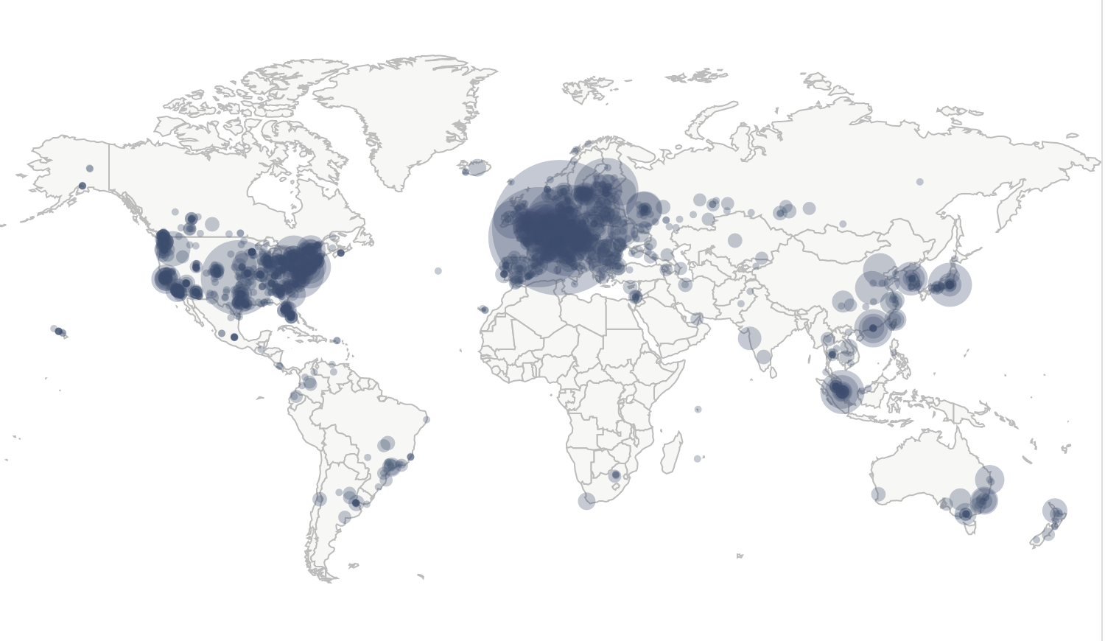
Blockchains
Permissionless Blockchains
Everyone can participate (including you)
Use Proof-of-X (e.g., Proof-of-Work) to defend against Sybil attacks
Bitcoin nodes distribution: 14593 nodes

Slide 11
Distributed Algorithm: The Stack
State Machine Replication
(Blockchain)
group membership
utrb
nbac
Consensus
Broadcast
FailureDedector
(timing assumption)
Quorum
PerfectLink

Slide 12

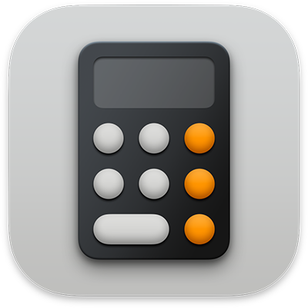
Sequential Algo. vs Distributed Algo.
Aggregate
Time complexity: O(m)
Average (or ML)
Average
Average
…
Data set 1
n elements
Data set 2
Data set m
A
Sequential Algo.
Time complexity: O(n)
Distributed Algo: consensus, GM
Number of phases
(Time complexity)
Message complexity
B
C

Slide 13
Exam
开卷考试：可以携带任何纸质资料
不可使用手机、笔记本电脑等电子设备,不可传阅资料
1月11日 13:10-15:10
上院212，上院213
判断题
基本概念和性质
（选择、填空题）
算法和论述题
Divide & Conquer
Graph algorithm (Greedy, Dynamic Programming)
Reduction
Broadcast
Consensus (variants)

Slide 14
谢谢！

