Slide 1
Friction and Search Costs
Discussion 5

Slide 2
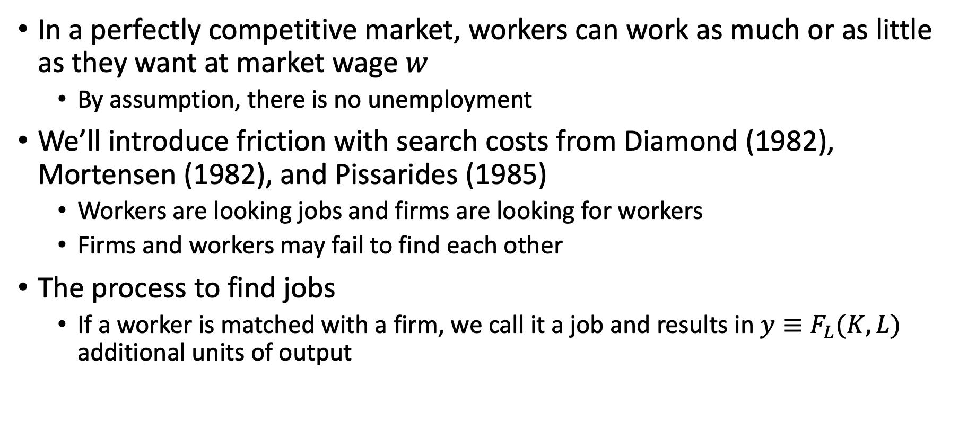
Adding Friction with Search Costs
In a perfectly competitive market, workers can work as much or as little as they want at market wage $w$
By assumption, there is no unemployment
We’ll introduce friction with search costs from Diamond (1982), Mortensen (1982), and Pissarides (1985)
Workers are looking jobs and firms are looking for workers
Firms and workers may fail to find each other
The process to find jobs
If a worker is matched with a firm, we call it a job and results in $y≡F_{L}(K,L)$ additional units of output

Slide 3
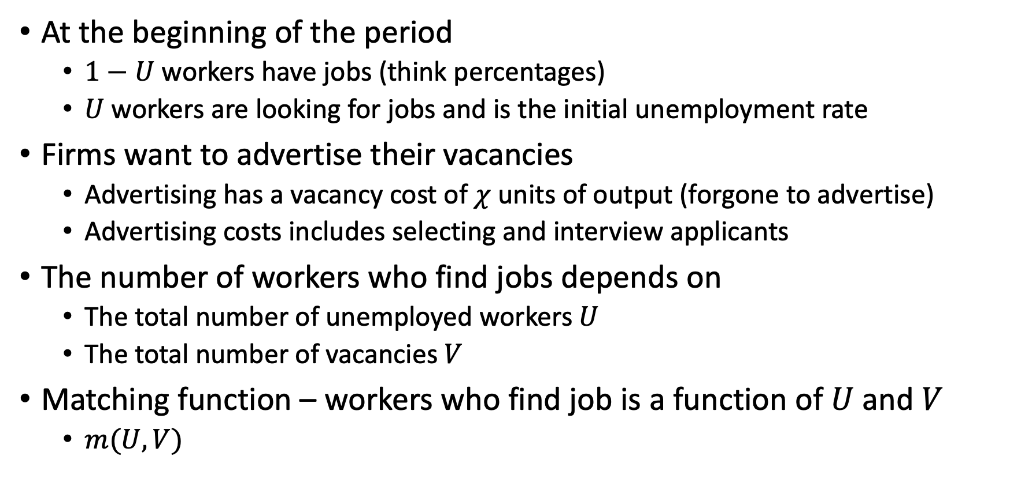
Adding Friction with Search Costs
At the beginning of the period
$1−U$ workers have jobs (think percentages)
$U$ workers are looking for jobs and is the initial unemployment rate
Firms want to advertise their vacancies
Advertising has a vacancy cost of $χ$ units of output (forgone to advertise)
Advertising costs includes selecting and interview applicants
The number of workers who find jobs depends on
The total number of unemployed workers $U$
The total number of vacancies $V$
Matching function – workers who find job is a function of $U$ and $V$
$m(U,V)$

Slide 4
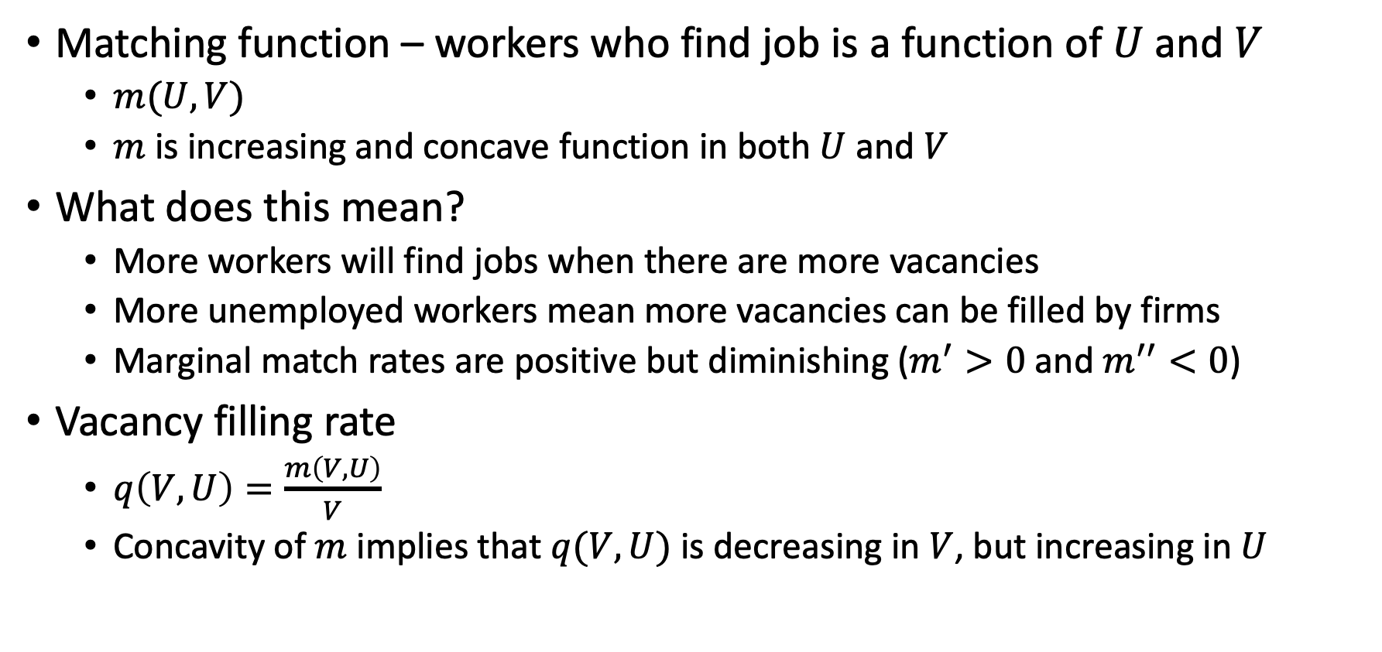
Adding Friction with Search Costs
Matching function – workers who find job is a function of $U$ and $V$
$m(U,V)$
$m$ is increasing and concave function in both $U$ and $V$
What does this mean?
More workers will find jobs when there are more vacancies
More unemployed workers mean more vacancies can be filled by firms
Marginal match rates are positive but diminishing ($m^{′}>0$ and $m^{′′}<0$)
Vacancy filling rate
$q\left(V,U\right)=\frac{m\left(V,U\right)}{V}$
Concavity of $m$ implies that $q(V,U)$ is decreasing in $V$, but increasing in $U$

Slide 5
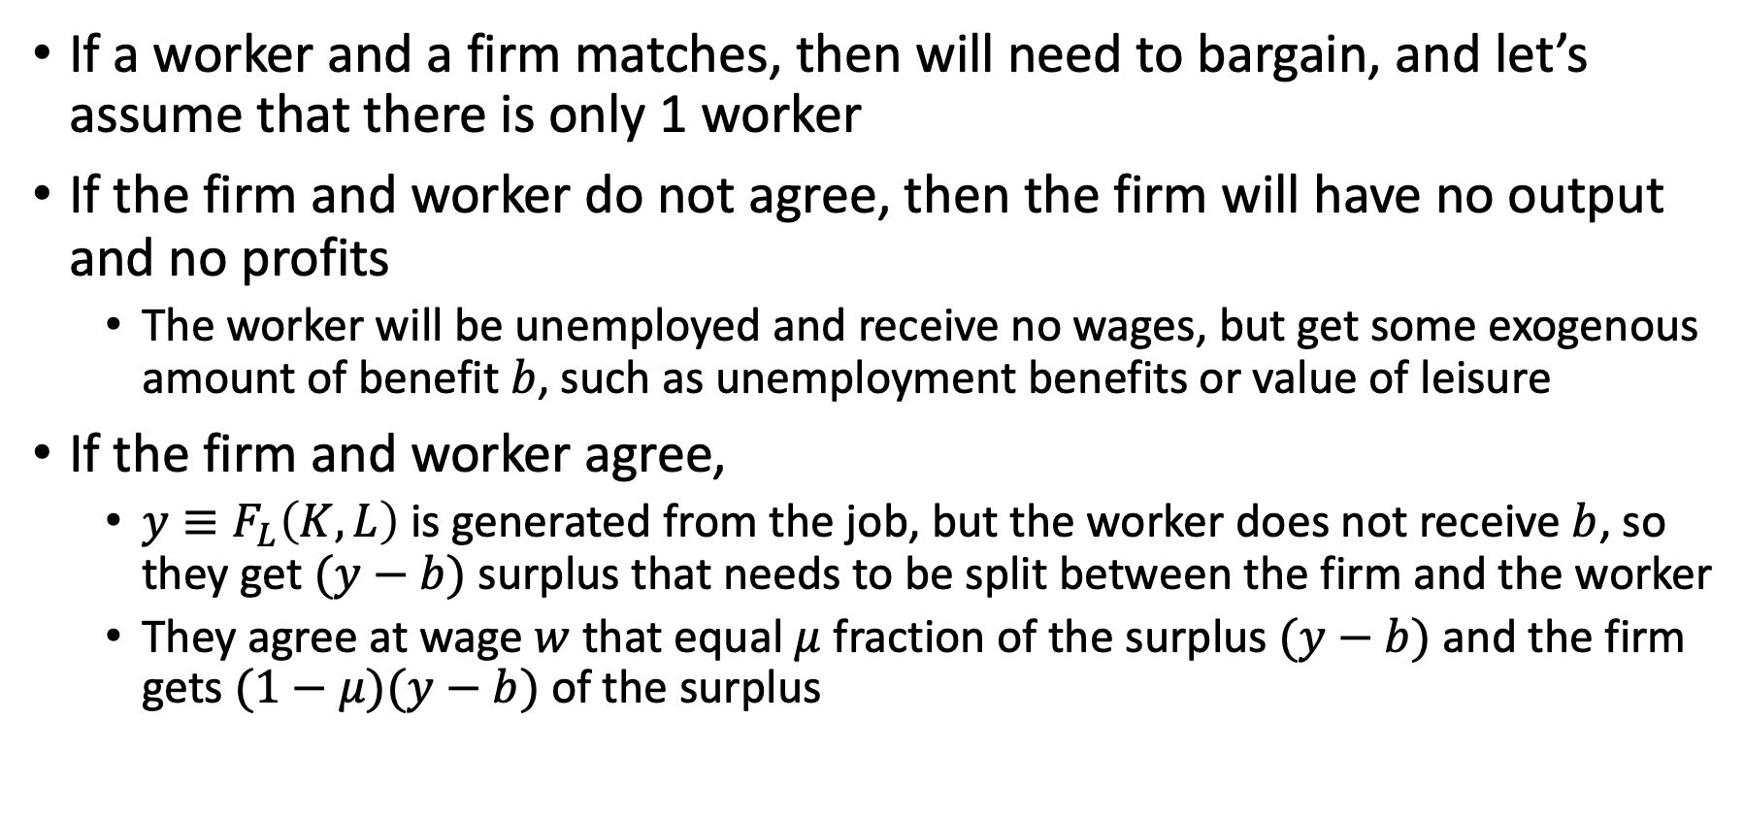
Adding Friction with Search Costs
If a worker and a firm matches, then will need to bargain, and let’s assume that there is only 1 worker
If the firm and worker do not agree, then the firm will have no output and no profits
The worker will be unemployed and receive no wages, but get some exogenous amount of benefit $b$, such as unemployment benefits or value of leisure
If the firm and worker agree,
$y≡F_{L}\left(K,L\right)$ is generated from the job, but the worker does not receive $b$, so they get $(y−b)$ surplus that needs to be split between the firm and the worker
They agree at wage $w$ that equal $μ$ fraction of the surplus $(y−b)$ and the firm gets $(1−μ)(y−b)$ of the surplus

Slide 6
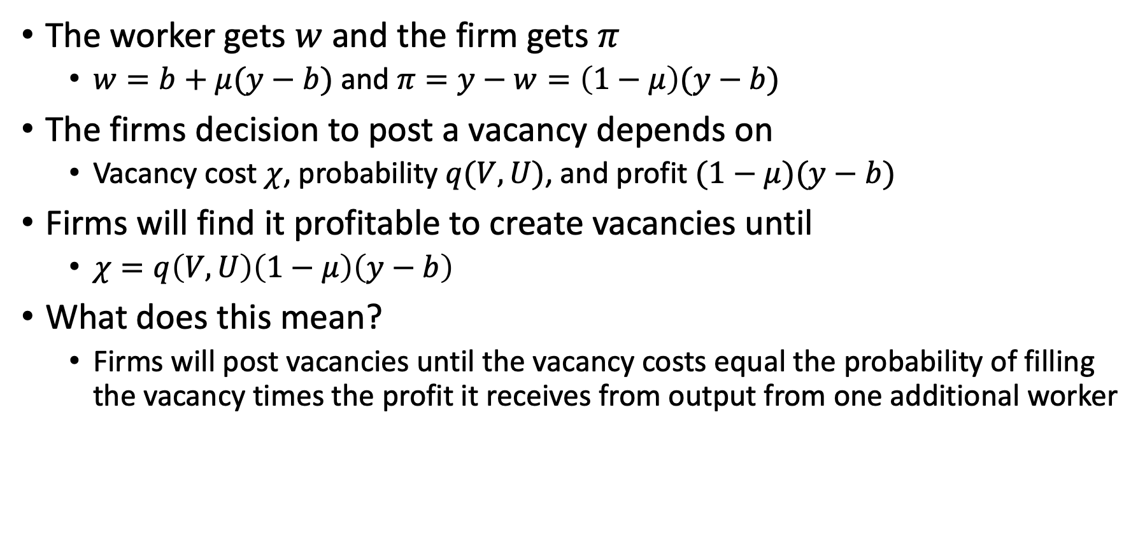
Adding Friction with Search Costs
The worker gets $w$ and the firm gets $π$
$w=b+μ(y−b)$ and $π=y−w=\left(1−μ\right)(y−b)$
The firms decision to post a vacancy depends on
Vacancy cost $χ$, probability $q(V,U)$, and profit $(1−μ)(y−b)$
Firms will find it profitable to create vacancies until
$χ=q\left(V,U\right)\left(1−μ\right)\left(y−b\right)$
What does this mean?
Firms will post vacancies until the vacancy costs equal the probability of filling the vacancy times the profit it receives from output from one additional worker

Slide 7
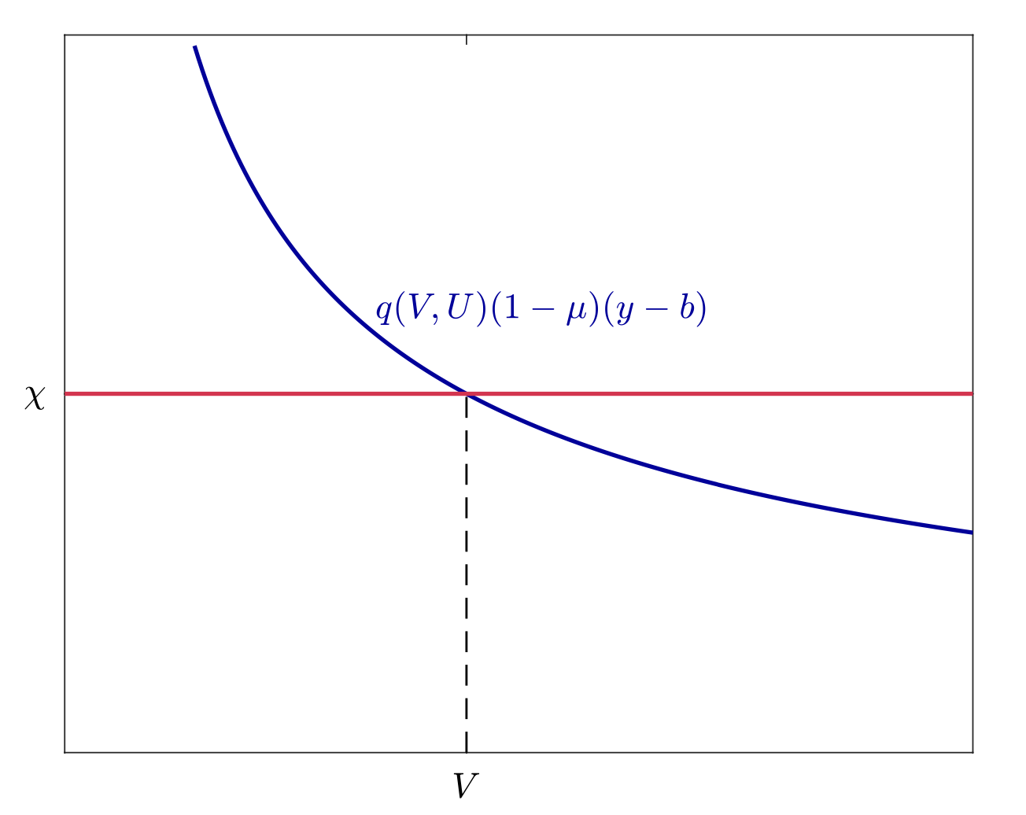

Adding Friction with Search Costs
Firms post vacancies until $χ=q\left(V,U\right)\left(1−μ\right)\left(y−b\right)$
If $χ>q\left(V,U\right)\left(1−μ\right)\left(y−b\right)$, the probability of filling the vacancy is too low and will not recoup the vacancy costs, so it does not hire
If $χ<q\left(V,U\right)\left(1−μ\right)\left(y−b\right)$, the probability of filling the vacancy is high and will make more profits than vacancy costs, so it opens more vacancies

Slide 8
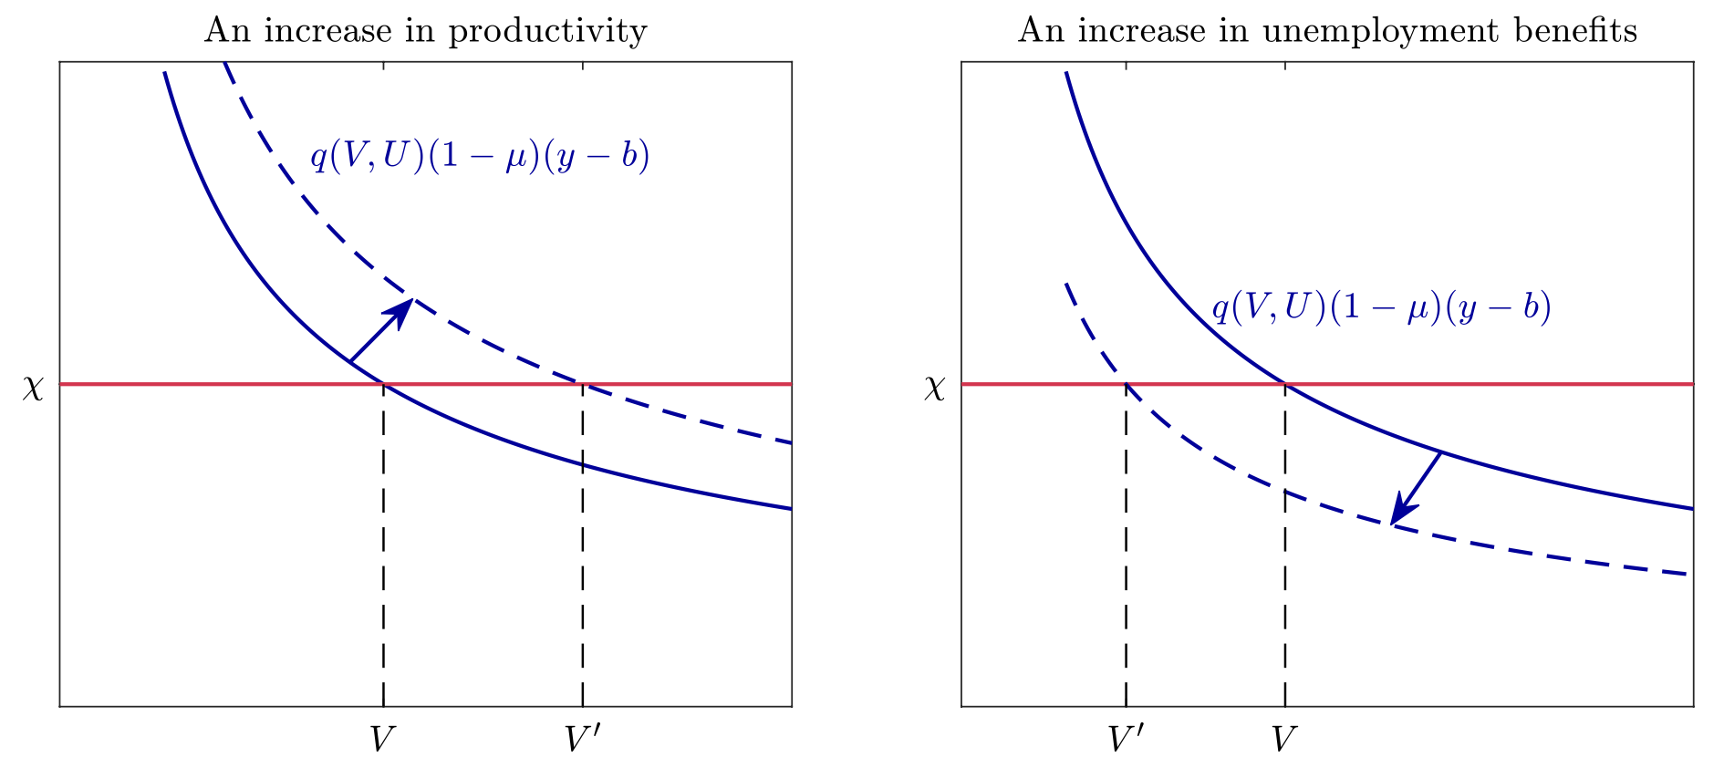
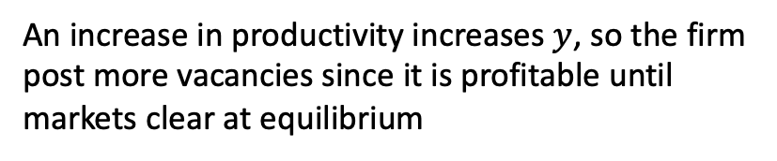
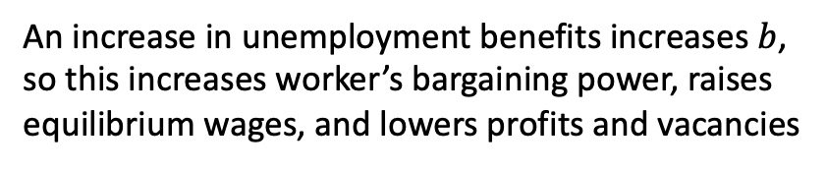
Adding Friction with Search Costs
An increase in productivity increases $y$, so the firm post more vacancies since it is profitable until markets clear at equilibrium
An increase in unemployment benefits increases $b$, so this increases worker’s bargaining power, raises equilibrium wages, and lowers profits and vacancies

Slide 9
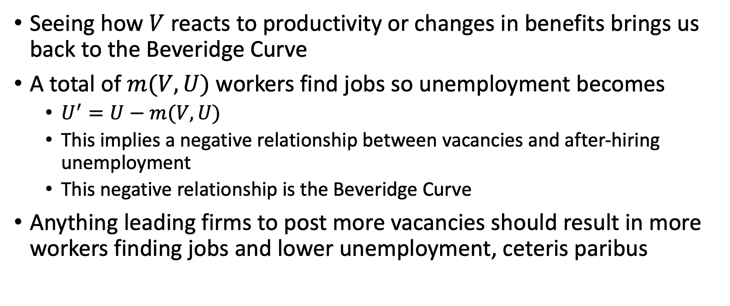
Adding Friction with Search Costs
Seeing how $V$ reacts to productivity or changes in benefits brings us back to the Beveridge Curve
A total of $m(V,U)$ workers find jobs so unemployment becomes
$U^{′}=U−m(V,U)$
This implies a negative relationship between vacancies and after-hiring unemployment
This negative relationship is the Beveridge Curve
Anything leading firms to post more vacancies should result in more workers finding jobs and lower unemployment, ceteris paribus

