Slide 1
Econ 645: Week 4
Panel Data Part 2

Slide 2
Overview
Fixed Effects Estimation
Random Effects Model
Stata Examples and Work

Slide 3
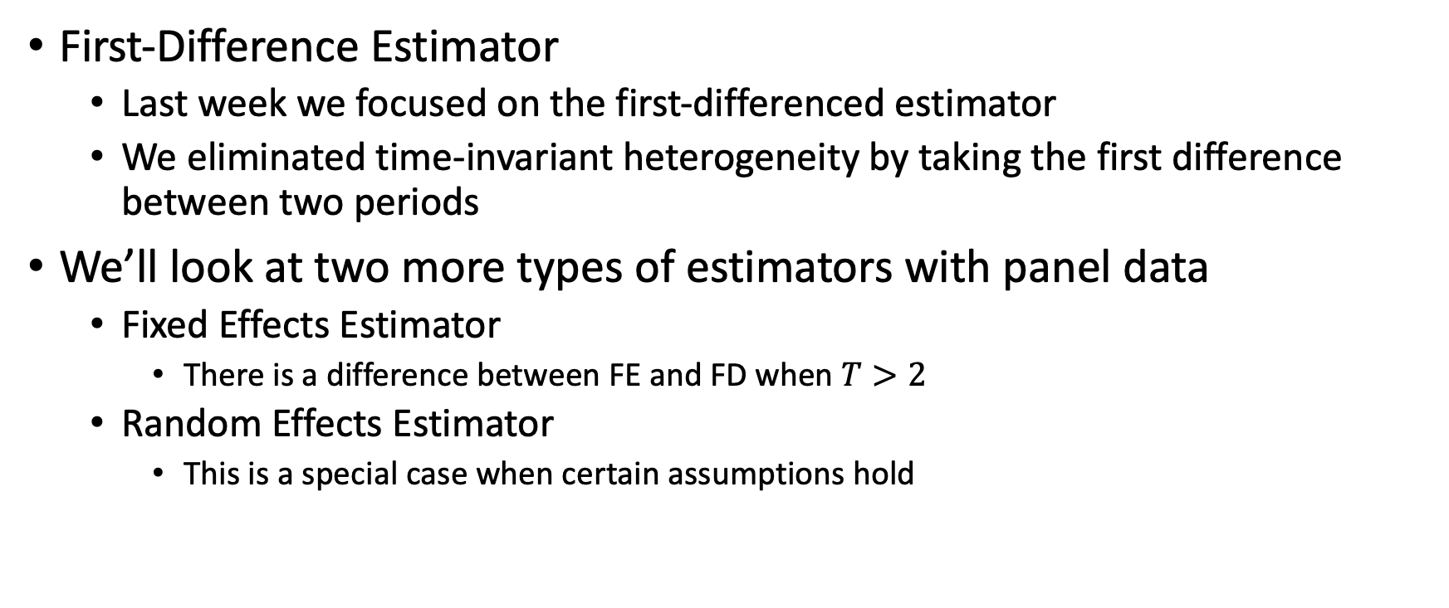
Introduction
First-Difference Estimator
Last week we focused on the first-differenced estimator
We eliminated time-invariant heterogeneity by taking the first difference between two periods
We’ll look at two more types of estimators with panel data
Fixed Effects Estimator
There is a difference between FE and FD when $T>2$
Random Effects Estimator
This is a special case when certain assumptions hold

Slide 4
Fixed Effects Estimation

Slide 5
Fixed Effects Estimator
We discussed three types of estimators with Panel Data
First-Differenced Estimator (covered last week)
Fixed Effects (Within) Estimator
Least Squares Dummy Variable (LSDV) Estimator
Fixed Effects (Within) Estimator
This is a different method to eliminate time-invariant heterogeneity
It works better under certain assumptions

Slide 6
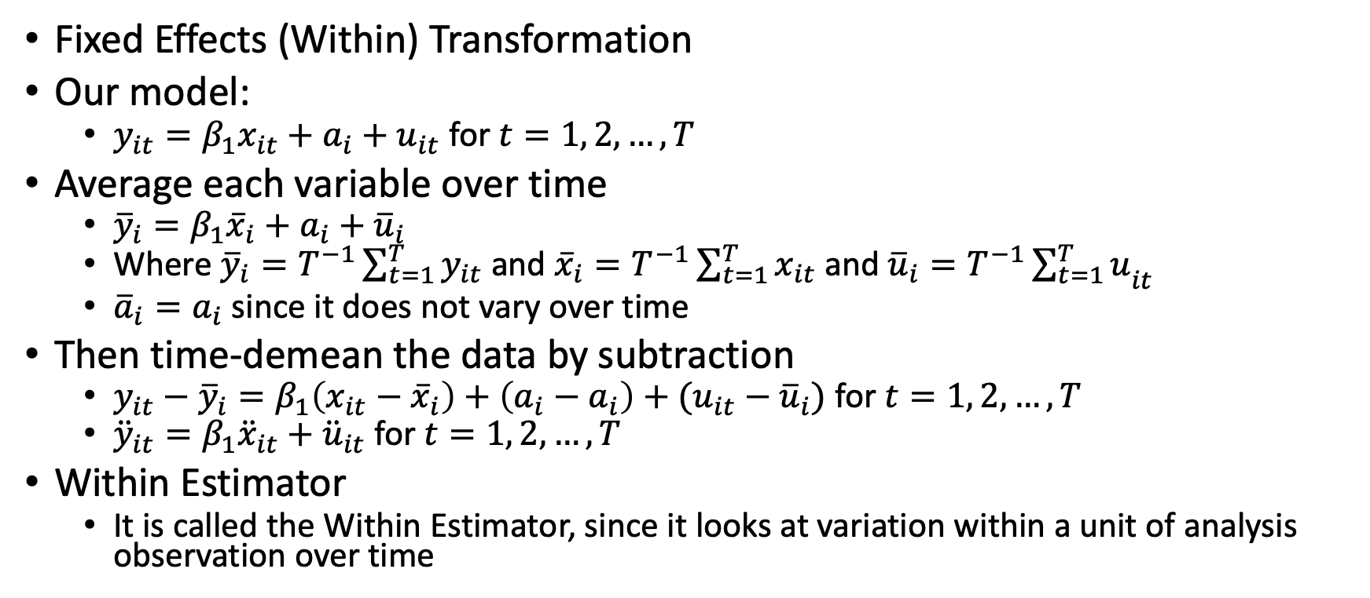
Fixed Effects (Within) Estimation
Fixed Effects (Within) Transformation
Our model:
$y_{it}=β_{1}x_{it}+a_{i}+u_{it}$ for $t=1, 2, …, T$
Average each variable over time
${\overline{y}}_{i}=β_{1}{\overline{x}}_{i}+a_{i}+{\overline{u}}_{i}$
Where ${\overline{y}}_{i}=T^{−1}\sum_{t=1}^{T}{y_{it}}$ and ${\overline{x}}_{i}=T^{−1}\sum_{t=1}^{T}{x_{it}}$ and ${\overline{u}}_{i}=T^{−1}{\sum_{t=1}^{T}{u}}_{it}$
${\overline{a}}_{i}=a_{i}$ since it does not vary over time
Then time-demean the data by subtraction
$y_{it}−{\overline{y}}_{i}=β_{1}\left(x_{it}−{\overline{x}}_{i}\right)+\left(a_{i}−a_{i}\right)+(u_{it}−{\overline{u}}_{i})$ for $t=1, 2, …, T$
${\ddot{y}}_{it}=β_{1}{\ddot{x}}_{it}+{\ddot{u}}_{it}$ for $t=1, 2, …, T$
Within Estimator
It is called the Within Estimator, since it looks at variation within a unit of analysis observation over time

Slide 7
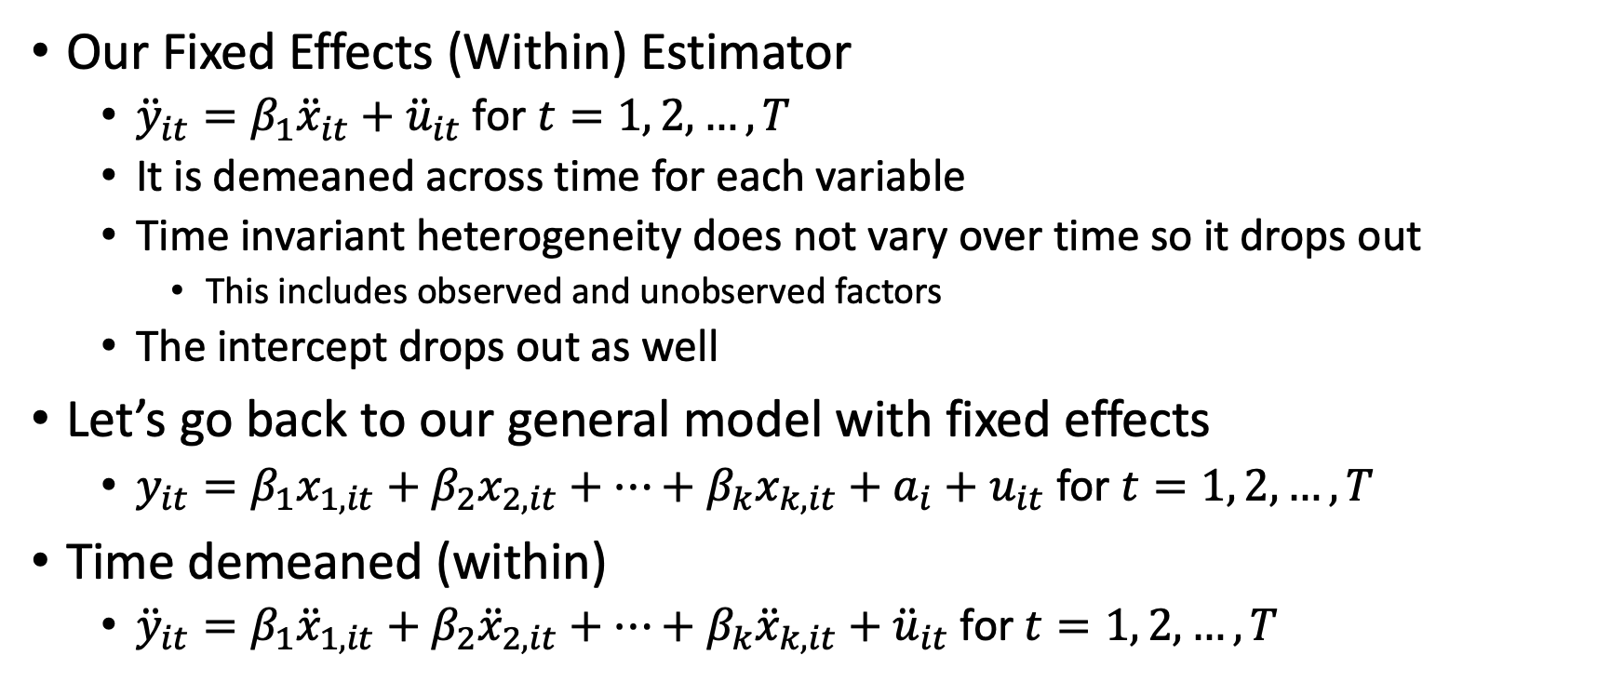
Fixed Effects (Within) Estimation
Our Fixed Effects (Within) Estimator
${\ddot{y}}_{it}=β_{1}{\ddot{x}}_{it}+{\ddot{u}}_{it}$ for $t=1, 2, …, T$
It is demeaned across time for each variable
Time invariant heterogeneity does not vary over time so it drops out
This includes observed and unobserved factors
The intercept drops out as well
Let’s go back to our general model with fixed effects
$y_{it}=β_{1}x_{1,it}+β_{2}x_{2,it}+…+β_{k}x_{k,it}+a_{i}+u_{it}$ for $t=1, 2, …, T$
Time demeaned (within)
${\ddot{y}}_{it}=β_{1}{\ddot{x}}_{1,it}+β_{2}{\ddot{x}}_{2,it}+…+β_{k}{\ddot{x}}_{k,it}+{\ddot{u}}_{it}$ for $t=1, 2, …, T$

Slide 8
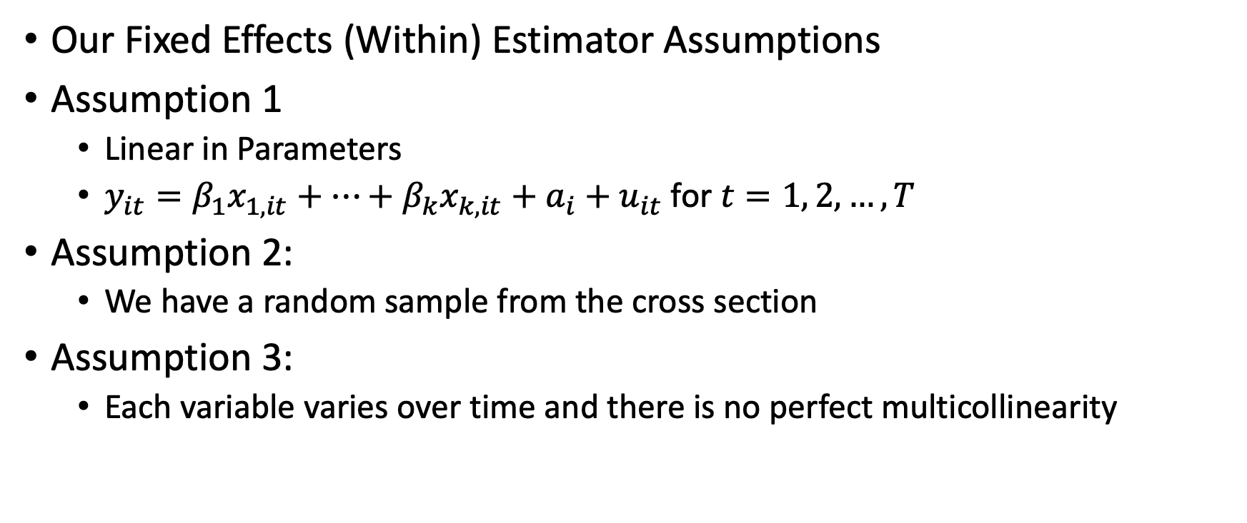
Fixed Effects (Within) Assumption
Our Fixed Effects (Within) Estimator Assumptions
Assumption 1
Linear in Parameters
$y_{it}=β_{1}x_{1,it}+…+β_{k}x_{k,it}+a_{i}+u_{it}$ for $t=1, 2, …, T$
Assumption 2:
We have a random sample from the cross section
Assumption 3:
Each variable varies over time and there is no perfect multicollinearity

Slide 9
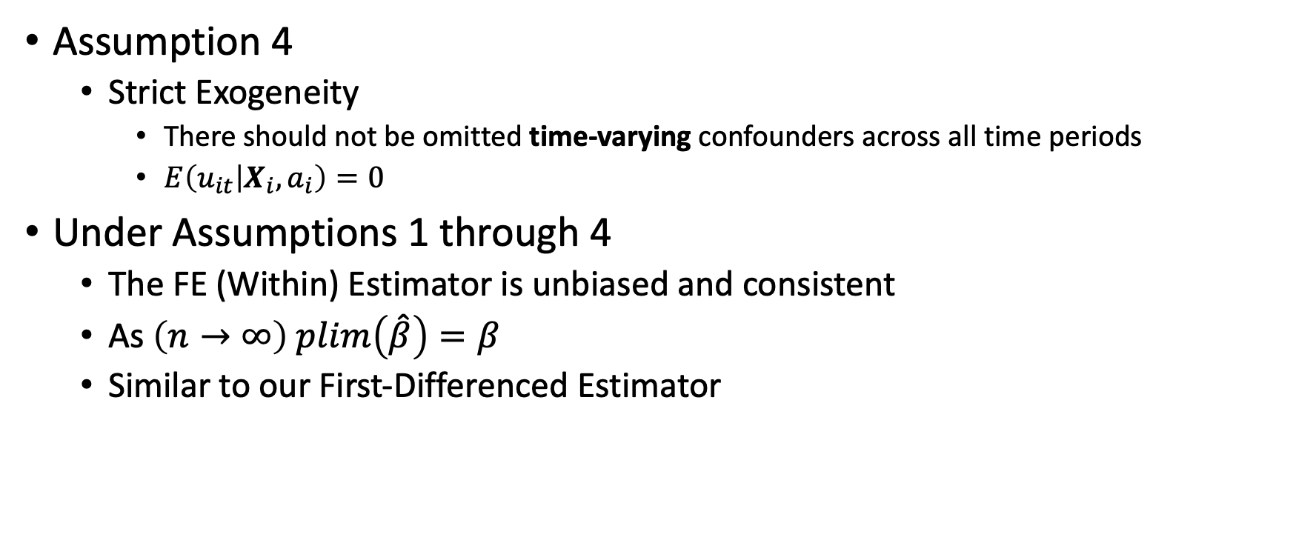
Fixed Effects (Within) Assumptions
Assumption 4
Strict Exogeneity
There should not be omitted time-varying confounders across all time periods
$E\left(u_{it} | X_{i},a_{i}\right)=0$
Under Assumptions 1 through 4
The FE (Within) Estimator is unbiased and consistent
As $\left(n→∞\right) plim\left(\hat{β}\right)=β$
Similar to our First-Differenced Estimator

Slide 10
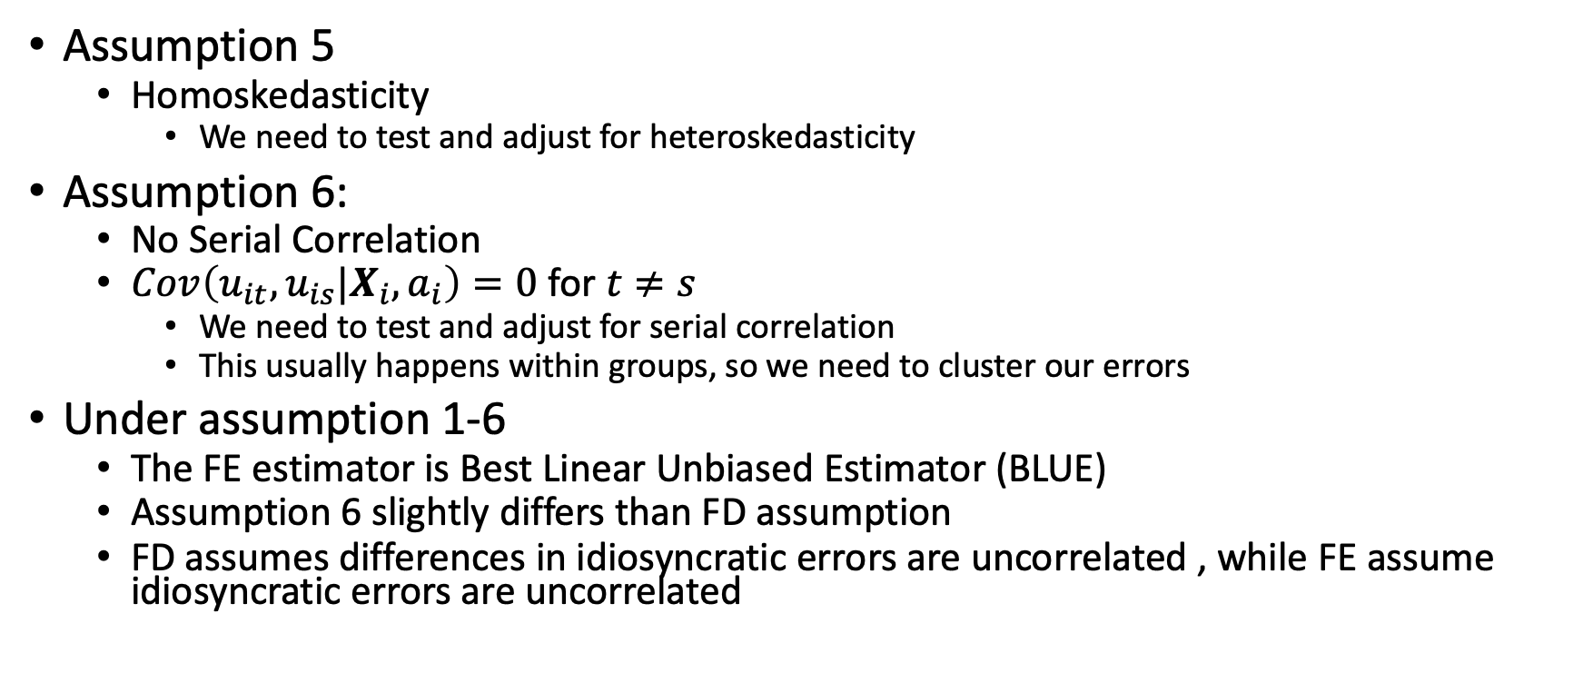
Fixed Effects (Within) Assumptions
Assumption 5
Homoskedasticity
We need to test and adjust for heteroskedasticity
Assumption 6:
No Serial Correlation
$Cov\left(u_{it},u_{is}|X_{i}, a_{i}\right)=0$ for $t≠s$
We need to test and adjust for serial correlation
This usually happens within groups, so we need to cluster our errors
Under assumption 1-6
The FE estimator is Best Linear Unbiased Estimator (BLUE)
Assumption 6 slightly differs than FD assumption
FD assumes differences in idiosyncratic errors are uncorrelated , while FE assume idiosyncratic errors are uncorrelated

Slide 11
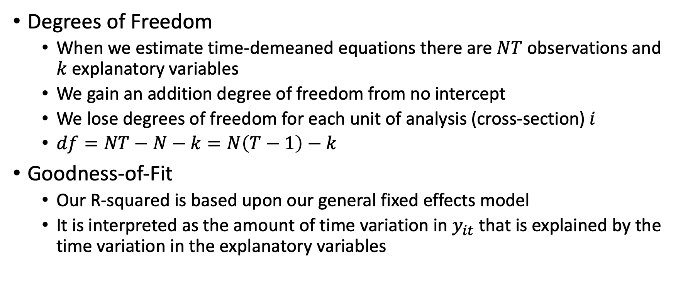
Fixed Effects (Within) Estimator
Degrees of Freedom
When we estimate time-demeaned equations there are $NT$ observations and $k$ explanatory variables
We gain an addition degree of freedom from no intercept
We lose degrees of freedom for each unit of analysis (cross-section) $i$
$df=NT−N−k=N\left(T−1\right)−k$
Goodness-of-Fit
Our R-squared is based upon our general fixed effects model
It is interpreted as the amount of time variation in $y_{it}$ that is explained by the time variation in the explanatory variables

Slide 12
Fixed Effects (Within) Estimator
Time-invariant observed variables
When we include time-invariant observed variables in our FE model, they drop out since they do not vary over time (sex, race, etc.)
We can interact these variables with time binaries to see how returns change over time
Examples
Experience which only changes by 1 over time or education might be fixed
We can interact these variables with time binaries to see how returns change over time compared to the base period
We cannot estimate returns to education in the base period, only how they have changed.

Slide 13
FE (Within) Example
Has the Returns to Education Changed Over Time?
In Stata

Slide 14
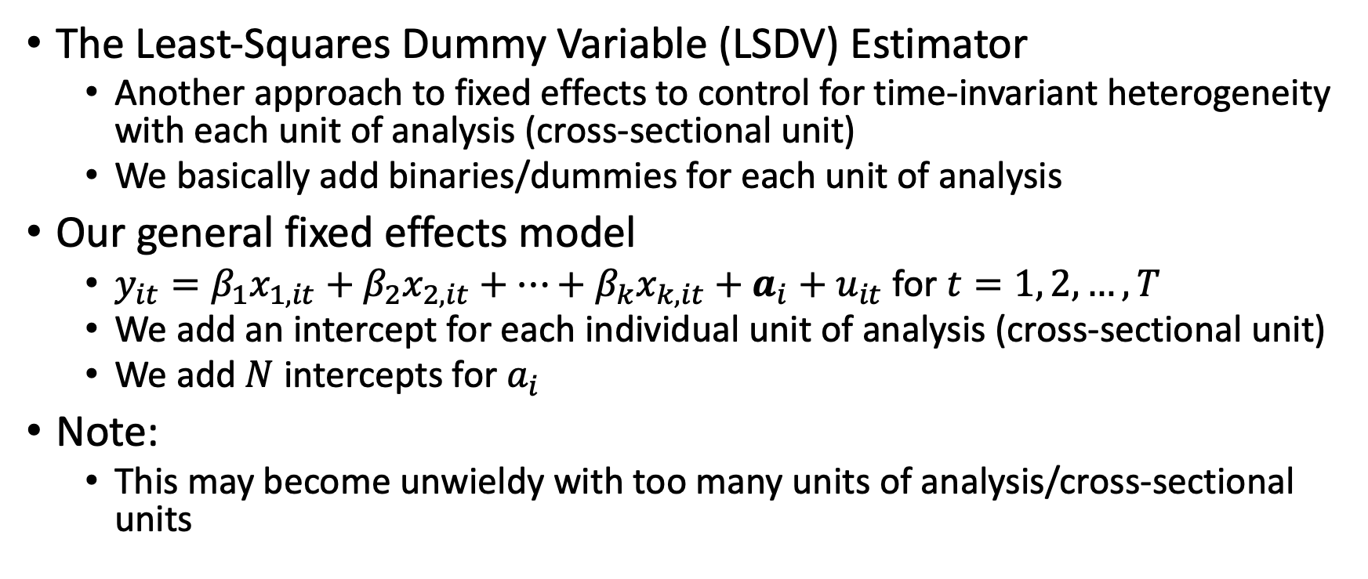
Least-Squares Dummy Variables Estimator
The Least-Squares Dummy Variable (LSDV) Estimator
Another approach to fixed effects to control for time-invariant heterogeneity with each unit of analysis (cross-sectional unit)
We basically add binaries/dummies for each unit of analysis
Our general fixed effects model
$y_{it}=β_{1}x_{1,it}+β_{2}x_{2,it}+…+β_{k}x_{k,it}+a_{i}+u_{it}$ for $t=1, 2, …, T$
We add an intercept for each individual unit of analysis (cross-sectional unit)
We add $N$ intercepts for $a_{i}$
Note:
This may become unwieldy with too many units of analysis/cross-sectional units

Slide 15
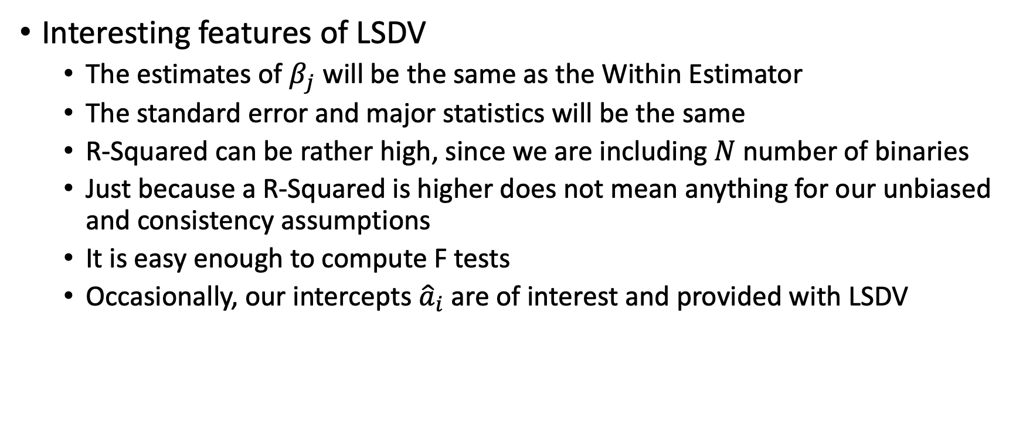
Least-Squares Dummy Variables Estimator
Interesting features of LSDV
The estimates of $β_{j}$ will be the same as the Within Estimator
The standard error and major statistics will be the same
R-Squared can be rather high, since we are including $N$ number of binaries
Just because a R-Squared is higher does not mean anything for our unbiased and consistency assumptions
It is easy enough to compute F tests
Occasionally, our intercepts ${\hat{a}}_{i}$ are of interest and provided with LSDV

Slide 16
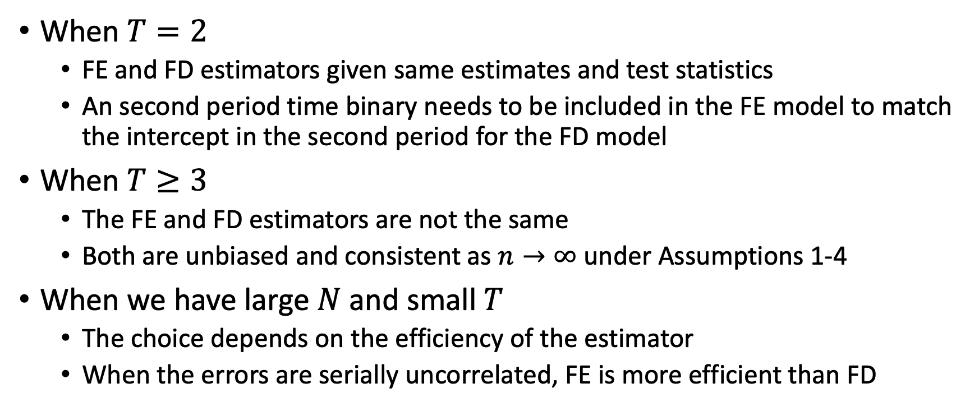
Fixed Effects or First Differencing?
When $T=2$
FE and FD estimators given same estimates and test statistics
An second period time binary needs to be included in the FE model to match the intercept in the second period for the FD model
When $T≥3$
The FE and FD estimators are not the same
Both are unbiased and consistent as $n→∞$ under Assumptions 1-4
When we have large $N$ and small $T$
The choice depends on the efficiency of the estimator
When the errors are serially uncorrelated, FE is more efficient than FD

Slide 17
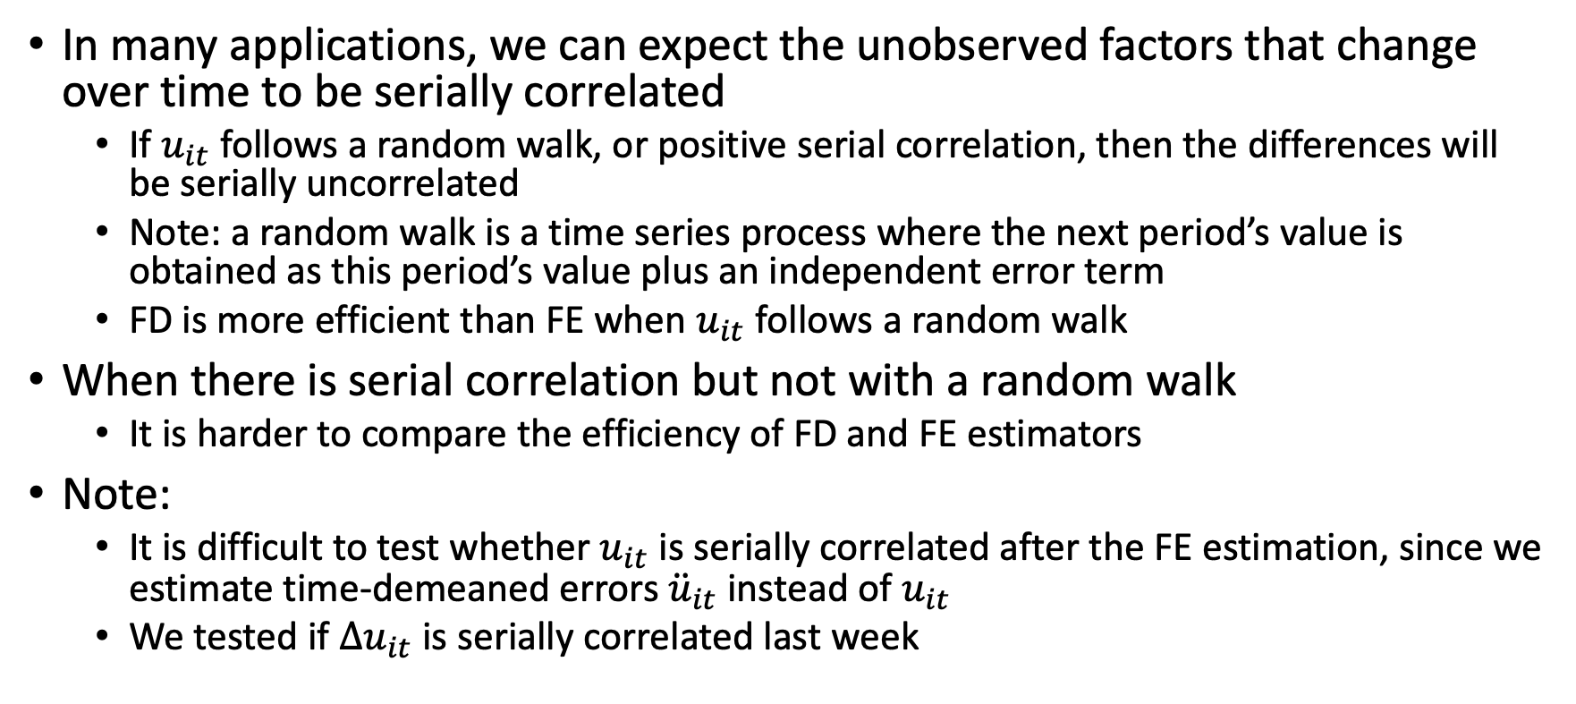
Fixed Effects or First Differencing?
In many applications, we can expect the unobserved factors that change over time to be serially correlated
If $u_{it}$ follows a random walk, or positive serial correlation, then the differences will be serially uncorrelated
Note: a random walk is a time series process where the next period’s value is obtained as this period’s value plus an independent error term
FD is more efficient than FE when $u_{it}$ follows a random walk
When there is serial correlation but not with a random walk
It is harder to compare the efficiency of FD and FE estimators
Note:
It is difficult to test whether $u_{it}$ is serially correlated after the FE estimation, since we estimate time-demeaned errors ${\ddot{u}}_{it}$ instead of $u_{it}$
We tested if $Δu_{it}$ is serially correlated last week

Slide 18
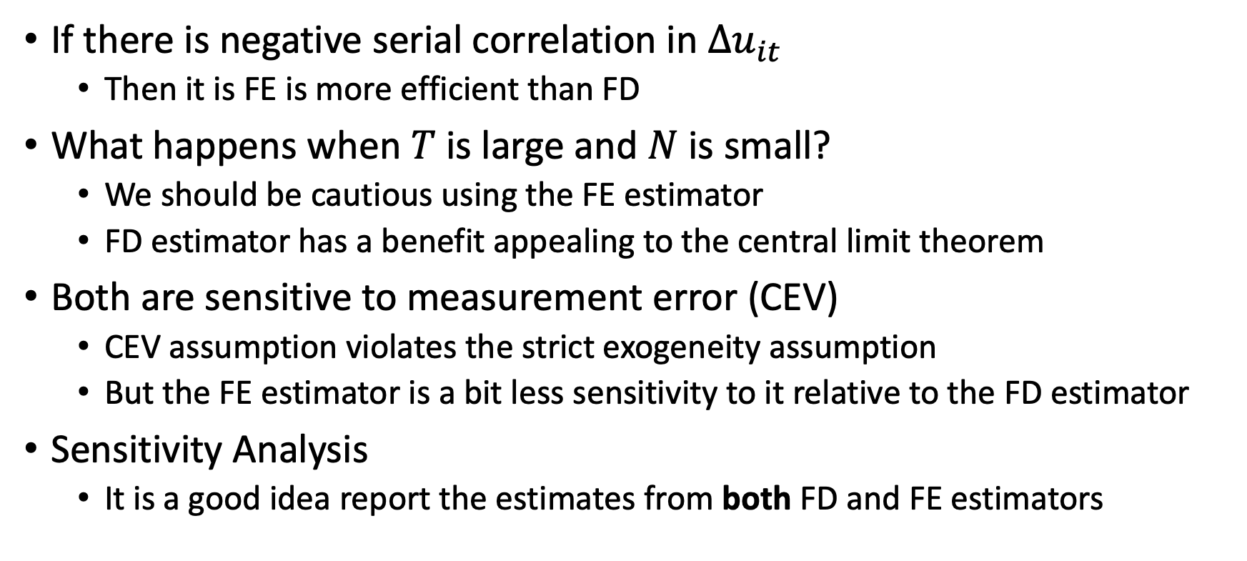
Fixed Effects or First Differencing?
If there is negative serial correlation in $Δu_{it}$
Then it is FE is more efficient than FD
What happens when $T$ is large and $N$ is small?
We should be cautious using the FE estimator
FD estimator has a benefit appealing to the central limit theorem
Both are sensitive to measurement error (CEV)
CEV assumption violates the strict exogeneity assumption
But the FE estimator is a bit less sensitivity to it relative to the FD estimator
Sensitivity Analysis
It is a good idea report the estimates from both FD and FE estimators

Slide 19
Unbalanced Panels and Fixed Effects
If there is an unbalanced panel, we can still estimate our FE estimates
Stata will take care of the unbalanced panel
The main problem is why the panel is unbalanced
Missing at random or systematic missing?
Are observations missing which is correlated with the idiosyncratic error?
Are observation dropping out due to unobserved reason?

Slide 20
Random Effects Estimation

Slide 21
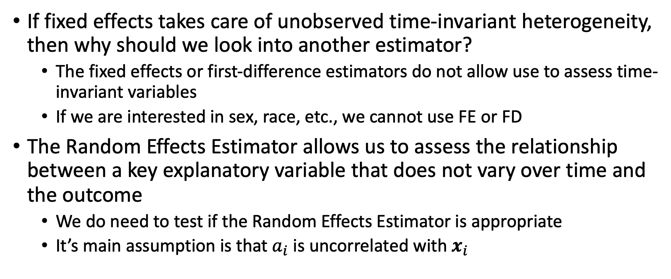
Random Effects Estimator
If fixed effects takes care of unobserved time-invariant heterogeneity, then why should we look into another estimator?
The fixed effects or first-difference estimators do not allow use to assess time-invariant variables
If we are interested in sex, race, etc., we cannot use FE or FD
The Random Effects Estimator allows us to assess the relationship between a key explanatory variable that does not vary over time and the outcome
We do need to test if the Random Effects Estimator is appropriate
It’s main assumption is that $a_{i}$ is uncorrelated with $x_{i}$

Slide 22
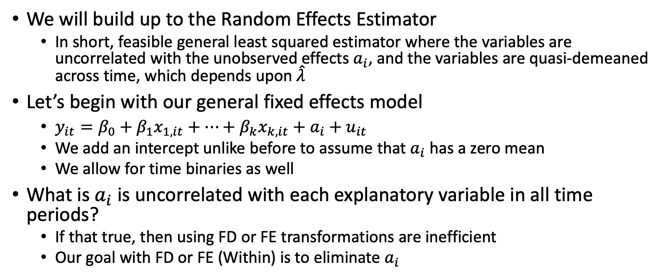
Random Effects Estimator
We will build up to the Random Effects Estimator
In short, feasible general least squared estimator where the variables are uncorrelated with the unobserved effects $a_{i}$, and the variables are quasi-demeaned across time, which depends upon $\hat{λ}$
Let’s begin with our general fixed effects model
$y_{it}=β_{0}+β_{1}x_{1,it}+…+β_{k}x_{k,it}+a_{i}+u_{it}$
We add an intercept unlike before to assume that $a_{i}$ has a zero mean
We allow for time binaries as well
What is $a_{i}$ is uncorrelated with each explanatory variable in all time periods?
If that true, then using FD or FE transformations are inefficient
Our goal with FD or FE (Within) is to eliminate $a_{i}$

Slide 23
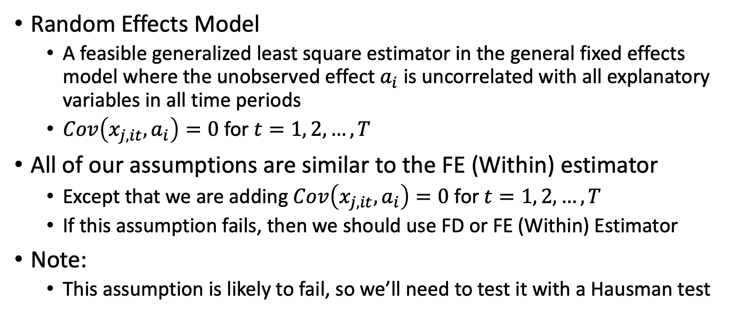
Random Effects Estimator
Random Effects Model
A feasible generalized least square estimator in the general fixed effects model where the unobserved effect $a_{i}$ is uncorrelated with all explanatory variables in all time periods
$Cov\left(x_{j,it},a_{i}\right)=0$ for $t=1, 2, …, T$
All of our assumptions are similar to the FE (Within) estimator
Except that we are adding $Cov\left(x_{j,it},a_{i}\right)=0$ for $t=1, 2, …, T$
If this assumption fails, then we should use FD or FE (Within) Estimator
Note:
This assumption is likely to fail, so we’ll need to test it with a Hausman test

Slide 24
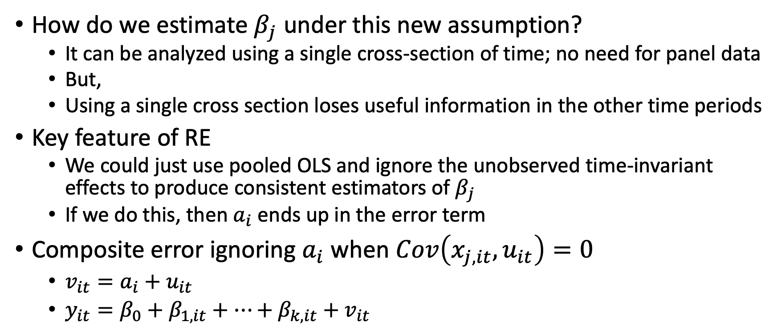
Random Effects Estimator
How do we estimate $β_{j}$ under this new assumption?
It can be analyzed using a single cross-section of time; no need for panel data
But,
Using a single cross section loses useful information in the other time periods
Key feature of RE
We could just use pooled OLS and ignore the unobserved time-invariant effects to produce consistent estimators of $β_{j}$
If we do this, then $a_{i}$ ends up in the error term
Composite error ignoring $a_{i}$ when $Cov\left(x_{j,it}, u_{it}\right)=0$
$v_{it}=a_{i}+u_{it}$
$y_{it}=β_{0}+β_{1,it}+…+β_{k,it}+v_{it}$

Slide 25
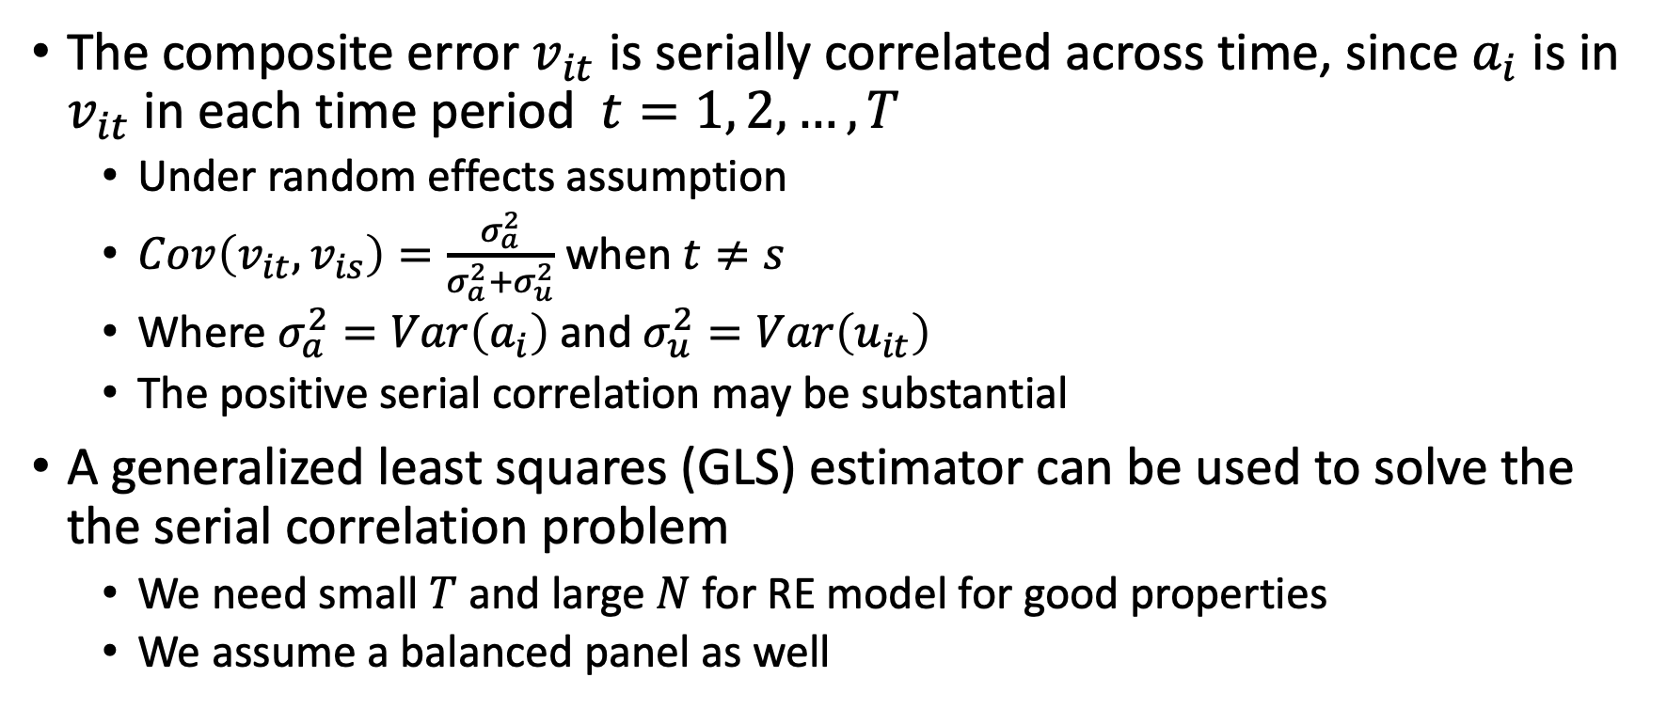
Random Effects Estimator
The composite error $v_{it}$ is serially correlated across time, since $a_{i}$ is in $v_{it}$ in each time period $t=1, 2, …, T$
Under random effects assumption
$Cov\left(v_{it},v_{is}\right)=\frac{σ_{a}^{2}}{σ_{a}^{2}+σ_{u}^{2}}$ when $t≠s$
Where $σ_{a}^{2}=Var\left(a_{i}\right)$ and $σ_{u}^{2}=Var\left(u_{it}\right)$
The positive serial correlation may be substantial
A generalized least squares (GLS) estimator can be used to solve the the serial correlation problem
We need small $T$ and large $N$ for RE model for good properties
We assume a balanced panel as well

Slide 26
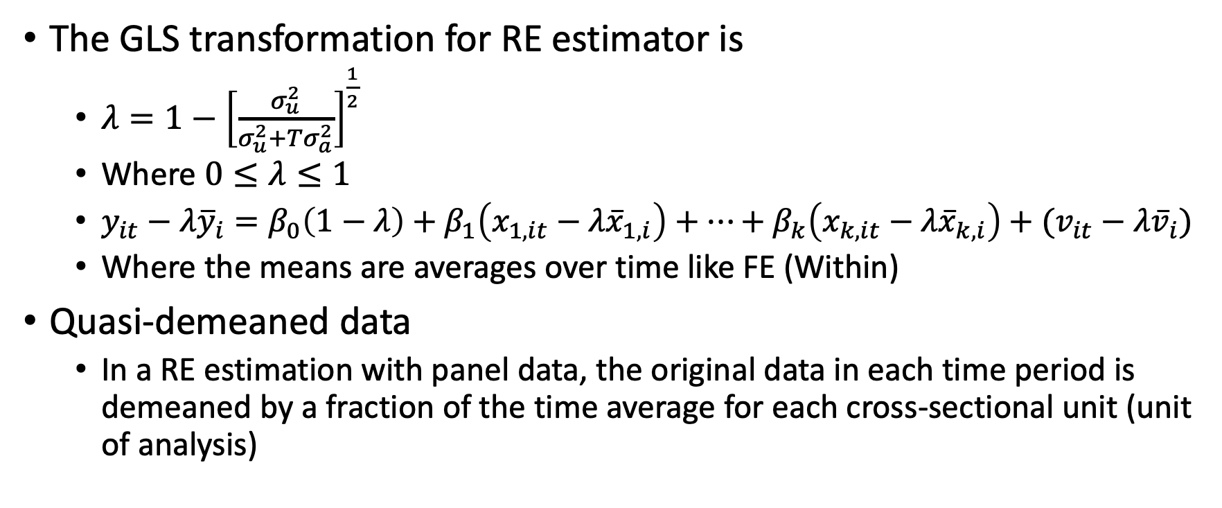
Random Effects Estimator
The GLS transformation for RE estimator is
$λ=1−{\left[\frac{σ_{u}^{2}}{σ_{u}^{2}+Tσ_{a}^{2}}\right]}^{\frac{1}{2}}$
Where $0≤λ≤1$
$y_{it}−λ{\overline{y}}_{i}=β_{0}\left(1−λ\right)+β_{1}\left(x_{1,it}−λ{\overline{x}}_{1,i}\right)+…+β_{k}\left(x_{k,it}−λ{\overline{x}}_{k, i}\right)+(v_{it}−λ{\overline{v}}_{i})$
Where the means are averages over time like FE (Within)
Quasi-demeaned data
In a RE estimation with panel data, the original data in each time period is demeaned by a fraction of the time average for each cross-sectional unit (unit of analysis)

Slide 27
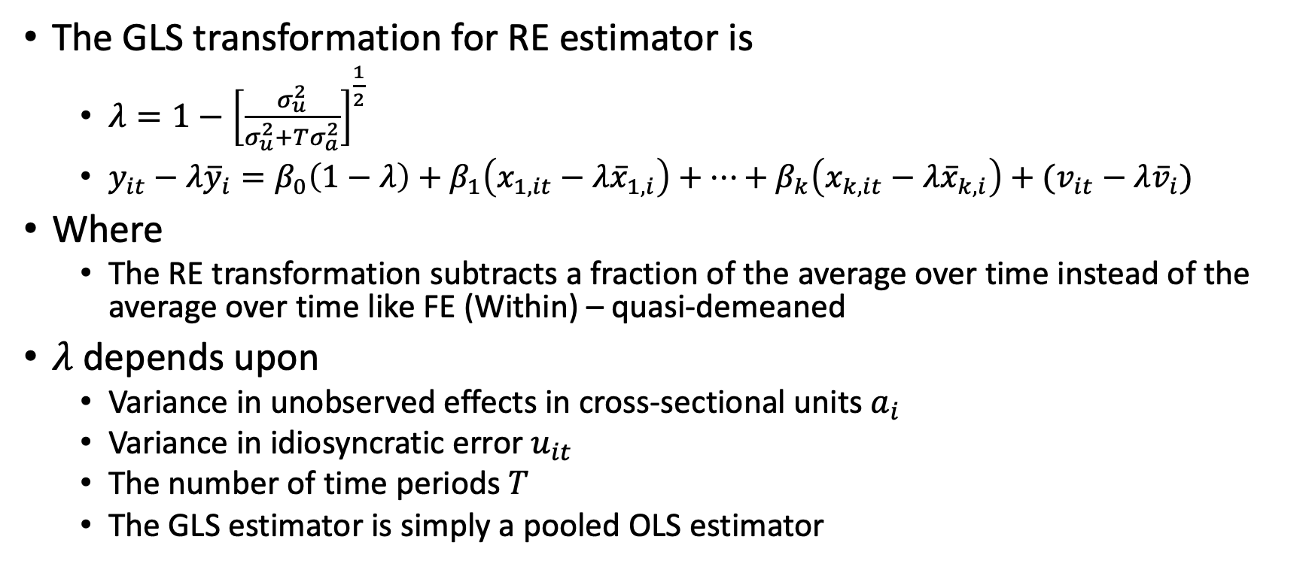
Random Effects Estimator
The GLS transformation for RE estimator is
$λ=1−{\left[\frac{σ_{u}^{2}}{σ_{u}^{2}+Tσ_{a}^{2}}\right]}^{\frac{1}{2}}$
$y_{it}−λ{\overline{y}}_{i}=β_{0}\left(1−λ\right)+β_{1}\left(x_{1,it}−λ{\overline{x}}_{1,i}\right)+…+β_{k}\left(x_{k,it}−λ{\overline{x}}_{k, i}\right)+(v_{it}−λ{\overline{v}}_{i})$
Where
The RE transformation subtracts a fraction of the average over time instead of the average over time like FE (Within) – quasi-demeaned
$λ$ depends upon
Variance in unobserved effects in cross-sectional units $a_{i}$
Variance in idiosyncratic error $u_{it}$
The number of time periods $T$
The GLS estimator is simply a pooled OLS estimator

Slide 28
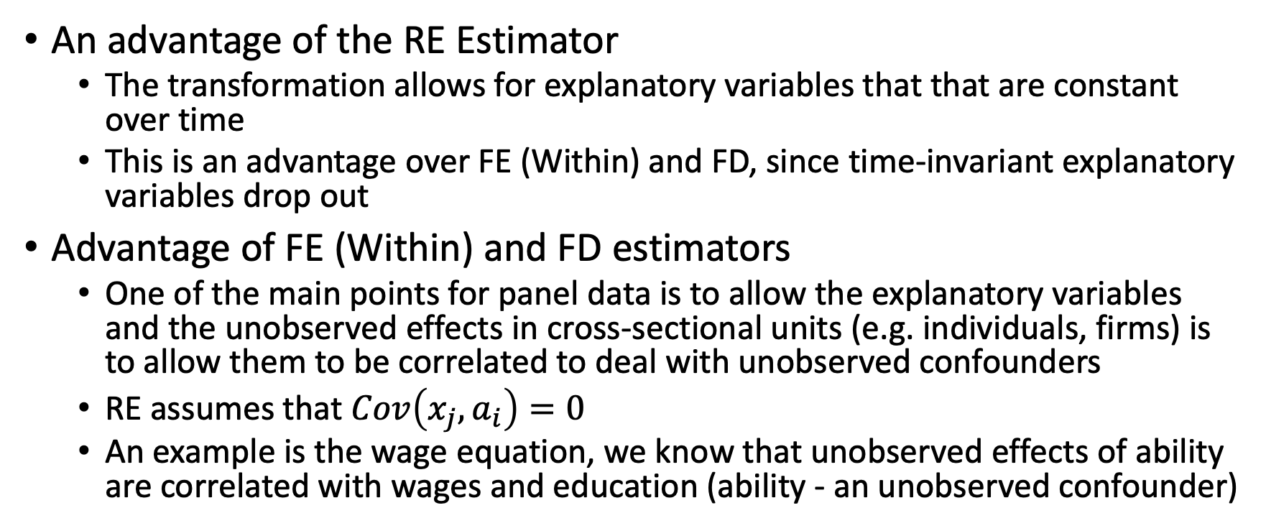
Random Effects Estimator (move to later)?
An advantage of the RE Estimator
The transformation allows for explanatory variables that that are constant over time
This is an advantage over FE (Within) and FD, since time-invariant explanatory variables drop out
Advantage of FE (Within) and FD estimators
One of the main points for panel data is to allow the explanatory variables and the unobserved effects in cross-sectional units (e.g. individuals, firms) is to allow them to be correlated to deal with unobserved confounders
RE assumes that $Cov\left(x_{j},a_{i}\right)=0$
An example is the wage equation, we know that unobserved effects of ability are correlated with wages and education (ability - an unobserved confounder)

Slide 29
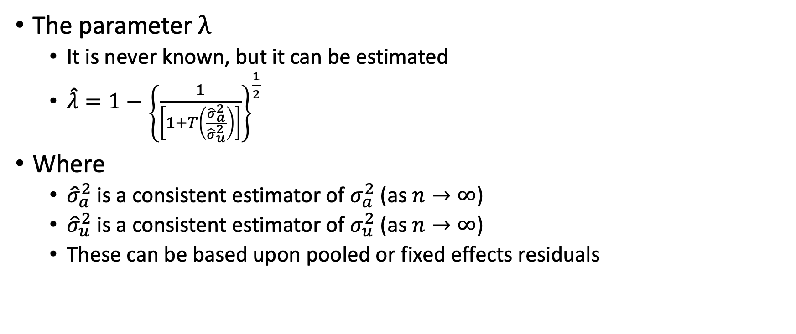
Random Effects Estimator
The parameter $λ$
It is never known, but it can be estimated
$\hat{λ}=1−{\left\{\frac{1}{\left[1+T\left(\frac{{\hat{σ}}_{a}^{2}}{{\hat{σ}}_{u}^{2}}\right)\right]}\right\}}^{\frac{1}{2}}$
Where
${\hat{σ}}_{a}^{2}$ is a consistent estimator of $σ_{a}^{2}$ (as $n→∞$)
${\hat{σ}}_{u}^{2}$ is a consistent estimator of $σ_{u}^{2}$ (as $n→∞$)
These can be based upon pooled or fixed effects residuals

Slide 30
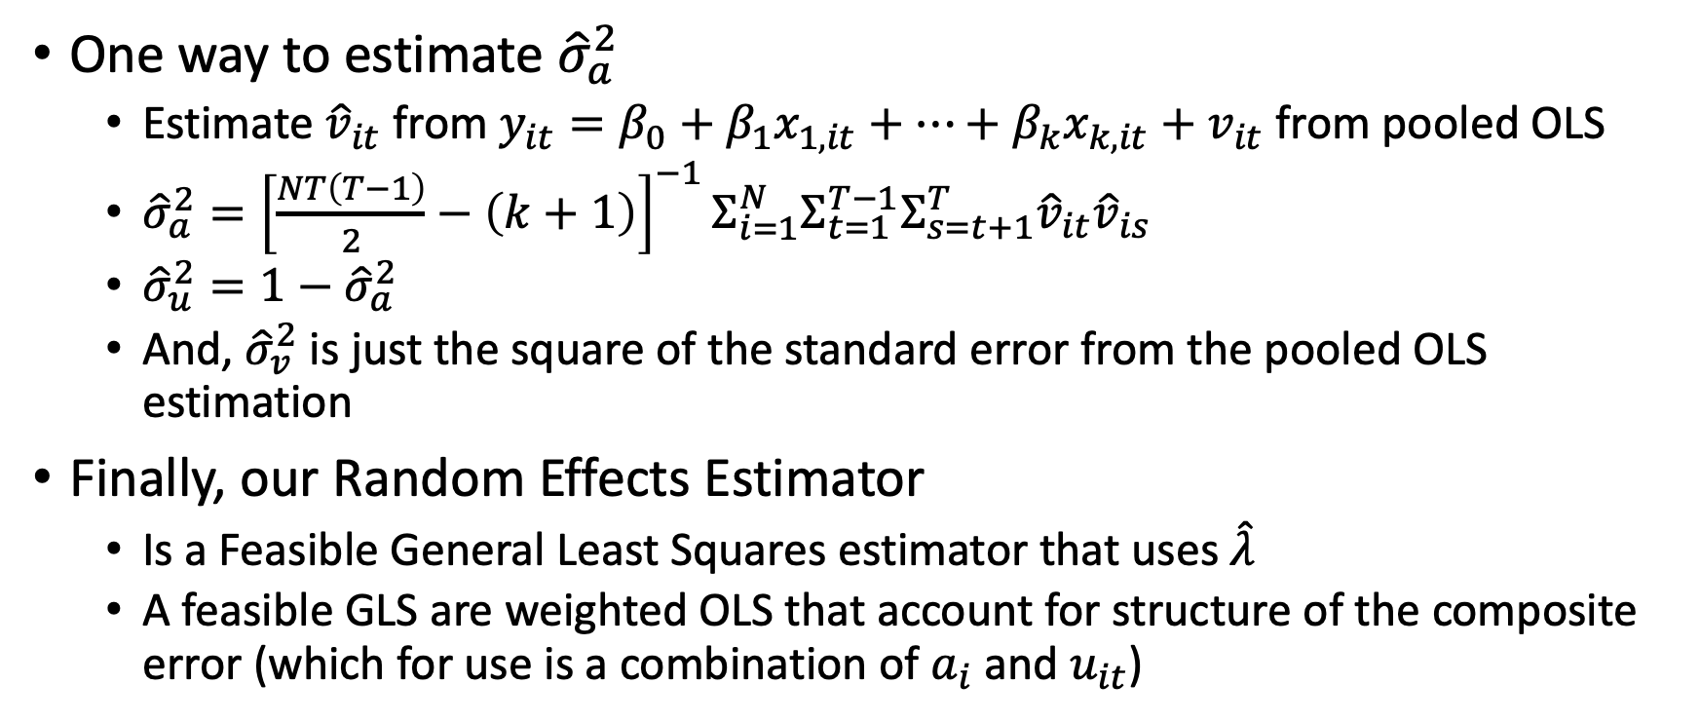
Random Effects Estimator
One way to estimate ${\hat{σ}}_{a}^{2}$
Estimate ${\hat{v}}_{it}$ from $y_{it}=β_{0}+β_{1}x_{1,it}+…+β_{k}x_{k,it}+v_{it}$ from pooled OLS
${\hat{σ}}_{a}^{2}={\left[\frac{NT\left(T−1\right)}{2}−\left(k+1\right)\right]}^{−1}Σ_{i=1}^{N}Σ_{t=1}^{T−1}Σ_{s=t+1}^{T}{\hat{v}}_{it}{\hat{v}}_{is}$
${\hat{σ}}_{u}^{2}=1−{\hat{σ}}_{a}^{2}$
And, ${\hat{σ}}_{v}^{2}$ is just the square of the standard error from the pooled OLS estimation
Finally, our Random Effects Estimator
Is a Feasible General Least Squares estimator that uses $\hat{λ}$
A feasible GLS are weighted OLS that account for structure of the composite error (which for use is a combination of $a_{i}$ and $u_{it}$)

Slide 31
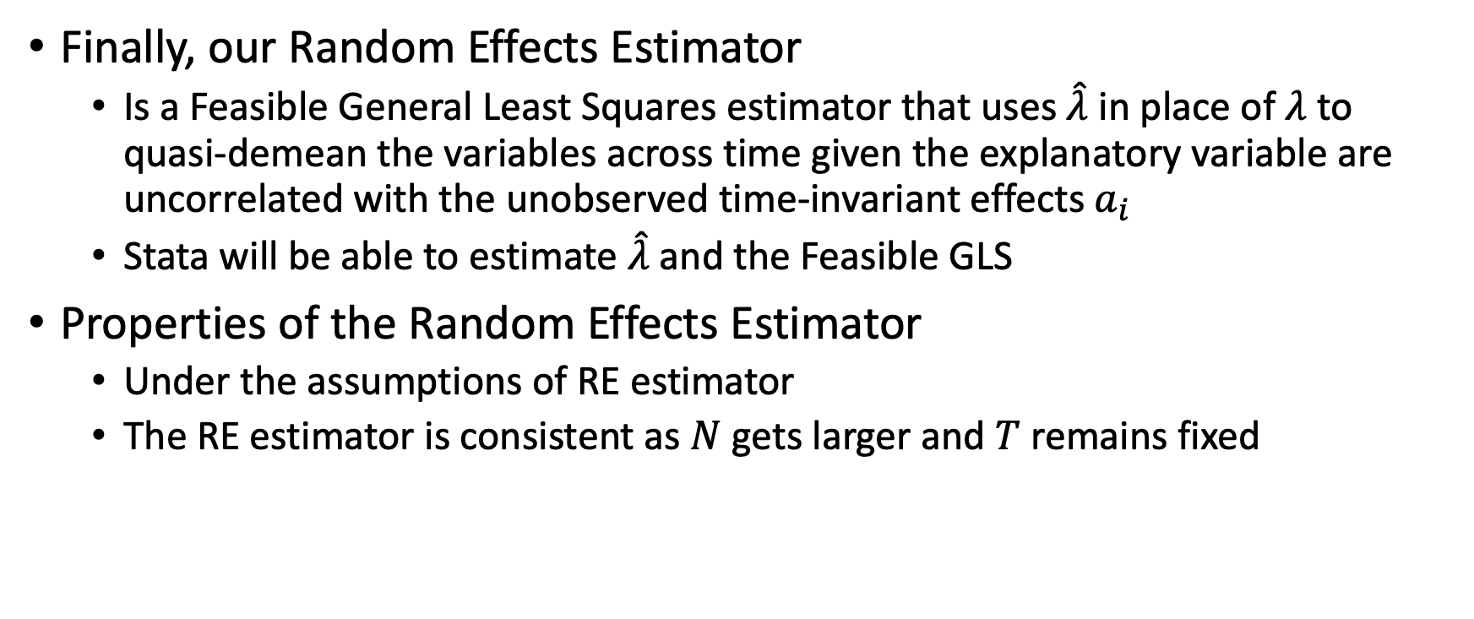
Random Effects Estimator
Finally, our Random Effects Estimator
Is a Feasible General Least Squares estimator that uses $\hat{λ}$ in place of $λ$ to quasi-demean the variables across time given the explanatory variable are uncorrelated with the unobserved time-invariant effects $a_{i}$
Stata will be able to estimate $\hat{λ}$ and the Feasible GLS
Properties of the Random Effects Estimator
Under the assumptions of RE estimator
The RE estimator is consistent as $N$ gets larger and $T$ remains fixed

Slide 32
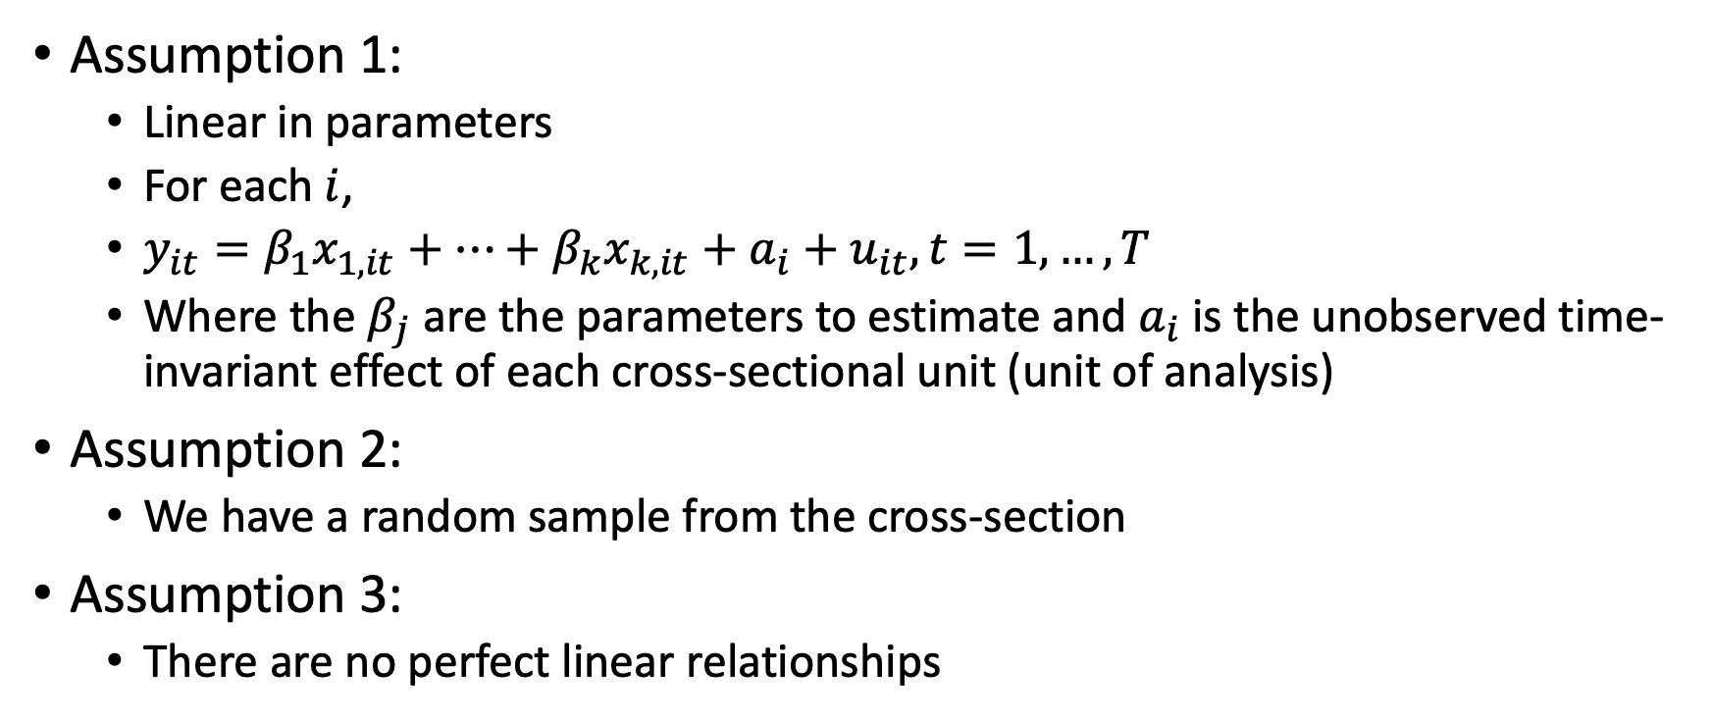
Assumptions of the Random Effects Estimator
Assumption 1:
Linear in parameters
For each $i$,
$y_{it}=β_{1}x_{1,it}+…+β_{k}x_{k,it}+a_{i}+u_{it}, t=1,…,T$
Where the $β_{j}$ are the parameters to estimate and $a_{i}$ is the unobserved time-invariant effect of each cross-sectional unit (unit of analysis)
Assumption 2:
We have a random sample from the cross-section
Assumption 3:
There are no perfect linear relationships

Slide 33
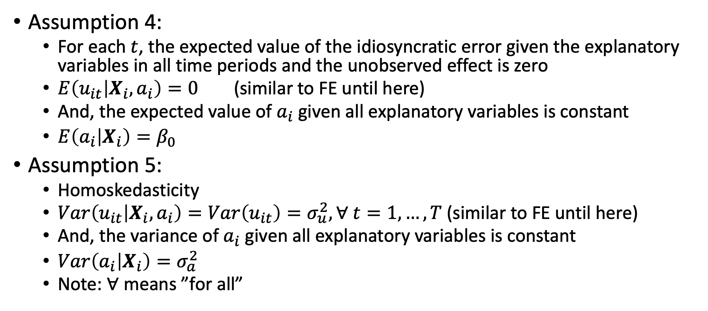
Assumptions of the Random Effects Estimator
Assumption 4:
For each $t$, the expected value of the idiosyncratic error given the explanatory variables in all time periods and the unobserved effect is zero
$E\left(u_{it} | X_{i},a_{i}\right)=0$ (similar to FE until here)
And, the expected value of $a_{i}$ given all explanatory variables is constant
$E\left(a_{i} | X_{i}\right)=β_{0}$
Assumption 5:
Homoskedasticity
$Var\left(u_{it} | X_{i},a_{i}\right)=Var\left(u_{it}\right)=σ_{u}^{2}, ∀ t=1,…,T$ (similar to FE until here)
And, the variance of $a_{i}$ given all explanatory variables is constant
$Var\left(a_{i} | X_{i}\right)=σ_{a}^{2}$
Note: $∀$ means ”for all”

Slide 34

Assumptions of the Random Effects Estimator
Assumption 6:
For all $t≠s$, the idiosyncratic errors are uncorrelated conditional on all explanatory variables and unobserved effects $a_{i}$
$Cov\left(u_{it},u_{is}|X_{i}, a_{i}\right)=0$

Slide 35

Random Effects Estimator
Properties of the Random Effects Estimator
Under the assumptions of RE estimator
The RE estimator is consistent as $N$ gets larger and $T$ remains fixed
The properties of the RE estimator when $N$ is small and $T$ is larger is undefined

Slide 36
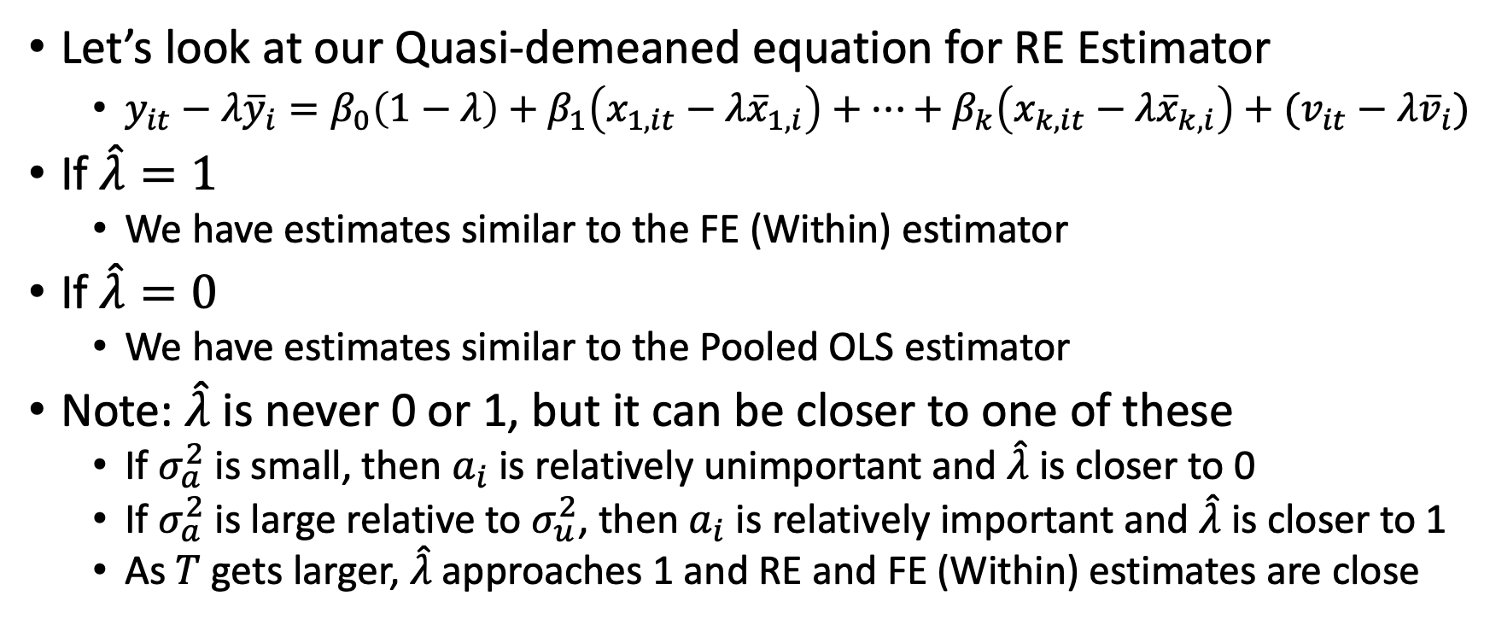
RE Estimator compared to Pooled OLS and FE
Let’s look at our Quasi-demeaned equation for RE Estimator
$y_{it}−λ{\overline{y}}_{i}=β_{0}\left(1−λ\right)+β_{1}\left(x_{1,it}−λ{\overline{x}}_{1,i}\right)+…+β_{k}\left(x_{k,it}−λ{\overline{x}}_{k, i}\right)+(v_{it}−λ{\overline{v}}_{i})$
If $\hat{λ}=1$
We have estimates similar to the FE (Within) estimator
If $\hat{λ}=0$
We have estimates similar to the Pooled OLS estimator
Note: $\hat{λ}$ is never 0 or 1, but it can be closer to one of these
If $σ_{a}^{2}$ is small, then $a_{i}$ is relatively unimportant and $\hat{λ}$ is closer to 0
If $σ_{a}^{2}$ is large relative to $σ_{u}^{2}$, then $a_{i}$ is relatively important and $\hat{λ}$ is closer to 1
As $T$ gets larger, $\hat{λ}$ approaches 1 and RE and FE (Within) estimates are close

Slide 37
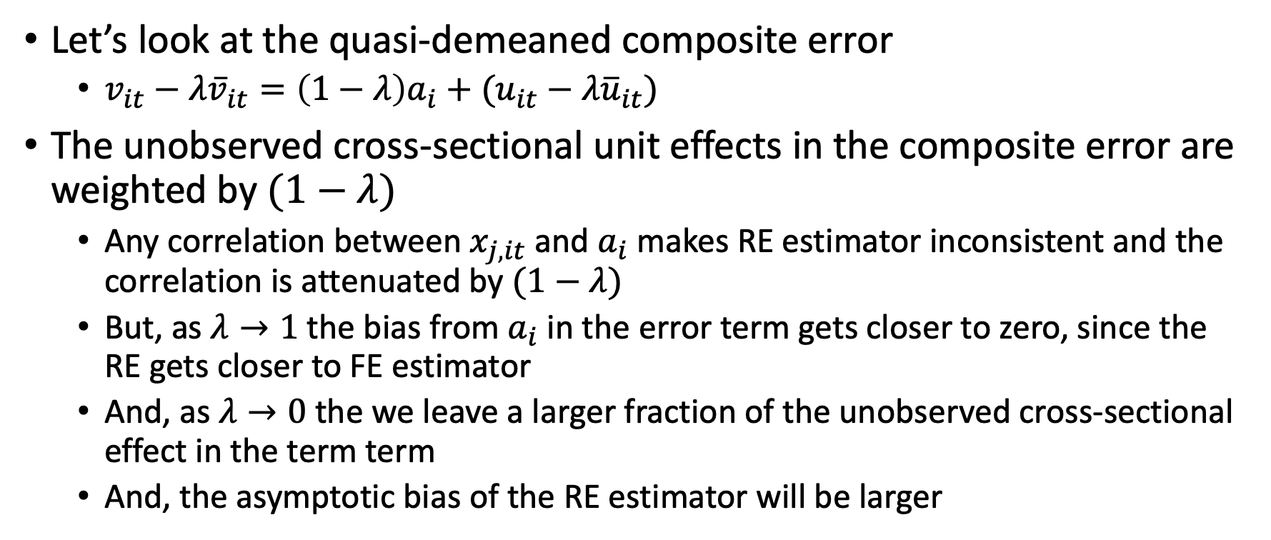
Composite Error of Random Effects Estimator
Let’s look at the quasi-demeaned composite error
$v_{it}−λ{\overline{v}}_{it}=\left(1−λ\right)a_{i}+(u_{it}−λ{\overline{u}}_{it})$
The unobserved cross-sectional unit effects in the composite error are weighted by $(1−λ)$
Any correlation between $x_{j,it}$ and $a_{i}$ makes RE estimator inconsistent and the correlation is attenuated by $(1−λ)$
But, as $λ→1$ the bias from $a_{i}$ in the error term gets closer to zero, since the RE gets closer to FE estimator
And, as $λ→0$ the we leave a larger fraction of the unobserved cross-sectional effect in the term term
And, the asymptotic bias of the RE estimator will be larger

Slide 38
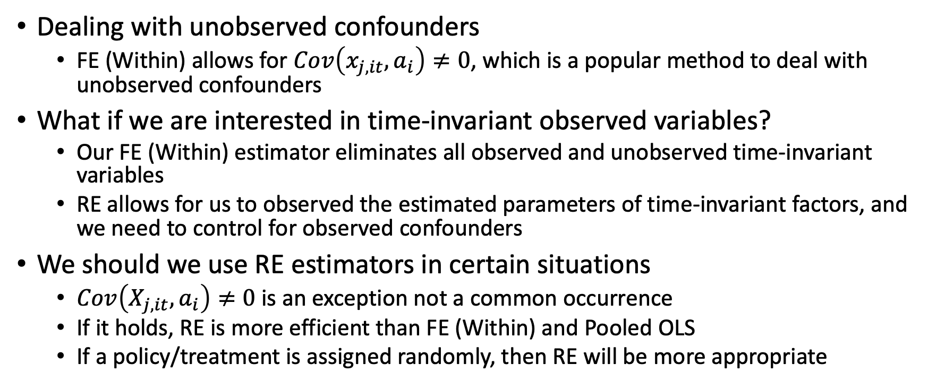
Pooled OLS, FE (Within), and RE Estimators
Dealing with unobserved confounders
FE (Within) allows for $Cov\left(x_{j,it},a_{i}\right)≠0$, which is a popular method to deal with unobserved confounders
What if we are interested in time-invariant observed variables?
Our FE (Within) estimator eliminates all observed and unobserved time-invariant variables
RE allows for us to observed the estimated parameters of time-invariant factors, and we need to control for observed confounders
We should we use RE estimators in certain situations
$Cov\left(X_{j,it},a_{i}\right)≠0$ is an exception not a common occurrence
If it holds, RE is more efficient than FE (Within) and Pooled OLS
If a policy/treatment is assigned randomly, then RE will be more appropriate

Slide 39
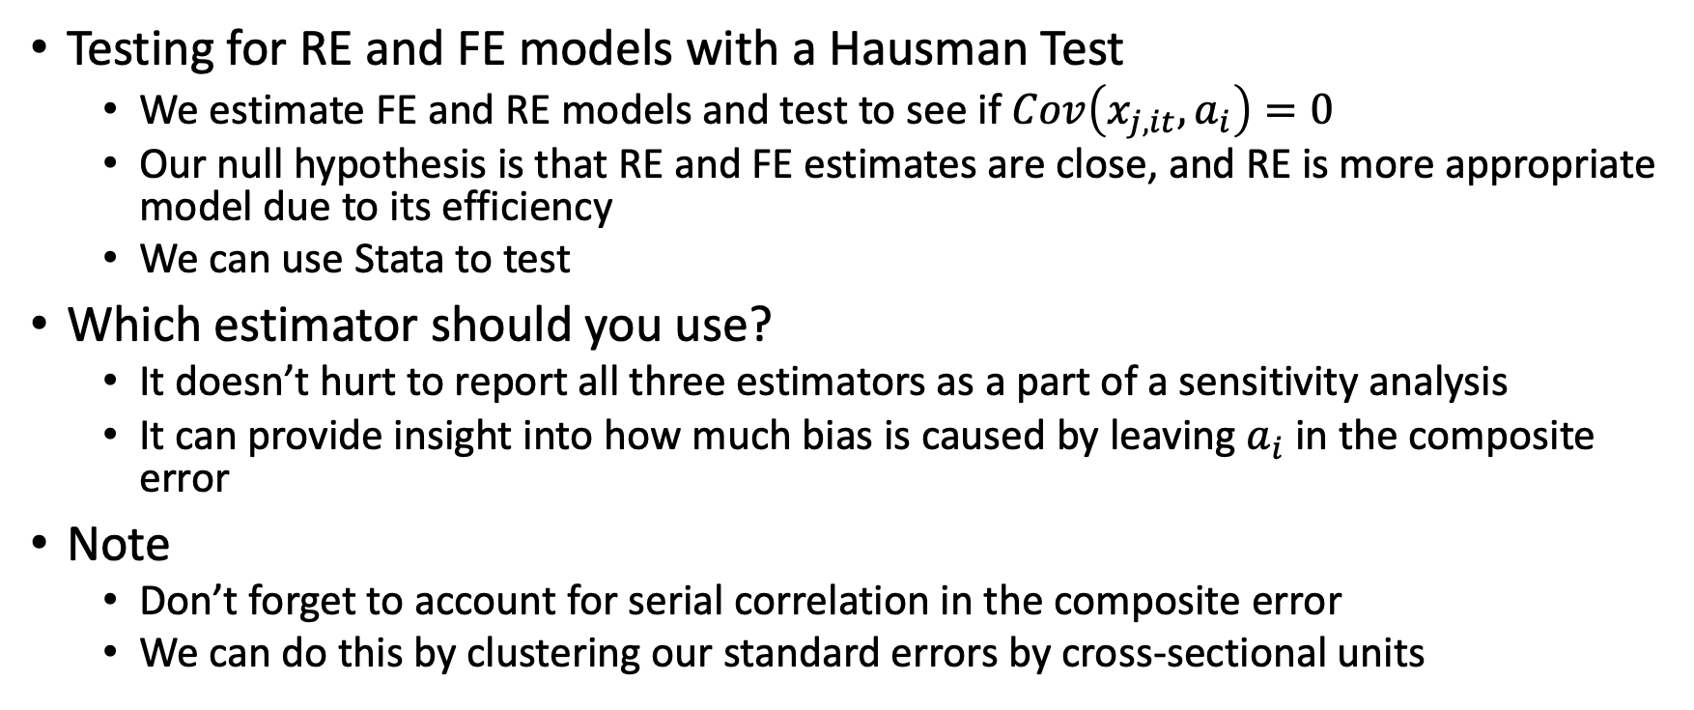
Pooled OLS, FE (Within), and RE Estimators
Testing for RE and FE models with a Hausman Test
We estimate FE and RE models and test to see if $Cov\left(x_{j,it},a_{i}\right)=0$
Our null hypothesis is that RE and FE estimates are close, and RE is more appropriate model due to its efficiency
We can use Stata to test
Which estimator should you use?
It doesn’t hurt to report all three estimators as a part of a sensitivity analysis
It can provide insight into how much bias is caused by leaving $a_{i}$ in the composite error
Note
Don’t forget to account for serial correlation in the composite error
We can do this by clustering our standard errors by cross-sectional units

Slide 40
Random Effects, Fixed Effects, and Pooled OLS
A Wage Equation using Panel Data
Comparing RE, FE, and Pooled OLS
In Stata

Slide 41
Stata Examples and Work

