Slide 1
Econ 645: Week 5
Natural Experiments and Introductory Difference-in-Differences
*Views do not represent HRSA or HHS

Slide 2
Overview
Policy Analysis with Fixed Effects
Natural Experiments
2-by-2 Difference-in-Differences
Stata Examples
Brief Review

Slide 3
Policy Analysis with Two-Period Panel Data

Slide 4
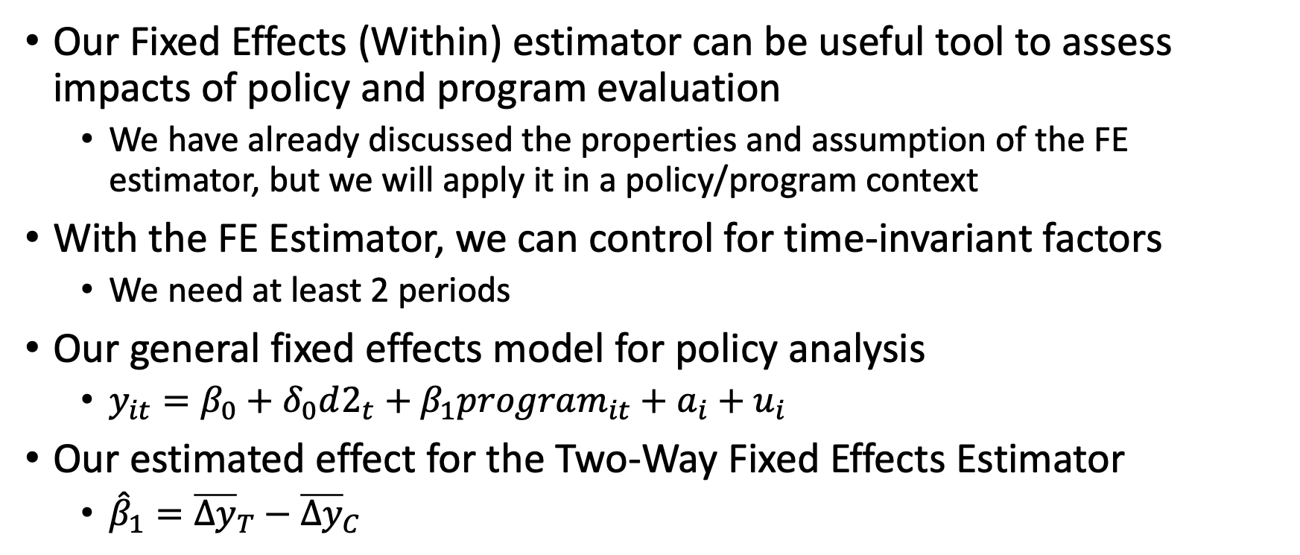
Fixed Effects (Within) for Policy Analysis
Our Fixed Effects (Within) estimator can be useful tool to assess impacts of policy and program evaluation
We have already discussed the properties and assumption of the FE estimator, but we will apply it in a policy/program context
With the FE Estimator, we can control for time-invariant factors
We need at least 2 periods
Our general fixed effects model for policy analysis
$y_{it}=β_{0}+δ_{0}d2_{t}+β_{1}program_{it}+a_{i}+u_{i}$
Our estimated effect for the Two-Way Fixed Effects Estimator
${\hat{β}}_{1}={\overline{Δy}}_{T}−{\overline{Δy}}_{C}$

Slide 5
Fixed Effects (Within)
We will cover two examples in Stata
Effect of grants on preventing scrap waste
Effect of open container laws on traffic deaths
Self-selection
As we go through these exercises, we need to consider self-selection
There is still a concern of self-selection into treatment that FE cannot control
Economic agents will self-select into various actions that will maximize their well-being (including firms maximizing economic profits)
Testing strict exogeneity
We cannot directly test the strict exogeneity assumption for Fixed Effects

Slide 6
Natural Experiments

Slide 7
Natural Experiments
Natural Experiments
These are situations where the economic environment, which may be summarized by an exogenous variable, exogenously changes
Sometimes this is inadvertently due to a policy or institutional change
The key term here is exogenously changes, which means economic agents do not have time to anticipate the change
There is randomization from the inadvertent change that leads some economic agents into treatment and others into no treatment

Slide 8
Natural Experiments
There are some inadvertent natural experiments that have occurred
The Vietnam draft lottery
The Oregon Medicaid lottery
Tennessee STAR
Arbitrary cutoffs for regulation assignment (e.g.: firm size of 50 employees)
Arbitrary SAT cutoff for admission
State adoption of policy (though there can be some serious self-selection)
Random assignment to judges
Exogeneity of instruments – wind direction, wave height, rain fall,

Slide 9
Natural Experiments
Natural experiments help with randomization, but they do not always have exogenous assignment to treatment
Lotteries are typical examples of natural experiments
But, there may be self-selection
For example, a student that does not win a charter school lottery may be place in a private school by their parents instead of going to the assigned public school
The parents self-selected the student out of the control group

Slide 10
Natural Experiments using IV
Vietnam Draft Lottery
Angrist (1990) What are the returns to education for military service during the Vietnam War?
Angrist uses the Vietnam draft lottery as an instrument and SS admin data
It randomly influenced who would serve in the military, and as a result Vietnam veterans earned about 15% less than comparable observations
Can you think of a problem or problems(s) with this instrument?
Oregon Medicaid Experiment
There was a lottery for enrollment into Medicaid after Oregon expanded the program
We’ll cover this in a discussion during Week 6

Slide 11
Quasi-experiments
Quasi-experiments
Natural experiments are sometimes called quasi-experiments
However, not all quasi-experimental designs have sufficient exogeneity
We will briefly cover some quasi-experimental designs and research using these methods
With experimental design or a randomized control trial (RCT)
Economic agents are intentionally randomized assigned to treatment or control
There can still be problems with compliance, but RCT usually have strong exogeneity
With quasi-experimental designs (QED), self-selection can still bias our parameters
Self-selection means that people will try to optimize their well-being and self-selection in or out of treatment
We may have endogeneity (such as omitted variable bias) from unobserved confounders, and our QED needs to account, control, or test for it

Slide 12
Quasi-experiment designs
Propensity Score Matching
Inverse Probability Weights
K-nearest neighbors
Instrumental Variables
We have a brief introduction to IV in ECON 645, but there is more to cover
Difference-in-Differences and its many offshoots
Triple Difference-in-Difference-in-Differences
Event Studies
Two-Way Fixed Effects with and without Staggered Adoption
Synthetic Control
Regression Discontinuity Design
Typically considered the strongest QED, due to testable assumptions

Slide 13
Quasi-experiment design
A more through walkthrough of different quasi-experiment designs is covered in ECON 672
What are we estimating?
What are the benefits of these research designs?
What are the problems with these research designs?
What are the assumptions?
Are these assumptions testable?
Which quasi-experiment research design is the most likely to have assumptions hold or at least be testable?
Are the results generalizable? If not, then to whom are they generalizable?

Slide 14
Intro to Difference-in-Differences

Slide 15
Difference-in-Differences with Pooled Cross Sections
Difference-in-Differences design is one of the most popular quasi-experimental designs
Especially for policy analysis
There are a few necessary groups
We need a treatment group affected by the change
We need a control group unaffected by the change
We need at least two time periods
Pooled Cross-sectional data can be used at aggregate levels
We may have two independent random samples at the state level
But we must have at least two observations from the state

Slide 16
Diff-in-Diff with Pooled Cross Sections
We will have four groups in all
Before the Change
Treatment group affected by the change before the change
Control group unaffected by the change before the change
After the Change
Treatment group affected by the change after the change
Control group unaffected by the change after the change
We have 2 time periods and 2 groups
Hence 2-by-2 Diff-in-Diff

Slide 17
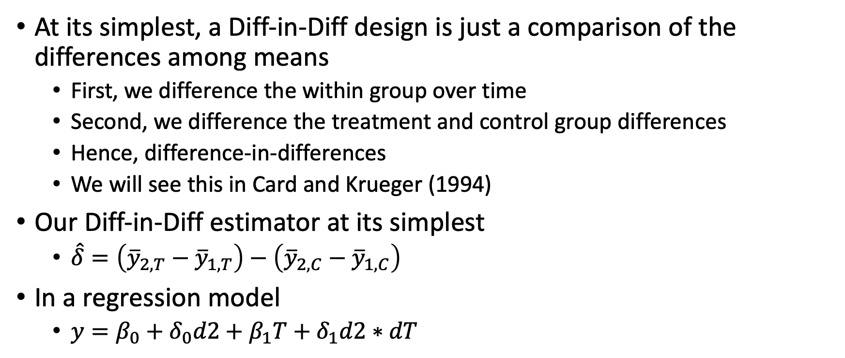
Diff-in-Diff with Pooled Cross Sections
At its simplest, a Diff-in-Diff design is just a comparison of the differences among means
First, we difference the within group over time
Second, we difference the treatment and control group differences
Hence, difference-in-differences
We will see this in Card and Krueger (1994)
Our Diff-in-Diff estimator at its simplest
$\hat{δ}=\left({\overline{y}}_{2,T}−{\overline{y}}_{1,T}\right)−\left({\overline{y}}_{2,C}−{\overline{y}}_{1,C}\right)$
In a regression model
$y=β_{0}+δ_{0}d2+β_{1}T+δ_{1}d2∗dT$

Slide 18
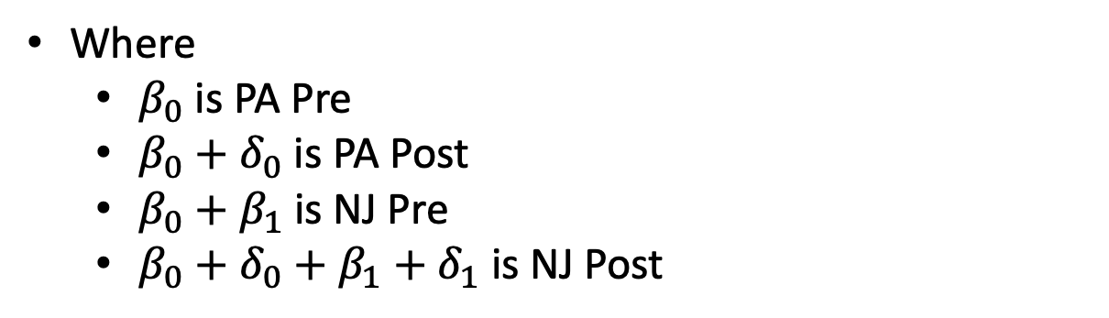
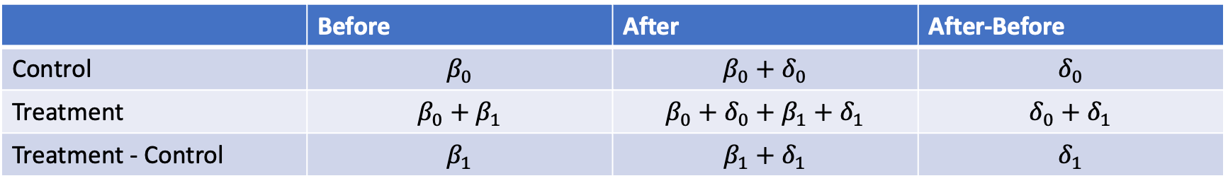
Diff-in-Diff with Pooled Cross Sections
 | Before | After | After-Before
Control | $$β_{0}$$ | $$β_{0}+δ_{0}$$ | $$δ_{0}$$
Treatment | $$β_{0}+β_{1}$$ | $$β_{0}+δ_{0}+β_{1}+δ_{1}$$ | $$δ_{0}+δ_{1}$$
Treatment - Control | $$β_{1}$$ | $$β_{1}+δ_{1}$$ | $$δ_{1}$$
Where
$β_{0}$ is PA Pre
$β_{0}+δ_{0}$ is PA Post
$β_{0}+β_{1}$ is NJ Pre
$β_{0}+δ_{0}+β_{1}+δ_{1}$ is NJ Post

Slide 19
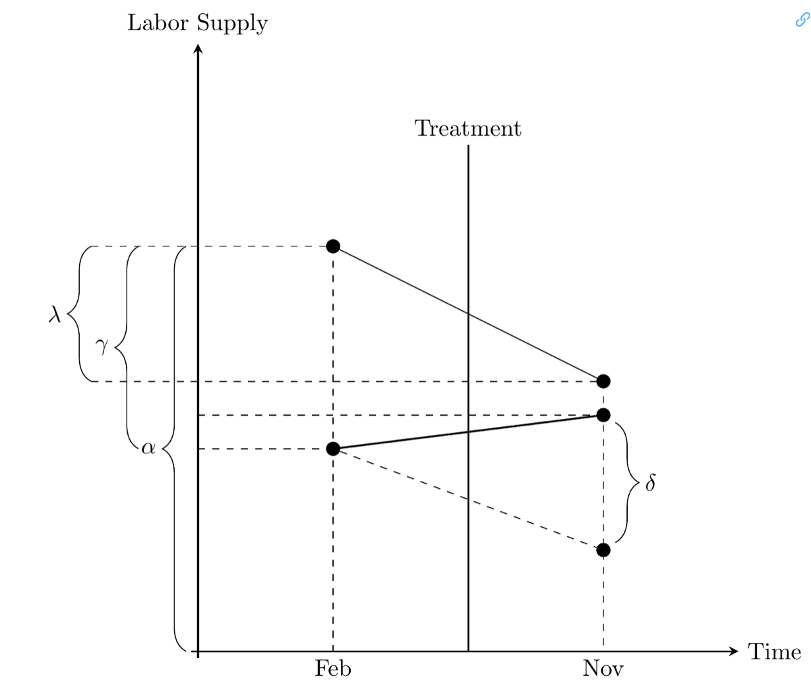

Diff-in-Diff
Where
$α$ is PA Pre
$α+λ$ is PA Post
$α+γ$ is NJ Pre
$α+γ+λ+δ$ is NJ Post
Different notation Same concept

Slide 20
Diff-in-Diff Assumptions
Unlike a randomized control trial or experiment
Observations are not randomly assigned to treatment and control
Key assumption: Parallel Trends
In absence of the treatment, the treatment group trend would have been the same as the control group
Under proper assumptions
If our assumptions hold, then our quasi-experimental design is as good as random (this is hard to achieve)
We will have found the average treatment on the treated effect (ATT)
We go over average treatment effects in more detail in ECON 672

Slide 21
Diff-in-Diff Assumptions
Diff-in-Diff takes a step beyond FE and FD estimators
We only control for time-invariant effects with FE and FD
If Diff-in-Diff we can control for time-invariant and time-varying unobserved confounders
The key assumption is the parallel trends assumption
Strict exogeneity can be tough to show or to cover with theory
Unlike the strict exogeneity assumption, there are indirect tests of the parallel trends assumption
There are placebo tests, pre-trends tests
One of the most popular forms of Diff-in-Diff is an event study

Slide 22
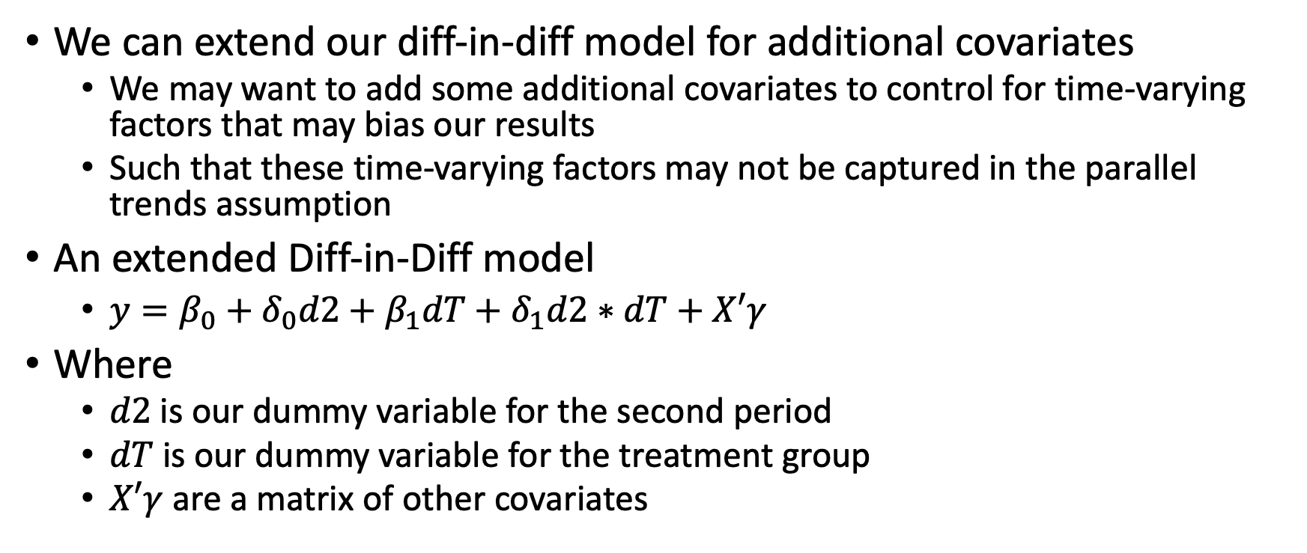
Diff-in-Diff with Pooled Cross Sections
We can extend our diff-in-diff model for additional covariates
We may want to add some additional covariates to control for time-varying factors that may bias our results
Such that these time-varying factors may not be captured in the parallel trends assumption
An extended Diff-in-Diff model
$y=β_{0}+δ_{0}d2+β_{1}dT+δ_{1}d2∗dT+X′γ$
Where
$d2$ is our dummy variable for the second period
$dT$ is our dummy variable for the treatment group
$X′γ$ are a matrix of other covariates

Slide 23
Stata examples and work

Slide 24
Review

Slide 25
Endogeneity
When is OLS BLUE?
When assumption Gauss-Markov 1-4 are satisfied is unbiased and consistent, but it might not be efficient
When assumption 1-6 are satisfied, OLS estimators are BLUE
Efficiency is what adds the best in BLUE
What happens to our estimators when we have endogeneity?
Our estimators are no longer consistent or unbiased
What happens when we have multicollinearity or heteroskedasticity
Our standard errors become biased, even though OLS can be LUE
What is the direction of the bias when we have on unobserved confounder?

Slide 26
Endogeneity
What causes endogeneity?
Omitted variable bias
Misspecification
Measurement Error (classic errors-in-variables)
Missing data on independent variables
Simultaneity Bias
What causes standard errors to be biased?
Multicollinearity
Heteroskedasticity

Slide 27
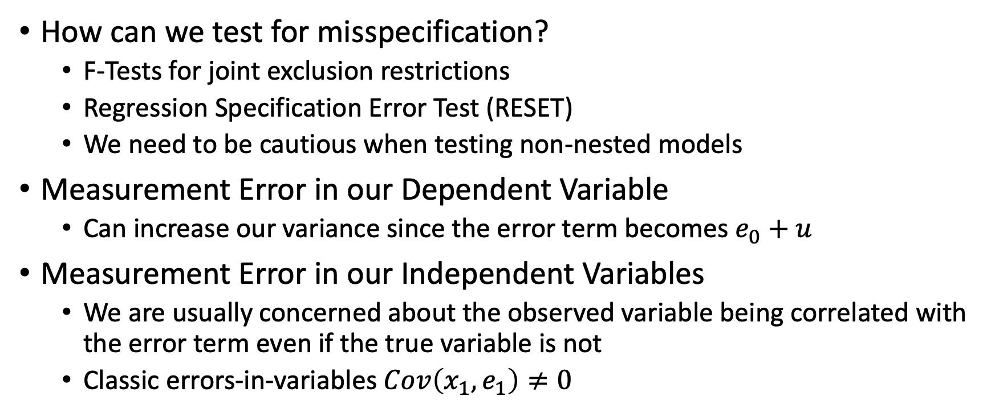
Endogeneity
How can we test for misspecification?
F-Tests for joint exclusion restrictions
Regression Specification Error Test (RESET)
We need to be cautious when testing non-nested models
Measurement Error in our Dependent Variable
Can increase our variance since the error term becomes $e_{0}+u$
Measurement Error in our Independent Variables
We are usually concerned about the observed variable being correlated with the error term even if the true variable is not
Classic errors-in-variables $Cov\left(x_{1},e_{1}\right)≠0$

Slide 28
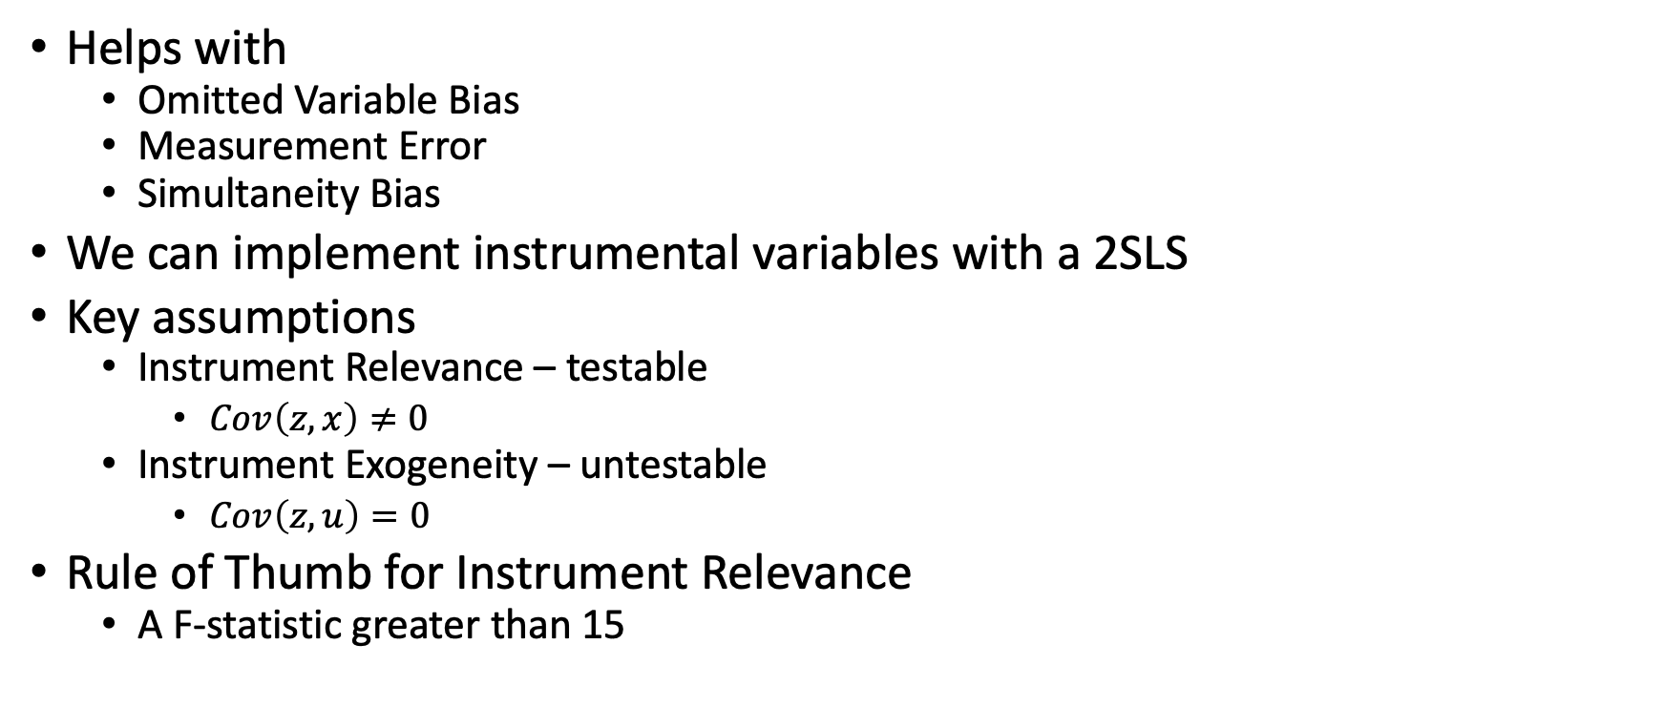
Instrumental Variables
Helps with
Omitted Variable Bias
Measurement Error
Simultaneity Bias
We can implement instrumental variables with a 2SLS
Key assumptions
Instrument Relevance – testable
$Cov\left(z,x\right)≠0$
Instrument Exogeneity – untestable
$Cov\left(z,u\right)=0$
Rule of Thumb for Instrument Relevance
A F-statistic greater than 15

Slide 29
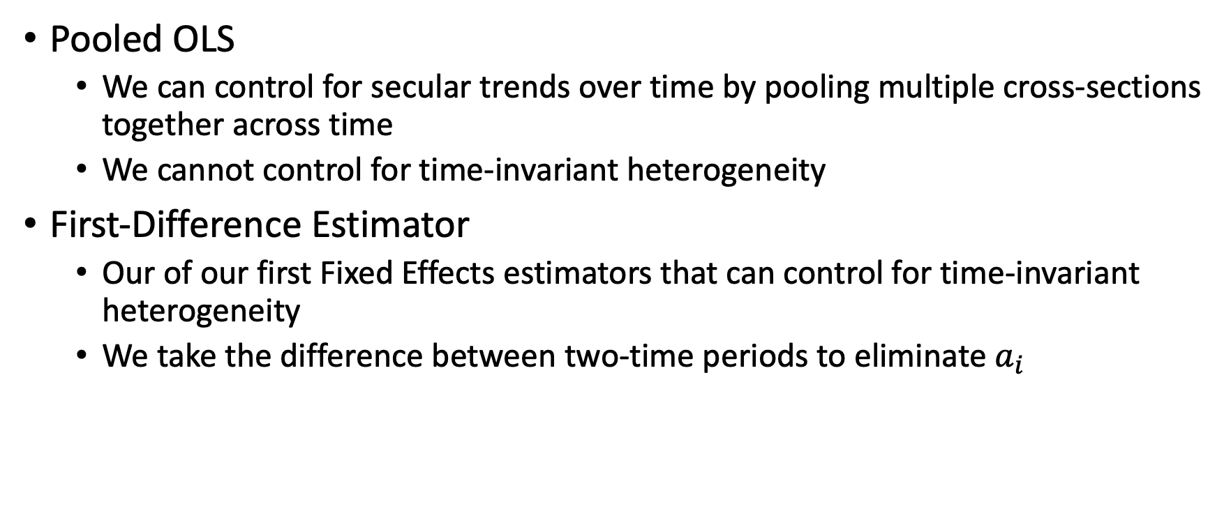
Panel Data
Pooled OLS
We can control for secular trends over time by pooling multiple cross-sections together across time
We cannot control for time-invariant heterogeneity
First-Difference Estimator
Our of our first Fixed Effects estimators that can control for time-invariant heterogeneity
We take the difference between two-time periods to eliminate $a_{i}$

Slide 30
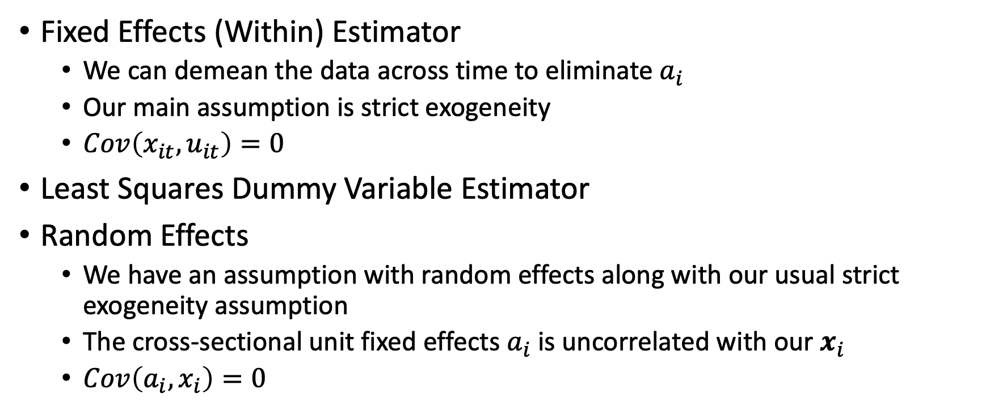
Panel Data
Fixed Effects (Within) Estimator
We can demean the data across time to eliminate $a_{i}$
Our main assumption is strict exogeneity
$Cov\left(x_{it},u_{it}\right)=0$
Least Squares Dummy Variable Estimator
Random Effects
We have an assumption with random effects along with our usual strict exogeneity assumption
The cross-sectional unit fixed effects $a_{i}$ is uncorrelated with our $x_{i}$
$Cov\left(a_{i},x_{i}\right)=0$

