Slide 1
Econ 645: Week 3
Pooling Cross Sections and First Difference Estimator

Slide 2
Announcements
Discussion 3 is available
Problem Set 1 – Instrumental Variables is available
Due April 1st

Slide 3
Overview
Pooling independent cross sections across time
Two-period panel data analysis
Differencing with more than two time periods
Stata Examples

Slide 4
Pooling Independent Cross-Sections Across Time

Slide 5
Pooling Independent Cross-Sections Across Time
Pooled Cross-sections
Pooled cross-sections are independent random samples of units of analysis from a large population at different points in time (such as months, years, etc)
There is a unit of analysis dimension and time dimension, but they are independent samples and not the same units followed over time
For example: in year 1, we randomly sample wages for workers; in year 2, we randomly sample wages of workers, etc.
Pooling independent cross-sections across time differ from single simple random sample
Distribution of variables may change over time;
We can account for time trends
Add time binaries to adjust intercepts
We still cannot account for time-invariant omitted variables (confounders) from within units of analysis, though

Slide 6
Reasons to Pool Cross-sectional Data
Pooling Independent Cross Sections across time
We are pooling independent random samples of the population at different points in time
We have a time dimensions that needs to be accounted
Why would we do this?
We can increase our sample size to increase power and statistical precision
As long as the relationship between the dependent variable and at least some explanatory variable are constant over time
We can use pooled cross-sections to answer important policy questions
The pattern of coefficients of the time binaries (dummy) might be of interest
How do secular trends affecting everyone change over time?

Slide 7
Time Trends or Secular Trends
We can look at the pattern of a trend by including time binaries (year, month, etc.)
Wooldridge uses the example of women’s fertility.
Does it change over time after controlling for education?
Is there a secular trend affecting all women holding education constant?
We can interact the time binary variables with explanatory variables
We can see if an explanatory variable changes over time
Note:
Adding time binaries/dummies changes the intercept
Interacting time binaries with explanatory changes the slope

Slide 8
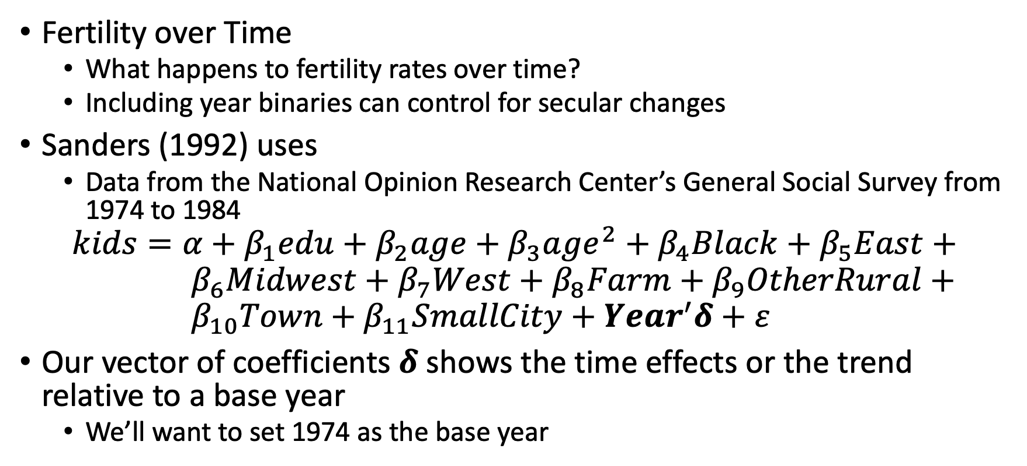
Time Trends or Secular Trends
Fertility over Time
What happens to fertility rates over time?
Including year binaries can control for secular changes
Sanders (1992) uses
Data from the National Opinion Research Center’s General Social Survey from 1974 to 1984
$$kids=α+β_{1}edu+β_{2}age+β_{3}age^{2}+β_{4}Black+β_{5}East+ \\ { β}_{6}Midwest+β_{7}West+β_{8}Farm+β_{9}OtherRural+ \\ β_{10}Town+β_{11}SmallCity+Year^{′}δ+ε$$
Our vector of coefficients $δ$ shows the time effects or the trend relative to a base year
We’ll want to set 1974 as the base year

Slide 9
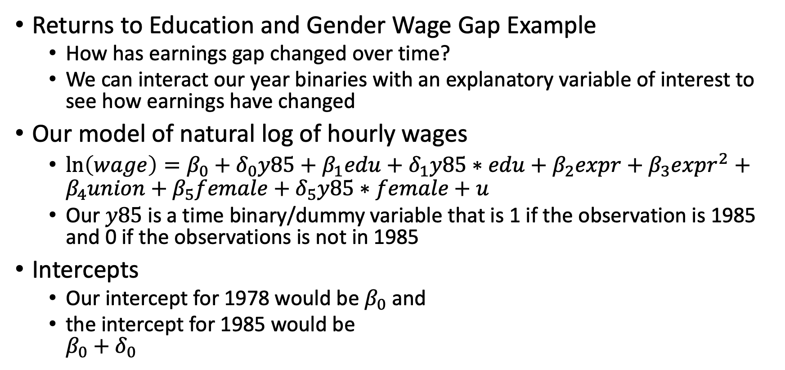
Interactions with Pooled Data
Returns to Education and Gender Wage Gap Example
How has earnings gap changed over time?
We can interact our year binaries with an explanatory variable of interest to see how earnings have changed
Our model of natural log of hourly wages
$\ln\left(wage\right)=β_{0}+δ_{0}y85+β_{1}edu+δ_{1}y85∗edu+β_{2}expr+β_{3}expr^{2}+β_{4}union+β_{5}female+δ_{5}y85∗female+u$
Our $y85$ is a time binary/dummy variable that is 1 if the observation is 1985 and 0 if the observations is not in 1985
Intercepts
Our intercept for 1978 would be $β_{0}$ and
the intercept for 1985 would be $β_{0}+δ_{0}$

Slide 10
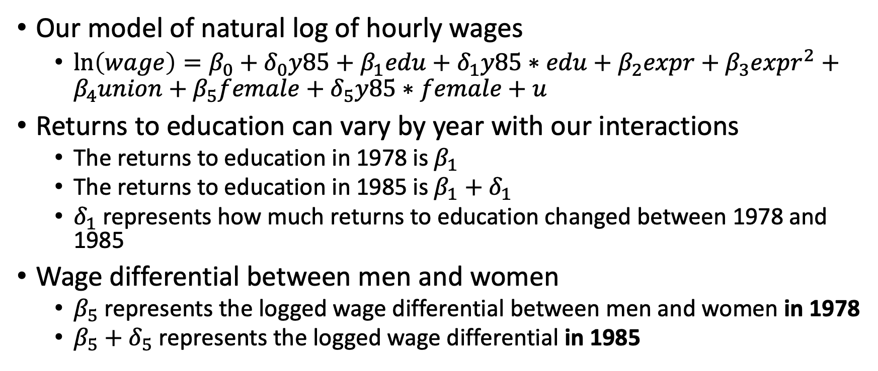
Interactions with Pooled Data
Our model of natural log of hourly wages
$\ln\left(wage\right)=β_{0}+δ_{0}y85+β_{1}edu+δ_{1}y85∗edu+β_{2}expr+β_{3}expr^{2}+β_{4}union+β_{5}female+δ_{5}y85∗female+u$
Returns to education can vary by year with our interactions
The returns to education in 1978 is $β_{1}$
The returns to education in 1985 is $β_{1}+δ_{1}$
$δ_{1}$ represents how much returns to education changed between 1978 and 1985
Wage differential between men and women
$β_{5}$ represents the logged wage differential between men and women in 1978
$β_{5}+δ_{5}$ represents the logged wage differential in 1985

Slide 11
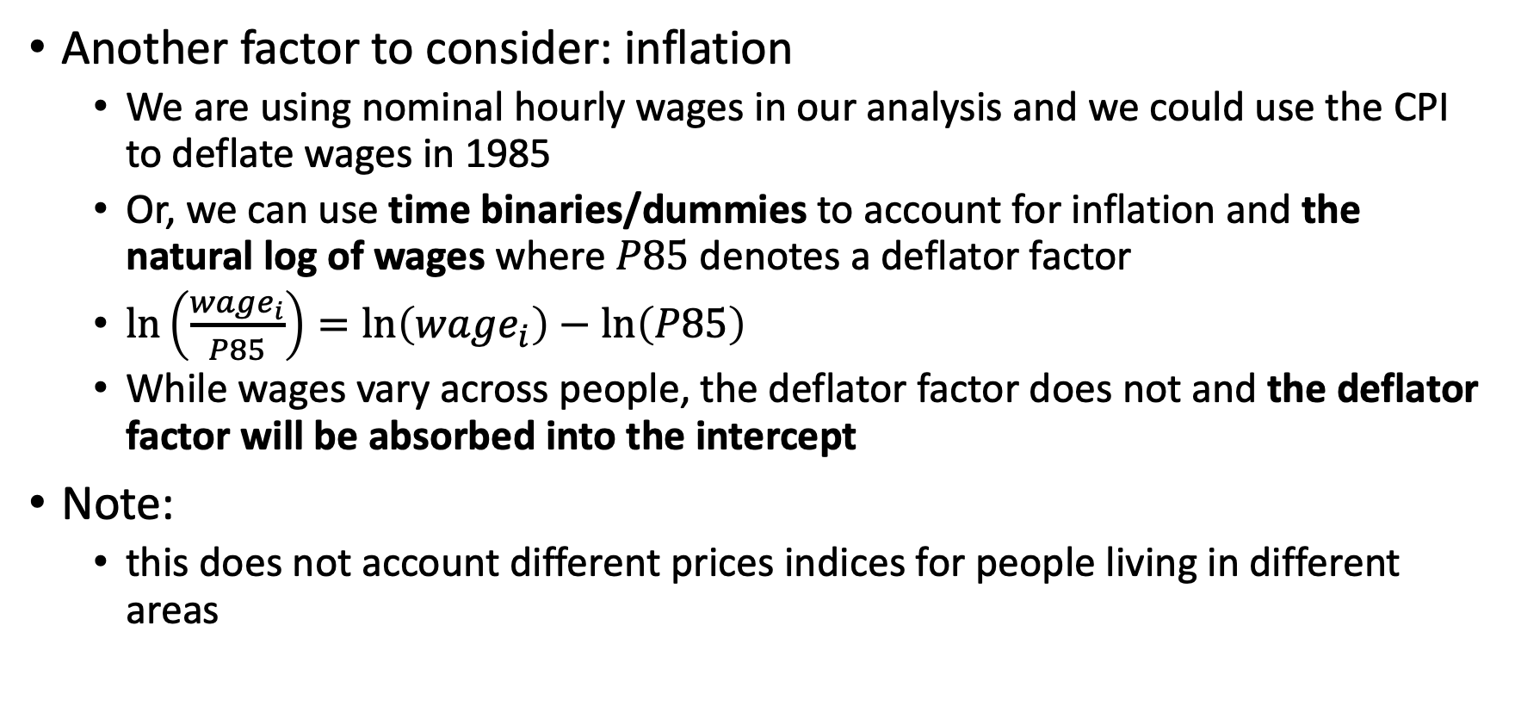
Interactions with Pooled Data
Another factor to consider: inflation
We are using nominal hourly wages in our analysis and we could use the CPI to deflate wages in 1985
Or, we can use time binaries/dummies to account for inflation and the natural log of wages where $P85$ denotes a deflator factor
$\ln\left(\frac{wage_{i}}{P85}\right)=\ln\left(wage_{i}\right)−\ln\left(P85\right)$
While wages vary across people, the deflator factor does not and the deflator factor will be absorbed into the intercept
Note:
this does not account different prices indices for people living in different areas

Slide 12
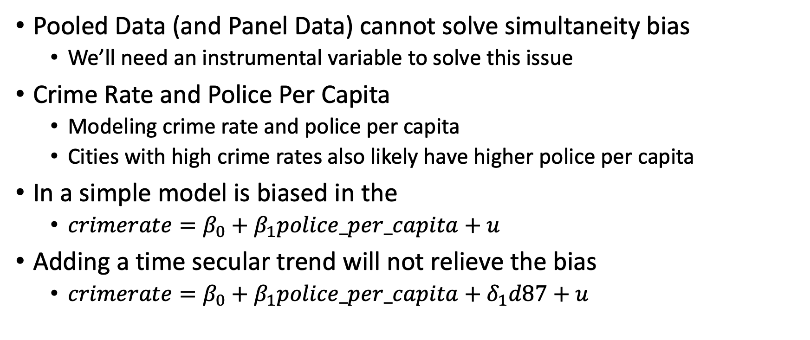
Limitations of Pooled Data
Pooled Data (and Panel Data) cannot solve simultaneity bias
We’ll need an instrumental variable to solve this issue
Crime Rate and Police Per Capita
Modeling crime rate and police per capita
Cities with high crime rates also likely have higher police per capita
In a simple model is biased in the
$crimerate=β_{0}+β_{1}police_per_capita+u$
Adding a time secular trend will not relieve the bias
$crimerate=β_{0}+β_{1}police_per_capita+δ_{1}d87+u$

Slide 13
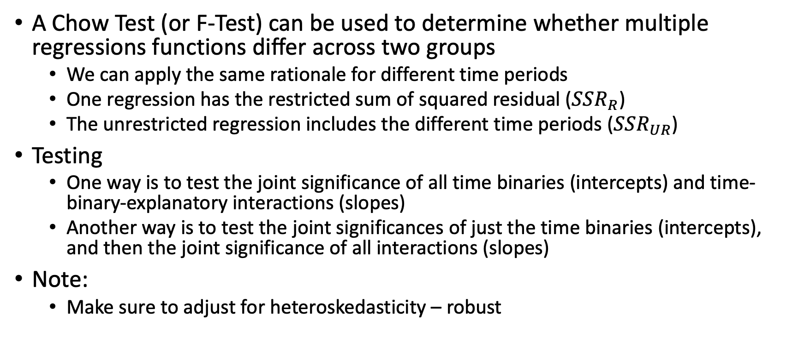
Chow Test for Structural Changes across Time
A Chow Test (or F-Test) can be used to determine whether multiple regressions functions differ across two groups
We can apply the same rationale for different time periods
One regression has the restricted sum of squared residual ($SSR_{R}$)
The unrestricted regression includes the different time periods ($SSR_{UR}$)
Testing
One way is to test the joint significance of all time binaries (intercepts) and time-binary-explanatory interactions (slopes)
Another way is to test the joint significances of just the time binaries (intercepts), and then the joint significance of all interactions (slopes)
Note:
Make sure to adjust for heteroskedasticity – robust

Slide 14
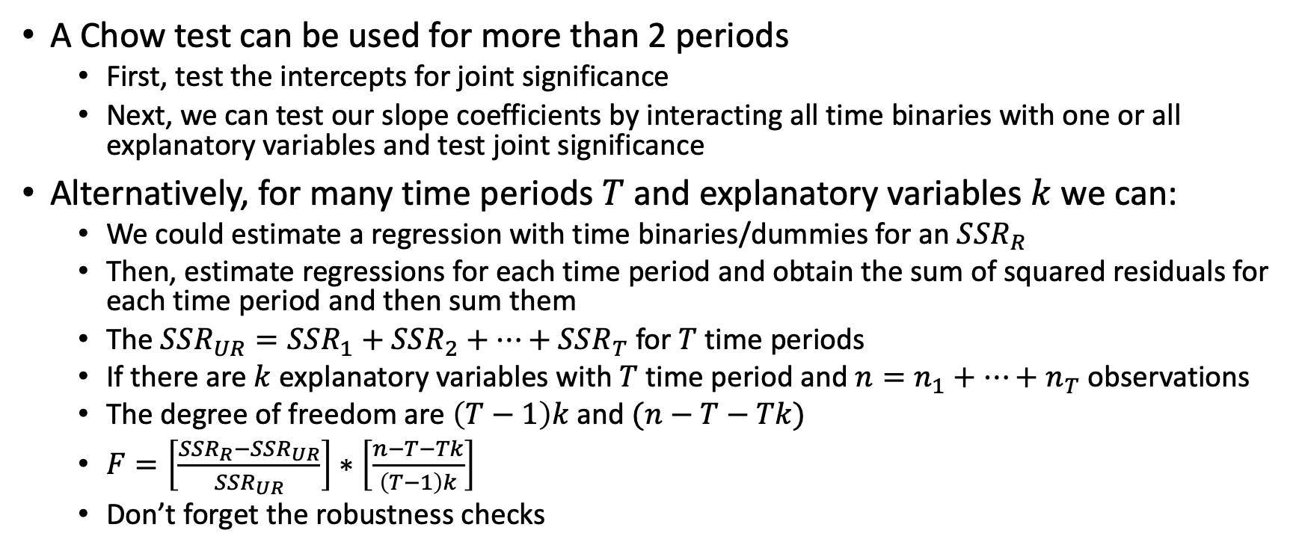
Chow Test for Structural Changes across Time
A Chow test can be used for more than 2 periods
First, test the intercepts for joint significance
Next, we can test our slope coefficients by interacting all time binaries with one or all explanatory variables and test joint significance
Alternatively, for many time periods $T$ and explanatory variables $k$ we can:
We could estimate a regression with time binaries/dummies for an $SSR_{R}$
Then, estimate regressions for each time period and obtain the sum of squared residuals for each time period and then sum them
The $SSR_{UR}=SSR_{1}+SSR_{2}+…+SSR_{T}$ for $T$ time periods
If there are $k$ explanatory variables with $T$ time period and $n=n_{1}+…+n_{T}$ observations
The degree of freedom are $\left(T−1\right)k$ and $(n−T−Tk)$
$F=\left[\frac{SSR_{R}−SSR_{UR}}{SSR_{UR}}\right]∗\left[\frac{n−T−Tk}{\left(T−1\right)k}\right]$
Don’t forget the robustness checks

Slide 15
Two-Period Panel Data Analysis

Slide 16
Two-Period Panel Data Analysis
Panel Data
Panel data or longitudinal data have a cross-section and a time dimension, but panel data follow the same unit over time
We randomly select units of analysis from the population, and then we follow them and collect data over time.
We cannot assume that panel data observations are independently distributed across time
Key difference with panel data and pooled cross-sections
We have a time dimension and a unit of analysis dimension
Key: We can follow a unit of analysis over time and control for observed and unobserved time-invariant confounders

Slide 17
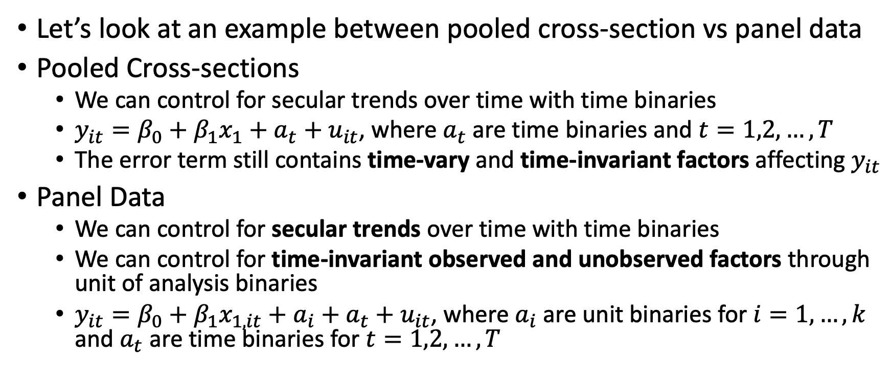
Two-Period Panel Data Analysis
Let’s look at an example between pooled cross-section vs panel data
Pooled Cross-sections
We can control for secular trends over time with time binaries
$y_{it}=β_{0}+β_{1}x_{1}+a_{t}+u_{it}$, where $a_{t}$ are time binaries and $t=1,2,…,T$
The error term still contains time-vary and time-invariant factors affecting $y_{it}$
Panel Data
We can control for secular trends over time with time binaries
We can control for time-invariant observed and unobserved factors through unit of analysis binaries
$y_{it}=β_{0}+β_{1}x_{1,it}+a_{i}+a_{t}+u_{it}$, where $a_{i}$ are unit binaries for $i=1,…,k$ and $a_{t}$ are time binaries for $t=1,2,…,T$

Slide 18
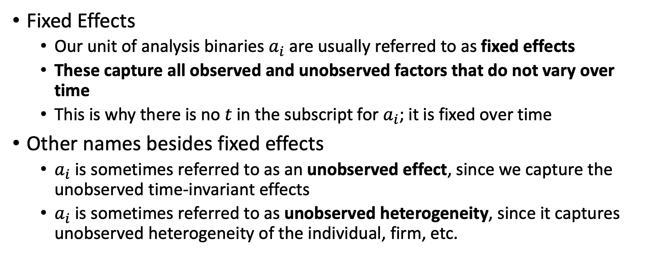
Fixed Effects
Fixed Effects
Our unit of analysis binaries $a_{i}$ are usually referred to as fixed effects
These capture all observed and unobserved factors that do not vary over time
This is why there is no $t$ in the subscript for $a_{i}$; it is fixed over time
Other names besides fixed effects
$a_{i}$ is sometimes referred to as an unobserved effect, since we capture the unobserved time-invariant effects
$a_{i}$ is sometimes referred to as unobserved heterogeneity, since it captures unobserved heterogeneity of the individual, firm, etc.

Slide 19
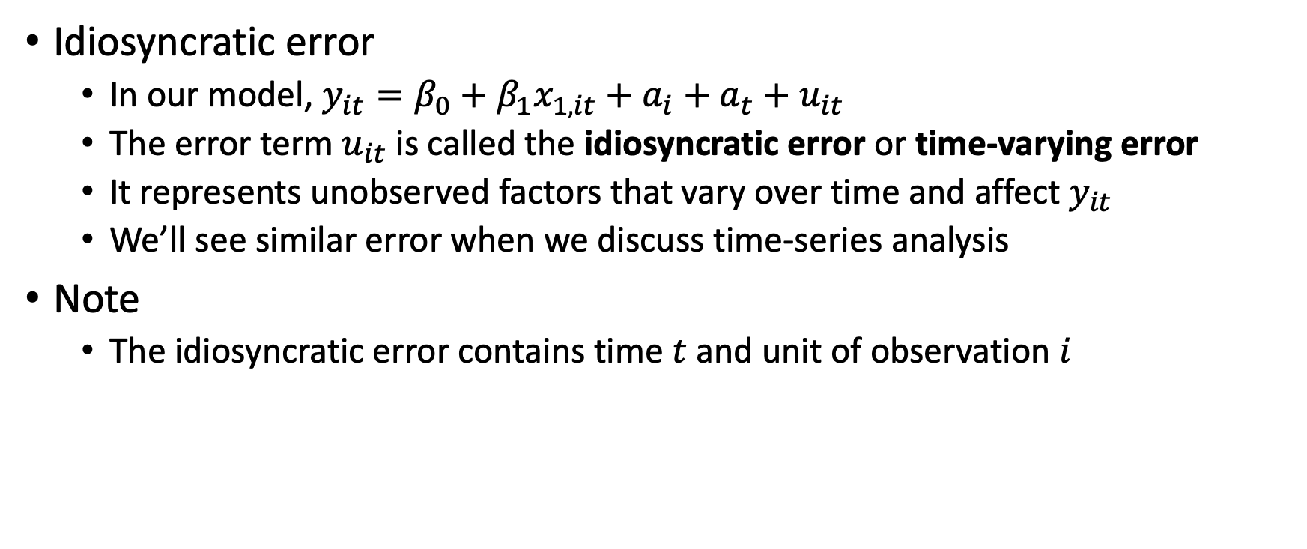
Idiosyncratic Error
Idiosyncratic error
In our model, $y_{it}=β_{0}+β_{1}x_{1,it}+a_{i}+a_{t}+u_{it}$
The error term $u_{it}$ is called the idiosyncratic error or time-varying error
It represents unobserved factors that vary over time and affect $y_{it}$
We’ll see similar error when we discuss time-series analysis
Note
The idiosyncratic error contains time $t$ and unit of observation $i$

Slide 20
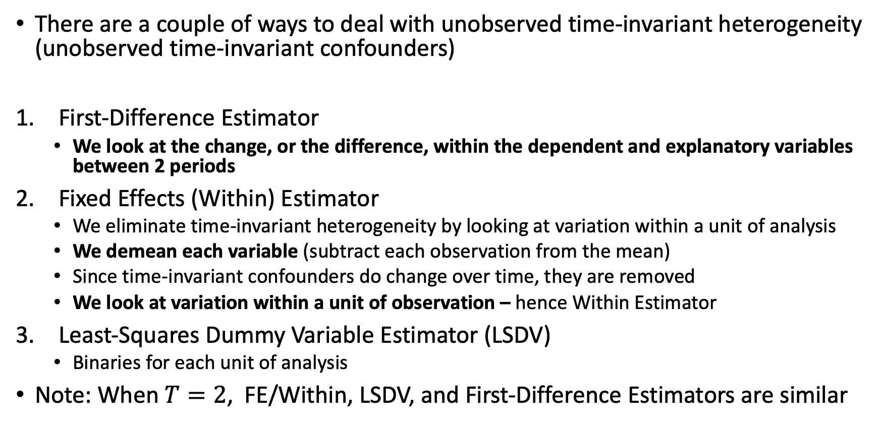
Types of Fixed Effects Estimators
There are a couple of ways to deal with unobserved time-invariant heterogeneity (unobserved time-invariant confounders)
First-Difference Estimator
We look at the change, or the difference, within the dependent and explanatory variables between 2 periods
Fixed Effects (Within) Estimator
We eliminate time-invariant heterogeneity by looking at variation within a unit of analysis
We demean each variable (subtract each observation from the mean)
Since time-invariant confounders do change over time, they are removed
We look at variation within a unit of observation – hence Within Estimator
Least-Squares Dummy Variable Estimator (LSDV)
Binaries for each unit of analysis
Note: When $T=2$, FE/Within, LSDV, and First-Difference Estimators are similar

Slide 21
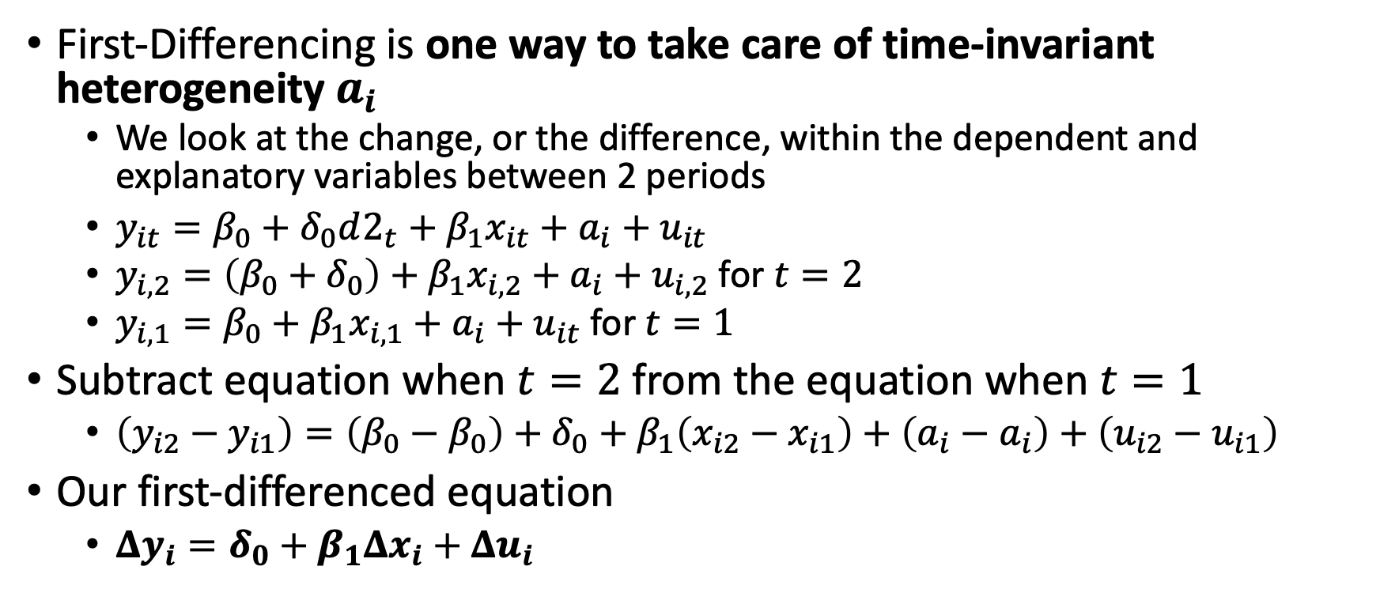
First-Difference Equation
First-Differencing is one way to take care of time-invariant heterogeneity $a_{i}$
We look at the change, or the difference, within the dependent and explanatory variables between 2 periods
$y_{it}=β_{0}+δ_{0}d2_{t}+β_{1}x_{it}+a_{i}+u_{it}$
$y_{i,2}=\left(β_{0}+δ_{0}\right)+β_{1}x_{i,2}+a_{i}+u_{i,2}$ for $t=2$
$y_{i,1}=β_{0}+β_{1}x_{i,1}+a_{i}+u_{it}$ for $t=1$
Subtract equation when $t=2$ from the equation when $t=1$
$\left(y_{i2}−y_{i1}\right)=\left(β_{0}−β_{0}\right)+δ_{0}+β_{1}\left(x_{i2}−x_{i1}\right)+\left(a_{i}−a_{i}\right)+\left(u_{i2}−u_{i1}\right)$
Our first-differenced equation
$Δy_{i}=δ_{0}+β_{1}Δx_{i}+Δu_{i}$

Slide 22
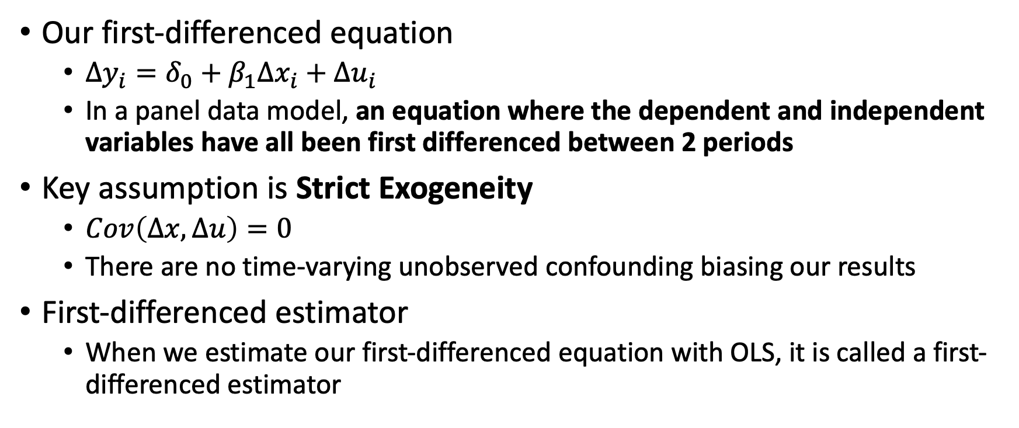
First-Difference Equation
Our first-differenced equation
$Δy_{i}=δ_{0}+β_{1}Δx_{i}+Δu_{i}$
In a panel data model, an equation where the dependent and independent variables have all been first differenced between 2 periods
Key assumption is Strict Exogeneity
$Cov\left(Δx,Δu\right)=0$
There are no time-varying unobserved confounding biasing our results
First-differenced estimator
When we estimate our first-differenced equation with OLS, it is called a first-differenced estimator

Slide 23
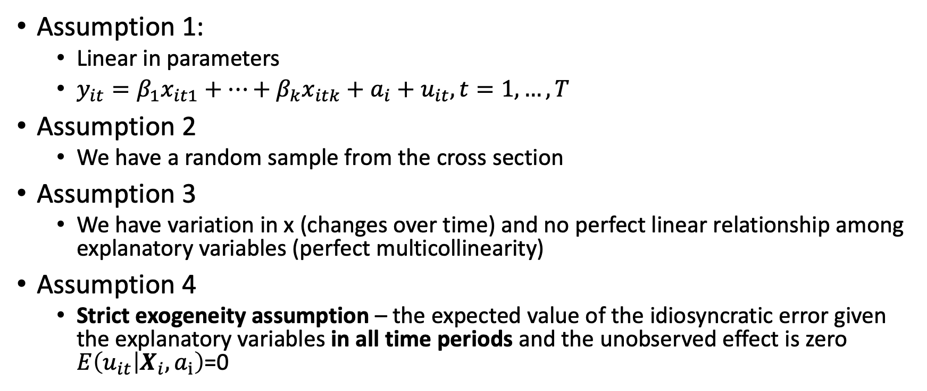
Assumptions of First-Difference Models
Assumption 1:
Linear in parameters
$y_{it}=β_{1}x_{it1}+…+β_{k}x_{itk}+a_{i}+u_{it}, t=1,…,T$
Assumption 2
We have a random sample from the cross section
Assumption 3
We have variation in x (changes over time) and no perfect linear relationship among explanatory variables (perfect multicollinearity)
Assumption 4
Strict exogeneity assumption – the expected value of the idiosyncratic error given the explanatory variables in all time periods and the unobserved effect is zero $E\left(u_{it} | X_{i}, a_{i}\right)$=0

Slide 24
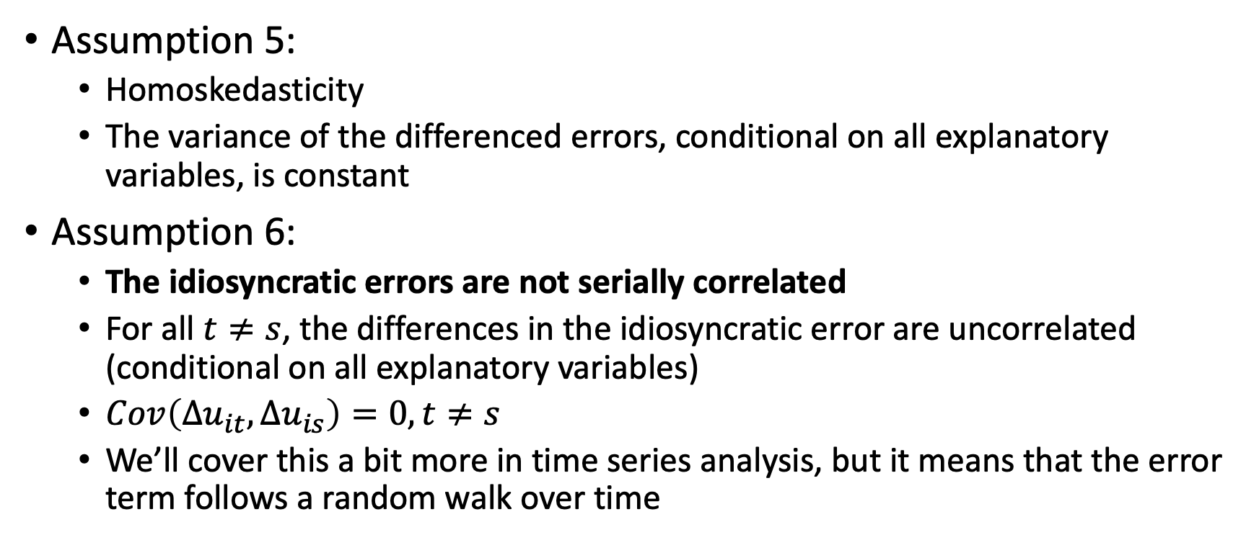
Assumptions of First-Difference Models
Assumption 5:
Homoskedasticity
The variance of the differenced errors, conditional on all explanatory variables, is constant
Assumption 6:
The idiosyncratic errors are not serially correlated
For all $t≠s$, the differences in the idiosyncratic error are uncorrelated (conditional on all explanatory variables)
$Cov\left(Δu_{it},Δu_{is}\right)=0, t≠s$
We’ll cover this a bit more in time series analysis, but it means that the error term follows a random walk over time

Slide 25
First-Differenced Estimator
Using first-differencing or fixed effects (within) estimator is a good way of dealing with time-invariant heterogeneity
Assuming strict exogeneity assumption holds
There are costs/limitations
Panel data are harder to collect then cross-sectional data
We lose variation when we take the first difference/fixed effects within our explanatory variables
We may not have that much variation in our explanatory variables, too

Slide 26
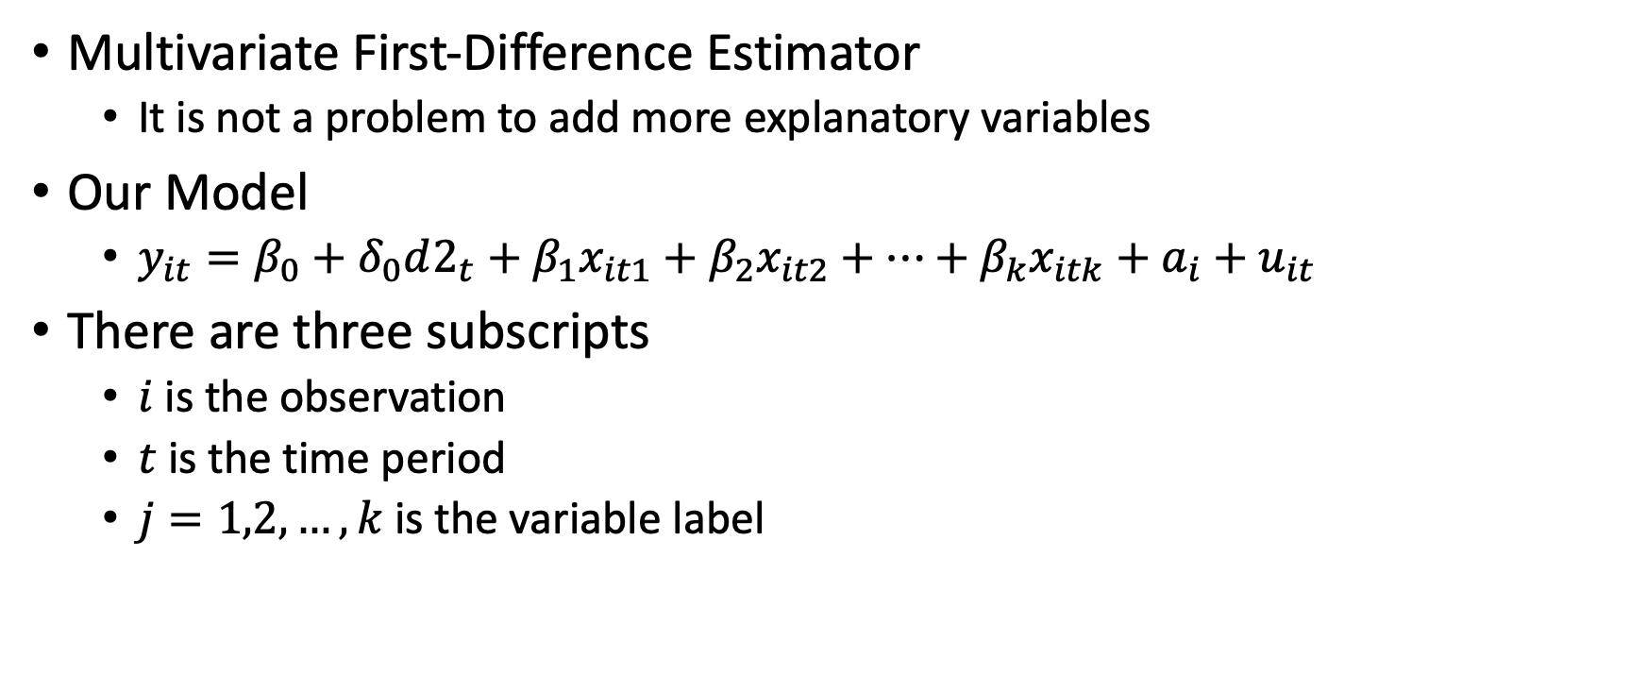
First-Differenced Estimator
Multivariate First-Difference Estimator
It is not a problem to add more explanatory variables
Our Model
$y_{it}=β_{0}+δ_{0}d2_{t}+β_{1}x_{it1}+β_{2}x_{it2}+…+β_{k}x_{itk}+a_{i}+u_{it}$
There are three subscripts
$i$ is the observation
$t$ is the time period
$j=1,2,…,k$ is the variable label

Slide 27
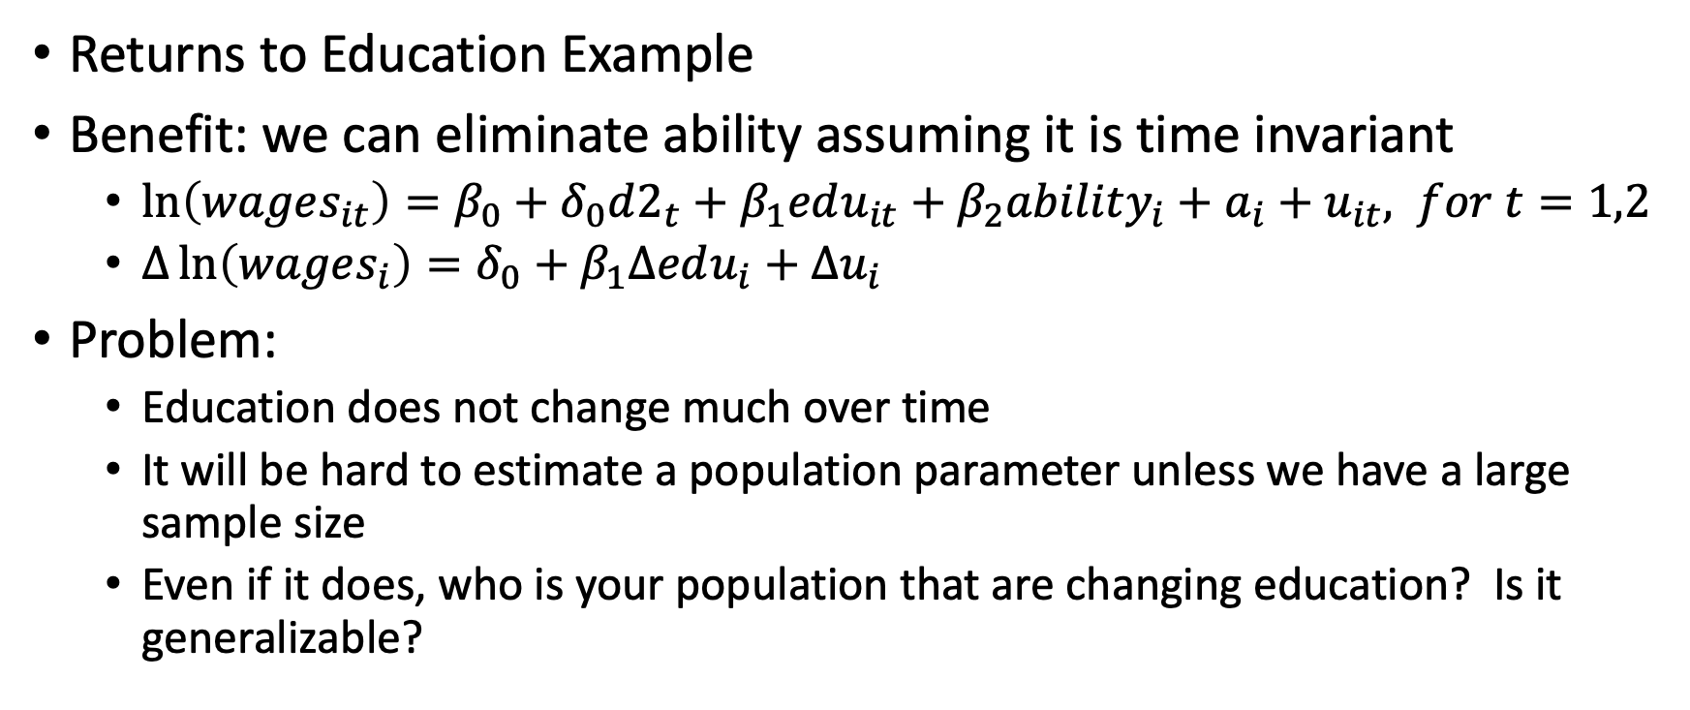
Problem with First Difference Models
Returns to Education Example
Benefit: we can eliminate ability assuming it is time invariant
$\ln\left(wages_{it}\right)=β_{0}+δ_{0}d2_{t}+β_{1}edu_{it}+β_{2}ability_{i}+a_{i}+u_{it}, for t=1,2$
$Δ\ln\left(wages_{i}\right)=δ_{0}+β_{1}Δedu_{i}+Δu_{i}$
Problem:
Education does not change much over time
It will be hard to estimate a population parameter unless we have a large sample size
Even if it does, who is your population that are changing education? Is it generalizable?

Slide 28
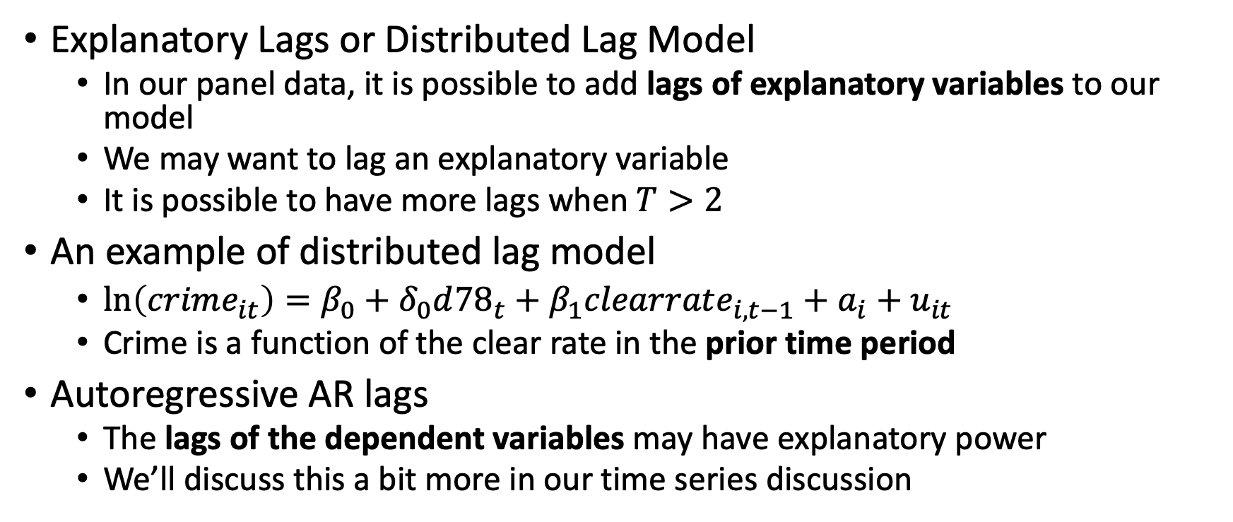
Adding Lags
Explanatory Lags or Distributed Lag Model
In our panel data, it is possible to add lags of explanatory variables to our model
We may want to lag an explanatory variable
It is possible to have more lags when $T>2$
An example of distributed lag model
$\ln\left(crime_{it}\right)=β_{0}+δ_{0}d{78}_{t}+β_{1}clearrate_{i,t−1}+a_{i}+u_{it}$
Crime is a function of the clear rate in the prior time period
Autoregressive AR lags
The lags of the dependent variables may have explanatory power
We’ll discuss this a bit more in our time series discussion

Slide 29
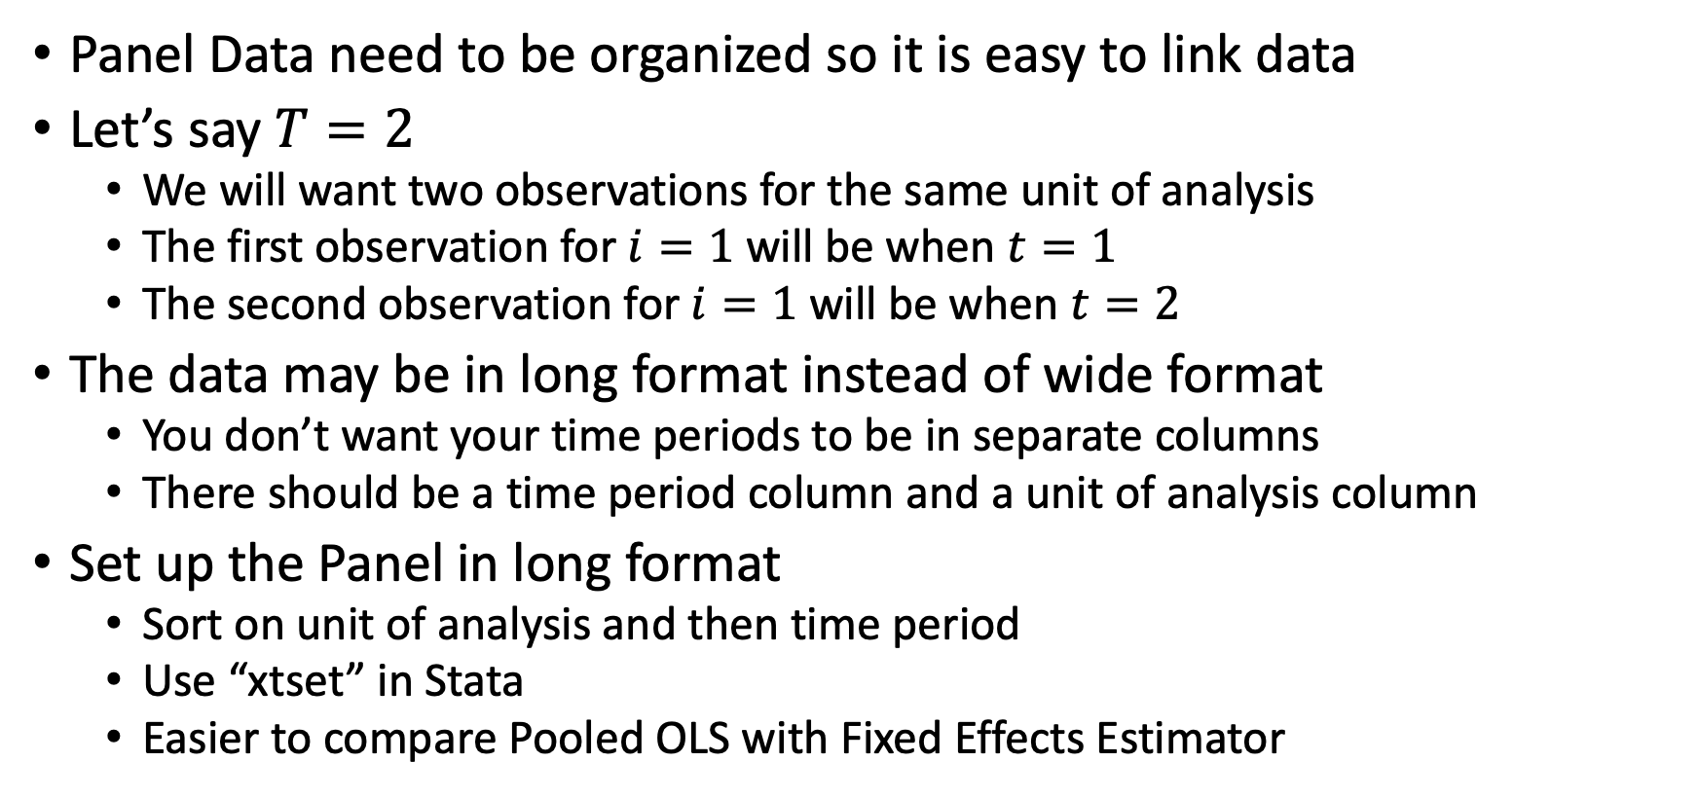
Organizing Panel Data
Panel Data need to be organized so it is easy to link data
Let’s say $T=2$
We will want two observations for the same unit of analysis
The first observation for $i=1$ will be when $t=1$
The second observation for $i=1$ will be when $t=2$
The data may be in long format instead of wide format
You don’t want your time periods to be in separate columns
There should be a time period column and a unit of analysis column
Set up the Panel in long format
Sort on unit of analysis and then time period
Use “xtset” in Stata
Easier to compare Pooled OLS with Fixed Effects Estimator

Slide 30
Differencing with More than Two Time Periods

Slide 31
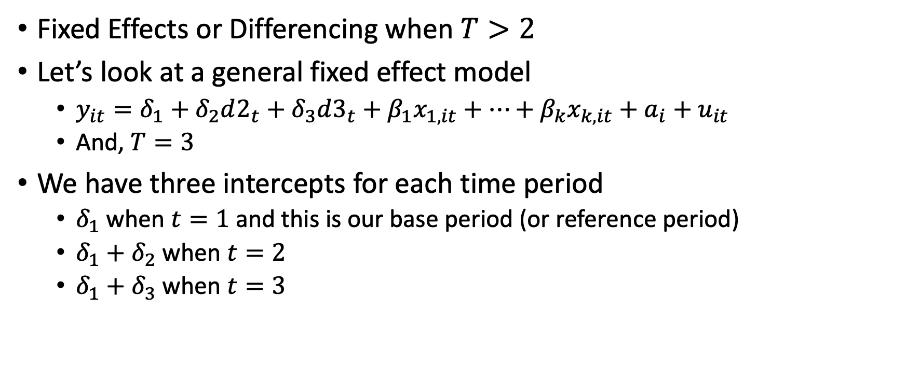
Differencing with More Than Two Time Periods
Fixed Effects or Differencing when $T>2$
Let’s look at a general fixed effect model
$y_{it}=δ_{1}+δ_{2}d2_{t}+δ_{3}d3_{t}+β_{1}x_{1,it}+…+β_{k}x_{k,it}+a_{i}+u_{it}$
And, $T=3$
We have three intercepts for each time period
$δ_{1}$ when $t=1$ and this is our base period (or reference period)
$δ_{1}+δ_{2}$ when $t=2$
$δ_{1}+δ_{3}$ when $t=3$

Slide 32
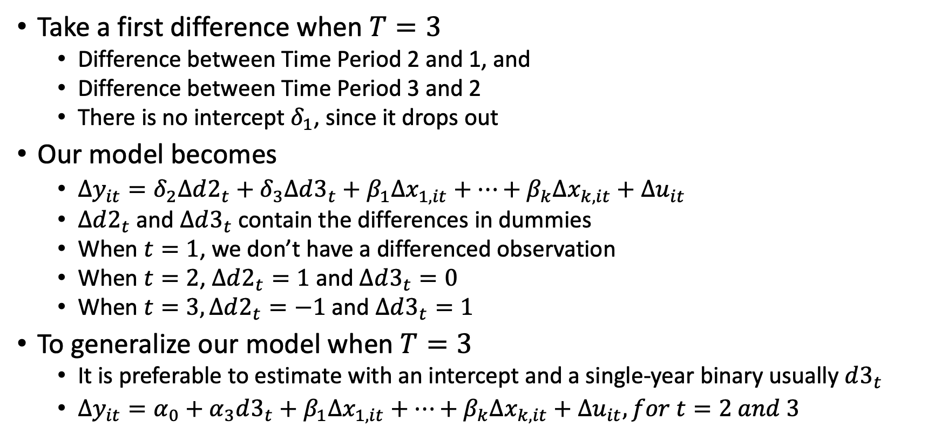
Differencing with More Than Two Time Periods
Take a first difference when $T=3$
Difference between Time Period 2 and 1, and
Difference between Time Period 3 and 2
There is no intercept $δ_{1}$, since it drops out
Our model becomes
$Δy_{it}=δ_{2}Δd2_{t}+δ_{3}Δd3_{t}+β_{1}Δx_{1,it}+…+β_{k}Δx_{k,it}+Δu_{it}$
$Δd2_{t}$ and $Δd3_{t}$ contain the differences in dummies
When $t=1$, we don’t have a differenced observation
When $t=2$, $Δd2_{t}=1$ and $Δd3_{t}=0$
When $t=3, Δd2_{t}=−1$ and $Δd3_{t}=1$
To generalize our model when $T=3$
It is preferable to estimate with an intercept and a single-year binary usually $d3_{t}$
$Δy_{it}=α_{0}+α_{3}d3_{t}+β_{1}Δx_{1,it}+…+β_{k}Δx_{k,it}+Δu_{it}, for t=2 and 3$

Slide 33
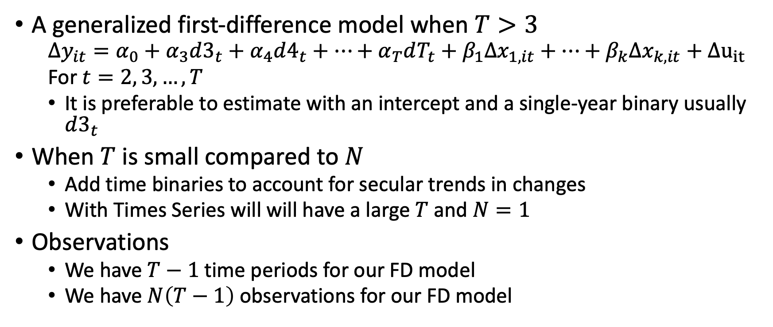
Generalized First-Differenced Model
A generalized first-difference model when $T>3$
$$Δy_{it}=α_{0}+α_{3}d3_{t}+α_{4}d4_{t}+…+α_{T}dT_{t}+β_{1}Δx_{1,it}+…+β_{k}Δx_{k,it}+Δu_{it}$$
For $t=2, 3, …, T$
It is preferable to estimate with an intercept and a single-year binary usually $d3_{t}$
When $T$ is small compared to $N$
Add time binaries to account for secular trends in changes
With Times Series will will have a large $T$ and $N=1$
Observations
We have $T−1$time periods for our FD model
We have $N\left(T−1\right)$ observations for our FD model

Slide 34
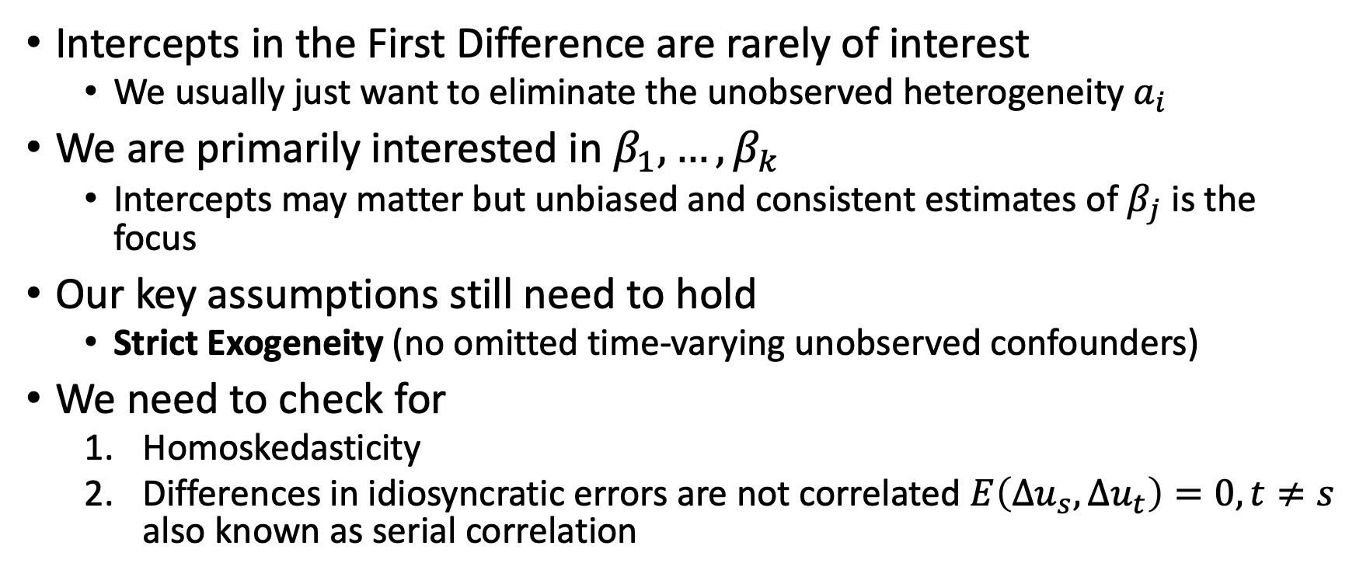
Differencing with More Than Two Time Periods
Intercepts in the First Difference are rarely of interest
We usually just want to eliminate the unobserved heterogeneity $a_{i}$
We are primarily interested in $β_{1},…, β_{k}$
Intercepts may matter but unbiased and consistent estimates of $β_{j}$ is the focus
Our key assumptions still need to hold
Strict Exogeneity (no omitted time-varying unobserved confounders)
We need to check for
Homoskedasticity
Differences in idiosyncratic errors are not correlated $E\left(Δu_{s},Δu_{t}\right)=0, t≠s$ also known as serial correlation

Slide 35
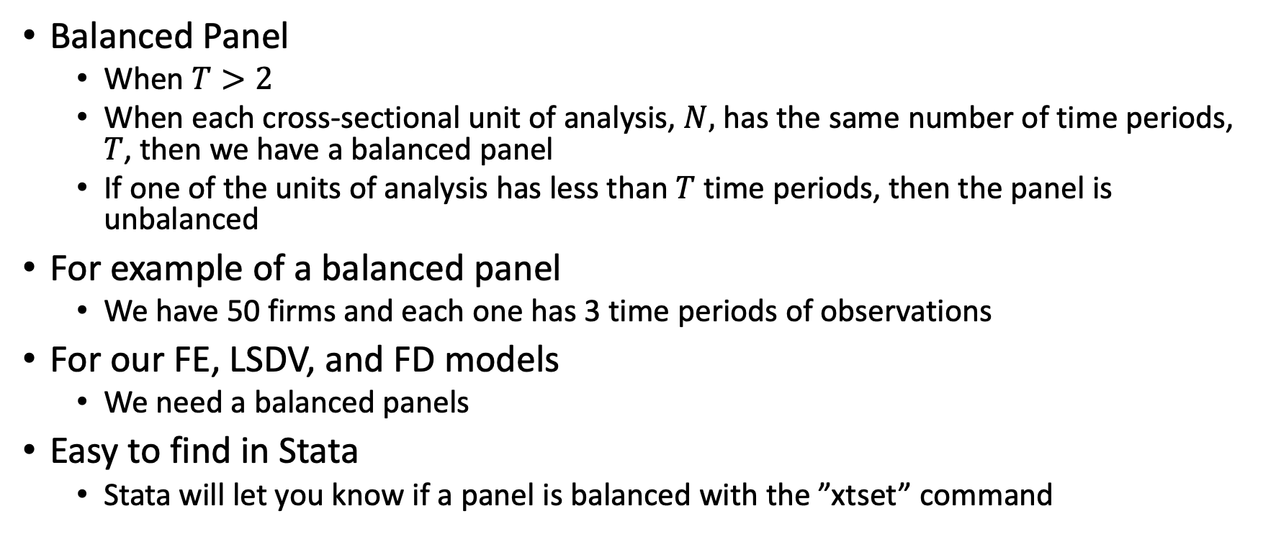
Balanced Panel
Balanced Panel
When $T>2$
When each cross-sectional unit of analysis, $N,$ has the same number of time periods, $T$, then we have a balanced panel
If one of the units of analysis has less than $T$ time periods, then the panel is unbalanced
For example of a balanced panel
We have 50 firms and each one has 3 time periods of observations
For our FE, LSDV, and FD models
We need a balanced panels
Easy to find in Stata
Stata will let you know if a panel is balanced with the ”xtset” command

Slide 36
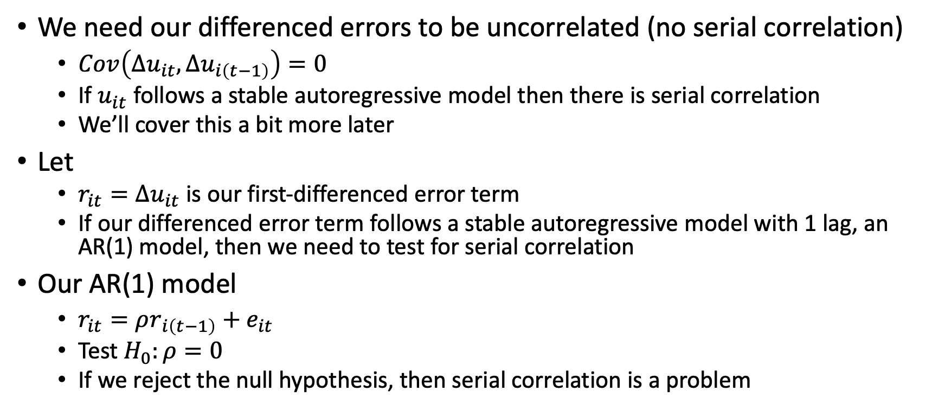
Testing for Serial Correlation in our FD Model
We need our differenced errors to be uncorrelated (no serial correlation)
$Cov\left(Δu_{it},Δu_{i\left(t−1\right)}\right)=0$
If $u_{it}$ follows a stable autoregressive model then there is serial correlation
We’ll cover this a bit more later
Let
$r_{it}=Δu_{it}$ is our first-differenced error term
If our differenced error term follows a stable autoregressive model with 1 lag, an AR(1) model, then we need to test for serial correlation
Our AR(1) model
$r_{it}=ρr_{i\left(t−1\right)}+e_{it}$
Test $H_{0}:ρ=0$
If we reject the null hypothesis, then serial correlation is a problem

Slide 37
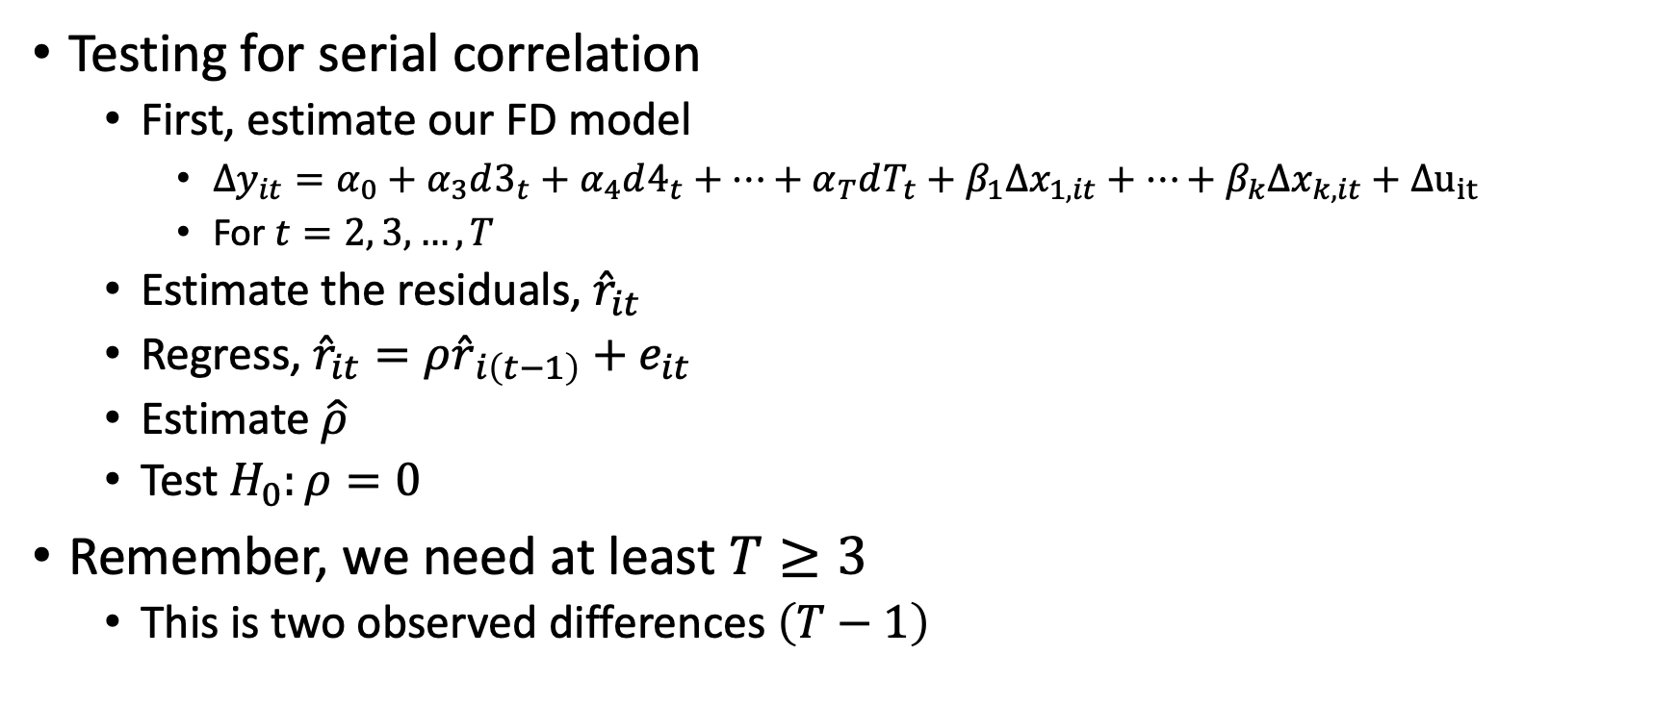
Testing for Serial Correlation in our FD Model
Testing for serial correlation
First, estimate our FD model
$Δy_{it}=α_{0}+α_{3}d3_{t}+α_{4}d4_{t}+…+α_{T}dT_{t}+β_{1}Δx_{1,it}+…+β_{k}Δx_{k,it}+Δu_{it}$
For $t=2, 3, …, T$
Estimate the residuals, ${\hat{r}}_{it}$
Regress, ${\hat{r}}_{it}=ρ{\hat{r}}_{i\left(t−1\right)}+e_{it}$
Estimate $\hat{ρ}$
Test $H_{0}:ρ=0$
Remember, we need at least $T≥3$
This is two observed differences $\left(T−1\right)$

Slide 38
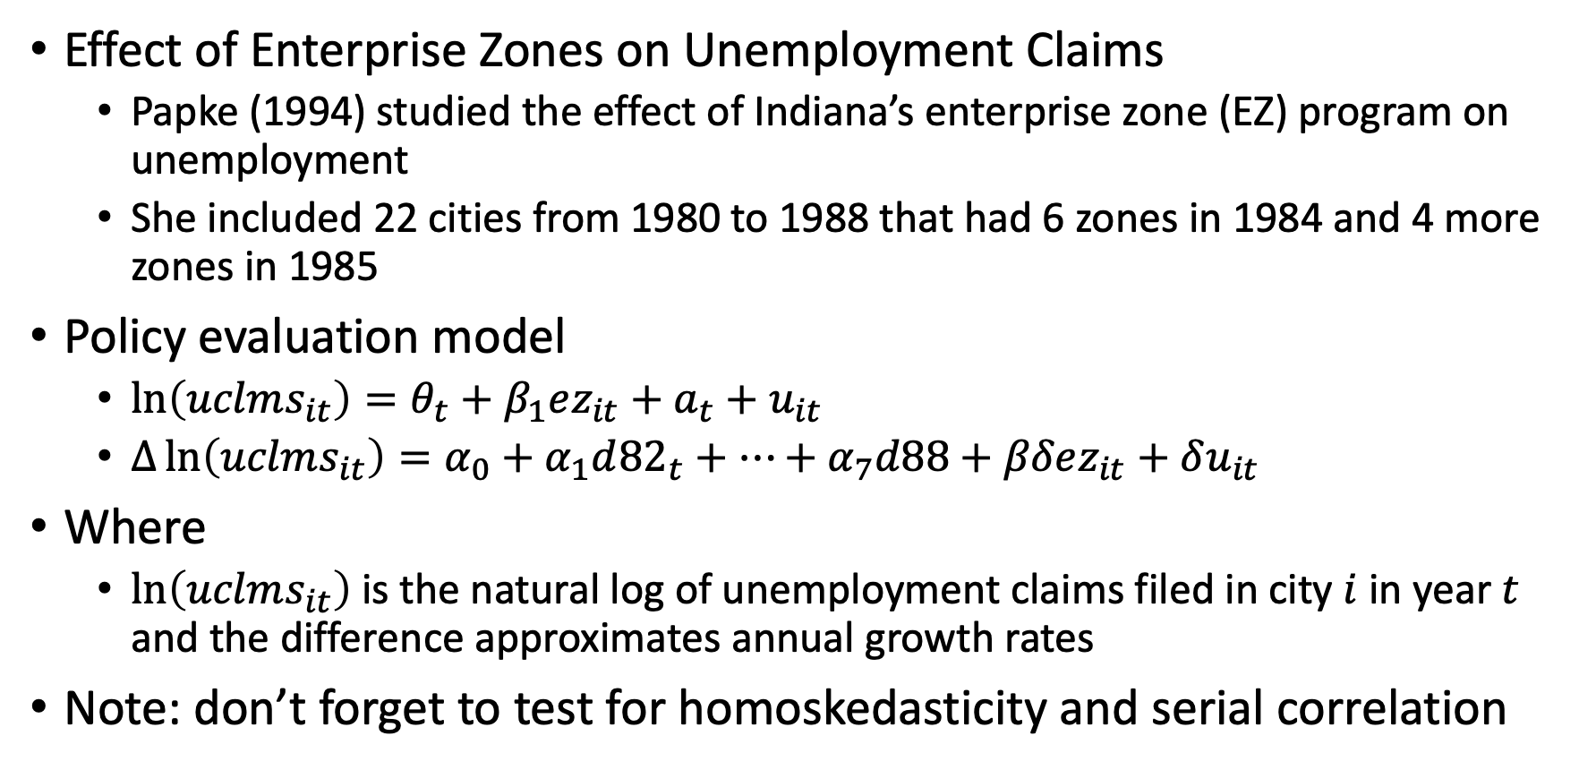
FD Example
Effect of Enterprise Zones on Unemployment Claims
Papke (1994) studied the effect of Indiana’s enterprise zone (EZ) program on unemployment
She included 22 cities from 1980 to 1988 that had 6 zones in 1984 and 4 more zones in 1985
Policy evaluation model
$\ln\left(uclms_{it}\right)=θ_{t}+β_{1}ez_{it}+a_{t}+u_{it}$
$Δ\ln\left(uclms_{it}\right)=α_{0}+α_{1}d{82}_{t}+…+α_{7}d88+βδez_{it}+δu_{it}$
Where
$\ln\left(uclms_{it}\right)$ is the natural log of unemployment claims filed in city $i$ in year $t$ and the difference approximates annual growth rates
Note: don’t forget to test for homoskedasticity and serial correlation

Slide 39
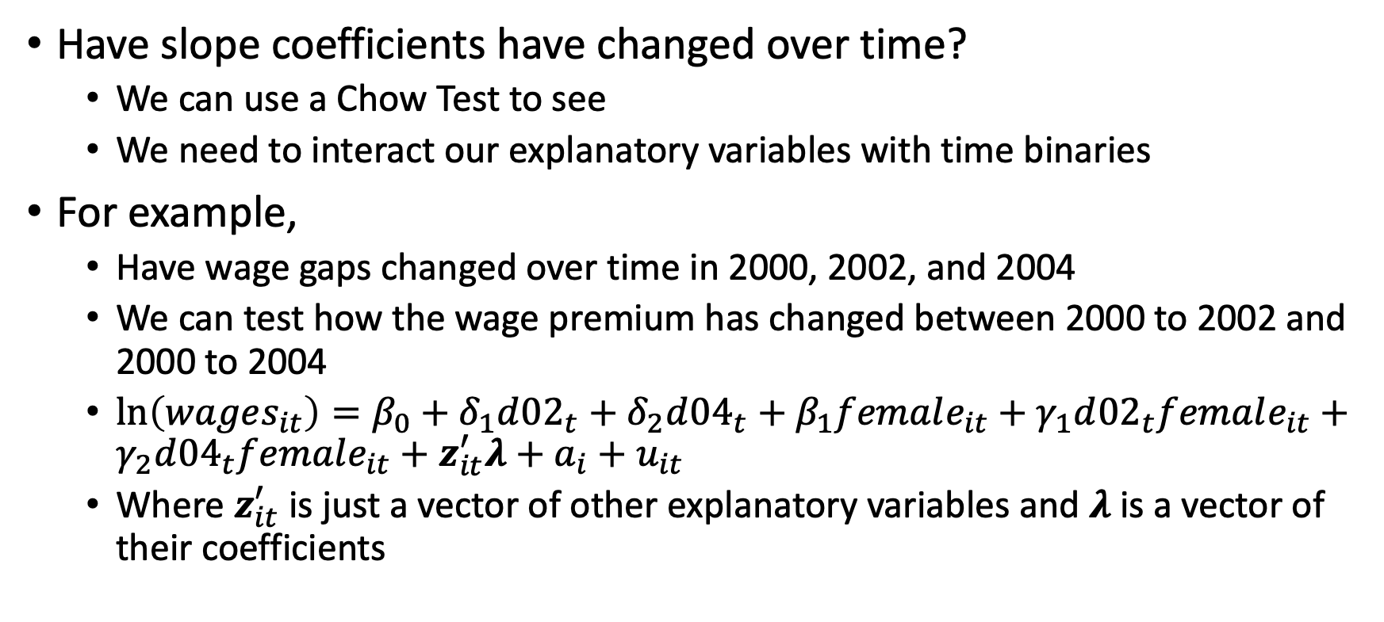
Chow Test for FD Models
Have slope coefficients have changed over time?
We can use a Chow Test to see
We need to interact our explanatory variables with time binaries
For example,
Have wage gaps changed over time in 2000, 2002, and 2004
We can test how the wage premium has changed between 2000 to 2002 and 2000 to 2004
$\ln\left(wages_{it}\right)=β_{0}+δ_{1}d{02}_{t}+δ_{2}d{04}_{t}+β_{1}female_{it}+γ_{1}d{02}_{t}female_{it}+γ_{2}d{04}_{t}female_{it}+z_{it}^{′}λ+a_{i}+u_{it}$
Where $z_{it}^{′}$ is just a vector of other explanatory variables and $λ$is a vector of their coefficients

Slide 40
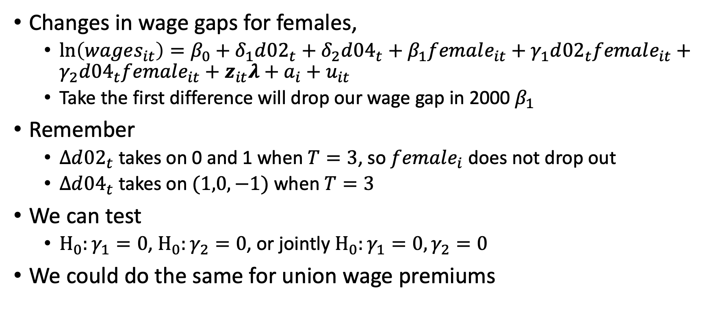
Chow Test for FD Models
Changes in wage gaps for females,
$\ln\left(wages_{it}\right)=β_{0}+δ_{1}d{02}_{t}+δ_{2}d{04}_{t}+β_{1}female_{it}+γ_{1}d{02}_{t}female_{it}+γ_{2}d{04}_{t}female_{it}+z_{it}λ+a_{i}+u_{it}$
Take the first difference will drop our wage gap in 2000 $β_{1}$
Remember
$Δd{02}_{t}$ takes on 0 and 1 when $T=3$, so $female_{i}$ does not drop out
$Δd{04}_{t}$ takes on $(1,0,−1)$ when $T=3$
We can test
$H_{0}:γ_{1}=0$, $H_{0}:γ_{2}=0$, or jointly $H_{0}:γ_{1}=0, γ_{2}=0$
We could do the same for union wage premiums

Slide 41
Potential Problems with FD Models
If key variables do not vary or lack variation
If strict exogeneity does not hold
We cannot directly test this
More time period will not fix this problem
If there is measurement error
FD estimators may be more biased and inconsistent than Pooled OLS
Especially when differencing when classic error-in-variables makes the bias potentially large
Will not solve simultaneity bias

Slide 42
Stata Examples and Work

