Slide 1
Econ 645: Week 8
Limited Dependent Variables
Review of Logit and Probit Estimators
Tobit and Poisson Estimators

Slide 2
Overview
Limited Dependent Variables
Binary Dependent Variables
Logit
Probit
Nonnegative Dependent Variables
Tobit – Corner Solution Response
Poisson – Count Model
Stata

Slide 3
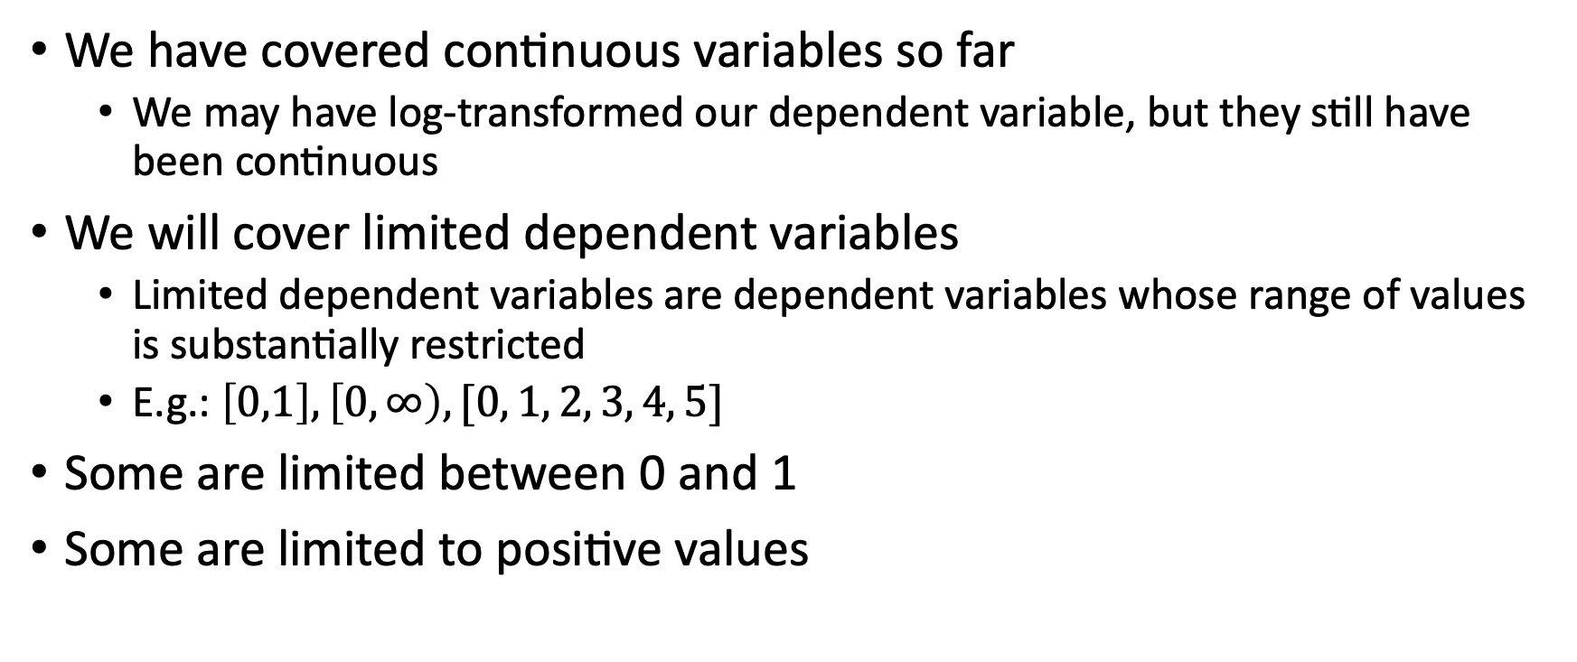
Limited Dependent Variables
We have covered continuous variables so far
We may have log-transformed our dependent variable, but they still have been continuous
We will cover limited dependent variables
Limited dependent variables are dependent variables whose range of values is substantially restricted
E.g.: $\left[0,1\right], \left[0,∞\right), [0, 1, 2, 3, 4, 5]$
Some are limited between 0 and 1
Some are limited to positive values

Slide 4
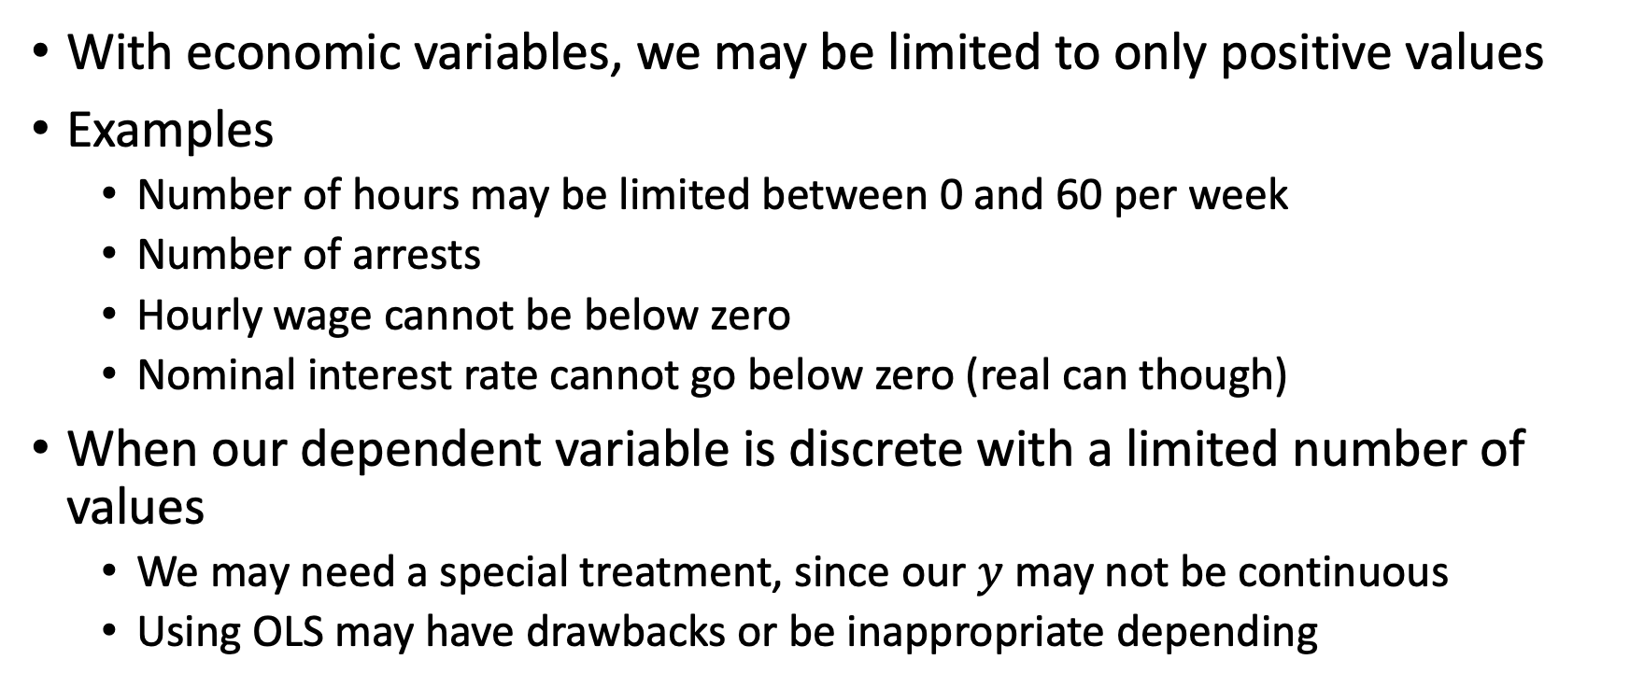
Limited Dependent Variables
With economic variables, we may be limited to only positive values
Examples
Number of hours may be limited between 0 and 60 per week
Number of arrests
Hourly wage cannot be below zero
Nominal interest rate cannot go below zero (real can though)
When our dependent variable is discrete with a limited number of values
We may need a special treatment, since our $y$ may not be continuous
Using OLS may have drawbacks or be inappropriate depending

Slide 5
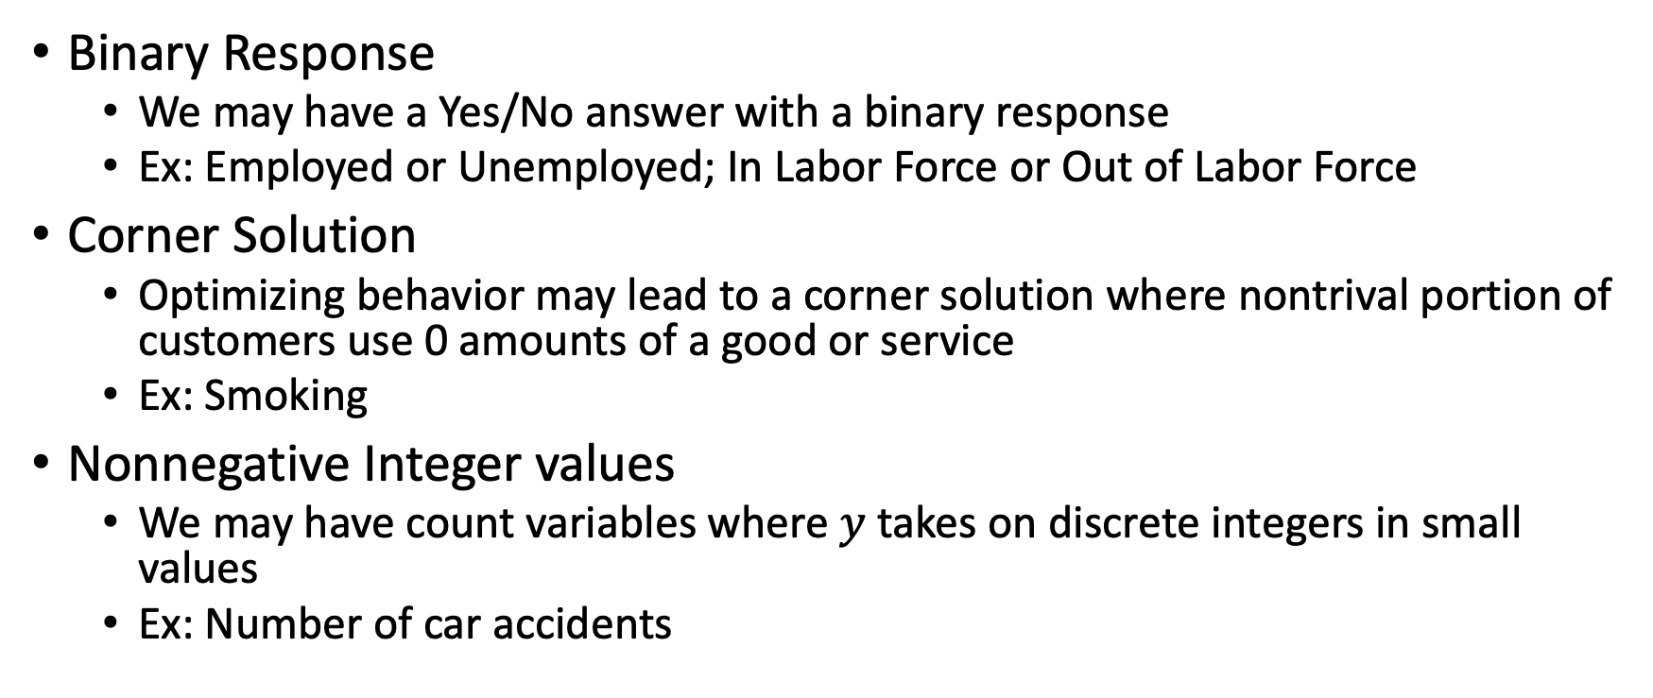
Limited Dependent Variables
Binary Response
We may have a Yes/No answer with a binary response
Ex: Employed or Unemployed; In Labor Force or Out of Labor Force
Corner Solution
Optimizing behavior may lead to a corner solution where nontrival portion of customers use 0 amounts of a good or service
Ex: Smoking
Nonnegative Integer values
We may have count variables where $y$ takes on discrete integers in small values
Ex: Number of car accidents

Slide 6
Binary Dependent Variables

Slide 7
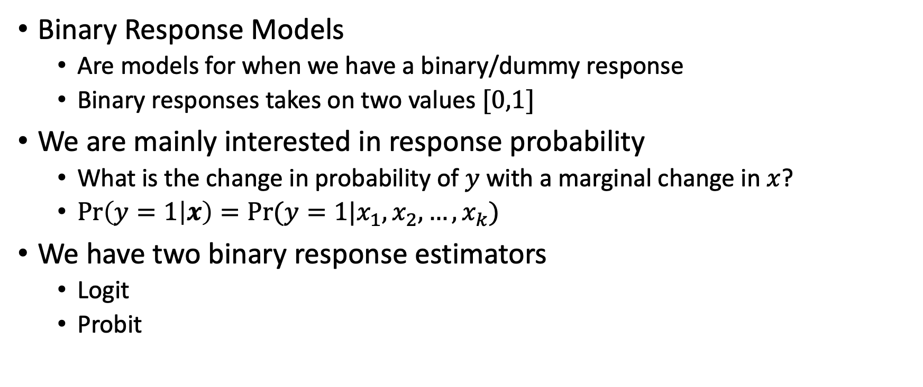
Binary Response Models
Binary Response Models
Are models for when we have a binary/dummy response
Binary responses takes on two values $[0,1]$
We are mainly interested in response probability
What is the change in probability of $y$ with a marginal change in $x$?
$\operatorname{Pr}\left(y=1 | x\right)=Pr⁡(y=1|x_{1},x_{2},…,x_{k})$
We have two binary response estimators
Logit
Probit

Slide 8
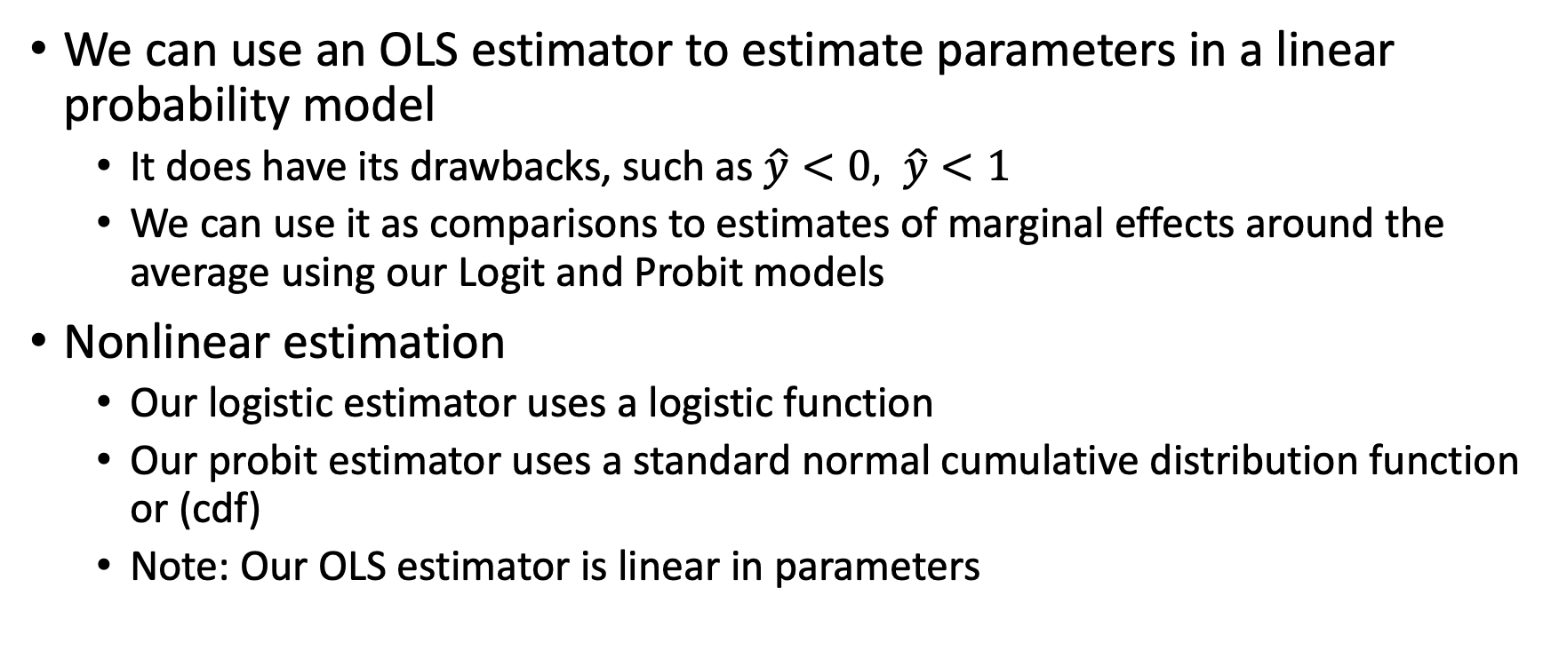
Binary Response Models
We can use an OLS estimator to estimate parameters in a linear probability model
It does have its drawbacks, such as $\hat{y}<0, \hat{y}<1$
We can use it as comparisons to estimates of marginal effects around the average using our Logit and Probit models
Nonlinear estimation
Our logistic estimator uses a logistic function
Our probit estimator uses a standard normal cumulative distribution function or (cdf)
Note: Our OLS estimator is linear in parameters

Slide 9
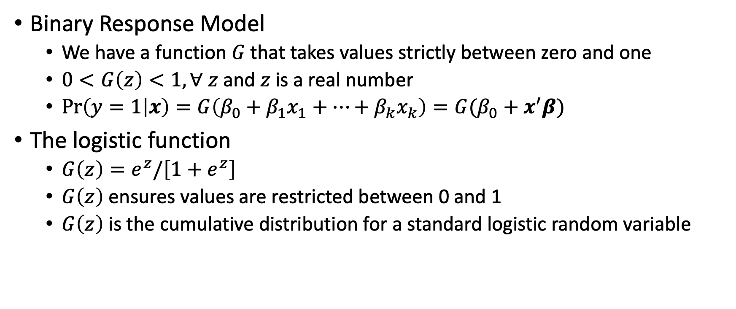
Logit Model
Binary Response Model
We have a function $G$ that takes values strictly between zero and one
$0<G\left(z\right)<1, ∀ z$ and $z$ is a real number
$\operatorname{Pr}\left(y=1 | x\right)=G\left(β_{0}+β_{1}x_{1}+…+β_{k}x_{k}\right)=G(β_{0}+x^{′}β)$
The logistic function
$G\left(z\right)=e^{z}/\left[1+e^{z}\right]$
$G\left(z\right)$ ensures values are restricted between 0 and 1
$G\left(z\right)$ is the cumulative distribution for a standard logistic random variable

Slide 10
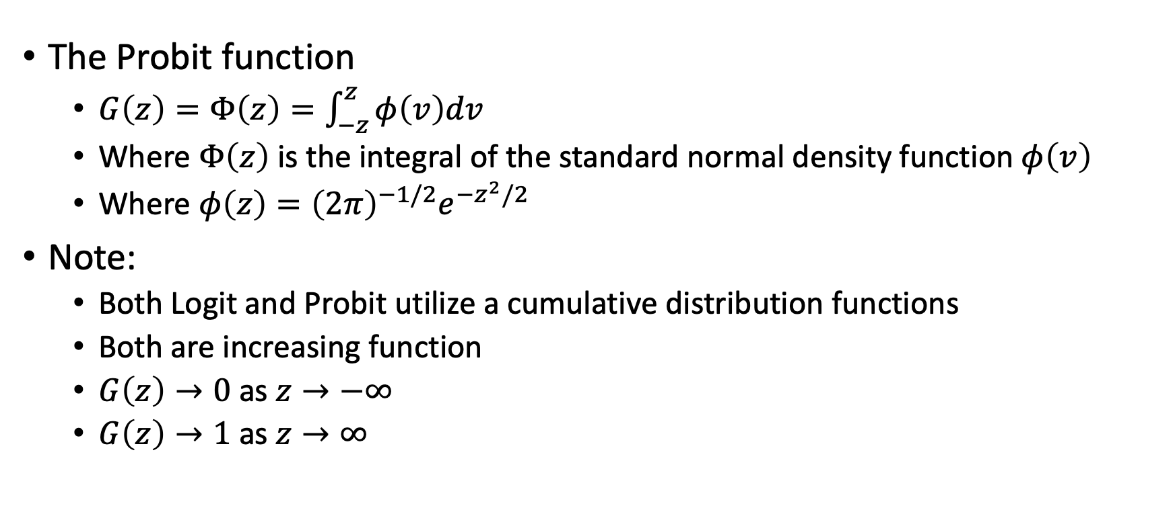
Logit Model
The Probit function
$G\left(z\right)=Φ\left(z\right)=\int_{−z}^{z}{φ\left(v\right)dv}$
Where $Φ\left(z\right)$ is the integral of the standard normal density function $φ\left(v\right)$
Where $φ\left(z\right)={\left(2π\right)}^{−1/2}e^{−z^{2}/2}$
Note:
Both Logit and Probit utilize a cumulative distribution functions
Both are increasing function
$G\left(z\right)→0$ as $z→−∞$
$G\left(z\right)→1$ as $z→∞$

Slide 11
Logit vs Probit
Probit
The errors are distributed normally
Logit

Slide 12
Nonnegative Dependent Variables

Slide 14
Stata

