Slide 1
Econ 645: Week 7
Simultaneous Equation Models
*Views do not represent HRSA or HHS

Slide 2
Overview
Simultaneous Equation Models
Simultaneity Bias in OLS
Identifying and Estimating a Structural Equation
Systems with More than Two Equations
Simultaneous Equations with Panel Data
Stata Section

Slide 3
Simultaneity
Simultaneity
When at least one explanatory variable in a multivariate regression is determined jointly with the dependent variable
This is a different form of endogeneity from omitted variable bias and measurement error
Simultaneous Equation Models
A model that jointly determines two or more endogenous variables, where each endogenous variable can be a function of the other endogenous variables, other exogenous variables, and an error term
Our main identification strategy
Using an instrument variable is a potential solution to simultaneity

Slide 4
Simultaneous Equation Models

Slide 5
Simultaneous Equation Models
Simultaneous Equations Models
The most classic example of simultaneous equation models is a supply and demand equation for some commodity or input to production (KLEMS)
Ceteris Paribus
Each equation should have a ceteris paribus or causal interpretation
A change will have a causal interpretation from economic theory
But, we have a problem with simultaneity bias preventing a causal interpretation

Slide 6
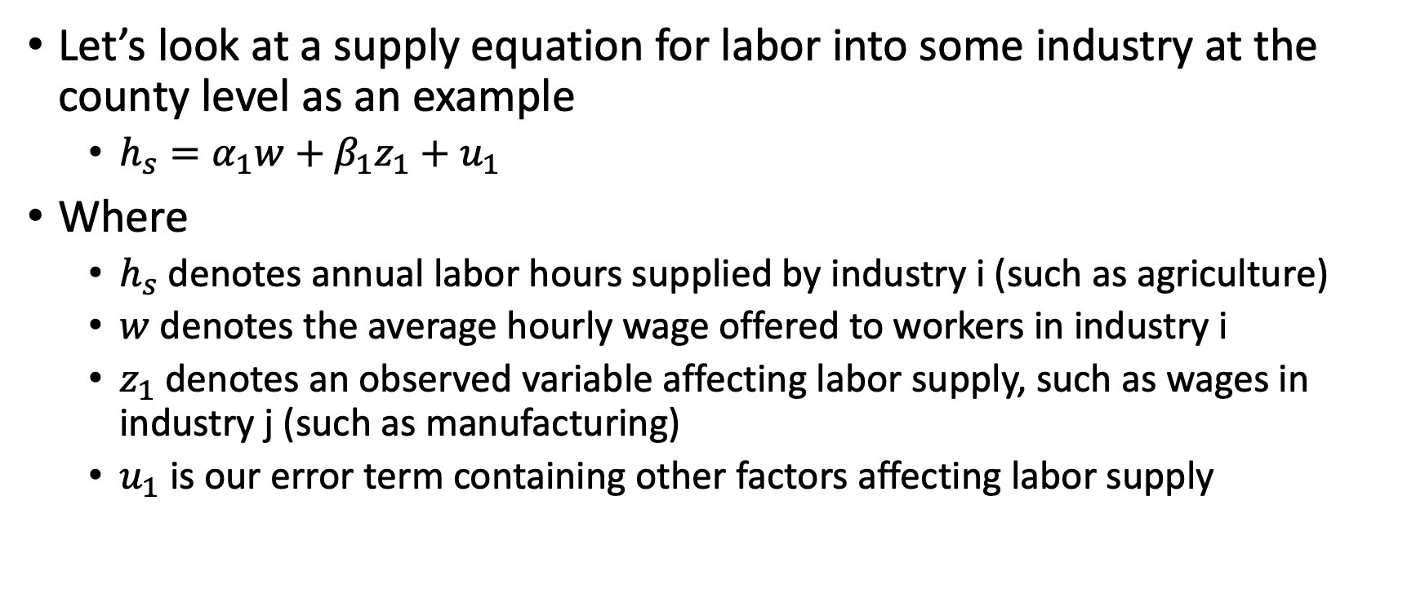
Simultaneous Equation Models
Let’s look at a supply equation for labor into some industry at the county level as an example
$h_{s}=α_{1}w+β_{1}z_{1}+u_{1}$
Where
$h_{s}$ denotes annual labor hours supplied by industry i (such as agriculture)
$w$ denotes the average hourly wage offered to workers in industry i
$z_{1}$ denotes an observed variable affecting labor supply, such as wages in industry j (such as manufacturing)
$u_{1}$ is our error term containing other factors affecting labor supply

Slide 7
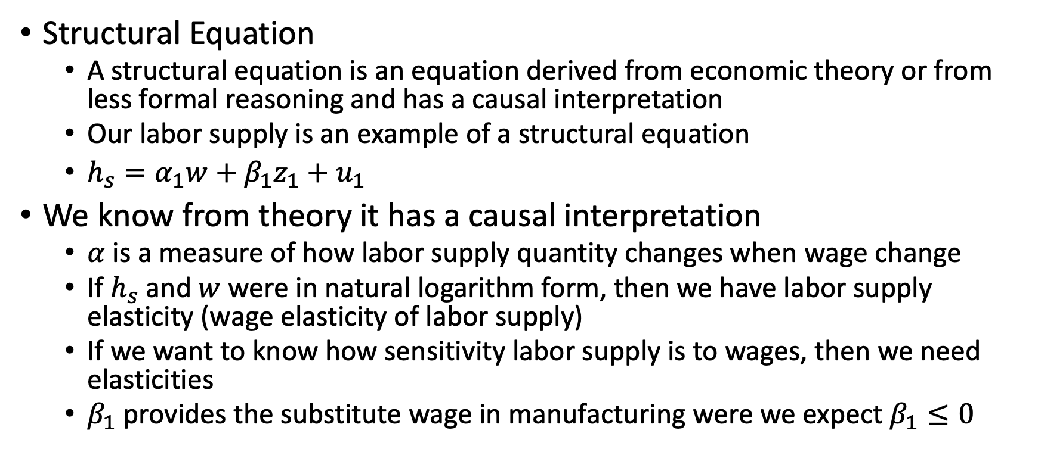
Simultaneous Equation Models
Structural Equation
A structural equation is an equation derived from economic theory or from less formal reasoning and has a causal interpretation
Our labor supply is an example of a structural equation
$h_{s}=α_{1}w+β_{1}z_{1}+u_{1}$
We know from theory it has a causal interpretation
$α$ is a measure of how labor supply quantity changes when wage change
If $h_{s}$ and $w$ were in natural logarithm form, then we have labor supply elasticity (wage elasticity of labor supply)
If we want to know how sensitivity labor supply is to wages, then we need elasticities
$β_{1}$ provides the substitute wage in manufacturing were we expect $β_{1}≤0$

Slide 8
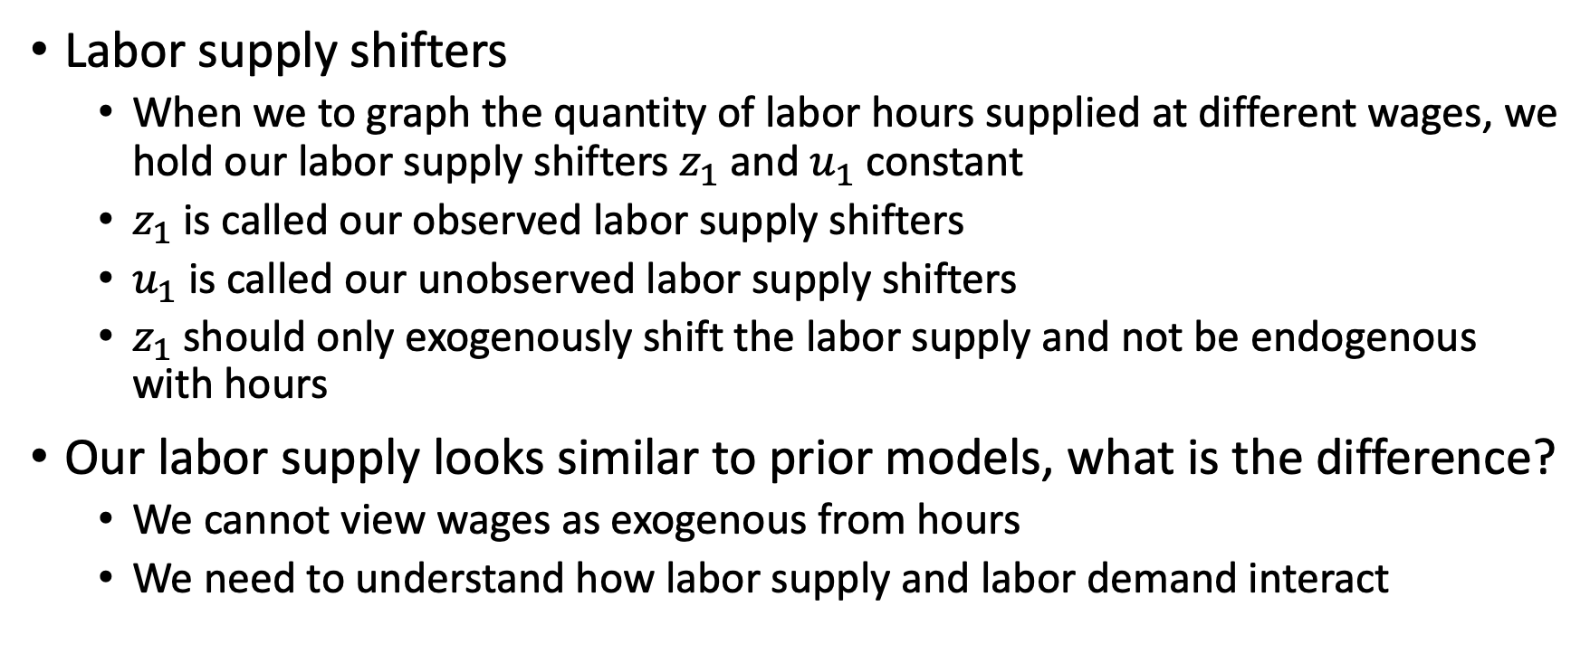
Simultaneous Equation Models
Labor supply shifters
When we to graph the quantity of labor hours supplied at different wages, we hold our labor supply shifters $z_{1}$ and $u_{1}$ constant
$z_{1}$ is called our observed labor supply shifters
$u_{1}$ is called our unobserved labor supply shifters
$z_{1}$ should only exogenously shift the labor supply and not be endogenous with hours
Our labor supply looks similar to prior models, what is the difference?
We cannot view wages as exogenous from hours
We need to understand how labor supply and labor demand interact

Slide 9
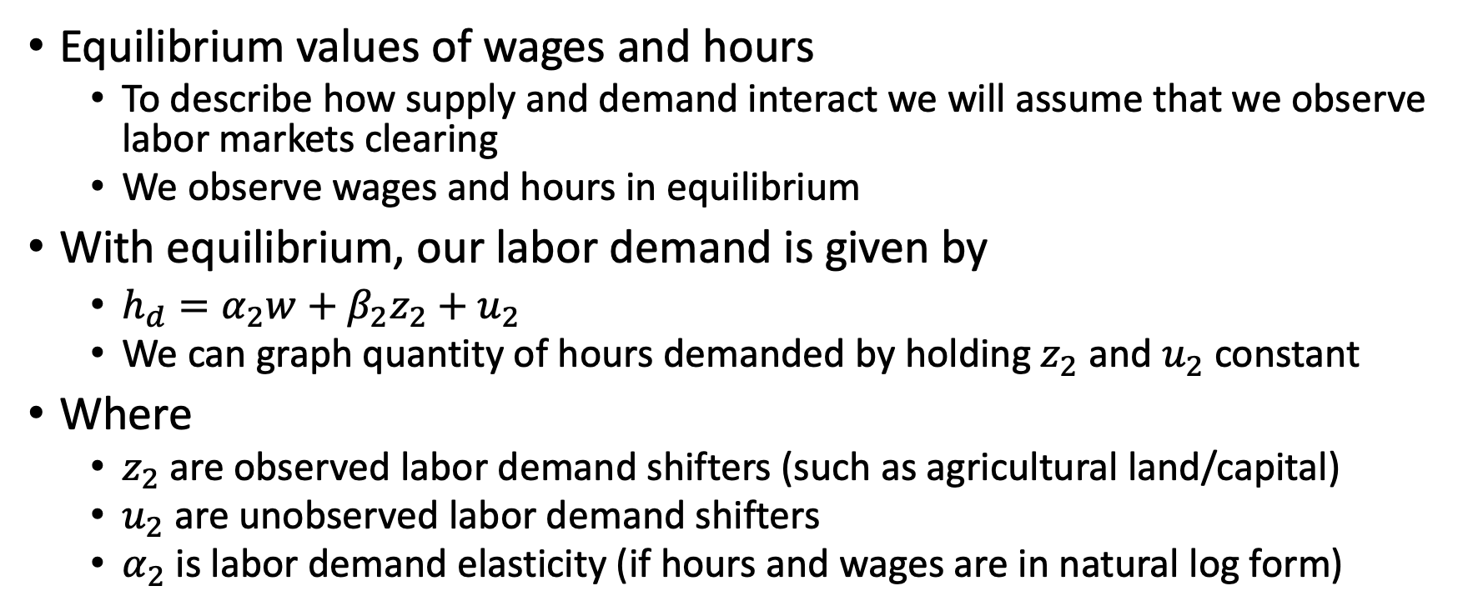
Simultaneous Equation Models
Equilibrium values of wages and hours
To describe how supply and demand interact we will assume that we observe labor markets clearing
We observe wages and hours in equilibrium
With equilibrium, our labor demand is given by
$h_{d}=α_{2}w+β_{2}z_{2}+u_{2}$
We can graph quantity of hours demanded by holding $z_{2}$ and $u_{2}$ constant
Where
$z_{2}$ are observed labor demand shifters (such as agricultural land/capital)
$u_{2}$ are unobserved labor demand shifters
$α_{2}$ is labor demand elasticity (if hours and wages are in natural log form)

Slide 10
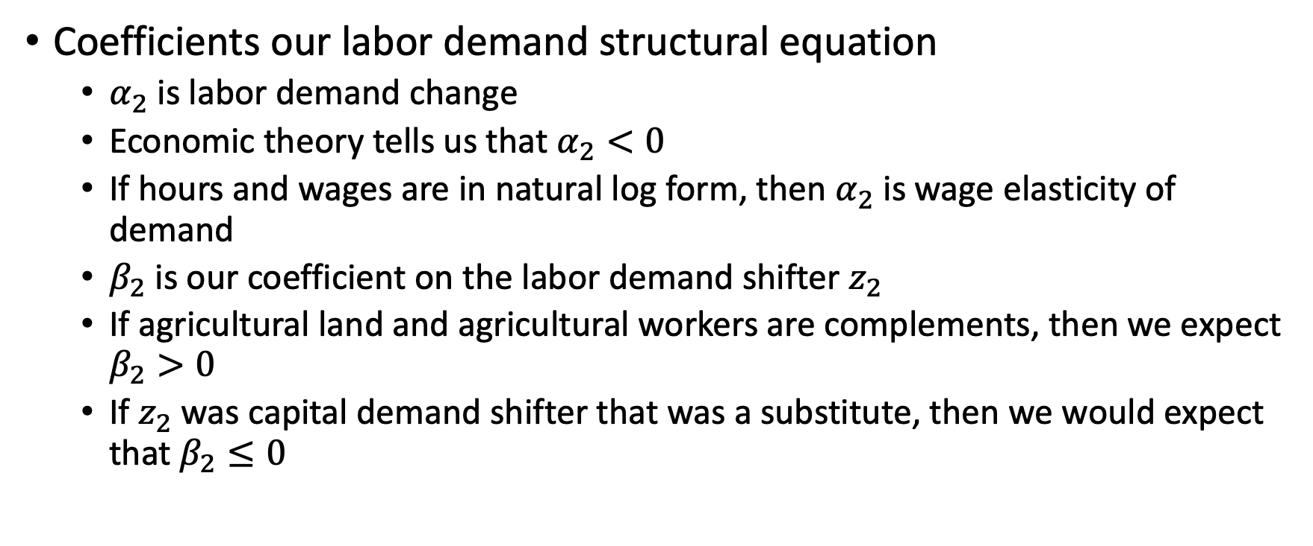
Simultaneous Equation Models
Coefficients our labor demand structural equation
$α_{2}$ is labor demand change
Economic theory tells us that $α_{2}<0$
If hours and wages are in natural log form, then $α_{2}$ is wage elasticity of demand
$β_{2}$ is our coefficient on the labor demand shifter $z_{2}$
If agricultural land and agricultural workers are complements, then we expect $β_{2}>0$
If $z_{2}$ was capital demand shifter that was a substitute, then we would expect that $β_{2}≤0$

Slide 11
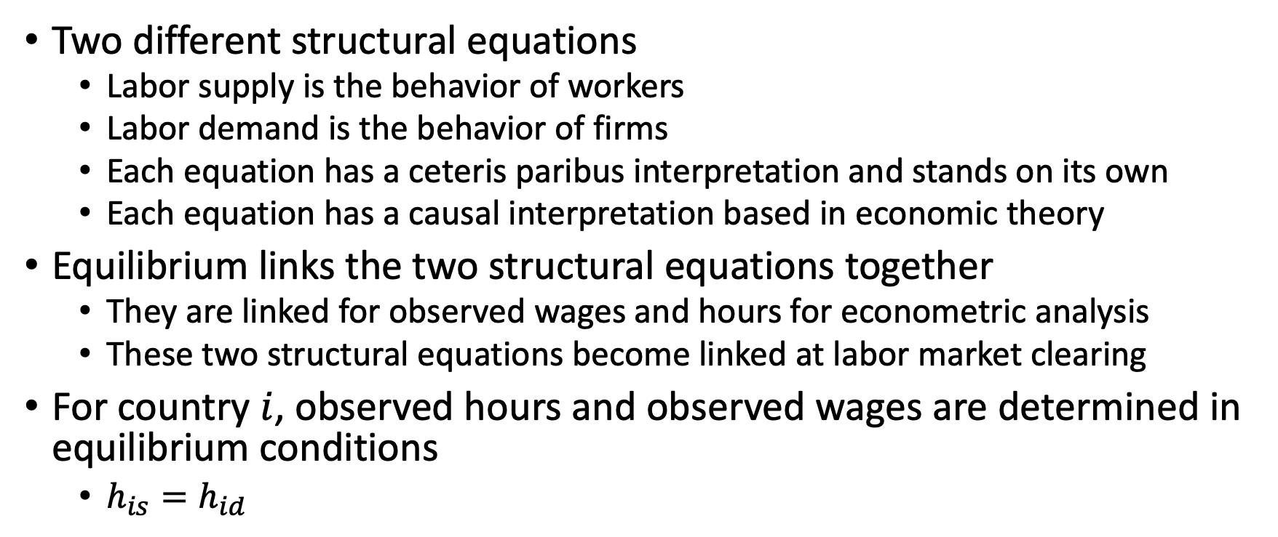
Simultaneous Equation Models
Two different structural equations
Labor supply is the behavior of workers
Labor demand is the behavior of firms
Each equation has a ceteris paribus interpretation and stands on its own
Each equation has a causal interpretation based in economic theory
Equilibrium links the two structural equations together
They are linked for observed wages and hours for econometric analysis
These two structural equations become linked at labor market clearing
For country $i$, observed hours and observed wages are determined in equilibrium conditions
$h_{is}=h_{id}$

Slide 12
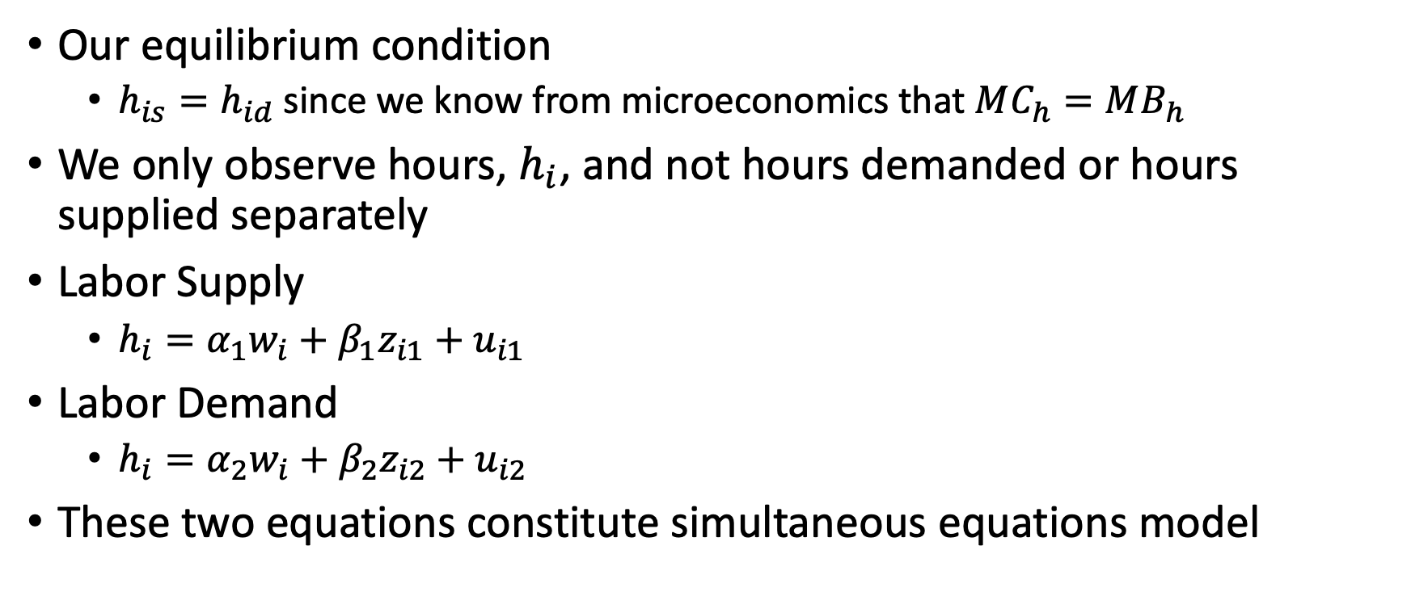
Simultaneous Equation Models
Our equilibrium condition
$h_{is}=h_{id}$ since we know from microeconomics that $MC_{h}=MB_{h}$
We only observe hours, $h_{i}$, and not hours demanded or hours supplied separately
Labor Supply
$h_{i}=α_{1}w_{i}+β_{1}z_{i1}+u_{i1}$
Labor Demand
$h_{i}=α_{2}w_{i}+β_{2}z_{i2}+u_{i2}$
These two equations constitute simultaneous equations model

Slide 13
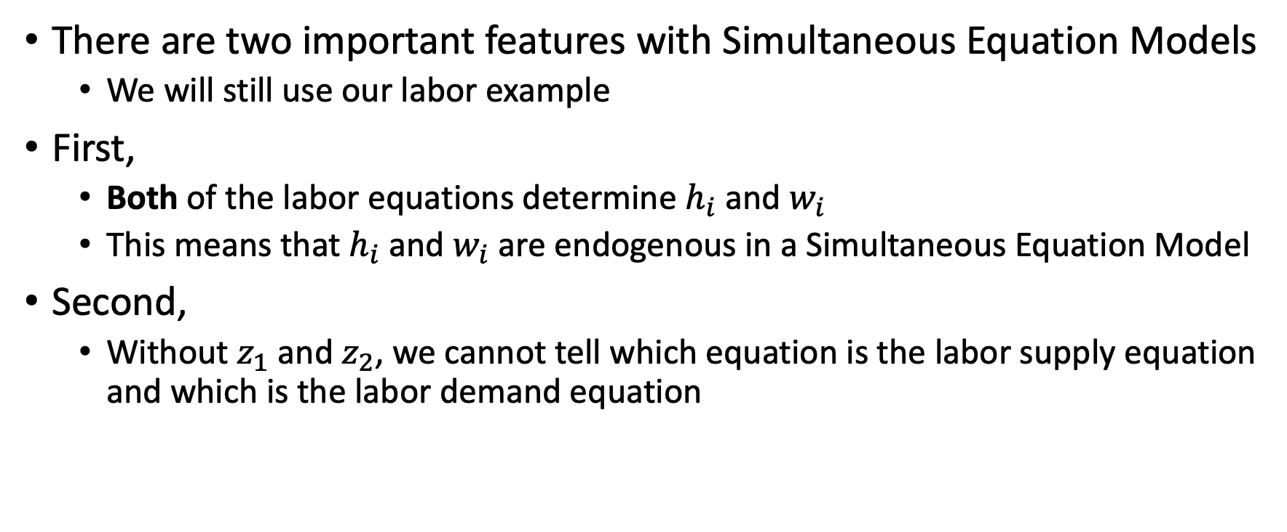
Simultaneous Equation Models
There are two important features with Simultaneous Equation Models
We will still use our labor example
First,
Both of the labor equations determine $h_{i}$ and $w_{i}$
This means that $h_{i}$ and $w_{i}$ are endogenous in a Simultaneous Equation Model
Second,
Without $z_{1}$ and $z_{2}$, we cannot tell which equation is the labor supply equation and which is the labor demand equation

Slide 14
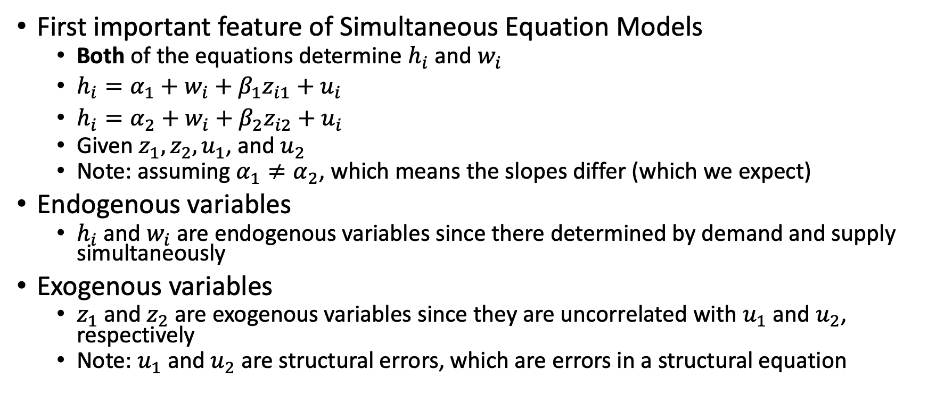
Simultaneous Equation Models
First important feature of Simultaneous Equation Models
Both of the equations determine $h_{i}$ and $w_{i}$
$h_{i}=α_{1}+w_{i}+β_{1}z_{i1}+u_{i}$
$h_{i}=α_{2}+w_{i}+β_{2}z_{i2}+u_{i}$
Given $z_{1}, z_{2}, u_{1}$, and $u_{2}$
Note: assuming $α_{1}≠α_{2}$, which means the slopes differ (which we expect)
Endogenous variables
$h_{i}$ and $w_{i}$ are endogenous variables since there determined by demand and supply simultaneously
Exogenous variables
$z_{1}$ and $z_{2}$ are exogenous variables since they are uncorrelated with $u_{1}$ and $u_{2}$, respectively
Note: $u_{1}$ and $u_{2}$ are structural errors, which are errors in a structural equation

Slide 15
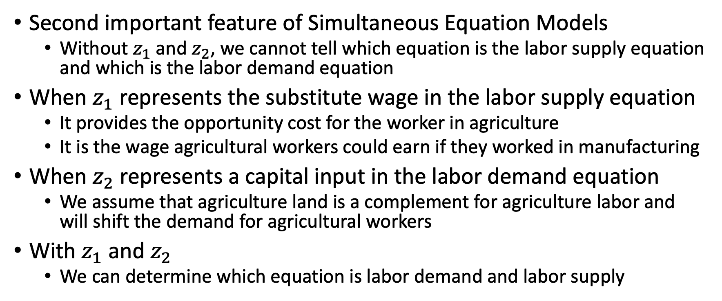
Simultaneous Equation Models
Second important feature of Simultaneous Equation Models
Without $z_{1}$ and $z_{2}$, we cannot tell which equation is the labor supply equation and which is the labor demand equation
When $z_{1}$ represents the substitute wage in the labor supply equation
It provides the opportunity cost for the worker in agriculture
It is the wage agricultural workers could earn if they worked in manufacturing
When $z_{2}$ represents a capital input in the labor demand equation
We assume that agriculture land is a complement for agriculture labor and will shift the demand for agricultural workers
With $z_{1}$ and $z_{2}$
We can determine which equation is labor demand and labor supply

Slide 16
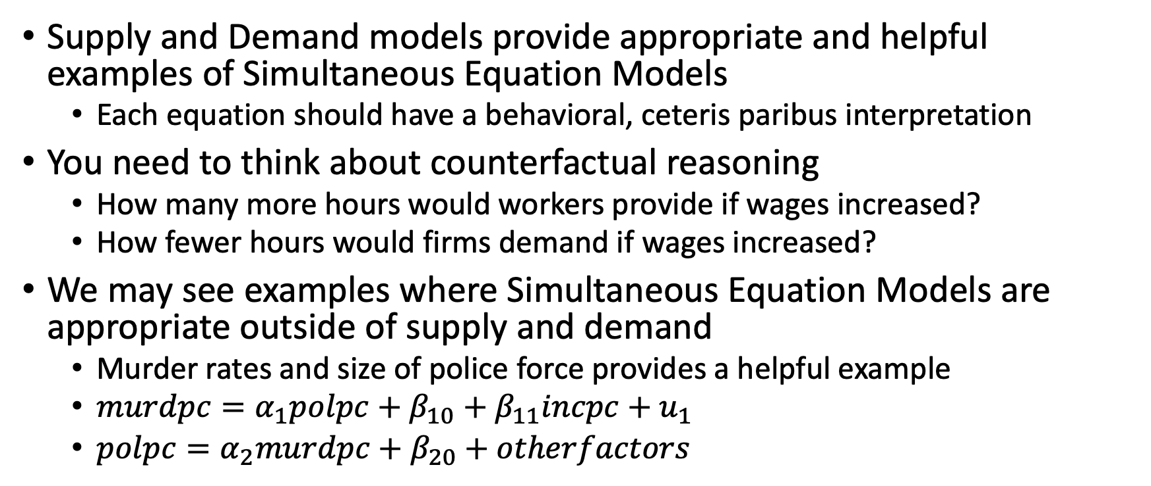
Simultaneous Equation Models
Supply and Demand models provide appropriate and helpful examples of Simultaneous Equation Models
Each equation should have a behavioral, ceteris paribus interpretation
You need to think about counterfactual reasoning
How many more hours would workers provide if wages increased?
How fewer hours would firms demand if wages increased?
We may see examples where Simultaneous Equation Models are appropriate outside of supply and demand
Murder rates and size of police force provides a helpful example
$murdpc=α_{1}polpc+β_{10}+β_{11}incpc+u_{1}$
$polpc=α_{2}murdpc+β_{20}+otherfactors$

Slide 17
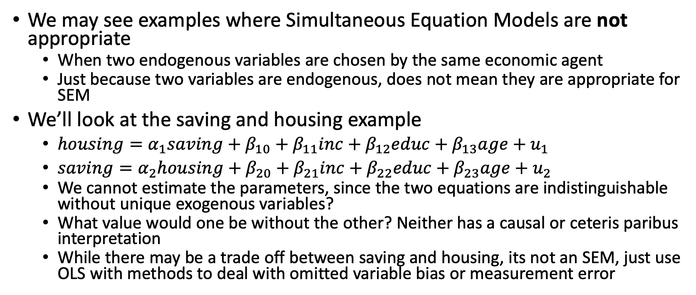
Simultaneous Equation Models
We may see examples where Simultaneous Equation Models are not appropriate
When two endogenous variables are chosen by the same economic agent
Just because two variables are endogenous, does not mean they are appropriate for SEM
We’ll look at the saving and housing example
$housing=α_{1}saving+β_{10}+β_{11}inc+β_{12}educ+β_{13}age+u_{1}$
$saving=α_{2}housing+β_{20}+β_{21}inc+β_{22}educ+β_{23}age+u_{2}$
We cannot estimate the parameters, since the two equations are indistinguishable without unique exogenous variables?
What value would one be without the other? Neither has a causal or ceteris paribus interpretation
While there may be a trade off between saving and housing, its not an SEM, just use OLS with methods to deal with omitted variable bias or measurement error

Slide 18
Simultaneity Bias in OLS

Slide 19
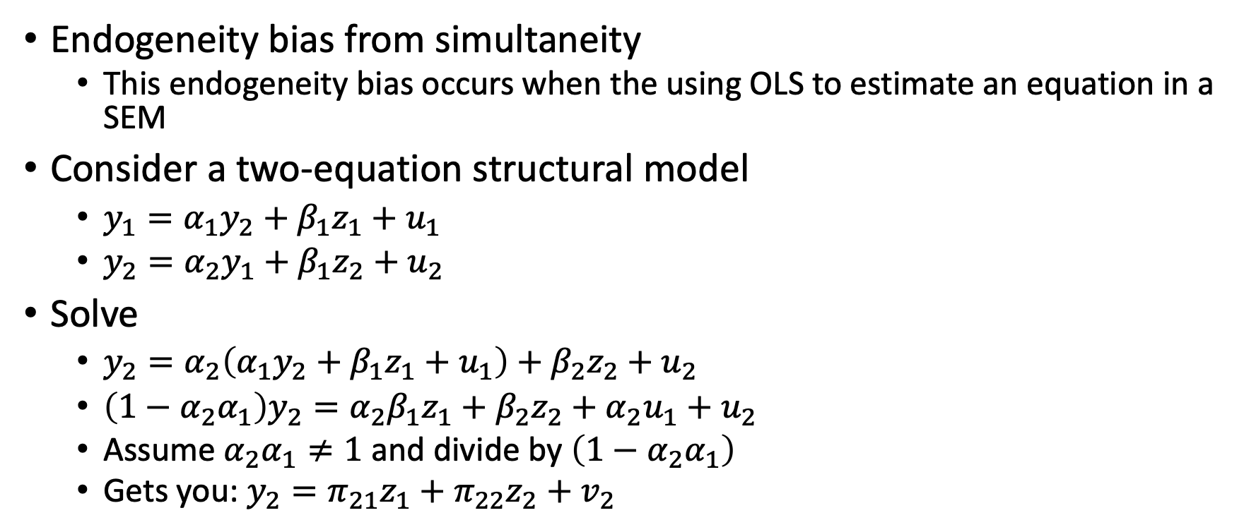
Simultaneity
Endogeneity bias from simultaneity
This endogeneity bias occurs when the using OLS to estimate an equation in a SEM
Consider a two-equation structural model
$y_{1}=α_{1}y_{2}+β_{1}z_{1}+u_{1}$
$y_{2}=α_{2}y_{1}+β_{1}z_{2}+u_{2}$
Solve
$y_{2}=α_{2}\left(α_{1}y_{2}+β_{1}z_{1}+u_{1}\right)+β_{2}z_{2}+u_{2}$
$\left(1−α_{2}α_{1}\right)y_{2}=α_{2}β_{1}z_{1}+β_{2}z_{2}+α_{2}u_{1}+u_{2}$
Assume $α_{2}α_{1}≠1$ and divide by $\left(1−α_{2}α_{1}\right)$
Gets you: $y_{2}=π_{21}z_{1}+π_{22}z_{2}+v_{2}$

Slide 20

Simultaneity
Reduced form equation
$y_{2}=π_{21}z_{1}+π_{22}z_{2}+v_{2}$
Where $π_{21}=\left(\frac{α_{2}β_{1}}{1−α_{2}α_{1}}\right)$, $π_{22}=\left(\frac{β_{2}}{1−α_{2}α_{1}}\right)$, and $v_{2}=\left(\frac{α_{2}u_{1}+u_{2}}{1−α_{2}α_{1}}\right)$
Where $π_{21}$ and $π_{22}$ are our reduced form parameters

