Slide 1
Econ 645: Week 5
Potential Outcomes, Natural Experiments, and Introductory Difference-in-Differences
*Views do not represent HRSA or HHS

Slide 2
Overview
Potential Outcomes and Selection Bias
Natural Experiments
2-by-2 Difference-in-Differences
Two-Way Fixed Effects for Policy Analysis
Stata Examples
Brief Review

Slide 3
Potential Outcomes and Self-Selection
Angrist and Pischke (2010)

Slide 4
Question of Interest
Always start off with a question!
Does this treatment work?
Do hospitals make people healthier?
This is a big question for health economists
Immediately, we think, yes, of course hospitals make them healthier
What a silly question!
However, we need to consider all possible impacts
This is a causal if-then, cause-effect question
It is not easy to answer without it being confounded by self-selection or selection bias

Slide 5
Simple Difference in Means
Comparing Simple Difference in Means
Simple difference in means will be confounded by self-selection unless individuals were randomized into treatment
Sick people may self-select into hospitals
Let’s consider poor elderly population that uses hospital ER as primary care
On the positive side
They have access to health care providers
On the negative side:
Hospital are expensive and crowded
Patients may get infected from other sick patients
Hospital might not be the most effective way to get primary care
May be sicker overall going into treatment

Slide 6
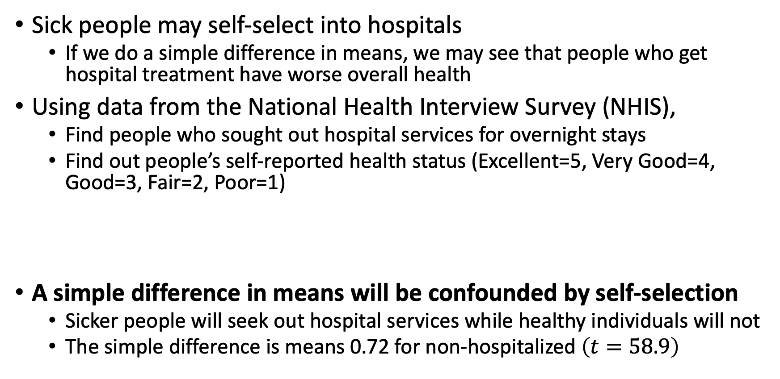
Simple Difference in Means
Sick people may self-select into hospitals
If we do a simple difference in means, we may see that people who get hospital treatment have worse overall health
Using data from the National Health Interview Survey (NHIS),
Find people who sought out hospital services for overnight stays
Find out people’s self-reported health status (Excellent=5, Very Good=4, Good=3, Fair=2, Poor=1)
A simple difference in means will be confounded by self-selection
Sicker people will seek out hospital services while healthy individuals will not
The simple difference is means 0.72 for non-hospitalized $\left(t=58.9\right)$
Group | Sample Size | Mean Health Status | Standard Error
Hospital | 7,774 | 3.21 | 0.014
No Hospital | 90,049 | 3.93 | 0.003

Slide 7
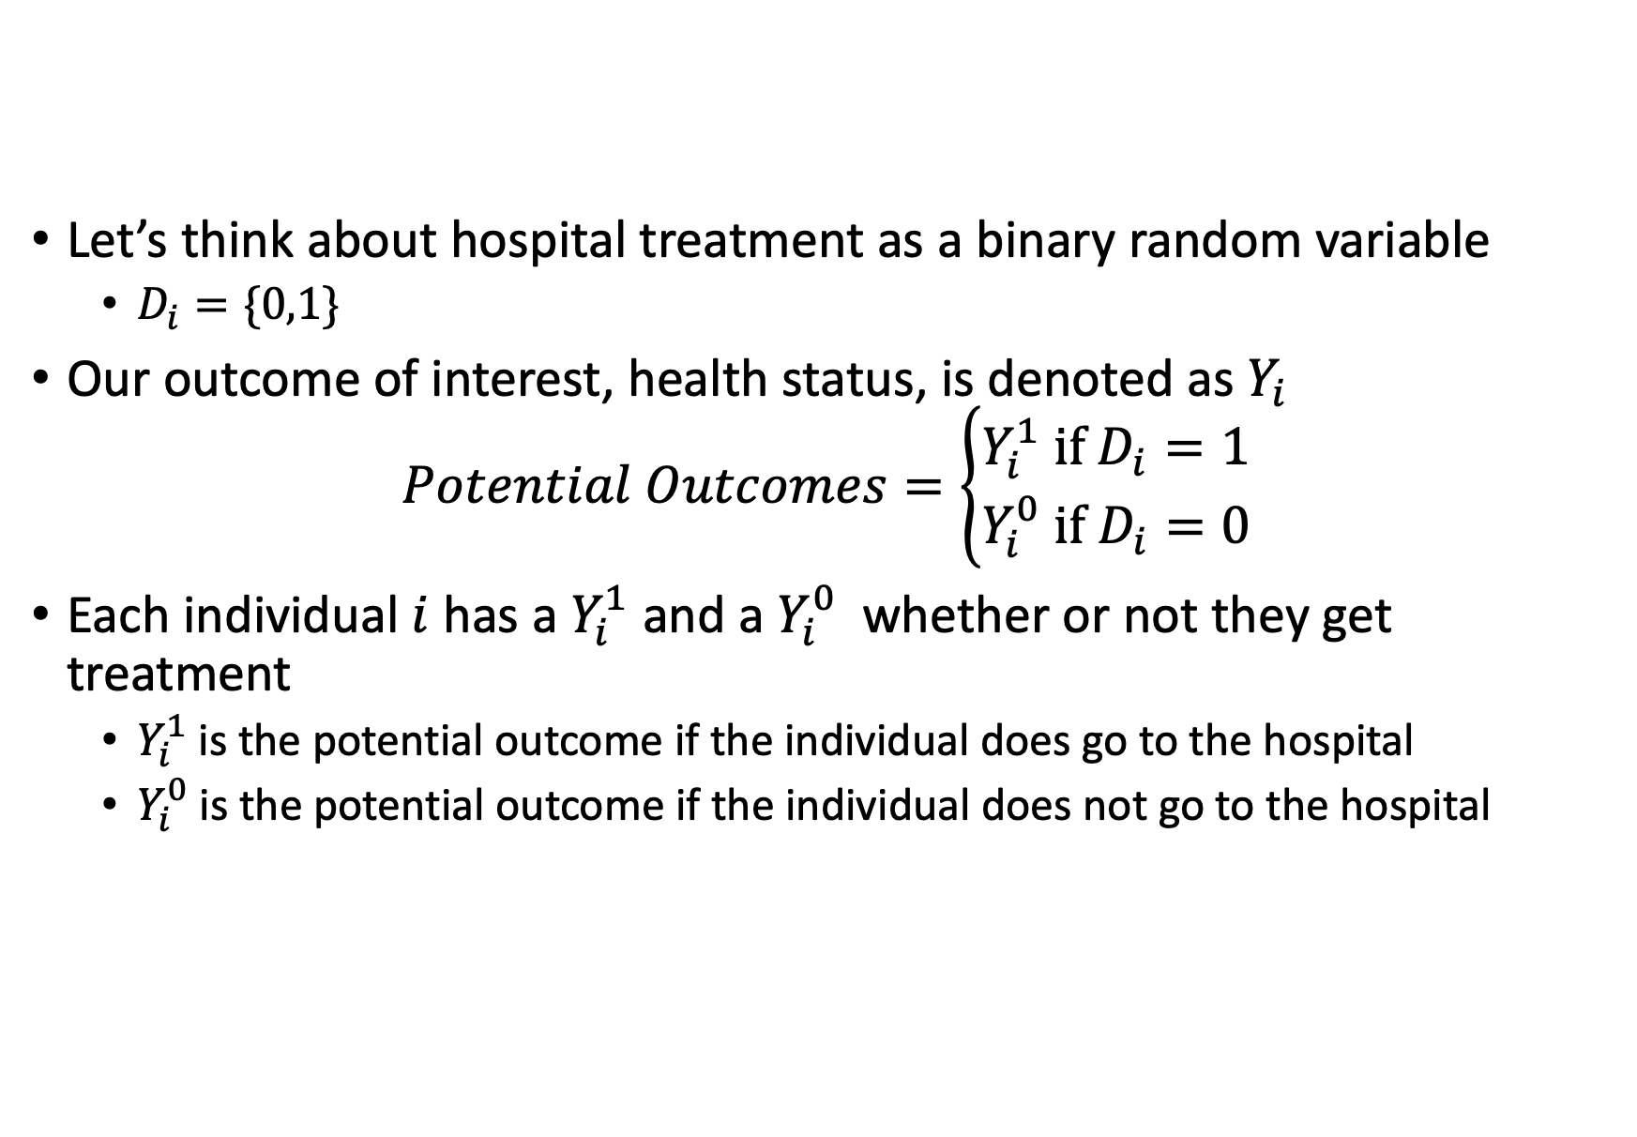
Potential Outcomes
Let’s think about hospital treatment as a binary random variable
$D_{i}=\{0,1\}$
Our outcome of interest, health status, is denoted as $Y_{i}$
$$Potential Outcomes=\left\{\begin{aligned}Y_{i}^{1} if D_{i}=1 \\ Y_{i}^{0} if D_{i}=0\end{aligned}\right.$$
Each individual $i$ has a $Y_{i}^{1}$ and a $Y_{i}^{0}$ whether or not they get treatment
$Y_{i}^{1}$ is the potential outcome if the individual does go to the hospital
$Y_{i}^{0}$ is the potential outcome if the individual does not go to the hospital

Slide 8
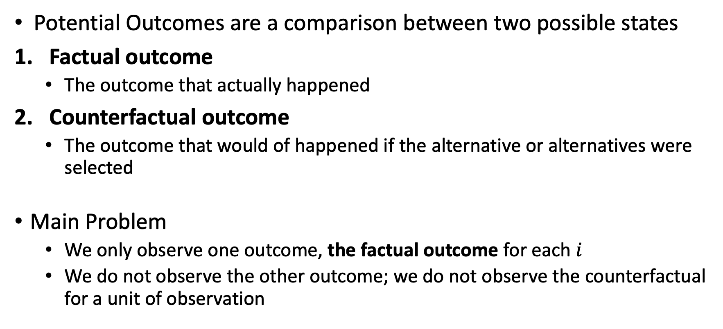
Potential Outcomes
Potential Outcomes are a comparison between two possible states
Factual outcome
The outcome that actually happened
Counterfactual outcome
The outcome that would of happened if the alternative or alternatives were selected
Main Problem
We only observe one outcome, the factual outcome for each $i$
We do not observe the other outcome; we do not observe the counterfactual for a unit of observation

Slide 9
Potential Outcomes
The counterfactual is a vital concept
What would the world look like if another outcome was chosen
However, the counterfactual is never observed
Counterfactuals exist ex ante (or before the fact) as a set of possibilities before one outcome is realized
To simply, we choose a binary outcome for the outcomes
We condense multiple outcomes into two: factual and counterfactual

Slide 10
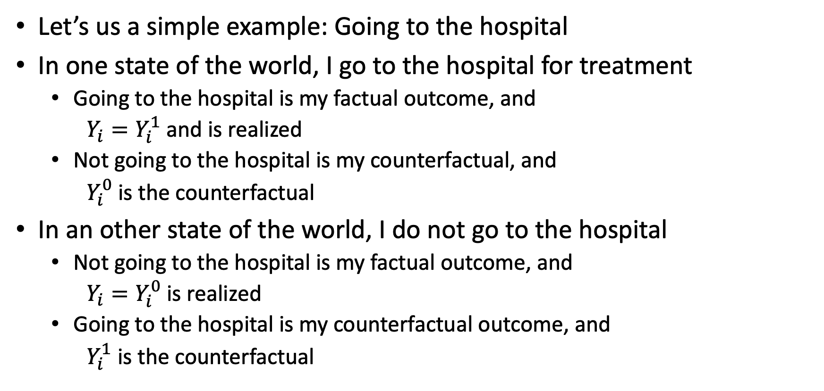
Potential Outcomes
Let’s us a simple example: Going to the hospital
In one state of the world, I go to the hospital for treatment
Going to the hospital is my factual outcome, and
$Y_{i}=Y_{i}^{1}$ and is realized
Not going to the hospital is my counterfactual, and
$Y_{i}^{0}$ is the counterfactual
In an other state of the world, I do not go to the hospital
Not going to the hospital is my factual outcome, and
$Y_{i}=Y_{i}^{0}$ is realized
Going to the hospital is my counterfactual outcome, and
$Y_{i}^{1}$ is the counterfactual

Slide 11
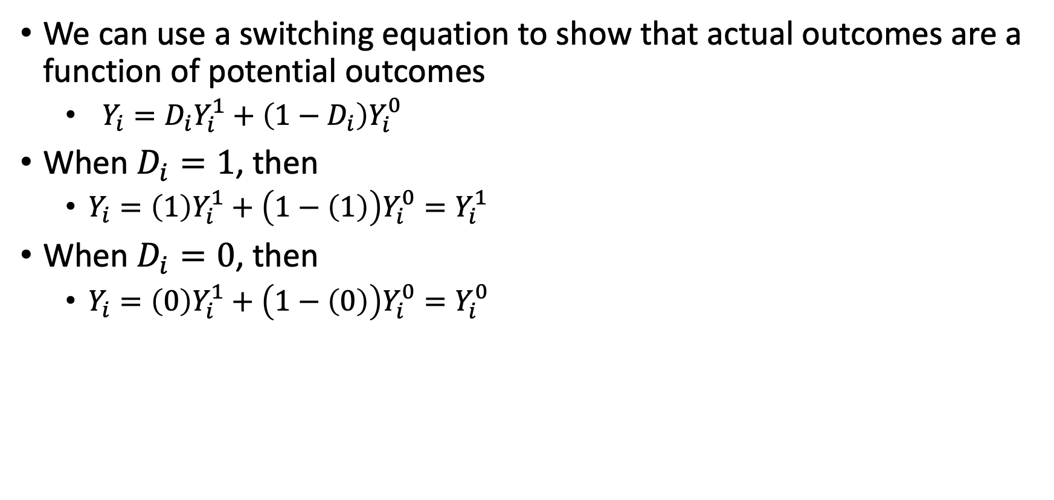
Potential Outcomes
We can use a switching equation to show that actual outcomes are a function of potential outcomes
$Y_{i}=D_{i}Y_{i}^{1}+\left(1−D_{i}\right)Y_{i}^{0}$
When $D_{i}=1$, then
$Y_{i}=\left(1\right)Y_{i}^{1}+\left(1−\left(1\right)\right)Y_{i}^{0}=Y_{i}^{1}$
When $D_{i}=0$, then
$Y_{i}=\left(0\right)Y_{i}^{1}+\left(1−\left(0\right)\right)Y_{i}^{0}=Y_{i}^{0}$

Slide 12
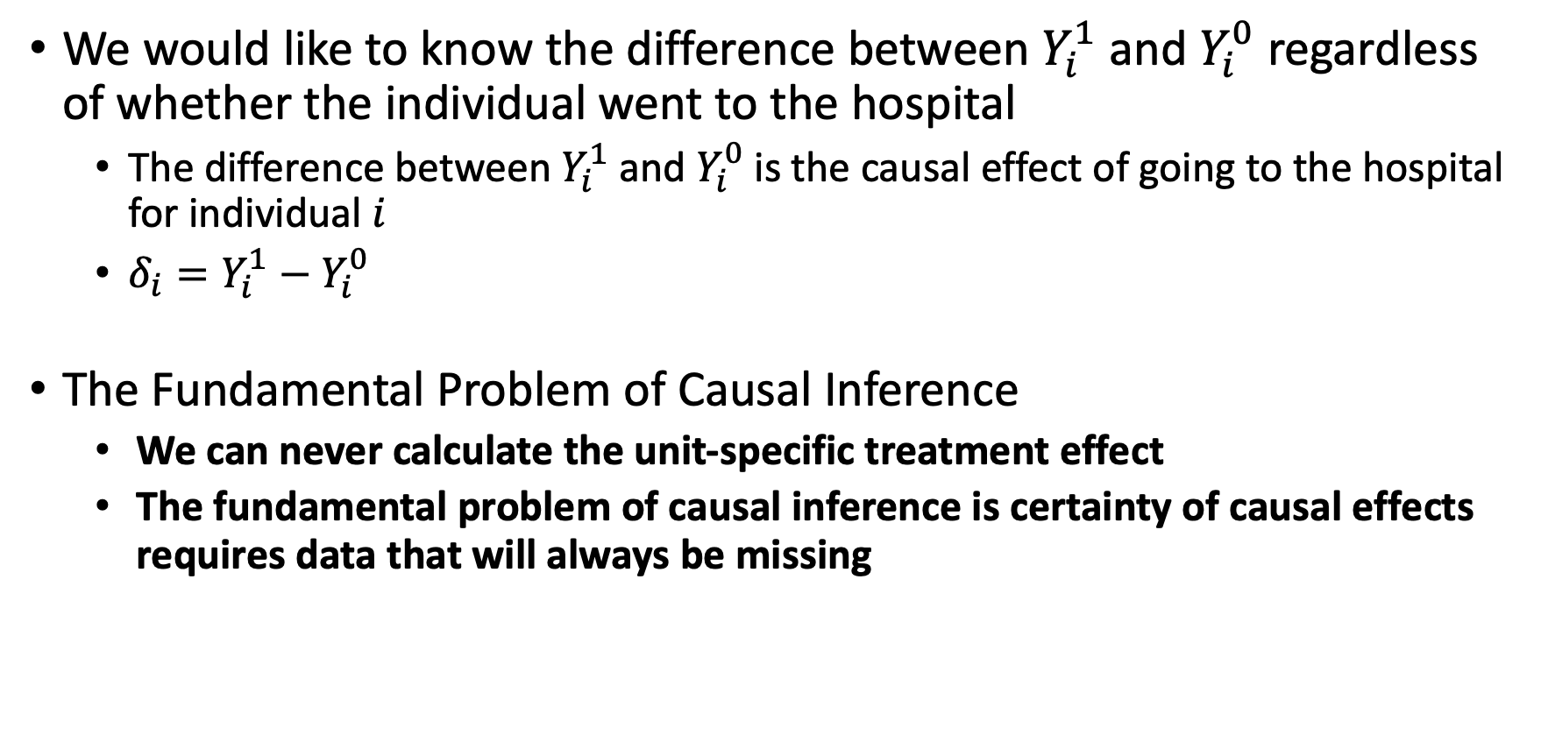
Potential Outcomes
We would like to know the difference between $Y_{i}^{1}$ and $Y_{i}^{0}$ regardless of whether the individual went to the hospital
The difference between $Y_{i}^{1}$ and $Y_{i}^{0}$ is the causal effect of going to the hospital for individual $i$
$δ_{i}=Y_{i}^{1}−Y_{i}^{0}$
The Fundamental Problem of Causal Inference
We can never calculate the unit-specific treatment effect
The fundamental problem of causal inference is certainty of causal effects requires data that will always be missing

Slide 13
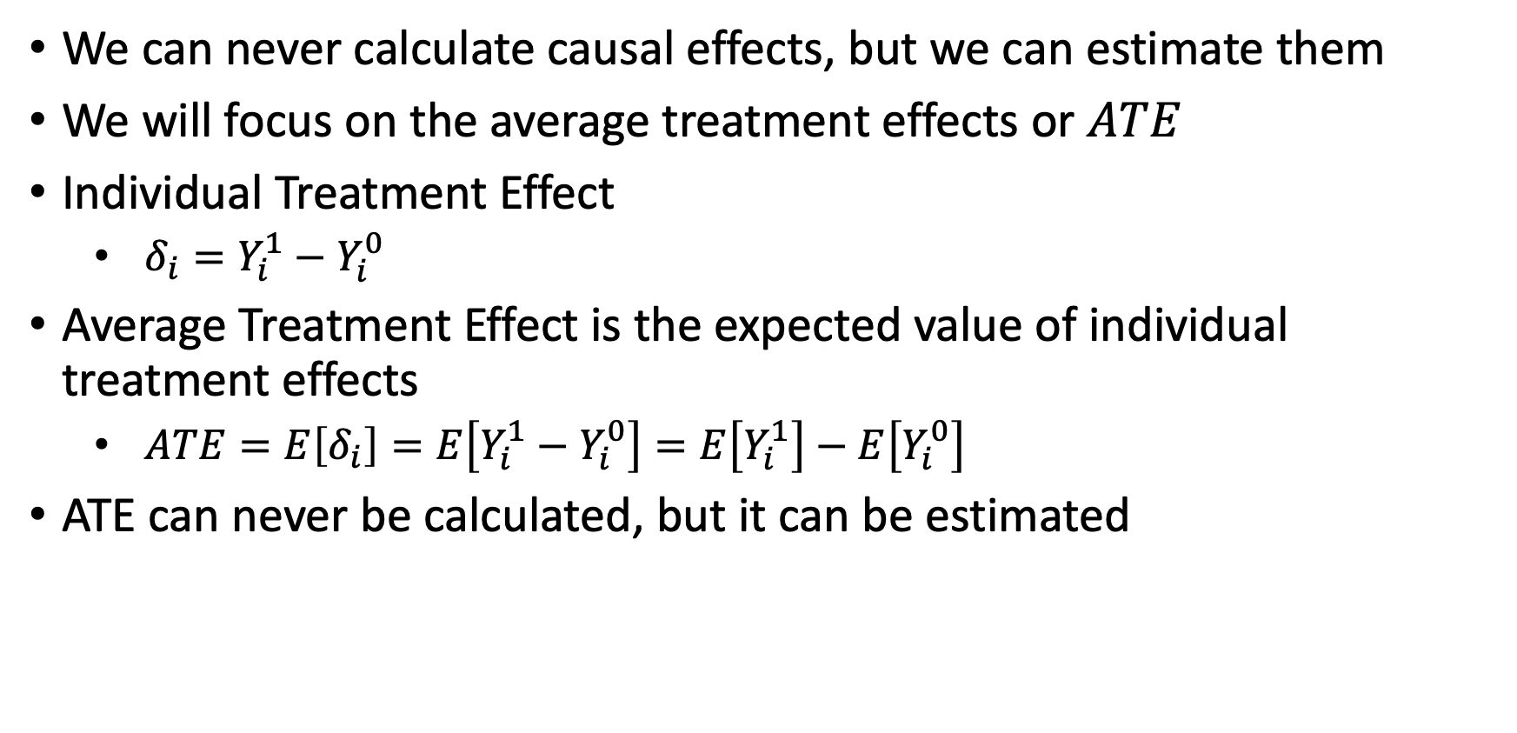
Potential Outcomes
We can never calculate causal effects, but we can estimate them
We will focus on the average treatment effects or $ATE$
Individual Treatment Effect
$δ_{i}=Y_{i}^{1}−Y_{i}^{0}$
Average Treatment Effect is the expected value of individual treatment effects
$ATE=E\left[δ_{i}\right]=E\left[Y_{i}^{1}−Y_{i}^{0}\right]=E\left[Y_{i}^{1}\right]−E\left[Y_{i}^{0}\right]$
ATE can never be calculated, but it can be estimated

Slide 14
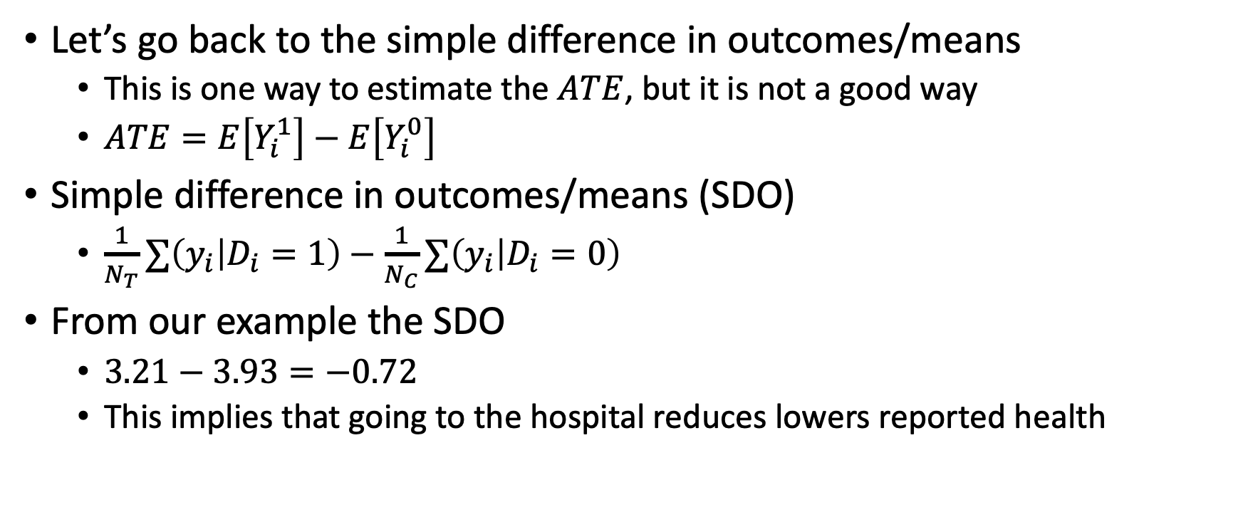
Simple Difference in Outcomes
Let’s go back to the simple difference in outcomes/means
This is one way to estimate the $ATE$, but it is not a good way
$ATE=E\left[Y_{i}^{1}\right]−E\left[Y_{i}^{0}\right]$
Simple difference in outcomes/means (SDO)
$\frac{1}{N_{T}}∑\left(y_{i} | D_{i}=1\right)−\frac{1}{N_{C}}∑\left(y_{i} | D_{i}=0\right)$
From our example the SDO
$3.21−3.93=−0.72$
This implies that going to the hospital reduces lowers reported health

Slide 15
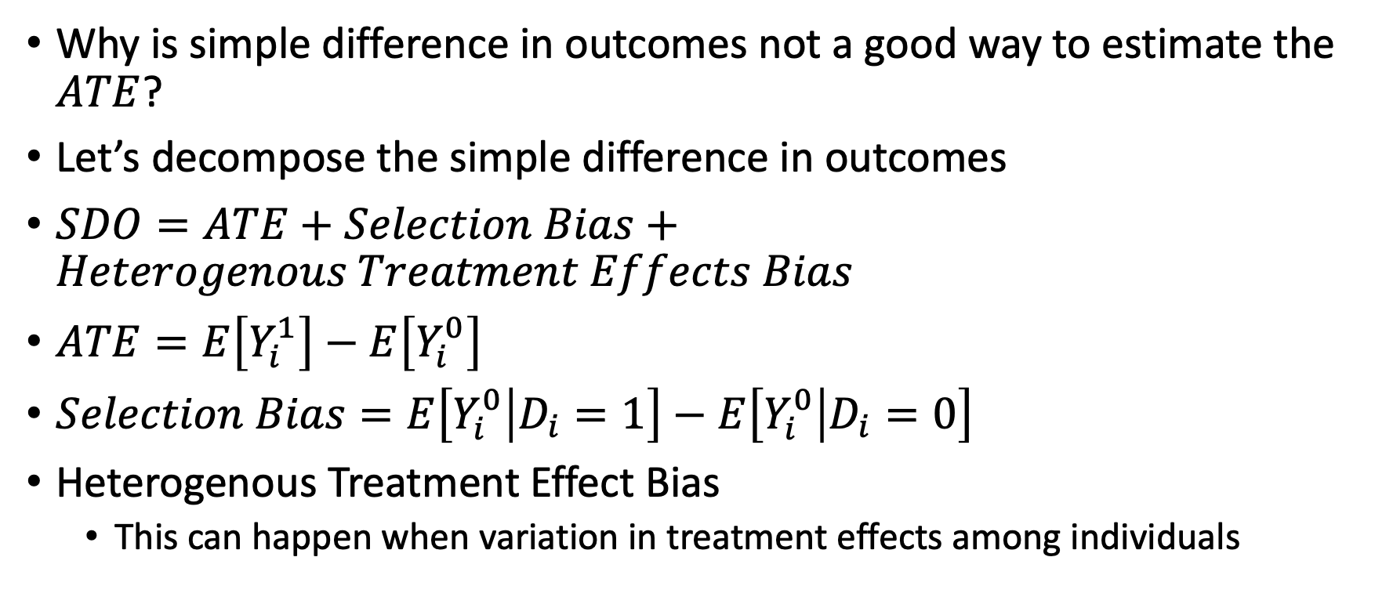
Simple Difference in Outcomes
Why is simple difference in outcomes not a good way to estimate the $ATE$?
Let’s decompose the simple difference in outcomes
$SDO=ATE+Selection Bias+Heterogenous Treatment Effects Bias$
$ATE=E\left[Y_{i}^{1}\right]−E\left[Y_{i}^{0}\right]$
$Selection Bias=E\left[Y_{i}^{0} | D_{i}=1\right]−E\left[Y_{i}^{0} | D_{i}=0\right]$
Heterogenous Treatment Effect Bias
This can happen when variation in treatment effects among individuals

Slide 16
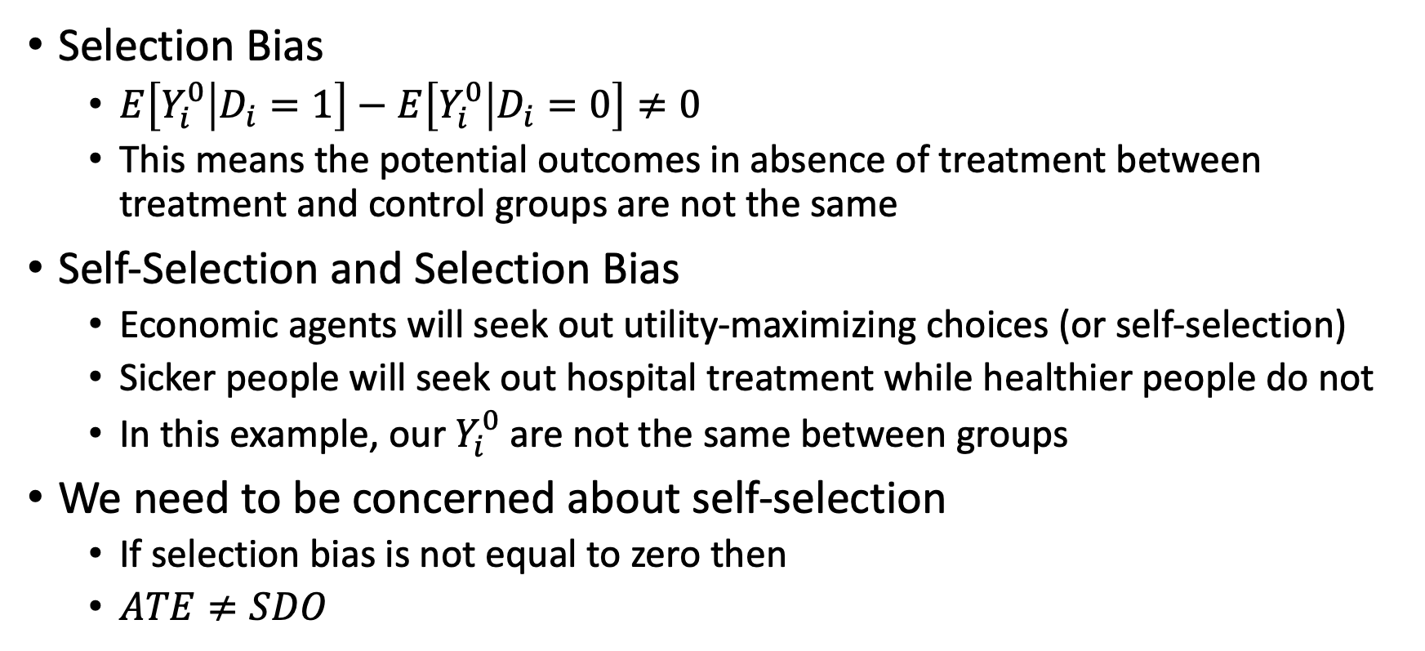
Selection Bias
Selection Bias
$E\left[Y_{i}^{0} | D_{i}=1\right]−E\left[Y_{i}^{0} | D_{i}=0\right]≠0$
This means the potential outcomes in absence of treatment between treatment and control groups are not the same
Self-Selection and Selection Bias
Economic agents will seek out utility-maximizing choices (or self-selection)
Sicker people will seek out hospital treatment while healthier people do not
In this example, our $Y_{i}^{0}$ are not the same between groups
We need to be concerned about self-selection
If selection bias is not equal to zero then
$ATE≠SDO$

Slide 17

Selection Bias
Patient | D/Treatment | Y¹ | Y⁰ | Delta | Y
1 | 1 | 7 | 1 | 6 | 7
3 | 1 | 5 | 1 | 4 | 5
5 | 1 | 4 | 2 | 2 | 4
6 | 1 | 10 | 1 | 9 | 10
10 | 1 | 9 | 8 | 1 | 9
2 | 0 | 5 | 6 | -1 | 6
4 | 0 | 7 | 8 | -1 | 8
7 | 0 | 1 | 10 | -9 | 10
8 | 0 | 5 | 6 | -1 | 6
9 | 0 | 3 | 7 | -4 | 7
Visualize when $E\left[Y^{0} | D_{i}=1\right]−$ $E\left[Y^{0} | D_{i}=0\right]≠0$
The average expected outcome of $Y^{0}$ is not the same between groups
This means that there is self-selection in the observational data

Slide 18
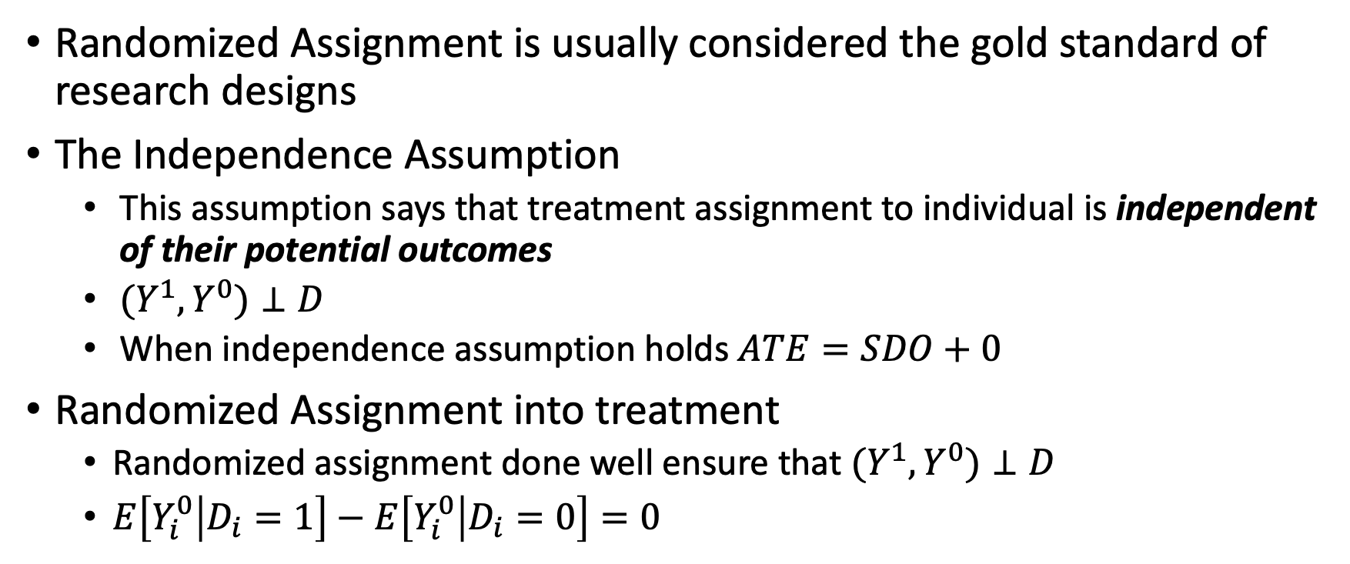
Randomized Assignment
Randomized Assignment is usually considered the gold standard of research designs
The Independence Assumption
This assumption says that treatment assignment to individual is independent of their potential outcomes
$(Y^{1},Y^{0})⊥D$
When independence assumption holds $ATE=SDO+0$
Randomized Assignment into treatment
Randomized assignment done well ensure that $(Y^{1},Y^{0})⊥D$
$E\left[Y_{i}^{0} | D_{i}=1\right]−E\left[Y_{i}^{0} | D_{i}=0\right]=0$

Slide 19
Policy and Program Analysis
We can expand the questions into the policy and program analysis
Always be thinking about how people self-select (optimizing their utility)
We need to be looking for exogenous sources of randomization into treatment – similar to instrument exogeneity
Program and policy questions
Does Head Start improve educational outcomes?
Does Medicaid improve health care utilization and health outcomes?
Does military service conscription improve or worse crime and labor outcomes?
Does labor training improve employment and earnings outcomes?

Slide 20
Natural Experiments

Slide 21
Natural Experiments
Natural Experiments
These are situations where the economic environment, which may be summarized by an exogenous variable, exogenously changes
Sometimes this is inadvertently due to a policy or institutional change
Exogenous changes
The key term here is exogenously changes, which means economic agents do not have time to anticipate the change
Remember, we need to be concerned about self-selection by economic agents trying to optimize their utility
There is randomization from the inadvertent change that leads some economic agents into treatment and others into no treatment

Slide 22
Natural Experiments
There are some inadvertent natural experiments that have occurred
The Vietnam draft lottery
The Oregon Medicaid lottery
Tennessee STAR
Arbitrary cutoffs for regulation assignment (e.g.: firm size of 50 employees)
Arbitrary SAT cutoff for admission
State adoption of policy (though there can be some serious self-selection)
Random assignment to judges
Exogeneity of instruments – wind direction, wave height, rain fall
Etc

Slide 23
Natural Experiments
Natural experiments help with randomization, but they do not always have exogenous assignment to treatment
Lotteries are typical examples of natural experiments
But, there may be self-selection
People “assigned” to control may seek treatment elsewhere
For example, a student that does not win a charter school lottery may be place in a private school by their parents instead of going to the assigned public school
The parents self-selected the student out of the control group

Slide 24
Natural Experiments using IV
Vietnam Draft Lottery
Angrist (1990) What are the returns to education for military service during the Vietnam War?
Angrist uses the Vietnam draft lottery as an instrument and SS admin data
It randomly influenced who would serve in the military, and as a result Vietnam veterans earned about 15% less than comparable observations
Can you think of a problem or problems(s) with this instrument?
Oregon Medicaid Experiment
There was a lottery for enrollment into Medicaid after Oregon expanded the program to low-income adults
The treated were 25 percentage points more likely to have insurance
The treated higher levels of health care utilization and other better reported health outcomes compared to the control group
This looks at the intent-to-treat not the treatment on the treated, such that not everyone who wins the lottery takes the treatment (Medicaid enrollment)

Slide 25
Quasi-experiments
Quasi-experiments
Natural experiments are sometimes called quasi-experiments
However, not all quasi-experimental designs have sufficient exogeneity
We will briefly cover some quasi-experimental designs and research using these methods
With experimental design or a randomized control trial (RCT)
Economic agents are intentionally randomized assigned to treatment or control
There can still be problems with compliance, but RCT usually have strong exogeneity
With quasi-experimental designs (QED), self-selection can still bias our parameters
Self-selection means that people will try to optimize their well-being and self-selection in or out of treatment
We may have endogeneity (such as omitted variable bias) from unobserved confounders, and our QED needs to account, control, or test for it

Slide 26
Quasi-experiment designs
Propensity Score Matching
Inverse Probability Weights
K-nearest neighbors
Instrumental Variables
We had a brief introduction into IV
Difference-in-Differences and its many offshoots
Triple Difference-in-Difference-in-Differences
Event Studies
Two-Way Fixed Effects with and without Staggered Adoption
Synthetic Control
Difference-in-Differences with Continuous Treatment
Regression Discontinuity Design
Typically considered the strongest QED, due to testable assumptions

Slide 27
Quasi-experiment designs
A more through walkthrough of different quasi-experiment designs is covered in ECON 672
What are we estimating?
What are the benefits of these research designs?
What are the problems with these research designs?
What are the assumptions?
Are these assumptions testable?
Which quasi-experiment research design is the most likely to have assumptions hold or at least be testable?
Are the results generalizable? If not, then to whom are they generalizable?

Slide 28
Intro to Difference-in-Differences

Slide 29
Difference-in-Differences with Pooled Cross Sections
Difference-in-Differences design is one of the most popular quasi-experimental designs
Especially for policy analysis
There are a few necessary groups
We need a treatment group affected by the change
We need a control group unaffected by the change
We need at least two time periods
Pooled Cross-sectional data can be used at aggregate levels
We may have two independent random samples at the state level
But we must have at least two observations from the state

Slide 30
Diff-in-Diff with Pooled Cross Sections
We will have four groups in all
Before the Change
Treatment group affected by the change before the change
Control group unaffected by the change before the change
After the Change
Treatment group affected by the change after the change
Control group unaffected by the change after the change
We have 2 time periods and 2 groups
Hence 2-by-2 Diff-in-Diff

Slide 31
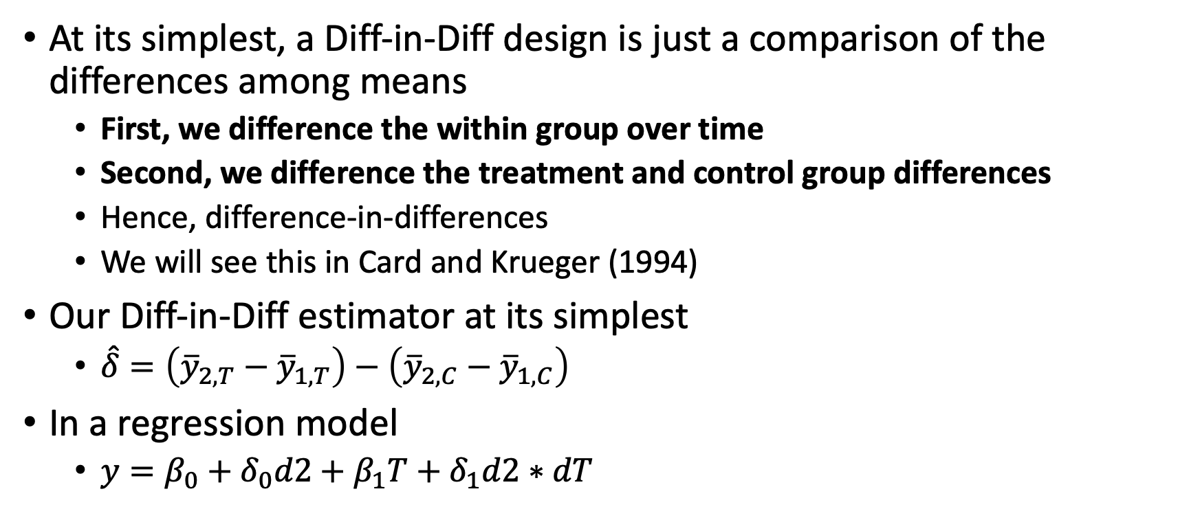
Diff-in-Diff with Pooled Cross Sections
At its simplest, a Diff-in-Diff design is just a comparison of the differences among means
First, we difference the within group over time
Second, we difference the treatment and control group differences
Hence, difference-in-differences
We will see this in Card and Krueger (1994)
Our Diff-in-Diff estimator at its simplest
$\hat{δ}=\left({\overline{y}}_{2,T}−{\overline{y}}_{1,T}\right)−\left({\overline{y}}_{2,C}−{\overline{y}}_{1,C}\right)$
In a regression model
$y=β_{0}+δ_{0}d2+β_{1}T+δ_{1}d2∗dT$

Slide 32
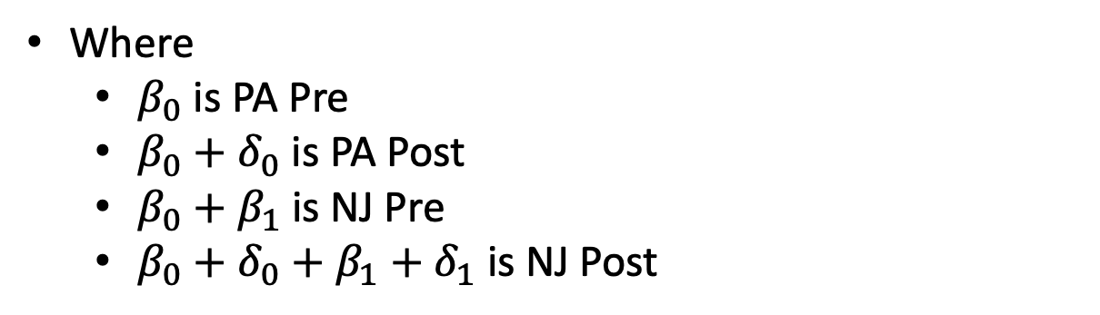
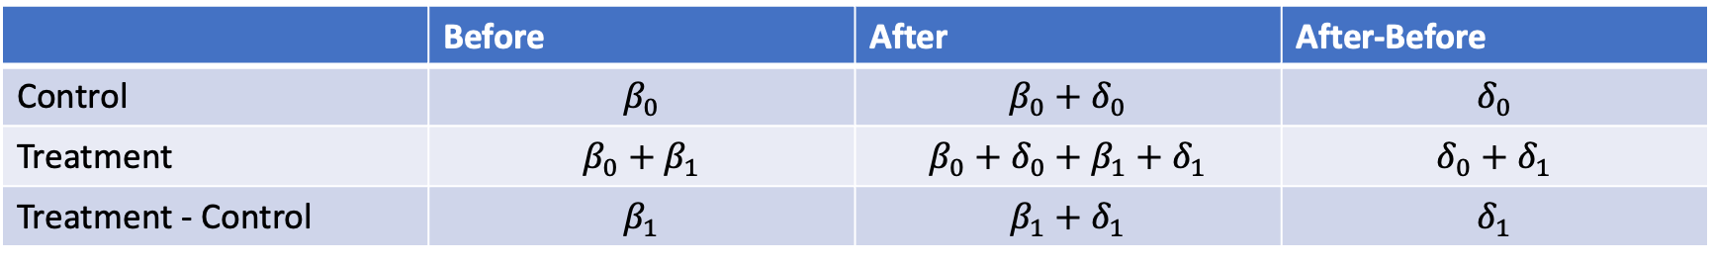
Diff-in-Diff with Pooled Cross Sections
 | Before | After | After-Before
Control | $$β_{0}$$ | $$β_{0}+δ_{0}$$ | $$δ_{0}$$
Treatment | $$β_{0}+β_{1}$$ | $$β_{0}+δ_{0}+β_{1}+δ_{1}$$ | $$δ_{0}+δ_{1}$$
Treatment - Control | $$β_{1}$$ | $$β_{1}+δ_{1}$$ | $$δ_{1}$$
Where
$β_{0}$ is PA Pre
$β_{0}+δ_{0}$ is PA Post
$β_{0}+β_{1}$ is NJ Pre
$β_{0}+δ_{0}+β_{1}+δ_{1}$ is NJ Post

Slide 33
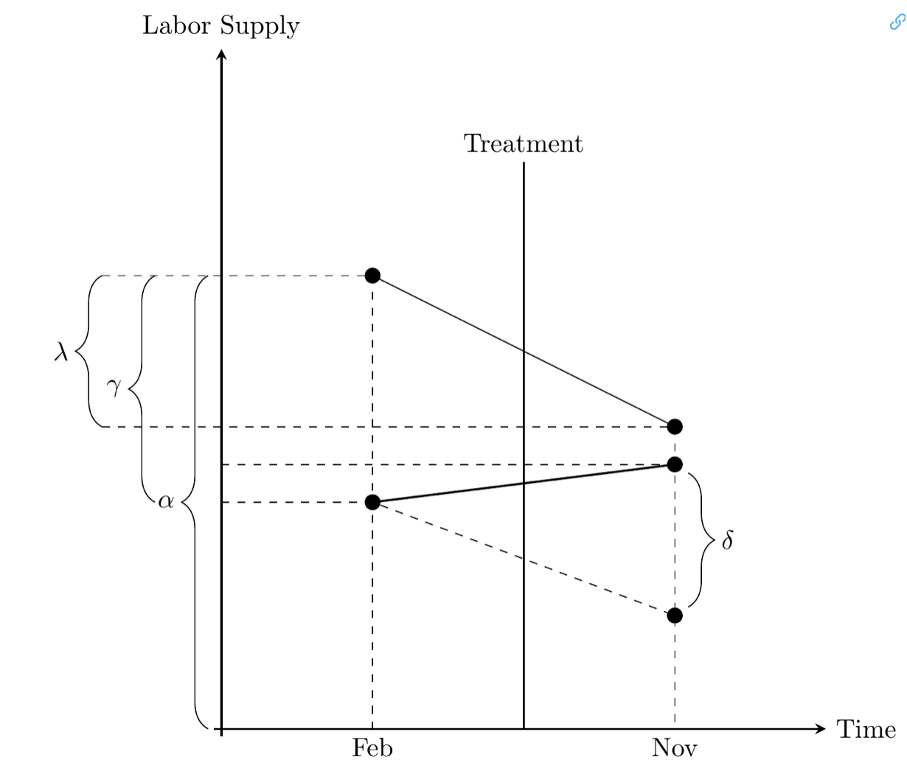
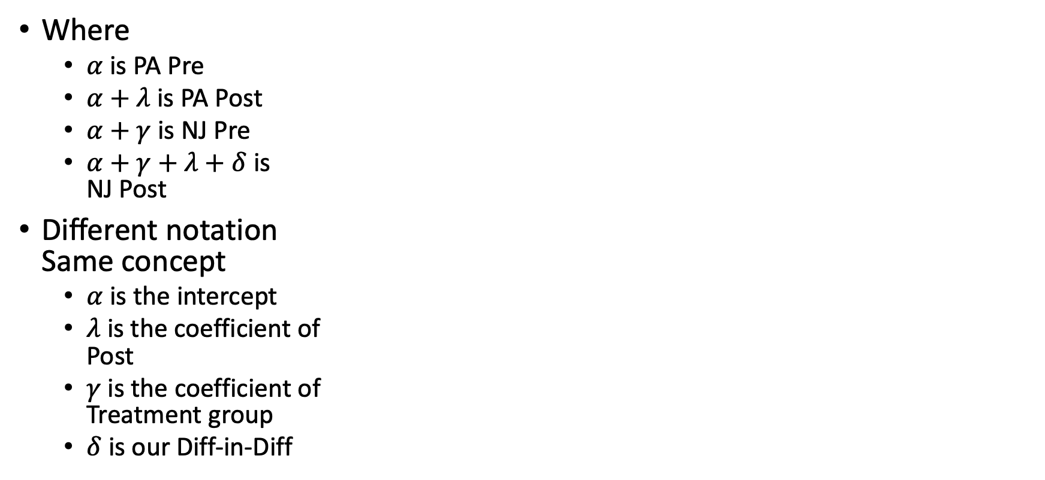
Diff-in-Diff
Where
$α$ is PA Pre
$α+λ$ is PA Post
$α+γ$ is NJ Pre
$α+γ+λ+δ$ is NJ Post
Different notation Same concept
$α$ is the intercept
$λ$ is the coefficient of Post
$γ$ is the coefficient of Treatment group
$δ$ is our Diff-in-Diff

Slide 34
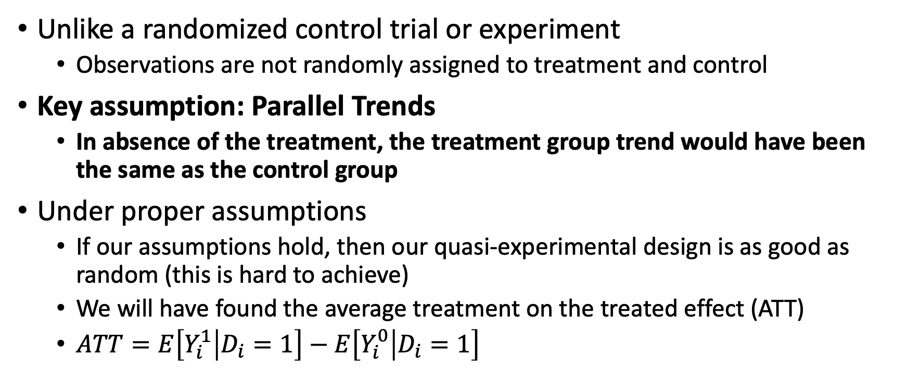
Diff-in-Diff Assumptions
Unlike a randomized control trial or experiment
Observations are not randomly assigned to treatment and control
Key assumption: Parallel Trends
In absence of the treatment, the treatment group trend would have been the same as the control group
Under proper assumptions
If our assumptions hold, then our quasi-experimental design is as good as random (this is hard to achieve)
We will have found the average treatment on the treated effect (ATT)
$ATT=E\left[Y_{i}^{1} | D_{i}=1\right]−E\left[Y_{i}^{0} | D_{i}=1\right]$

Slide 35
Diff-in-Diff Assumptions
Diff-in-Diff takes a step beyond FE and FD estimators
We only control for time-invariant effects with FE and FD
If Diff-in-Diff we can control for time-invariant and time-varying unobserved confounders
Some of the most popular forms of Diff-in-Diff include an event studies and two-way fixed effects (TWFE)
The key assumption is the parallel trends assumption
There are indirect tests of the parallel trends assumption,
Unlike the strict exogeneity assumption
There are placebo tests, pre-trends tests to test the parallel trends assumption

Slide 36
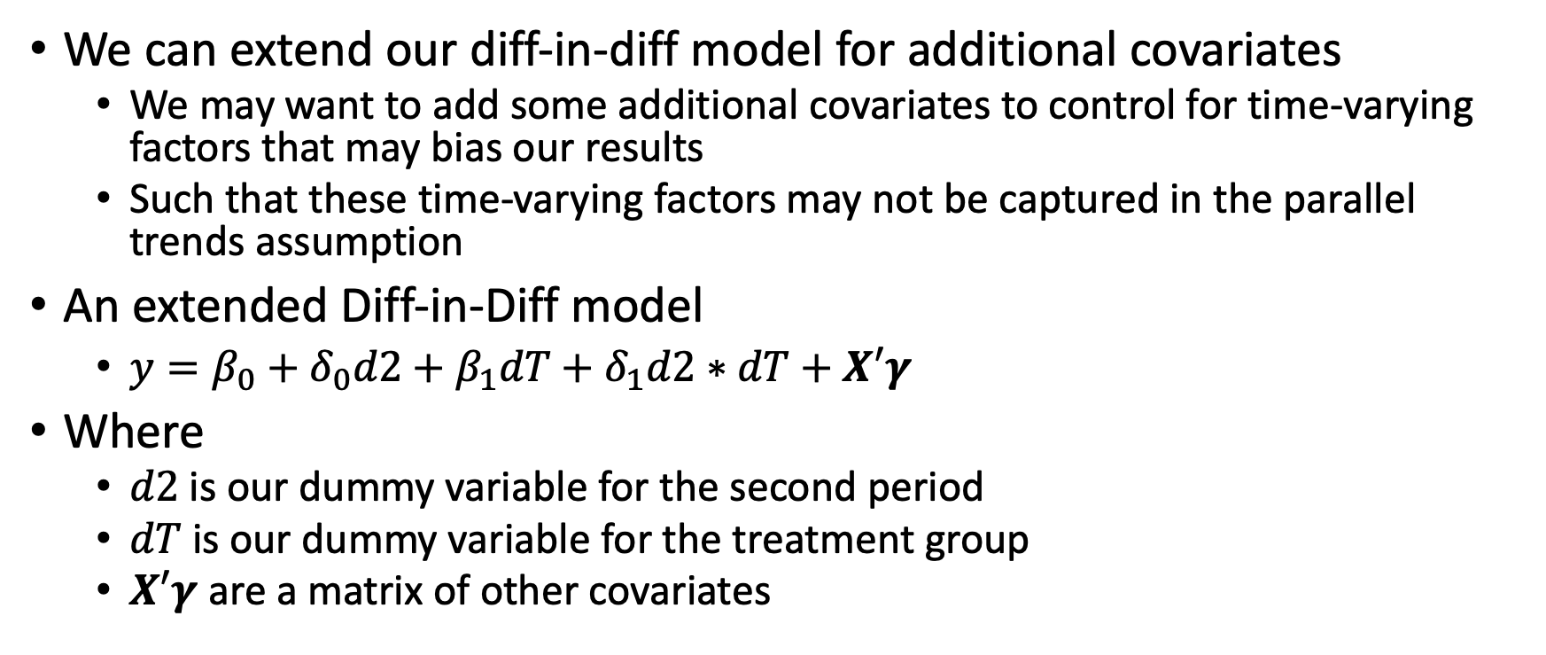
Diff-in-Diff with Pooled Cross Sections
We can extend our diff-in-diff model for additional covariates
We may want to add some additional covariates to control for time-varying factors that may bias our results
Such that these time-varying factors may not be captured in the parallel trends assumption
An extended Diff-in-Diff model
$y=β_{0}+δ_{0}d2+β_{1}dT+δ_{1}d2∗dT+X′γ$
Where
$d2$ is our dummy variable for the second period
$dT$ is our dummy variable for the treatment group
$X′γ$ are a matrix of other covariates

Slide 37
Policy Analysis with Two-Period Panel Data

Slide 38
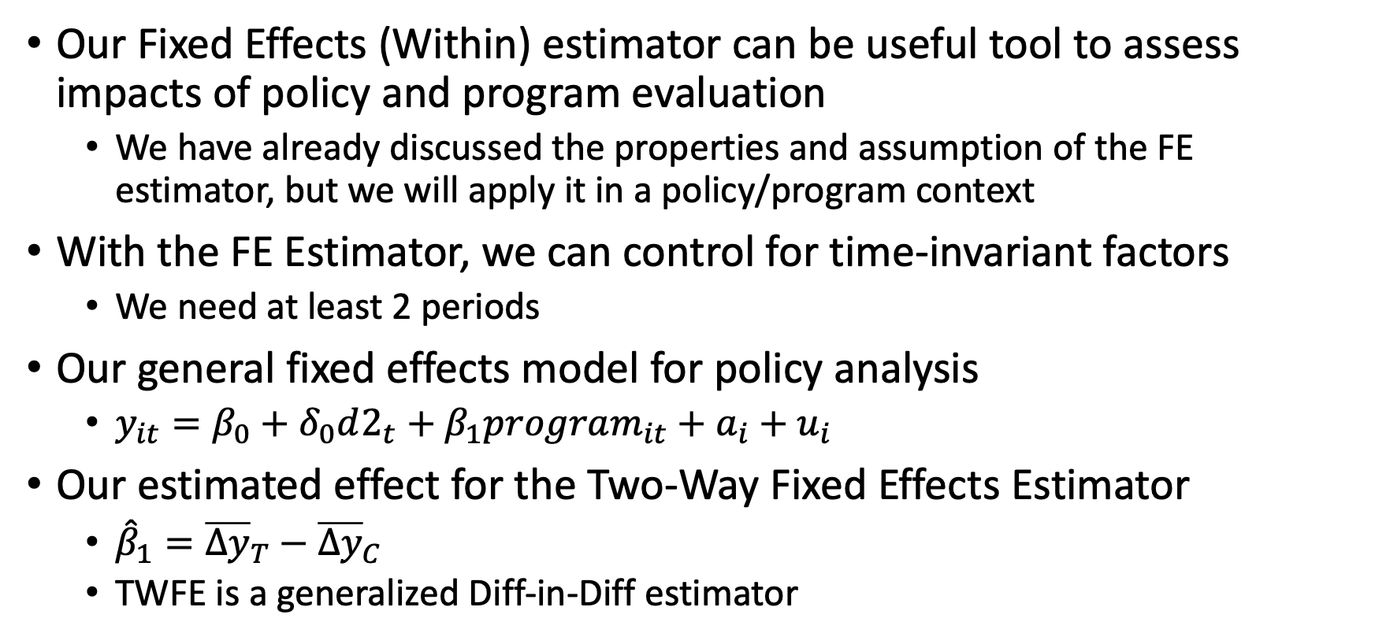
Two-Way Fixed Effects for Policy Analysis
Our Fixed Effects (Within) estimator can be useful tool to assess impacts of policy and program evaluation
We have already discussed the properties and assumption of the FE estimator, but we will apply it in a policy/program context
With the FE Estimator, we can control for time-invariant factors
We need at least 2 periods
Our general fixed effects model for policy analysis
$y_{it}=β_{0}+δ_{0}d2_{t}+β_{1}program_{it}+a_{i}+u_{i}$
Our estimated effect for the Two-Way Fixed Effects Estimator
${\hat{β}}_{1}={\overline{Δy}}_{T}−{\overline{Δy}}_{C}$
TWFE is a generalized Diff-in-Diff estimator

Slide 39
Fixed Effects (Within) for Policy Analysis
We will cover two examples in Stata
Effect of grants on preventing scrap waste
Effect of open container laws on traffic deaths
Self-selection
As we go through these exercises, we need to consider and be cautious of self-selection
There is still a concern of self-selection into treatment that FE cannot control
Economic agents will self-select into various actions that will maximize their well-being (including firms maximizing economic profits)
Testing strict exogeneity
We cannot directly test the strict exogeneity assumption
We need to appeal to theory and other literature

Slide 40
Stata examples and work

Slide 41
Review

Slide 42
Endogeneity
When is OLS BLUE?
When assumption Gauss-Markov 1-4 are satisfied is unbiased and consistent, but it might not be efficient
When assumption 1-6 are satisfied, OLS estimators are BLUE
Efficiency is what adds the best in BLUE
What happens to our estimators when we have endogeneity?
Our estimators are no longer consistent or unbiased
What happens when we have multicollinearity or heteroskedasticity
Our standard errors become biased, even though OLS can be LUE
What is the direction of the bias when we have on unobserved confounder?

Slide 43
Endogeneity
What causes endogeneity?
Omitted variable bias
Misspecification
Measurement Error (classic errors-in-variables)
Missing data on independent variables
Simultaneity Bias
What causes standard errors to be biased?
Multicollinearity
Heteroskedasticity

Slide 44
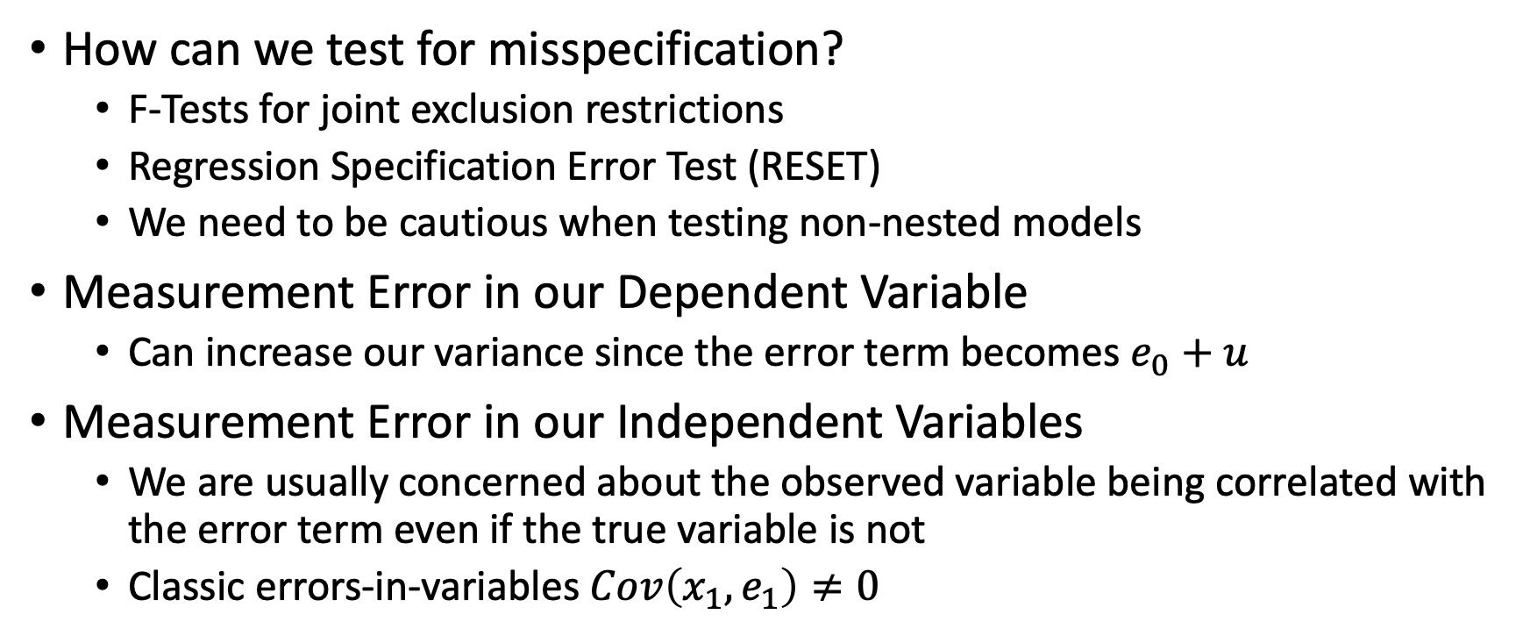
Endogeneity
How can we test for misspecification?
F-Tests for joint exclusion restrictions
Regression Specification Error Test (RESET)
We need to be cautious when testing non-nested models
Measurement Error in our Dependent Variable
Can increase our variance since the error term becomes $e_{0}+u$
Measurement Error in our Independent Variables
We are usually concerned about the observed variable being correlated with the error term even if the true variable is not
Classic errors-in-variables $Cov\left(x_{1},e_{1}\right)≠0$

Slide 45
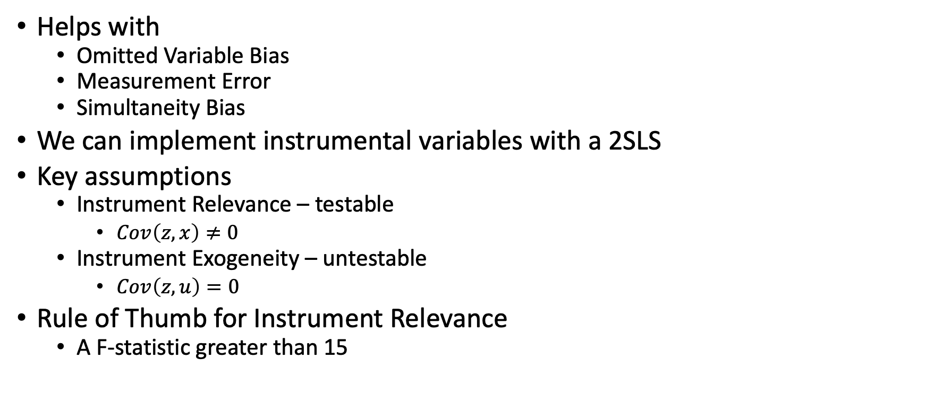
Instrumental Variables
Helps with
Omitted Variable Bias
Measurement Error
Simultaneity Bias
We can implement instrumental variables with a 2SLS
Key assumptions
Instrument Relevance – testable
$Cov\left(z,x\right)≠0$
Instrument Exogeneity – untestable
$Cov\left(z,u\right)=0$
Rule of Thumb for Instrument Relevance
A F-statistic greater than 15

Slide 46
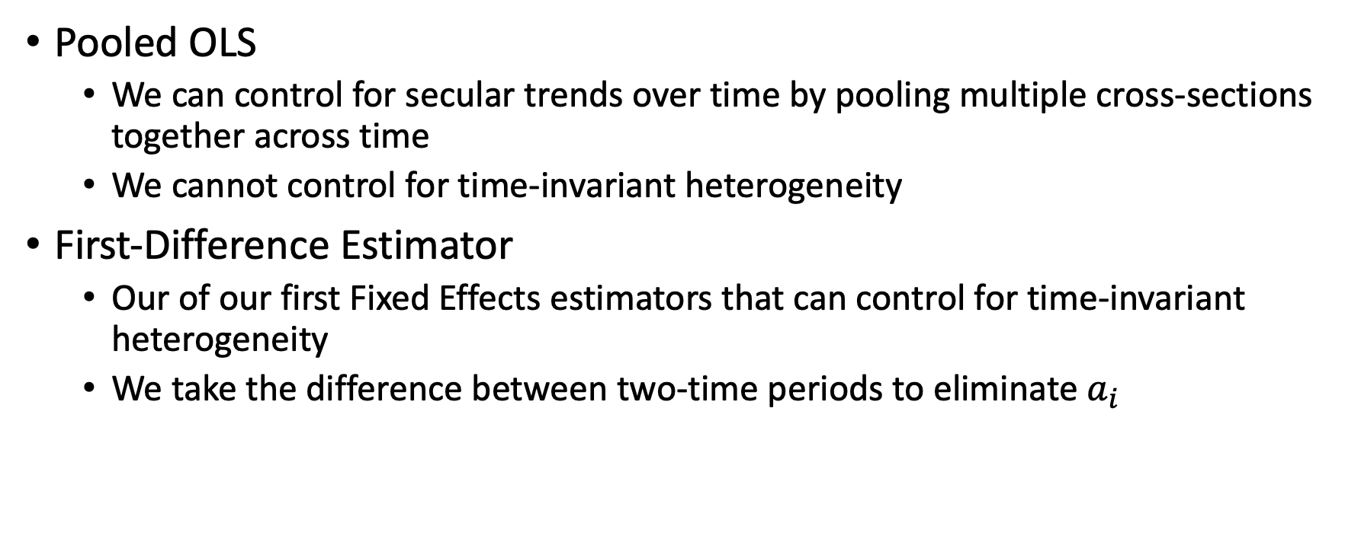
Panel Data
Pooled OLS
We can control for secular trends over time by pooling multiple cross-sections together across time
We cannot control for time-invariant heterogeneity
First-Difference Estimator
Our of our first Fixed Effects estimators that can control for time-invariant heterogeneity
We take the difference between two-time periods to eliminate $a_{i}$

Slide 47
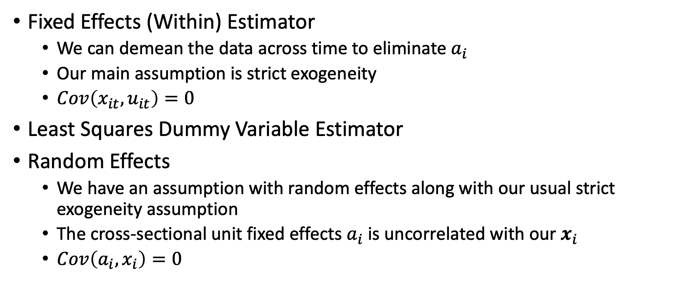
Panel Data
Fixed Effects (Within) Estimator
We can demean the data across time to eliminate $a_{i}$
Our main assumption is strict exogeneity
$Cov\left(x_{it},u_{it}\right)=0$
Least Squares Dummy Variable Estimator
Random Effects
We have an assumption with random effects along with our usual strict exogeneity assumption
The cross-sectional unit fixed effects $a_{i}$ is uncorrelated with our $x_{i}$
$Cov\left(a_{i},x_{i}\right)=0$

