Slide 1

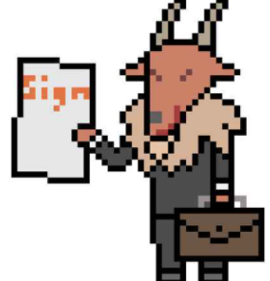
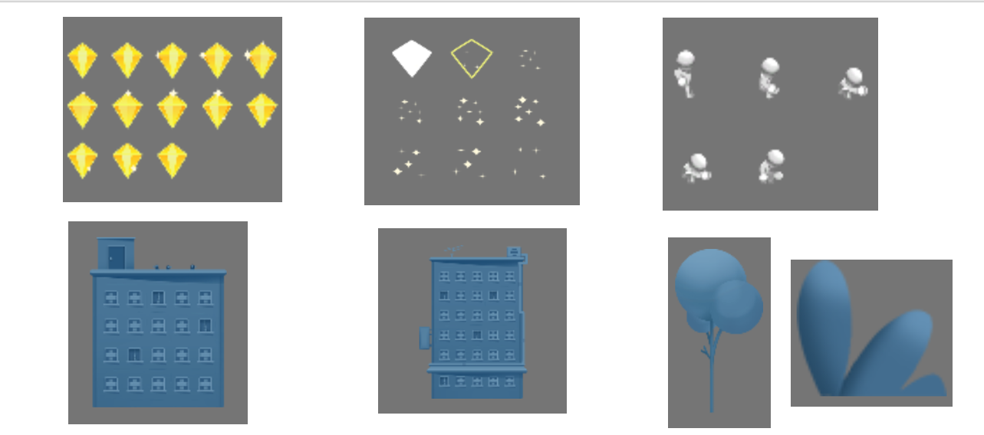
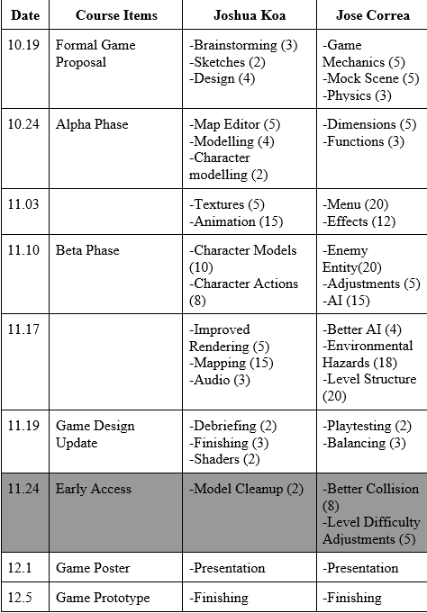
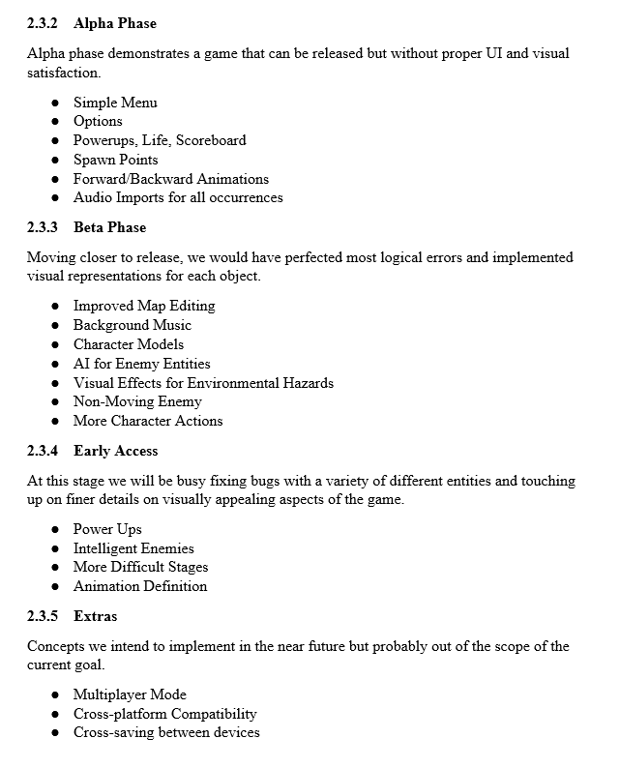
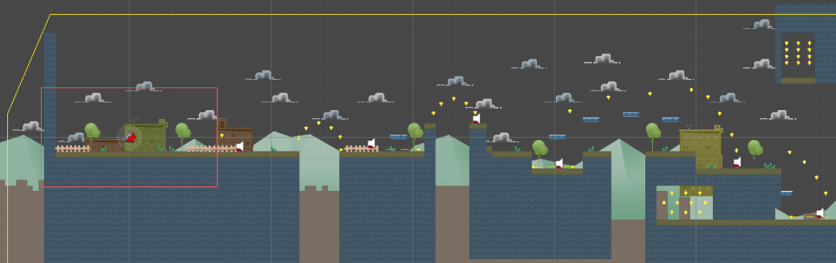
Evil Tales Joshua Koa & Jose Correa CIS 3830 - Game Project
Overview
Evil Tales is based on the 1980s classic game series called Super Mario. The primary objective of the game is to maneuver the Pustin Aowers through a series of increasingly difficult environments to survive the evil forces of Dr. Evil. The game demonstrates the basic content for a side-scrolling platformer; the player is able to move from left to right of the screen in order to reach the checkpoint at the end of each level. The player will have utmost control in how they wish to accomplish each level and will be given no assistance in determining choices to achieve their desired goals. The overall purpose of our game is to provide entertainment value and engage player creativity. Platformers relatively have basic game mechanics such as running, jumping, and double jumping to name a few. Yet, these mechanics throughout the span of the gameplay can grow repetitive or uninteresting for the player. Our goal is variability, with stages that can be approached through varying degrees of options. When we see platformers with one clear solution to a given level, we feel ourselves immediately losing interest. Monotony sets in when we realize that we are just doing the same thing we did a few levels earlier. This game will tackle that dilemma, we offer total replay-ability and a completely new experience each run for the player.
Game Features
The primary mechanics for Evil Tales will be standard 2 dimensional, possibly 2.5D, platforming with an active momentum system. ●players will have a forward, upward, and backwards attack for primary offense ●players will have a bottom block for use to bypass enemies ●standard health bar with some varying amounts of damage received from enemies ●objects can be found that increase or decrease momentum adding challenge and depth ●the player must collect gems to increase score but primary goal is to reach the end of the level User Interface: The player UI will consist of a HUD that contains the health bar, percent of level completed, score in points, gems collected, and hidden gems collected. The pause menu can be pulled but using the escape key with options to restart, resume, load checkpoint.
Updates
While we started initial development in MelonJS because we already did one platformer we decided to switch to the Unity engine. While Melon has a lot of potential Unity has the most support for almost all aspects of development. In terms of actually using unity we still have to adapt to the new environment but we already have a good part of the ground work to start. Most of the team is not very artistically inclined so using premade assists will quicken the development process. Our main goal for using premade assist is to make sure everything works well together in the unity environment. This includes collision points and overall art style. While we will try and make as much original content as possible it won't always be possible. We have already been narrowing down environmental programming aspects like gravity and velocity but will likely be tweaked until the working prototype is completed.
Objects
3.4.1 Pustin Aowers Our titular main character and who the player controls Values ● x and y coordinates ● x and y velocity ● amount of health left ● boolean for direction ● boolean for if alive Functions ● left(boolean):move left if true ● right(boolean):move right if true ● spawn(): spawn in the player character ● die():kill/ remove the player from the screen 3.4.2 Mini Mes Common enemy Values ● boolean for direction ● boolean for if alive
Developmental Schedule

Slide 2
Overview
Inspired by the popular classic game series, Super Mario
Primary Objective is to maneuver Pustin Aowers through a series of increasingly difficult levels to survive the evil forces of Dr. Evil
A 2D side-scrolling platformer; the player is able to move from left to right of the screen in order to reach the checkpoint at the end of each level.

Slide 3
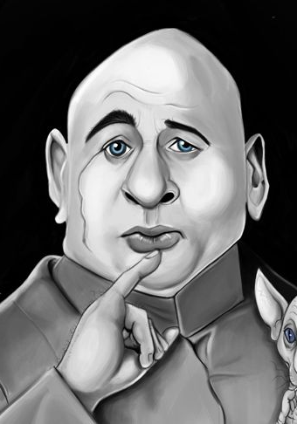

Story
The menacing psychopath Dr. Evil wants to take over the world and he needs gems to finance his company Evil Corp
With your help, prevent Dr. Evil from acquiring the necessary assets to finance Evil Corp and put a stop to his evil plans.
Through your journey aid those in need and fend off clout chasing lunatics

Slide 4

Planning
Brainstorm
-Playable Character
-Standard Map
1st Phase
-Simple Menu, Options, Powerups, Life, Scoreboard
-Spawn Points, Animations, Audio Imports
2nd Phase
-Improved Map Edits, Hazards,
-Character Models, Enemy Entities
Early Prototype
-Level Stages
-Smarter AI

Slide 5
Gameplay features
Players will have a forward, upward, and backwards attack for primary offense
Players will have a bottom block for use to bypass enemies
Standard health bar with some varying amounts of damage received from enemies
Objects can be found that increase or decrease momentum adding challenge and depth
The player must collect gems to increase score but primary goal is to reach the end of the level

Slide 6
Advanced Features
Enemies can either be fought for more score or bypassed to decrease time
Music will be played in the background
Standard sounds to represent interaction with the world(walking noise, grunting, etc)
Walking animations, attack animations, jumping animation
Check point system. activates at specific points
Once the player runs out of health they can either restart the whole level or from check point
Power ups can also be purchased with the bonus gems found in each level for a permanent stat boost

Slide 7
Objects
Pustin Aowers
Our titular main character and who the player controls
Values
x and y coordinates
x and y velocity
amount of health left
boolean for direction
boolean for if alive
Functions
left(boolean):move left if true
right(boolean):move right if true
up(boolean):move up if true
spawn(): spawn in the player character
die():kill/ remove the player from the screen
Mini Mes
Common enemy
Values
boolean for direction
boolean for if alive
X and Y coordinates and velocity
Functions
spawn(): spawn in the enemy
die():kill/ remove the enemy from the screen

Slide 8
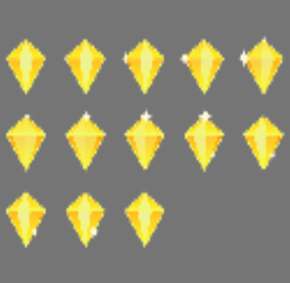

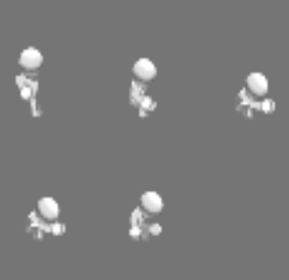




Assets

Slide 9
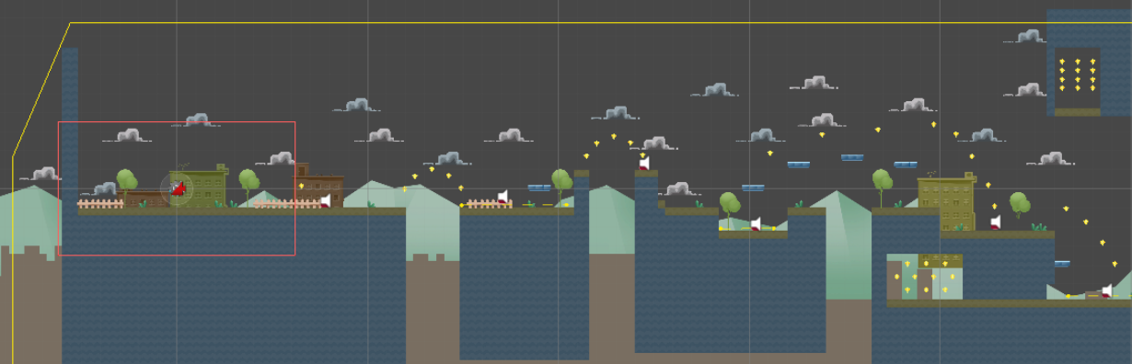
Sneak Peek

Slide 10


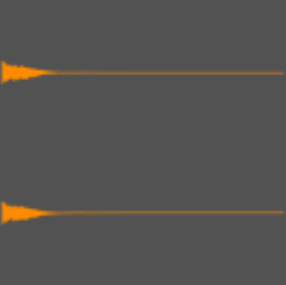
Audio
Background Music.wav
Death.wav
Collectable.wav

