Slide 1
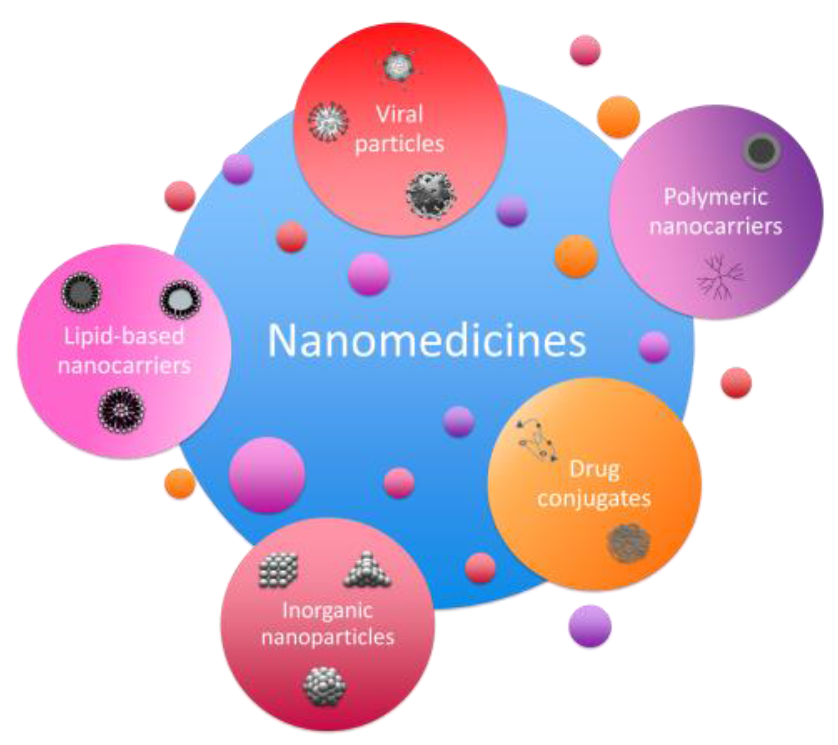
BIOL 1414 Intro to Mol/Cell Biology
Lecture #7
16/17 September 2026
Last Lecture:
Cell Structure and Function
Today:
Plasma Membrane
  Introduction
  Fluid mosaic models
Passive Transport
  Diffusion
  Osmosis
Active Transport
  Electrochemical gradients
Bulk Transport
Nanomedicine Technology
Notes:
Nanomedicine is the medical application of nanotechnology¹.
Nanotechnology involves the use of nanomaterials, or nanoparticles, which are very small particles that can have different properties than larger particles²¹.
Nanoparticles can be used as a form of transport for drugs, or as nanoelectronic biosensors, to deliver medicine to specific targets in the body²¹.
Nanomedicine has the potential to improve diagnosis, treatment, and prevention of diseases¹.
VIDEO

Slide 2

Introduction
Has any one been to grand central station?
  Seems very chaotic
  Functions with high level of organization
    People move from one place to another
    They cross or are contained by certain boundaries
  These activities aid in the larger function of the station

Slide 3
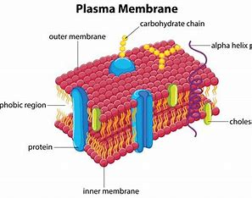
Introduction
Plasma membrane
  Also called the cell membrane
  Has numerous functions
    Most important is to define cells border and keep cell functional
  Selectively permeable
    Some materials can come and go from the cell freely
    Other materials require specialized equipment
      Sometime even large energy investments

Slide 4
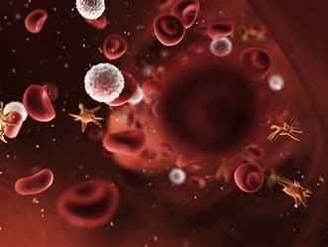
Components and Structure
Plasma membrane
  Defines cells outer border
  Determines nature of cells interactions with environment
  Allows for:
    Exclusion of some substances
    Taking in of other substances
    Excretes still other substances
  Very flexible in nature
    Red and white blood cell must change shape as they pass though small capillaries
  Carries markers
    Allow cells to recognize one another
      Important in tissue formation
      Important in immune response

Slide 5
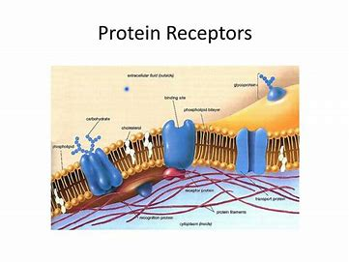
Components and Structure
Plasma membrane
  Act as protein receptors
    Transmit signals throughout the body
      Extracellular and intercellular functions
    Can be highjacked sometimes
      Human immunodeficiency virus
        Uses receptors to gain entry into cells
        Causes signal transduction process to malfunction

Slide 6
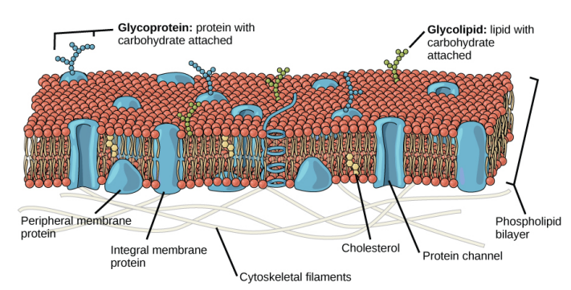
Fluid Mosaic Model
Principal components are:
  Lipids
    Phospholipids and cholesterol
  Proteins
  Carbohydrates
    Attached to some of the lipids and proteins
Components give membrane a fluid character
Phospholipids
  Create very effective barrier
    Separating fluids from inside cell from those outside the cell
    Hydrophilic and hydrophobic portions
      Hydrophilic – water loving – heads of molecule
      Hydrophobic – water fearing – tails of molecule
Notes:
The protein, lipid, and carbohydrate proportions in the plasma membrane vary with cell type, but for a typical human cell, protein accounts for about 50 percent of the composition by mass, lipids (of all types) account for about 40 percent, and carbohydrates comprise the remaining 10 percent

Slide 7
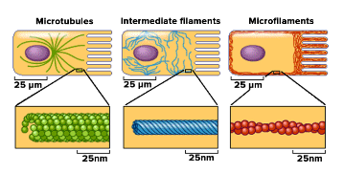
Fluid Mosaic Model
Proteins
  Integral proteins (integrins) – integrate completely into the membrane structure
  Peripheral proteins – occur on membranes inter and exterior surface
    Attach to integral proteins or phospholipids
  Both may serve as:
    Enzymes
    Structural attachments for the cytoskeleton’s fibers
    Part of cells recognition site

Slide 8
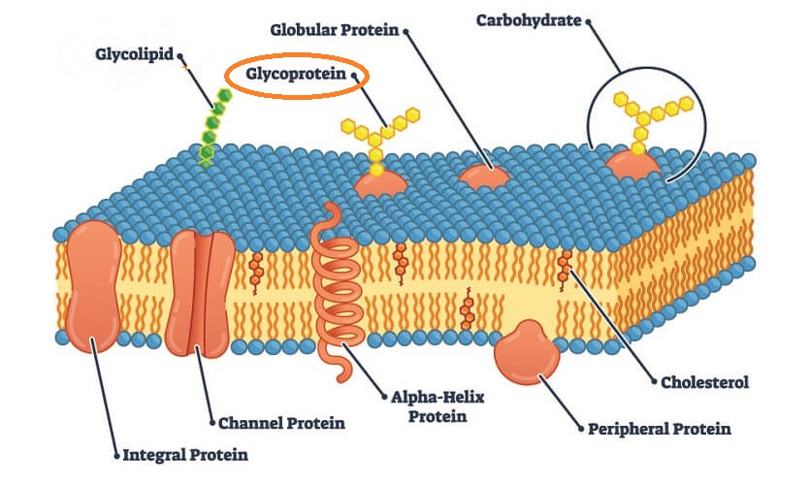
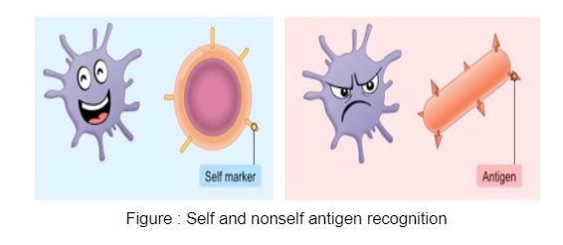
Fluid Mosaic Model
Carbohydrates
  Always on cells exterior surface
  Two types
    Glycoproteins – carbohydrate bound to protein
    Glycolipids – carbohydrates bound to lipids
  Aid in cell to cell recognition
    Important in immune response
      Self cells – normal functioning body cells
      Non-self cell – foreign to the body
  Glycocalyx – collective term for all carbohydrates on cells exterior surface
    Glycoproteins and glycolipids
    Term means sugar coating
    Highly hydrophilic – attracts large amounts of water
      Aids cell in obtaining nutrients dissolved in water

Slide 9
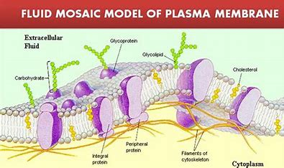
Fluid Mosaic Model
Membrane fluidity
  Membrane is fluid and can change shape
  Not like a balloon though
    Cannot expand and contract
    Is fairly rigid and can burst
      Penetrated by an object
      Fills with too much water
    Very fine needle will not cause the membrane to burst
      Membrane will flow and seal the hole once needle is removed
Notes:
https://www.youtube.com/watch?v=ipa1vmQ7H_4

Slide 10
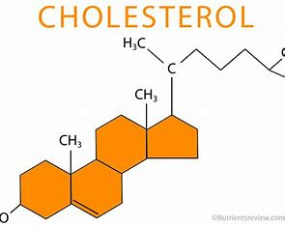
Fluid Mosaic Model
Membrane fluidity
  Two other factors contribute to fluidity
    Phospholipid structure
      Saturated – no double bonds and lay straight
        Cold temps compress fatty acids and make a more rigid membrane
      Unsaturated – have at least one double bond which creates a bend
        Bend maintains space between phospholipids
        Helps maintain fluidity as temperature drops
    Animals have cholesterol in cell membrane
      Aids in maintaining fluidity
      Dampens the impact of temperature change
        Prevents rigidity when cold
        Prevent too much fluidity when temperature warms
      Aid in maintain function of membrane during temperature changes
Notes:
Fish living in environment that has changing temperatures – alter amount of saturated vs. unsaturated fats

Slide 11
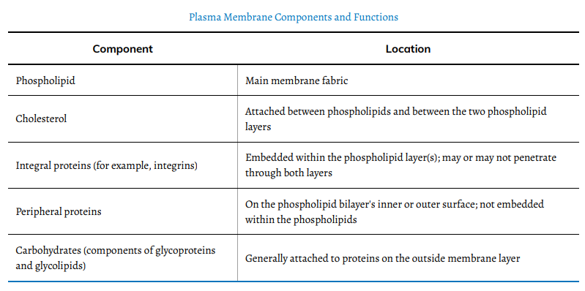
Fluid Mosaic Model

Slide 12
Passive Transport
Membranes must be selectively permeable
  Passive transport – naturally occurring phenomenon allowing for movement of substances into and out of cell without cell using any energy
    Substances move from high concentration to low concentration
      Concentration gradient – physical space that has a range of substance concentration within it
  Mechanisms aiding passive transport
    Glycocalyx – helps cell bind to substances in extracellular fluid
    Amphiphilic nature – helps move some substances while hindering the movement of others
      Non-polar and lipid soluble materials easily move through
        Fat soluble vitamins A, D, E, and K
        Fat soluble drugs and hormones
      Oxygen and carbon dioxide have no charge and pass by diffusion
      Polar molecules can bond to exterior of cell but need help moving to interior
        Ions of sodium, potassium, and calcium
        Simple sugars and amino acids
Notes:
Amphiphilic – polar and non-polar portions

Slide 13
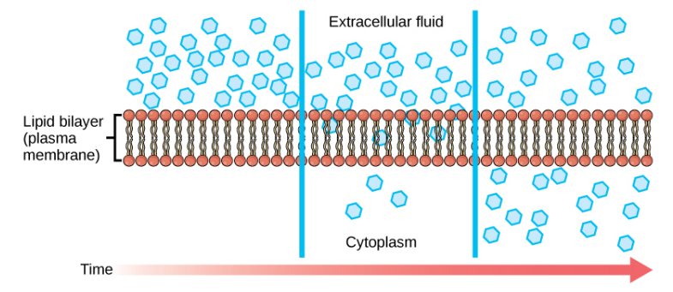
Passive Transport
Diffusion – passive transport where a single some moves from high to low concertation until equal across the entire space
  Requires no energy (passive)
  Material within cytosol move by diffusion
  Some material move through cell membrane by diffusion
  Concentration gradient are a form of potential energy
    Energy dissipates as gradient is eliminated
  Multiple substances may be diffusing at same time
    Each will diffuse at its own specific rate
Notes:
Air freshener in a room example

Slide 14
Passive Transport

Slide 15
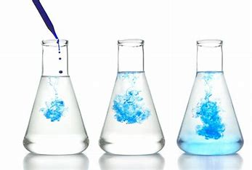
Passive Transport
Factors affecting diffusion:
  Extent of the concentration gradient
    The greater the concentration the faster the diffusion
  Mass of the molecule
    Heavier molecules move more slowly
      Slower diffusion rate
    Lighter molecules move quicker
      Faster diffusion rate
  Temperature
    Higher temps mean more diffusion
      Molecules has more energy
    Lower temps mean less diffusion
      Molecules have less energy

Slide 16

Passive Transport
Factors affecting diffusion:
  Solvent Density
    As solvent density increases diffusion decreases
      Molecules slow due to difficulty moving
    As solvent density decreases diffusion increases
      Molecules can move easier
    Example – Dehydration
      As a person loses water so does cells cytoplasm
        Function deteriorates
      Can lead to unconsciousness and possibly coma
        Due to decreased diffusion rates
  Solubility
    Non-polar or lipid-soluble materials diffuse faster
    Polar materials diffuse slower

Slide 17
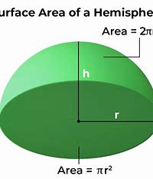
Passive Transport
Factors affecting diffusion:
  Surface area and plasma membrane thickness
    Increased surface area = faster diffusion rates
    Thicker membranes = slower diffusion rates
  Distance travelled
    Greater distance results in slower diffusion
      This impacts the upper limit of a cells size
Filtration – variation in the diffusion process
  Each substance moves according to its concentration gradient
  Sometimes pressure can enhance diffusion rate
    Causes substances filter more rapidly
    Example – kidneys
      Blood pressure forces water and solutes out of blood into renal tubes
    Symptom of high blood pressure is proteins in the urine Why?
Notes:
Therefore, cells must either be small in size, as in the case of many prokaryotes, or be flattened, as with many single-celled eukaryotes.

Slide 18
Passive Transport
Facilitated transport – materials diffuse across the plasma membrane with help of membrane proteins
  Concentration gradient exists – would allow materials to diffuse without cell investing energy but they are polar
  Proteins shield these materials from hydrophobic forces
    Transport proteins – proteins involved in facilitated transport
      Channels – have hydrophilic domains exposed to inter and extracellular fluids and through their core
        Specific for the transported substance
        Can be open all the time or gated
      Carrier proteins – bind to substance that causes change in proteins shape that moves substance into or out of cell
        Usually specific for a single substance
    Channel proteins transport much quicker than carrier proteins

Slide 19
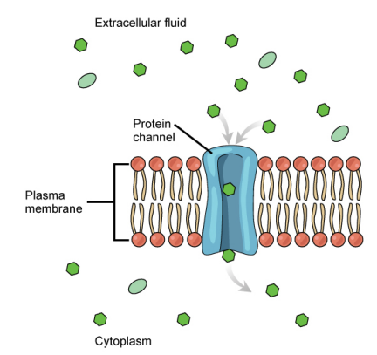
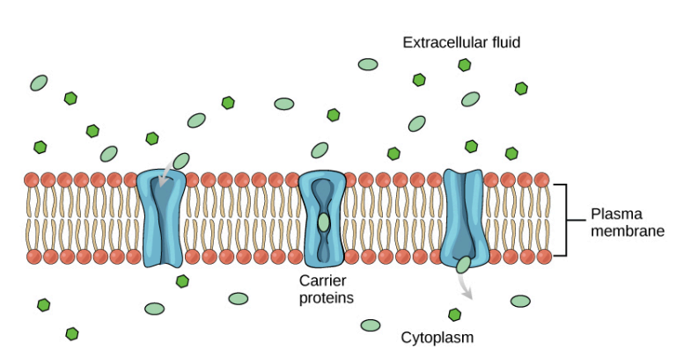
Passive Transport
Notes:
Channel
Carrier

Slide 20
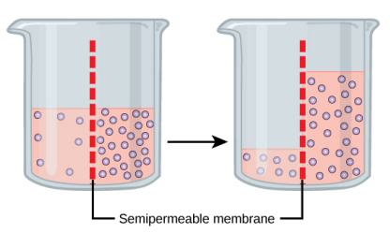
Passive Transport
Osmosis – movement of water through a semipermeable membrane
  Occurs in relation to waters concentration gradient across a membrane
    Above is inversely related to solutes concentration
  Transports only water across the membrane
    Membrane limits solutes movement in the water
    Diffusion transports materials
  Water moves from low solute to high solute concentration
  What makes water move?
    Different solute concentrations
      Solute – dissolved substance
Notes:
An obvious question is what makes water move at all? Imagine a beaker with a semipermeable membrane separating the two sides or halves (Figure 5.11). On both sides of the membrane the water level is the same, but there are different dissolved substance concentrations, or solute, that cannot cross the membrane (otherwise the solute crossing the membrane would balance concentrations on each side). If the solution's volume on both sides of the membrane is the same, but the solute's concentrations are different, then there are different amounts of water, the solvent, on either side of the membrane.

Slide 21

Passive Transport
Notes:
To illustrate this, imagine two full water glasses. One has a single teaspoon of sugar in it; whereas, the second one contains onequarter cup of sugar. If the total volume of the solutions in both cups is the same, which cup contains more water? Because the large sugar amount in the second cup takes up much more space than the teaspoon of sugar in the first cup, the first cup has more water in it
Returning to the beaker example, recall that it has a solute mixture on either side of the membrane. A principle of diffusion is that the molecules move around and will spread evenly throughout the medium if they can. However, only the material capable of getting through the membrane will diffuse through it. In this example, the solute cannot diffuse through the membrane, but the water can. Water has a concentration gradient in this system. Thus, water will diffuse down its concentration gradient, crossing the membrane to the side where it is less concentrated. This diffusion of water through the membrane—osmosis—will continue until the water's concentration gradient goes to zero or until the water's hydrostatic pressure balances the osmotic pressure. Osmosis proceeds constantly in living systems

Slide 22
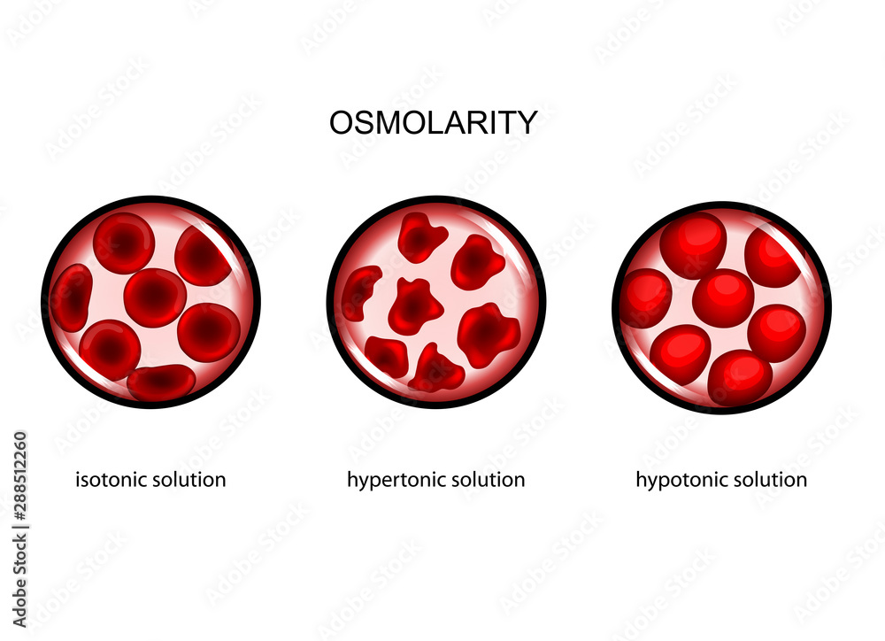
Passive Transport
Tonicity – how an extracellular solution can alter a cells volume
  Directly related to solutions osmolarity
    Osmolarity – a solutions total solute concentration
      High osmolarity = fewer water particles than solute particles
        Low amount of water
      Low osmolarity = greater number of water molecules than solute particles
        High amount of water
      Movement is from low osmolarity to high osmolarity

Slide 23
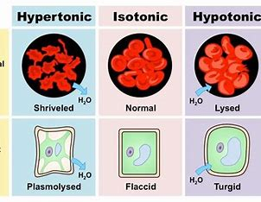
Passive Transport
Tonicity – how an extracellular solution can alter a cells volume
  Three terms used to relate cells osmolarity to extracellular fluids osmolarity
    Hypotonic – extracellular fluid has lower osmolarity than the cells cytoplasm
      Water enters the cell
    Hypertonic – extracellular fluid has higher osmolarity than cells cytoplasm
      Water moves out of cell
    Isotonic – extracellular fluid has same osmolarity as cells cytoplasm
      No net movement of water
      Water still moves in and out

Slide 24
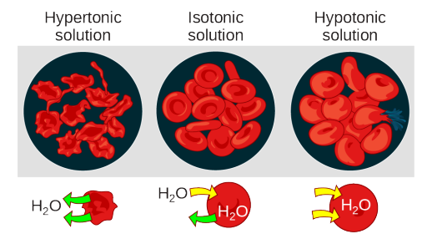
Passive Transport

Slide 25
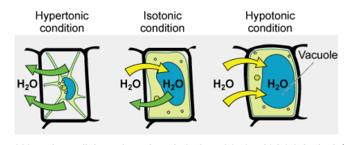
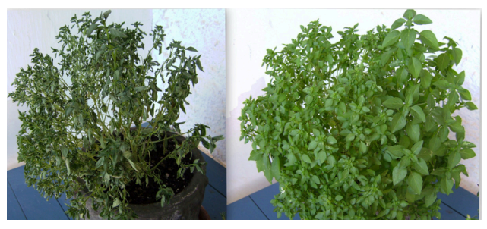
Passive Transport
Notes:
Various living things have ways of controlling the effects of osmosis—a mechanism we call osmoregulation. Some organisms, such as plants, fungi, bacteria, and some protists, have cell walls that surround the plasma membrane and prevent cell lysis in a hypotonic solution. The plasma membrane can only expand to the cell wall's limit, so the cell will not lyse. The cytoplasm in plants is always slightly hypertonic to the cellular environment, and water will always enter a cell if water is available. This water inflow produces turgor pressure, which stiffens the plant's cell walls (Figure 5.13). In nonwoody plants, turgor pressure supports the plant. Conversly, if you do not water the plant, the extracellular fluid will become hypertonic, causing water to leave the cell. In this condition, the cell does not shrink because the cell wall is not flexible. However, the cell membrane detaches from the wall and constricts the cytoplasm. We call this plasmolysis. Plants lose turgor pressure in this condition and wilt (Figure 5.14).

Slide 26
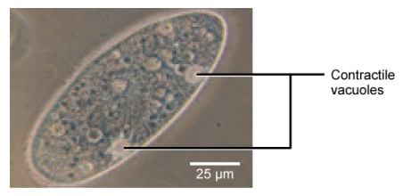
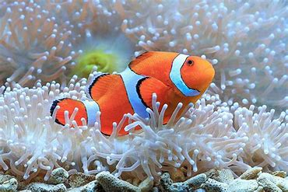
Passive Transport
Notes:
Tonicity is a concern for all living things. For example, paramecia and amoebas, which are protists that lack cell walls, have contractile vacuoles. This vesicle collects excess water from the cell and pumps it out, keeping the cell from lysing as it takes on water from its environment (Figure 5.15).
Many marine invertebrates have internal salt levels matched to their environments, making them isotonic with the water in which they live. Fish, however, must spend approximately five percent of their metabolic energy maintaining osmotic homeostasis. Freshwater fish live in an environment that is hypotonic to their cells. These fish actively take in salt through their gills and excrete diluted urine to rid themselves of excess water. Saltwater fish live in the reverse environment, which is hypertonic to their cells, and they secrete salt through their gills and excrete highly concentrated urine

Slide 27
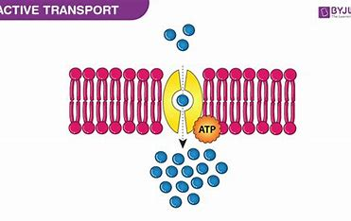
Active Transport
Active transport – mechanisms require cells energy to move across membrane
  If moving against the concentration gradient energy
  Some mechanisms move small items
  Other mechanisms move large molecules
Electrochemical gradient – a gradient defined by solute concentrations and electrical charges
  Cells have a difference of charge across the plasma membrane not just substances
    Ions move back and forth across membrane
    Cells interior has proteins that do not cross the membrane
      Mostly negatively charged
  Cells electronegatively charged compared to extracellular fluid

Slide 28
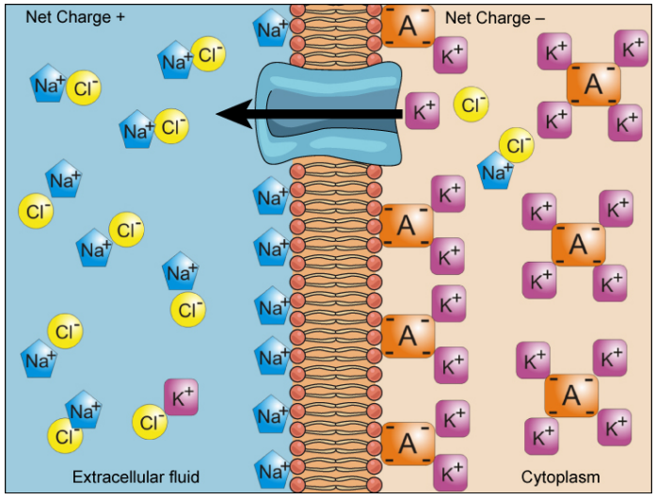
Active Transport
Electrochemical gradient – a gradient defined by solute concentrations and electrical charges
  Cells also have the following compared to extracellular fluid:
    Higher concentration of K⁺ (potassium)
    Lower concentration of Na⁺ (sodium)
  Creates unique dynamics at the membrane
    Na⁺ is driven into cell by concentration gradient and by electrical charge gradient
    K⁺ is driven in by electrical charge gradient but pushed out by the concentration gradient

Slide 29
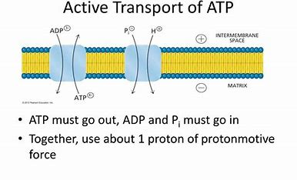
Active Transport
Pumps – active transport mechanisms
  Use ATP to move substances against electrical and/or concentration gradient
  Constantly working to maintain needed concentrations for cells function
  Function can be impacted by metabolic fluctuations or poisons
Two mechanism for small materials
  Primary active transport – uses ATP to move ions across membrane and creates a difference in charge
  Secondary active transport – does not use ATP but moves materials due to electrochemical gradient established by primary active transport
Notes:
Small substances constantly pass through plasma membranes. Active transport maintains concentrations of ions and other substances that living cells require in the face of these passive movements. A cell may spend much of its metabolic energy supply maintaining these processes. (A red blood cell uses most of its metabolic energy to maintain the imbalance between exterior and interior sodium and potassium levels that the cell requires.)
The primary active transport that functions with the active transport of sodium and potassium allows secondary active transport to occur. The second transport method is still active because it depends on using energy as does primary transport (Figure 5.18).

Slide 30
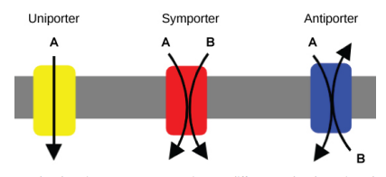
Active Transport
Pumps are formed from specific carrier proteins
  Transporters – different types of carrier proteins with different function
Three types of transporters:
  Uniporter – carries one specific ion or molecule
  Symporter – carries two different ions or molecules
    Both move in the same direction
  Antiporter – carries two different ions or molecules
    Each moves in a different direction
Notes:
All of these transporters can also transport small, uncharged organic molecules like glucose. These three types of carrier proteins are also in facilitated diffusion, but they do not require ATP to work in that 144 Chapter 5 • Structure and Function of Plasma Membranes Access for free at openstax.org. process.

Slide 31
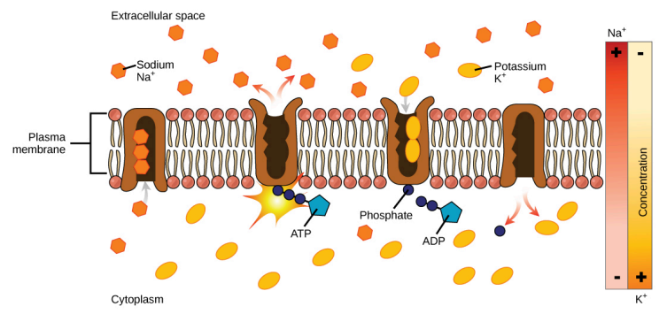
Active Transport
Primary active transport
  On of the most important pumps in animal cells is the sodium potassium pump
    Moves K⁺ into cell and Na⁺ out at same time
      Ratio = 3 Na⁺ for every 2 K⁺
  Creates slightly negative cell interior compared to exterior
    Important for maintaining secondary active transport
  Electrogenic pump – pump creating charge imbalance
    Creates the membrane potential needed for secondary active transport
Notes:
VIDEO

Slide 32
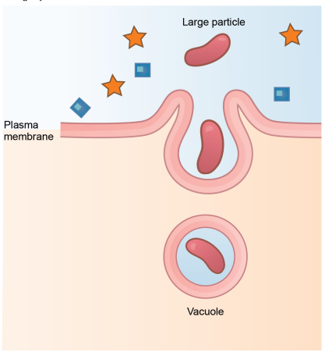
Bulk Transport
Bulk transport – movement of large molecules or particles into or out of cell
  Some cells are capable of engulfing whole unicellular organisms
  Process requires energy
    Even with energy large particles cannot pass through the membrane
  Endocytosis – type of active transport that moves large particles or even whole cells into a cell
    Many different types but all share common characteristics:
      Membrane invaginates
      Forms a pocket around target particle
      Pocket pinches off
      Particle ends up contained in newly formed vesicle

Slide 33
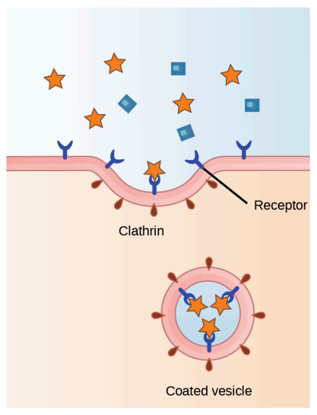
Bulk Transport
Endocytosis types
  Phagocytosis – process of cell eating
    Neutrophils – type of white blood cell
      Removes harmful microorganisms by surrounding and engulfing them
        Will be destroyed in once inside the neutrophil
        Occurs when new vesicle merges with lysosome
  Pinocytosis – process of cell drinking
    Cell takes in water and molecules in it from extra cellular fluid
      Results in small vesicles
      No need to merge with lysosome
  Receptor-mediated – a targeted type of endocytosis
    Receptor proteins on plasma membrane
      Have specific affinity for certain substances
Notes:
If a compound's uptake is dependent on receptor-mediated endocytosis and the process is ineffective, the material will not be removed from the tissue fluids or blood. Instead, it will stay in those fluids and increase in concentration. The failure of receptor-mediated endocytosis causes some human diseases. For example, receptor mediated endocytosis removes low density lipoprotein or LDL (or "bad" cholesterol) from the blood. In the human genetic disease familial hypercholesterolemia, the LDL receptors are defective or missing entirely. People with this condition have life-threatening levels of cholesterol in their blood, because their cells cannot clear LDL particles.
Although receptor-mediated endocytosis is designed to bring specific substances that are normally in the extracellular fluid into the cell, other substances may gain entry into the cell at the same site. Flu viruses, diphtheria, and cholera toxin all have sites that cross-react with normal receptor-binding sites and gain entry into cells.

Slide 34
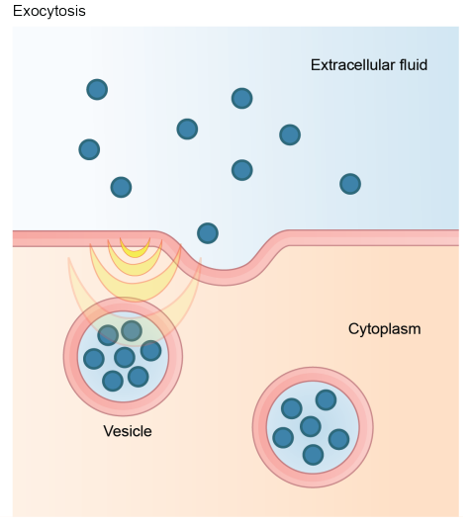
Bulk Transport
Exocytosis – process of moving large materials from cell to extracellular fluid
  Waste material is enveloped in membrane
  Fuses with plasma membrane
  Opens envelope to exterior of cell
  Waste materials are expelled

Slide 35
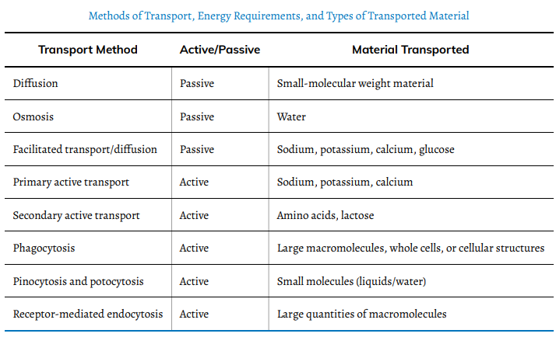
Methods of Transport

Slide 36
Triple P Activity
A morbid focus!
  A doctor injects a patient with what the doctor thinks is an isotonic saline solution. The patient dies, and an autopsy reveals that many red blood cells have been destroyed.
    Do you think the solution the doctor injected was really isotonic?
    What was the cause of these destroyed cells?
  Injecting a potassium solution into a person’s blood is lethal. Capital punishment and euthanasia utilize this method in their subjects.
    Why do you think a potassium solution injection is lethal?
Notes:
Hypertonic situation in which extracellular fluid has a higher osmolarity than the fluid inside the cell, resulting in water moving out of the cell hypotonic situation in which extracellular fluid has a lower osmolarity than the fluid inside the cell, resulting in water moving into the cell
When the potassium reaches the inmate’s heart, it disrupts the delicate balance of sodium and potassium ions that keep the heart beating. The inmate’s heart would begin beating irregularly - and then stop.

Slide 37
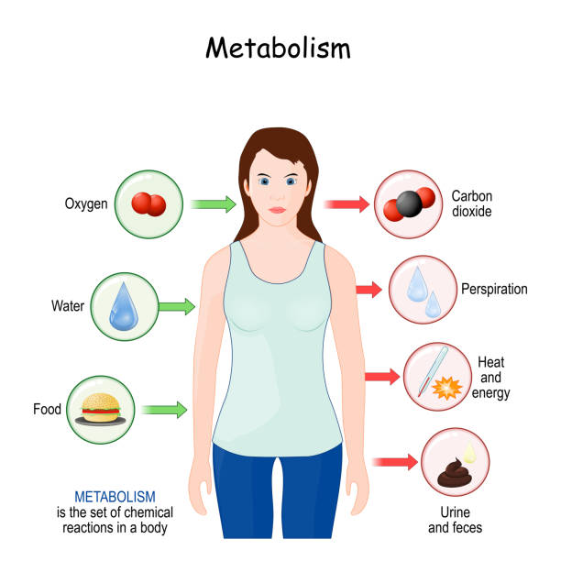
Next Time
Metabolism

