Slide 1
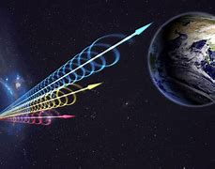
BIOL 1414 Intro to Mol/Cell Biology
Lecture #8
28/29 September 2026
Last Lecture:
Plasma Membrane
Passive Transport
Active Transport
Bulk Transport
Today:
Metabolism
  Energy and Metabolism
  Metabolic Pathways
Types of Energy
Laws of Thermodynamics
ATP
Enzymes
FRB 20220610A
Notes:
What makes them truly astonishing is that these radio waves have been travelling through space for a total of 8 billion years – and it could help experts to gain a better understanding of one of the great mysteries of the universe.
Astronomers have uncovered something pretty remarkable emerging from the depths of space, after detecting a powerful series of radio waves.
The signal, known as FRB 20220610A, is made up of dazzling radio wave flashes that last just milliseconds at a time.
The fast radio burst, or FRB 121102, has been traced to a faint, dwarf galaxy three billion light-years away. “It’s an incredibly, tiny, nondescript galaxy to be producing something this bright
It’s one of the most distant ever recorded and no-one knows for sure where these bursts of energy come from, or indeed who might be sending them.
The strength of the newly observed signal is truly staggering, with FRB 20220610A emitting the same amount of energy that our sun produces in 30 years in the space of just a few milliseconds.
Experts involved in new research published in the journal Science have speculated that signals such as this one could be linked to the remains of exploded stars, known as magnetars.
These signals could theoretically help astronomers to put together a more comprehensive understanding of the universe, given that the weight of normal matter out there doesn’t add up to what experts theorize there should be.

Slide 2
Introduction
Virtually all tasks performed by living organisms requires energy
  Every organisms' cells constantly use energy
    Import nutrients and other molecules
      Metabolize (breakdown) and synthesize new molecules
        Energy needed to build or demolish a building
    Some molecules modify and move around the cell
    Others distribute themselves to entire organism
    Examples:
      Large muscle proteins are built from smaller molecules
      Complex carbohydrates breakdown into simple sugars
    Cells must export waste and toxins
    Many cells need to move using flagella or cilia

Slide 3
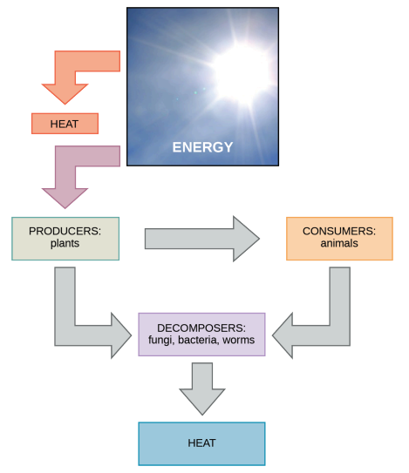
Energy and Metabolism
Bioenergetics – energy flow through living things
  Includes synthesizing and metabolizing complex molecules
    Occurs through stepwise chemical reactions
      Exergonic – reactions releasing energy when occurring
      Endergonic – reactions requiring energy to occur
  Cells must continually acquire energy
    Replenish energy used in continually occurring chemical reactions
  Metabolism – all chemical reactions occurring in cell that use or release energy

Slide 4


Carbohydrate Metabolism
Living things consume sugar for energy
  Sugar is a simple carbohydrate
  Sugar molecules have lots of energy stored in their bonds
  Consumed carbohydrates get their energy from where?
    The sun via photosynthesis
    Plants use sunlight to convert CO₂ into sugar molecules
      Requires energy to generate energy storing molecules (sugars)
    Glucose (carbohydrate) used to create ATP
      Adenosine triphosphate – primary energy currency of cells
    Glucose is stored as starch (plants) or glycogen (animals)
      These break down into glucose
      Glucose breaks down to form ATP
Notes:
Note the two formulas are reverse of each other

Slide 5
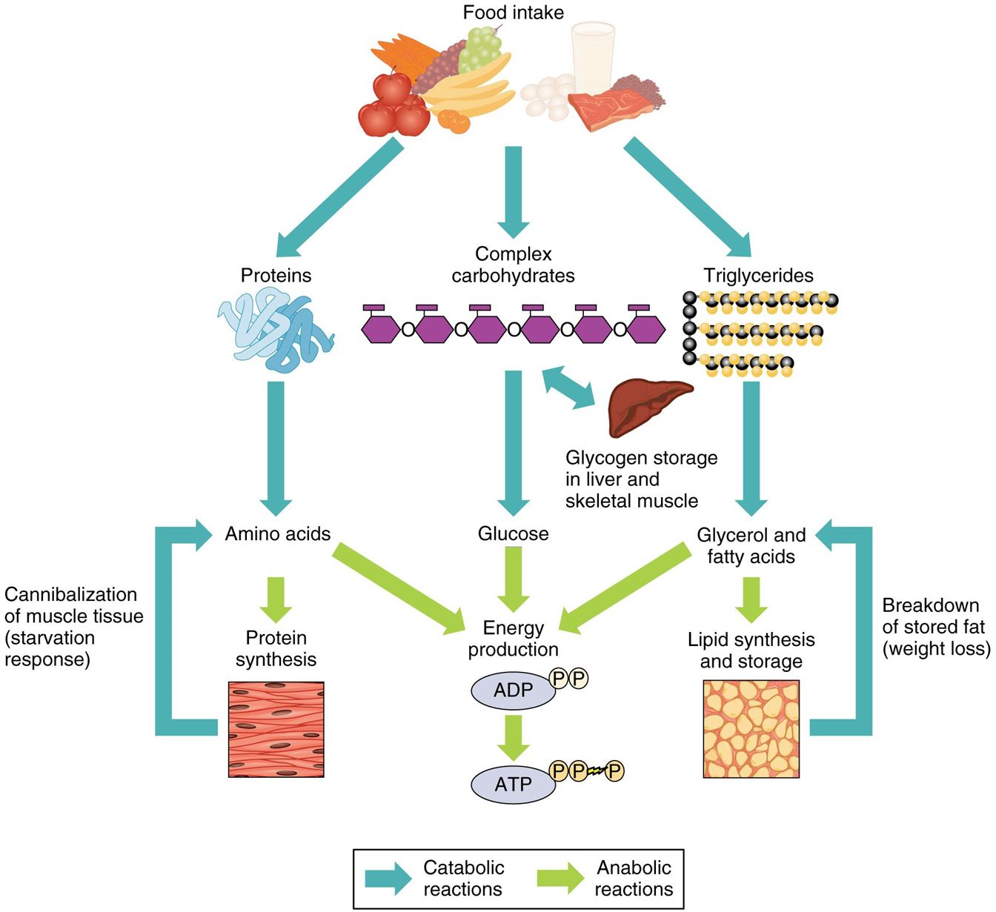
Metabolic Pathways
Metabolic pathway – series of interconnected biochemical reactions that convert substrates molecules into final products
  Proceed in a step-by-step manner
    Creating a series of metabolic intermediates
  Breaking down and building = two types of pathways
    Anabolic pathway – building = requires energy
    Catabolic pathway – breaking down = releases energy
    Combined the above = metabolism

Slide 6
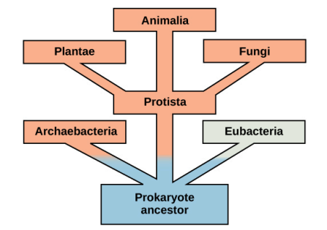
Metabolic Pathways
Notes:
,Some eukaryotes perform catabolic processes without oxygen (fermentation); that is, they perform or use anaerobic metabolism.
Organisms probably evolved anaerobic metabolism to survive (living organisms came into existence about 3.8 billion years ago, when the atmosphere lacked oxygen).
Despite the differences between organisms and the complexity of metabolism, researchers have found that all branches of life share some of the same metabolic pathways, suggesting that all organisms evolved from the same ancient common ancestor (Figure 6.4).
Evidence indicates that over time, the pathways diverged, adding specialized enzymes to allow organisms to better adapt to their environment, thus increasing their chance to survive.
However, the underlying principle remains that all organisms must harvest energy from their environment and convert it to ATP to carry out cellular functions.

Slide 7
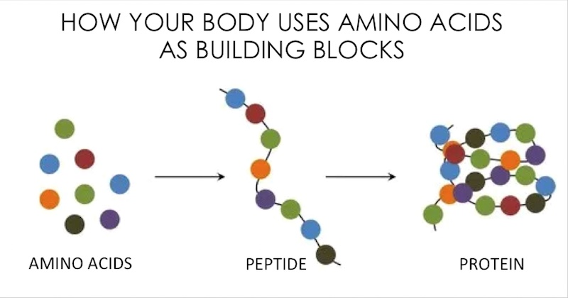
Metabolic Pathways
Anabolic – requires energy to synthesize complex molecules from simple ones
  Examples:
    Synthesizing sugar from CO₂
    Synthesizing proteins from amino acids
    Synthesizing DNA from nucleic acids
  Get energy from molecules like ATP
Catabolic – give off energy when complex molecules are broken down
  Example:
    Single glucose molecule can make 36-38 ATP
Pathway reactions do not occur spontaneously
  Enzyme – catalyzes each reaction step
    Both those giving off energy and those requiring energy

Slide 8
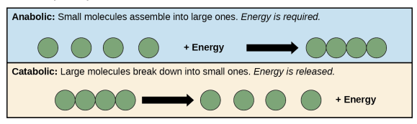
Metabolic Pathways

Slide 9
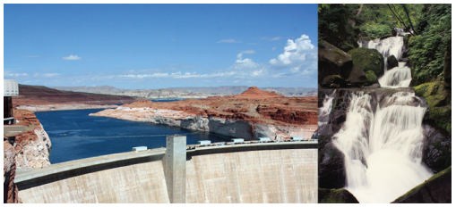
Types of Energy
Energy – ability to do work
  Comes in many forms
    Kinetic energy – energy of objects in motion
      Speeding bullet, rapidly moving molecule in air, light
    Potential energy – results from potential to do work
      Wrecking ball hanging above ground has potential energy
    Can transfer between these two:
      Hanging = 0 kinetic and 100 potential
      Mid fall = ~50 kinetic and ~50 potential
      Right before impact = nearly 100% kinetic and 0% potential
Notes:
Light energy, heat energy, electrical – different forms of energy
Kinetic - Plane needs energy to fly or a wrecking ball (even moving slowly) can do big damage – not moving = no work being done (does it have energy)

Slide 10
Types of Energy
Notes:
What type of energy in pictures?

Slide 11
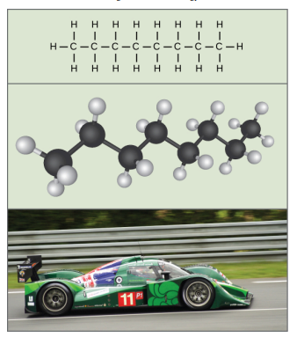
Types of Energy
Potential energy
  Bonds holding molecules together
    All bonds making up our food hold energy
      We harness this for use in our bodies
  Chemical energy – potential energy that exists between chemical bonds
    Released when bonds are broken
Notes:
Remember that anabolic cellular pathways require energy to synthesize complex molecules from simpler ones, and catabolic pathways release energy when complex molecules break down.
The molecules in gasoline contain chemical energy within the chemical bonds. This energy transforms into kinetic energy that allows a car to race on a racetrack.

Slide 12
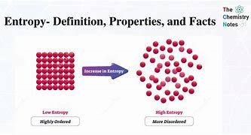
Types of Energy
How do we quantify energy of a chemical reaction?
How do we compare the energy of two different reactions?
Free energy – usable energy (can do work)
  Also knows as Gibbs Free Energy (G)
  Energy available after we account for entropy
    Entropy – measure of randomness or disorder
      Heat energy = entropy
      In all chemical reactions some energy is lost as heat

Slide 13
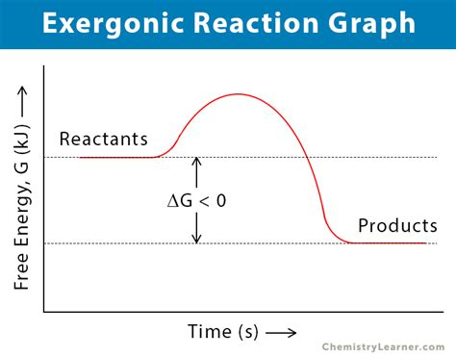
Types of Energy
Free energy
  Measured as change in free energy ∆G
Exergonic reaction – reaction releasing free energy
  ∆G < 0 (will be negative)
  Products have less free energy than reactants
    Some was lost as heat
  Sometimes called spontaneous reactions
    Does not occur at random or quickly/immediately
      Rusting iron is a spontaneous reaction but is very slow
    Occurs with out the addition of energy
  Released energy can be captured and used by cell

Slide 14
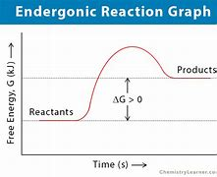
Types of Energy
Free energy
  Measured as change in free energy ∆G
Endergonic reaction – reaction requiring free energy input
  ∆G > 0 (will be positive)
  Products have more free energy than reactants
  Not spontaneous
    Will require free energy additions to allow reaction to occur

Slide 15
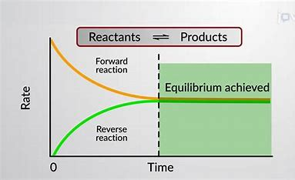
Types of Energy
Chemical equilibrium
  Most chemical reactions are reversable
    Can proceed in both directions
      Releasing energy into environment in one direction
      Absorbing it from the environment in the other direction
  Reactions go back and forth until at equilibrium
    Lowest possible free energy
    Maximum state of entropy
    Energy required to move reaction away from equilibrium
      Reactants or products must be added, removed, or changed
  Living cells reactions always approaching equilibrium but it never actually occurs
    If equilibrium was reached the cell would die
      No free energy left to do work to maintain function
    Never occurs as materials constantly moving in an out of membrane
      Think sodium and potassium pump
    Put cells in a constant energy requiring state
Notes:
VIDEO

Slide 16
Types of Energy
Activation Energy – energy input required for chemical reaction to occur (E_{A})
  Both exergonic and endergonic reactions require at least small amount of energy to allow reaction to proceed
    This must occur before energy releasing phase in exergonic reactions
  Energy required to get molecule into contorted state
    Transition state - state where bonds are capable of being broken
      High-energy and unstable state
  Amount of activation energy required determines rate at which it will proceed
    Higher the activation energy = slower the reaction
      Rusting iron
      Burning of many fuels = strongly exergonic
        Negligible reaction unless energy from a spark overcomes activation energy
        Once started reactions release enough energy to keep them going
Notes:
VIDEO

Slide 17
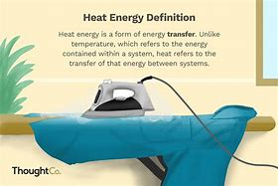
Types of Energy
Heat Energy – energy transferred from one system to another without doing work
  Speeds up molecules motion
  Increase force and frequency at which they collide
  Moves atoms and bonds in molecules
    Helps them reach their transition state
Heating a system
  Causes reactions to happen more frequently
Pressurizing a system
  Causes reactions to happen more frequently
Notes:
VIDEO

Slide 18
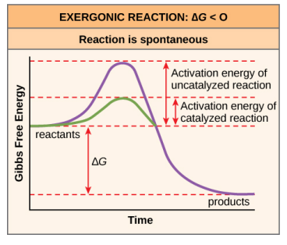
Types of Energy
Activation energy
  For most cellular activities, the activation energy is too high for heat energy to overcome at efficient rates
    In other words – the activation must be lowered
    Catalysis – lowering of activation energy
Notes:
VIDEO

Slide 19
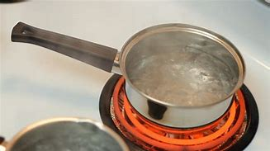
Laws of Thermodynamics
Thermodynamics – study of energy and energy transfer involving physical matter
  System = matter and its environment in any specific case of energy transfer
    Open system – energy can transfer between system and environment
      Biological organisms are open systems
    Closed system – energy cannot transfer outside the system
Notes:
For instance, when heating a pot of water on the stove, the system includes the stove, the pot, and the water. Energy transfers within the system (between the stove, pot, and water)

Slide 20
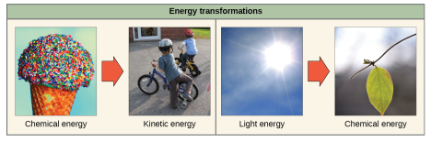
Laws of Thermodynamics
1st Law of Thermodynamics – total amount of energy in the universe is constant
  Always has and always will be the same amount of energy
  Energy is neither created or destroyed
    Can exist in many forms
    Can be transferred between forms
  Challenge of all living things
    Obtain energy from surroundings
      In forms that they can transfer or transform to do work
Notes:
The transfers and transformations of energy take place around us all the time.
~Light bulbs transform electrical energy into light energy.
~Gas stoves transform chemical energy from natural gas into heat energy.
~Plants perform one of the most biologically useful energy transformations on earth: that of converting sunlight energy into the chemical energy stored within organic molecules

Slide 21
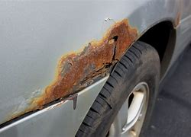
Laws of Thermodynamics
2nd Law of Thermodynamics – no energy transfers are 100% efficient
  In every transfer there is some energy lost in an unusable form
    In most cases this form is heat energy
  Entropy – measure of disorder
    More energy a system loses to its surround = more entropy
      High entropy = High disorder = Low energy
    As a chemical reaction reaches equilibrium
      Entropy increase = Lower energy
    As molecules at high concertation spread out
      Entropy increase = Lower energy
  Living things are highly organized
    Require constant energy inputs to maintain
      Keeps entropy low in system
    Transformations of the above energy result in
      Increased entropy in the universe
    2nd Law also states universes entropy is constantly increasing
Notes:
For example, when an airplane flies through the air, it loses some of its energy as heat energy due to friction with the surrounding air. This friction actually heats the air by temporarily increasing air molecule speed.
Likewise, some energy is lost as heat energy during cellular metabolic reactions. This is good for warm-blooded creatures like us, because heat energy helps to maintain our body temperature
To better understand entropy, think of a student’s bedroom. If no energy or work were put into it, the room would quickly become messy. It would exist in a very disordered state, one of high entropy.
Energy must be put into the system, in the form of the student doing work and putting everything away, in order to bring the room back to a state of cleanliness and order. This state is one of low entropy

Slide 22
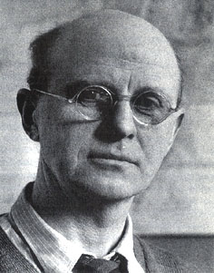
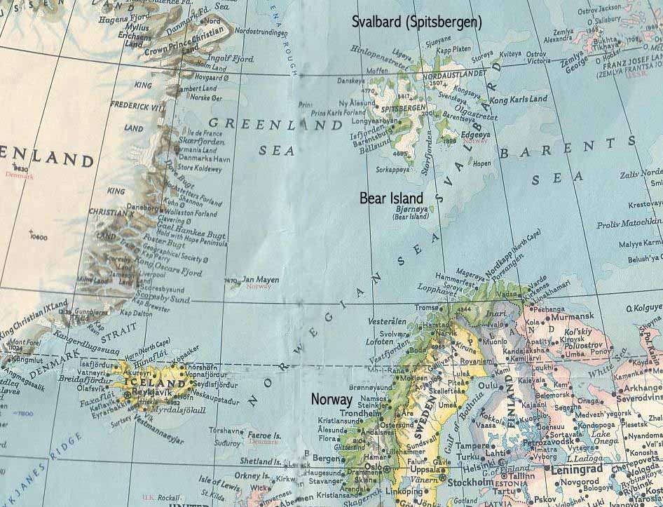
Laws of Thermodynamics – An Example
Charles Elton 1900-1991
  British zoologist and ecologist
  Know studying role of energy in organizing communities

Slide 23
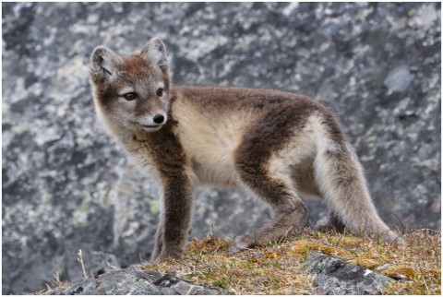
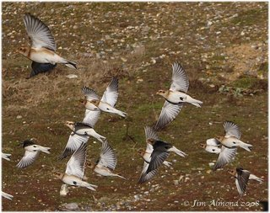
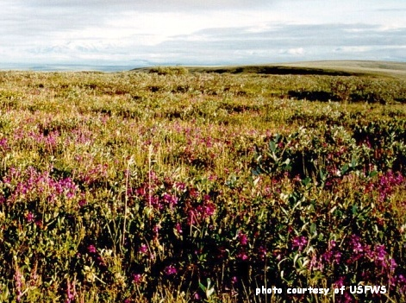
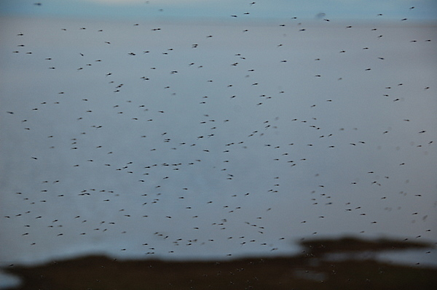
Laws of Thermodynamics – An Example
He tracked the flow of Nitrogen through the Arctic food web by simply mapping out what ate what.
  Nitrogen use related to energy use
His question – Why are larger organisms in fewer numbers than smaller ones?
  Polar bears < lemmings

Slide 24
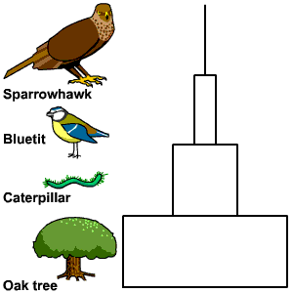
Laws of Thermodynamics – An Example
His pyramids of energy, numbers, size, biomass, etc.
have appeared in every Ecology textbook since.

Slide 25
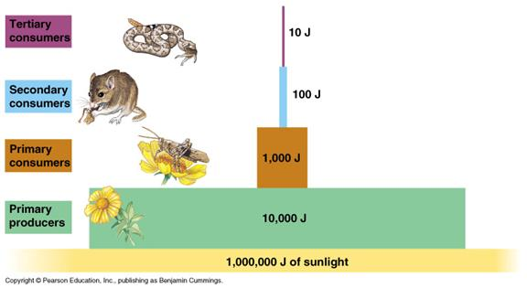
Laws of Thermodynamics – An Example
Energy transfer is inefficient
  Only 1% of sunlight (energy) turned into plant biomass (potential energy)
  Only 10% plant biomass (energy) is turned into primary consumers (potential energy)
  Only 10% of primary consumers biomass (energy) turned into secondary consumers (potential energy) and so on.

Slide 26
Laws of Thermodynamics – An Example
This inefficiency of energy transfer means:
  That larger organisms or organisms higher in the food chain must be less numerous than smaller organisms or organisms lower in the food chain

Slide 27
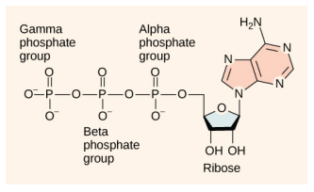
ATP – Adenosine Triphosphate
ATP – energy supplying molecule
  Cells energy currency
    Just like our money that we exchange for things
  Small and simple molecule
  Some of its bonds contain large amounts of energy
    Can be harnessed to perform cellular work
  Powers majority of energy-requiring cellular reactions

Slide 28
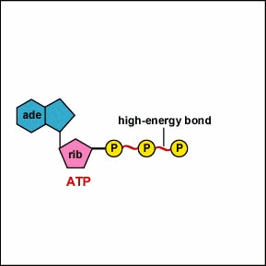
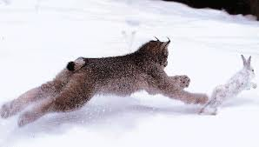
ATP is Fuel for Cells
Adenosine Tri-phosphate
There is a release of energy when any chemical bond is broken, but there is a relatively much larger release when a phosphate bond
ATP helps cells do things that require lots of energy, like move something like legs when running from a predator.
Where does ATP come from?

Slide 29
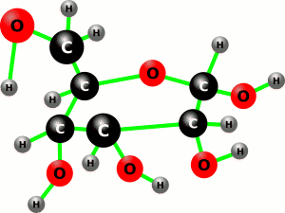
It All Starts Here
Glucose: 6 carbons, 12 hydrogen's, 6 oxygen's

Slide 30

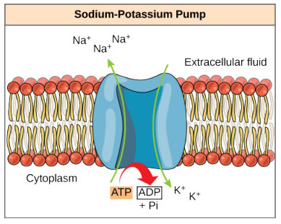
ATP – Adenosine Triphosphate
ATP – energy supplying molecule
  Energy is released through a hydrolysis reaction
    Hydrolysis – breaking down of a molecule by adding a water molecule
    This reaction is reversable
  Highly unstable molecule
    Must be used quickly or it returns to ADP and P_{i}
      Energy released in this situation is lost as heat
  How is energy used by cell?
    Energy coupling – energy generated from one reaction drives a second reaction
    Example – Sodium potassium pump
      Energy from ATP release powers this pump
      ATP releases a phosphate group
        Attaches to protein = phosphorylation
Notes:
VIDEO

Slide 31
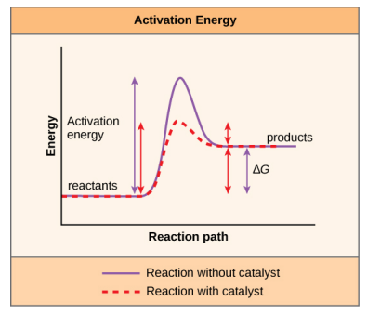
Enzymes
Catalyst - substance helping a chemical reaction occur
  Almost all enzymes are proteins
  Lower the activation energy
    Holds molecule in a way that allows reaction to occur
      Bond breaking or bond forming
    Does not change the reactions ∆G
      i.e. does not change if reaction is endergonic or exergonic
    Only reduces the reactions activation energy
Notes:
FIX do to DOES

Slide 32
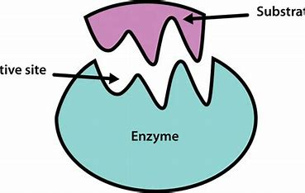
Enzymes
Active Site and Substrate Specificity
  Substrates – chemical reactants to which enzymes bind
    May be one or more substrates
      Depends on the chemical reaction
        Single-reactant substrate breaks down into multiple products
        Two substrates may bind to create one larger molecule
        Two reactants may enter, and both become modified and leave as two products
  Active site – location within enzyme where substrate binds
    Where the “action” happens
  Highly specific “fits” for each substrate and active site
    There is a specifically matched enzyme for each substrate
      There is some flexibility
  Enzymes can become denatured
    Increased heat will increase reaction rate
      But can become too warm
      Can become too cold
    pH can cause denaturalization
      Too acidic or too basic
Notes:
Since enzymes are proteins, there is a unique combination of amino acid residues (also side chains, or R groups) within the active site.
Different properties characterize each residue. These can be large or small, weakly acidic or basic, hydrophilic or hydrophobic, positively or negatively charged, or neutral.
The unique combination of amino acid residues, their positions, sequences, structures, and properties, creates a very specific chemical environment within the active site.

Slide 33
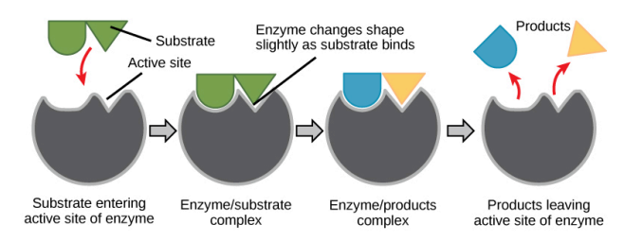
Enzymes
Active Site and Substrate Specificity
  Induced Fit Model – as substrate and active site a mild shift occurs in enzyme structure
    Ensures and ideal binding arrangement
      Maximizes enzyme's ability to catalyze reaction
    Updated view of lock and key model

Slide 34
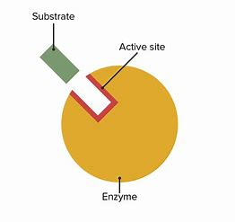
Enzymes
Enzyme-substrate complex – formed when substrate bonds to enzyme
  Lowers the activation energy
  Promotes rapid progression
    Many ways in which this can happen
      Bring substrates together in optimal orientation
      Creates an optimal environment for reaction to occur
        Some perform best in slightly acidic environment
        Others may perform best in a non-polar environment
      Can aid in contorting bonds into breakable arrangement
      Can take part in the chemical reaction themselves
        May provide certain ions or chemical groups
    Proteins will always return to original state after reaction
      Hallmark trait of an enzyme is that they remain unchanged by reactions they catalyze
  Once reaction is complete products are released

Slide 35
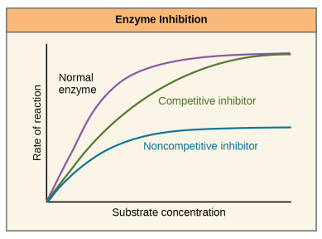
Enzymes
Are enzyme activities consistent all the time?
  Are they consistent between different cells?
NO
  Enzyme functionality and amounts vary
  Vary with cellular demands and conditions
    Stomach cells have different demands than blood cells
    A digestive cell has more need for function directly after a meal
  Vary with environmental factors
    pH and temperature are two big ones
  Other mechanisms
    Competitive inhibition – molecule similar to substrate binds to enzyme at active site and blocks the actual substrate from binding
    Non-competitive inhibition – molecule binds to an allosteric (non active) site and blocks substrate from binding to active site
      Allosteric inhibition – molecule binds to enzyme and causes shape change
        Reduces enzymes affinity for its substrate
    Allosteric activators – binds to enzyme causing a shape change
      Increases the affinity for substrate
Notes:
It would seem ideal to have a scenario in which all the encoded enzymes in an organism’s genome existed in abundant supply and functioned optimally under all cellular conditions, in all cells, at all times. In reality, this is far from the case. A variety of mechanisms ensure that this does not happen

Slide 36
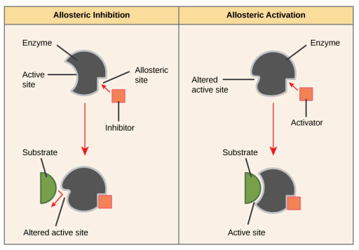

Enzymes

Slide 37
Enzymes

Slide 38
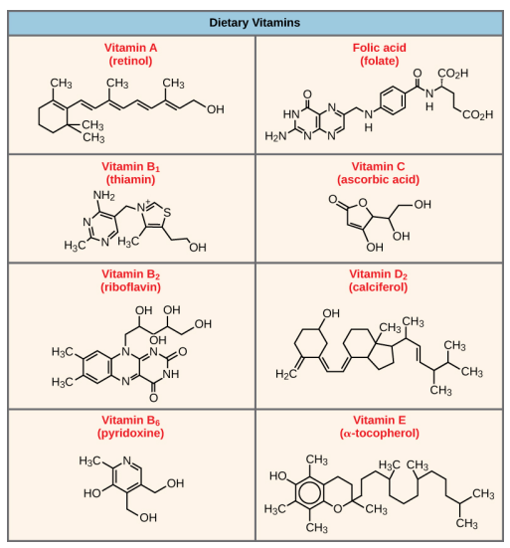
Enzymes
Many enzymes work poorly or not at all
  Unless they are bound to a non-protein helper molecule
    Bonds may be temporary or permanent
    Cofactors and Coenzymes – helper molecules that promote optimal shape and function of their respective enzyme
      Examples:
        DNA Polymerase – builds DNA – requires zinc ion to function
        Pyruvate Dehydrogenase – aids in glucose break down – vitamin C
    Main source of coenzymes is dietary vitamins
  Enzyme function partially regulated by
    Cofactors and coenzymes
      Diet of most organism supply these
Notes:
VIDEO

Slide 39
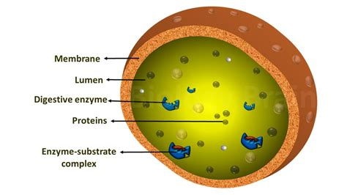
Enzymes
In many eukaryotes enzymes are compartmentalized
  Located in different organelles
    Add another level of regulation
  Specialized enzymes used in only specific cell actions
    Housed separately with their substrate
      More efficient chemical reactions
    Examples:
      Enzyme used in in digesting cellular debris occurs in lysosome
      Enzymes used in late-stage respiration occur in mitochondria

Slide 40
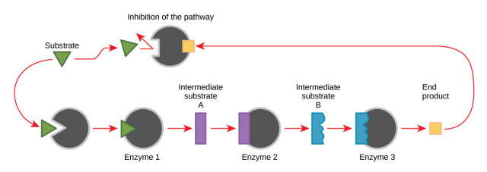
Enzymes
Feedback inhibition – uses a reactions product to regulate its own further production
  As reaction products increases enzymes slows its own production
    Example:
      ATP production slows when it becomes abundant
        ATP is unstable and disassociate spontaneously
        Having too much is a cell would waste it

Slide 41
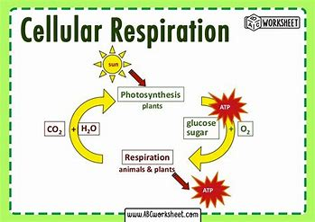
Next Time
Cellular Respiration

