Slide 1
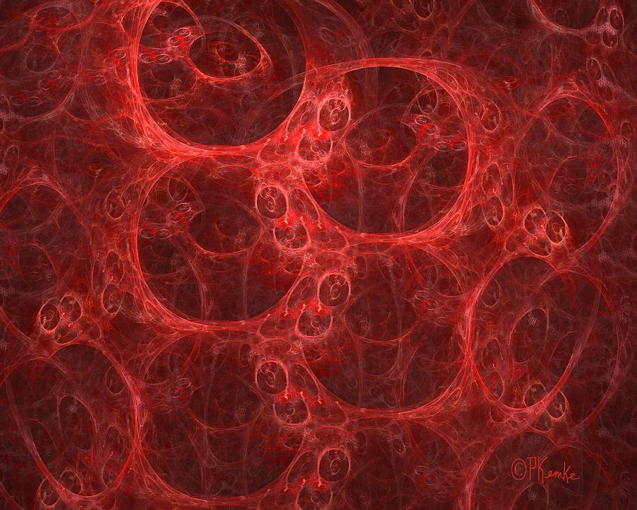
Lecture 15
Blood

Slide 2
OVERVIEW
Transportation– how do we move things throughout our bodies?
Components of Blood – what are plasma, red blood cells, white blood cells, and platelets?
Hemostasis – how does blood clot?
Blood Types – what are blood types and why are they important to consider during a transfusion?

Slide 3
INTRODUCTION
Blood transports everything that must be carried from one place to another, including:
  Oxygen and carbon dioxide
  Clotting proteins and immune system cells
  Nutrients
  Hormones
  Body heat
Blood is the only fluid tissue in the human body
  A type of connective tissue

Slide 4
COMPONENTS OF BLOOD
Components
  Solid = Cells
  Liquid = Plasma
Characteristics
  8% of the human body weight
  Salty – maintains isotonic environment for cells
  Slightly alkaline – pH = 7.35-7.45
  Warmer than body temperature due to friction – 100.4 degrees F
Connective Tissue
  Cells = RBCs, WBCs, platelets
  Ground substance = Plasma
  Proteins = Albumin, clotting proteins

Slide 5
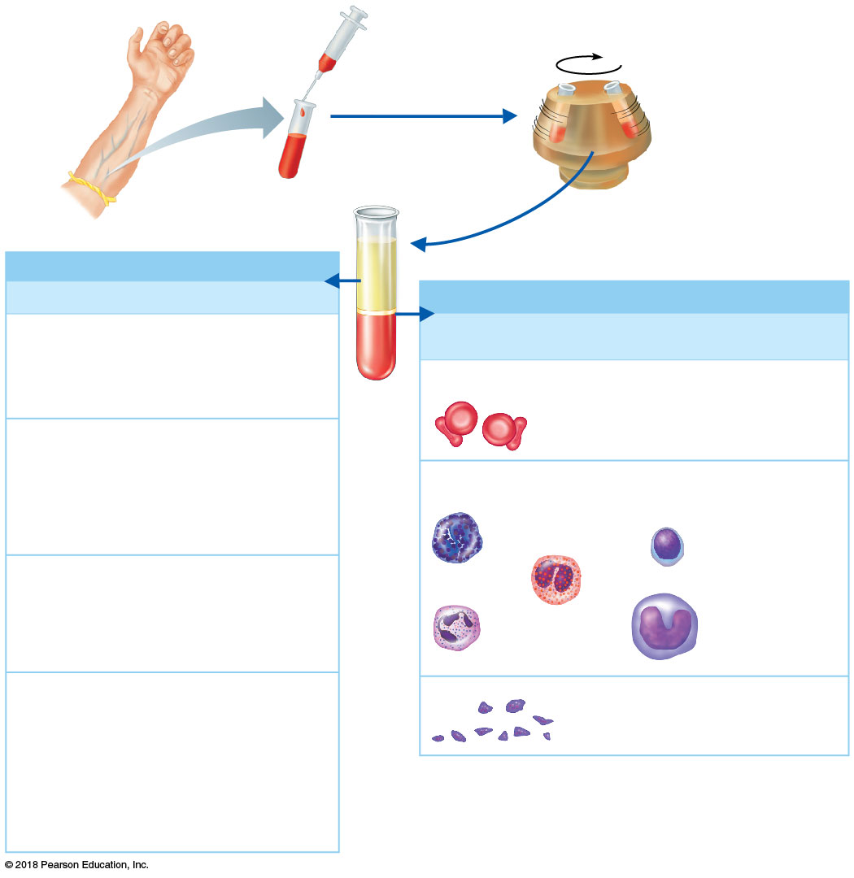
COMPONENTS OF BLOOD
Solids
Red Blood Cells (RBCs)
  45% of blood, a percentage known as the hematocrit
White Blood Cells(WBCs) and Platelets
  Less than 1% of blood
Liquid
Plasma
  55% percent of blood
Plasma 55%
Constituent
Major Functions
Formed elements (cells) 45%
Water
90% of plasma
volume; solvent
for carrying other
substances;
absorbs heat
Cell Type
Number
(per mm³ of blood)
Functions
Erythrocytes
(red blood cells)
4–6 million
Transport oxygen
and help transport
carbon dioxide
Salts (electrolytes)
Osmotic balance,
pH buffering,
regulation of
membrane
permeability
Sodium
Potassium
Leukocytes
(white blood cells)
Calcium
4,800–10,800
Defense and
immunity
Magnesium
Chloride
Bicarbonate
Lymphocyte
Plasma proteins
Osmotic balance,
pH buffering
Basophil
Albumin
Fibrinogen
Clotting of blood
Eosinophil
Globulins
Defense (antibodies)
and lipid transport
Monocyte
Neutrophil
Substances transported by blood
Platelets
Nutrients (glucose, fatty acids, amino
acids, vitamins)
250,000–400,000
Blood clotting
Waste products of metabolism
(urea, uric acid)
Respiratory gases (O₂ and CO₂)
Hormones (steroids and thyroid hormone
are carried by plasma proteins)

Slide 6
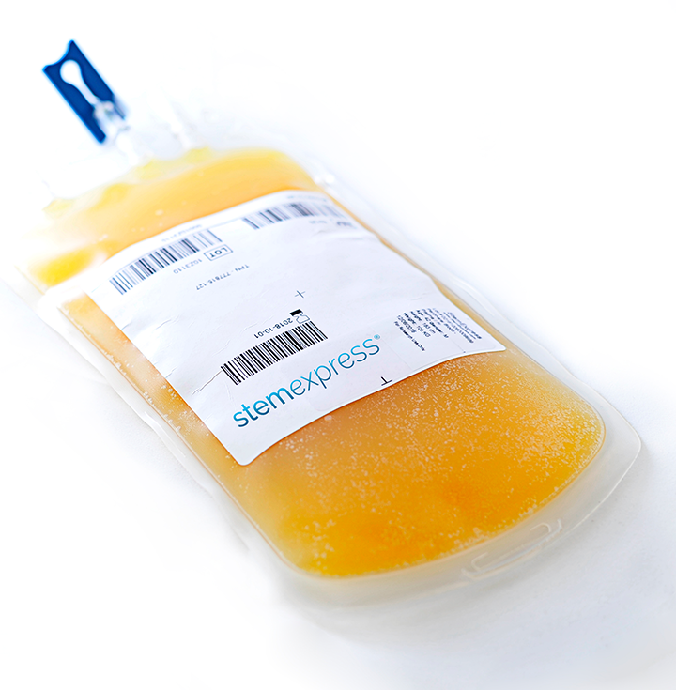
COMPONENTS OF BLOOD
Liquid Component: Plasma
  55% of blood
  90% water
  10% dissolved substances:
    Plasma proteins
    Nutrients
    Waste products
    Electrolytes
    Hormones

Slide 7
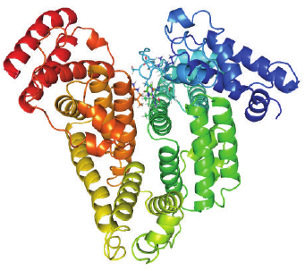
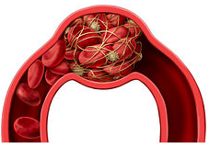

COMPONENTS OF BLOOD
Liquid Component: Plasma
  3 Types of Plasma Proteins:
    Albumin
      Transports hydrophobic substances
      Contributes to oncotic pressure to keep water in the blood
    Clotting proteins
      Help platelets repair a blood vessel when it is injured
    Antibodies
      Help protect the body from pathogens
  Plasma proteins are NOT nutrient proteins
    Stay in the bloodstream – not taken into the cell for energy

Slide 8
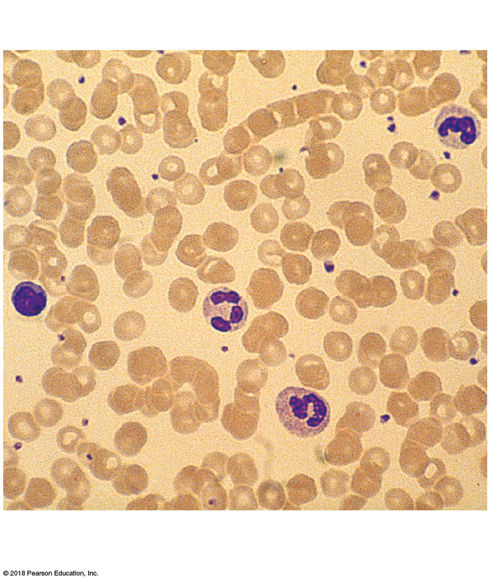
COMPONENTS OF BLOOD
Solid Component = Cells
All cells of the blood are made in bone marrow
  Rapidly dividing stem cells
Red blood cells (RBCs)
  Erythrocytes, erythro = red, cyte = cell
White blood cells (WBCs)
  Leukoocytes, leuko = white, cyte = cell
Platelets
  Cell fragments
WBC
Lymphocyte
Platelets
RBCs
WBCs
Neutrophils

Slide 9
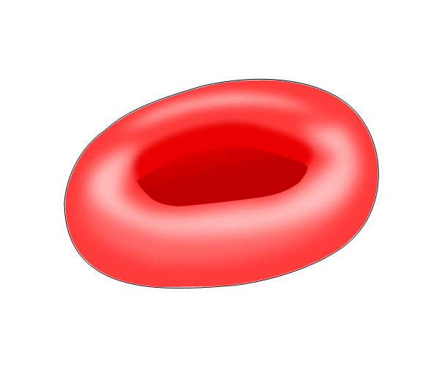
COMPONENTS OF BLOOD
Solid Component: Red Blood Cells
  Function: Carry oxygen
  Structure:
    Biconcave disc shape
      Provides flexibility and large surface area for O₂ transport
    No nucleus
      → No mitosis
    No organelles, including mitochondria
      → No aerobic respiration
    Essentially just bags of hemoglobin
If RBCs had organelles, they would have less room for O₂ and could possible use it!

Slide 10
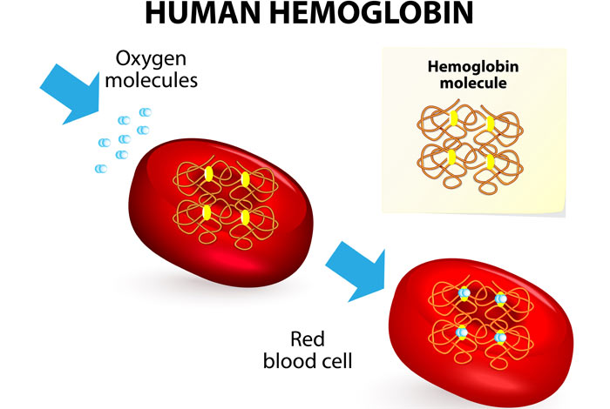
COMPONENTS OF BLOOD
Hemoglobin
  Iron-containing protein within the RBC
    Each RBC has 250 million hemoglobin molecules
Binds oxygen
Hemoglobin allows 1 RBC to bind 1 billion O₂ molecules
  But ONLY if blood contains 12–18 g of hemoglobin per
  100 milliliters

Slide 11
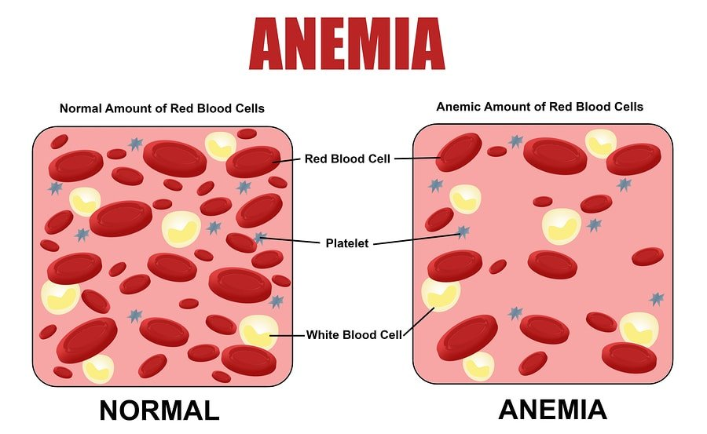
COMPONENTS OF BLOOD
Anemia
  A decrease in the oxygen-carrying ability of the blood
  2 Types of Anemia
    Low # of RBCs
    Low hemoglobin in RBCs
  Sickle cell anemia results from abnormally shaped hemoglobin

Slide 12
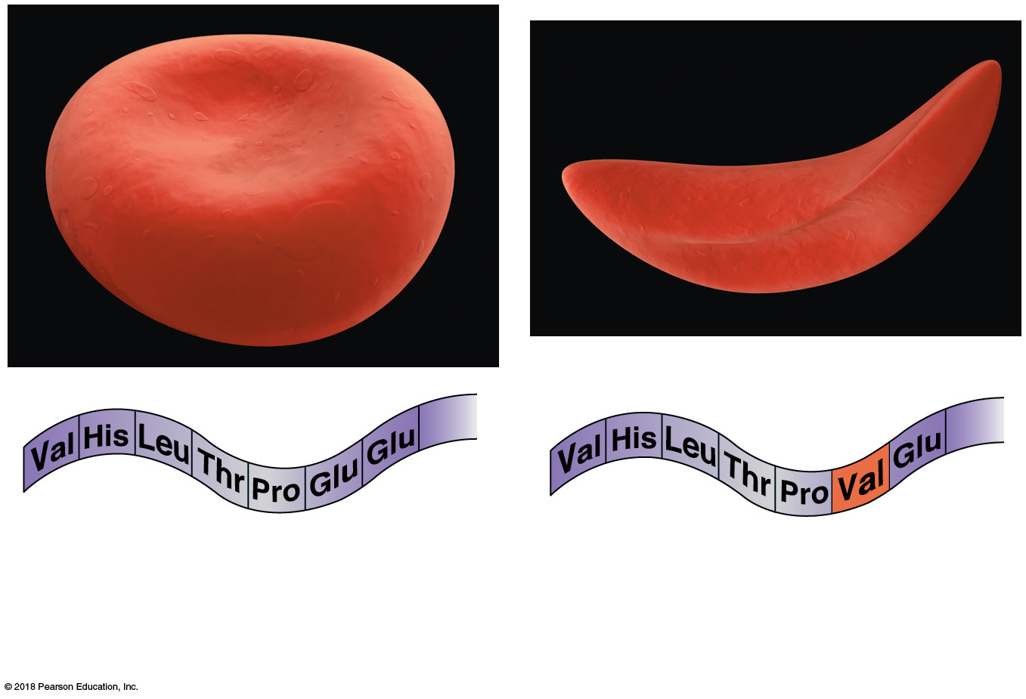
COMPONENTS OF BLOOD
2
3
7...146
2
3
7...146
1
4
1
6
4
6
5
5
Normal RBC and part of the
amino acid sequence of its
hemoglobin
Sickled RBC and part of its
hemoglobin sequence

Slide 13
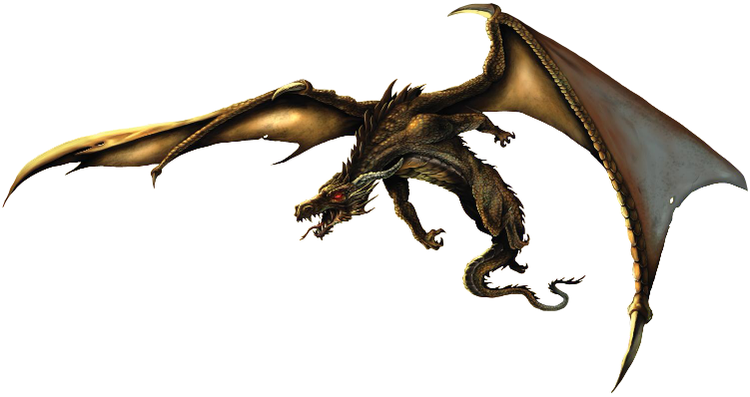

WHY DOES THIS MATTER?

Slide 14
COMPONENTS OF BLOOD
Polcythemia
  Disorder resulting from excessive #’s of RBCs
    Increased viscosity decreases circulation
    Promotes hypoglycaemia
  3 Causes of Polycythemia
    Bone marrow cancer
    Heart disease
    Life at higher altitudes

Slide 15
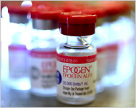
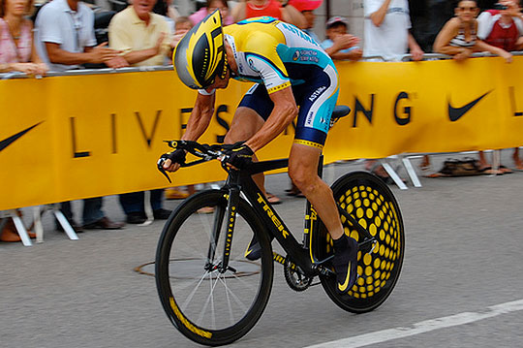
COMPONENTS OF BLOOD
Lance Armstrong
  Stripped of his titles after “blood doping” using EPO (and other substances) to increase his number of RBCs
  This artificially increased his aerobic efficiency: More RBCs → more oxygen to cells → more ATP → more energy → better performance
Notes:
15

Slide 16
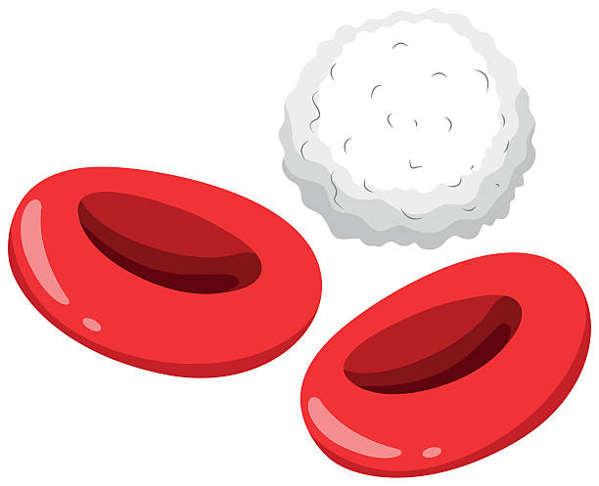
COMPONENTS OF BLOOD
Solid Component: White Blood Cells
  Function: Immune defense
  Structure:
    Nucleus and organelles are present
      WBCs differentiated based on nucleus shape
      WBCs are the only “complete” cell type in the blood
  Physiology:
    Diapedesis = Ability to move into and out of blood vessels
      The entire purpose of a WBC is to use the blood to get to tissue, then leave the blood to fight within the tissue!
    Chemotaxis = Response to chemicals released by damaged tissues

Slide 17
COMPONENTS OF BLOOD
WBCs use blood to get to problem areas elsewhere
Bacteria
Virus-infected cell
Cancer cell
Self-protein

Slide 18
COMPONENTS OF BLOOD
Leukocytosis
  Abnormally high # of WBCs
  Generally indicates an infection
Leukopenia
  Abnormally low # of WBCs
  Commonly caused by certain drugs, such as prednisone and anticancer agents
  Can indicate particularly severe infection
Leukemia
  Bone marrow becomes cancerous
  Numerous immature WBC are produced

Slide 19
COMPONENTS OF BLOOD
Leukocytosis = Bone marrow increases WBCs to fight infection

Slide 20
COMPONENTS OF BLOOD
Leukopenia = Sometimes an infection is so severe, WBCs leave the blood to fight faster than bone marrow can make more

Slide 21
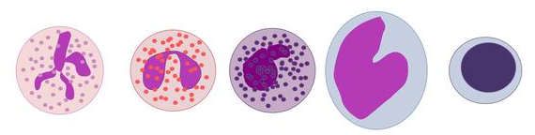
COMPONENTS OF BLOOD
2 Types of WBCs
  Granulocytes
    Granules visible in cytoplasm
    Lobed nuclei
    Include neutrophils, eosinophils, and basophils
  Agranulocytes
    Granules NOT visible in cytoplasm
    Spherical, oval, or kidney-shaped nuclei
    Include lymphocytes and monocytes

Slide 22
COMPONENTS OF BLOOD
List of the WBCs, from most to least abundant:
  Neutrophils
  Lymphocytes
  Monocytes
  Eosinophils
  Basophils
Easy way to remember this list:
  Never
  Let
  Monkeys
  Eat
  Bananas

Slide 23
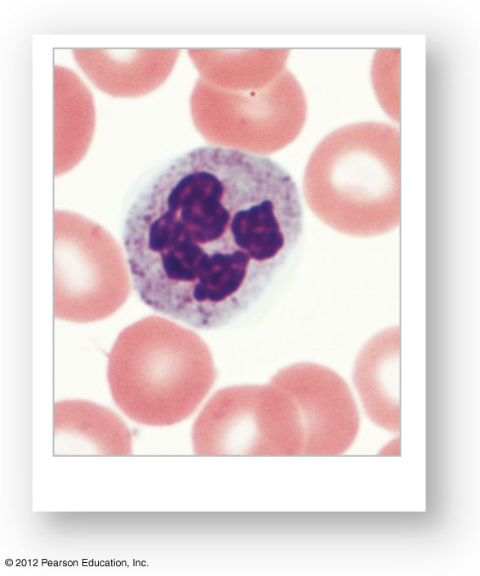
COMPONENTS OF BLOOD
Neutrophils
  Most numerous WBC
  Multilobed nucleus
  Function as phagocytes at active sites of infection
    Bacterial and fungal
  Numbers increase during bacterial infection
Neutrophil

Slide 24
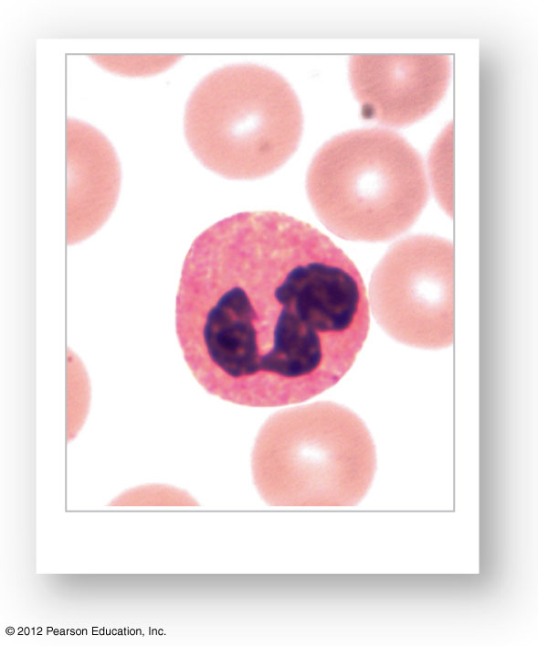
COMPONENTS OF BLOOD
Eosinophils
  Multilobed nucleus
  Brick-red cytoplasmic granules
  Function is to kill parasites and play a role in the allergic response
Eosinophil

Slide 25
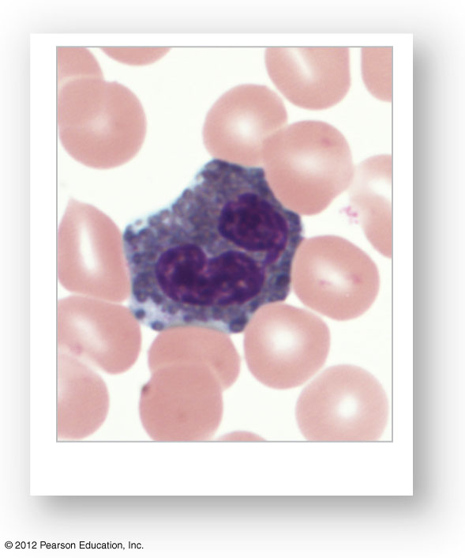
COMPONENTS OF BLOOD
Basophils
  Rarest of the WBCs
  Mimic the behavior of eosinophils
Basophil

Slide 26
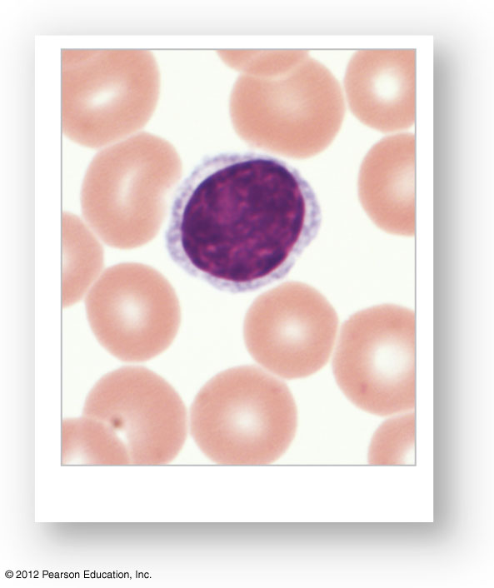
COMPONENTS OF BLOOD
Lymphocytes
  Second most common WBC
  Large, circular nucleus
  Reside in blood AND lymph nodes
  Long-term immune response:
    B-Cells: make antibodies
    T-Cells: kill infected cells
    NK cells: kill suspicious cells
  Numbers increase (then sometimes decrease) during viral infection
Lymphocyte

Slide 27
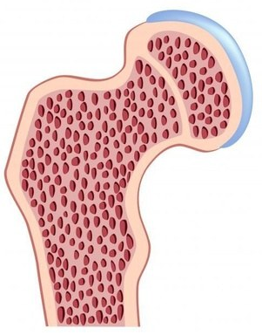
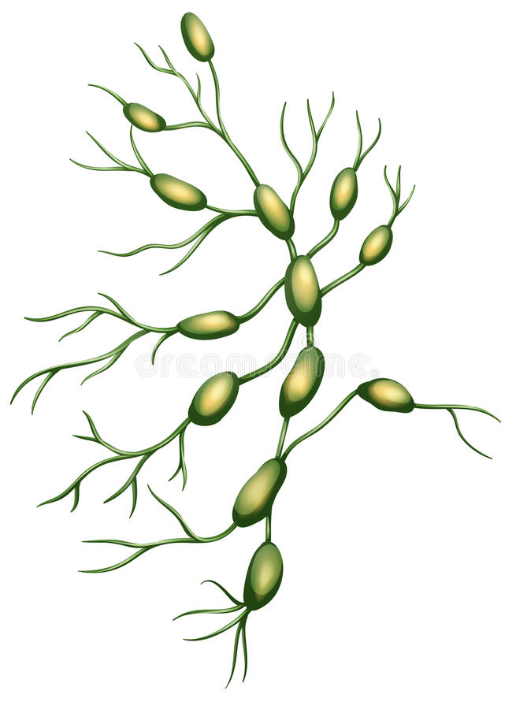
WHY DOES THIS MATTER?
Leukemia vs. Lymphoma
  Leukemia affects ANY cell in the bone marrow
  Lymphoma affects ONLY lymphocytes ONLY in lymph nodes
  Location and cell type differentiate these 2 cancers
VS

Slide 28
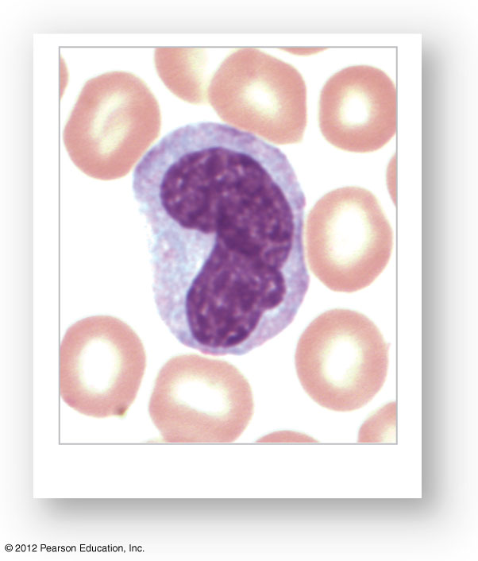
COMPONENTS OF BLOOD
Monocytes
  Largest of the white blood cells
  Kidney-shaped nucleus
  Function as macrophages when they migrate into tissues
  Important in fighting chronic infection
Monocyte

Slide 29
Which WBC is associated with allergies?

Slide 30
Which WBC is associated with viral infections?

Slide 31
Which WBC is associated with bacterial infections?

Slide 32
Which WBC is associated with chronic infections?

Slide 33
Which WBC mimics the behavior of Eosinophils?

Slide 34
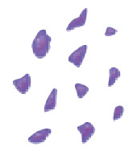
COMPONENTS OF BLOOD
Solid Component: Platelets
  Needed for hemostasis – blood clotting
  Fragments of megakaryocytes in bone marrow

Slide 35
HEMOSTASIS
Hemostasis is the process of stopping the bleeding that results from a break in a blood vessel
3 Phases of Hemostasis
  Vascular spasms
  Platelet plug formation
  Coagulation (blood clotting)

Slide 36
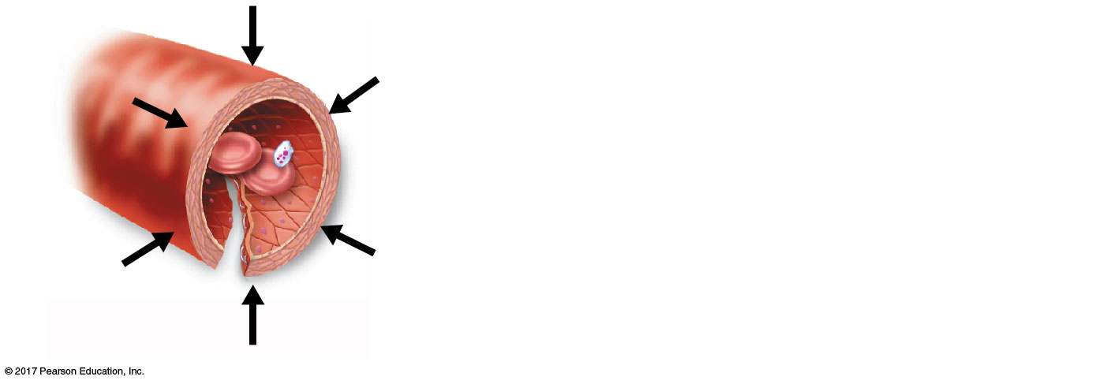
HEMOSTASIS
Step 1: Vascular spasms
  Immediate response to blood vessel injury
  Vasoconstriction causes blood vessel to spasm
  Spasms narrow the blood vessel, decreasing blood loss
1
Step Vascular spasms occur.
• Smooth muscle contracts,
causing vasoconstriction.

Slide 37
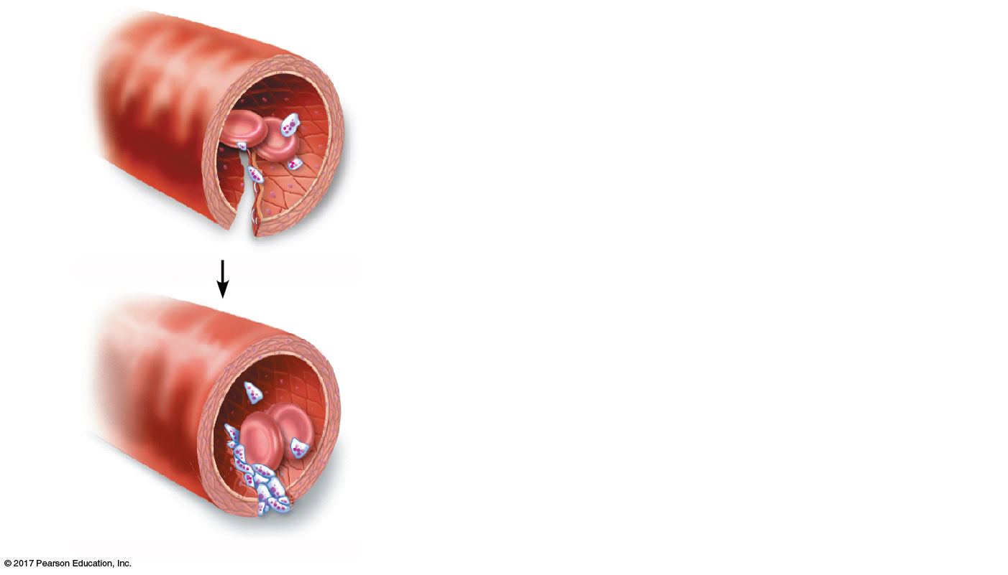
HEMOSTASIS
Step 2: Platelet plug formation
  Protein fibers are exposed by a break in a blood vessel
  Platelets become “sticky” and cling to fibers
  Anchored platelets release chemicals to attract more platelets
  Platelets pile up to form a platelet plug
2
Step Platelet plug forms.
• Platelets release chemicals that
make nearby platelets sticky;
platelet plug forms.
Platelets

Slide 38
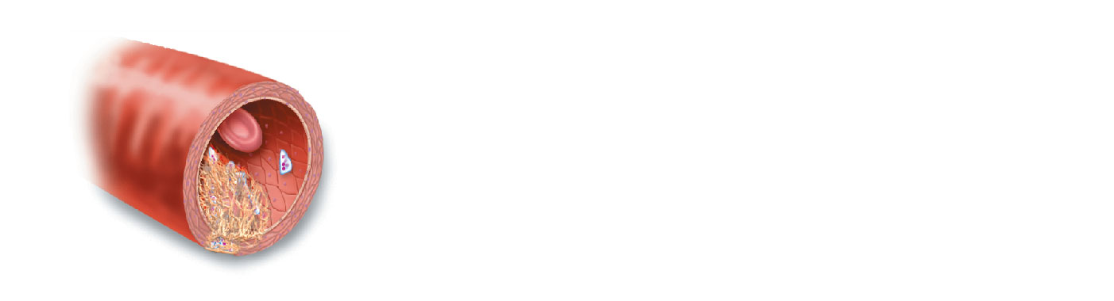
HEMOSTASIS
Step 3: Coagulation
  Chemicals from injured tissues, protein clotting factors, and calcium interact to form thrombin, an enzyme
  Thrombin joins fibrinogen proteins into hair-like molecules of insoluble fibrin
  Fibrin forms a meshwork template for a clot
Step Coagulation events occur.
3
• Clotting factors present in plasma
and released by injured tissue cells
interact to form thrombin, which forms fibrin.
Fibrin
• Fibrin forms a mesh that traps red blood
cells and platelets, forming the clot.

Slide 39
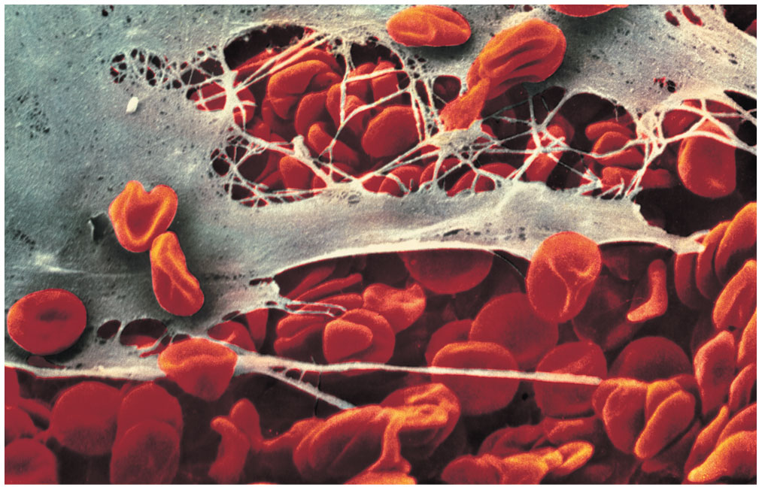
HEMOSTASIS
Blood usually clots within 3 to 6 minutes
The clot remains as the vessel wall heals
The clot is broken down after tissue repair

Slide 40
HEMOSTASIS
Too much clotting
  Thrombus
    A clot in an unbroken blood vessel
    Can be deadly in areas such as the lungs
  Embolus
    A thrombus that breaks away and floats freely in the bloodstream
    Can later clog vessels in critical areas such as the brain

Slide 41
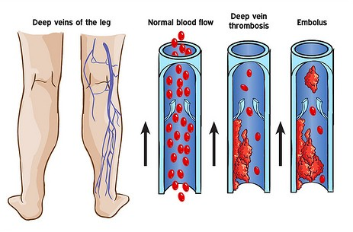
HEMOSTASIS

Slide 42
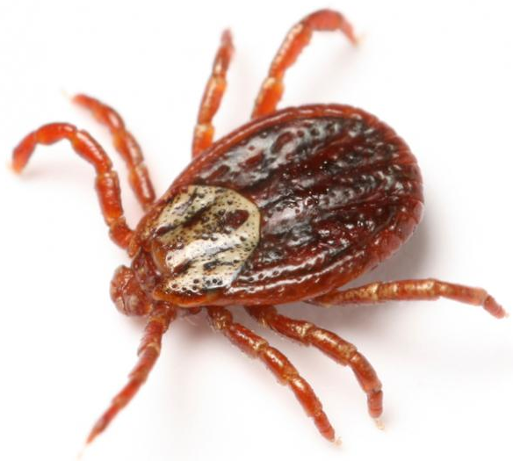
HEMOSTASIS
Not enough clotting
  Thrombocytopenia
    Low # of platelets
    Arises from any condition that suppresses the bone marrow
    Even normal movements can cause bleeding from small blood vessels that require platelets for clotting
      Evidenced by petechiae (small purplish bruises on the skin)

Slide 43
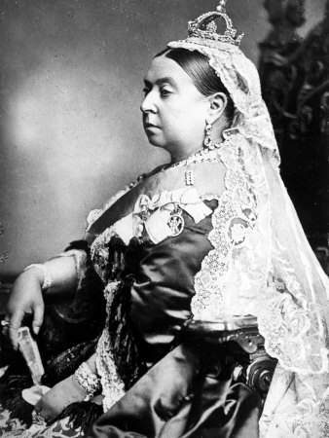
HEMOSTASIS
Not enough clotting
  Hemophilia
    Low # of blood proteins (clotting factors)
    Genetic bleeding disorder
    Minor tissue damage can cause life-threatening prolonged bleeding

Slide 44
BLOOD TYPES
Large losses of blood have serious consequences
  Loss of 15 to 30 percent causes weakness
  Loss of over 30 percent causes shock, which can be fatal
Blood transfusions are given to replace blood cells:
  Hemorrhage from injury
  Anemia from autoimmune disease or leukemia
  Leukopenia from cancer treatment
  Thrombocytopenia from tick disease

Slide 45
BLOOD TYPES
RBCS are coated with genetically determined proteins called antigens
Antigens = Substances that the body recognizes as foreign
  Most antigens are foreign proteins
  “Self” antigens are tolerated
Antibodies = Recognize and bind to antigens
Blood is “typed” by using antibodies that will cause blood with certain proteins to clump (agglutination) and rupture

Slide 46
BLOOD TYPES
ABO blood group
  Blood types based on presence or absence of 2 antigens:
    Antigen A
    Antigen B
  Patients with Antigen A and B = type AB
  Patients with Antigen A = type A
  Patients with Antigen B = type B
  Patients without antigens = type O

Slide 47
BLOOD TYPES
Type O = NO antigens

Slide 48
BLOOD TYPES
Type A = Has A antigens
A
A
A
A
A
A
A
A

Slide 49
BLOOD TYPES
Type B = Has B antigens
B
B
B
B
B
B
B
B

Slide 50
BLOOD TYPES
Type AB = Has both A and B antigens
A
B
B
A
A
B
B
A

Slide 51

BLOOD TYPES
Rh blood group
  Named for the Rh antigen (agglutinogen D)
  Most Americans are Rh⁺, meaning they carry the Rh antigen
  If an Rh– person receives Rh⁺ blood:
    The immune system becomes sensitized and begins producing antibodies
    All future transfusions involve antibodies attacking donor’s Rh⁺ RBCs, and RBCs are destroyed

Slide 52
BLOOD TYPES
Rh – = NO antigens

Slide 53
BLOOD TYPES
Rh + = Has Rh antigen
Rh
Rh
Rh
Rh
Rh
Rh
Rh
Rh

Slide 54
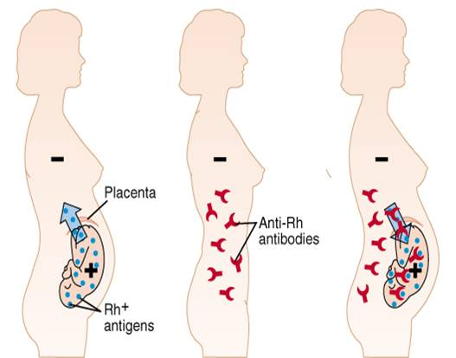
BLOOD TYPES
Rh-related problem during pregnancy
  Danger occurs only when the mother is Rh– and the child inherits the Rh⁺ factor
  After the first Rh+ pregnancy, the mother’s immune system will produce antibodies to attack the baby’s Rh⁺ blood

Slide 55
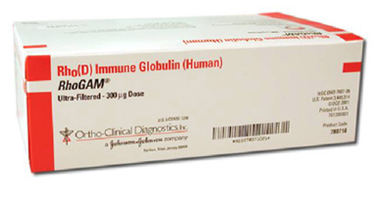
BLOOD TYPES
Rh-related problem during pregnancy
  RhoGAM shot can prevent buildup of anti-Rh⁺ antibodies in mother’s blood
  This doesn’t happen as severely with ABO incompatibility

Slide 56
BLOOD TYPES
Identify the blood type:
Rh
A
A
Rh
Rh
A
A
Rh

Slide 57
BLOOD TYPES
Identify the blood type:
B
B
B
B
B
B
B
B

Slide 58
BLOOD TYPES
Identify the blood type:
Rh
Rh
Rh
Rh
Rh
Rh
Rh
Rh

Slide 59
BLOOD TYPES
Identify the blood type:
A
B
B
A
A
B
B
A

Slide 60
BLOOD TYPES
Identify the blood type:
A
Rh
Rh
B
B
Rh
Rh
A
A
Rh
Rh
B
B
Rh
Rh
A

Slide 61
BLOOD TYPES
Identify the blood type:

Slide 62
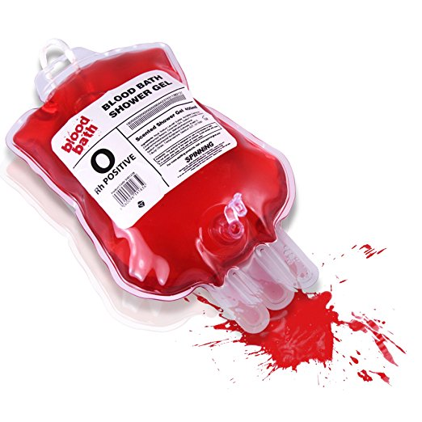
BLOOD TYPES
Rh+ blood can receive Rh+ and Rh- blood
  Rh- cannot receive Rh+ blood
Type AB can receive A, B, AB, and O blood
  Type AB+ = “universal recipient”
Type B can receive B and O blood
Type A can receive A and O blood
Type O can receive O blood
  Type O- = “universal donor”
Ex) A- blood can receive A-, O-,

Slide 63
BLOOD TYPES
–
+
Safe transfusions: Donor only has what patient recognizes as “self”
O
A
B
AB
Notes:
Safe transfusions don’t HAVE to be your exact blood type.
Donor blood just can’t have anything it that you don’t already recognize as yourself.

Slide 64
BLOOD TYPES
–
+
What blood types can B+ blood receive?
O
A
B
AB

Slide 65
BLOOD TYPES
–
+
What blood types can A- blood receive?
O
A
B
AB

Slide 66
BLOOD TYPES
–
+
What blood types can AB+ blood receive?
O
A
B
AB

Slide 67
BLOOD TYPES
–
+
To what blood types can AB+ blood donate?
O
A
B
AB

Slide 68
BLOOD TYPES
–
+
To what blood types can B- blood donate?
O
A
B
AB

Slide 69
BLOOD TYPES
–
+
To what blood types can O+ blood donate?
O
A
B
AB

Slide 70
BLOOD TYPES
–
+
To what blood types can O- blood donate?
O
A
B
AB

Slide 71
BLOOD TYPES
–
+
O
Unsafe transfusions → Antibodies
You are born with antibodies to ABO antigens you don’t recognize
Y
Y
Y
Y
Y
A
Y
Y
Y
B
Y
Y
Y
AB
Y

Slide 72
BLOOD TYPES
Blood samples are mixed serum containing anti-A and anti-B antibodies
Agglutination (clumping) → Antibodies have recognized and bound to the blood type
No Agglutination → Antibodies didn’t recognize anything

Slide 73
BLOOD TYPES
Y
Anti-B Antibody =
Y
Y
Y
Y
Y
Y
Y
Y
Y
Y

Slide 74
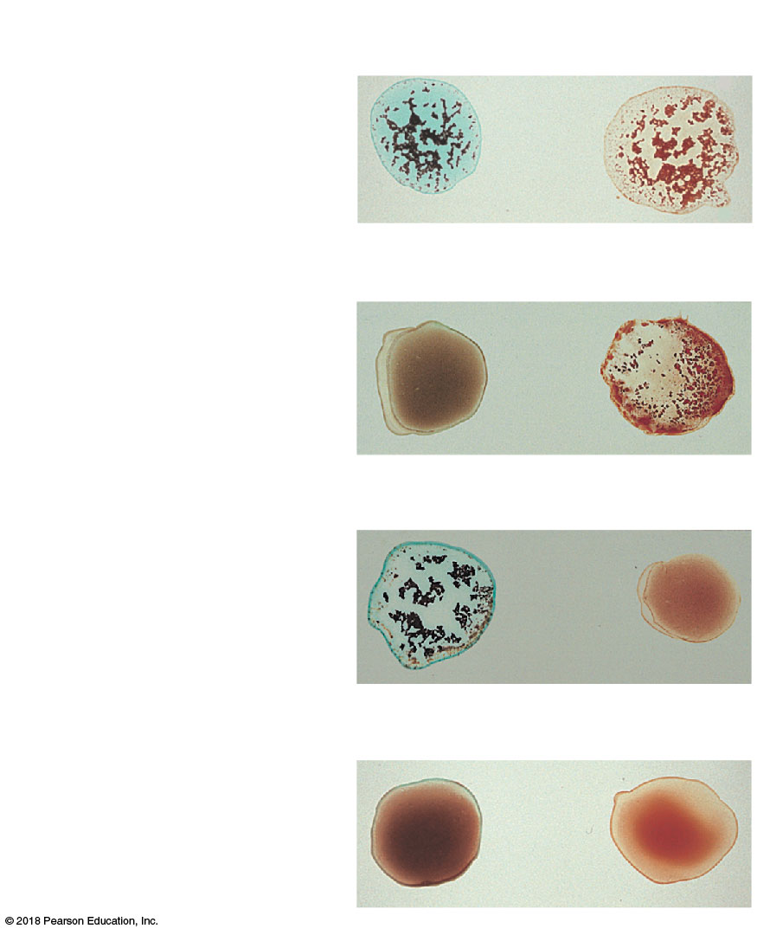
Blood being tested
Serum containing Antibodies
Anti-A
Anti-B
Type AB
(contains antigens A and B;
agglutinates with both sera)
Agglutinated
RBCs
Type B
(contains antigen B;
agglutinates with
anti-B serum)
Type A
(contains antigen A;
agglutinates with
anti-A serum)
Type O
(contains no antigens;
does not agglutinate with
either serum)

