Slide 1
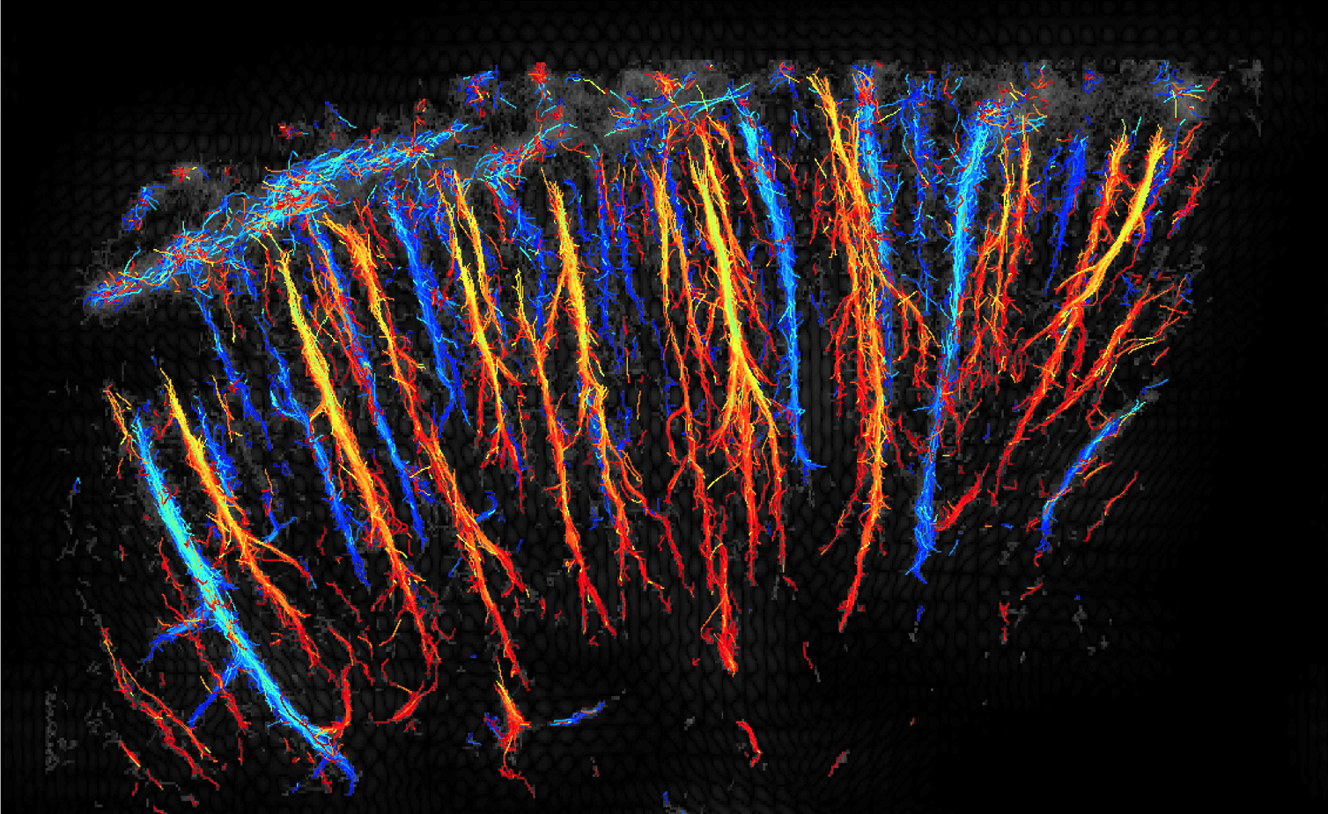
Lecture 18
The Lymphatic System

Slide 2
OVERVIEW
Transportation– how do we move things throughout our bodies?
Interstitial Fluid – what role does interstitial fluid play in the lymphatic system?
Lymph Nodes – what is the basic structure of a lymph node, and how does it work?
Lymphoid Organs – what are other organs of the lymphatic system, and what do they do?
The Immune System – how does the lymphatic system protect the body?

Slide 3
INTRODUCTION
2 Structures of the Lymphatic System
  Lymphatic vessels
  Lymphoid organs
3 Functions of the Lymphatic System
  Transports leaked fluids from the cardiovascular system back to the blood
  Transport dietary lipids
  Plays essential roles in immunity
3 Cells Types of the Lymphatic System
  Macrophages
  Dendritic cells
  Lymphocytes

Slide 4
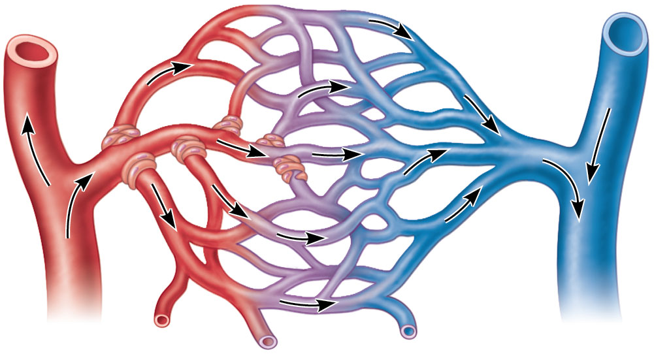
INTERSTITIAL FLUID
  Plasma moves out of the capillary at the beginning
    Due to high blood pressure in the arteriole
  Most plasma is pulled back into the capillary at the end
    Due to the pull exerted by osmotic pressure in the venule
  interstitial fluid
Arteriole
Capillary beds in tissue
Venule

Slide 5
INTERSTITIAL FLUID
Lymphatic vessels pick up excess interstitial fluid (now called lymph) and return it to the blood
Lymph = Plasma that leaked out of capillaries, entered interstitial fluid, and is now being transported by the lymphatic system
If fluids are not picked up, edema occurs as fluid accumulates in tissues

Slide 6
INTERSTITIAL FLUID
Edema occurs when there is:
  Increased fluid delivery to the capillary bed
  Increased blood pressure
  Decreased removal of fluid at the capillary bed

Slide 7
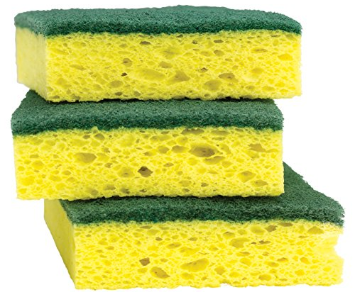
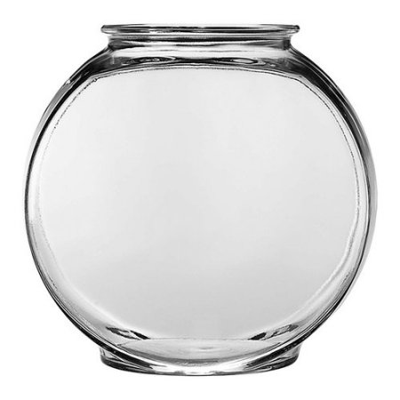
INTERSTITIAL FLUID
Edema = Fluid in tissue
  NOT “drainable”
  Fluid is with tissue
Effusion = Fluid in a cavity
  “Drainable”
  Fluid is within an empty space

Slide 8
INTERSTITIAL FLUID
Which of the following is an effusion?
  a. A person’s fingers swell while gardening on a hot day
  b. A person with left-sided congestive heart failure has trouble breathing
  c. A dog’s splenic mass ruptures, leaking blood into the abdomen

Slide 9
INTERSTITIAL FLUID
A person with left-sided congestive heart failure develops pulmonary edema. Which of the following would be an effective treatment?
  a. Place a chest tube to drain the fluid
  b. Prescribe Lasix, a medication that encourages the kidneys to excrete more fluid
  c. Administer a rescue inhaler of albuterol or other medication that widens the airways

Slide 10
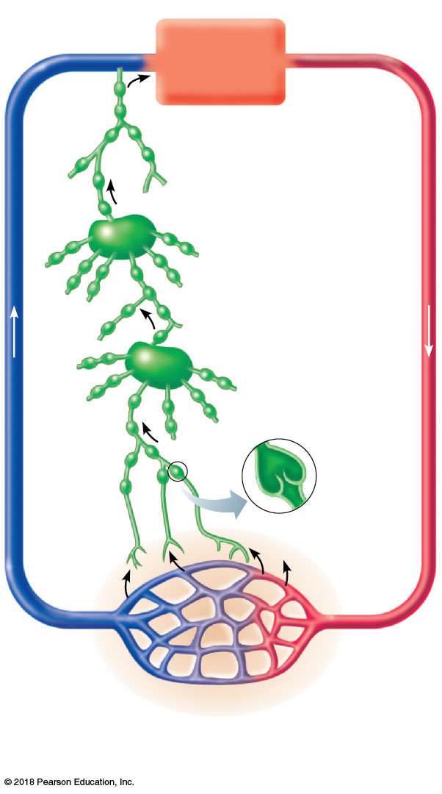
Venous
system
Arterial
system
Heart
Lymph node
Lymphatic
system
Lymphatic
vessels
Lymph
capillary
Interstitial
fluid
(becomes
lymph)
Blood
capillaries
Interstitial fluid

Slide 11
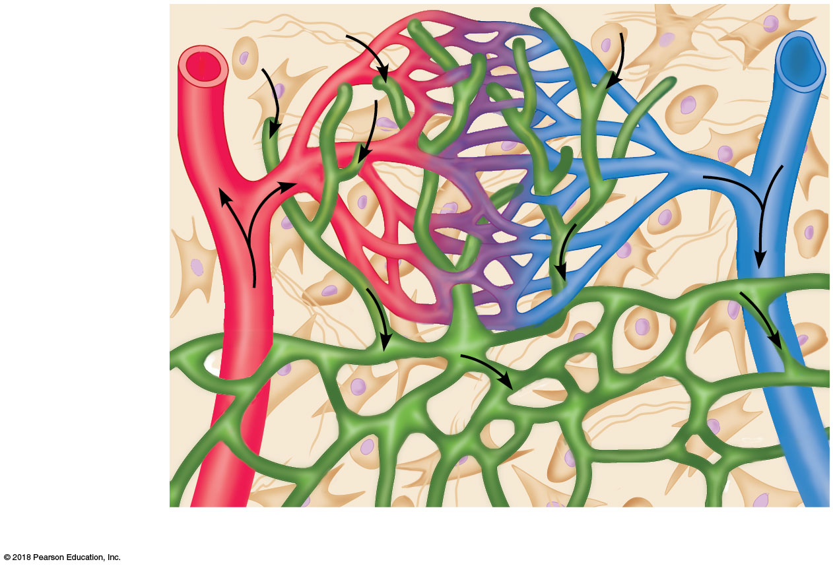
INTERSTITIAL FLUID
Interstitial fluid
Tissue cell
Lymphatic
capillary
Blood
capillaries
Arteriole
Venule

Slide 12
LYMPH NODES
Lymph nodes filter lymph before returning it to blood
  Filter = Remove
Materials removed during filtration include:
  Bacteria
  Viruses
  Cancer cells
  Cell debris
3 Lymph Node Regions
  Cervical
  Axillary
  Inguinal

Slide 13
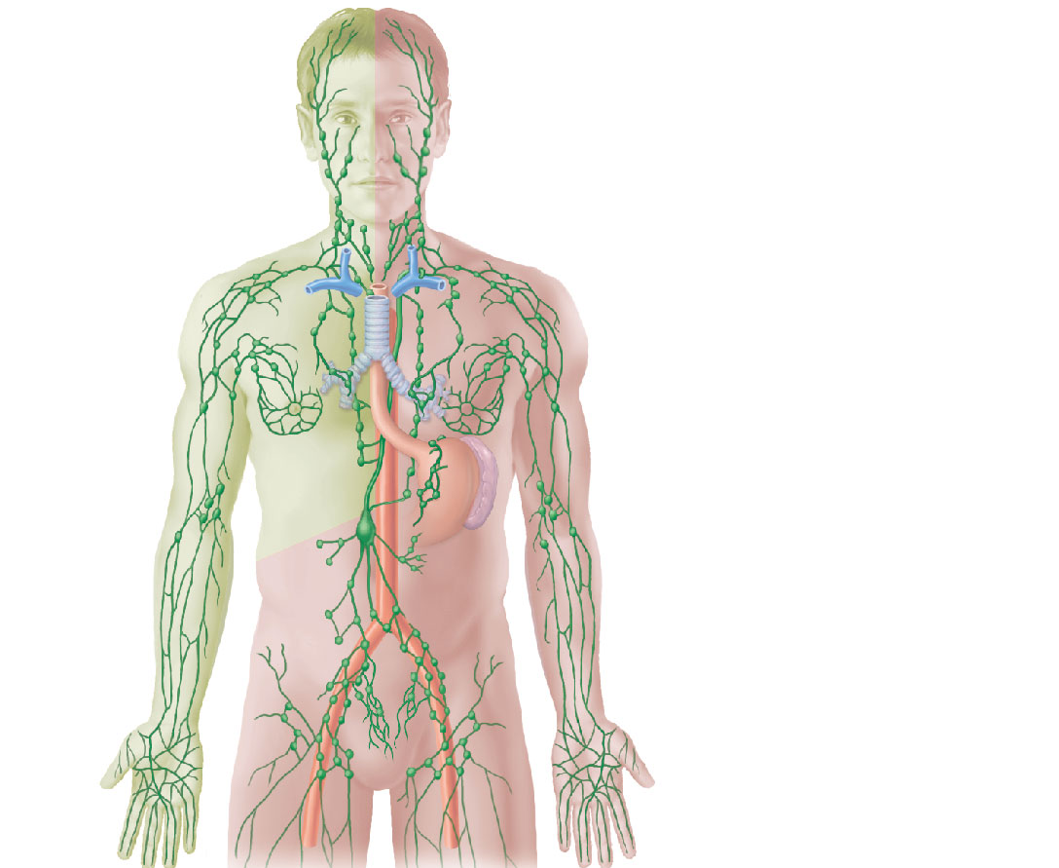
LYMPH NODES
Regional
lymph nodes:
Cervical
nodes
Axillary
nodes
Inguinal
nodes
Lymphatic vessels

Slide 14
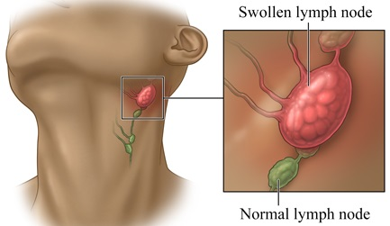
LYMPH NODES

Slide 15
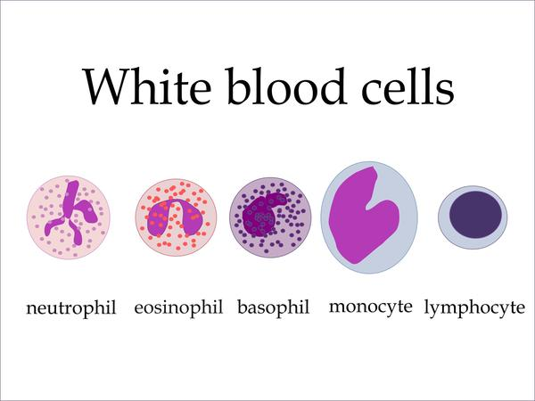
LYMPH NODES
2 Types of WBCs in Lymph Nodes
  Macrophages
    Monocytes that have left blood and entered tissue
    “Eat” and destroy bacteria, viruses, and other foreign substances in lymph
    The filtering cell
  Lymphocytes
    Respond to foreign substances in lymph in a variety of ways
    Includes T-Cells and B-Cells
    The detecting cell

Slide 16
LYMPH NODES
Most lymph nodes are kidney-shaped, less than
½ inch long, and buried in connective tissue
2 Compartments of a Lymph Node
  Cortex (outer part)
    Contain lymphocytes
    Produces antibodies
    Collections of follicles
  Medulla (inner part)
    Contains macrophages

Slide 17
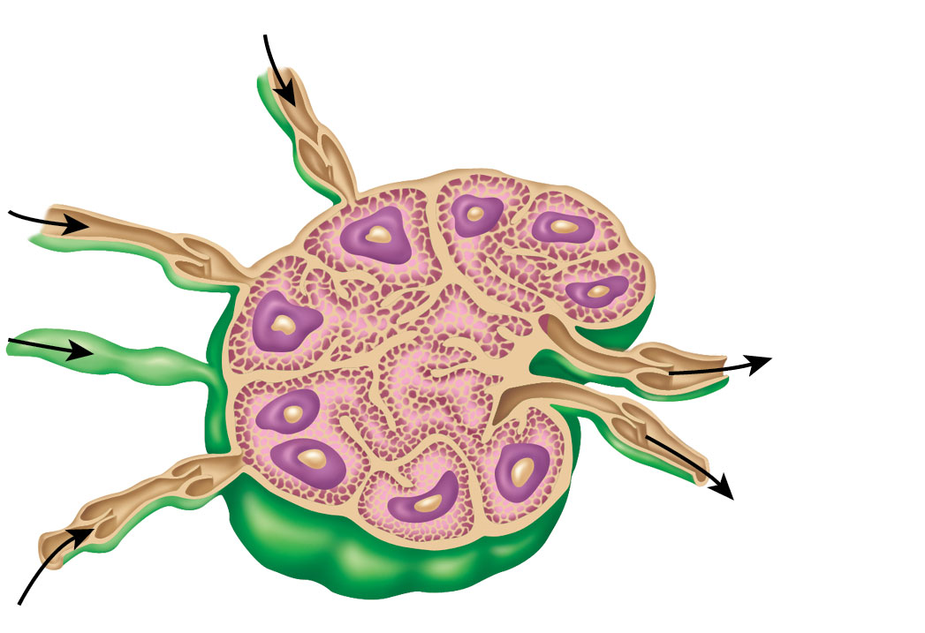
LYMPH NODES
Lymph nodes create congestion to allow time for detection and filtration
Antibody
center in
follicle
Cortical
follicle
Cortex
Location of lymphocytes
Medulla
Location of Macrophages

Slide 18
LYMPHOID ORGANS
Lymph nodes are NOT the only organs of the lymphatic system
Lymphoid Organs:
  Spleen
  Thymus
  Tonsils
  Peyer’s patches
  Appendix
All lymphoid organs are filled with lymphocytes

Slide 19
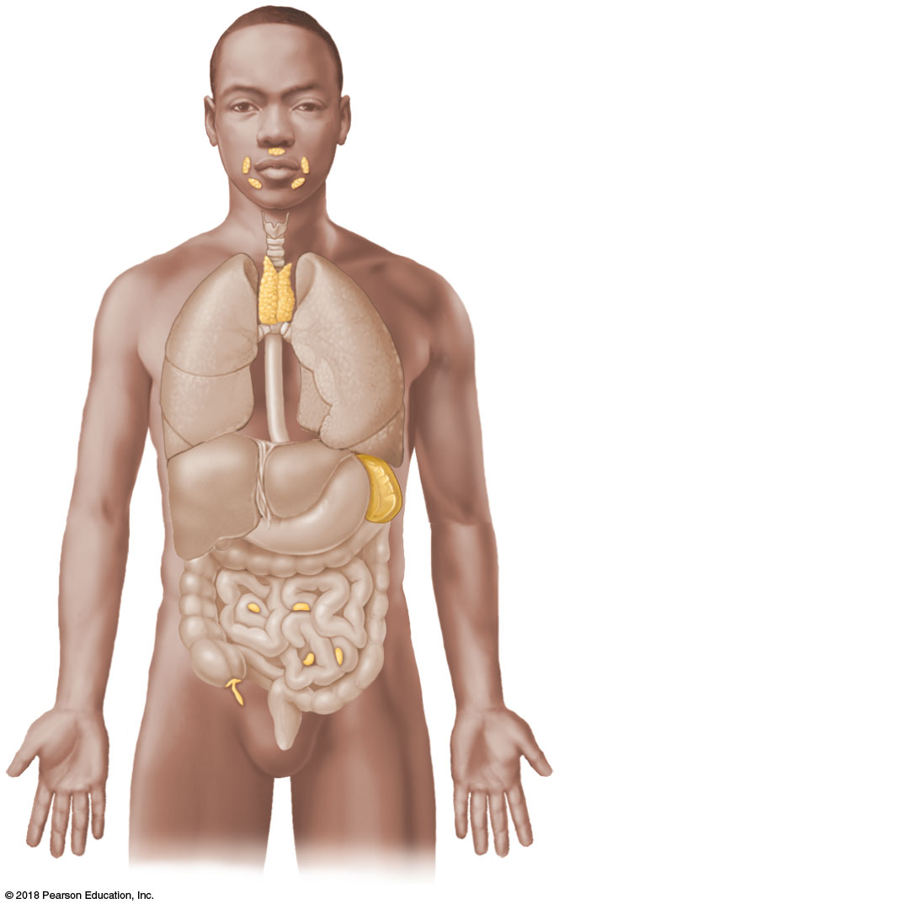
Tonsils
Thymus
Spleen
Peyer’s patches
Appendix

Slide 20
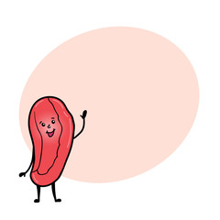

LYMPHOID ORGANS
Spleen
  Filters blood of bacteria, viruses, debris
  Contains lymphocytes for immune surveillance
  “Recycle center” that destroys worn-out RBCs and recycles their contents

Slide 21
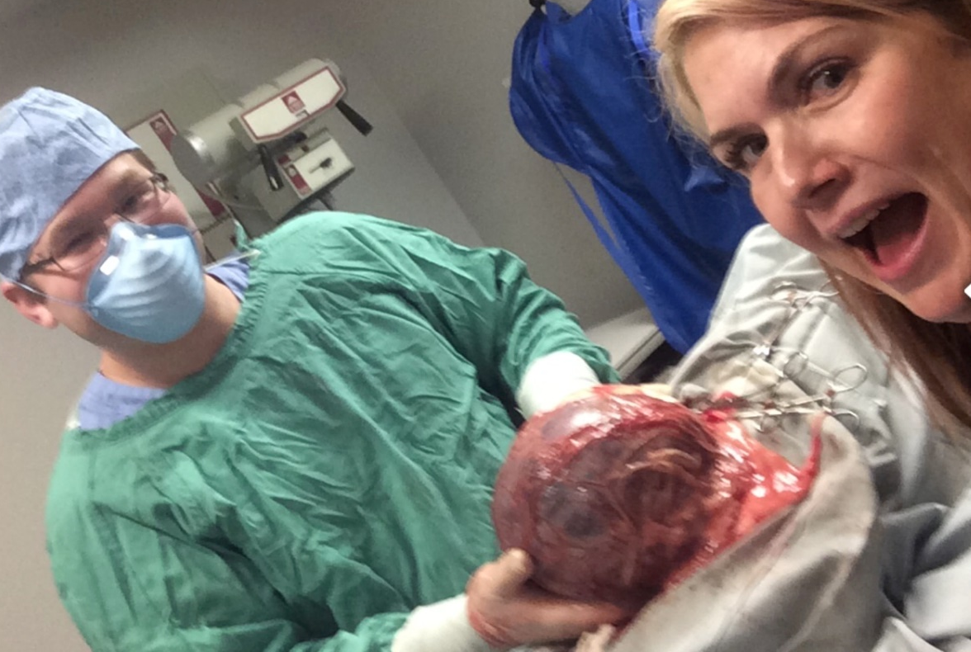
LYMPHOID ORGANS
Splenectomy = Surgical removal of the Spleen
  Treatment for certain autoimmune diseases
  Can raise risk of infection and disease
  The liver takes over some of the spleen’s function

Slide 22

LYMPHOID ORGANS
Thymus
  Found overlying the heart
  Functions at peak levels only during youth
  Helps make T-Lymphocytes
    The cells affected by HIV

Slide 23
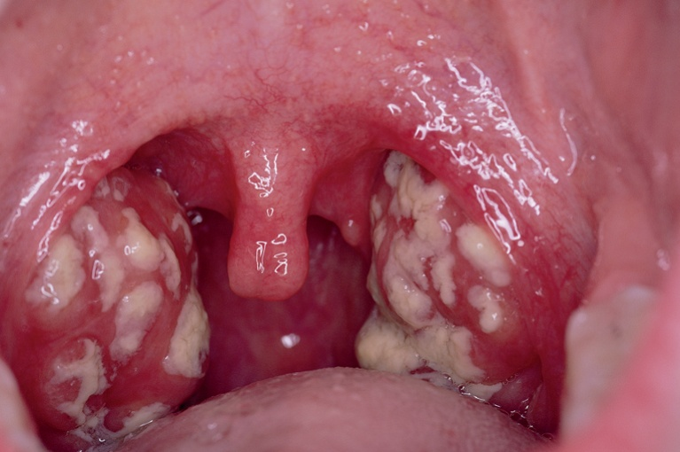
LYMPHOID ORGANS
Tonsils
  Small masses of lymphoid tissue in the throat
  Trap and remove foreign pathogens
  Tonsillitis = Inflammation from tonsil congestion
    Chronic tonsilitis prevent the tonsils from functioning
    Tonsils can become a source of pain and infection

Slide 24
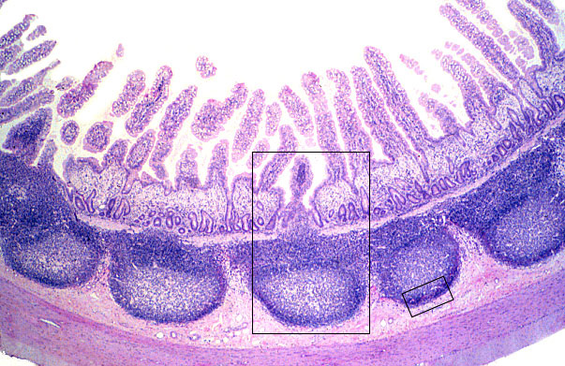
LYMPHOID ORGANS
Peyer’s patches
  Found in the wall of the ileum of the small intestine
  Filter and cleans digesta of bacteria, viruses, debris
  Similar lymphoid follicles are found in the appendix

Slide 25

WHY DOES THIS MATTER?
70% of the immune system is in the Peyer’s Patches
Modern diets have been linked to Peyer’s Patch dysfunction, or “Leaky Gut Syndrome”
“Leaky Gut” has been implicated in the development of allergies and autoimmune disease

Slide 26
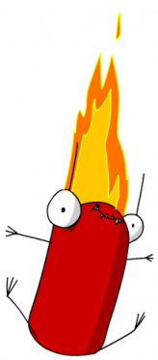
LYMPHOID ORGANS
Appendix
  Filters digesta like the Peyer’s Patches
  Appendicitis = Inflammation from congestion, similar to tonsilitis
    Can be life-threatening if the appendix gets a bacterial infection or “bursts”
  Removal may raise risk of autoimmune disease

Slide 27
Identify the Spleen
Notes:
Click on the lymphoid organs

Slide 28
Identify the Appendix
Notes:
Click on the lymphoid organs

Slide 29
Identify the Peyer’s Patches
Notes:
Click on the lymphoid organs

Slide 30
Identify the Tonsils
Notes:
Click on the lymphoid organs

Slide 31
Identify the Thymus
Notes:
Click on the lymphoid organs

Slide 32
THE IMMUNE SYSTEM
Immunity = Specific resistance to disease
Immune system is a functional system rather than an organ system in an anatomical sense
2 Parts of the Immune System
  Innate immune system
    Inborn
  Adaptive immune system
    Learned

Slide 33
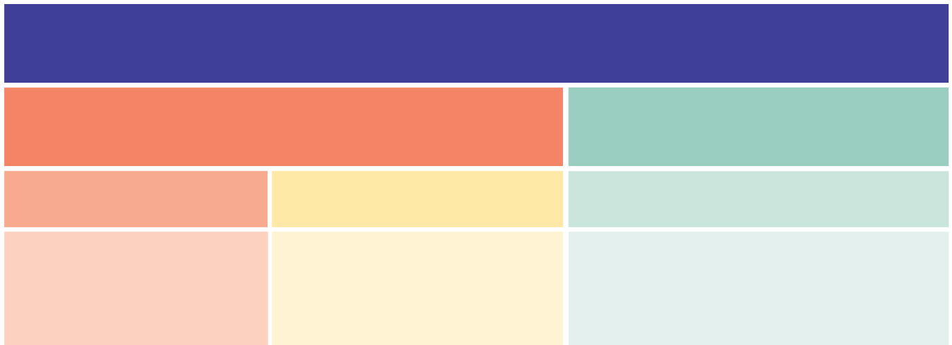
THE IMMUNE SYSTEM
Innate Immune System
  Inborn mechanisms protect against a variety of invaders
  Responds immediately to protect body from foreign materials
The Immune System
Innate Immune System
Adaptive Immune System
First line of defense
Second line of defense
Third line of defense
• Skin
• The inflammatory
response
• Lymphocytes
• Mucous membranes
• Antibodies
• Secretions
• Phagocytic cells

Slide 34
THE IMMUNE SYSTEM
Skin and mucous membranes provide the first line of defense against invasion
Protective secretions:
  Acidic sweat inhibits bacterial growth
  Sebum is toxic to bacteria
  Mucus traps microorganisms
  Saliva and tears contain enzymes that destroy bacteria
  Gastric juices are acidic and kill pathogens

Slide 35
THE IMMUNE SYSTEM
Cells and chemicals provide a second line of defense
  Cells of the innate immune system
    Macrophages, NK cells, and Dendritic cells
  Inflammatory response
The Immune System
Innate Immune System
Adaptive Immune System
First line of defense
Second line of defense
Third line of defense
• Skin
• Innate Immune Cells
• Lymphocytes
• Mucous membranes
• The inflammatory
response
• Antibodies
• Secretions

Slide 36
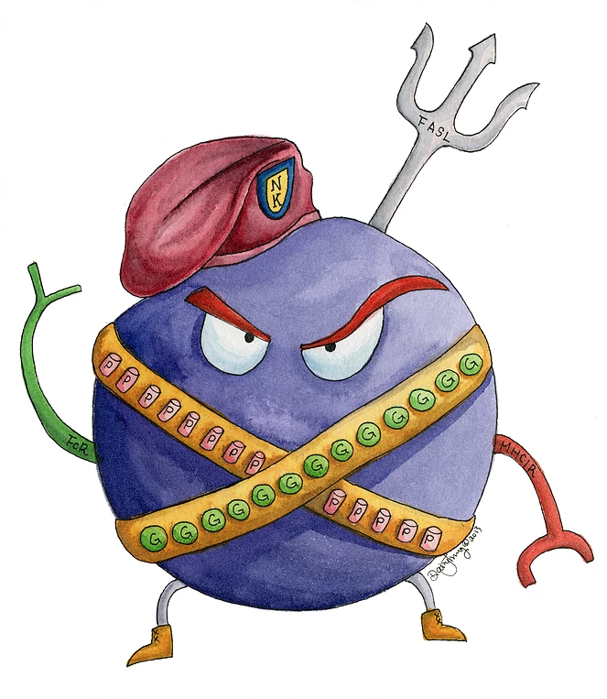
THE IMMUNE SYSTEM
3 Cells of the Innate Immune System
Macrophages
    Phagocytize foreign invaders within tissues
    Cause fever
    Derived from Monocytes
Natural Killer (NK) cells
    Identify and kill a variety of cancer and virus-infected cells
    Fight tissue damage caused by “rogue” cells
    Lymphocytes
Dendritic cells
    Activate the cells of the adaptive immune system

Slide 37
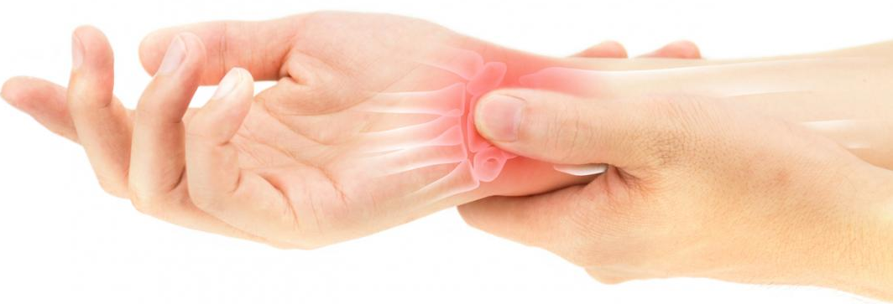
THE IMMUNE SYSTEM
Inflammatory response
  General response triggered whenever body tissues are injured
  4 Indicators of Inflammation
    Redness
    Heat
    Pain
    Edema, or swelling
  The presence of all 4 indicators means the body is responding to some sort of injury

Slide 38
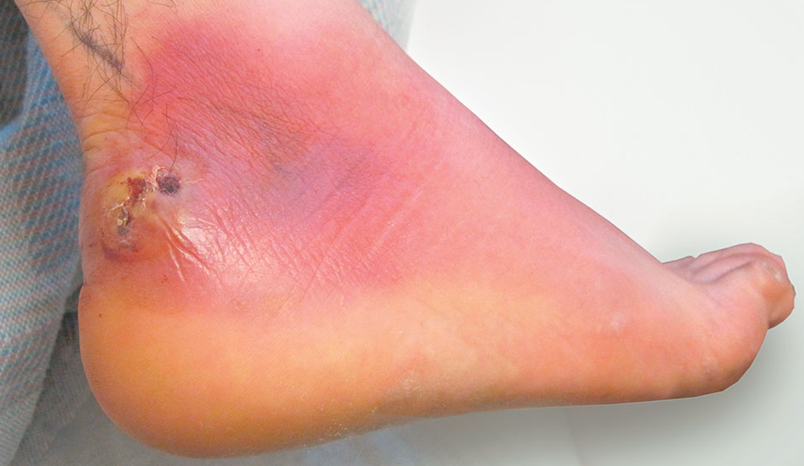
THE IMMUNE SYSTEM
Functions of the inflammatory response
  Prevents spread of damaging agents
  Disposes of cell debris and pathogens through phagocytosis
  Sets the stage for repair

Slide 39
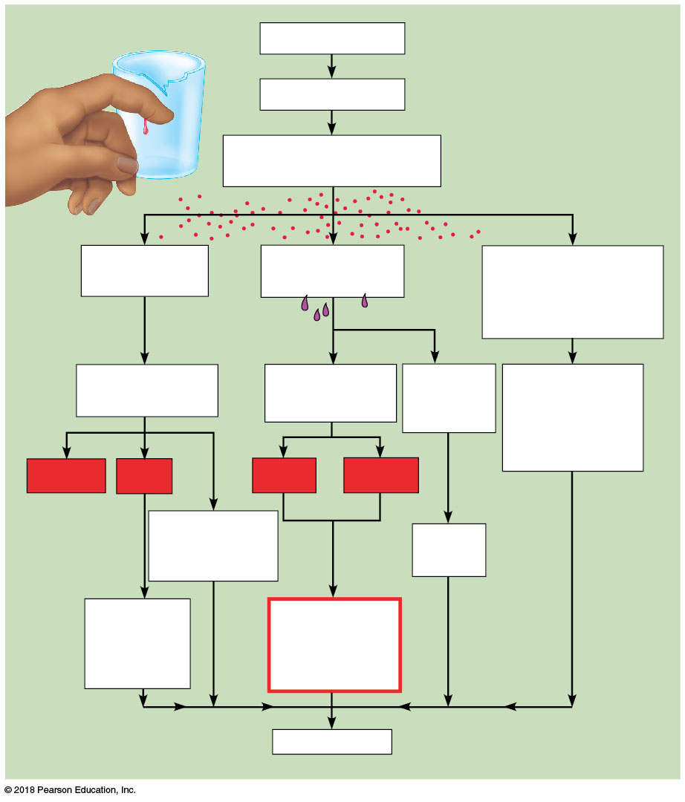
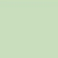


THE IMMUNE SYSTEM
Inflammatory response
  Damaged cells release inflammatory chemicals called cytokines
  Cytokines cause:
    Blood vessels to dilate → Redness/Heat
    Capillaries to become leaky → Swelling/Pain
    WBCs to move into the area
  Promotes healing
Injurious agents
Cells damaged
Release kinins, histamine,
and other cytokines
Blood vessels
dilate
Capillaries
become “leaky”
WBC soldiers enter
the affected area
Increased blood
flow into area
Edema (fluid in
tissue spaces)
Removal of
damaged/dead
tissue cells and
pathogens
from area
Redness
Heat
Pain
Swelling
Brings more
nutrients and
oxygen to area
Increases
metabolic
rate of
tissue cells
Healing

Slide 40
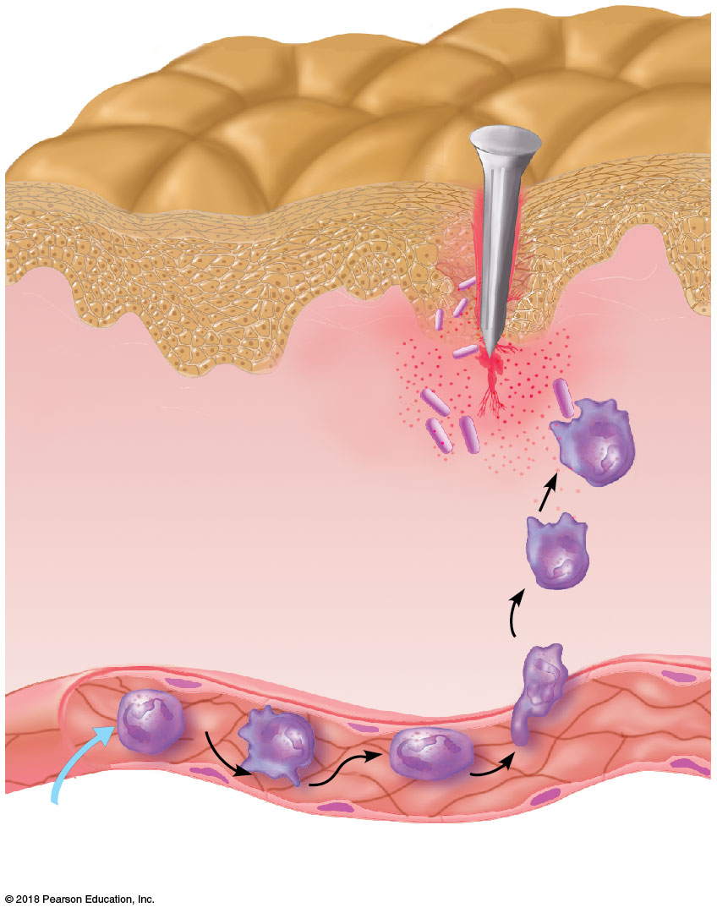
THE IMMUNE SYSTEM
3
Phagocytosis
Inflammatory
chemicals calling
in WBCs
Phagocytic WBCs
1
Enter blood from bone marrow
and roll along the vessel wall
2
Diapedesis

Slide 41
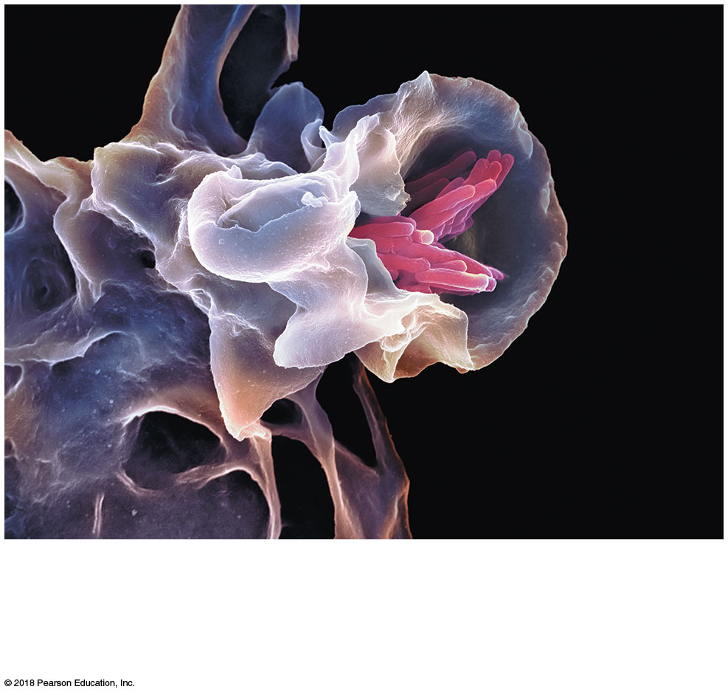
THE IMMUNE SYSTEM
A macrophage (purple) uses its cytoplasmic
extensions to ingest bacteria (pink) by phagocytosis

Slide 42
THE IMMUNE SYSTEM
Cytokine Storm
  Cytokines trigger hyperinflammation
  The immune system creates more problems than the disease

Slide 43
THE IMMUNE SYSTEM
Adaptive immune system
  Learned response to fight highly specific diseases
  Fights invaders that get past the innate system
Lymphocytes and antibodies are the third line of defense
The Immune System
Innate Immune System
Adaptive Immune System
First line of defense
Second line of defense
Third line of defense
• Skin
• The inflammatory
response
• Lymphocytes
• Mucous membranes
• Antibodies
• Secretions
• Phagocytic cells

Slide 44
THE IMMUNE SYSTEM
2 Cells of the Adaptive Immune System
  T-Lymphocytes
    Fight antigens directly
    T-cells learn what to fight in the Thymus
  B-Lymphocytes
    Secrete antibodies that eventually destroy antigens indirectly
    B-cells learn what to antibodies to make in the Bone Marrow
T
B

Slide 45
THE IMMUNE SYSTEM
Antigen = Any substance capable of exciting the immune system and provoking an immune response
  Microorganisms, like bacteria, fungi, viruses
  Foreign proteins, like RBC proteins A and B and pollen
  Self proteins, like organelles in the case of autoimmune diseases

Slide 46

THE IMMUNE SYSTEM
T and B lymphocytes migrate to the lymph nodes and spleen, where dendritic cells show them antigens
As cells encounter antigens, they learn to recognize only one very efficiently
Mature lymphocytes then circulate continuously throughout the body looking for their antigen “soulmate”

Slide 47
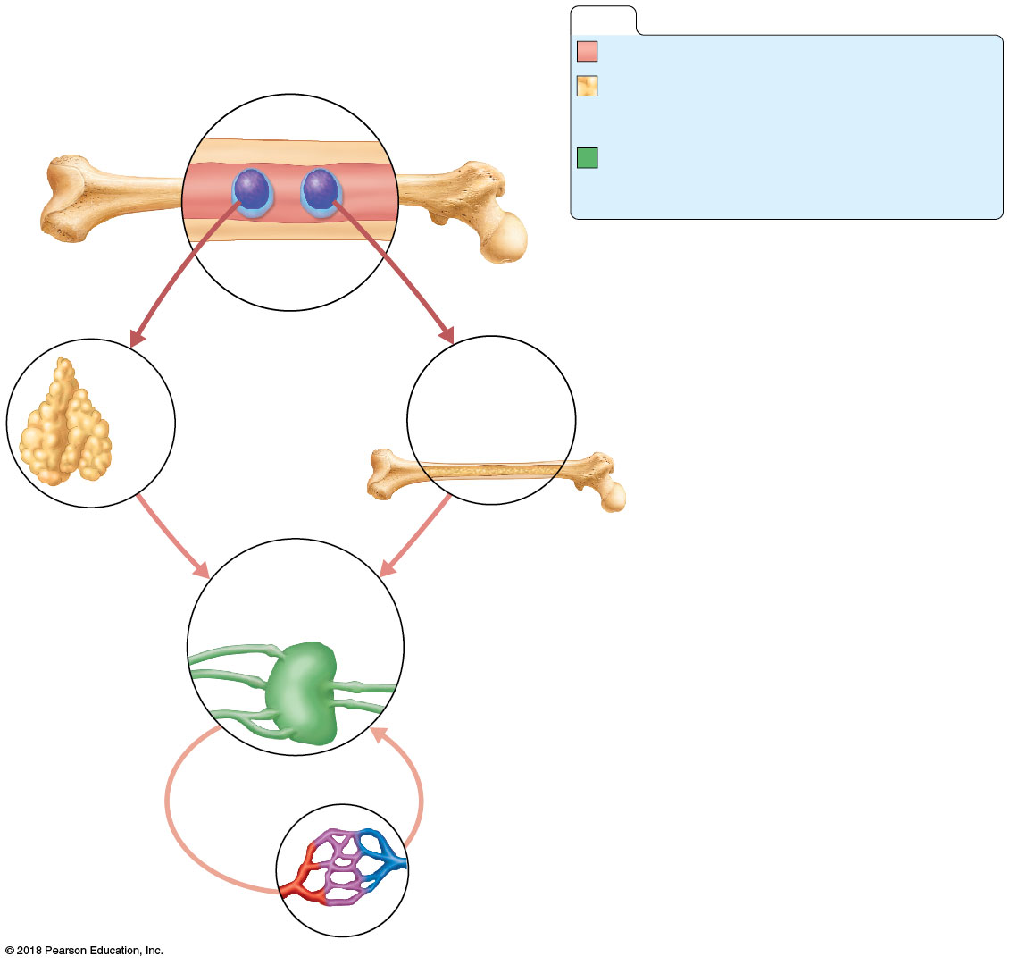
KEY:
Red bone marrow: site of lymphocyte origin
Primary lymphoid organs: sites of
Development for T or B cells
Red
bone marrow
Secondary lymphoid organs: sites of
antigen encounter, and activation to
T or B cells
Immature (naive)
lymphocytes
Lymphocytes destined to become T cells
migrate to the thymus. B cells develop in red
bone marrow.
1
1
Thymus
Bone marrow
2
2
Lymphocytes leave the thymus and bone
marrow. They “seed” the lymph nodes,
spleen, and other lymphoid tissues, where
they encounter their SINGLE antigen and
become activated.
Lymph nodes,
spleen, and other
lymphoid tissues
Activated lymphocytes circulate
continuously in the bloodstream and lymph
looking for the antigen they recognize
3
3

Slide 48
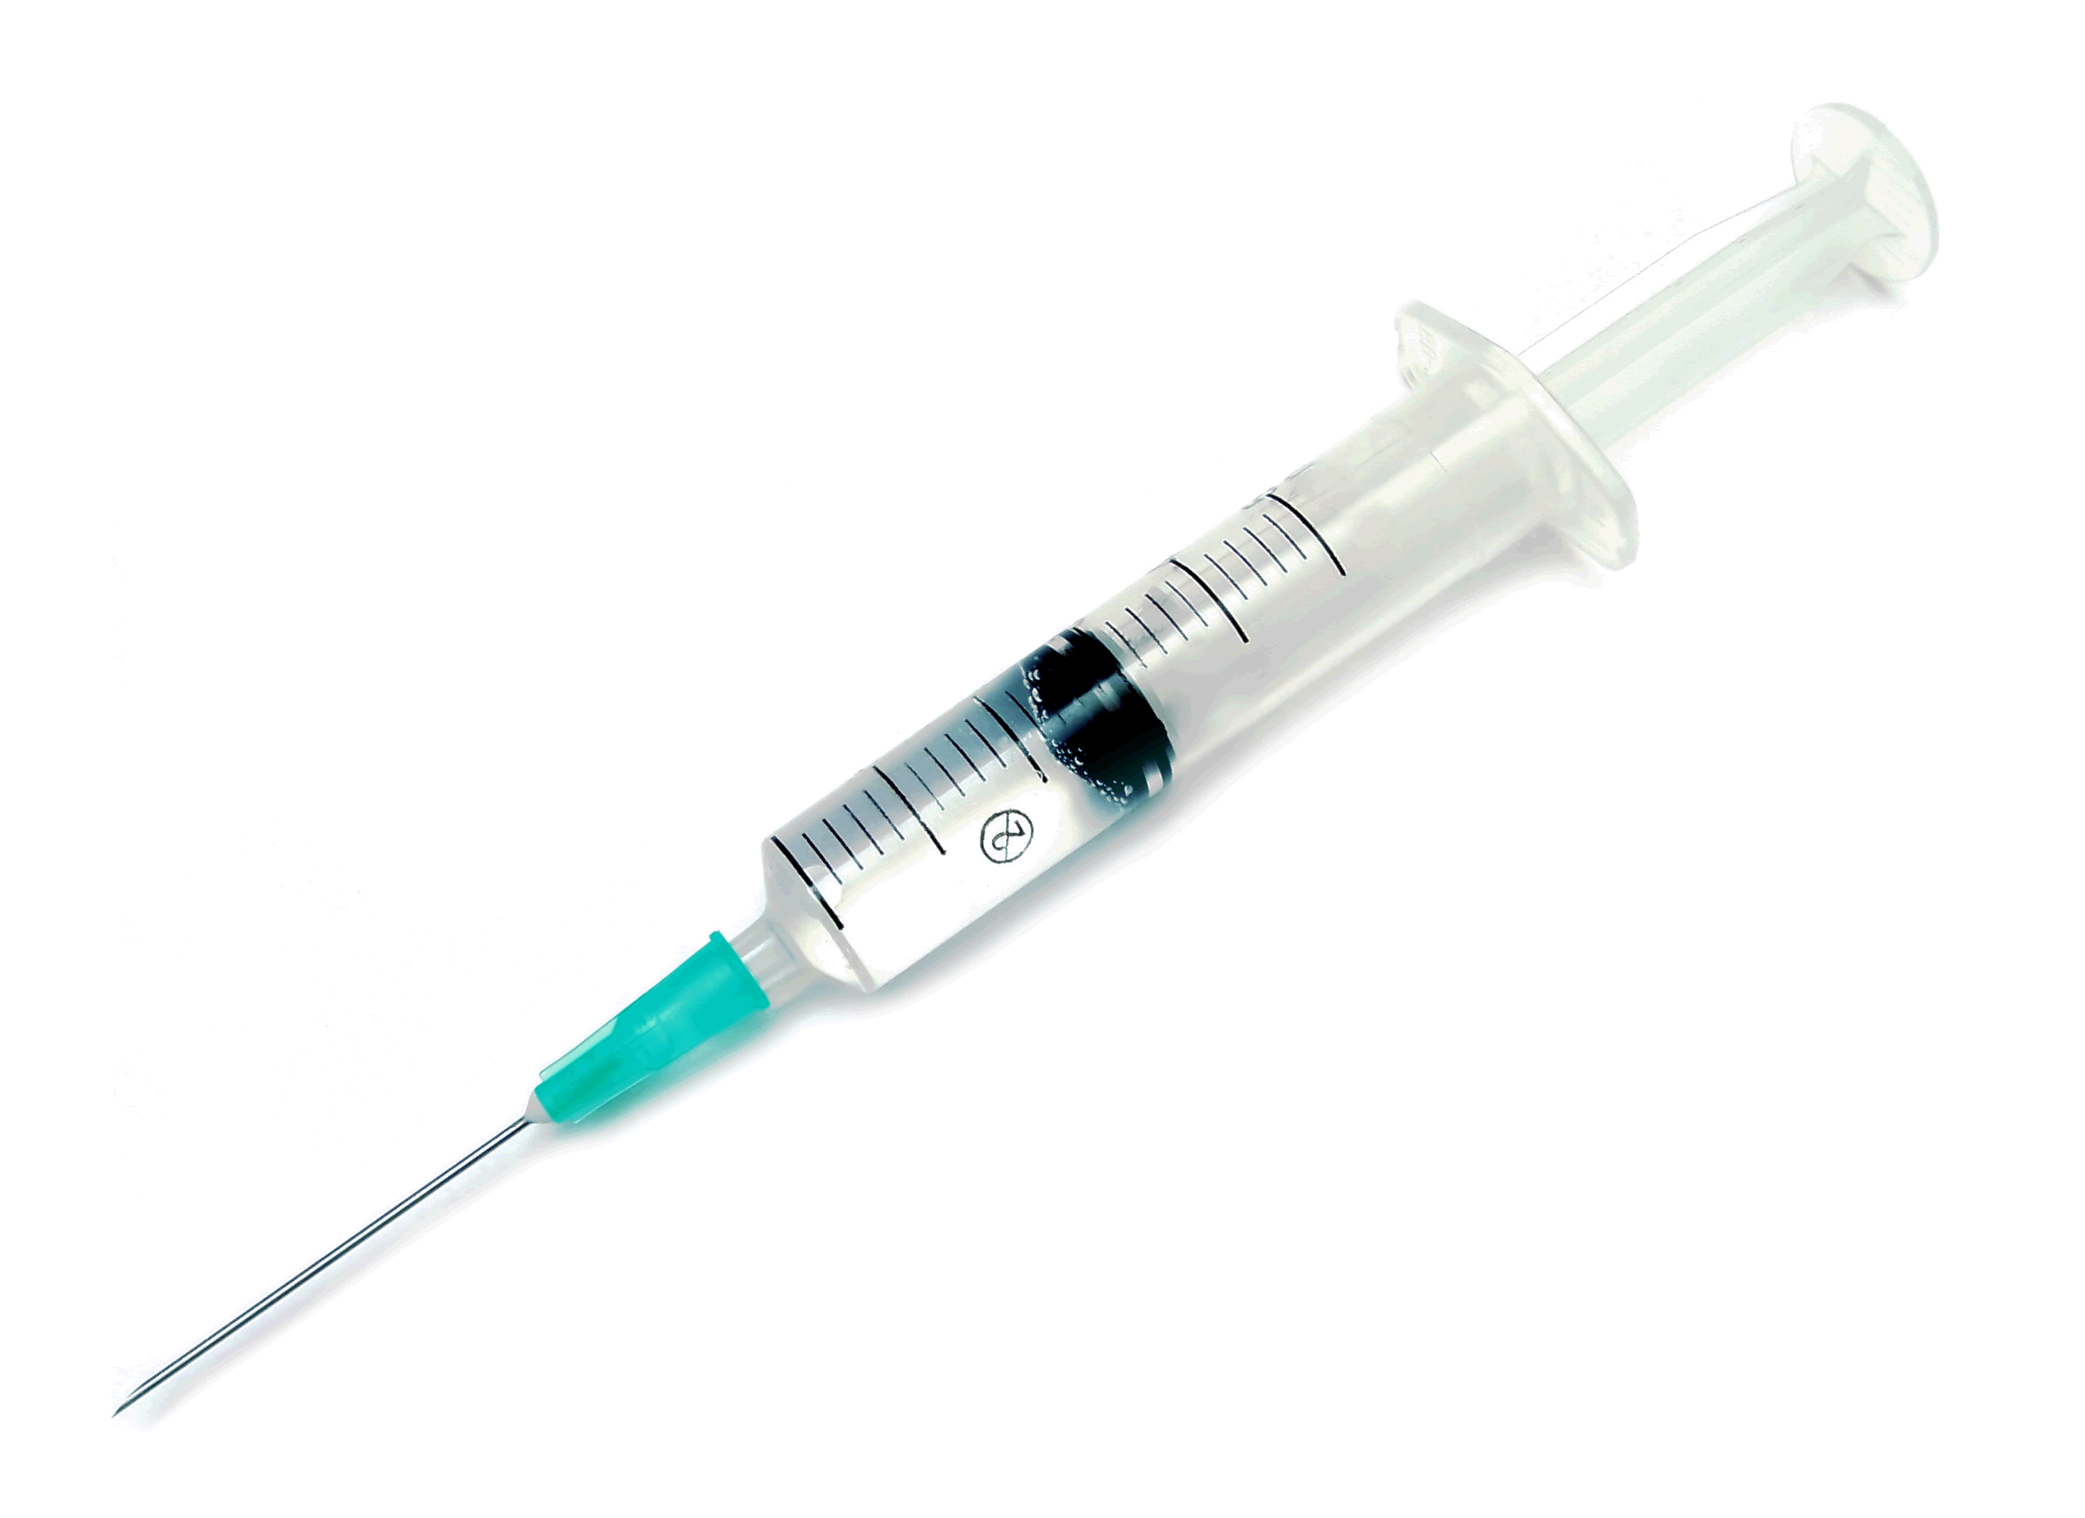
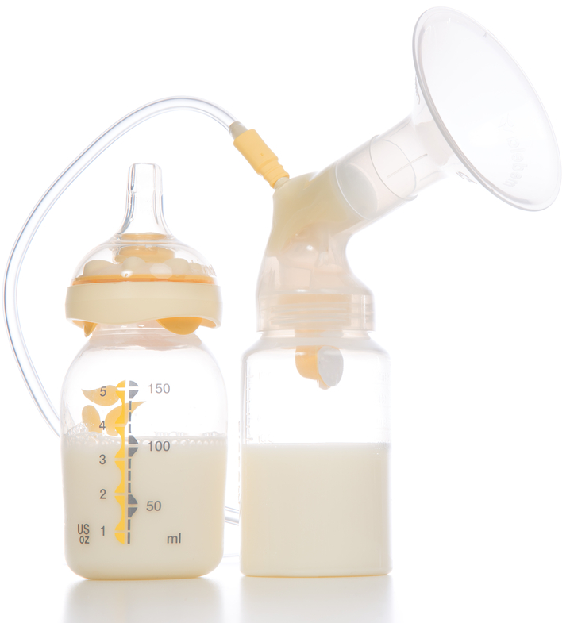
THE IMMUNE SYSTEM
Passive immunity
  When antibodies are made by someone else’s B-cells
    Acquired via the placenta or breast milk
    Donated through a plasma transfusion
  Protection is short-lived (2–3 weeks)
Active Immunity
  B-cells encounter antigens and produce antibodies
  Active immunity can be:
    Acquired during infections
    Acquired from vaccines

Slide 49
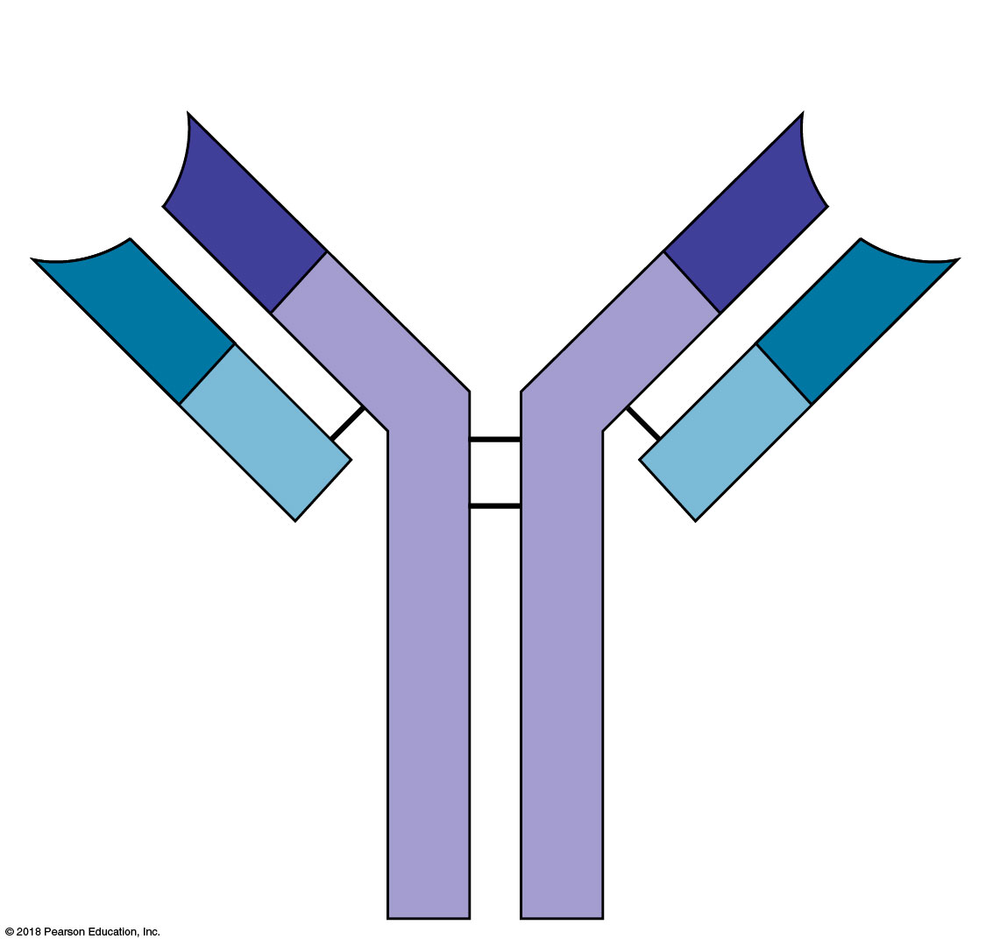
Antigen-binding
sites
Heavy
chain

Slide 50
THE IMMUNE SYSTEM
2 Mechanisms of Antibody Function
  Neutralization = Antibodies bind to specific areas that mask dangerous parts of antigens
  Agglutination = Antibody-antigen binding reaction causes clumping of cells
  Both mechanisms enhance phagocytosis!

Slide 51
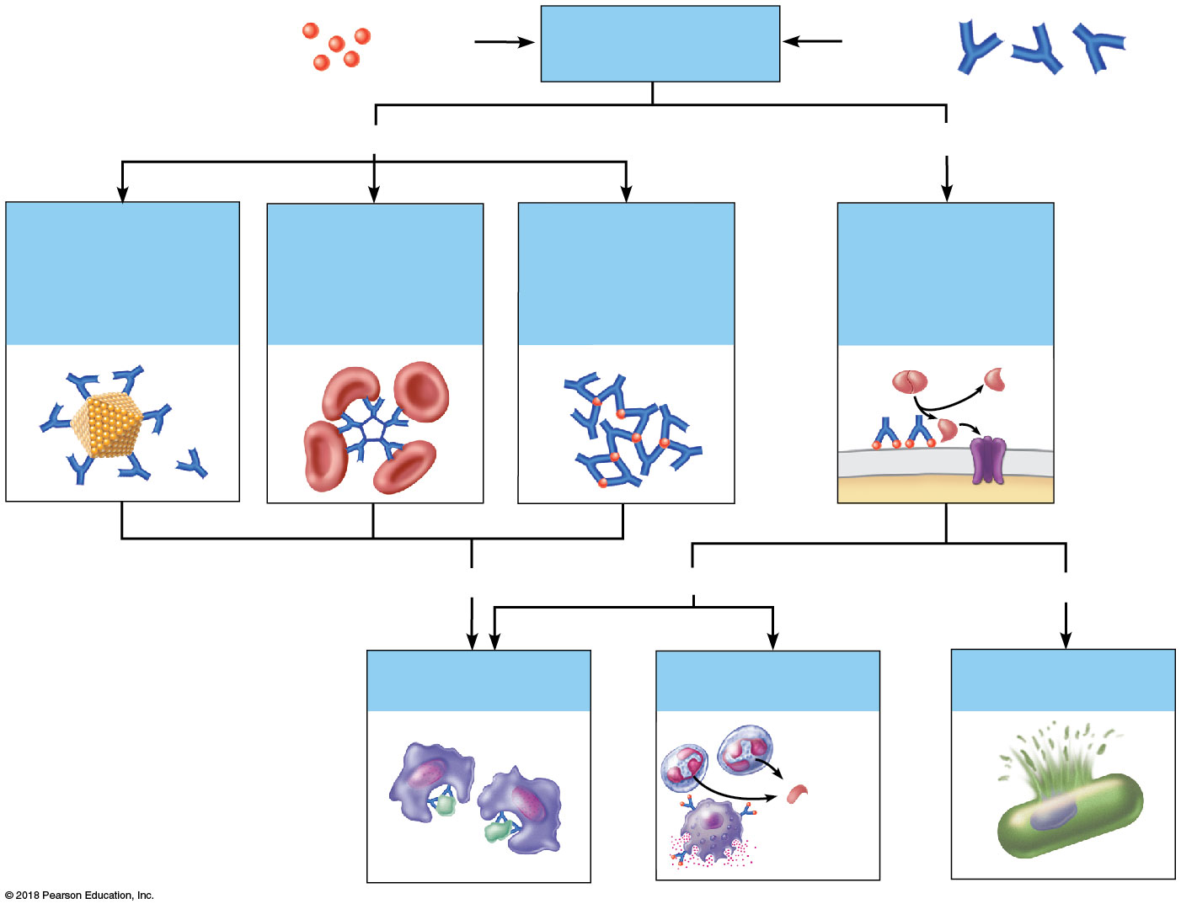
THE IMMUNE SYSTEM
= Neutralization
= Agglutination
= Phagocytosis

Slide 52
THE IMMUNE SYSTEM
The vaccine for SARS-CoV-2, the virus that causes the disease COVID-19, creates what kind of immunity?
  a. Active immunity
  b. Passive immunity

Slide 53
THE IMMUNE SYSTEM
One treatment that was used at the beginning of the COVID-19 pandemic is administering antibodies from the plasma of recovered patients into the blood of sick patients.
What kind of immunity did this give sick patients?
  a. Active immunity
  b. Passive immunity

Slide 54
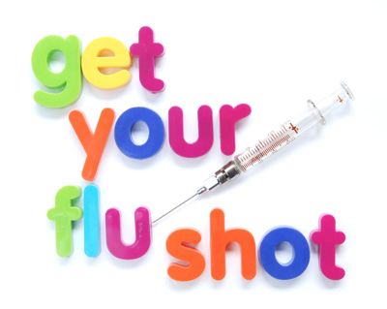
THE IMMUNE SYSTEM
Some vaccines are more effective than others
  It depends on the antigen, and its ability to change

Slide 55
THE IMMUNE SYSTEM
Allergies
  The immune system overreacts to an otherwise harmless environmental antigen, and tissue damage occurs
  Once the antigen is gone, the reaction stops
Autoimmune Diseases
  The immune system overreacts to a previously hidden self-antigen, and tissue damage occurs
  The self-antigen never goes away because it is a part of “self”, so the reaction never stops

Slide 56
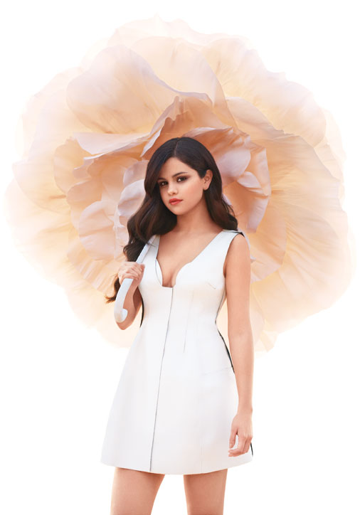
THE IMMUNE SYSTEM
Example Autoimmune Diseases
  Celiac disease: destroys microvilli
  Rheumatoid arthritis: destroys joints
  Type I diabetes mellitus: destroys pancreatic beta cells that produce insulin
  Hashimoto’s Thyroiditis: destroys the thyroid gland
  Multiple sclerosis: destroys white matter of brain and spinal cord
  Lupus: destroys nuclei → kidney, heart, lung, and skin damage

Slide 57
END OF UNIT IV
MATERIAL

