Slide 1
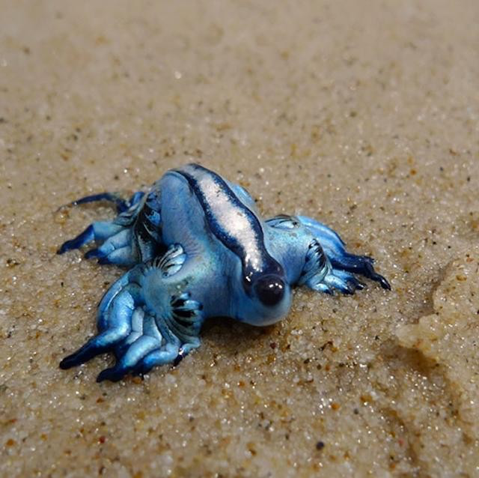
BIOL 1414 Intro to Mol/Cell Biology Lecture #2 19/20 August 2026
Last time:
My background
Class Blackboard
Class Expectations
Today:
Scientific Method
Experimental Design
Start Reporting Scientific Work
Blue Dragon
Glaucus atlanticus
Notes:
~Real life pokeman
~Species of blue sea slug
~Found in warm water areas of the ocean
~Floats on the surface of the water by using gas filled air sacks
~Blue color faces up blends in with ocean from above; silver color faces down and blends in with ocean surface from below
~Eats poisonous floating creatures and stores it for its own defense

Slide 2
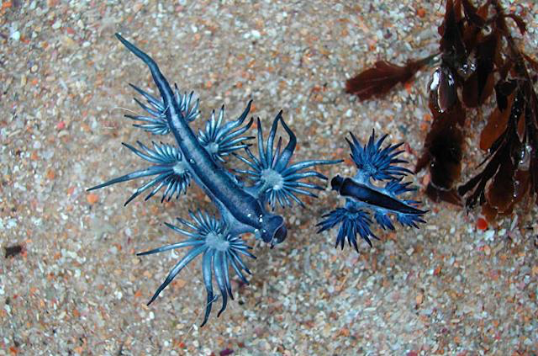
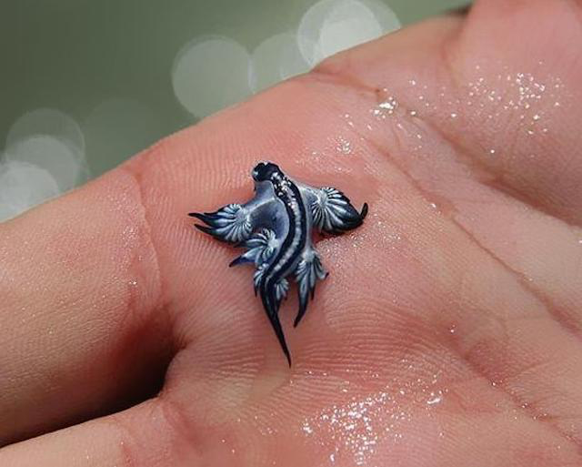

Slide 3
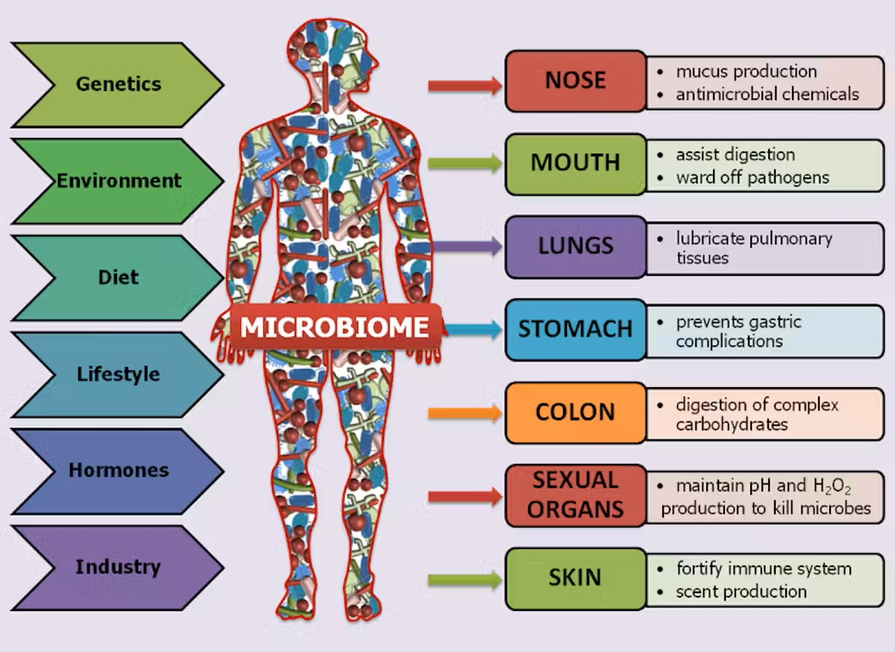
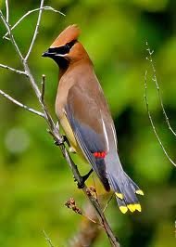
Putting the “ology” in “Biology”
Ology = the study of
From the Greek word “logia” meaning study, speak, lecture
“O” is usually from the word proceeding logy = Eco logy = Ecology
Bio = life
From the Greek word “bios” meaning life
Biology = study of life
scientific study of living things
Eco = house
From the Greek word “oikoc” meaning house
Ecology = study of the house
scientific study of organisms and their environment

Slide 4

What is Science?

Slide 5
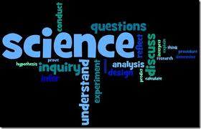
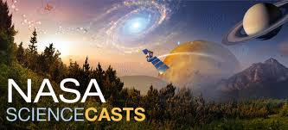

Putting the “ology” in “biology”
Science – the systematic observation of natural events and conditions in order to discover facts about them and to formulate, principles, theories and laws based on these facts.
Science does not progress by accumulating facts, it progresses by addressing the stuff we don’t know and trying to figure out how it works.
We use what we have found to ask more in-depth question – Science is circular
“Religion is a culture of faith; science is a culture of doubt.”
Physicist Richard Feynman
Notes:
Latin scientia - knowledge
Different ways to label sciences
Natural Sciences = Life sciences and physical sciences
Hard sciences vs soft sciences
Basic or theoretical science vs. Applied science

Slide 6
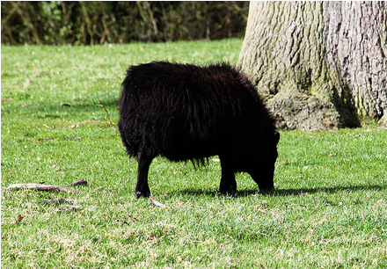
Parable of the Black Sheep
Three scientists are traveling in Scotland, when they see a lone black sheep on a hillside.

Slide 7
Parable of the black sheep
Three scientists are traveling in Scotland, when they see a lone black sheep on a hillside.
Young scientist: “Hey, the sheep are black in Scotland.”

Slide 8
Parable of the black sheep
Three scientists are traveling in Scotland, when they see a lone black sheep on a hillside.
Young scientist: “Hey, the sheep are black in Scotland.”
Middle career scientist: “Well, some of the sheep in Scotland are black.”

Slide 9
Parable of the black sheep
Three scientists are traveling in Scotland, when they see a lone black sheep on a hillside.
Young scientist: “Hey, the sheep are black in Scotland.”
Middle career scientist: “Well, some of the sheep in Scotland are black.”
Retired after 40 years scientist: “At least one sheep in Scotland is black on one side.”

Slide 10
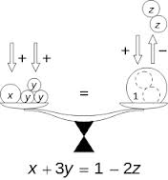
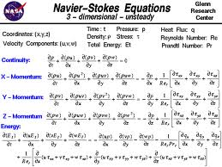

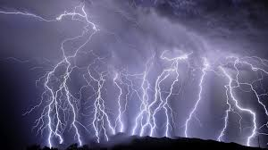
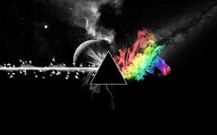
Science is not just about being nerdy and boring; science can be beautiful.

Slide 11
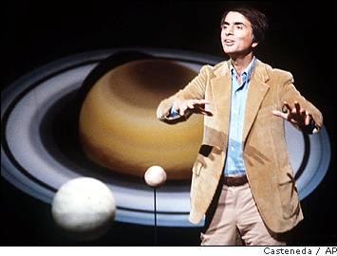
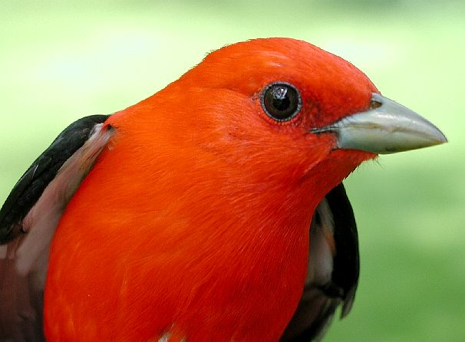
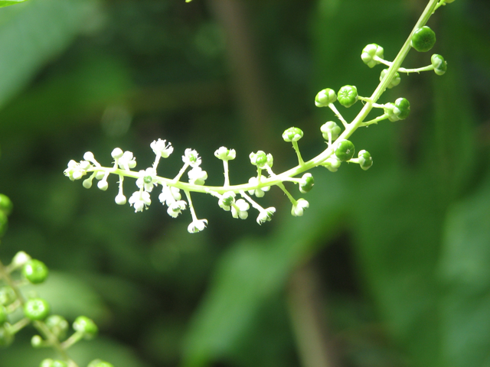
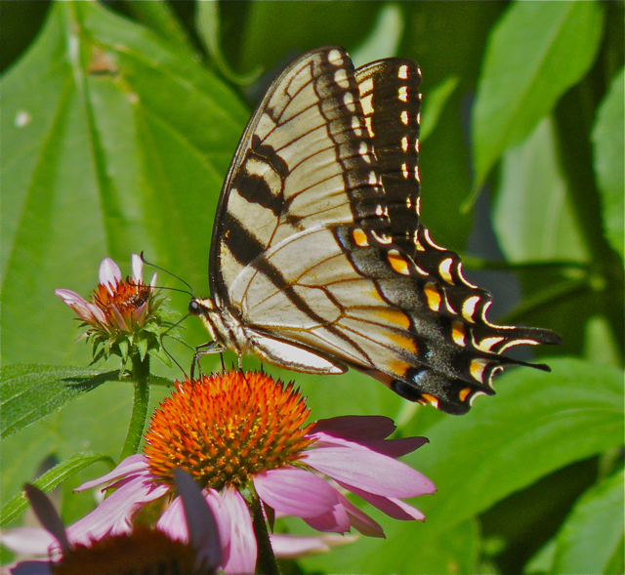
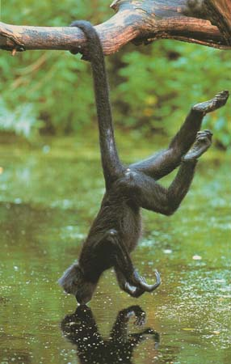
Science is not just about being nerdy and boring; science can be beautiful.
“The beauty of a living thing is not the atoms that go into it, but the way those atoms are put together and how they work together.”
~Carl Sagan
Cool science videos - http://symphonyofscience.com/

Slide 12
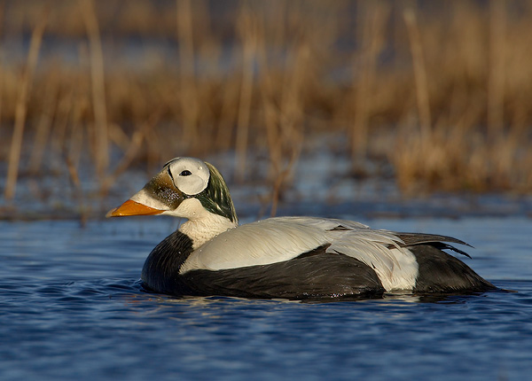
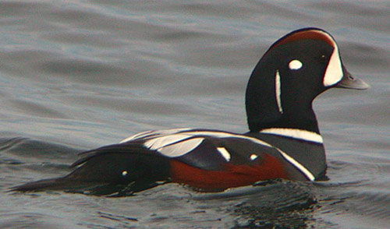
Scientific Method Terms
Hypothesis - is a proposed explanation for a given phenomena (educated guess).
One that can be tested!!
Observation - an act of recognizing and noting a fact or occurrence often involving measurement with instruments.
Data - values of qualitative or quantitative variables, belonging to a set of items.

Slide 13
Two Types of Data
Qualitative - Deals with descriptions, data can be observed but not measured.
Colors, textures, smells, tastes, appearance, beauty, etc.
Quantitative - Deals with numbers, data which can be measured.
Length, height, area, volume, weight, speed, time, temperature, humidity, sound levels, cost, members, ages, etc.

Slide 14
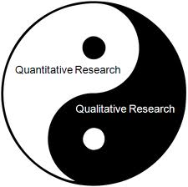
Qualitative vs. Quantitative
My cool Trout – Roland the Rainonbow Trout
This class

Slide 15
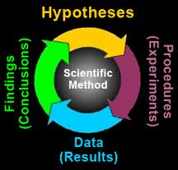
Science
Operates under philosophy that knowledge and understanding are gained through application of the scientific method:
Observation
Asking a question
Hypothesis formulation
Maybe more than one
Experimentation (hypothesis testing)
Observations
Data recording
Evaluation of test results
Review observations and data
Share findings of experiment
Conference presentations (oral or poster)
Publications
Formulate new hypothesis from findings
Notes:
Room is hot why? Forgot to tourn on AC or Power outage

Slide 16
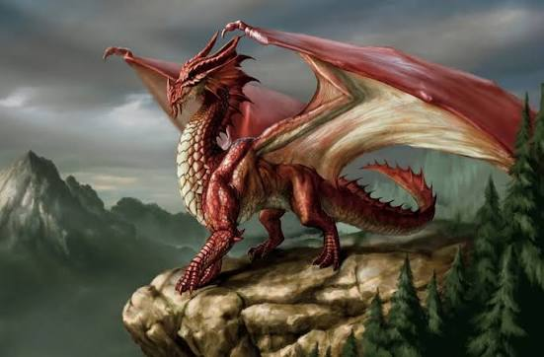
Science
A good hypothesis must be Falsifiable and Testable
You must be able to disprove it
IMPORTANT - science never proves anything
But it can disprove hypotheses – this is what makes it science
Existence of : Invisible, incorporeal, heatless dragon living in my office.
Not testable and not falsifiable = not science
Notes:
Incorporeal - not composed of matter; having no material existence

Slide 17
Experimental Design
Control – receives every element of the experiment except the one being tested
Variable – any part of the experiment that can change during the experiment
Independent – is what is being tested or changed in an experiment
Independent = what I change
Dependent – what is being recorded or monitored
Dependent – DEPEDNS on independent
Control – variables that should be kept constant as not to influence the results

Slide 18
Science
SCIENCE NEVER PROVES ANYTHING!!!!!!
It can only supply support for hypotheses
Hypotheses that are consistently supported by data may eventually be considered “theory” – unifying principles in a discipline that inform new hypotheses.
Note: In science, a theory is not the same as our common usage, i.e., a “guess”. Theories don’t get to be theories until they can be shown to work numerous times.
Principal - a fundamental, primary, or general finding based from a single experiment (one evaluation of a hypothesis)
Theory - A scientific theory summarizes a hypothesis or group of hypotheses that have been supported with repeated testing. A theory is valid as long as there is no evidence to dispute it. May cover many scientific laws. (Theory of Relativity)
Law - A law generalizes a body of observations. At the time it is made, no exceptions have been found to a law. Scientific laws describe things, but they do not explain them. (Law of Gravity)
Notes:
Special Relativity
Constant Light Speed: The speed of light in a vacuum is always the same for everyone, no matter how fast you move.
Time Dilation: The faster you move through space, the slower time moves for you compared to someone staying still.
Mass and Energy: Energy and mass are the same thing in different forms, written as the famous equation E = mc². [1, 2, 3, 4]
General Relativity
Gravity as Curvature: Heavy objects like stars and planets warp and bend the fabric of space and time (called spacetime).
The Path of Objects: Gravity is not an invisible pulling force. Instead, it is objects rolling along the curves created by heavy things in space.
Bending Light: Heavy masses can bend the path of light because they bend space itself.

Slide 19
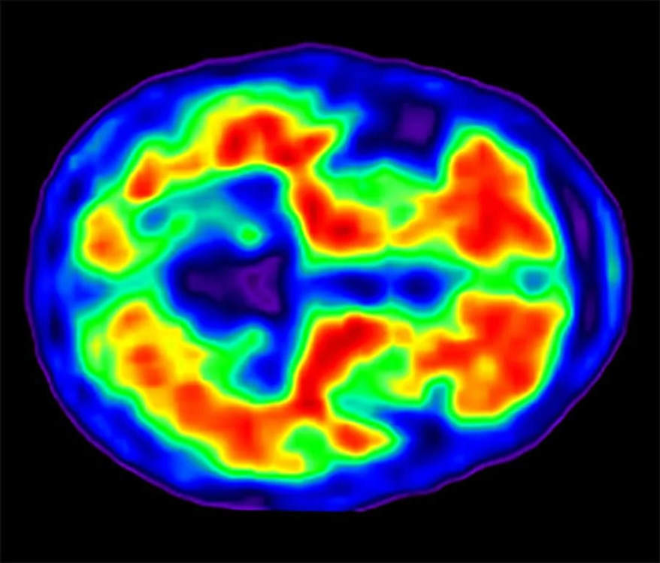
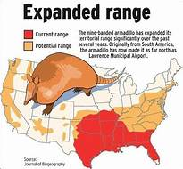
Science
Scientist use two types of logical thinking:
Inductive reasoning – uses observations to come to a logical conclusion
Small to big – example studies of the brain
Deductive reasoning – used a general law or theory to predict specific results
Big to small – example climate change and animal distribution
Notes:
Armadillo found in Wrenshall MN recently.

Slide 20
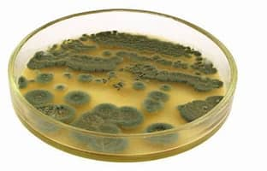
Science
Fun fact:
Scientific discoveries usually result from well planned experiments but…
Some made by serendipity or fortunate accidents
Example: Discover of penicillin – Alexander Flemming
Accidentally left a petri dish of Staphylococcus bacteria open
Unwanted mold grew on the dish and killed the bacteria
Fleming then investigated the bacterial death using science
Led to the discovery of antibiotic penicillin
Produced by the fungus Penecillium
Shows the power of observation
Yogi Berra – “You can learn a lot by just watching”

Slide 21
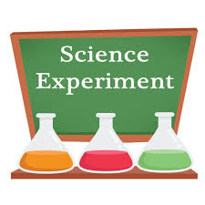
Experiments
Let’s try one!!!
I read a news article the other day and it said…

Slide 22
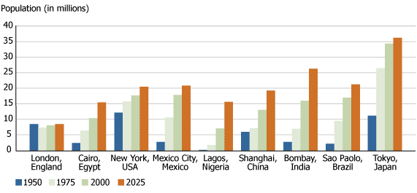
That ~ 50% of the worlds population now lives in cities.
My question - Is this true here at TCC?
Notes:
Observation Hypothesis formulation

Slide 23

Some say that ~ 50% of population lives in cities. Is this true here?
We will test the hypothesis that a (more or less) random sample of people in this class live in big cities.
Survey “What is your hometown?”
Predefined categories:
City (urban area) – greater than 200,000 people
Rural area – fewer than 200,000

Slide 24
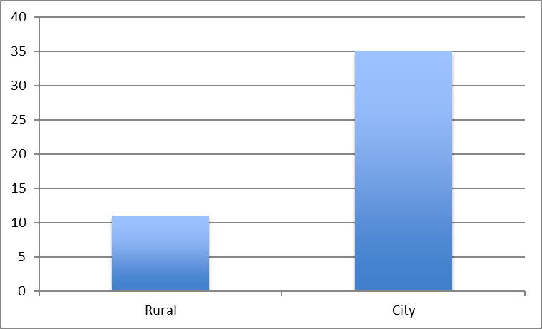
Some say that ~ 50% of population lives in cities. Is this true here?
77%
23%

Slide 25

Some say that ~ 50% of population lives in cities. Is this true here?
Do we support or reject the hypothesis?
Any concerns with this??
Is our sample representative of world?
Would we find different results in:
The NYC area?
The Hays Kansas area?
South Dakota?
Why we need to test hypotheses numerous times.

Slide 26
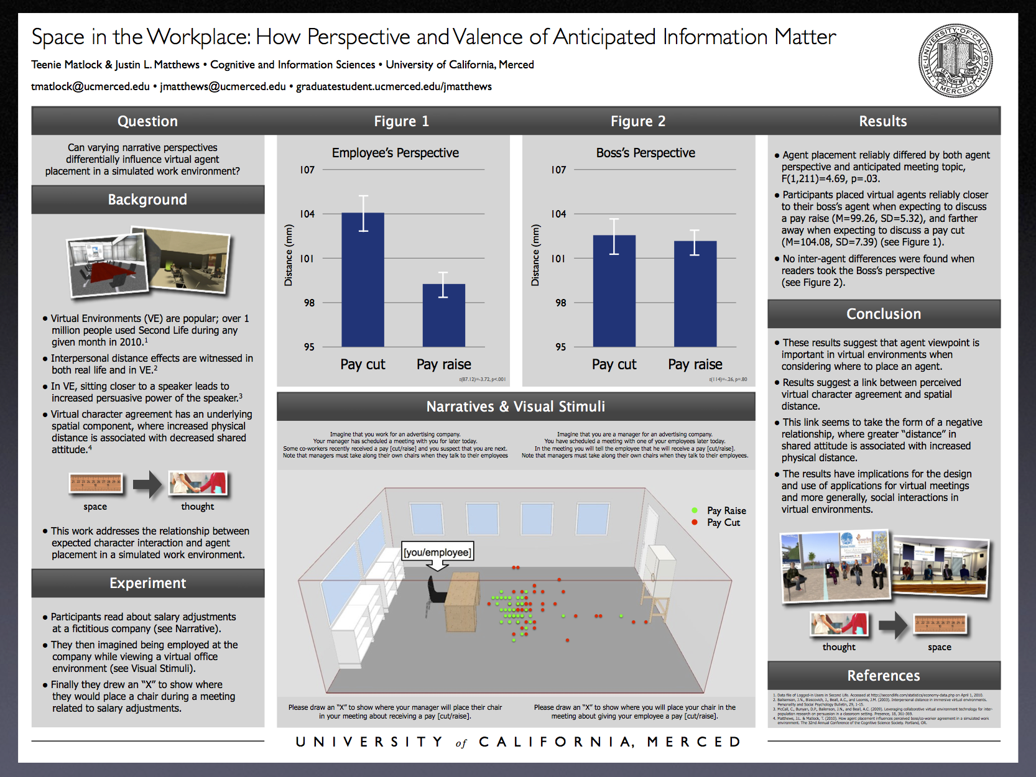
Reporting Scientific Work
One of the most important steps in the science
Can share results in different ways:
Meeting poster or presentation
Only a small audience
Classroom examples
Only a small audience
Interpretive dance portrayal on the street
Very small audience
Peer-reviewed manuscripts
Largest audience
Peer-reviewed process add validity to findings

Slide 27
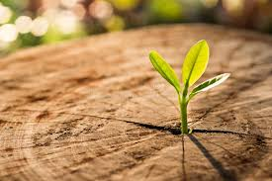
Next Time
The study of life continued

