Slide 1
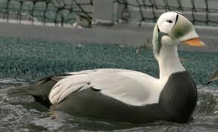
BIOL 1414 Intro to Mol/Cell Biology
Lecture #3
25 August 2028
Last Lecture:
Class Stats
Scientific Method
Experimental Design
Start Reporting Scientific Work
Today:
Class Stats
Finish Reporting Scientific Work
What is life? Where is life?
Levels of Organization
Intro to Chemical Foundation of Life
Structure of an Atom
Spectacled Eider
Notes:
20-22 inches long
about 3 lbs
3 separate breeding populations but all group together at one place in the northern Bering sea
Up till 1995 wintering grounds were unknown, they just disappeared

Slide 2
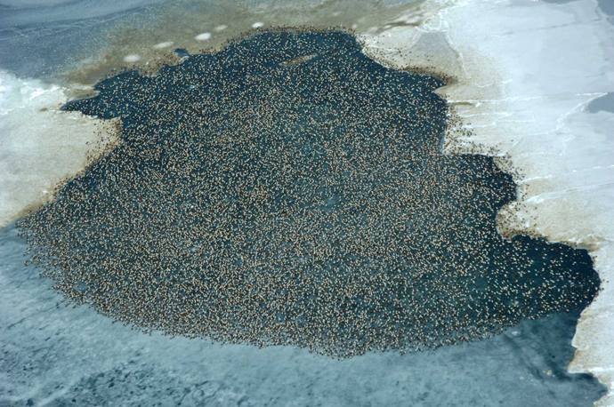
Notes:
Polynyas – open areas of seas surrounded by ice

Slide 3
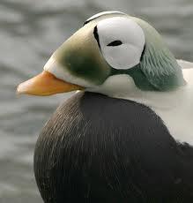
Notes:
Can dive up to 300 ft to gather food from the ocean floor.
Population on the decline 96% population decline from 1952-1993
Contaminants, predation, hunting
Federally endangered

Slide 4
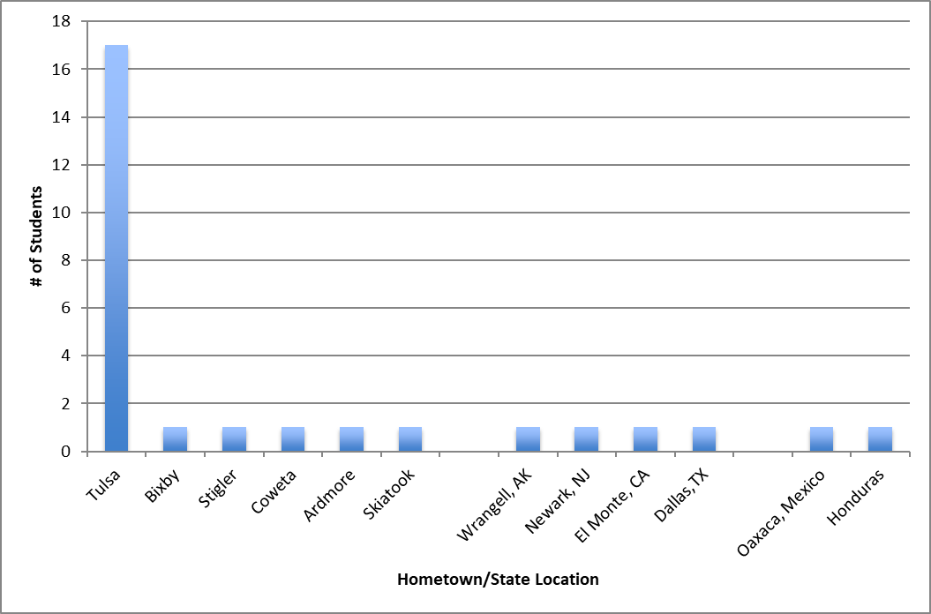
Where are we from?

Slide 5
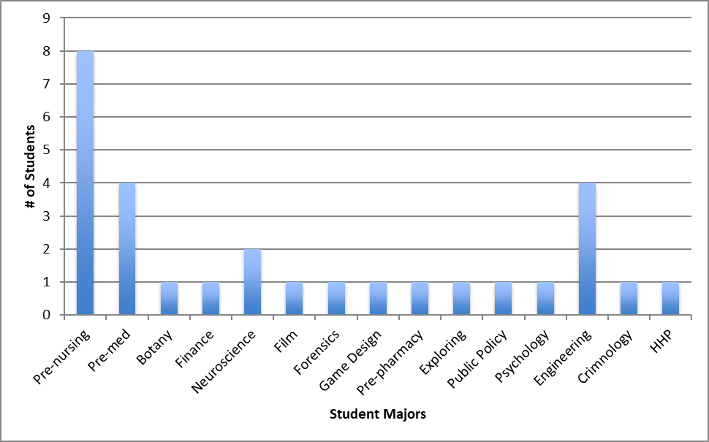
What is our major?

Slide 6
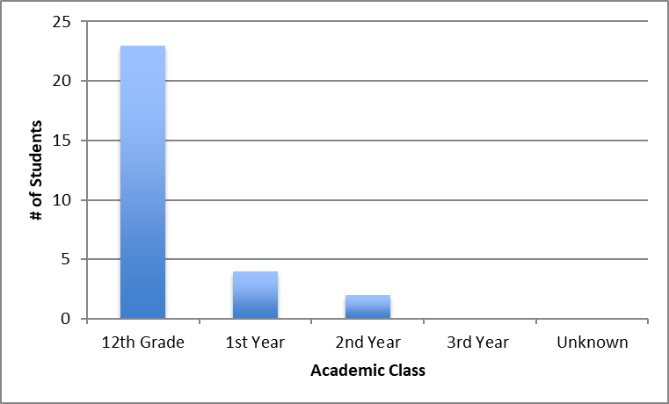
How Long Have We Been Here?

Slide 7
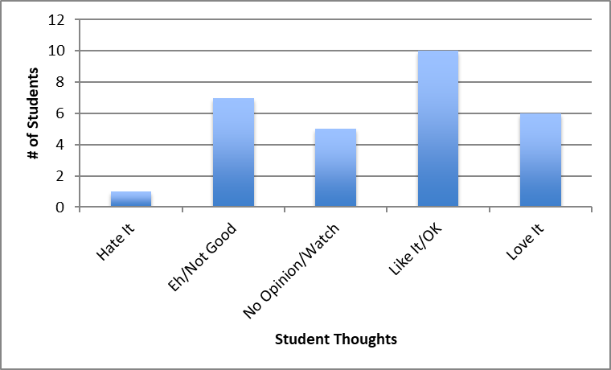
Thoughts on The AGT

Slide 8
Thoughts on The AGT
(An Indicator of Class Success)
D
B
F
C
Moral of the story… I am always RIGHT!!
A
The show makes no sense how can you compare singing to dancing to acrobatics fairly?

Slide 9


Where do we get information?
Books
Newspapers
Radio talk shows or “news” channels
Our friends or family
Websites
Social media
Government reports

Slide 10

Where do we get valid scientific information?
Not books*
Not newspapers*
Not radio talk shows or “news” channels*
Not your friends or family*
Not websites*
– not even Wikipedia
Not Social Media*
Not government reports*
* Doesn’t mean that we can’t get valid scientific information, but these sources usually aren’t checked.
Notes:
Some websites more reliable than others.

Slide 11
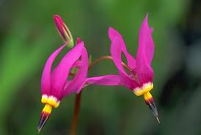
Sooooo…….
Where do we get valid scientific information?
  Peer Reviewed Journals
Why are these journals so good?
  Difficult to get a paper published in them
How can we access these journals?
  TCC library
    JSTOR
  Google scholar

Slide 12



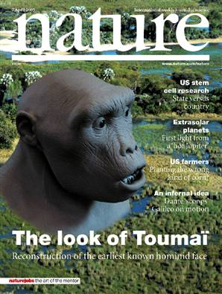
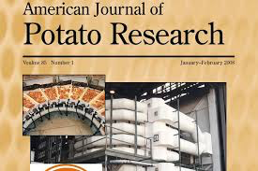

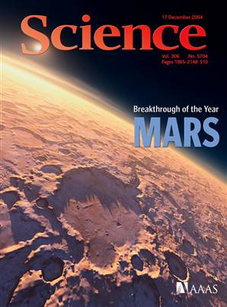





Slide 13
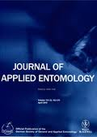
Steps in publishing a paper
    Read at least 20 other scientific papers (usually it’s more like 40–50)
    2. Do some original analysis and write a paper about it (easier said than done)
    3. Choose a journal in which to publish
    4. Submit paper and a cover letter to the main journal Editor

Slide 14
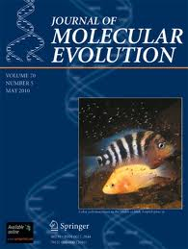
Steps in publishing a paper
    Editor sends your paper to three peer reviewers
    6. Each reviewer sends a report to the Editor
    Editor responds to author (usually ~ 3 months later):
      Paper rejected (fate of ~ 70% of papers)
      b. Paper may be acceptable if revised

Slide 15
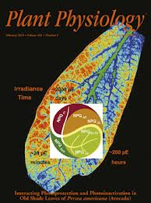

Steps in publishing a paper
    Author makes changes suggested by reviewers
    9. Author submits new version to Editor
    Editor sends new version to reviewers
    11. Reviewers send opinion of changes to Editor

Slide 16
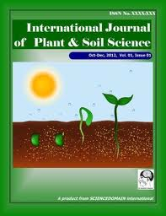

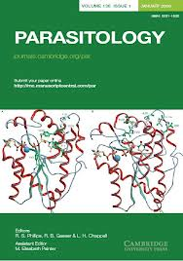
Steps in publishing a paper
    12. Editor responds to author (usually ~ 2 months later):
      a. Paper rejected
      Paper accepted for publication!
    Copy editor sends mock-up of paper to the author
    14. Author charged ~ $100-$300/page for the privilege of publishing

Slide 17
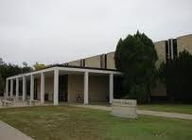
How can we access these journals??
Go to the Library and ask for guidance from the Reference Librarian.
Check the TCC Library website to access various search engines for articles:
Home - Library - Website at Tulsa Community College (tulsacc.edu)
Begin your search with Google’s Scholar application: http://scholar.google.com/.

Slide 18
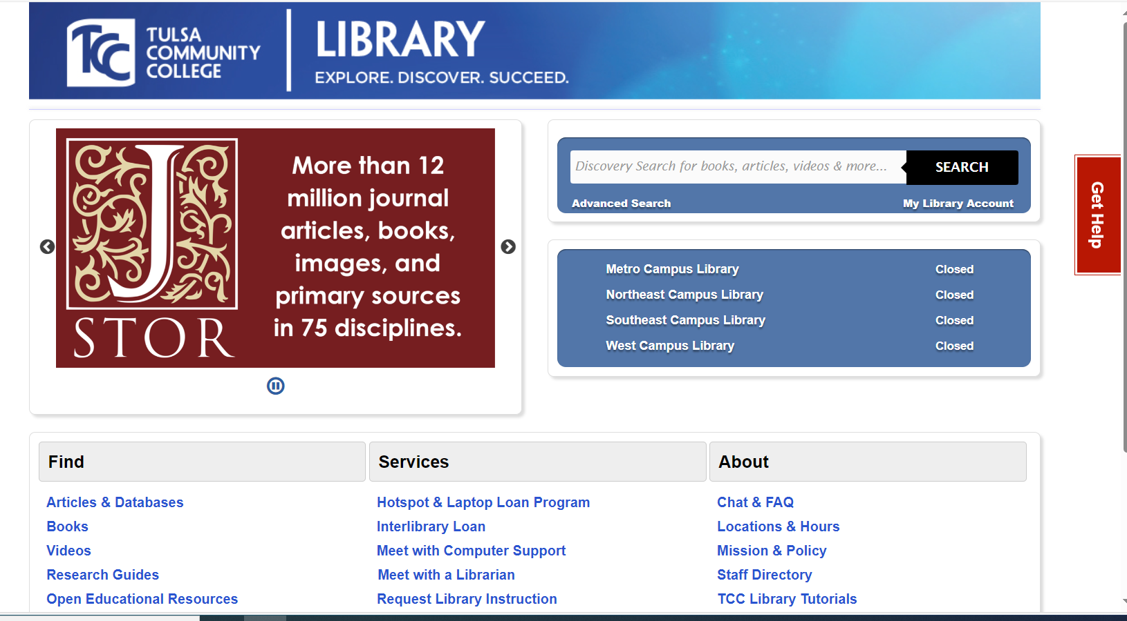
JSTOR Overview

Slide 19
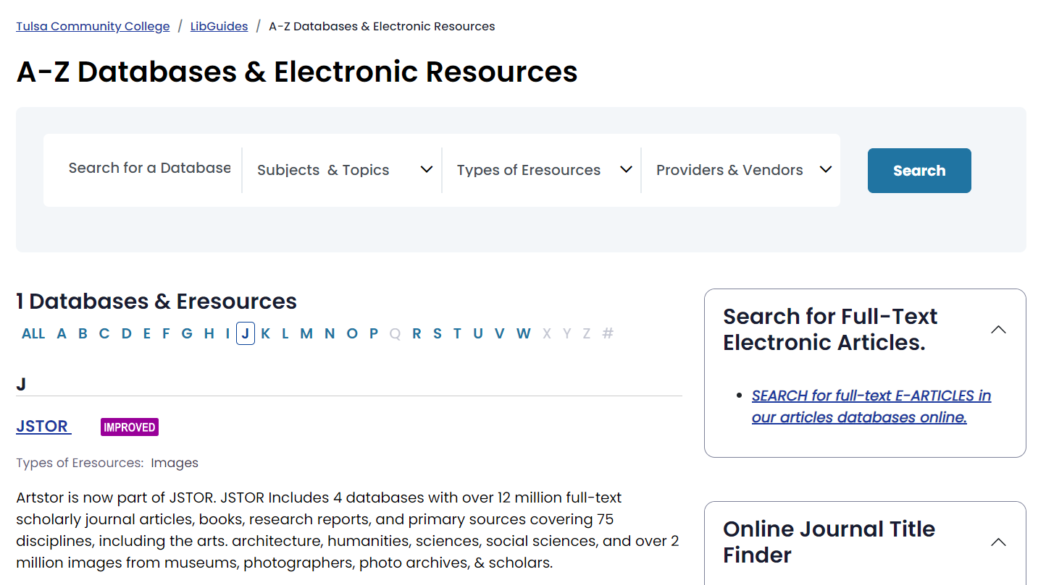
JSTOR Overview

Slide 20

JSTOR Overview

Slide 21
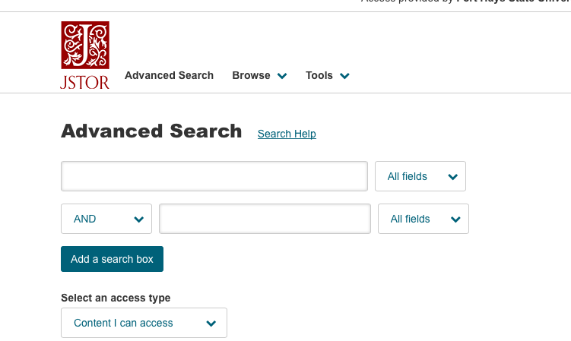
JSTOR Overview

Slide 22
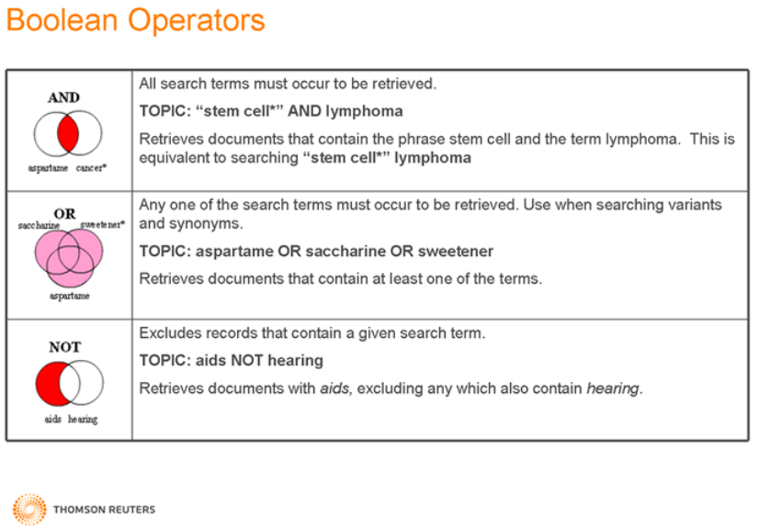
Boolean Operators

Slide 23
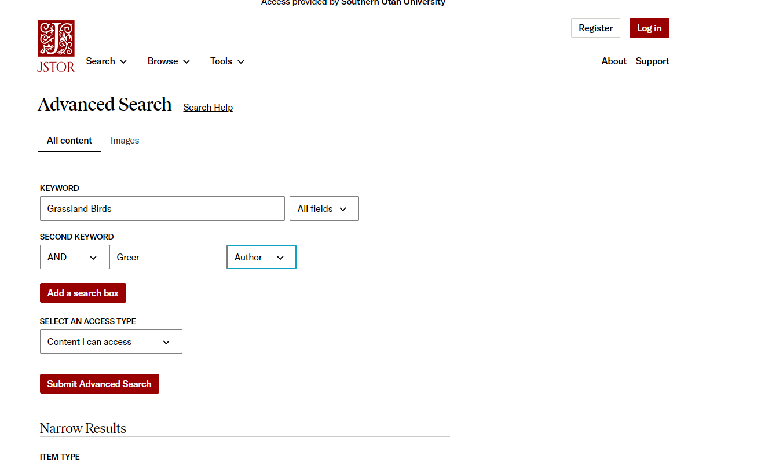
JSTOR Overview

Slide 24
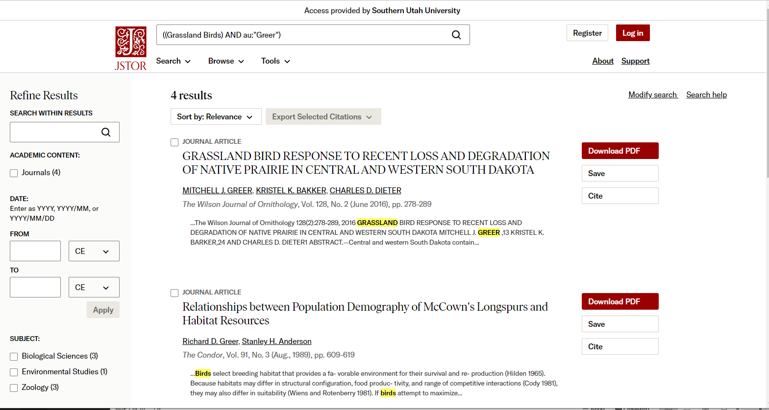
JSTOR Overview

Slide 25
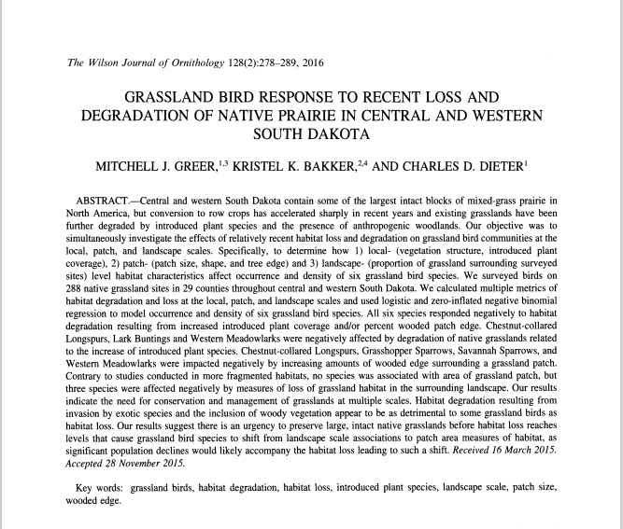
JSTOR Overview

Slide 26

Library Help

Slide 27


Pick a topic to look up.
Let’s look it up on JSTOR
Let’s look it up on Google Scholar.

Slide 28
How to Approach Scientific Paper
Abstract – A quick summary of the entire paper. Should contain a bit of each section below.
Introduction - what’s the issue? What don’t we know that these authors plan to tell us? Includes background information new ideas for this paper.
  Starts broad and narrows down to current study (upside down pyramid)
Methods - what did they do? To address that issue, what sort of data did they collect? Very detailed, want others to be able to replicate.
Results - what did they find? What’s the main piece of information they claim to have provided in the paper? Lots of numbers and stats talk usually.
Discussion - what does it mean? In the context of the issue outlined in the Introduction, what is the real contribution of the paper? What do the results tell us and how can that influence management?
Review Papers – Do not follow IMRaD format. They simply summarize numerous papers on a given topic.
Notes:
IMRaD – Intro, Methods, Results, and discussion.

Slide 29
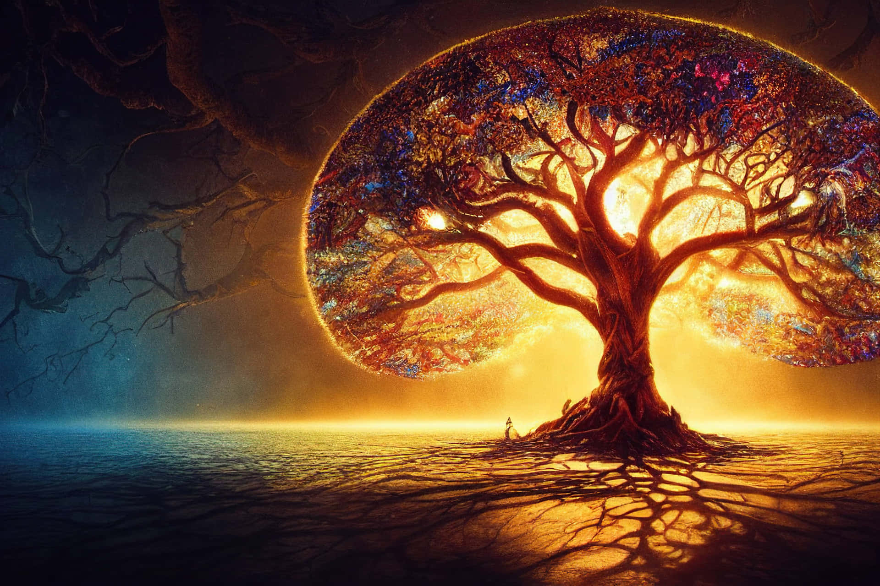
What is life?
What makes something living?

Slide 30
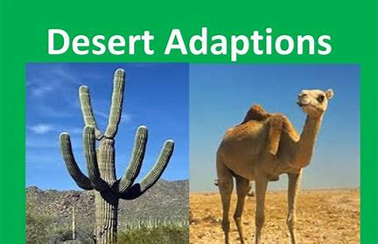
Eight Criteria for Life
Must meet all eight to be alive:
  Organization
  Energy use and metabolism
  Homeostasis (maintenance of internal constancy)
  Reproduction
  Growth and development
  Irritability (response to stimuli)
  Adaptation
  Evolution

Slide 31
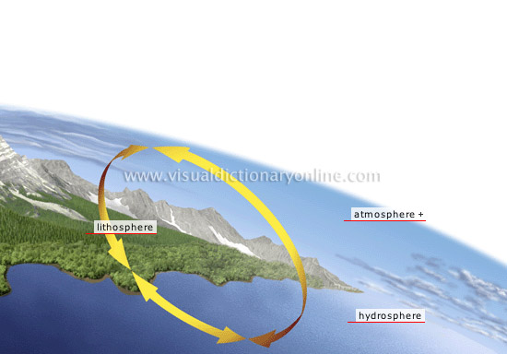
Where is life?
Biosphere - total area of earth’s surface, subsurface, and atmosphere in which living things exist.
Ranges from deep sea vents of water > 750 degrees, ocean depths where methane ice is food for Archaea, ultra-thin atmosphere at 30,000 feet.
And as far as we know, nowhere else in the universe . . .

Slide 32
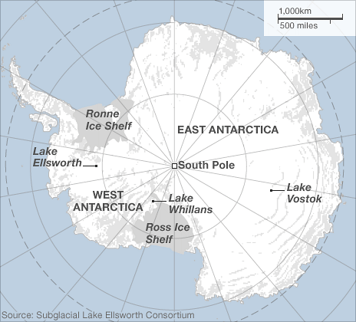
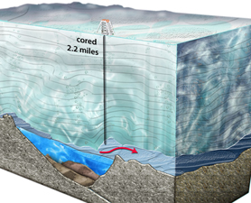
Where is life?
Lakes Vostok, Ellsworth, Whillans
Notes:
Antarctica was very pleasant up till 45 million years ago when the glacier formed
When standing on the flat glacier top you are actually at 11,000 feet.
61% of Earths freshwater locked up in the one glacier

Slide 33
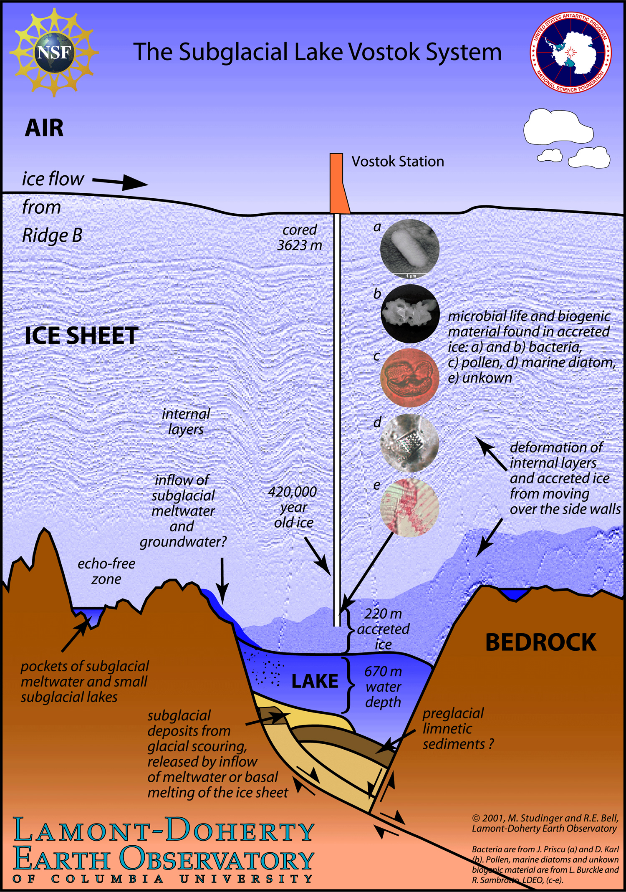
Where is life?
Lakes Vostok
Environments covered in ice for millions of years
  No sun
Geothermal heating and intense pressure keep the water liquid
  65 degrees F
Scientist believe they will find never before seen microbial life
  Bored through 13,000ft of ice
  Found more than 3,000 bacteria species
    Some Eukarya
Notes:
They obtained 3,507 unique gene sequences from concentrates of 500 ml of 0.22 mm-filtered accretion ice meltwater.
Taxonomic classifications (to genus and/or species) were possible for 1,623 of the sequences.
Approximately 94% of the sequences were from Bacteria and 6% were from Eukarya.
Only two sequences were from Archaea.
In general, the taxa were similar to organisms previously described from lakes, brackish water, marine environments, soil, glaciers, ice, lake sediments, deep-sea sediments, deep-sea thermal vents, animals and plants.
Sequences from aerobic, anaerobic, psychrophilic, thermophilic, halophilic, alkaliphilic, acidophilic, desiccation-resistant, autotrophic and heterotrophic organisms were present, including a number from multicellular eukaryotes.

Slide 34
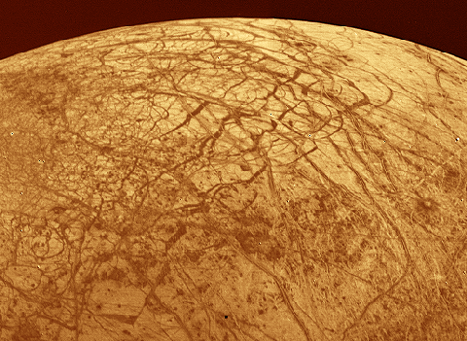
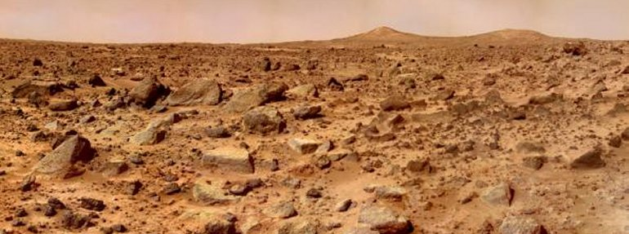
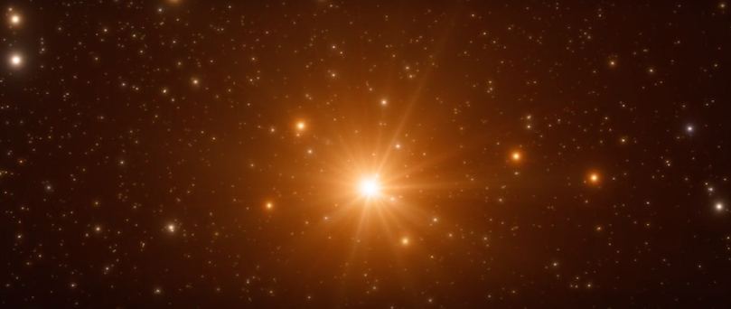
Where is life?
Extraterrestrial life
Best bet in our own solar system is Mars, Jupiter’s moon Europa, and Saturn’s moon Enceladus.
We’re looking for organic molecules: backbones are carbon, hydrogen, and oxygen
  Water is big indictor of possible life
Europa, 1996
Mars, 2008
Trappist 1, 2017

Slide 35
Levels of Organization
Life is organized from small to large
  Atom – smallest unit of matter
    Nucleus surrounded by electrons
  Molecule – chemical structure made of at least two atoms
    Atoms are held together by at least one chemical bond
  Macromolecule – large molecule typically formed by polymerization
    Polymerization = big molecule made by combining many small
      DNA – deoxyribonucleic acid
  Organelle – aggregate of macromolecules surrounded by a membrane
    Exist within cells (mitochondria, chloroplasts, etc.)

Slide 36
Levels of Organization
Life is organized from small to large
  Cell – smallest unit of structure and function in living organisms
    Organisms can single celled or multi-cellular
  Tissue – groups of similar cells preforming similar function
  Organ – group of tissues preforming similar function
  Organ system – contains functionally related organs
  Organism – individual living entity
    Composed of all the above
Combined the above make the biological hierarchy!
Notes:
Scientist do not consider virus living because they are not made of cells

Slide 37
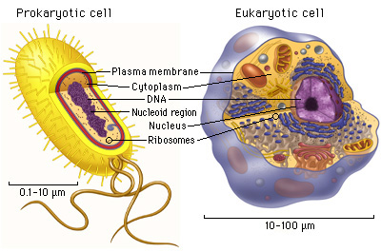
Two types of cells – does it have a nucleus?
Prokaryotes – no nucleus and no membrane bound organelles.
  These are exceedingly tiny 0.1–10 microns diameter.
Eukaryotes – DNA contained in a nucleus and numerous membrane-bound organelles.
  Larger cells (10–100 microns)

Slide 38
Levels of Organization
Life is organized from small to large
  Organism – individual living entity
  Population – all individuals of specific species living in and area at a given time
  Community – all populations in an area at a given time
    A population of populations
    All living components of an environment
  Ecosystem – all the biotic and abiotic components of an environment
    Biotic – living
    Abiotic – non-living
  Biosphere - total area of earth’s surface, subsurface, and atmosphere in which living things exist
Combined the above make the ecological hierarchy!

Slide 39
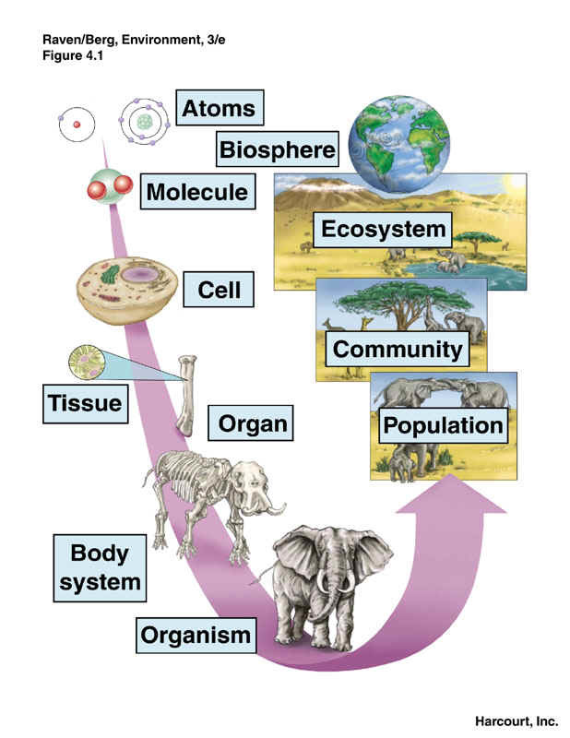
Levels of Organization

Slide 40
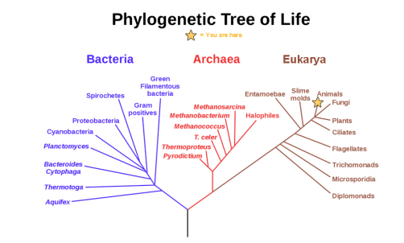
Levels of Organization
Diversity of life on Earth is amazing
Diversity comes from the process of evolution
  Evolution – gradual change in a population over time
Phylogenetic tree – summarizes the evolution of various life forms on Earth
Notes:
Each node – is where a speciation event occurred
Length pf branch is proportional to time since the speciation event occurred.

Slide 41
Levels of Organization
Originally only two domains of life – based on analysis of just the physical appearance
Carl Woese work with RNA in the 1970’s showed there was a third domain!!

Slide 42
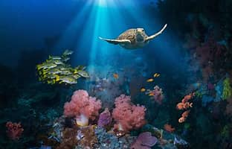
Branches of Biology
Biology is a very broad field and thus has many areas of study to choose from:
  Molecular biology and biochemistry
    Studies biological processes at molecular and chemical level
  Microbiology
    Study of microorganisms
  Neurobiology
    Study of the nervous system
  Paleontology
    Study of fossils
  Zoology
    Study of animals
  Botany
    Study of plants
  Ecology
    Study of organisms and their environment
Notes:
Not testable inormation

Slide 43
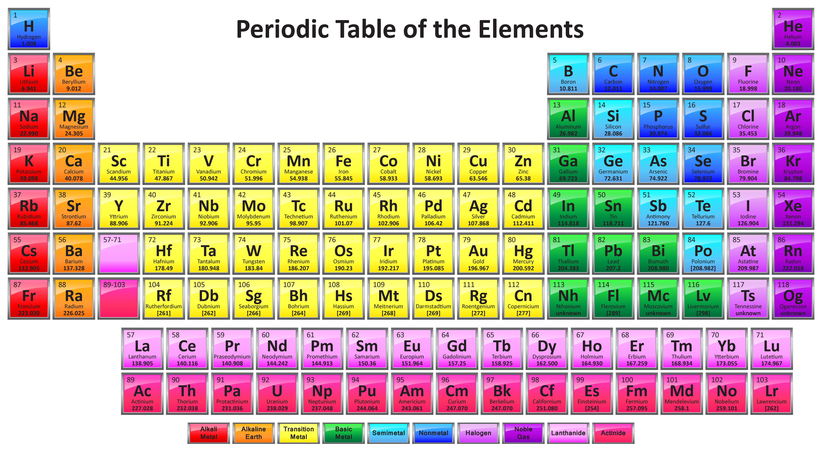
Chemical Foundations of Life
All biological processes follow laws of physics and chemistry
Life is made up of matter
  Matter – any substance that has mass and takes up space
Elements – unique forms of matter with specific chemical and physical properties
  Cannot be broken down into smaller substances through normal chemical reactions
    118 elements – 98 occur naturally
Notes:
Blood in circulatory system follows laws of fluid flow
Release of energy from ATP follows laws of chemistry like laws of thermos dynamics

Slide 44
Chemical Foundations of Life
Notes:
Some follow English C = Carbon
If letter already taken use first two Ca for Calcium
Others use latin Na = sodium = natrium

Slide 45
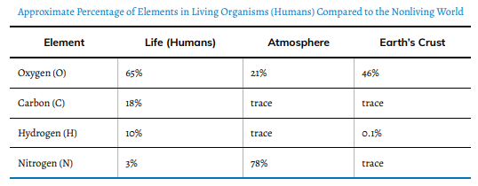
Chemical Foundations of Life
Four elements important to life…What are they?
  Oxygen (O), Carbon (C), Hydrogen (H), Nitrogen (N)

Slide 46
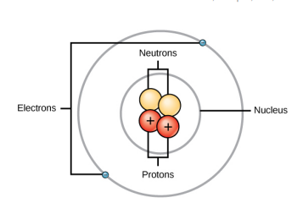
Structure of an Atom
Atom – smallest unit of matter that retains all the chemical properties of the element
  Gold coin is just a molded mass of gold atoms
Atom composed of two regions made of three particles
  Nucleus – center of an atom made of protons (+) and neutrons (0)
  Electrons (–) – travel in orbits around the nucleus

Slide 47
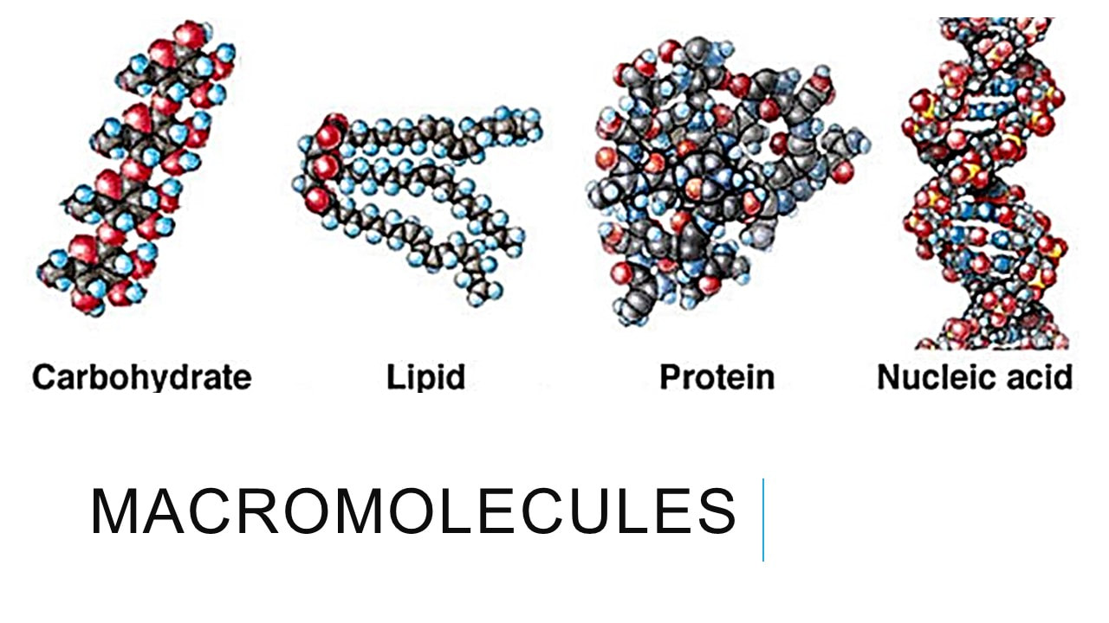
Next Time
Biological Macromolecules

