Slide 1
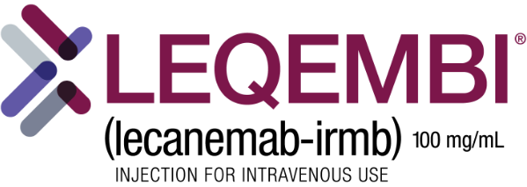
BIOL 1414 Intro to Mol/Cell Biology
Lecture #4
26/27 August 2026
Last Lecture:
Finish Reporting Scientific Work
What is life? Where is life?
Levels of Organization
Intro to Chemical Foundation of Life
Today (CH. 2):
Chemical Foundation of Life
  Atomic Number and Mass
  Chemical Reactions and Molecules
  Ions and Ionic Bonding
  Covalent Bonds
  Hydrogen Bonds
Water
Lecanemab-irmb
Notes:
~Drug fully approved by FDA in July
~Slows cognitive decline by 30% over 18 months
~Removes amyloid plaques that build up on brain
Amyloid plaques are extracellular deposits of the amyloid beta (Aβ) protein mainly in the grey matter of the brain¹.
They are aggregates of misfolded proteins that form in the spaces between nerve cells and play a central role in Alzheimer's disease².
These plaques can lead to problems with brain function and are associated with degenerative neuronal elements, microglia, and astrocytes¹.
They begin as strings of amino acids called amyloid-β (Aβ) peptides³. In addition to Alzheimer's, they can also raise the risk of strokes when they form around blood vessels in the brain⁴.
~Does not stop the disease

Slide 2
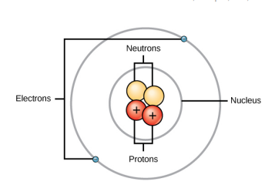
Structure of an Atom
Atom – smallest unit of matter that retains all the chemical properties of the element
  Gold coin is just a molded mass of gold atoms
Atom composed of two regions made of three particles
  Nucleus – center of an atom made of protons (+) and neutrons (0)
  Electrons (–) – travel in orbits around the nucleus

Slide 3
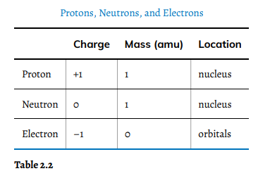
Structure of an Atom
Notes:
Protons and neutrons add to weight but only protons add to charge
Electrons add to charge but not the wight

Slide 4
Atomic Number and Mass
Protons determine the elements atomic number
Neutrons are variable
  Results in isotopes of the element
    Isotope – different forms of an element that has the same number of protons but different number of neutrons
    Carbon 13 vs. Carbon 14
Protons + Neutrons determine mass number
Atomic Mass – calculated mean of all element's isotopes
  Example – Cl = atomic mass 35.45
    Several isotopes – most with atomic mass of 35 (17P and 18 N) and some with atomic mass of 37 (17P and 20N)
Notes:
Video link in mass number

Slide 5
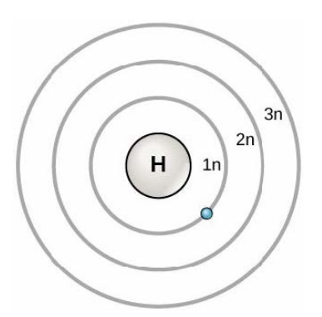
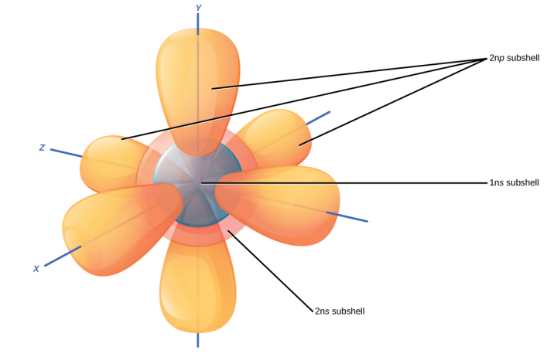
Chemical Reactions and Molecules
Elements are most stable when outermost electron shell is full

Slide 6
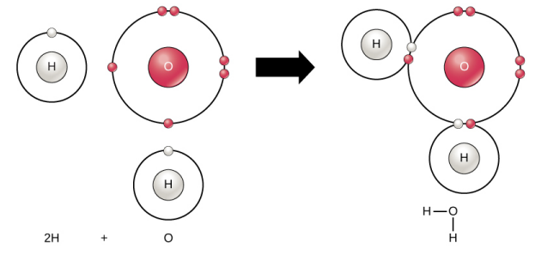
Chemical Reactions and Molecules
Elements are most stable when outermost electron shell is full
Many elements do not have full outer orbitals
  Form chemical bonds with other elements to fill outermost orbital
    More stable as it is more energetically favorable
Molecule – two or more atoms chemically bonded together

Slide 7

Chemical Reactions and Molecules
Chemical reaction – occurs when:
  Two or more atoms bond together to form molecules
  When bonds of molecules break apart
Reactants – substances going into a chemical reaction
  Left side of the arrow in a chemical equation
Products – substances that are formed by chemical reaction
  Right side of the arrow in a chemical reaction
Chemical reactions must remain balanced
  Law of conservation of mass – mass not created or destroyed
Compounds – contain atoms of more than one element

Slide 8
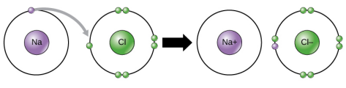
Ions and Ionic Bonding
Ions – atoms that become more stable by altering the number of electrons to fill outer most shell
  Cations – have a positive charge from losing electrons
  Anions – have a negative charge from gaining electrons
Ionic bonds – form between ions with opposite charges
  Think north and south poles of magnets
    Positive sodium (lost electron) and negative chloride (gained electron)
      Sodium chloride = table salt
Notes:
Ide is ending given to anions (gain electron)
Electrolytes – salts such as (sodium, potassium, and calcium) necessary for nerve impulse and muscle contraction

Slide 9
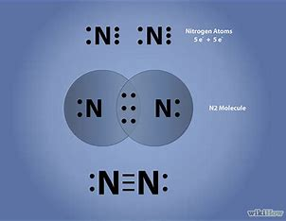
Covalent Bonds
Atoms may share electrons to fill outer most shell
Covalent bonds – created when two atoms share electrons
  Stronger and more common than ionic bonds in living things
  Can share 1, 2, or 3 electrons
    1 electron = single bond
    2 electrons = double bond
    3 electrons = triple bonds
  More shared electrons means stronger bond
QUESTION??
  If nitrogen is 78.1% of our atmosphere, why is it so limiting in nature?
Covalent example = H₂0
  Oxygen 6 electrons in outer shell and Hydrogen has one
    Electrons from two Hydrogen atoms share time between H and O

Slide 10
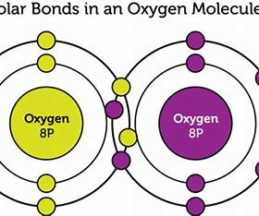
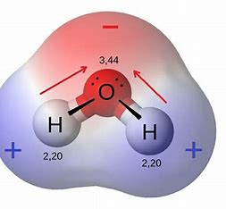
Covalent Bonds
Polar covalent – do not share electrons evenly
  Electrons attracted more to one atom than the other
    Example = Water
Non-polar covalent – electron is shared evenly between atoms
  Example – molecular oxygen (O₂)

Slide 11
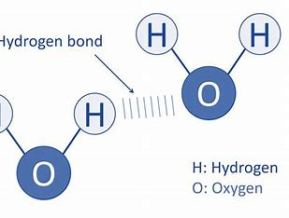
Hydrogen Bonds
Hydrogen bond – form when slightly positive charge of hydrogen bonded molecules bind to slightly negative charges from other molecules
  Think magnets again but this time we are bonding molecules to one another not atoms
  Bonds are weak and easily broken
  Example water molecules
Career connection
  Pharmaceutical chemist
    Taxol
    Aspirin
Notes:
Video
Taxol – anti-cancer drug – discovered from Pacific Yew tree
Aspirin – acetylsalicylic acid – from the willow tree

Slide 12
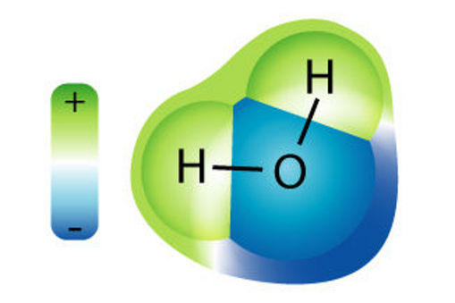

Why Water Rules
Water is polar – no net charge to molecule
  Hydrogen slightly positive
  Oxygen slightly negative
Water’s Polarity
  Water molecules attract other water molecules
    Forms hydrogen bonds
  Water attracts or is attracted to other polar molecules
    Hydrophilic – polar substances that dissolves readily in water
    Hydrophobic – non-polar substances not dissolving in water
      Example – Vinegar (acidic water solution) and oil salad dressing
        Shake before each use to combine
Notes:
Hydro – water + phylic – loving
Hydro – water + phobic – fearing

Slide 13
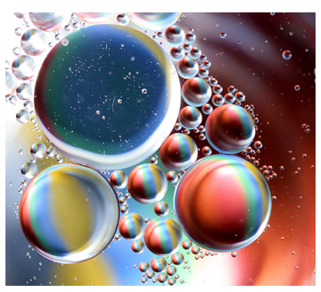
Why Water Rules
Notes:
Oil droplets formed in water – no mixing

Slide 14

Why Water Rules
Water has three states
  All are related to hydrogen bonding
    Liquid – bonds break and reform quickly (kinetic energy)
    Gas – bonds break permanently due to more kinetic energy
    Solid – forms crystalline structure due to hydrogen bonds
      Not enough kinetic energy to break bonds
      Molecules push further apart than liquid water
        It's why water expands as it freezes
Notes:
Kinetic energy – energy of motion creates heat.

Slide 15
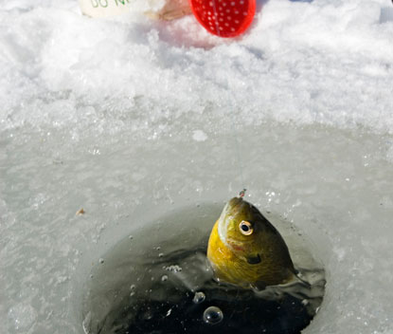
Why Water Rules
Three P’s activity
  Ponder, Partner, Present
The solvent in which just about every chemical reaction in living things occurs
Weak hydrogen bonds provide cohesion and adhesion
High heat capacity
High heat of vaporization
Water is less dense as a solid than as a liquid - so ice floats!

Slide 16
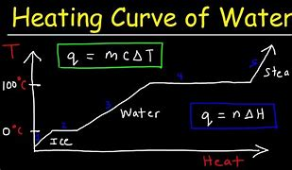
Why Water Rules
High heat capacity
  Why important?
Specific heat – amount of heat (energy) a gram of a substance must absorb or lose to change 1º C.
This property is caused by the hydrogen bonding among water molecules
Water has highest specific heat of any liquid

Slide 17
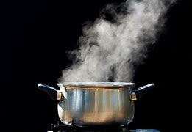
Why Water Rules
High heat of vaporization
  Why important?
Heat of vaporization – amount of energy required to change one gram of liquid to a gas
Hydrogen bonding makes it hard to separate the water molecules
  This separation is required to make steam
  Happens when water reaches 100º C (212º F)

Slide 18
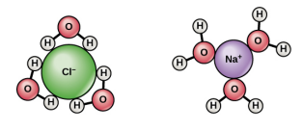
Why Water Rules
Universal solvent
  Why important?
Solvent – substance capable of dissolving other polar molecules and ionic compounds
  Remember ionic compounds are formed by oppositely charged ions
Notes:
Charges of polar molecules causes hydrogen bonding with water and results in them being surrounded with water (sphere of hydration)
Ionic compounds – disassociate (molecule breaks apart into ions) each ion surrounded by water molecules (sphere of hydration)

Slide 19
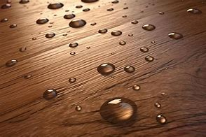
Why Water Rules
Cohesion and Adhesion
  Why important?
Cohesion – water molecules are attracted to each other
  Due to hydrogen bonding
    Think about a glass of water filled to the top and then some
Results in water having high surface tension
  Surface tension – ability of substance to with stand rupturing when placed under stress
    Why water forms drops on dry surface

Slide 20
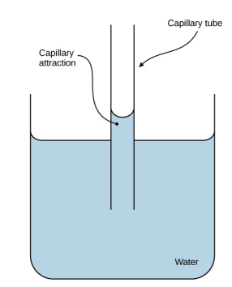
Why Water Rules
Cohesion and Adhesion
  Why important?
Adhesion – attraction between water molecules and other molecules
  Capillary action is why water “climbs” walls of glass beaker
    Water attracted more to the charged glass than itself

Slide 21
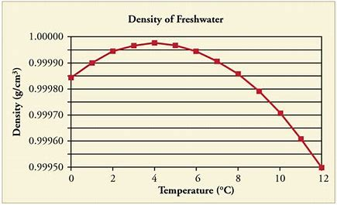
Why Water Rules
Unique density
  Why important?
Water is less dense as a solid than as a liquid
  Ice floats

Slide 22
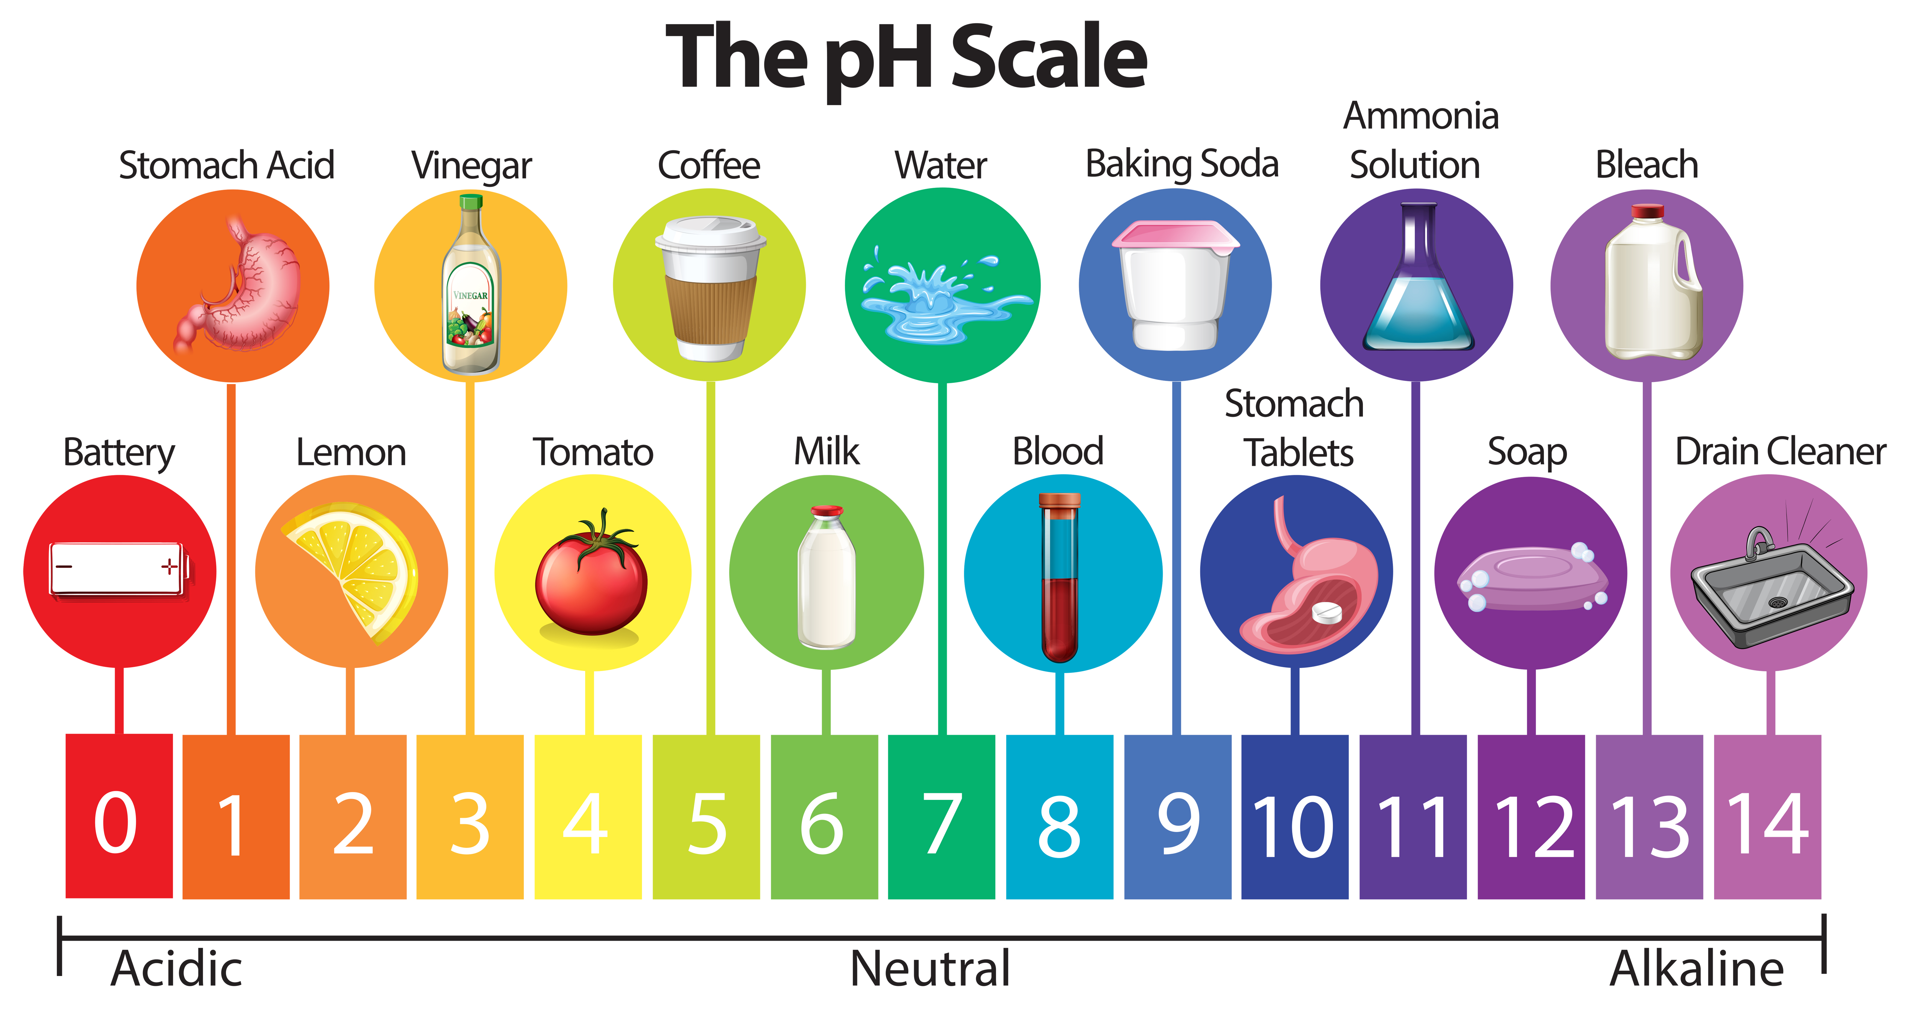
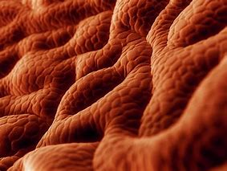
Ph, Buffers, Acids, and Bases
pH – indicates the acidity or basicity of a solution
  Measure of the hydrogen ion (H⁺) concentration
Scale
  Ranges from 0 – 14
    7 = neutral
    0 – 6.99 = acidic
      Increases H⁺ ions in a solution
    7.01 – 14 = basic
      Increases hydroxide ions (OH⁻) or other negatively charge ions that can bond with free H⁺ ions
The stronger the acid or base the more readily it donates the above
Common pH’s in the body
  Blood 7.4
  Cell interior 6.8
  Stomach 1 – 2
How do cells in stomach survive such harsh conditions?
Notes:
They don’t and are constantly being replaced. Entire stomach lining every 7-10 days.

Slide 23

Ph, Buffers, Acids, and Bases
How are humans (near neutral pH) able to drink orange juice (pH = 3) and survive?
Buffers – substances that readily absorb H⁺ or OH⁻ ions
  Help to keep the body pH in a narrow range
Notes:
HCO3- = bicarbonate
H2CO3 = carbonic acid – coral reefs

Slide 24
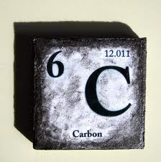

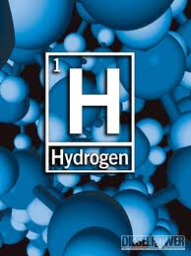
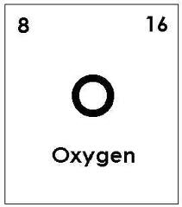
Backbone of Life

Slide 25
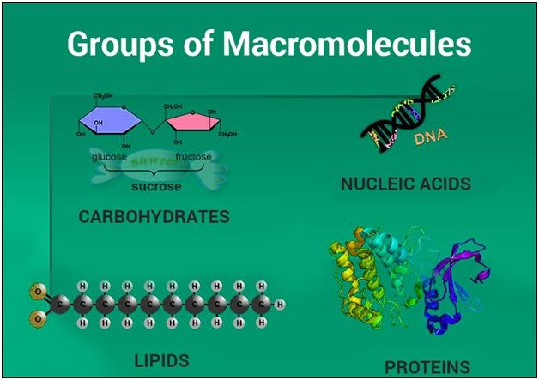
Carbon
Cells are composed of many macromolecules
Macromolecules are a subset of organic molecules
  Macromolecule – any carbon containing liquid, solid or gas that is important to life
Hydrocarbons – organic molecules containing only carbon and hydrogen
Carbon has unique properties that make it important to life as we know it

Slide 26
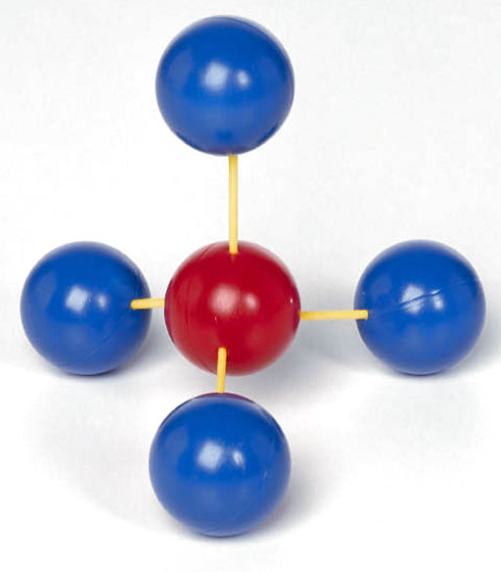
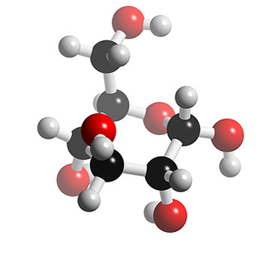
Carbon
Four covalent bonds
Bond to other atoms including other carbons
  Can for single, double or triple bonds
glucose: C₆H₁₂O₆
methane: CH₄
Notes:
Atomic number of 6 – outermost shell only has 4
Methane is a hydrocarbon – great source of fuel as there is much energy stored in the four covalent bonds and is released as it is burned

Slide 27
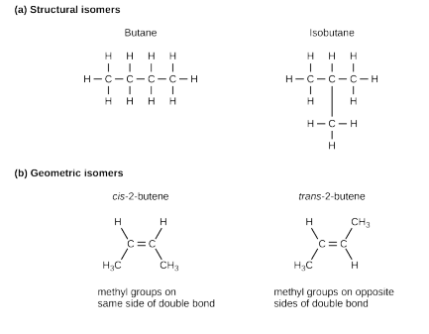
Carbon
Can form isomers
  Isomer – molecules with same chemical formula but have a different structure (placement of atoms and/or bonds)
    Impacts the chemical properties of molecules
Notes:
Butane = fuel in lighters and isobutane = refrigerant

Slide 28
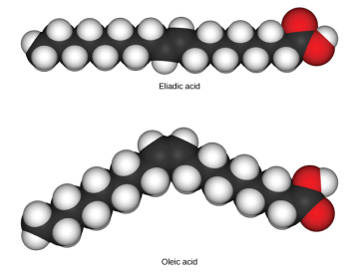
Carbon
Can form isomers
  Isomer – molecules with same chemical formula but have a different structure (placement of atoms and/or bonds)
    Impacts the chemical properties of molecules
Notes:
Fatty acids with one or more double bonds are unsaturated lack hydrogens that could bond if double bond was not present
When bonds are in cis formation they cannot pack together tightly and remain a liquid at room temp
When in trans form (trans fat) they can pack tightly and can be solid at room temp. (linked to increased risk of cardiovascular disease).
Saturated fats lack double bond and are saturated with hydrogens – solid at room temp and usually of animal origin

Slide 29
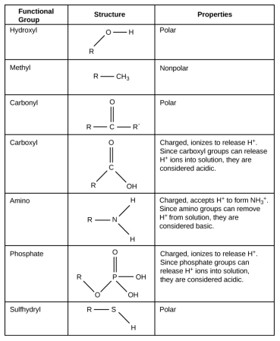
Functional Groups
Functional groups – groups of atoms within molecules that supply specific chemical properties to the molecules
  Found along the C backbone of macromolecules
    Each macromolecule has its own characteristic set of functional groups
      Contributes greatly to its chemical properties and function
Notes:
These groups important for forming the macromolecules

Slide 30
Organic molecules that make life possible
Carbohydrates – short-term energy storage and structural uses
Lipids – long-term energy storage, membranes (insoluble in water), insulation
Proteins – catalyze other reactions (enzymes), structural, muscle contraction. Complex three-dimensional structure is essential to function.
Nucleic Acids – DNA and RNA – encode the information to make proteins. Complex helical structure also essential to function.

Slide 31
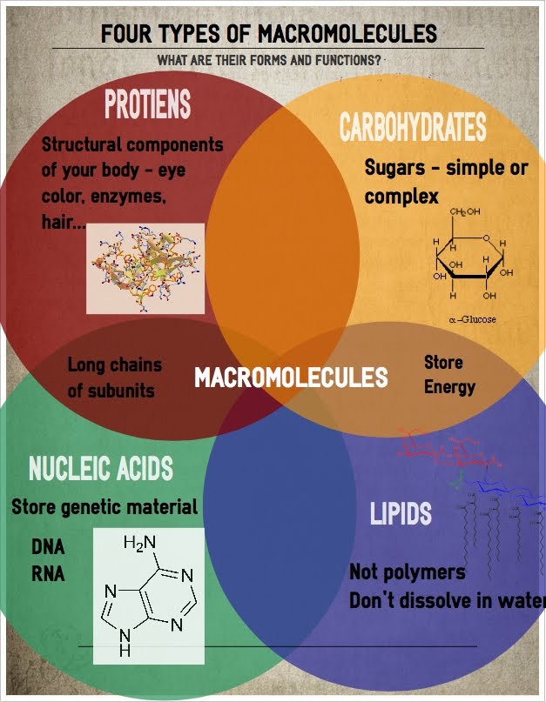
Next Time
Biological Macromolecules

