Slide 1
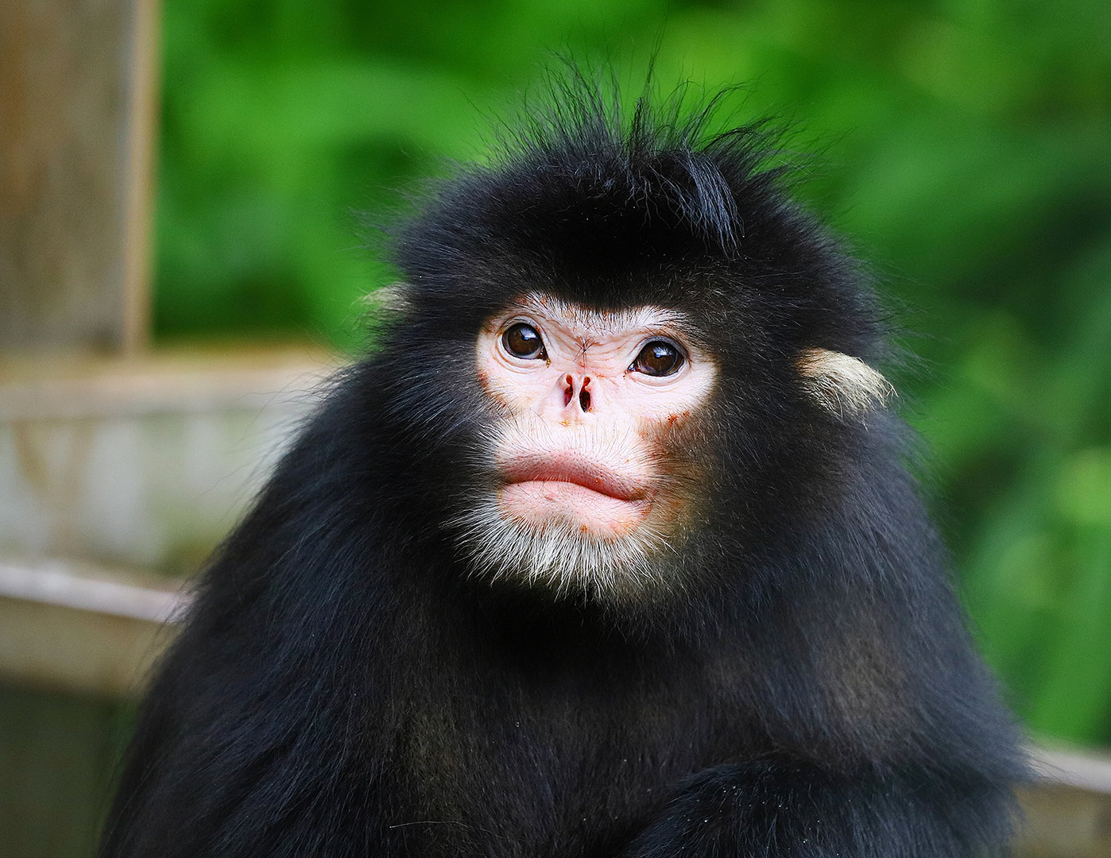
BIOL 1414 Intro to Mol/Cell Biology
Lecture #6
9/10 September 2026
Last Lecture:
Biological Macromolecules
Today: (Ch 4)
Introduction
Studying Cells
Cell Theory
Prokaryotes
Eukaryotes
  Plant vs. Animal Cells
Endomembrane system
Exoskeleton
Extra cellular Matrix
Myanmar snub-nosed monkey
Rhinopithecus strykeri
Notes:
First discovered in 2010
Other species of snub-nosed monkey exist in other areas of Asia
Hunted for food at times by locals
Numbers are declining due to habitat loss
Currently listed as critically endangered
Locals say they are easier to hunt in the rain.

Slide 2
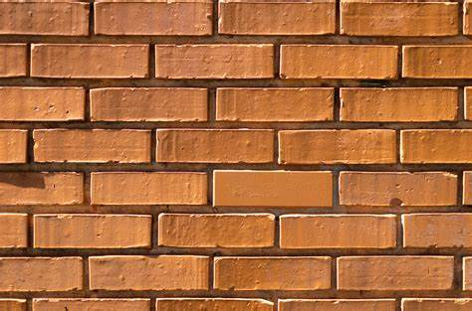
Introduction
Take a second close your eyes and think about a brick wall.
  What is the basic component that makes up the wall?
    The brick
  What is the basic building block of our bodies?
    The cell

Slide 3
Introduction
Body consists of many types of cells
  Each is specialized for a specific purpose
Compare to building a house
  Need a wide variety of different materials
    Each has a specific purpose as well
Examples of cells:
  Epithelial – protect body surface and cover organs
  Bone – help support and protect the body
  Blood – carry nutrients and gas through body
Cells from all organisms share fundamental characteristics between them

Slide 4
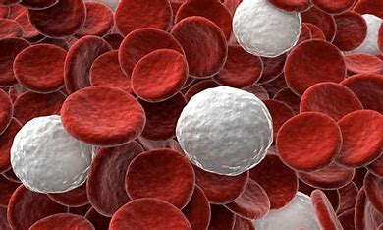
Introduction
Cells function in:
  Growth of an organism
  Development of an organism
  Day-today maintenance
  Reproduction
  Much more

Slide 5
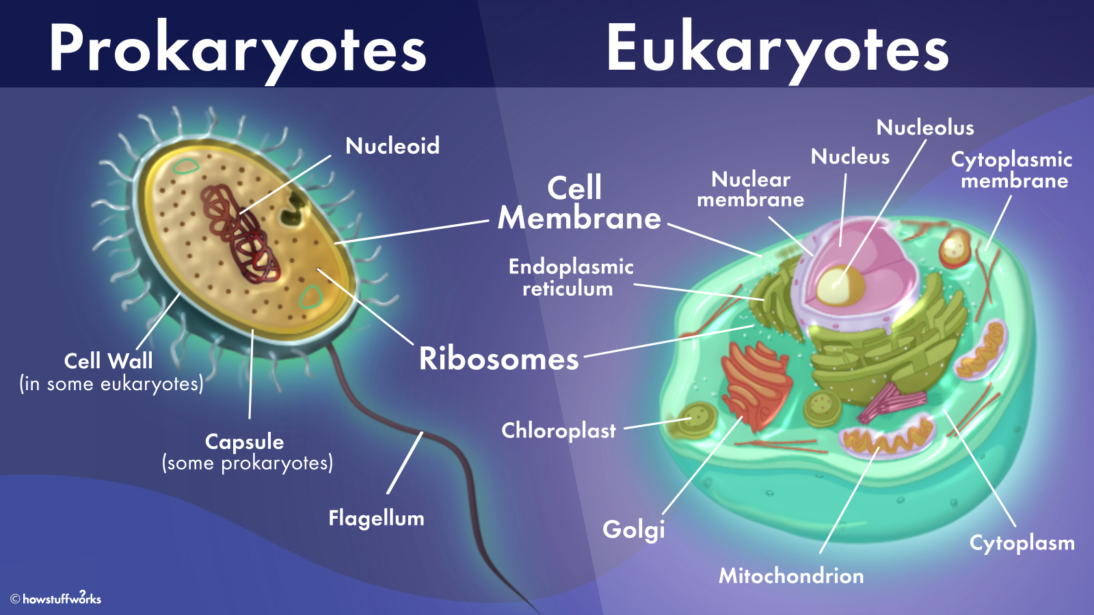
Studying Cells
Cell is the smallest unit of a living thing
  Basic building blocks of all organisms
    Single celled bacteria
    Complex multicellular human
Cells classified into two groups
  Prokaryotes
  Eukaryotes

Slide 6
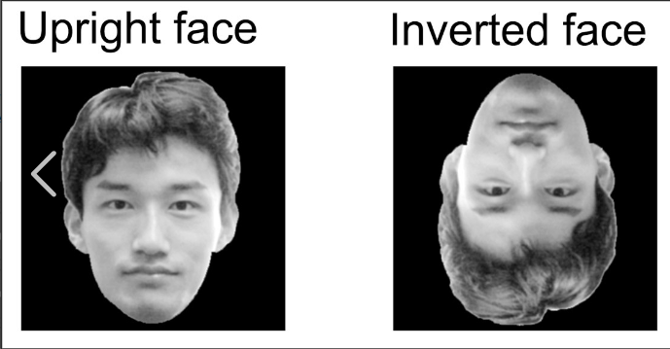
Studying Cells
Microscope:
  Micro – small
  Scope – to look at
Image is inverted in a microscope
  Right side up and facing right to naked eye
    Will be upside down and facing left through scope
  Due to compound scope
    Two sets of lenses to magnify image
    As light travels though these lenses it is inverted
Notes:
Red blood cells – 250 red blood cells fit on a pinhead
As you move the stage right – image goes left
Move the stage up the image goes down.

Slide 7
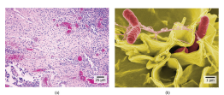
Studying Cells
Light microscope
  What we use in lab
    Many advantages
      40x to 1000x magnification
      Light aids in viewing cells as they are transparent
      Small and easy to work with
    Disadvantages
      Usually need to stain cells to see organelles
      Have lower resolving power
Electron microscopes
  What scientist use to study cells
    More magnification and resolution
    More expensive and very large
Notes:
Uses a beam of electrons not light for viewing object.

Slide 8
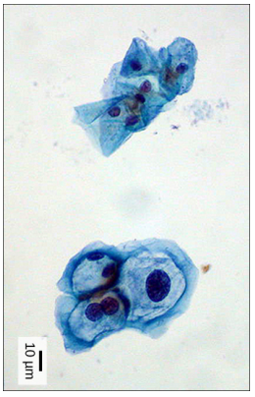
Cell Theory
Unified Cell Theory:
  All living things are comprised of cells
    One or more cells
  The cell is the basic unit of life
  New cells arise from existing cells
Career connection:
  Pap smear – test of the uterine cervical cells
    Cytotechnologists:
      Scientist who study cells via microscopes
        Cyto = cell
    Determine if cell changes are normal or not
      Test more than just cervical cells
Notes:
These uterine cervix cells, viewed through a light microscope, are from a Pap smear. Normal cells are on the left. The cells on the right are infected with human papillomavirus (HPV). Notice that the infected cells are larger. Also, two of these cells each have two nuclei instead of one, the normal number.

Slide 9
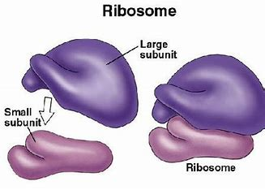
Cell Theory
All cells share four common components:
  1) Plasma membrane – outer covering separating cell interiors from its surrounding environment
  2) Cytoplasm – jelly like liquid within cell in which there are other components
  3) DNA – the cells genetic material
  4) Ribosomes – synthesize proteins

Slide 10
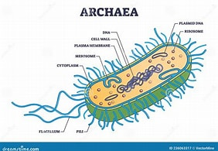
Prokaryotic Cells
Predominately single celled organisms
  Bacteria and Archaea
  Pro = before and kary = nucleus
Prokaryote:
  Simple
  Mostly unicellular
  Lack a nucleus
  Lack other membrane bound organelles
Notes:
Eu = true Eukaryotes = true nucleus

Slide 11
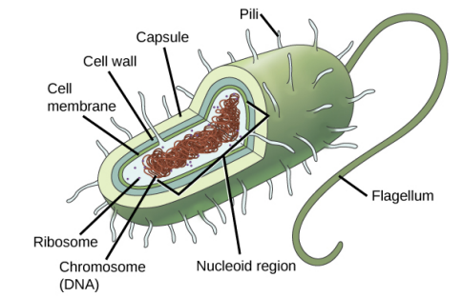
Prokaryotic Cells
Prokaryote:
  DNA is located in nucleoid (central region)
    Organized into single circular chromosome
  Most have a peptidoglycan cell wall
    Protection and helps maintain shape
  Many have a polysaccharide capsule
    Aids in attachment to surfaces
  Some contain flagella, pili, or fimbriae
    Flagella – used for locomotion
    Pili – exchange genetic material during conjugation
      Conjugation – transfer of genetic material through direct contact
    Fimbriae – bacteria use to attach to host cell
Notes:
The most effective action anyone can take to prevent the spread of contagious illnesses is to wash his or her hands. Why? Because microbes (organisms so tiny that they can only be seen with microscopes) are ubiquitous. They live on doorknobs, money, your hands, and many other surfaces. If someone sneezes into his hand and touches a doorknob, and afterwards you touch that same doorknob, the microbes from the sneezer’s mucus are now on your hands. If you touch your hands to your mouth, nose, or eyes, those microbes can enter your body and could make you sick. However, not all microbes (also called microorganisms) cause disease; most are actually beneficial. You have microbes in your gut that make vitamin K. Other microorganisms are used to ferment beer and wine.

Slide 12
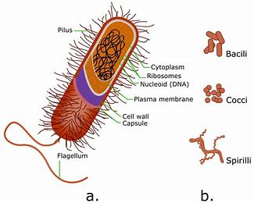
Prokaryotic Cells
Cell size
  0.1 – 5.0μm
    Small size allows for quick movement of:
      Ions and organic molecules into and throughout the cell
      Waste materials produced in cell out
Small size is necessary for all cells:
  If a cell is too large it lacks enough surface area to diffuse fast enough to support the cell
    As a cell grows it becomes less efficient
    To fix this a cell can:
      Divide
      Increase surface area by folding or changing shape
      Develop specialized organelles
      These all lead to more complex cells (eukaryotes)
Notes:
Thus, as the radius of a cell increases, its surface area increases as the square of its radius, but its volume increases as the cube of its radius (much more rapidly

Slide 13
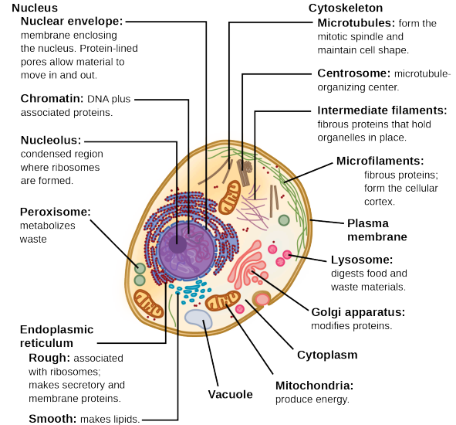
Eukaryotic Cells
Eukaryotic cells:
  Membrane bound nucleus
  Numerous membrane bound organelles
    Organelle = little organ
      Endoplasmic reticulum
      Golgi apparatus
      Chloroplasts
      Mitochondria
      Others
    Allow function to be compartmentalized in a cell
  Numerous rod-shaped chromosomes
  Far more complex than prokaryotic cells
Notes:
Form follows function - It’s a philosophy that many industries follow. In architecture, this means that buildings should be constructed to support the activities that will be carried out inside them. For example, a skyscraper should include several elevator banks. A hospital should have its emergency room easily accessible.
Eu = true – Eukaryotic = true nucleus

Slide 14
Eukaryotic Cells
Notes:
Animal Cell

Slide 15
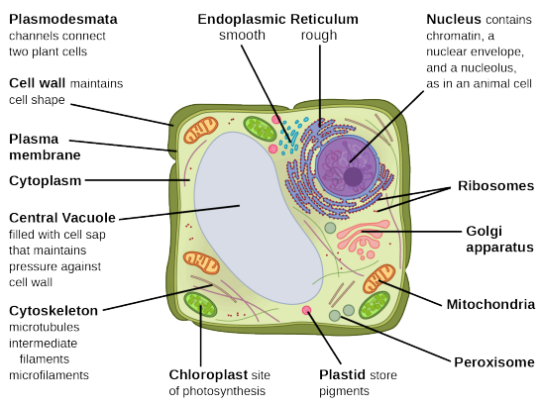
Eukaryotic Cells
Notes:
Plant Cell

Slide 16
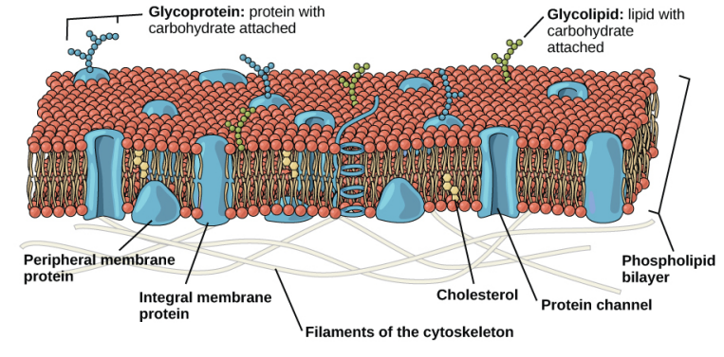
Eukaryotic Cells
Plasma membrane:
  Phospholipid bilayer with embedded proteins
    Separates cells interiors from environment
  Controls passage of:
    Ions
    Organic molecules
    Water
    Oxygen
    Waste
    Carbon dioxide
Notes:
Plasma Membrane occurs in both pro and eukaryotic cells

Slide 17
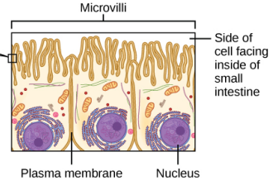
Eukaryotic Cells
Plasma membrane:
  Real world example:
    Cells that are used for absorption have a plasma membrane that fold into finger like projections
      Microvilli – finger like folds used in absorption
    Line the small intestine
      Absorbs nutrients from our food
    Celiacs disease
      Immune response to gluten (protein in wheat, barley, and rye)
        Damages the microvilli – prevents absorption
        Causes malnutrition, cramping, and diarrhea

Slide 18
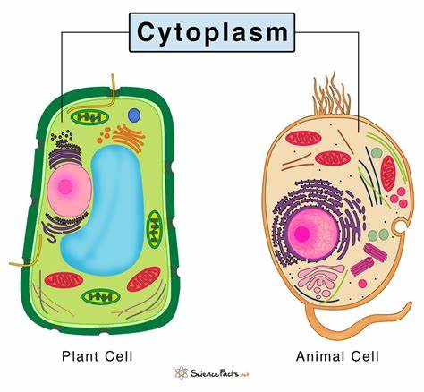
Eukaryotic Cells
Cytoplasm – entire area between plasma membrane and nuclear envelope
  Consists of a gel like cytosol (cytoskeleton)
    Cytosol – liquid like part of the cytoplasm
  Is 70-80% water but is a semi solid
    Due to the proteins contained within it
  Many other organic molecules and ions as well
  Many metabolic reactions occur here
    Including protein synthesis
Notes:
Contained in the cytoplasm - Glucose and other simple sugars, polysaccharides, amino acids, nucleic acids, fatty acids, and derivatives of glycerol are also there. Ions of sodium, potassium, calcium, and many other elements also dissolve in the cytoplasm

Slide 19
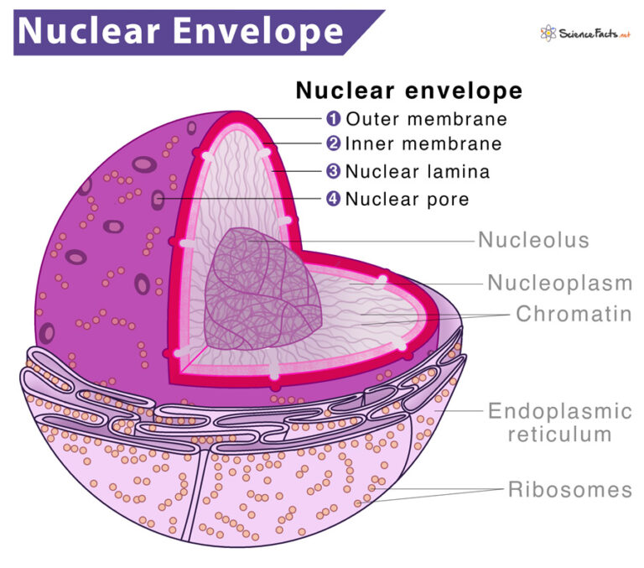
Eukaryotic Cells
Nucleus – houses cells DNA and directs synthesis of ribosomes and proteins
  Usually most prominent organelle in a cell
Nuclear Envelope – double membrane structure that makes up outermost part of the nucleus
  Both membranes are phospholipid bilayers
  Has many pores to control passage between cytoplasm and nucleoplasm
    Ions, molecules, and RNA
    Nucleoplasm – semi-fluid inside nucleus
      Where we find chromatin and nucleolus

Slide 20
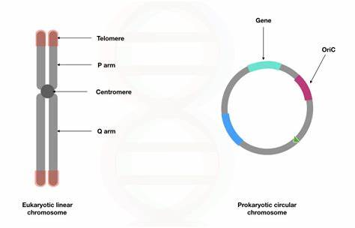
Eukaryotic Cells
Chromosomes – structures in the nucleus that are made up of DNA
  Are linear in nature
  Each eukaryotic organism has a set number in the nucleus of every cell
    We as humans have 46 chromosomes
    Fruit flies have 8 chromosomes
  Only visible when cell is getting ready to divide
    During most times it is unwound (not condensed)
  Made of chromatin
    Chromatin – material that make up chromosome

Slide 21
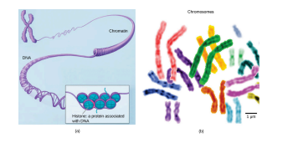
Eukaryotic Cells

Slide 22
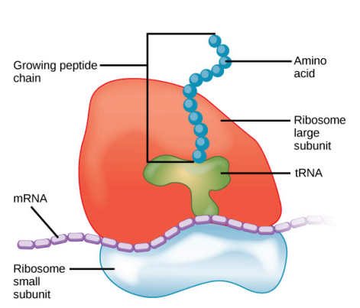
Eukaryotic Cells
Nucleolus – non-membrane bound organelle in nucleus that synthesizes ribosomal RNA and forms ribosomes
Ribosomes – responsible for protein synthesis
  Large clusters of RNA and protein
  Viewed through electron microscope appear as:
    Single tiny dots floating in cytoplasm
    Polyribosomes – clusters of tiny dots
  Receive orders from DNA in nucleus
    DNA is transcribed into mRNA
  Translates mRNA nitrogenous bases into a specific order of amino acids
    Amino acids are the monomers of proteins
  Occur in almost every cell
Notes:
Because protein synthesis is an essential function of all cells (including enzymes, hormones, antibodies, pigments, structural components, and surface receptors), there are ribosomes in practically every cell. Ribosomes are particularly abundant in cells that synthesize large amounts of protein. For example, the pancreas is responsible for creating several digestive enzymes and the cells that produce these enzymes contain many ribosomes.

Slide 23
Eukaryotic Cells

Slide 24
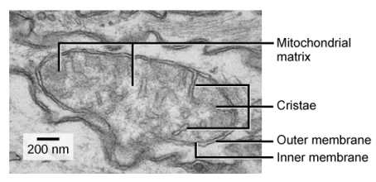
Eukaryotic Cells
Mitochondria – powerhouse of animal and plant cells
  Make ATP – Adenosine triphosphate
    Cells main energy carrying molecule
    Short term stored energy in a cell
    Produced during cellular respiration
  Muscle cells have a lot of mitochondria
  Oval shaped with a double membrane
    Have own DNA and ribosomes

Slide 25
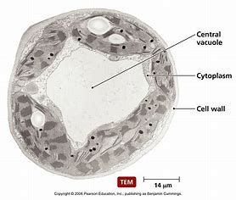
Eukaryotic Cells
Peroxisomes – break down fatty acids and amino acids and detoxify poisons that enter the body
  Small, round, only a single membrane
Vesicles and Vacuoles – membrane bound sacs that function in storage and transport
Notes:
Peroxisomes - Many of these oxidation reactions release hydrogen peroxide, H2O2 , which would be damaging to cells; however, when these reactions are confined to peroxisomes, enzymes safely break down the H2O2 into oxygen and water.) For example, peroxisomes in liver cells detoxify alcohol.

Slide 26
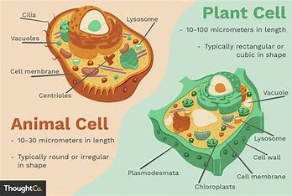
Plant vs. Animal Cells
Both Plant and Animal Cells
  Plasma membrane
  Cytoplasm
  Nucleus
  Ribosomes
  Mitochondria
  Peroxisomes
  Some have vacuoles
  Endo plasmic reticulum
  Golgi apparatus
  Cytoskeleton

Slide 27
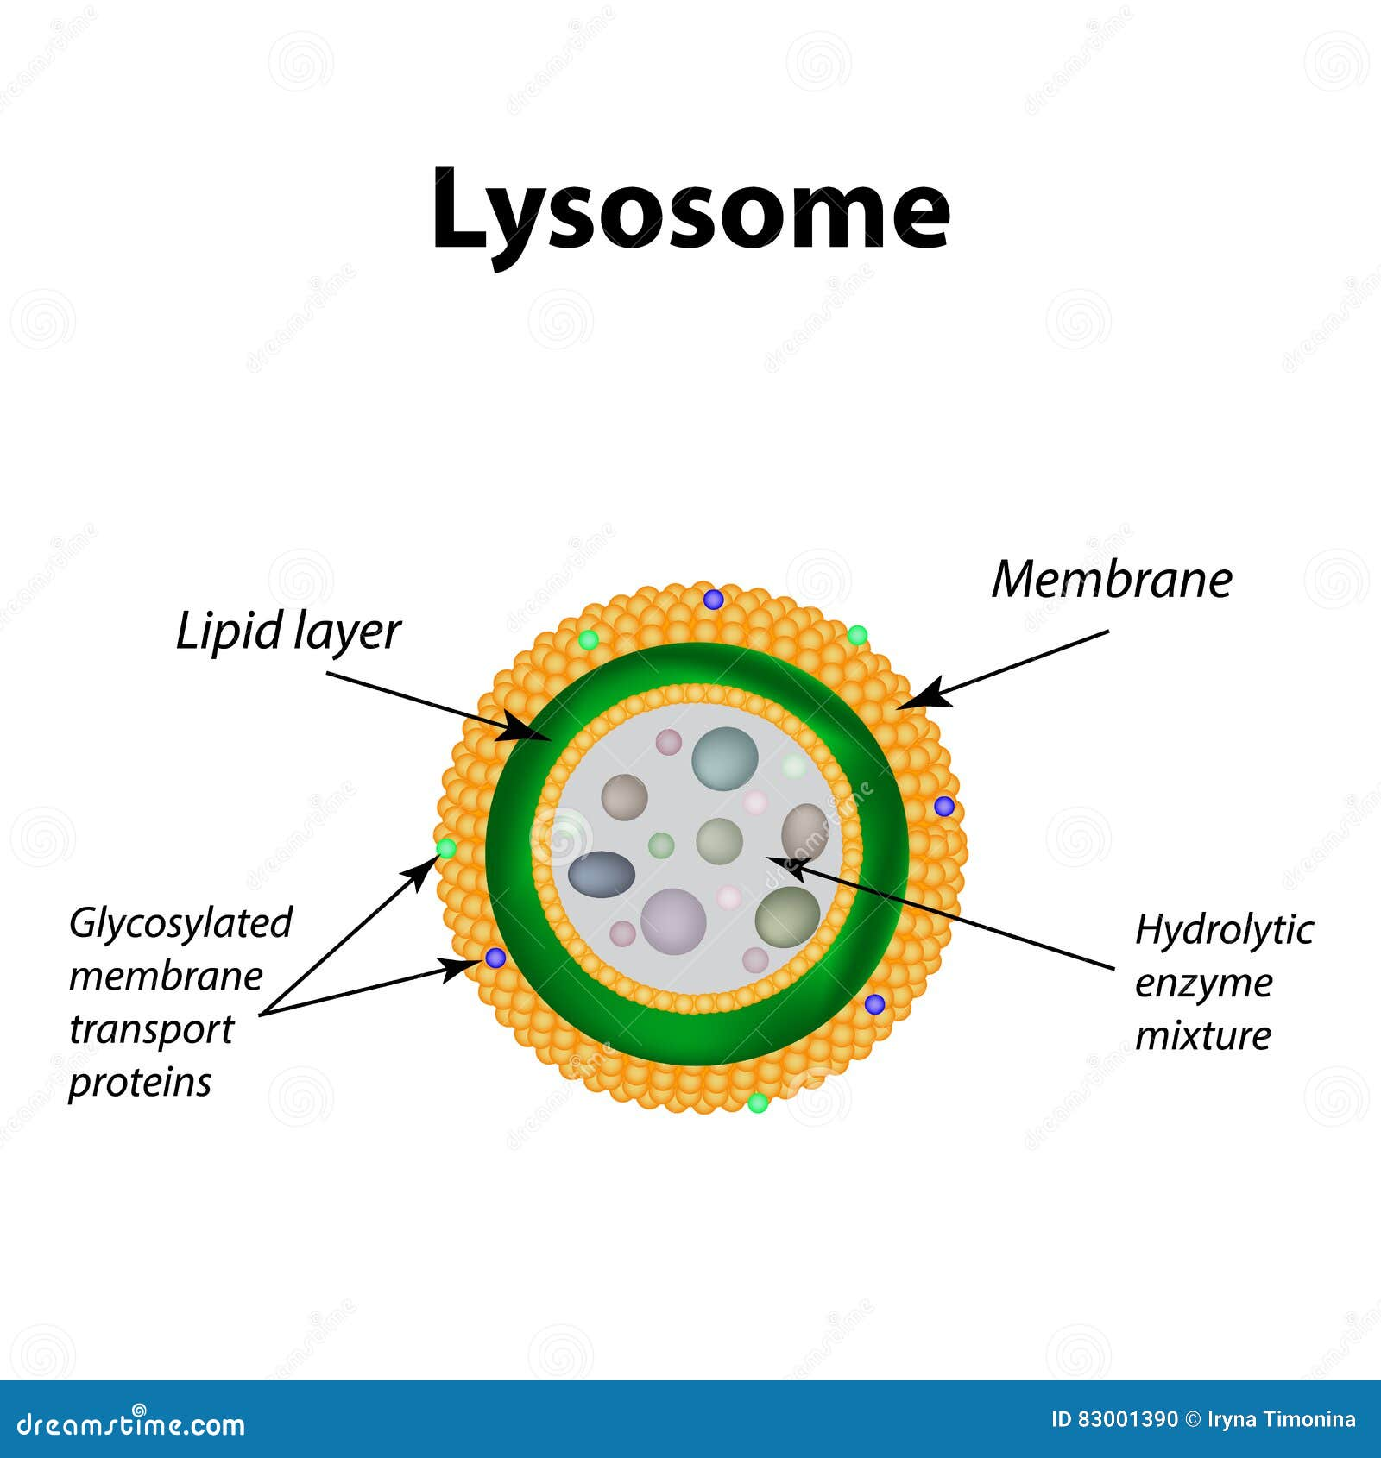
Plant vs. Animal Cells
Animal Cells Only
  Centrosome – appear to play a role in pulling duplicated chromosomes to opposite sides of the dividing cell
    Large tube made up of nine sections of three smaller tubes
    Role is still being studied
      Cells without centrioles or plant cells still divide
  Lysosomes – a cells garbage disposal
    Contain enzymes that break down:
      Proteins, polysaccharides, lipids, nucleic acids, old organelles
    pH in lysosome much lower than cytoplasm
    Note – in plant cells digestion occurs in the vacuoles
Notes:
The pH within lysosomes is more acidic than the cytoplasm's pH. Many reactions that take place in the cytoplasm could not occur at a low pH, so again, the advantage of compartmentalizing the eukaryotic cell into organelles

Slide 28
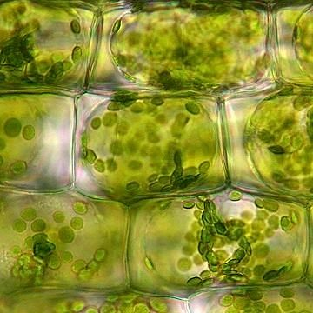
Plant vs. Animal Cells
Plant Cells Only
  Cell wall – rigid covering that protects the cell, supplies support, and gives shape to the cell
    Located outside the plasma membrane
  Some fungi and protists have a cell wall
  Composed of primarily of cellulose (polysaccharide)
    This is why raw vegetables crunch

Slide 29
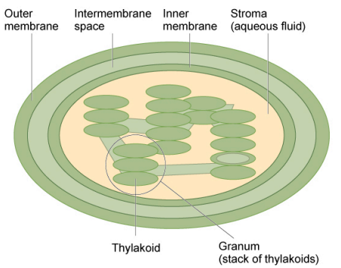
Plant vs. Animal Cells
Plant Cells Only
  Chloroplast – carry out photosynthesis
    Photosynthesis produces glucose and oxygen
      Plants are Autotrophs
      Autotroph – capable of making their own food
    Have their own DNA and ribosomes
    Composed of two membranes
    Inside inner membrane are:
      Thylakoid – contains much of the chlorophyll
        Chlorophyll – green pigment that captures the light for photosynthesis
      Granum – stack of thylakoids
      Stroma – liquid contained within the inner membrane

Slide 30
Plant vs. Animal Cells

Slide 31
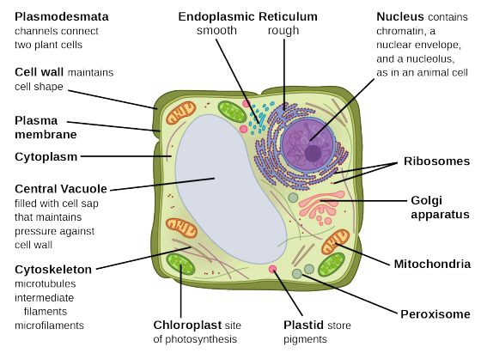
Plant vs. Animal Cells
Plant Cells Only
  Central Vacuole – helps regulate water in a plants changing environment
    Note – animal cells have vacuoles but not a large central vacuole
    Wilting of a plant occurs when
      Central vacuole and cytoplasm lose water to dry soil
    Supports cells expansion
      Central vacuole filled with water cell can expand
        Does this without making new cytoplasm

Slide 32
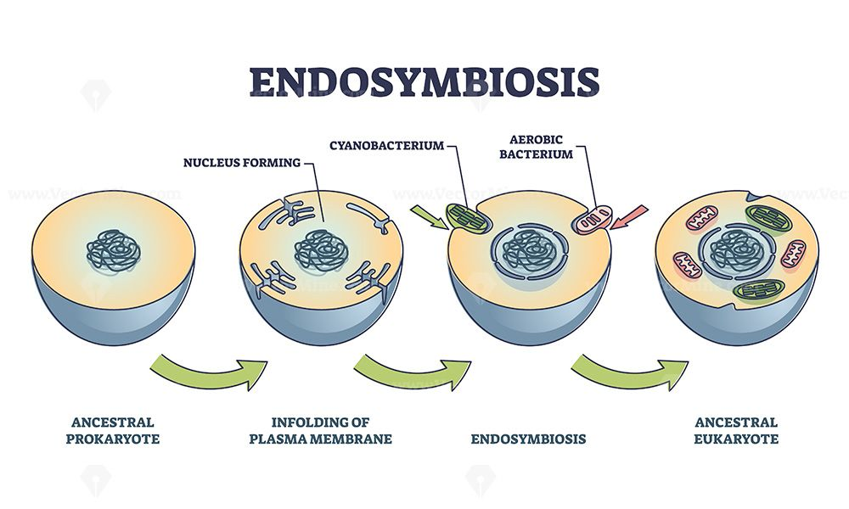
Evolution and Eukaryotic Cells
Mitochondria and Chloroplasts both have DNA and Ribosomes
  WHY?
  Endosymbiosis is best explanation!!

Slide 33
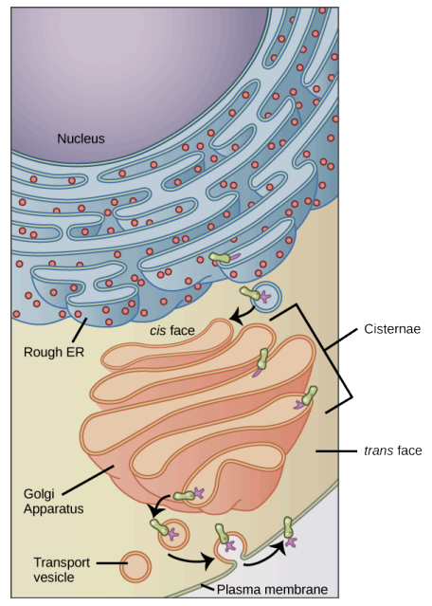
Endomembrane System
Endomembrane system – group of membranes and organelles within the cell that modify, package, and transport lipids and proteins
  Includes the following:
    Nuclear envelope
    Lysosomes
    Vesicles
    Endoplasmic reticulum
    Golgi apparatus

Slide 34
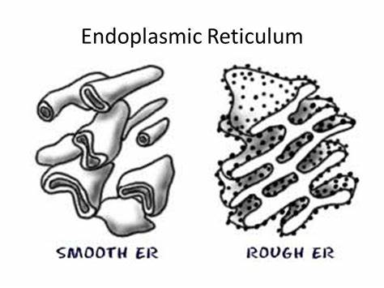
Endomembrane System
Endoplasmic reticulum (ER) – modifies proteins and synthesizes lipids
  Series of interconnected membranous sacs and tubules
  The above functions occur in different locations of the ER
    Rough ER – modifies proteins and makes phospholipids
      Named for the ribosomes attached to its cytoplasmic surface
      Ribosomes send newly synthesized proteins to Rough ER
        Rough ER creates structural modifications (folding or adding side chains)
    Smooth ER – synthesis of carbohydrates, lipids, and steroid hormones, detoxification of medications and poisons, and storing calcium
      Is a continuation of the rough ER but lack ribosomes or has very few

Slide 35
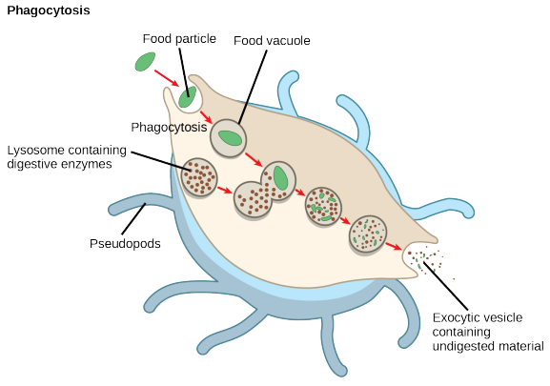
Endomembrane System
Golgi Apparatus – sorting, tagging, packaging, and distributing lipids and proteins from the ER systems
  Also called the Golgi Body
  Composed of a series of flattened membrane
  In plants it synthesizes polysaccharides
    Incorporated into cell wall
  Cells that have a large secretory function have lots of Golgi
    Salivary glands for example
Lysosomes – help to destroy pathogens in animals
Notes:
A good example of this occurs in macrophages, a group of white blood cells which are part of your body’s immune system.

Slide 36
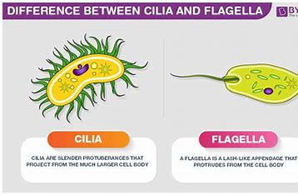
Cytoskeleton
Cytoskeleton – maintain the cell’s shape, secure some organelles in place, allows cytoplasm and vesicles to move, and enable cells within multicellular organisms to move
  Series of protein fibers, ions, and organic molecules
  Three types of fibers:
    Microfilaments – used in cellular movement
      Narrowest of all fibers
      White blood cells – move to where infection is occurring
    Intermediate filaments – function purely in structure
      Several strands of fibrous proteins wove together
        Keratin strengthens nails and hair
    Microtubules – help cells resist compression and are part of flagella's, cilia, and centrioles
      Small hallow tubes of proteins
      Widest of three fibers
Notes:
If you were to remove all the organelles from a cell, would the plasma membrane and the cytoplasm be the only components left?
No
The flagella (singular = flagellum) are long, hair-like structures that extend from the plasma membrane and enable an entire cell to move (for example, sperm, Euglena, and some prokaryotes). When present, the cell has just one flagellum or a few flagella. However, when cilia (singular = cilium) are present, many of them extend along the plasma membrane's entire surface. They are short, hair-like structures that move entire cells (such as paramecia) or substances along the cell's outer surface (for example, the cilia of cells lining the Fallopian tubes that move the ovum toward the uterus, or cilia lining the cells of the respiratory tract that trap particulate matter and move it toward your nostrils.)

Slide 37
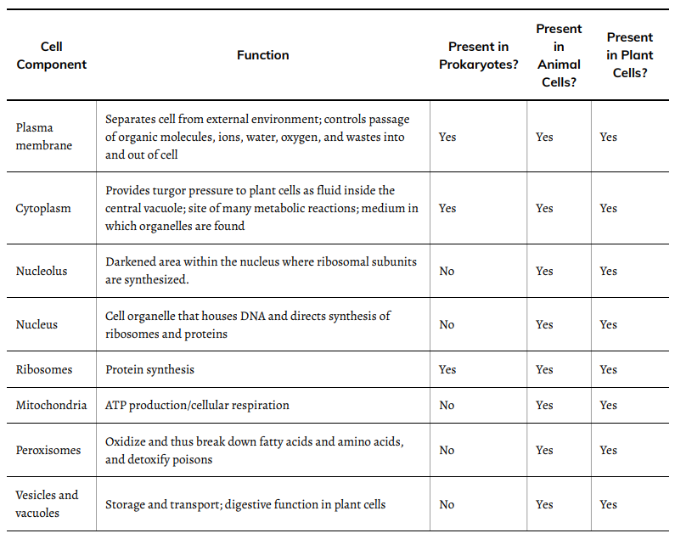
Review Table
Notes:
video

Slide 38
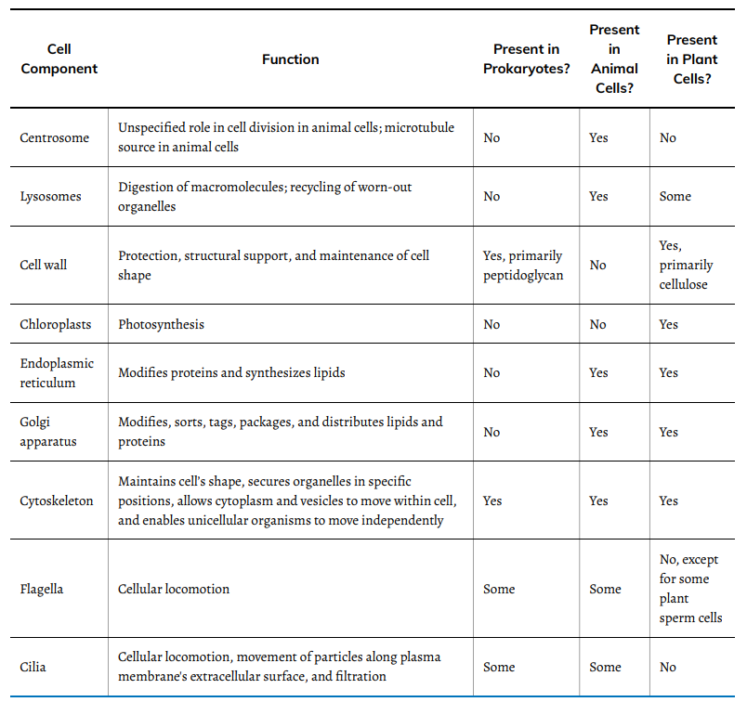
Review Table

Slide 39
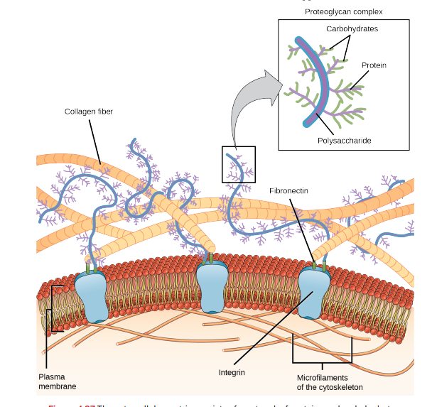
Extra Cellular Matrix
Extracellular matrix – holds cells together to form tissues allows cells in tissue to communicate
  Made of materials released from cells into the intercellular space
    Proteins and carbohydrates containing proteins
  Blood clotting is an example

Slide 40
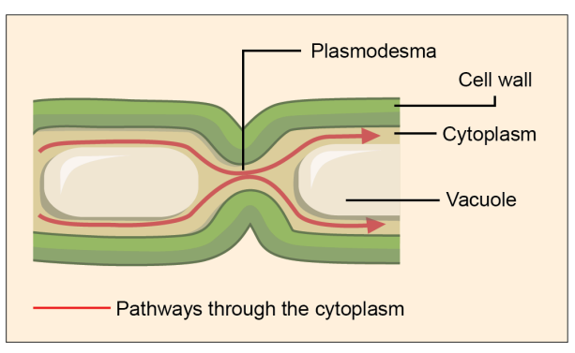
Intercellular Junctions
Cells can communicate via:
  Extracellular matrix
  Direct contact
  Intercellular junctions
Plasmodesmata – junctions between plant cells
  Channels between plant cells that connect cytoplasm
    Important in xylem and phloem transport

Slide 41
Intercellular Junctions
Animal cells
  Tight junction – watertight seal that prevents materials from leaking between two animal cells
    Bladder of skin cells
  Desmosomes – act like a spot weld between animal cells maintain the sheet-like formation
    Found in organs and tissues that stretch
      Heart, skin, and muscles
  Gap junctions – cells with a channel between them
    Similar to plasmodesmata in plant cells
    Allow transport between two cells
      Example = cardiac muscle – allows electrical signal to contract to pass though quickly so all contract at the same time

Slide 42
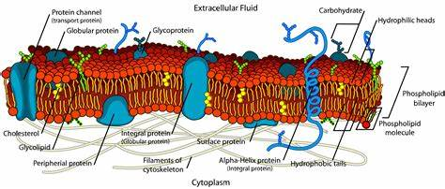
Next Time
Structure and Function of Plasma Membranes (Chapter 5)

