Slide 1


Presentation on
COMMUNICATION
Team Members:-
Aatish Shrestha
Aklesh Kumar Yadav
Dipak Das
Roman Dulal
Thilen Lama
Presented By:-
Agile COPS

Slide 2
IN THIS PRESENTATION……
INTRODUCTION
TYPES OF COMMUNICATION
PROCESS OF COMMUNICATION
IMPORTANCE OF COMMUNICATION
COMMUNICATION IN AGILE
MEANS OF COMMUNICATION
CHALLENGES IN COMMUNICATION
COPING UP WITH FACED CHALLENGES
QUESTION SEGMENTS

Slide 3
INTRODUCTION
derived from a Latin word meaning “to share.”
The act of transferring information from one place, person or group to another
Includes at least one sender, a message and a recipient

Slide 4
TYPES OF COMMUNICATION
Verbal: encompasses all communication using spoken words, or unspoken words as in the case with sign language
Non Verbal: your tone, facial expressions, body language, hand movements, and eye contact.
Written: form of anything you write or type such as letters, emails, notes, texts, billboards,
Visual: delivering information, messages, and points by way of graphical representations, or visual aids.
Listening: engaging your mind while the person speaks, intently focusing on what they are saying.

Slide 5
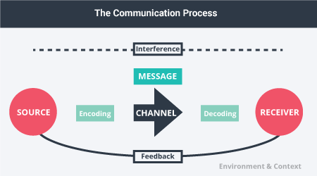
PROCESS OF COMMUNICATION
SOURCE: source comes up with an idea and sends a message in order to share information with others
MESSAGE: information or subject matter the source is intending to share
CHANNEL: includes verbal, non-verbal, written, digital form or simply gesture
RECEIVER: person for whom the message is intended.
INTERFACE: include poor audio quality or too much sound, poor image quality or simply noise

Slide 6
IMPORTANCE OF COMMUNICATION
Organizational/Functional: Greater information access and awareness
Improves Coordination: Reduces logical gaps
Encourage Cooperation: helps bring everyone in the mainstream
Gives a direction: Proper planning for tasks and activities
Problem solving: By clarity, precision and feedbacks
Better Focus: On requirements and agendas

Slide 7
COMMUNICATION IN AGILE
Most important part of Agile Development
Included in most of the values and manifesto of Agile.
Communication between Client and Developers
Communication between Product Manager and Scrum Master
Communication between Scrum Master and Developing team
Communication among Developing teams
Daily Meeting (Daily Scrum)
Weekly Scrum Meeting (Review, Retrospective and Planning)

Slide 8


MEANS OF COMMUNICATION
Facebook Messenger
For informal communication
Mostly used application
For Instant messaging
For emergency call
Microsoft Teams
For formal communication
Used for scrum meetings
For Descriptive discussion
For screen sharing
For problem solving and errors solving

Slide 9
CHALLENGES IN COMMUNICATION
Lack of Face to Face Communication
Lack of Documentation for proper discussion on the project
Different working hours
Internet/ Electricity Issues
Ever changing situation and features
Lack of commitment and teamwork

Slide 10
COPING UP WITH CHALLENGES
Face to Face communication starting from today
Designing prototype before implementation
Preparing Documentation for clear requirements
Reducing work disruptions due to each other like same emails, messenger accounts
Synchronizing working hours to get at least 1-2 hour overlap
Arranging Personal meetings along with Scrum meetings
Sharing visions of every team members

Slide 11


