Slide 1

Predicting Popular Recipes
By: Rindolfo Barra
Date: 21-07-2024
Notes:
Hello everyone. This time I’m going to expose on the prediction of popular recipes.

Slide 2

Overview and Business Goals
Objective: Predict popular recipes to increase site traffic and subscriptions.
Business Goal: Achieve 80% prediction accuracy for high traffic recipes.
Notes:
The objetive is predict popular recipes to increase site traffic and subscriptions.
And the business goal is achieve with 80% of accuracy for high traffic recipes.

Slide 3
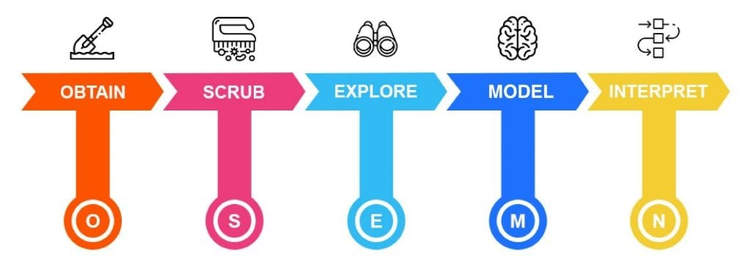
Summary of the Project
Data Validation and Cleaning
Exploratory Data Analysis (EDA)
Model Development and Evaluation
Business Metric Definition
Recommendations
Notes:
To develop the project we will carry out the following process.

Slide 4
Data Validation and Cleaning
Column | Initial Data Type | Final Data Type | Validation Steps | Cleaning Process
recipe | int64 | int64 | Duplicates (none found) | No changes needed.
calories | float64 | float64 | Identify missing values (52) | Drop missing values.
carbohydrate | float64 | float64 | Identify missing values (52) | Drop missing values.
sugar | float64 | float64 | Identify missing values (52) | Drop missing values.
protein | float64 | float64 | Identify missing values (52) | Drop missing values.
category | object | category | Inspect distribution of values | Merge "Chicken Breast" with "Chicken“ Convert data type to category.
servings | object | int64 | Replace " as a snack" with an empty string Convert data type to integer | All values converted to integers.
high_traffic | object | bool | Replace "High" with True and null values with False Convert data type to Boolean | High traffic → True Otherwise → False
Notes:
I found no duplicate records for the column recipes, so no changes needed.
There were 52 missing values in the columns for calories, carbohydrates, sugars and proteins. Since the nutritional information is not available, so I have decided to eliminate those records.
The category column was classified as object type. We inspected the distribution of values and found two categories starting with Chicken, so I unified these values. After that we changed the data type from object to category.
For the servings column I find numerical values at the beginning with 2 categories ' as a snack'. So I replace that string with an empty string. Finally I change the data type to int64 to treat the data in a better way.
For the high traffic column we only found 'high' values so we converted the column to boolean type considering 1 for high and 0 for otherwise.

Slide 5
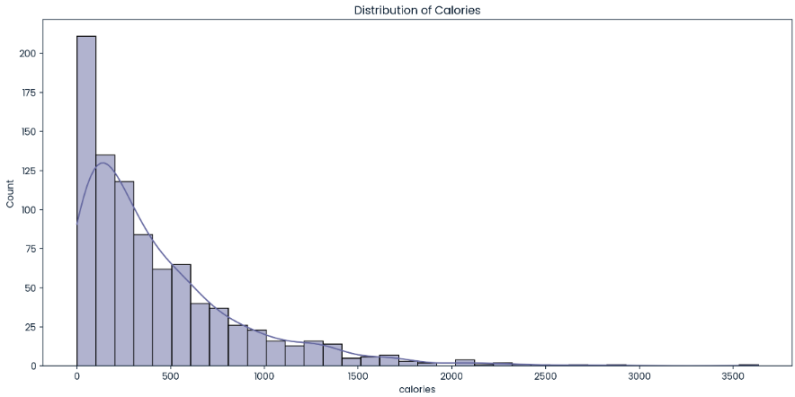
Exploratory Data Analysis
Key Insights:
Notes:
Calories distribution shows right skewness.(it should be noted that for the columns carbohydrate, proteins and sugar is the same thing)

Slide 6
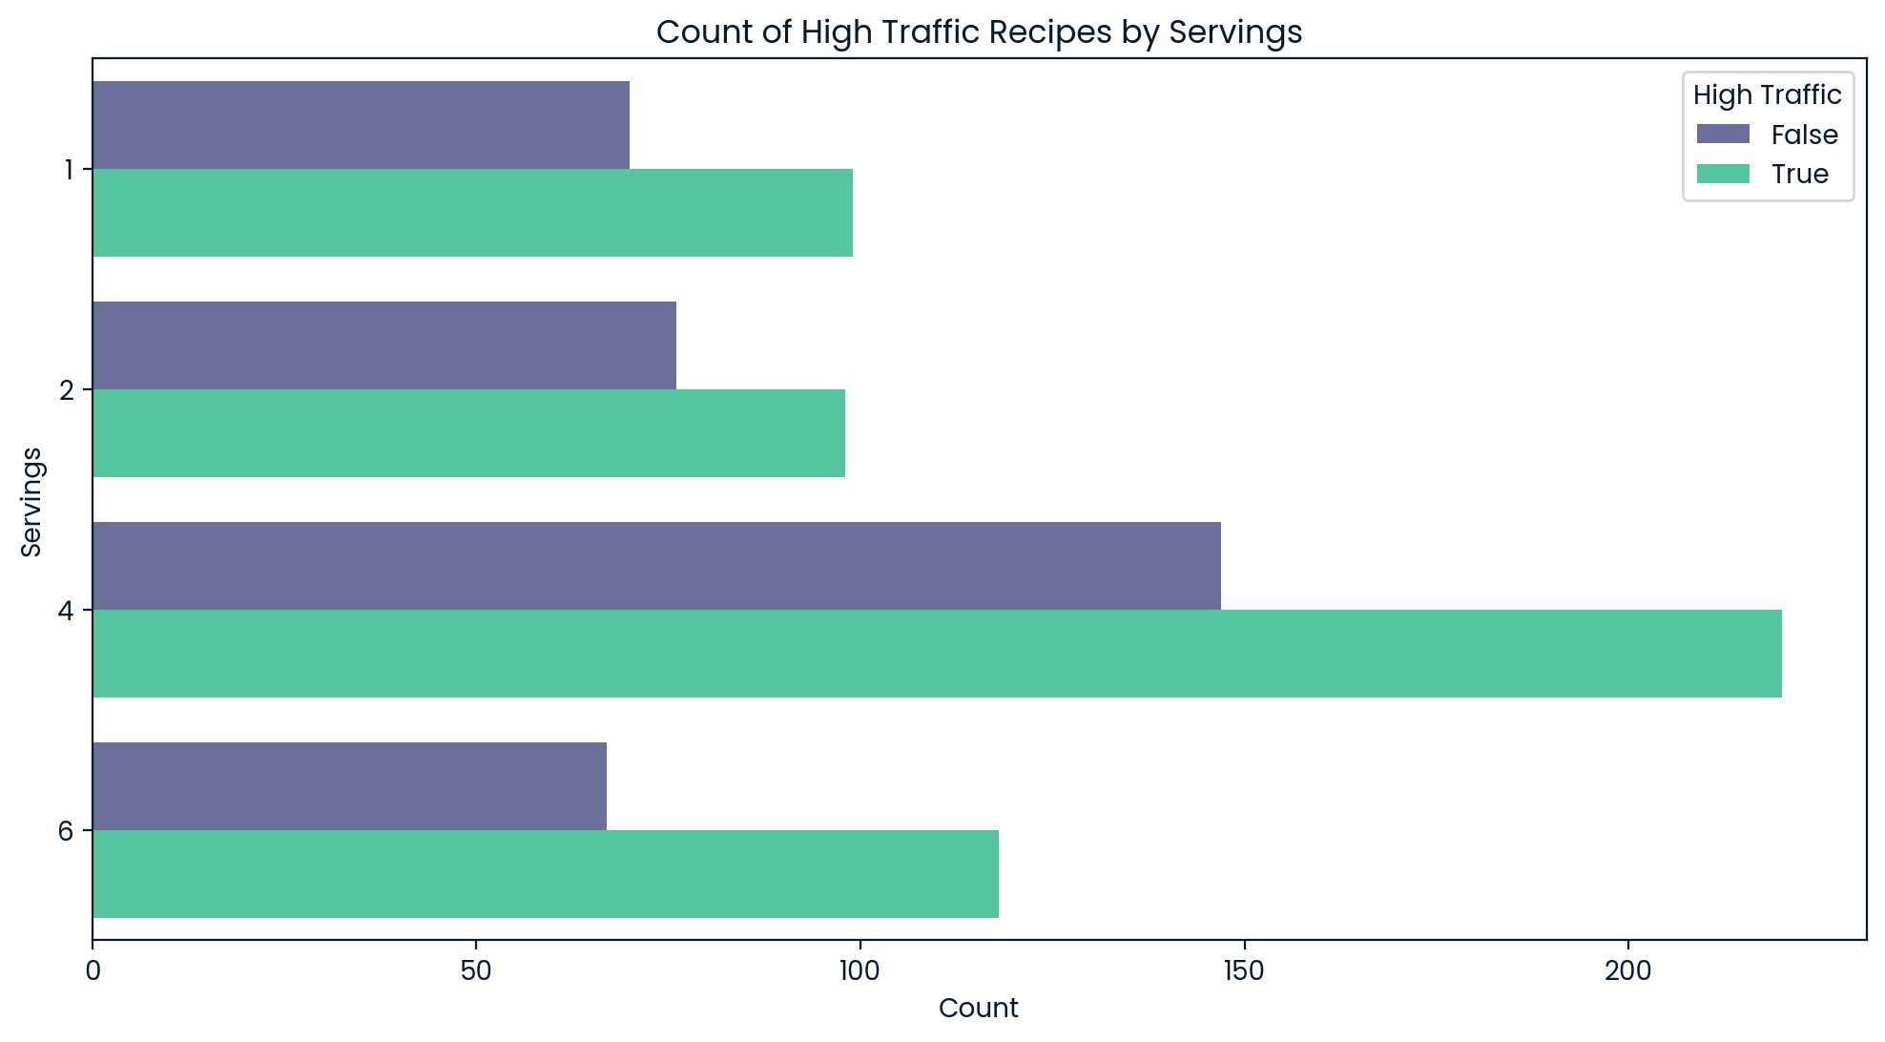
Exploratory Data Analysis
People clearly prefer recipes with 4 or more servings
Notes:
Recipes with 4 servings are the most popular, followed by those with 6 servings.
High traffic is generally more common than low traffic across all serving sizes.

Slide 7
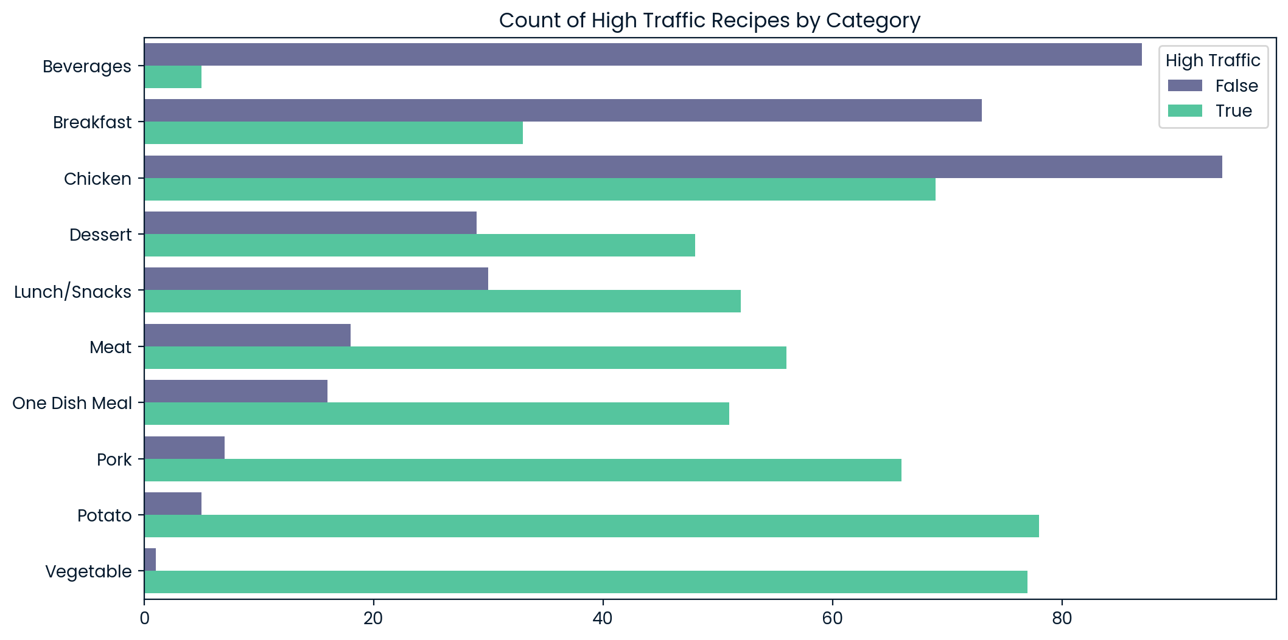
Exploratory Data Analysis
Notes:
The top three categories in terms of High traffic are Potato, Vegetable and Chicken. By the other hand, the Beverages appears to have the lowest traffic.

Slide 8

Model Development
Data Pretreatment:
Determine the upper and lower boundaries to manage the outliers by Interquartile Range (IQR)
Yeo-Johnson Transformation
One-hot encoding on the category column
Split the data into features (X) and the target variable (y), where the target variable is the high_traffic column
Model 80% to training and 20% for testing
Notes:
Before starting with the model development , it’s necessary to perform a pre-processing of the data.
There are no concerns with respect to low values; however, certain high values require attention.
Upon evaluation, it's apparent that outright removal of outliers leads to significant data loss, making this approach less favorable
Through experimentation with diverse transformation methods including Logarithmic, Square Root, Yeo-Johnson, and Box-Cox Transformation, it has been determined that the Yeo-Johnson is the most effective approach.

Slide 9
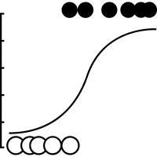
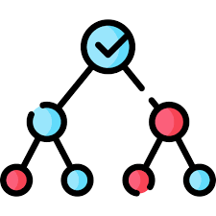
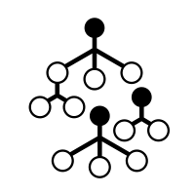

Model Development
Models Used:
Logistic Regression
Decision Tree
Random Forest
Support Vector Machine (SVM)
Baseline model: Logistic Regression
Comparison models: Decision Tree, Random Forest, SVM
Notes:
I used Logistic Regression like Baseline model and Decision Tree, Random Forest and Super Vector Machine to Comparison Models

Slide 10
Model Evaluation
Model | Data Set | Accuracy | Precision | Recall | F1-Score | Confusion Matrix
Logistic Regression | Train | 0.765 | 0.801 | 0.801 | 0.801 | [[210, 84], [84, 338]]
 | Test | 0.765 | 0.809 | 0.823 | 0.816 | [[44, 22], [20, 93]]
Decision Tree | Train | 1.000 | 1.000 | 1.000 | 1.000 | [[294, 0], [0, 422]]
 | Test | 0.670 | 0.750 | 0.717 | 0.733 | [[39, 27], [32, 81]]
Random Forest | Train | 1.000 | 1.000 | 1.000 | 1.000 | [[294, 0], [0, 422]]
 | Test | 0.765 | 0.803 | 0.832 | 0.817 | [[43, 23], [19, 94]]
Support Vector Machine | Train | 0.589 | 0.589 | 1.000 | 0.742 | [[0, 294], [0, 422]]
 | Test | 0.631 | 0.631 | 1.000 | 0.774 | [[0, 66], [0, 113]]
Overfitting
Underfitting
Notes:
Logistic Regression: This model shows a good balance between the training and test sets, with no indication of overfitting or underfitting. It meets the target accuracy and precision of around 80%, making it a suitable choice for this dataset.
Decision Tree: The model demonstrates significant overfitting, achieving perfect scores on the training data but considerably lower scores on the test data. This indicates it has memorized the training data and is not generalizing well to new data.
Random Forest: Similar to the Decision Tree, the Random Forest model also exhibits overfitting, with perfect scores on the training data but lower performance on the test data. Despite good test results, the overfitting issue makes it less reliable.
Support Vector Machine (SVM): This model suffers from underfitting, as indicated by the low accuracy on the training data and a perfect recall of 1 (which suggests it predicts only one class). This model is not learning the patterns in the data effectively.

Slide 11


Business Metric Definition
Metric:
High Traffic Conversion Rate
(True Positives / False Positives)
Initial Value:
Based on Logistic Regression train results, KPI = 4
Notes:
This KPI, which we can refer to as High Traffic Conversion Rate, should be maintained at or above 4.0, based on the training and testing results of our benchmark model.
This KPI can serve as a valuable metric for our business model, providing insight into the accuracy of high traffic predictions.

Slide 12

Conclusions
Our analysis revealed that recipes categorized as Vegetable, Potato, or Pork consistently generate high traffic, making them ideal for the website. Conversely, Beverages typically result in low traffic and should be excluded.
Recipes with 4 servings are the most popular.
Categories as Potato, Vegetable or Pork consistently generate high traffic, making them ideal for the website. Conversely, Beverages tend to generate low traffic and should be excluded.
Logistic Regression is the best model considering that there is no overfitting and provides a good balance of precision and recall, resulting in a high F1-score(0.82).

Slide 13

Recommendations
1. Implement the Logistic Regression model.
2. Refine the Random Forest model with hyperparameters tuning.
3. Incorporate additional features and class adjustment.
4. Regularly monitor model performance using the business metric.

