Slide 1

Task manager
Your day-to-day task companion​
Presented by:
Rusafi Bin Rowshan
ID:242-35-520

Slide 2
INTRODUCTION
The Task manager is a console-based to-do list and task sorting application developed in C. It provides an intuitive interface to add, sort, view and remove daily tasks

Slide 3
Data structures used:
Array traversal
Sorting algorithm: Bubble sorting
Stack
Queue

Slide 4

Key Features:
Adding and deleting tasks
Sorting the tasks using sorting algorithm
Undo last action
View action history

Slide 5
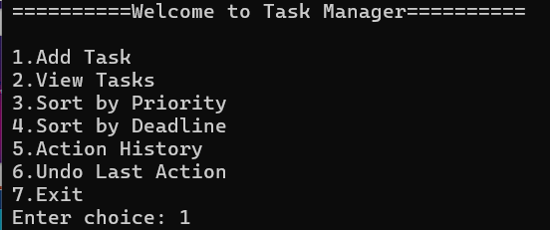
Functionality
Start
Run compiled C program (EMS.c)
System shows main menu.
2. Menu
The menu contains several options which are the key functionalities of the project.

Slide 6
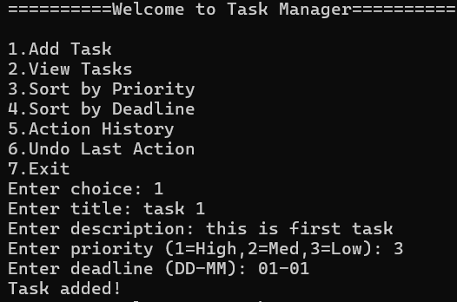
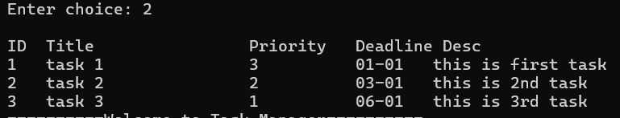
Functionality
Dashboard
Add task lets the user add a task using desired information
View task shows an intuitive overview

Slide 7

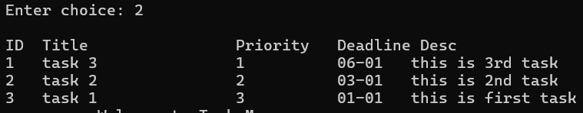

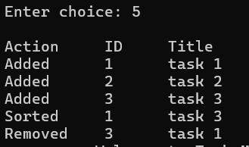
Functionality
Sortng:
Sorting, Undo and Action History:
Sorting the tasks uses sorting algorithm based on requirements
Undo uses stack function to remove the last input task
Action history shows previous actions using queue
Undo:
Action History:

Slide 8
REAL-LIFE IMPACT
Simple interface:
Replaces paper-based records
Removes manual tracking
Accessibility:
Runs on Windows with C compiler
No database required
Simple text-file storage

Slide 9
CONCLUSION
The Task manager shows:
Intuitive task management in C
Easy sorting capabilities
Practical daily life application
Better productivity

Slide 10
Thank you!

