Slide 1
DNA Mapping and Brute Force Algorithms

Slide 2
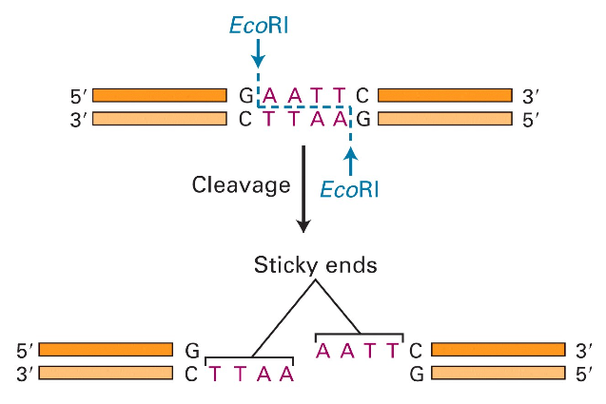
Molecular Scissors
Molecular Cell Biology, 4th edition

Slide 3
Discovering Restriction Enzymes
HindII - first restriction enzyme – was discovered accidentally in 1970 while studying how the bacterium Haemophilus influenzae takes up DNA from the virus
Recognizes and cuts DNA at sequences:
GTGCAC
GTTAAC

Slide 4
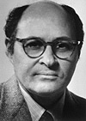
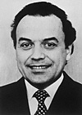

Discovering Restriction Enzymes
My father has discovered a servant who serves as a pair of scissors. If a foreign king invades a bacterium, this servant can cut him in small fragments, but he does not do any harm to his own king. Clever people use the servant with the scissors to find out the secrets of the kings. For this reason my father received the Nobel Prize for the discovery of the servant with the scissors".
Daniel Nathans’ daughter
(from Nobel lecture)
Werner Arber Daniel Nathans Hamilton Smith
Werner Arber – discovered restriction
enzymes
Daniel Nathans - pioneered the application
of restriction for the
construction of genetic
maps
Hamilton Smith - showed that restriction
enzyme cuts DNA in the
middle of a specific sequence

Slide 5
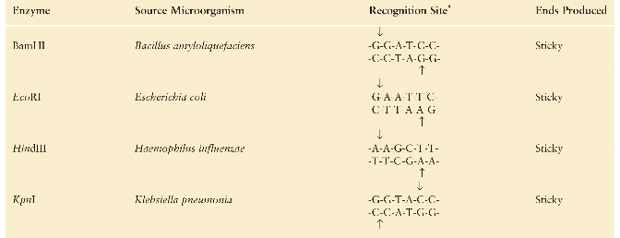
Recognition Sites of Restriction Enzymes
Molecular Cell Biology, 4th edition

Slide 6
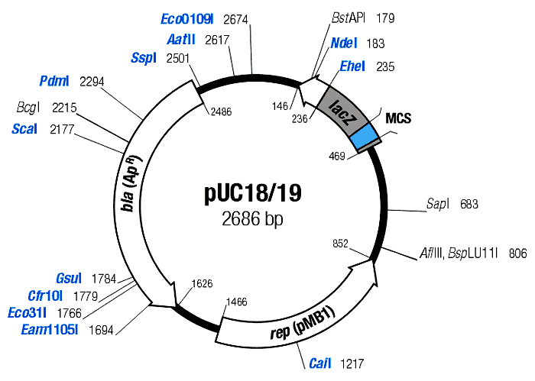
Restriction Maps
• A map showing positions of restriction sites in a DNA sequence
• If DNA sequence is known then construction of restriction map is a trivial exercise
• In early days of molecular biology DNA sequences were often unknown
• Biologists had to solve the problem of constructing restriction maps without knowing DNA sequences

Slide 7
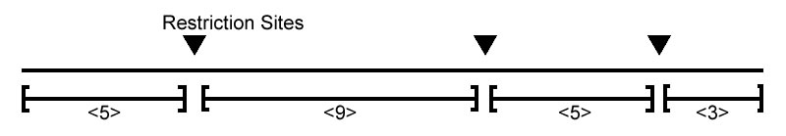
Full Restriction Digest
• Cutting DNA at each restriction site creates
multiple restriction fragments:
• Is it possible to reconstruct the order of
the fragments from the sizes of the fragments
{3,5,5,9} ?

Slide 8
Full Restriction Digest: Multiple Solutions
• Alternative ordering of restriction fragments:
vs

Slide 9
Measuring Length of Restriction Fragments
Restriction enzymes break DNA into restriction fragments.
Gel electrophoresis is a process for separating DNA by size and measuring sizes of restriction fragments
Can separate DNA fragments that differ in length in only 1 nucleotide

Slide 10
Partial Restriction Digest
The sample of DNA is exposed to the restriction enzyme for only a limited amount of time to prevent it from being cut at all restriction sites
This experiment generates the set of all possible restriction fragments between every two (not necessarily consecutive) cuts
This set of fragment sizes is used to determine the positions of the restriction sites in the DNA sequence

Slide 11
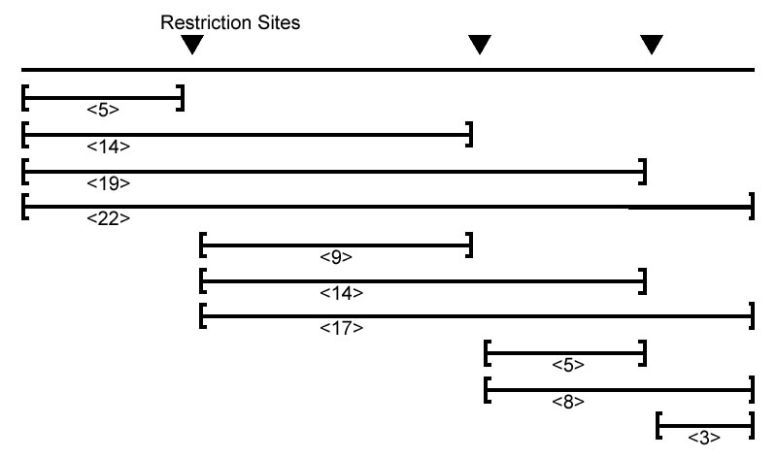
Partial Digest Example
Partial Digest results in the following 10 restriction fragments:

Slide 12
Multiset of Restriction Fragments
We assume that multiplicity of a fragment can be detected, i.e., the number of restriction fragments of the same length can be determined (e.g., by observing twice as much fluorescence intensity for a double fragment than for a single fragment)
Multiset: {3, 5, 5, 8, 9, 14, 14, 17, 19, 22}

Slide 13
Partial Digest Fundamentals
X:
the set of n integers representing the location of all cuts in the restriction map, including the start and end
n:
the total number of cuts
DX:
the multiset of integers representing lengths of each of the fragments produced from a partial digest

Slide 14
One More Partial Digest Example
X | 0 | 2 | 4 | 7 | 10
0 |  | 2 | 4 | 7 | 10
2 |  |  | 2 | 5 | 8
4 |  |  |  | 3 | 6
7 |  |  |  |  | 3
10
Representation of DX = {2, 2, 3, 3, 4, 5, 6, 7, 8, 10} as a two dimensional table, with elements of X = {0, 2, 4, 7, 10}
along both the top and left side. The elements at (i, j) in the table is x_{j} – x_{i} for 1 ≤ i < j ≤ n.

Slide 15
Partial Digest Problem: Formulation
Goal: Given all pairwise distances between points on a line, reconstruct the positions of those points
Input: The multiset of pairwise distances L, containing n(n-1)/2 integers
Output: A set X, of n integers, such that DX = L

Slide 16
Partial Digest: Multiple Solutions
It is not always possible to uniquely reconstruct a set X based only on DX.
For example, the set
X = {0, 2, 5}
and (X + 10) = {10, 12, 15}
both produce DX = {2, 3, 5} as their partial digest set.
The sets {0,1,3,8,9,11,12,13,15} and {0,1,3,4,5,7,12,13,15} present a less trivial example of non-uniqueness. They both digest into same multiset.

Slide 17
Homometric Sets
Two sets A and B are said to be homometric if DA = DB.
Let U ⊕ V = {u + v : u ∈ U, v ∈ V}, and
U ⊗ V = {u - v : u ∈ U, v ∈ V},
where U and V are two sets of numbers.
Then the multisets U ⊕ V and U ⊗ V are homometric.
Let U = {6, 7, 9} and V = {-6, 2, 6}. Then
U ⊕ V = {0,1,3,8,9,11,12,13,15}, and
U ⊗ V = {0,1,3,4,5,7,12,13,15}.

Slide 18
Homometric Sets
The sets {0,1,2,5,7,9,12} and {0,1,5,7,8,10,12} present a less trivial example of non-uniqueness. They both digest into:
{1, 1, 2, 2, 2, 3, 3, 4, 4, 5, 5, 5, 6, 7, 7, 7, 8, 9, 10, 11, 12}
 | 0 | 1 | 2 | 5 | 7 | 9 | 12
0 |  | 1 | 2 | 5 | 7 | 9 | 12
1 |  |  | 1 | 4 | 6 | 8 | 11
2 |  |  |  | 3 | 5 | 7 | 10
5 |  |  |  |  | 2 | 4 | 7
7 |  |  |  |  |  | 2 | 5
9 |  |  |  |  |  |  | 3
12
 | 0 | 1 | 5 | 7 | 8 | 10 | 12
0 |  | 1 | 5 | 7 | 8 | 10 | 12
1 |  |  | 4 | 6 | 7 | 9 | 11
5 |  |  |  | 2 | 3 | 5 | 7
7 |  |  |  |  | 1 | 3 | 5
8 |  |  |  |  |  | 2 | 4
10 |  |  |  |  |  |  | 2
12

Slide 19
Brute Force Algorithms
Also known as exhaustive search algorithms; examine every possible variant to find a solution
Efficient in rare cases; usually impractical

Slide 20
Partial Digest: Brute Force
Find the restriction fragment of maximum length M. M is the length of the DNA sequence.
For every possible set
X = {0, x₂, … ,x_{n-1}, M}
compute the corresponding DX
If DX is equal to the experimental partial digest L, then X is the correct restriction mapping

Slide 21
BruteForcePDP
BruteForcePDP(L, n):
M <- maximum element in L
for every set of n – 2 integers 0 < x₂ < … x_{n-1} < M
X <- {0, x₂,…, x_{n-1}, M}
Form DX from X
if DX = L
return X
output “no solution”

Slide 22
Efficiency of BruteForcePDP
BruteForcePDP takes O(M ^{n-2}) time since it must examine all possible sets of positions.
One way to improve the algorithm is to limit the values of x_{i} to only those values which occur in L.

Slide 23
AnotherBruteForcePDP
AnotherBruteForcePDP(L, n)
M <- maximum element in L
for every set of n – 2 integers 0 < x₂ < … x_{n-1} < M
X <- { 0, x₂, …, x_{n-1}, M }
Form DX from X
if DX = L
return X
output “no solution”

Slide 24
AnotherBruteForcePDP
AnotherBruteForcePDP(L, n)
M <- maximum element in L
for every set of n – 2 integers 0 < x₂ < … x_{n-1} < M from L
X <- { 0, x₂, …, x_{n-1}, M }
Form DX from X
if DX = L
return X
output “no solution”

Slide 25
Efficiency of AnotherBruteForcePDP
It’s more efficient, but still slow
If L = {2, 998, 1000} (n = 3, M = 1000), BruteForcePDP will be extremely slow, but AnotherBruteForcePDP will be quite fast
Fewer sets are examined, but runtime is still exponential: O(n^{2n-4})

Slide 26
Defining D(y, X)
Before describing PartialDigest, first define
D(y, X)
as the multiset of all distances between point y and all other points in the set X
D(y, X) = {|y – x₁|, |y – x₂|, …, |y – x_{n}|}
for X = {x₁, x₂, …, x_{n}}

Slide 27
PartialDigest Algorithm
PartialDigest(L):
width <- Maximum element in L
DELETE(width, L)
X <- {0, width}
PLACE(L, X)

Slide 28
PartialDigest Algorithm (cont’d)
PLACE(L, X)
if L is empty
output X
return
y <- maximum element in L
Delete(y, L)
if D(y, X ) Í L
Add y to X and remove lengths D(y, X) from L
PLACE(L, X )
Remove y from X and add lengths D(y, X) to L
if D(width - y, X ) Í L
Add width - y to X and remove lengths D(width-y, X) from L
PLACE(L, X )
Remove width-y from X and add lengths D(width-y, X ) to L
return

Slide 29
An Example
L = { 2, 2, 3, 3, 4, 5, 6, 7, 8, 10 }
X = { 0 }

Slide 30
An Example
L = { 2, 2, 3, 3, 4, 5, 6, 7, 8, 10 }
X = { 0 }
Remove 10 from L and insert it into X. We know this must be
the length of the DNA sequence because it is the largest
fragment.

Slide 31
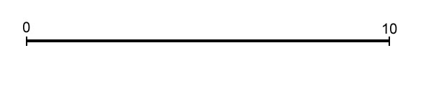
An Example
L = { 2, 2, 3, 3, 4, 5, 6, 7, 8, 10 }
X = { 0, 10 }

Slide 32
An Example
L = { 2, 2, 3, 3, 4, 5, 6, 7, 8, 10 }
X = { 0, 10 }
Take 8 from L and make y = 2 or 8. But since the two cases are symmetric, we can assume y = 2.

Slide 33
An Example
L = { 2, 2, 3, 3, 4, 5, 6, 7, 8, 10 }
X = { 0, 10 }
We find that the distances from y=2 to other elements in X are D(y, X) = {8, 2}, so we remove {8, 2} from L and add 2 to X.

Slide 34
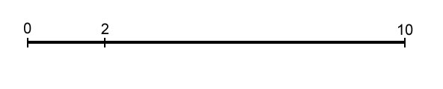
An Example
L = { 2, 2, 3, 3, 4, 5, 6, 7, 8, 10 }
X = { 0, 2, 10 }

Slide 35
An Example
L = { 2, 2, 3, 3, 4, 5, 6, 7, 8, 10 }
X = { 0, 2, 10 }
Take 7 from L and make y = 7 or y = 10 – 7 = 3. We will
explore y = 7 first, so D(y, X ) = {7, 5, 3}.

Slide 36
An Example
L = { 2, 2, 3, 3, 4, 5, 6, 7, 8, 10 }
X = { 0, 2, 10 }
For y = 7 first, D(y, X ) = {7, 5, 3}. Therefore we
remove {7, 5 ,3} from L and add 7 to X.

Slide 37
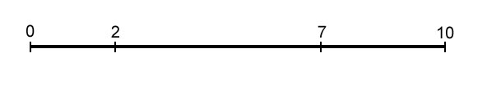
An Example
L = { 2, 2, 3, 3, 4, 5, 6, 7, 8, 10 }
X = { 0, 2, 7, 10 }

Slide 38
An Example
L = { 2, 2, 3, 3, 4, 5, 6, 7, 8, 10 }
X = { 0, 2, 7, 10 }
Take 6 from L and make y = 6. Unfortunately
D(y, X) = {6, 4, 1 ,4}, which is not a subset of L. Therefore we won’t explore this branch.
6

Slide 39
An Example
L = { 2, 2, 3, 3, 4, 5, 6, 7, 8, 10 }
X = { 0, 2, 7, 10 }
This time make y = 10 - 6 = 4. D(y, X) = {4, 2, 3 ,6}, which is a
subset of L so we will explore this branch. We remove
{4, 2, 3 ,6} from L and add 4 to X.

Slide 40
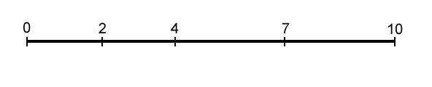
An Example
L = { 2, 2, 3, 3, 4, 5, 6, 7, 8, 10 }
X = { 0, 2, 4, 7, 10 }

Slide 41
An Example
L = { 2, 2, 3, 3, 4, 5, 6, 7, 8, 10 }
X = { 0, 2, 4, 7, 10 }
L is now empty, so we have a solution, which is X.

Slide 42
An Example
L = { 2, 2, 3, 3, 4, 5, 6, 7, 8, 10 }
X = { 0, 2, 7, 10 }
To find other solutions, we backtrack.

Slide 43
An Example
L = { 2, 2, 3, 3, 4, 5, 6, 7, 8, 10 }
X = { 0, 2, 10 }
More backtrack.

Slide 44
An Example
L = { 2, 2, 3, 3, 4, 5, 6, 7, 8, 10 }
X = { 0, 2, 10 }
This time we will explore y = 3. D(y, X) = {3, 1, 7}, which is
not a subset of L, so we won’t explore this branch.

Slide 45
An Example
L = { 2, 2, 3, 3, 4, 5, 6, 7, 8, 10 }
X = { 0, 10 }
We backtracked back to the root. Therefore we have found all the solutions.

Slide 46
Analyzing PartialDigest Algorithm
Still exponential in worst case, but is very fast on average
Informally, let T(n) be time PartialDigest takes to place n cuts
No branching case: T(n) < T(n-1) + O(n)
Quadratic
Branching case: T(n) < 2T(n-1) + O(n)
Exponential

Slide 47
Further Readings
Ahrabian H, Ganjtabesh M, Nowzari-Dalini A, and Razaghi-Moghadam-Kashani Z, “Genetic algorithm solution for partial digest problem”, International Journal of Bioinformatics Research and Applications, (2013), pages 584-594.
Mostafa M. Abbas, and Hazem M. Bahig, “A fast exact sequential algorithm for the partial digest problem”, 15th International Conference on Bioinformatics (InCoB 2016), 17(Suppl 19) : 510. Published: 22 December 2016.

