Slide 1
Dynamic Programming:
Edit Distance &
Sequence Alignment
Saturday, May 27, 2017
Dr.
Md.
Abul
Kashem
Mia,
Professor,
CSE Dept,
BUET
1

Slide 2
DNA Sequence Comparison: First
Success Story
•
Finding sequence similarities with genes of
known function is a common approach to infer a
newly sequenced gene’s function
•
In 1984 Russell Doolittle and colleagues found
similarities between cancer-causing gene and
normal growth factor (PDGF) gene
Saturday, May 27, 2017
Dr.
Md.
Abul
Kashem
Mia,
Professor,
CSE Dept,
BUET
2

Slide 3
Bring in the Bioinformaticians
• Gene similarities between two genes with
known and unknown function alert biologists
to some possibilities
• Computing a similarity score between two
genes tells how likely it is that they have
similar functions
• Dynamic programming is a technique for
revealing similarities between genes
Saturday, May 27, 2017
Dr.
Md.
Abul
Kashem
Mia,
Professor,
CSE Dept,
BUET
3

Slide 4
Alignment: 2 row representation
Given 2 DNA sequences v and w:
v : A T GT T A T
n = 7
m = 7
w :
A T C GT A C
Alignment : 2 * k matrix ( k >= m, n )
letters of v
A
T
--
G
T
T
A
T
--
letters of w
A
T
C
G
T
--
A
--
C
Saturday, May 27, 2017
Dr.
Md.
Abul
Kashem
Mia,
Professor,
CSE Dept,
BUET
4

Slide 5
Alignment: 2 row representation
Columns that contain the same letter in both rows are called matches.
Columns containing different letters are called mismatches.
The columns of the alignment containing one space are called indels.
The columns containing a space in the top row called insertions.
The columns with a space in the bottom row deletions.
letters of v
A
T
--
G
T
T
A
T
--
letters of w
A
T
C
G
T
--
A
--
C
5 matches
2 insertions
2 deletions
Saturday, May 27, 2017
Dr.
Md.
Abul
Kashem
Mia,
Professor,
CSE Dept,
BUET
5

Slide 6
Aligning DNA Sequences
V = ATCTGATG
n
= 8
4
1
matches
mismatches
W = TGCATAC
m = 7
2 insertions
match
mismatch
3 deletions
V
W
A T
C
T G A T G
T G C A T
A
C
indels
insertion
deletion
Saturday, May 27, 2017
Dr.
Md.
Abul
Kashem
Mia,
Professor,
CSE Dept,
BUET
6

Slide 7
Longest Common Subsequence (LCS) –
Alignment without Mismatches
•
Given two sequences
v = v v …v
and w = w w …w
1
2
m
1
2
n
• The LCS of v and w is a sequence of positions in
v: 1 <
i < i < … < i <
m
1
2
k
and a sequence of positions in
w: 1 <
j < j < … < j <
n
1
2
k
such that i -th letter of v equals to j -letter of w and t
t
t
is maximal
Saturday, May 27, 2017
Dr.
Md.
Abul
Kashem
Mia,
Professor,
CSE Dept,
BUET
7

Slide 8
LCS: Example
i coords:
0
1
2
2
3
3
4
5
6
7
8
elements of v
A
T
--
C
--
T
G
A
T
C
elements of w
--
T
G
C
A
T
--
A
--
C
j coords:
0
0
1
2
3
4
5
5
6
6
7
(0,0)→(1,0)→(2,1)→(2,2)→(3,3)→(3,4)→(4,5)→(5,5)→(6,6)→(7,6)→(8,7)
positions in v: 2 < 3 < 4 < 6 < 8
Matches shown in yellow
positions in w:
1 < 3 < 5 < 6 < 7
Every common subsequence is a path in 2-D grid
Saturday, May 27, 2017
Dr.
Md.
Abul
Kashem
Mia,
Professor,
CSE Dept,
BUET
8

Slide 9
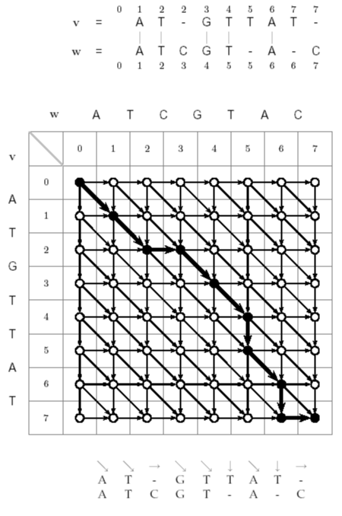
LCS: Dynamic Programming
• Find the LCS of two
strings
Input
: A weighted graph G
with two distinct vertices,
one labeled “source” one
labeled “sink”
Output
: A longest path in
G from “source” to “sink”
Solve
•
using an LCS edit
graph with diagonals
replaced with +1 edges
Saturday, May 27, 2017
Dr.
Md.
Abul
Kashem
Mia,
Professor,
CSE Dept,
BUET
9

Slide 10
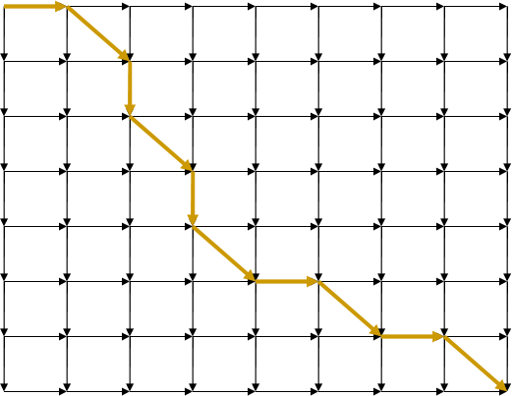
LCS Problem as Manhattan Tourist Problem
j
A
T
C
T
G
A
T
C
0
1
2
3
4
5
6
7
8
i 0
T 1
G 2
C 3
A 4
T 5
A 6
C 7
Saturday, May 27, 2017
Dr.
Md.
Abul
Kashem
Mia,
Professor,
CSE Dept,
BUET
10

Slide 11
Edit Graph for LCS Problem
j
A
T
C
T
G
A
T
C
0
1
2
3
4
5
6
7
8
i 0
T 1
G 2
C 3
A 4
T 5
A 6
C 7
Saturday, May 27, 2017
Dr.
Md.
Abul
Kashem
Mia,
Professor,
CSE Dept,
BUET
11

Slide 12
Edit Graph for LCS Problem
j
A
T
C
T
G
A
T
C
0
1
2
3
4
5
6
7
8
Every path is a
common
subsequence.
i 0
T 1
G 2
Every diagonal
edge adds an
extra element to
common
subsequence
C 3
A 4
T 5
LCS Problem:
Find a path with
maximum
number of
diagonal edges
A 6
C 7
Saturday, May 27, 2017
Dr.
Md.
Abul
Kashem
Mia,
Professor,
CSE Dept,
BUET
12

Slide 13
Computing LCS
Let v
= prefix of v of length i: v … v
i
1
i
and w
= prefix of w of length j: w … w
j
1
j
The length of LCS(v ,w ) is computed by:
i
j
i-1,j -1
i
-1,j
s
+ 0
max
i-1, j
1
0
s
=
i, j
s
+ 0
i,j -1
0
i, j-1
i,j
s
+ 1 if v = w
i-1, j-1
i
j
Saturday, May 27, 2017
Dr.
Md.
Abul
Kashem
Mia,
Professor,
CSE Dept,
BUET
13

Slide 14
Every Path in the Grid Corresponds
to an Alignment
W
A
T
C
G
V
0
1
2
3
4
0 1 2 2 3 4
0
V = A T – G T
A
| | |
1
W= A T C G –
T
2
0 1 2 3 4 4
G
3
T
4
Saturday, May 27, 2017
Dr.
Md.
Abul
Kashem
Mia,
Professor,
CSE Dept,
BUET
14

Slide 15
Aligning Sequences without Insertions
and Deletions: Hamming Distance
Given two DNA sequences v and w :
v : A T A T A T A T
w : T A T A T A T A
• The Hamming distance: d (v, w) = 8 is
large but the sequences are very similar
H
Saturday, May 27, 2017
Dr.
Md.
Abul
Kashem
Mia,
Professor,
CSE Dept,
BUET
15

Slide 16
Aligning Sequences with Insertions
and Deletions
By shifting one sequence over one position:
v : A T A T A T A T --
w : -- T A T A T A T A
• The edit distance: d (v, w) = 2.
H
• Hamming distance neglects insertions and
deletions in DNA
Saturday, May 27, 2017
Dr.
Md.
Abul
Kashem
Mia,
Professor,
CSE Dept,
BUET
16

Slide 17
Edit Distance
Levenshtein (1966) introduced edit distance
between two strings as the minimum number
of elementary operations (insertions, deletions,
and substitutions) to transform one string into
the other
d(v,w) = MIN number of elementary operations
to transform v → w
Saturday, May 27, 2017
Dr.
Md.
Abul
Kashem
Mia,
Professor,
CSE Dept,
BUET
17

Slide 18
Edit Distance vs Hamming Distance
Hamming distance
always compares
i
i
-th
letter of v with
letter of w
-th
V = ATATATAT
W = TATATATA
Hamming distance:
d(v, w)=8
Computing Hamming distance
is a trivial task
Saturday, May 27, 2017
Dr.
Md.
Abul
Kashem
Mia,
Professor,
CSE Dept,
BUET
18

Slide 19
Edit Distance vs Hamming Distance
Hamming distance
always compares
Edit
distance
may compare
i
i
-th
letter of v with
letter of w
i
j
-th
letter
letter
of
of
v
w
with
-th
-th
V = ATATATAT
V = - ATATATAT
Just one shift
W = TATATATA
Make it all line up
W = TATATATA
Hamming distance:
d(v, w)=8
Edit distance:
d(v, w)=2
Computing Hamming distance Computing edit distance
is a trivial task is a non-trivial task
Saturday, May 27, 2017
Dr.
Md.
Abul
Kashem
Mia,
Professor,
CSE Dept,
BUET
19

Slide 20
Edit Distance vs Hamming Distance
Hamming distance
always compares
Edit
distance
may compare
i
i
-th
letter of v with
letter of w
i
j
-th
letter
letter
of
of
v
w
with
-th
-th
V = ATATATAT
V = - ATATATAT
W = TATATATA
W = TATATATA
Hamming distance:
d(v, w)=8
Edit distance:
d(v, w)=2
(one insertion and one deletion)
How to find what j goes with what i ???
Saturday, May 27, 2017
Dr.
Md.
Abul
Kashem
Mia,
Professor,
CSE Dept,
BUET
20

Slide 21
Edit Distance: Example
TGCATAT → ATCCGAT in 5 steps
TGCATAT → (delete last T)
TGCATA
→ (delete last A)
TGCAT → (insert A at front)
ATGCAT → (substitute C for 3
rd
G)
ATCCAT → (insert G before last A)
ATCCGAT (Done)
Saturday, May 27, 2017
Dr.
Md.
Abul
Kashem
Mia,
Professor,
CSE Dept,
BUET
21

Slide 22
Edit Distance: Example
TGCATAT → ATCCGAT in 5 steps
TGCATAT → (delete last T)
TGCATA
→ (delete last A)
TGCAT → (insert A at front)
ATGCAT → (substitute C for 3
rd
G)
ATCCAT → (insert G before last A)
ATCCGAT (Done)
What is the edit distance? 5?
Saturday, May 27, 2017
Dr.
Md.
Abul
Kashem
Mia,
Professor,
CSE Dept,
BUET
22

Slide 23
Edit Distance: Example (cont’d)
TGCATAT → ATCCGAT in 4 steps
TGCATAT → (insert A at front)
ATGCATAT → (delete 6 T)
ATGCATA → (substitute G for 5 A)
th
th
ATGCGTA → (substitute C for 3
ATCCGAT (Done)
rd
G)
Saturday, May 27, 2017
Dr.
Md.
Abul
Kashem
Mia,
Professor,
CSE Dept,
BUET
23

Slide 24
Edit Distance: Example (cont’d)
TGCATAT → ATCCGAT in 4 steps
TGCATAT → (insert A at front)
ATGCATAT → (delete 6 T)
ATGCATA → (substitute G for 5 A)
th
th
ATGCGTA → (substitute C for 3
ATCCGAT (Done)
rd
G)
Can it be done in 3 steps???
Saturday, May 27, 2017
Dr.
Md.
Abul
Kashem
Mia,
Professor,
CSE Dept,
BUET
24

Slide 25
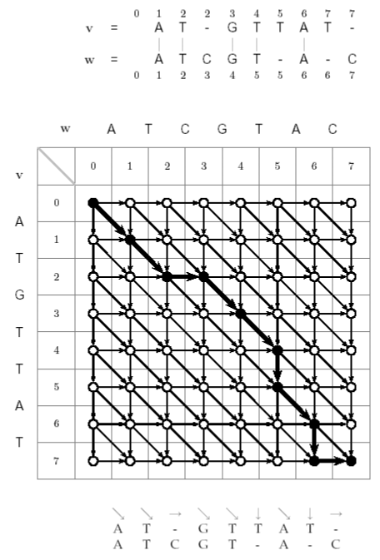
The Alignment Grid
• Every alignment
path is from
source to sink
Saturday, May 27, 2017
Dr.
Md.
Abul
Kashem
Mia,
Professor,
CSE Dept,
BUET
25

Slide 26
Alignment as a Path in the Edit Graph
0
0 1
1 2
2 2
2 3
3 4
4 5
5 6
6 7
7 7
7
A
A T
T _
_ G
G T
T T
T A
A T
T _
_
A
A T
T C
C G
G T
T _
_ A
A _
_ C
C
0
0 1
1 2
2 3
3 4
4 5
5 5
5 6
6 6
6 7
7
- Corresponding path -
(0,0)
(0,0) ,
, (1,1)
(1,1) ,
, (2,2),
(2,2), (2,3),
(2,3),
(3,4),
(3,4), (4,5),
(4,5), (5,5),
(5,5), (6,6),
(6,6),
(7,6),
(7,6), (7,7)
(7,7)
Saturday, May 27, 2017
Dr.
Md.
Abul
Kashem
Mia,
Professor,
CSE Dept,
BUET
26

Slide 27
Alignments in Edit Graph (cont’d)
and represent
indels in v and w with
score 0.
represent matches
with score 1.
• The score of the
alignment path is 5.
Saturday, May 27, 2017
Dr.
Md.
Abul
Kashem
Mia,
Professor,
CSE Dept,
BUET
27

Slide 28
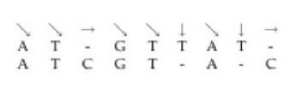

Alignment as a Path in the Edit Graph
Every path in the edit
graph corresponds to
an alignment:
Saturday, May 27, 2017
Dr.
Md.
Abul
Kashem
Mia,
Professor,
CSE Dept,
BUET
28

Slide 29
Alignment as a Path in the Edit Graph
Old Alignment
Old Alignment
01223
0122345
45677
677
v=
v= AT_G
AT_GTT
TTAT_
AT_
w=
w= ATCG
A_C
0123455667
ATCGT_
T_A_C
0123455667
New Alignment
New Alignment
01223
0122345
45677
677
v=
v= AT_G
AT_GTT
TTAT_
AT_
w=
w= ATCG
ATCG_T
_TA_C
A_C
01234
0123445
45667
667
Saturday, May 27, 2017
Dr.
Md.
Abul
Kashem
Mia,
Professor,
CSE Dept,
BUET
29

Slide 30
Alignment as a Path in the Edit Graph
012
012234
23456
5677
77
v= AT_GTTAT
v=
w=
AT_GTTAT_
_
w= ATCGT_A_
ATCGT_A_C
C
012
012345566
3455667
7
(0,0) , (1,1) ,
(0,0) ,
(2,3),
(3,4), (4,5), (5,5), (6,6),
(1,1) , (2,2),
(2,2), (2,3),
(3,4), (4,5), (5,5), (6,6),
(7,6),
(7,6), (7,7)
(7,7)
Saturday, May 27, 2017
Dr.
Md.
Abul
Kashem
Mia,
Professor,
CSE Dept,
BUET
30

Slide 31
Alignment: Dynamic Programming
s
= s
+1 if v = w
i,j
i-1, j-1
i
j
s
max i-1, j
s
i, j-1
Saturday, May 27, 2017
Dr.
Md.
Abul
Kashem
Mia,
Professor,
CSE Dept,
BUET
31

Slide 32
Dynamic Programming Example
Initialize 1
st
row and
1
st
column to be all
zeroes.
Or, to be more
precise, initialize 0
th
row and 0
th
column to
be all zeroes.
Saturday, May 27, 2017
Dr.
Md.
Abul
Kashem
Mia,
Professor,
CSE Dept,
BUET
32

Slide 33
Dynamic Programming Example
S
i,j
= S
i-1, j-1
⬅value from NW +1, if v = w
⬅ value from North (top)
⬅ value from West (left)
i
j
max
S
i-1, j
S
i, j-1
Saturday, May 27, 2017
Dr.
Md.
Abul
Kashem
Mia,
Professor,
CSE Dept,
BUET
33

Slide 34
Alignment: Backtracking
Arrows show where the score
originated from.
if from the top
if from the left
if v = w
i
j
Saturday, May 27, 2017
Dr.
Md.
Abul
Kashem
Mia,
Professor,
CSE Dept,
BUET
34

Slide 35
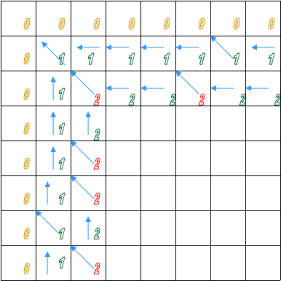
Backtracking Example
Find a match in row and column 2.
i=2, j=2,5 is a match (T).
j=2, i=4,5,7 is a match (T).
Since v = w s = s
+1
i
j,
i,j
i-1,j-1
s
s
= [s
= [s
= 1] + 1
= 1] + 1
2,2
1,1
2,5
1,4
s = [s
= 1] + 1
4,2
3,1
s
s
= [s
= [s
= 1] + 1
= 1] + 1
5,2
4,1
7,2
6,1
Saturday, May 27, 2017
Dr.
Md.
Abul
Kashem
Mia,
Professor,
CSE Dept,
BUET
35

Slide 36
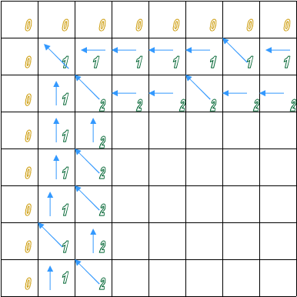
Backtracking Example
Continuing with the
dynamic programming
algorithm gives this
result.
Saturday, May 27, 2017
Dr.
Md.
Abul
Kashem
Mia,
Professor,
CSE Dept,
BUET
36

Slide 37
Alignment: Dynamic Programming
s
= s
+1 if v = w
i,j
i-1, j-1
i
j
s
max i-1, j
s
i, j-1
Saturday, May 27, 2017
Dr.
Md.
Abul
Kashem
Mia,
Professor,
CSE Dept,
BUET
37

Slide 38
Alignment: Dynamic Programming
s
= s
+1 if v = w
i,j
i-1, j-1
i
j
s
+0
max i-1, j
s
+0
i, j-1
This recurrence corresponds to the Manhattan Tourist
problem (three incoming edges into a vertex) with all
horizontal and vertical edges weighted by zero.
Saturday, May 27, 2017
Dr.
Md.
Abul
Kashem
Mia,
Professor,
CSE Dept,
BUET
38

Slide 39
LCS Algorithm
1. LCS(v,w)
2. for i ← 1 to n
3.
s
← 0
i,0
4. for j ← 1 to m
5.
s
← 0
0,j
6. for i ← 1 to n
7.
for
j
← 1
to m
8.
s
i-1,j
9.
s ← max s
i,j
i,j-1
s
+
1
10.
i-1,j-1
, if v
=
w
i
j
11.
“ “ if s
i,j
=
s
i-1,j
•
b
←
“ “ if s =
s
i,j
i,j
i,j-1
•
“ “ if s =
s
+
1
i,j
i-1,j-1
•
return
(s
n,m
,
b
)
Saturday, May 27, 2017
Dr.
Md.
Abul
Kashem
Mia,
Professor,
CSE Dept,
BUET
39

Slide 40
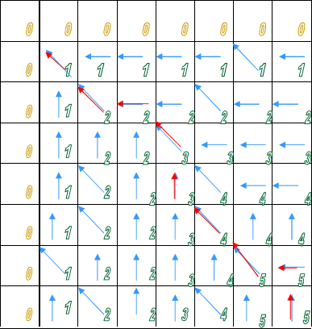
Now What?
• LCS(v,w) created the
alignment grid
• Now we need a way
to read the best
alignment of v and w
• Follow the arrows
backwards from sink
Saturday, May 27, 2017
Dr.
Md.
Abul
Kashem
Mia,
Professor,
CSE Dept,
BUET
40

Slide 41
Printing LCS: Backtracking
1. PrintLCS(b,v,i,j)
2.
3.
4.
5.
6.
if i = 0 or j = 0
return
if b = “ “
i,j
PrintLCS(b,v,i-1,j-1)
print v
i
7.
else
if
8.
9.
10.
11.
b = “ “
PrintLCS(b,v,i-1,j)
i,j
else
PrintLCS(b,v,i,j-1)
Saturday, May 27, 2017
Dr.
Md.
Abul
Kashem
Mia,
Professor,
CSE Dept,
BUET
41

Slide 42
LCS Runtime
• It takes O(nm) time to fill in the nxm dynamic
programming matrix.
• Why O(nm)? The pseudocode consists of a
nested “for” loop inside of another “for” loop
to set up a nxm matrix.
Saturday, May 27, 2017
Dr.
Md.
Abul
Kashem
Mia,
Professor,
CSE Dept,
BUET
42

Slide 43
Sequence Alignment
Saturday, May 27, 2017
Dr.
Md.
Abul
Kashem
Mia,
Professor,
CSE Dept,
BUET
43

Slide 44
From LCS to Alignment: Change up the Scoring
•
The Longest Common Subsequence (LCS) problem
– the simplest form of sequence alignment –
allows only insertions and deletions (no mismatches).
•
In the LCS Problem, we scored 1 for matches and 0
for indels
•
Consider penalizing indels and mismatches with
negative scores
•
Simplest scoring schema:
+1 : match premium
-μ : mismatch penalty
-σ : indel penalty
Saturday, May 27, 2017
Dr.
Md.
Abul
Kashem
Mia,
Professor,
CSE Dept,
BUET
44

Slide 45
Simple Scoring
• When mismatches are penalized by –μ,
indels are penalized by –σ,
and matches are rewarded with +1,
the resulting score is:
#matches – μ(#mismatches) – σ (#indels)
Saturday, May 27, 2017
Dr.
Md.
Abul
Kashem
Mia,
Professor,
CSE Dept,
BUET
45

Slide 46
The Global Alignment Problem
Find the best alignment between two strings under a given scoring
schema
Input
: Strings v and w and a scoring schema
Output
: Alignment of maximum score
↑→ = -б
= 1 if match
= -µ if mismatch
s
+1 if v = w
m : mismatch penalty
σ : indel penalty
s
= max s
i-1,j-1
i
j
i,j
i-1,j-1
-µ if v ≠ w
i
j
s
s
i-1,j
- σ
- σ
i,j-1
Saturday, May 27, 2017
Dr.
Md.
Abul
Kashem
Mia,
Professor,
CSE Dept,
BUET
46

Slide 47
Scoring Matrices
To generalize scoring, consider a (4+1) x(4+1)
scoring matrix δ.
In the case of an amino acid sequence alignment, the
scoring matrix would be a (20+1)x(20+1) size. The
addition of 1 is to include the score for comparison
of a gap character “-”.
This will simplify the algorithm as follows:
s
+ δ (v , w )
i-1,j-1
i
j
s
= max s
+ δ (v , -)
i,j
i-1,j
i
s
+ δ (-, w )
i,j-1
j
Saturday, May 27, 2017
Dr.
Md.
Abul
Kashem
Mia,
Professor,
CSE Dept,
BUET
47

Slide 48
Making a Scoring Matrix
• Scoring matrices are created based on
biological evidence.
• Alignments can be thought of as two
sequences that differ due to mutations.
• Some of these mutations have little effect on
the protein’s function, therefore some
penalties, δ(v , w ), will be less harsh than
i
j
others.
Saturday, May 27, 2017
Dr.
Md.
Abul
Kashem
Mia,
Professor,
CSE Dept,
BUET
48

Slide 49
Scoring Matrix: Example
A
R
N
K
• Notice that although
R and K are different
amino acids, they
have a positive score.
A
5
-2
-1
-1
R
-
7
-1
3
N
-
-
7
0
K
-
-
-
6
• Why? They are both
positively charged
amino acids→ will not
greatly change
function of protein.
Saturday, May 27, 2017
Dr.
Md.
Abul
Kashem
Mia,
Professor,
CSE Dept,
BUET
49

Slide 50
Local vs. Global Alignment
• The Global Alignment Problem
tries to find
the longest path between vertices (0,0) and
(n,m) in the edit graph.
• The Local Alignment Problem
tries to find the
longest path among paths between arbitrary
vertices (i, j) and (i’, j’) in the edit graph.
Saturday, May 27, 2017
Dr.
Md.
Abul
Kashem
Mia,
Professor,
CSE Dept,
BUET
50

Slide 51
Local vs. Global Alignment
• The Global Alignment Problem
tries to find
the longest path between vertices (0,0) and
(n,m) in the edit graph.
• The Local Alignment Problem
tries to find the
longest path among paths between arbitrary
vertices (i, j) and (i’, j’) in the edit graph.
• In the edit graph with negatively-scored
edges, Local Alignment may score higher
than Global Alignment
Saturday, May 27, 2017
Dr.
Md.
Abul
Kashem
Mia,
Professor,
CSE Dept,
BUET
51

Slide 52
Local vs. Global Alignment (cont’d)
• Global Alignment
--T—-CC-C-AGT—-TATGT-CAGGGGACACG—A-GCATGCAGA-GAC
| || | || | | | ||| || | | | | |||| |
AATTGCCGCC-GTCGT-T-TTCAG----CA-GTTATG—T-CAGAT--C
• Local Alignment—better alignment to find
conserved segment
tccCAGTTATGTCAGgggacacgagcatgcagagac
||||||||||||
aattgccgccgtcgttttcagCAGTTATGTCAGatc
Saturday, May 27, 2017
Dr.
Md.
Abul
Kashem
Mia,
Professor,
CSE Dept,
BUET
52

Slide 53
Local Alignment: Example
Compute a “mini”
Global Alignment to
get Local
Local alignment
Global alignment
Saturday, May 27, 2017
Dr.
Md.
Abul
Kashem
Mia,
Professor,
CSE Dept,
BUET
53

Slide 54
Local Alignments: Why?
• Two genes in different species may be similar
over short conserved regions and dissimilar
over remaining regions.
• Example:
• Homeobox genes have a short region
called the homeodomain that is highly
conserved between species.
• A global alignment would not find the
homeodomain because it would try to align
the ENTIRE sequence
Saturday, May 27, 2017
Dr.
Md.
Abul
Kashem
Mia,
Professor,
CSE Dept,
BUET
54

Slide 55
The Local Alignment Problem
• Goal
: Find the best local alignment between
two strings
• Input
: Strings v, w and scoring matrix δ
• Output
: Alignment of substrings of v and w
whose alignment score is maximum among
all possible alignments of all possible
substrings
Saturday, May 27, 2017
Dr.
Md.
Abul
Kashem
Mia,
Professor,
CSE Dept,
BUET
55

Slide 56
The Problem with this Problem
• High running time O(n ):
4
- In the grid of size n x n there are ~n
2
vertices (i, j) that may serve as a source.
- For each such vertex computing alignments
from (i, j) to (i’, j’) takes O(n ) time.
2
• This can be remedied by giving free rides
Saturday, May 27, 2017
Dr.
Md.
Abul
Kashem
Mia,
Professor,
CSE Dept,
BUET
56

Slide 57
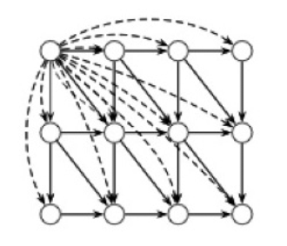
Local Alignment: Free Rides
Yeah, a free ride!
Vertex (0,0)
The dashed edges represent the free rides from
(0,0) to every other node.
Saturday, May 27, 2017
Dr.
Md.
Abul
Kashem
Mia,
Professor,
CSE Dept,
BUET
57

Slide 58
The Local Alignment Recurrence
• The largest value of s
over the whole edit
i,j
graph is the score of the best local alignment.
• The recurrence:
Power of ZERO: there is
only this change from the
original recurrence of a
Global Alignment - since
there is only one “free ride”
edge entering into every
vertex
0
s
= max s
+ δ (v , w )
i,j
i-1,j-1
i
j
s
s
+ δ (v , -)
+ δ (-, w )
i-1,j
i
i,j-1
j
Saturday, May 27, 2017
Dr.
Md.
Abul
Kashem
Mia,
Professor,
CSE Dept,
BUET
58

Slide 59
Scoring Indels: Naive Approach
• A fixed penalty σ is given to every indel:
•
-σ for 1 indel,
• -2σ for 2 consecutive indels
• -3σ for 3 consecutive indels, etc.
Can be too severe penalty for a series of
100 consecutive indels
Saturday, May 27, 2017
Dr.
Md.
Abul
Kashem
Mia,
Professor,
CSE Dept,
BUET
59

Slide 60
Affine Gap Penalties
• In nature, a series of k indels often come as a
single event rather than a series of k single
nucleotide events:
Normal scoring would
give the same score
for both alignments
This is more
likely.
This is less
likely.
Saturday, May 27, 2017
Dr.
Md.
Abul
Kashem
Mia,
Professor,
CSE Dept,
BUET
60

Slide 61
Accounting for Gaps
• Gaps- contiguous sequence of spaces in one of the
rows
•
Score for a gap of length x is:
-(ρ + σx)
where ρ >0 is the penalty for introducing a gap:
gap opening penalty
ρ will be large relative to σ:
gap extension penalty
because you do not want to add too much of a
penalty for extending the gap.
Saturday, May 27, 2017
Dr.
Md.
Abul
Kashem
Mia,
Professor,
CSE Dept,
BUET
61

Slide 62
Affine Gap Penalties
• Gap penalties:
•
-ρ-σ when there is 1 indel
• -ρ-2σ when there are 2 indels
• -ρ-3σ when there are 3 indels, etc.
• -ρ- x·σ (-gap opening - x gap extensions)
• Somehow reduced penalties (as compared to
naïve scoring) are given to runs of horizontal
and vertical edges
Saturday, May 27, 2017
Dr.
Md.
Abul
Kashem
Mia,
Professor,
CSE Dept,
BUET
62

Slide 63
Affine Gap Penalties and Edit Graph
To reflect affine gap
penalties we have to
add “long” horizontal
and vertical edges to
the edit graph. Each
such edge of length x
should have weight
- - x *
Saturday, May 27, 2017
Dr.
Md.
Abul
Kashem
Mia,
Professor,
CSE Dept,
BUET
63

Slide 64
Adding “Affine Penalty” Edges to the Edit Graph
There are many such edges!
Adding them to the graph
increases the running time
of the alignment algorithm
by a factor of n (where n is
the number of vertices)
So the complexity increases
from O(n ) to O(n )
2
3
Saturday, May 27, 2017
Dr.
Md.
Abul
Kashem
Mia,
Professor,
CSE Dept,
BUET
64

Slide 65
Adding “Affine Penalty” Edges to the Edit Graph
There are many such edges!
Adding them to the graph
increases the running time
of the alignment algorithm
by a factor of n (where n is
the number of vertices)
So the complexity increases
from O(n ) to O(n )
2
3
Saturday, May 27, 2017
Dr.
Md.
Abul
Kashem
Mia,
Professor,
CSE Dept,
BUET
65

Slide 66
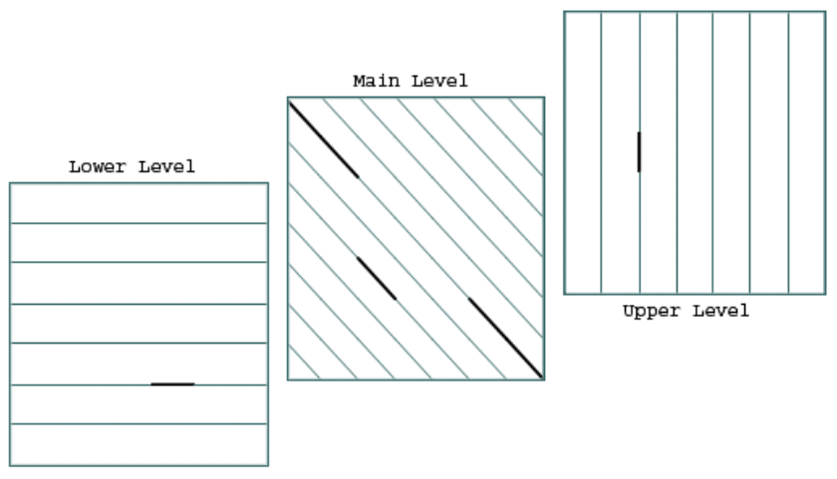
Manhattan in 3 Layers
ρ
δ
δ
σ
δ
ρ
δ
δ
σ
Saturday, May 27, 2017
Dr.
Md.
Abul
Kashem
Mia,
Professor,
CSE Dept,
BUET
66

Slide 67
Affine Gap Penalties and 3 Layer Manhattan Grid
• The three recurrences for the scoring
algorithm creates a 3-layered graph.
• The top level creates/extends gaps in the
sequence v.
• The bottom level creates/extends gaps in
sequence w.
• The middle level extends matches and
mismatches.
Saturday, May 27, 2017
Dr.
Md.
Abul
Kashem
Mia,
Professor,
CSE Dept,
BUET
67

Slide 68
Switching between 3 Layers
• Levels:
•
The main level is for diagonal edges
•
The upper level is for horizontal edges
•
The lower level is for vertical edges
•
A jumping penalty is assigned to moving from the
main level to either the upper level or the lower level
(-- )
•
There is a gap extension penalty for each
continuation on a level other than the main level (-)
Saturday, May 27, 2017
Dr.
Md.
Abul
Kashem
Mia,
Professor,
CSE Dept,
BUET
68

Slide 69
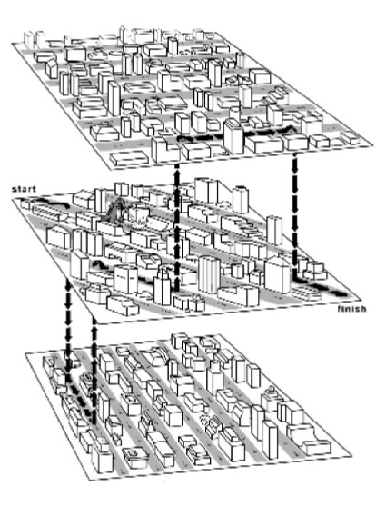
The 3-leveled Manhattan Grid
Saturday, May 27, 2017
Dr.
Md.
Abul
Kashem
Mia,
Professor,
CSE Dept,
BUET
69

Slide 70
Affine Gap Penalty Recurrences
s
= s
- σ
Continue Gap in w (deletion)
i,j
i-1,j
max s
–(ρ+σ)
Start Gap in w (deletion): from middle
i-1,j
s
= s
- σ
Continue Gap in v (insertion)
i,j
i,j-1
max s
–(ρ+σ)
Start Gap in v (insertion):from middle
i,j-1
s
= s
+ δ (v , w )
Match or Mismatch
i,j
i-1,j-1
i
j
max s
End deletion: from top
i,j
s
End insertion: from bottom
i,j
Saturday, May 27, 2017
Dr.
Md.
Abul
Kashem
Mia,
Professor,
CSE Dept,
BUET
70

