Slide 1
Finding Regulatory Motifs in DNA Sequences

Slide 2
Random Sample
atgaccgggatactgataccgtatttggcctaggcgtacacattagataaacgtatgaagtacgttagactcggcgccgccg
acccctattttttgagcagatttagtgacctggaaaaaaaatttgagtacaaaacttttccgaatactgggcataaggtaca
tgagtatccctgggatgacttttgggaacactatagtgctctcccgatttttgaatatgtaggatcattcgccagggtccga
gctgagaattggatgaccttgtaagtgttttccacgcaatcgcgaaccaacgcggacccaaaggcaagaccgataaaggaga
tcccttttgcggtaatgtgccgggaggctggttacgtagggaagccctaacggacttaatggcccacttagtccacttatag
gtcaatcatgttcttgtgaatggatttttaactgagggcatagaccgcttggcgcacccaaattcagtgtgggcgagcgcaa
cggttttggcccttgttagaggcccccgtactgatggaaactttcaattatgagagagctaatctatcgcgtgcgtgttcat
aacttgagttggtttcgaaaatgctctggggcacatacaagaggagtcttccttatcagttaatgctgtatgacactatgta
ttggcccattggctaaaagcccaacttgacaaatggaagatagaatccttgcatttcaacgtatgccgaaccgaaagggaag
ctggtgagcaacgacagattcttacgtgcattagctcgcttccggggatctaatagcacgaagcttctgggtactgatagca

Slide 3
Implanting Motif AAAAAAAGGGGGGG
atgaccgggatactgatAAAAAAAAGGGGGGGggcgtacacattagataaacgtatgaagtacgttagactcggcgccgccg
acccctattttttgagcagatttagtgacctggaaaaaaaatttgagtacaaaacttttccgaataAAAAAAAAGGGGGGGa
tgagtatccctgggatgacttAAAAAAAAGGGGGGGtgctctcccgatttttgaatatgtaggatcattcgccagggtccga
gctgagaattggatgAAAAAAAAGGGGGGGtccacgcaatcgcgaaccaacgcggacccaaaggcaagaccgataaaggaga
tcccttttgcggtaatgtgccgggaggctggttacgtagggaagccctaacggacttaatAAAAAAAAGGGGGGGcttatag
gtcaatcatgttcttgtgaatggatttAAAAAAAAGGGGGGGgaccgcttggcgcacccaaattcagtgtgggcgagcgcaa
cggttttggcccttgttagaggcccccgtAAAAAAAAGGGGGGGcaattatgagagagctaatctatcgcgtgcgtgttcat
aacttgagttAAAAAAAAGGGGGGGctggggcacatacaagaggagtcttccttatcagttaatgctgtatgacactatgta
ttggcccattggctaaaagcccaacttgacaaatggaagatagaatccttgcatAAAAAAAAGGGGGGGaccgaaagggaag
ctggtgagcaacgacagattcttacgtgcattagctcgcttccggggatctaatagcacgaagcttAAAAAAAAGGGGGGGa

Slide 4
Where is the Implanted Motif?
atgaccgggatactgataaaaaaaagggggggggcgtacacattagataaacgtatgaagtacgttagactcggcgccgccg
acccctattttttgagcagatttagtgacctggaaaaaaaatttgagtacaaaacttttccgaataaaaaaaaaggggggga
tgagtatccctgggatgacttaaaaaaaagggggggtgctctcccgatttttgaatatgtaggatcattcgccagggtccga
gctgagaattggatgaaaaaaaagggggggtccacgcaatcgcgaaccaacgcggacccaaaggcaagaccgataaaggaga
tcccttttgcggtaatgtgccgggaggctggttacgtagggaagccctaacggacttaataaaaaaaagggggggcttatag
gtcaatcatgttcttgtgaatggatttaaaaaaaaggggggggaccgcttggcgcacccaaattcagtgtgggcgagcgcaa
cggttttggcccttgttagaggcccccgtaaaaaaaagggggggcaattatgagagagctaatctatcgcgtgcgtgttcat
aacttgagttaaaaaaaagggggggctggggcacatacaagaggagtcttccttatcagttaatgctgtatgacactatgta
ttggcccattggctaaaagcccaacttgacaaatggaagatagaatccttgcataaaaaaaagggggggaccgaaagggaag
ctggtgagcaacgacagattcttacgtgcattagctcgcttccggggatctaatagcacgaagcttaaaaaaaaggggggga

Slide 5
Implanting Motif AAAAAAGGGGGGG with Four Mutations
atgaccgggatactgatAgAAgAAAGGttGGGggcgtacacattagataaacgtatgaagtacgttagactcggcgccgccg
acccctattttttgagcagatttagtgacctggaaaaaaaatttgagtacaaaacttttccgaatacAAtAAAAcGGcGGGa
tgagtatccctgggatgacttAAAAtAAtGGaGtGGtgctctcccgatttttgaatatgtaggatcattcgccagggtccga
gctgagaattggatgcAAAAAAAGGGattGtccacgcaatcgcgaaccaacgcggacccaaaggcaagaccgataaaggaga
tcccttttgcggtaatgtgccgggaggctggttacgtagggaagccctaacggacttaatAtAAtAAAGGaaGGGcttatag
gtcaatcatgttcttgtgaatggatttAAcAAtAAGGGctGGgaccgcttggcgcacccaaattcagtgtgggcgagcgcaa
cggttttggcccttgttagaggcccccgtAtAAAcAAGGaGGGccaattatgagagagctaatctatcgcgtgcgtgttcat
aacttgagttAAAAAAtAGGGaGccctggggcacatacaagaggagtcttccttatcagttaatgctgtatgacactatgta
ttggcccattggctaaaagcccaacttgacaaatggaagatagaatccttgcatActAAAAAGGaGcGGaccgaaagggaag
ctggtgagcaacgacagattcttacgtgcattagctcgcttccggggatctaatagcacgaagcttActAAAAAGGaGcGGa

Slide 6
Where is the Motif???
atgaccgggatactgatagaagaaaggttgggggcgtacacattagataaacgtatgaagtacgttagactcggcgccgccg
acccctattttttgagcagatttagtgacctggaaaaaaaatttgagtacaaaacttttccgaatacaataaaacggcggga
tgagtatccctgggatgacttaaaataatggagtggtgctctcccgatttttgaatatgtaggatcattcgccagggtccga
gctgagaattggatgcaaaaaaagggattgtccacgcaatcgcgaaccaacgcggacccaaaggcaagaccgataaaggaga
tcccttttgcggtaatgtgccgggaggctggttacgtagggaagccctaacggacttaatataataaaggaagggcttatag
gtcaatcatgttcttgtgaatggatttaacaataagggctgggaccgcttggcgcacccaaattcagtgtgggcgagcgcaa
cggttttggcccttgttagaggcccccgtataaacaaggagggccaattatgagagagctaatctatcgcgtgcgtgttcat
aacttgagttaaaaaatagggagccctggggcacatacaagaggagtcttccttatcagttaatgctgtatgacactatgta
ttggcccattggctaaaagcccaacttgacaaatggaagatagaatccttgcatactaaaaaggagcggaccgaaagggaag
ctggtgagcaacgacagattcttacgtgcattagctcgcttccggggatctaatagcacgaagcttactaaaaaggagcgga

Slide 7
Why Finding (15,4) Motif is Difficult?
atgaccgggatactgatAgAAgAAAGGttGGGggcgtacacattagataaacgtatgaagtacgttagactcggcgccgccg
acccctattttttgagcagatttagtgacctggaaaaaaaatttgagtacaaaacttttccgaatacAAtAAAAcGGcGGGa
tgagtatccctgggatgacttAAAAtAAtGGaGtGGtgctctcccgatttttgaatatgtaggatcattcgccagggtccga
gctgagaattggatgcAAAAAAAGGGattGtccacgcaatcgcgaaccaacgcggacccaaaggcaagaccgataaaggaga
tcccttttgcggtaatgtgccgggaggctggttacgtagggaagccctaacggacttaatAtAAtAAAGGaaGGGcttatag
gtcaatcatgttcttgtgaatggatttAAcAAtAAGGGctGGgaccgcttggcgcacccaaattcagtgtgggcgagcgcaa
cggttttggcccttgttagaggcccccgtAtAAAcAAGGaGGGccaattatgagagagctaatctatcgcgtgcgtgttcat
aacttgagttAAAAAAtAGGGaGccctggggcacatacaagaggagtcttccttatcagttaatgctgtatgacactatgta
ttggcccattggctaaaagcccaacttgacaaatggaagatagaatccttgcatActAAAAAGGaGcGGaccgaaagggaag
ctggtgagcaacgacagattcttacgtgcattagctcgcttccggggatctaatagcacgaagcttActAAAAAGGaGcGGa
AgAAgAAAGGttGGG
..|..|||.|..|||
cAAtAAAAcGGcGGG

Slide 8
Challenge Problem
  Find a motif in a sample of
  - 20 “random” sequences (e.g. 600 nt long)
  - each sequence containing an implanted
  pattern of length 15,
  - each pattern appearing with 4 mismatches
  as (15,4)-motif.

Slide 9
Regulatory Regions
Every gene contains a regulatory region (RR) typically stretching 100-1000 bp upstream of the transcriptional start site
Located within the RR are the Transcription Factor Binding Sites (TFBS), also known as motifs, specific for a given transcription factor
TFs influence gene expression by binding to a specific location in the respective gene’s regulatory region - TFBS

Slide 10
Transcription Factor Binding Sites
A TFBS can be located anywhere within the
Regulatory Region.
TFBS may vary slightly across different regulatory regions since non-essential bases could mutate

Slide 11
Motifs and Transcriptional Start Sites
ATCCCG
gene
TTCCGG
gene
ATCCCG
gene
ATGCCG
gene
ATGCCC
gene

Slide 12
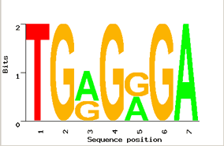
Motif Logo
T G G G G G A
T G A G A G A
T G G G G G A
T G A G A G A
T G A G G G A
Motifs can mutate on non important bases
The five motifs in five different genes have mutations in position 3 and 5
Representations called motif logos illustrate the conserved and variable regions of a motif

Slide 13
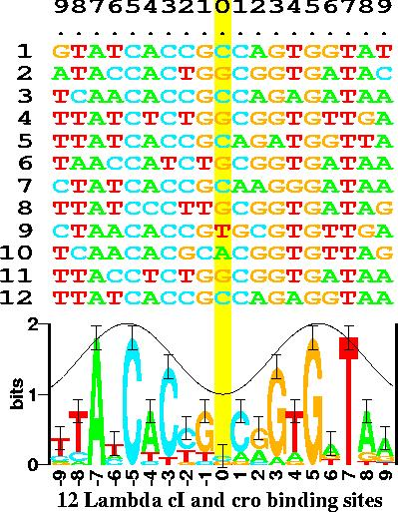
Motif Logos: An Example
(http://www-lmmb.ncifcrf.gov/~toms/sequencelogo.html)

Slide 14
Identifying Motifs
Genes are turned on or off by regulatory proteins
These proteins bind to upstream regulatory regions of genes to either attract or block an RNA polymerase
Regulatory protein (TF) binds to a short DNA sequence called a motif (TFBS)
So finding the same motif in multiple genes’ regulatory regions suggests a regulatory relationship amongst those genes

Slide 15
Identifying Motifs: Complications
We do not know the motif sequence
We do not know where it is located relative to the genes start
Motifs can differ slightly from one gene to the next
How to distinguish it from “random” motifs?

Slide 16
The Motif Finding Problem
Given a random sample of DNA sequences:
  cctgatagacgctatctggctatccacgtacgtaggtcctctgtgcgaatctatgcgtttccaaccat
  agtactggtgtacatttgatacgtacgtacaccggcaacctgaaacaaacgctcagaaccagaagtgc
  aaacgtacgtgcaccctctttcttcgtggctctggccaacgagggctgatgtataagacgaaaatttt
  agcctccgatgtaagtcatagctgtaactattacctgccacccctattacatcttacgtacgtataca
  ctgttatacaacgcgtcatggcggggtatgcgttttggtcgtcgtacgctcgatcgttaacgtacgtc
Find the pattern that is implanted in each of the individual sequences, namely, the motif

Slide 17
The Motif Finding Problem (cont’d)
Additional information:
  The hidden sequence is of length 8
  The pattern is not exactly the same in each array because random point mutations may occur in the sequences

Slide 18
The Motif Finding Problem (cont’d)
The patterns revealed with no mutations:
  cctgatagacgctatctggctatccacgtacgtaggtcctctgtgcgaatctatgcgtttccaaccat
  agtactggtgtacatttgatacgtacgtacaccggcaacctgaaacaaacgctcagaaccagaagtgc
  aaacgtacgtgcaccctctttcttcgtggctctggccaacgagggctgatgtataagacgaaaatttt
  agcctccgatgtaagtcatagctgtaactattacctgccacccctattacatcttacgtacgtataca
  ctgttatacaacgcgtcatggcggggtatgcgttttggtcgtcgtacgctcgatcgttaacgtacgtc
  acgtacgt
  Consensus String

Slide 19
The Motif Finding Problem (cont’d)
The patterns with 2 point mutations:
  cctgatagacgctatctggctatccaGgtacTtaggtcctctgtgcgaatctatgcgtttccaaccat
  agtactggtgtacatttgatCcAtacgtacaccggcaacctgaaacaaacgctcagaaccagaagtgc
  aaacgtTAgtgcaccctctttcttcgtggctctggccaacgagggctgatgtataagacgaaaatttt
  agcctccgatgtaagtcatagctgtaactattacctgccacccctattacatcttacgtCcAtataca
  ctgttatacaacgcgtcatggcggggtatgcgttttggtcgtcgtacgctcgatcgttaCcgtacgGc

Slide 20
The Motif Finding Problem (cont’d)
The patterns with 2 point mutations:
  cctgatagacgctatctggctatccaGgtacTtaggtcctctgtgcgaatctatgcgtttccaaccat
  agtactggtgtacatttgatCcAtacgtacaccggcaacctgaaacaaacgctcagaaccagaagtgc
  aaacgtTAgtgcaccctctttcttcgtggctctggccaacgagggctgatgtataagacgaaaatttt
  agcctccgatgtaagtcatagctgtaactattacctgccacccctattacatcttacgtCcAtataca
  ctgttatacaacgcgtcatggcggggtatgcgttttggtcgtcgtacgctcgatcgttaCcgtacgGc
Can we still find the motif, now that we have 2 mutations?

Slide 21
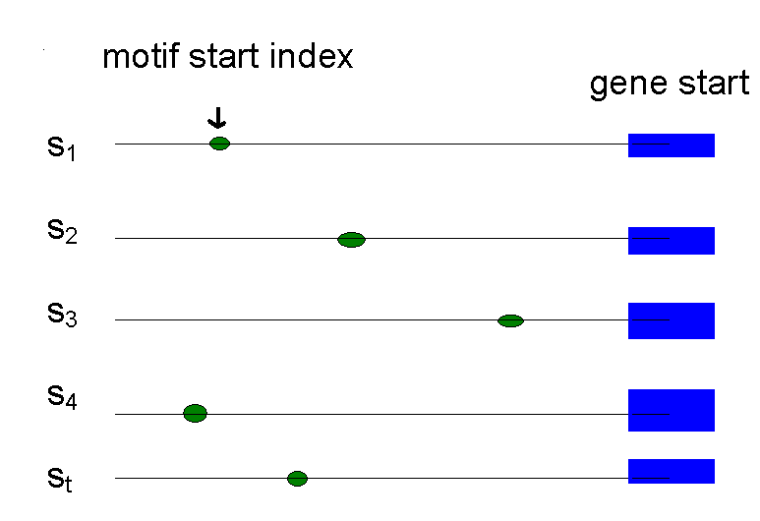
Defining Motifs
To define a motif, let us say we know where the motif starts in the sequence
The motif start positions in their sequences can be represented as s = (s₁,s₂,s₃,…,s_{t})

Slide 22
Motifs: Profiles and Consensus
  a G g t a c T t
  C c A t a c g t
  Alignment a c g t T A g t
  a c g t C c A t
  C c g t a c g G
  _________________
  A 3 0 1 0 3 1 1 0
  Profile C 2 4 0 0 1 4 0 0
  G 0 1 4 0 0 0 3 1
  T 0 0 0 5 1 0 1 4
  _________________
  Consensus A C G T A C G T
Line up the patterns by their start indexes
s = (s₁, s₂, …, s_{t})
Construct matrix profile with frequencies of each nucleotide in columns
Consensus nucleotide in each position has the highest score in column

Slide 23
Consensus
Think of consensus as an “ancestor” motif, from which mutated motifs emerged
The distance between a real motif and the consensus sequence is generally less than that for two real motifs

Slide 24
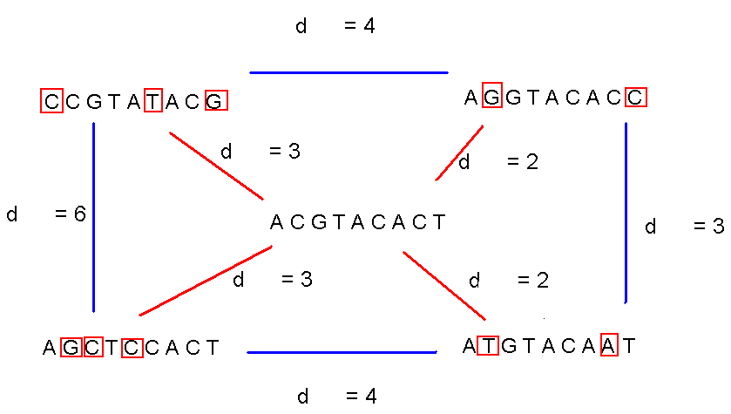
Consensus (cont’d)

Slide 25
Evaluating Motifs
We have a guess about the consensus sequence, but how “good” is this consensus?
Need to introduce a scoring function to compare different guesses and choose the “best” one.

Slide 26
Defining Some Terms
t - number of sample DNA sequences
n - length of each DNA sequence
DNA - sample of DNA sequences (t x n array)
l - length of the motif (l-mer)
s_{i} - starting position of an l-mer in sequence i
s=(s₁, s₂,… s_{t}) - array of motif’s starting positions

Slide 27
Parameters
  cctgatagacgctatctggctatccaGgtacTtaggtcctctgtgcgaatctatgcgtttccaaccat
  agtactggtgtacatttgatCcAtacgtacaccggcaacctgaaacaaacgctcagaaccagaagtgc
  aaacgtTAgtgcaccctctttcttcgtggctctggccaacgagggctgatgtataagacgaaaatttt
  agcctccgatgtaagtcatagctgtaactattacctgccacccctattacatcttacgtCcAtataca
  ctgttatacaacgcgtcatggcggggtatgcgttttggtcgtcgtacgctcgatcgttaCcgtacgGc
l = 8
DNA
t=5
n = 69
s
s₁ = 26 s₂ = 21 s₃= 3 s₄ = 56 s₅ = 60

Slide 28
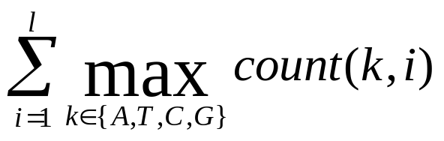
Scoring Motifs
l
Given s = (s₁, … s_{t}) and DNA:
Score(s,DNA) =
  a G g t a c T t
  C c A t a c g t
  a c g t T A g t
  a c g t C c A t
  C c g t a c g G
  _________________
  A 3 0 1 0 3 1 1 0
  C 2 4 0 0 1 4 0 0
  G 0 1 4 0 0 0 3 1
  T 0 0 0 5 1 0 1 4
  _________________
  Consensus a c g t a c g t
  Score 3+4+4+5+3+4+3+4=30
t

Slide 29
The Motif Finding Problem
If starting positions s=(s₁, s₂,… s_{t}) are given, finding consensus is easy even with mutations in the sequences because we can simply construct the profile to find the motif (consensus)
But… the starting positions s are usually not given. How can we find the “best” profile matrix?

Slide 30
The Motif Finding Problem: Formulation
Goal: Given a set of DNA sequences, find a set of l-mers, one from each sequence, that maximizes the consensus score
Input: A t x n matrix of DNA, and l, the length of the pattern to find
Output: An array of t starting positions
s = (s₁, s₂, … s_{t}) maximizing Score(s,DNA)

Slide 31
The Motif Finding Problem: Brute Force Solution
  Compute the scores for each possible combination of starting positions s
  The best score will determine the best profile and the consensus pattern in DNA
  The goal is to maximize Score(s,DNA) by varying the starting positions s_{i}, where:
  s_{i} = [1, …, n-l+1]
  i = [1, …, t]

Slide 32
BruteForceMotifSearch
BruteForceMotifSearch(DNA, t, n, l)
bestScore ← 0
for each s = (s₁,s₂ , . . ., s_{t}) from (1,1 . . . 1)
to (n-l+1, . . ., n-l+1)
if (Score(s,DNA) > bestScore)
bestScore ← score(s, DNA)
bestMotif ← (s₁,s₂ , . . . , s_{t})
return bestMotif

Slide 33
Running Time of BruteForceMotifSearch
Varying (n - l + 1) positions in each of t sequences, we’re looking at (n - l + 1)^{t} sets of starting positions
For each set of starting positions, the scoring function makes l.t operations, so complexity is
l .t(n – l + 1)^{t} = O(l t n^{t})
That means that for t = 8, n = 1000, l = 10 we must perform approximately 10²⁴ computations – it will take billions years

Slide 34
The Median String Problem
Given a set of t DNA sequences find a pattern that appears in all t sequences with the minimum number of mutations
This pattern will be the motif

Slide 35
Hamming Distance
Hamming distance:
  d_{H}(v, w) is the number of nucleotide pairs that do not match when v and w are aligned. For example:
d_{H}(AAAAAA, ACAAAC) = 2

Slide 36
Total Distance: An Example
Given v = “acgtacgt” and s
acgtacgt
  cctgatagacgctatctggctatccacgtacgtaggtcctctgtgcgaatctatgcgtttccaaccat
  acgtacgt
  agtactggtgtacatttgatacgtacgtacaccggcaacctgaaacaaacgctcagaaccagaagtgc
  acgtacgt
  aaacgtacgtgcaccctctttcttcgtggctctggccaacgagggctgatgtataagacgaaaatttt
  acgtacgt
  agcctccgatgtaagtcatagctgtaactattacctgccacccctattacatcttacgtacgtataca
  acgtacgt
  ctgttatacaacgcgtcatggcggggtatgcgttttggtcgtcgtacgctcgatcgttaacgtacgtc
v is the sequence in red, x is the sequence in blue
TotalDistance(v,DNA) = 0
d_{H}(v, x) = 0
d_{H}(v, x) = 0
d_{H}(v, x) = 0
d_{H}(v, x) = 0
d_{H}(v, x) = 0

Slide 37
Total Distance: Example
Given v = “acgtacgt” and s
acgtacgt
  cctgatagacgctatctggctatccacgtacAtaggtcctctgtgcgaatctatgcgtttccaaccat
  acgtacgt
  agtactggtgtacatttgatacgtacgtacaccggcaacctgaaacaaacgctcagaaccagaagtgc
  acgtacgt
  aaaAgtCcgtgcaccctctttcttcgtggctctggccaacgagggctgatgtataagacgaaaatttt
  acgtacgt
  agcctccgatgtaagtcatagctgtaactattacctgccacccctattacatcttacgtacgtataca
  acgtacgt
  ctgttatacaacgcgtcatggcggggtatgcgttttggtcgtcgtacgctcgatcgttaacgtaGgtc
v is the sequence in red, x is the sequence in blue
TotalDistance(v,DNA) = 1+0+2+0+1 = 4
d_{H}(v, x) = 1
d_{H}(v, x) = 0
d_{H}(v, x) = 2
d_{H}(v, x) = 0
d_{H}(v, x) = 1

Slide 38
Total Distance: Definition
  For each DNA sequence i, compute all d_{H}(v, x), where x is an l-mer with starting position s_{i}
  (1 < s_{i} < n – l + 1)
  Find minimum of d_{H}(v, x) among all l-mers in sequence i
  TotalDistance(v, DNA) is the sum of the minimum Hamming distances for each DNA sequence i
  TotalDistance(v, DNA) = min_{s} d_{H}(v, s), where s is the set of starting positions s₁, s₂,… s_{t}

Slide 39
The Median String Problem: Formulation
Goal: Given a set of DNA sequences, find a median string
Input: A t x n matrix DNA, and l, the length of the pattern to find
Output: A string v of l nucleotides that minimizes TotalDistance(v,DNA) over all strings of that length

Slide 40
Median String Search Algorithm
MedianStringSearch (DNA, t, n, l)
bestWord ← AAA…A
bestDistance ← ∞
for each l-mer s from AAA…A to TTT…T if TotalDistance(s, DNA) < bestDistance
bestDistance←TotalDistance(s, DNA)
bestWord ← s
return bestWord

Slide 41
Motif Finding Problem == Median String Problem
The Motif Finding is a maximization problem while Median String is a minimization problem
However, the Motif Finding problem and Median String problem are computationally equivalent
Need to show that minimizing TotalDistance is equivalent to maximizing Score

Slide 42
We are looking for the same thing
l
  a G g t a c T t
  C c A t a c g t
  Alignment a c g t T A g t
  a c g t C c A t
  C c g t a c g G
  _________________
  A 3 0 1 0 3 1 1 0
  Profile C 2 4 0 0 1 4 0 0
  G 0 1 4 0 0 0 3 1
  T 0 0 0 5 1 0 1 4
  _________________
  Consensus a c g t a c g t
  Score 3+4+4+5+3+4+3+4
  TotalDistance 2+1+1+0+2+1+2+1
  Sum 5 5 5 5 5 5 5 5
At any column i
Score_{i} + TotalDistance_{i} = t
Because there are l columns
Score + TotalDistance = l * t
Rearranging:
Score = l * t - TotalDistance
l * t is constant the minimization of the right side is equivalent to the maximization of the left side
t

Slide 43
Motif Finding Problem vs.
Median String Problem
Why bother reformulating the Motif Finding problem into the Median String problem?
  The Motif Finding Problem needs to examine all the combinations for s. That is (n - l + 1)^{t} combinations !!!
  The Median String Problem needs to examine all 4^{l} combinations for v. This number is relatively smaller

Slide 44
Motif Finding: Improving the Running Time
Recall the BruteForceMotifSearch:
BruteForceMotifSearch(DNA, t, n, l)
bestScore ← 0
for each s=(s₁,s₂ , . . ., s_{t}) from (1,1 . . . 1) to (n-l+1, . . ., n-l+1)
if (Score(s,DNA) > bestScore)
bestScore ← Score(s, DNA)
bestMotif ← (s₁,s₂ , . . . , s_{t})
return bestMotif

Slide 45
Structuring the Search
How can we perform the line
for each s=(s₁,s₂ , . . ., s_{t}) from (1,1 . . . 1) to (n-l+1, . . ., n-l+1) ?
We need a method for efficiently structuring and navigating the many possible motifs
This is not very different than exploring all t-digit numbers

Slide 46
Median String: Improving the Running Time
MedianStringSearch (DNA, t, n, l)
bestWord ← AAA…A
bestDistance ← ∞
for each l-mer s from AAA…A to TTT…T if TotalDistance(s,DNA) < bestDistance
bestDistance←TotalDistance(s,DNA)
bestWord ← s
return bestWord

Slide 47
Structuring the Search
  For the Median String Problem we need to consider all 4^{l} possible l-mers:
aa… aa
aa… ac
aa… ag
aa… at
.
.
tt… tt
How to organize this search?
l

Slide 48
Alternative Representation of the Search Space
Let A = 1, C = 2, G = 3, T = 4
Then the sequences from AA…A to TT…T become:
11…11
11…12
11…13
11…14
.
.
44…44
Notice that the sequences above simply list all numbers as if we were counting on base 4 without using 0 as a digit
l

Slide 49
Linked List
Suppose l = 2
aa ac ag at ca cc cg ct ga gc gg gt ta tc tg tt
Need to visit all the predecessors of a sequence before visiting the sequence itself
Start

Slide 50
Linked List (cont’d)
Linked list is not the most efficient data structure for motif finding
Let’s try grouping the sequences by their prefixes
aa ac ag at ca cc cg ct ga gc gg gt ta tc tg tt

Slide 51
Search Tree
a- c- g- t-
aa ac ag at ca cc cg ct ga gc gg gt ta tc tg tt
root
--

Slide 52
Analyzing Search Trees
Characteristics of the search trees:
  The sequences are contained in its leaves
  The parent of a node is the prefix of its children
How can we move through the tree?

Slide 53
Moving through the Search Trees
Four common moves in a search tree that we are about to explore:
  Move to the next leaf
  Visit all the leaves
  Visit the next node
  Bypass the children of a node

Slide 54
Visit the Next Leaf
Given a current leaf a , we need to compute the “next” leaf:
NextLeaf( a,L, k ) // a : the array of digits
for i ← L to 1 // L: length of the array
if a_{i} < k // k : max digit value
a_{i} ← a_{i} + 1
return a
a_{i} ← 1
return a

Slide 55
NextLeaf (cont’d)
The algorithm is common addition in radix k:
Increment the least significant digit
“Carry the one” to the next digit position when the digit is at maximal value

Slide 56
NextLeaf: Example
Moving to the next leaf:
1- 2- 3- 4-
11 12 13 14 21 22 23 24 31 32 33 34 41 42 43 44
Current Location
--

Slide 57
NextLeaf: Example (cont’d)
Moving to the next leaf:
1- 2- 3- 4-
11 12 13 14 21 22 23 24 31 32 33 34 41 42 43 44
Next Location
--

Slide 58
Visit All Leaves
Printing all permutations in ascending order:
AllLeaves(L,k) // L: length of the sequence
a ← (1,...,1) // k : max digit value
while forever // a : array of digits
output a
a ← NextLeaf(a,L,k)
if a = (1,...,1)
return

Slide 59
Visit All Leaves: Example
Moving through all the leaves in order:
1- 2- 3- 4-
11 12 13 14 21 22 23 24 31 32 33 34 41 42 43 44
1 2 3 4 5 6 7 8 9 10 11 12 13 14 15
--
Order of steps

Slide 60
Depth First Search
So we can search leaves
How about searching all vertices of the tree?
We can do this with a depth first search

Slide 61
Visit the Next Vertex
  NextVertex(a,i,L,k) // a : the array of digits
  if i < L // i : prefix length
  a _{i+1} ← 1 // L: max length
  return ( a,i+1) // k : max digit value
  else
  for j ← l to 1
  if a_{j} < k
  a_{j} ← a_{j} +1
  return( a,j )
  return(a,0)

Slide 62
Example
Moving to the next vertex:
1- 2- 3- 4-
11 12 13 14 21 22 23 24 31 32 33 34 41 42 43 44
Current Location
--

Slide 63
Example
Moving to the next vertices:
1- 2- 3- 4-
11 12 13 14 21 22 23 24 31 32 33 34 41 42 43 44
Location after 5 next vertex moves
--

Slide 64
Bypass Move
Given a prefix (internal vertex), find next vertex after skipping all its children
Bypass(a,i,L,k) // a: array of digits
for j ← i to 1 // i : prefix length
if a_{j} < k // L: maximum length
a_{j} ← a_{j} +1 // k : max digit value
return(a,j)
return(a,0)

Slide 65
Bypass Move: Example
Bypassing the descendants of “2-”:
1- 2- 3- 4-
11 12 13 14 21 22 23 24 31 32 33 34 41 42 43 44
Current Location
--

Slide 66
Example
Bypassing the descendants of “2-”:
1- 2- 3- 4-
11 12 13 14 21 22 23 24 31 32 33 34 41 42 43 44
Next Location
--

Slide 67
Revisiting Brute Force Search
Now that we have method for navigating the tree, lets look again at BruteForceMotifSearch

Slide 68
Brute Force Search Again
BruteForceMotifSearchAgain(DNA, t, n, l)
s ← (1,1,…, 1)
bestScore ← Score(s,DNA)
while forever
s ← NextLeaf (s, t, n- l +1)
if (Score(s,DNA) > bestScore)
bestScore ← Score(s, DNA)
bestMotif ← (s₁,s₂ , . . . , s_{t})
return bestMotif

Slide 69
Can We Do Better?
Sets of s=(s₁, s₂, …,s_{t}) may have a weak profile for the first i positions (s₁, s₂, …,s_{i})
Every row of alignment may add at most l to Score
Optimism: if all subsequent (t-i) positions (s_{i+1}, …s_{t}) add
  (t – i ) * l to Score(s,i,DNA)
If Score(s,i,DNA) + (t – i ) * l < BestScore, it makes no sense to search in vertices of the current subtree
  Use ByPass()

Slide 70
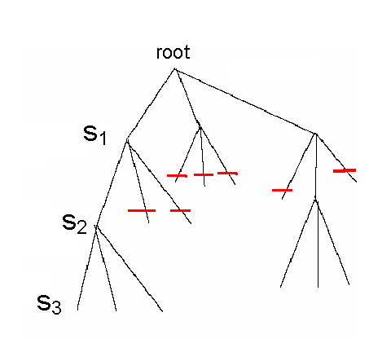
Branch and Bound Algorithm for Motif Search
Since each level of the tree goes deeper into search, discarding a prefix discards all following branches
This saves us from looking at (n – l + 1)^{t-i} leaves
  Use NextVertex() and ByPass() to navigate the tree

Slide 71
Pseudocode for Branch and Bound Motif Search
BranchAndBoundMotifSearch(DNA,t,n,l)
s ← (1,…,1)
bestScore ← 0
i ← 1
while i > 0
if i < t
optimisticScore ← Score(s, i, DNA) +(t – i ) * l
if optimisticScore < bestScore
(s, i) ← Bypass(s,i, n-l +1)
else
(s, i) ← NextVertex(s, i, n-l +1)
else
if Score(s,DNA) > bestScore
bestScore ← Score(s)
bestMotif ← (s₁, s₂, s₃, …, s_{t})
(s,i) ← NextVertex(s,i,t,n-l + 1)
return bestMotif

Slide 72
Median String Search Improvements
Recall the computational differences between motif search and median string search
  The Motif Finding Problem needs to examine all (n-l +1)^{t} combinations for s.
  The Median String Problem needs to examine 4^{l} combinations of v. This number is relatively small
We want to use median string algorithm with the Branch and Bound trick!

Slide 73
Branch and Bound Applied to Median String Search
Note that if the total distance for a prefix is greater than that for the best word so far:
  TotalDistance (prefix, DNA) > BestDistance
there is no use exploring the remaining part of the word
We can eliminate that branch and BYPASS exploring that branch further

Slide 74
Bounded Median String Search
BranchAndBoundMedianStringSearch(DNA,t,n,l )
s ← (1,…,1)
bestDistance ← ∞
i ← 1
while i > 0
if i < l
prefix ← string corresponding to the first i nucleotides of s
optimisticDistance ← TotalDistance(prefix,DNA)
if optimisticDistance > bestDistance
(s, i ) ← Bypass(s,i, l, 4)
else
(s, i ) ← NextVertex(s, i, l, 4)
else
word ← nucleotide string corresponding to s
if TotalDistance(s,DNA) < bestDistance
bestDistance ← TotalDistance(word, DNA)
bestWord ← word
(s,i ) ← NextVertex(s,i,l, 4)
return bestWord

Slide 75
Further Readings
Marius Nicolae & Sanguthevar Rajasekaran, “qPMS9: An Efficient Algorithm for Quorum Planted Motif Search”, Nature, Scientific Reports 5, Article No: 7813 (2015).
Marius Nicolae & Sanguthevar Rajasekaran, Efficient Sequential and Parallel Algorithms for Planted Motif Search. BMC Bioinformatics, 15, 34 (2014).

