Slide 1

SMART INVENTORY MANAGEMENT SYSTEM
Team Members :
Shweta Patil
Sneha Harugeri
Devika Rowthu
Asif
Revanth Kola
Rayala Charanya
Mentor Name :
Suramya Biswas

Slide 2
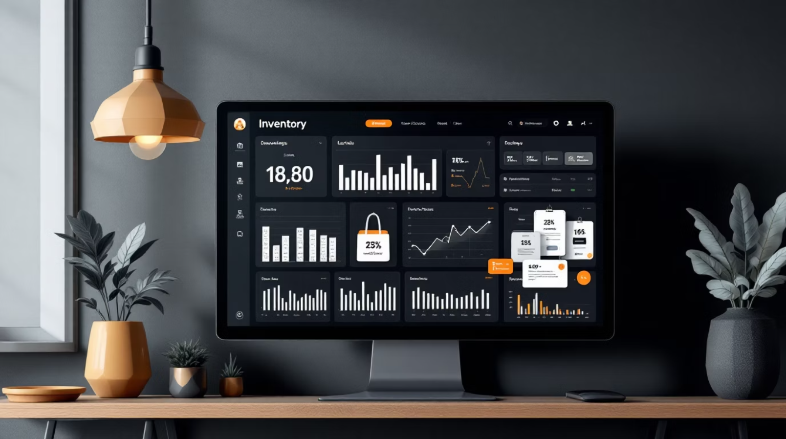
System Overview
Key features of our web-based inventory management system include:
Web-based platform for real-time inventory management
Tracking of product stock and transaction records
Automatic detection of low inventory using threshold values
Automated alerts and restocking triggers
Reduced risk of stockouts and manual errors

Slide 3
Technology Stack
Spring Boot (Java)
React.js
MySQL
Backend logic development
API creation
Robust server-side operations
Interactive frontend development
Responsive UI design
Seamless user experience
Structured data storage
Reliable inventory tracking
Data integrity management

Slide 4
System Roles Overview
Three distinct system roles.
Each role has specific responsibilities.
Goal: Ensure smooth inventory management and operational efficiency.
01
02
03
Admin
Manager
Vendor
Manage all users.
Handle data imports.
View full system-wide analytics and reports.
Track real-time stock movement.
Approve automated purchase orders.
Monitor inventory status.
Handle orders.
Supply goods.
Update product information.
Manage delivery logistics.

Slide 5

Admin Responsibilities
Core Functions
Create, update, and manage SKU/product listings
Manage users (Manager & Vendor)
Define roles, permissions, and access control
Maintain and oversee master inventory data
Monitoring & Security
Approve or reject product and vendor updates
Monitor system activity, logs, and performance reports
Generate reports for stock, transactions, and usage
Configure system settings and thresholds

Slide 6
Manager Functions
Real-Time Stock Tracking
Purchase Order Approval
Monitor inventory levels
Track products in real-time
Manage inbound and outbound stock
Review restocking requests
Approve automated orders
Verify supply requirements
Transaction Oversight
Alert Management
Track all stock movements
Maintain accurate records
Update system logs
Respond to low stock notifications
Handle system exceptions
Monitor inventory thresholds

Slide 7
Vendor Operations
Order Processing
Product Supply
Product Updates
Handle incoming purchase orders
Confirm stock availability
Supply goods
Ensure alignment with order specifications
Update product information
Maintain inventory details

Slide 8
Key Features
Automated Low Stock Detection
Real-Time Inventory Tracking
System automatically monitors inventory levels
Triggers alerts when stock goes below threshold
Live updates of product and SKU data
Instant stock status visibility
Digital Transaction Management
Role-Based Access Control
Records all stock In/Out activities
Generates reports automatically
Separate dashboards for Admin, Manager, and Vendor
Displays relevant data access only
Centralized SKU Management
Product Analysis & Reporting
Unique SKU system for each product
Simplifies tracking and organization
Built-in analysis tools
Provides transaction reports for demand trends

Slide 9
Future Enhancements
Email/SMS Notifications
AI-Based Demand Prediction
Automatic alerts for low stock and restock updates
Predict future stock needs using past data
Auto Purchase Order Generation
Mobile App Integration
Directly send restock requests to vendors
Access system on mobile devices
Advanced Analytics Dashboard
Cloud Deployment
Visual insights with graphs and trends
Improve scalability and remote access
Bulk CSV Import/Export
Supplier System Integration
Manage large data efficiently
Direct communication with vendor systems

Slide 10

Thank you

