Slide 1
HomeViews:
P2P Middleware for Personal Data Sharing Applications
Roxana Geambasu, Magdalena Balazinska,
Steve Gribble, Hank Levy
University of Washington

Slide 2
HomeViews
P2P personal data sharing
Views for organizing and sharing personal data
Lightweight protection using capabilities

Slide 3
Outline
Motivation and goals
HomeViews design
Evaluation
Conclusions

Slide 4
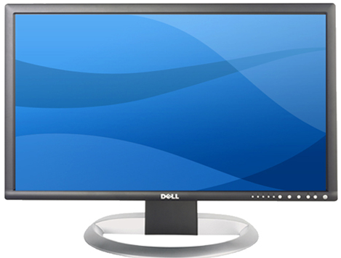









Motivation
3 problems
How to organize all this data?
How to share files with friends?
How to integrate others’ shared files with their own?
Bob

Slide 5


1) How can users organize their data?
Hierarchy of directories
Views over the personal files
  E.g. tools supporting views: Spotlight, WinFS, iTunes
Bob
2006
Goal:
Use views to organize
personal data
Parties
Christmas
Jan 2006
Dec 2006
Files

Slide 6

2) How can users share their data?
Protected and selective sharing
Goal:
Lightweight P2P selective
sharing of views
P2P sharing?
Bob
Mom
Centralized
sites?
Parties
Christmas
Christmas
Email?
share
Files

Slide 7
3) How can users integrate shared files with their own?
Organize and share the global file collection further
Goal:
Seamless access and composition
of views
Bob
Mom
Italy
France
Parties
Christmas
Christmas
share
Files
Files

Slide 8
Goals
Personal data organization using views
Lightweight P2P selective sharing of views
  No account registration or management
Seamless access and composition of views

Slide 9
Outline
Motivation and goals
HomeViews design
Evaluation
Conclusions

Slide 10
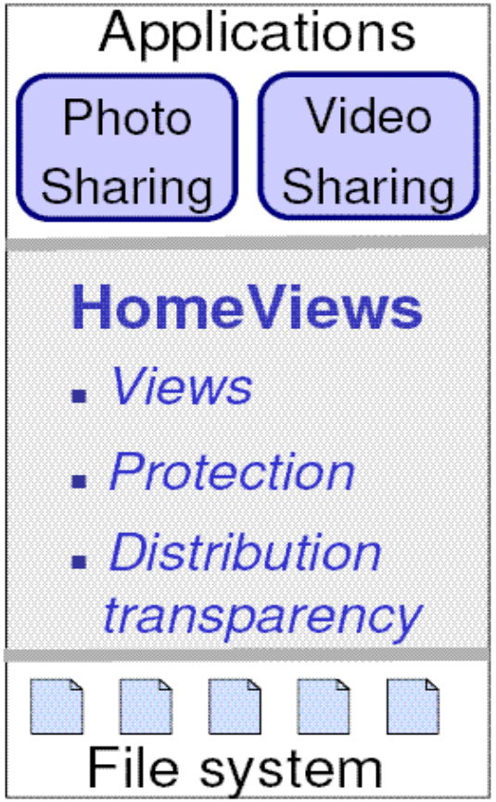
HomeViews Middleware
Models the file system as a relation with SQL-based QL to build views over personal files
Lightweight protection
  No user accounts
  Enable P2P selective sharing
Provides distribution transparency

Slide 11
Design Challenges
How to protect views in P2P, with no user accounts?
How to integrate the new protection with DB views?
How to execute distributed queries in new environment?

Slide 12
Challenge 1: Lightweight Protection
Use capabilities from operating systems
Capability = secure token that:
  bundles an object name and a set of access rights
  provides holder with authority to execute the specified actions on the named object
Without a valid capability for an object, one cannot access that object
object ID rights

Slide 13
HomeViews Capabilities
Serve to access, protect, and share views
Long random password ensures unforgeability of capability probabilistically
Example rights: select, drop, alter, catalog lookup, etc.
Capability
128 bits 128 bits 32 bits
view ID password IP hint
CapTable (in local catalog)
view ID password rights
lookup

Slide 14
Benefits of Capabilities
Facilitate sharing
  Grant access simply by emailing capabilities
  Sharing is similar to sharing private Web pages
Ease management
  No user accounts
  No global protection structure
Capabilities perfectly match our unmanaged P2P environment

Slide 15
Challenge 2:
Integrating OS Capabilities with DB Views
Surprisingly easy to modify SQL to support capability-based protection: SQLCapa
SQLCapa accommodates:
  Capability-based naming of views
  Creation of (restricted) capabilities
  Capability revocation

Slide 16
SQLCapa
Use capabilities to name views in queries
CREATE VIEW returns a fully-enabled capability
  This capability can be used to query the new view
  Copies of this capability can be shared
Select all Christmas photos
Bob
Mom
Christmas
C_{C}
CREATE VIEW Christmas
email
SELECT * FROM
WHERE occasion = `Christmas’
C_{B0}
C_{B0}
C'_{C}
Bob_
BaseView
=> Returns C_{C}

Slide 17
SQLCapa
Compose views seamlessly
CREATE VIEW Italy AS
  SELECT * FROM C’_{C} WHERE place = `Italy’
  UNION SELECT * FROM C_{M0} WHERE place = `Italy’
=> Returns C_{IT}
Mom
Italy
C_{IT}
(to Bob’s Christmas view)
C'_{C}
C_{M0}
Mom’s
BaseView

Slide 18
Challenge 3: Distributed Query Execution
Two techniques:
Recursive evaluation
Can be slow
Peer node
C₁
C
Capability
C₂
C₃
Queries
Results
C₄
C₅
C₆
Base views
Files

Slide 19
Challenge 3: Distributed Query Execution
Two techniques:
Query rewrite and evaluation
Query rewrite yields better performance, but needs right to lookup view definition in catalog
Step 1.
Recursive lookups of view definitions & query rewrite
C₁
C₂
C₃
C₄
C₅
C₆
Step 2.
Query execution on base views
Base views
Files

Slide 20
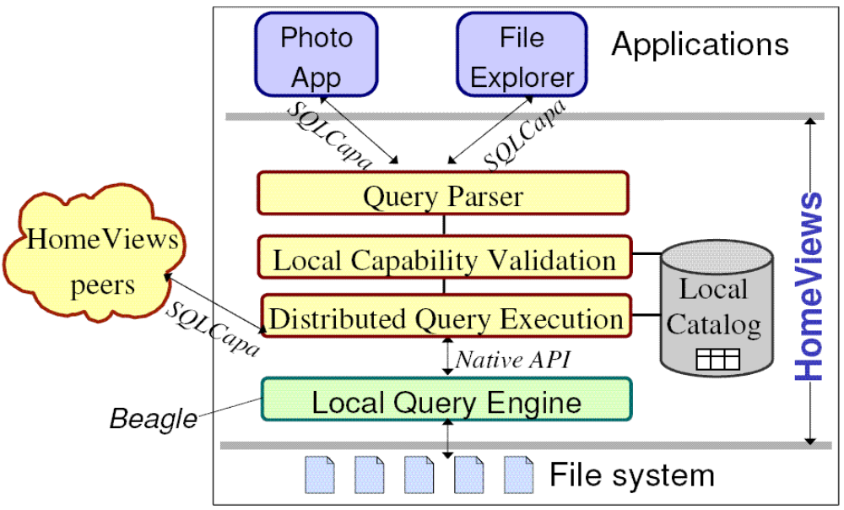
Putting it all together:
HomeViews Architecture

Slide 21
Outline
Motivation and goals
HomeViews design
Evaluation
Conclusions

Slide 22
Evaluation Questions
Q1: What are the system’s bottlenecks?
Q2: Are distributed queries fast enough to be
practical?
Q3: How easy is it to build P2P file sharing apps on
top of HomeViews?

Slide 23
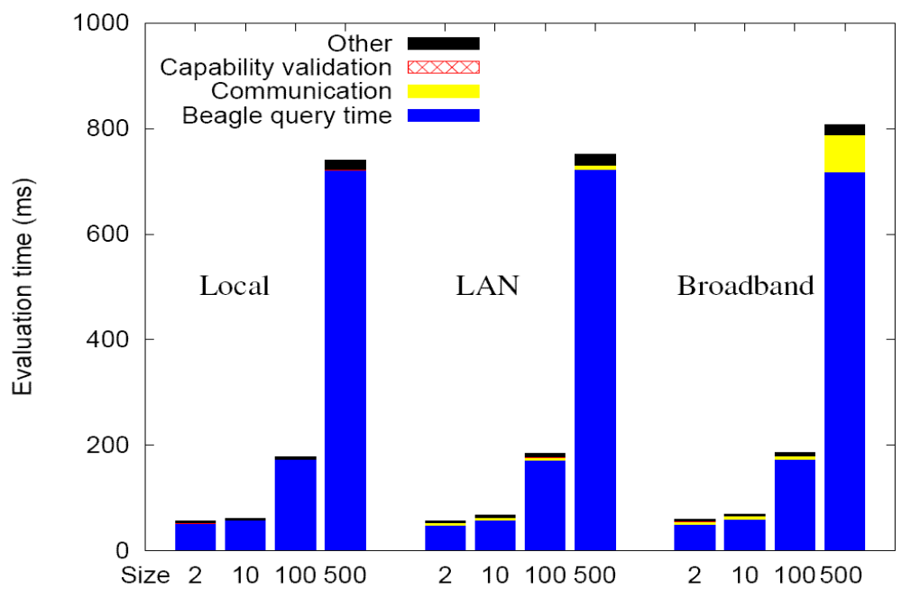
Q1: What are the system’s bottlenecks?
Answer: Beagle search engine and/or network

Slide 24
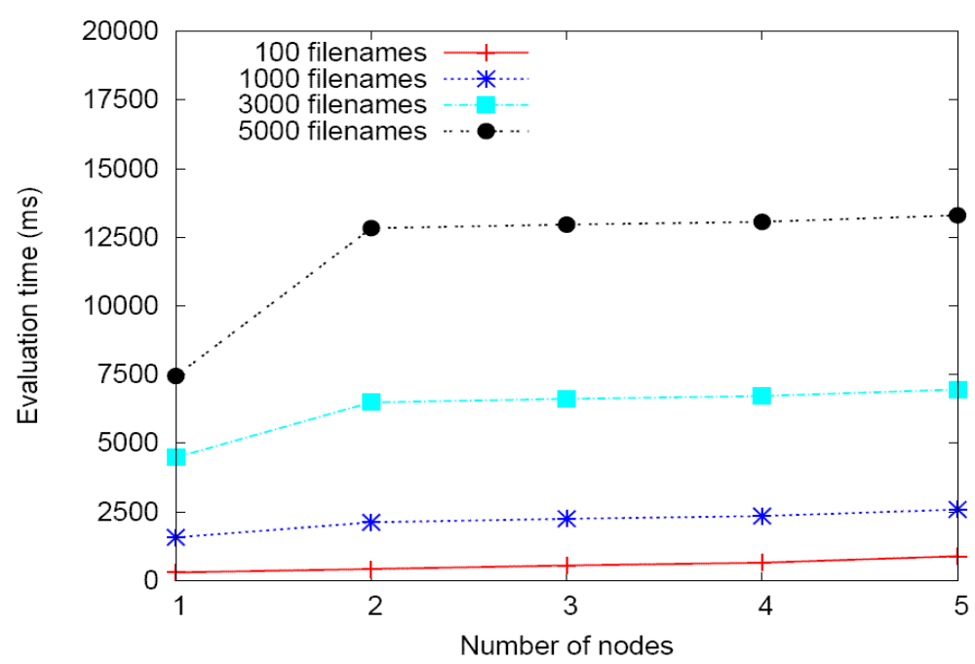
Q2: Are distributed queries fast enough to be practical?
Method:
  Distribute queries on multiple machines
  Simulate broadband (2Mbps, 20ms)
Query rewrite time (ms)
Answer: Medium-size queries are responsive
  Query rewrite technique scales well with number of nodes

Slide 25
Q3: How easy is it to build P2P sharing apps on HomeViews?
Modified Gallery to run atop HomeViews
Easy to build
  11 out of 787 files touched, 488 lines of code changed
Gallery v.1 | ViewGallery
Centralized | Peer-to-peer
Static albums | Dynamic albums
Photos are uploaded by users | Photos “appear” in album when they match album’s query
Sharing with registered users | Sharing with anybody by emailing capability
Notes:
End: 5

Slide 26
Outline
Motivation and goals
HomeViews design
Evaluation
Conclusions

Slide 27
Conclusions
HomeViews – middleware for building personal data sharing applications
  Peer-to-Peer environment
  Database Views for flexible data organization
  OS Capabilities for lightweight selective sharing of views
  Seamless composition of local and remote views
Easy to build powerful personal data organization and sharing applications

Slide 28
Questions?

Slide 29
Related Work
Personal data organization
  Views: WinFS, Spotlight
  Personal information management: Haystack [Karger et.al., CIDR '05]
File sharing
  P2P: Kazaa, BitTorrent
Access control
  ACLs
  Cryptography for selective sharing [Miklau et.al., VLDB '03]
  Capabilities [Wulf et.al., Comm.ACM 74; Pose, IEEE Comp. Society '01]

Slide 30
Capabilities versus ACLs
Advantages of capabilities:
  Facilitate sharing
  Ease management by not requiring user accounts
  Preferable for the unmanaged P2P home environment, in which users want to simplify selective sharing
Advantages of ACLs:
  Support tight access control
  Enable accountability and auditing
  Preferable in a business / banking environment
Thus, capabilities are better suited for our environment and application

Slide 31
Future directions
Caching
Replication
More applications
User experience

Slide 32
Query execution performance with Spotlight
Spotlight is much faster than Beagle
The HomeViews overhead remains beyond 25% of the total local query time
Result size (# filenames) | Beagle time (ms) | Spotlight time (ms)
1000 | 1,297 | 332
3000 | 3,897 | 473
5000 | 6,465 | 546

Slide 33
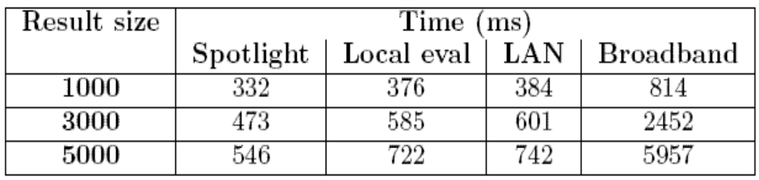
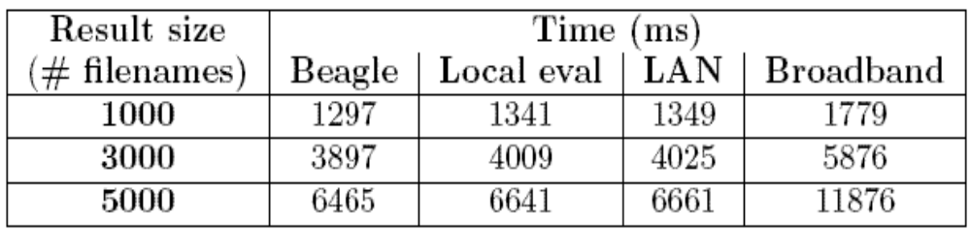
Performance of HomeViews queries with Spotlight vs. Beagle
Estimated query performance with Spotlight
HomeViews query performance with Beagle

