Slide 1
Keypad: Auditing Encrypted Filesystem for Theft-prone Devices
Roxana Geambasu
John P. John
Steve Gribble
Yoshi Kohno
Hank Levy
University of Washington

Slide 2
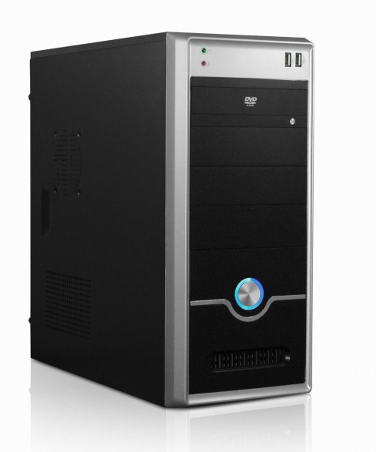
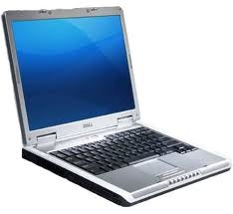

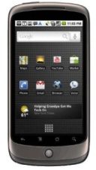
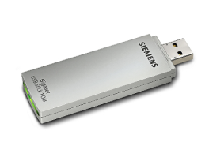
The Move to Small, Powerful, Mobile Devices
Small, powerful mobile devices are replacing desktops
Mobile devices bring important advantages:
  Location-based services, mobile web
  Constant connectivity, data access, email
Desktop
Small mobile devices

Slide 3
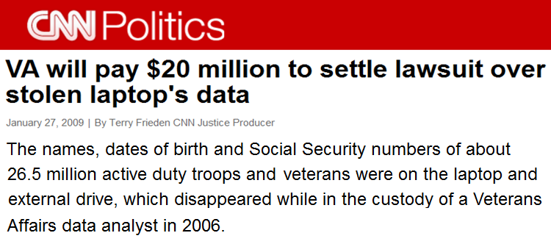
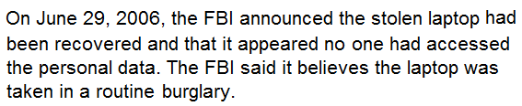
The Problem with Mobile Devices
Mobile devices are prone to theft and loss
  500K laptops per year are lost in US airports ^{[Ponemon Institute '09]}
Mobile device theft/loss exposes sensitive data
  SSNs, financial data, health data, trade secrets, state secrets, …

Slide 4
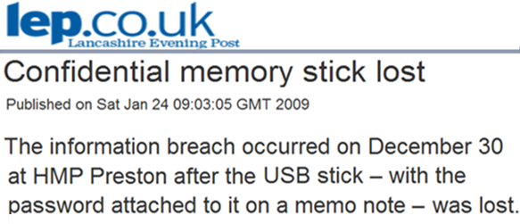
Is Encryption Sufficient?
Encrypting files on a mobile device increases security
  E.g.: BitLocker, PGP Whole Disk Encryption, TrueCrypt, …
But is encryption enough?

Slide 5
Problems with Encryption
Problem 1: Encryption can and does fail
  Security and usability are at odds
    “Johnny can’t encrypt” ^{[Whitten, Tygar '99]}
    Users set guessable passwords, reuse them [Gaw, Felten '05] , [Imperva '10]
    Users leave smartcards inside laptops ^{[Caveo '03]}
  Hardware attacks are possible
    Cold-boot attacks [Halderman , Schoen, Heninger, et.al. '08]
    TPM attacks ^{[Anderson, Kuhn '96]}
Problem 2: When encryption fails, it fails silently
  User cannot know whether or not the data was compromised

Slide 6
Our Goals
After a device is stolen or lost, we want to:
  know whether or not the data was compromised
  know exactly what data was compromised
  prohibit future compromises once the user detects theft
We want strong auditing guarantees:
  Even if thief turns off network (unlike Apple MobileMe, Intel AT)
  Even if thief tampers with the device
  Without impacting usability
T_{loss}
T_{notice}
time
audit compromises
prohibit future compromises

Slide 7
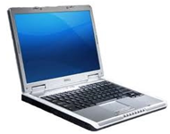




Keypad: An Auditing Encrypted File System
  Provides fine-grained remote access auditing and control
Core idea: Force remote access auditing with encryption
  Encrypt each file with its own random key
  Store the keys on a remote server, which logs all accesses
T_{loss}
T_{notice}
Keypad FS
audit server
user
access file F
File F
get file F’s key
file F’s key
audit log

Slide 8

Keypad: An Auditing Encrypted File System
  Provides fine-grained remote access auditing and control
Core idea: Force remote access auditing with encryption
  Encrypt each file with its own random key
  Store the keys on a remote server, which logs all accesses
T_{loss}
T_{notice}
Keypad FS
audit server
thief
access file F
File F
get file F’s key
file F’s key
audit log
Any compromise leaves a forensic trail on the server.

Slide 9

Keypad: An Auditing Encrypted File System
  Provides fine-grained remote access auditing and control
Core idea: Force remote access auditing with encryption
  Encrypt each file with its own random key
  Store the keys on a remote server, which logs all accesses
T_{loss}
T_{notice}
My laptop is gone!!
audit server
1. Disable keys for my laptop
2. What’s been accessed since 5pm?
audit log

Slide 10
Keypad: An Auditing Encrypted File System
  Provides fine-grained remote access auditing and control
Core idea: Force remote access auditing with encryption
  Encrypt each file with its own random key
  Store the keys on a remote server, which logs all accesses
4:00pm: picture1.jpg
auditor
4:05pm: picture2.jpg
audit server
4:10pm: calendar.cal
T_{loss}: 5pm
5:05pm: ccard.txt
5:10pm: tax2011.pdf
T_{notice}: 6pm
audit log
Compromised files.

Slide 11
Keypad’s Architecture
audit server
(trusted)
mobile device
application
key requests
(on read, write)
key table
audit log
file operations
(read, write, rename, ...)
ID_{F}
R_{F}
time: ID_{F}
ID_{F}
Keypad FS
R_{F}
ID_{F}
ID_{F}, filename
filename table
1
E (L_{F})
R_{F}
OK
ID_{F}
filename
E (F)
2
L_{F}
filename registrations
(on create, rename)
e.g., /home/ccard.txt
1
file F’s internal header (ID_{F} is a long, random number)
2
file F’s contents, encrypted with symmetric key L_{F}

Slide 12
Huge Practical Challenges
Challenge 1: Performance over mobile networks
  Mobile networks have huge RTTs (e.g., 300ms for 3G)
Challenge 2: Disconnected data access
  Disconnection is rare (WiFi, 3G, 4G), but it happens
Keypad’s design includes novel techniques to address challenges while preserving strong auditing semantics
  Short-term key caching
  Localized key prefetching
  Key preallocation
  Key derivation
  Limited scope/granularity
  IBE-based filename registrations
  Device pairing
  …

Slide 13
Challenge 1: Performance Over Mobile Networks
mobile device
audit server
application
1. key requests
(on read, write)
key table
audit log
file ops
ID_{F}
R_{F}
time: ID_{F}
Keypad FS
network (e.g., 3G)
ID_{F}
filename table
E (L_{F})
R_{F}
ID_{F}
filename
E (F)
2. filename registrations
(on create, rename)
L_{F}
Optimizing key requests:
  Standard techniques: key caching, prefetching, preallocation, …
  2 order of magnitude improvement (compilation now takes 8 min)
Optimizing filename registrations:
  After key optimizations, 56% of the time goes to registrations!
  Next: optimizing filename registrations with strong semantics

Slide 14
Name Registrations: Semantics/Performance Tradeoff
Strong semantics requires up-to-date filenames on the server for any compromised file ID
audit server
audit log
key table
T_{loss}
ID_{F}
R_{F}
time: ID_{F}
T_{notice}
filename table
ID_{F} was compromised!
old filename
???
ID_{F}
filename
e.g.: /tmp/IRS_form.pdf instead of
/home/my_taxes.pdf

Slide 15
Two Options for Filename Registrations
Blocking registrations
Non-blocking registrations
Device
Audit server
Device
Audit server
create/rename F
create/rename F
filename
filename
write F
?
(user)
300ms!
read F
write F
OK
write F
OK
read F
write F
T_{loss}
T_{loss}
read F
read F
(thief)
time
time
time
time
Good semantics
Poor performance
Poor semantics
Good performance

Slide 16
How to Have Your Cake and Eat It Too
Our Idea:
Do non-blocking registration
But if it fails, force the thief to reveal the filename in order to access the file!
The Challenge:
How do we force the thief to tell us the filename?
  Thief might lie to mislead user
  E.g., declare /tmp/download instead of /home/ccard.txt
Device
Audit server
create/rename F
filename
(user)
write F
read F
write F
OK
T_{loss}
filename
(thief)
read F
time
time
Good semantics
Good performance

Slide 17
One Solution: Identity-based Encryption (IBE)
We develop a protocol for both efficient and secure filename registrations that relies on IBE
IBE background ^{[Boneh, Franklin '01]}:
  A client can encrypt data using any string as the public key
  A designated server can produce a private key for any public key
  To decrypt, client must provide public key to get private key
Our protocol uses the filename as the public key

Slide 18
IBE-Based Filename Registrations (Intuition)
Wrap encrypted L_{F} with IBE using filename as the public key*
  Only the audit server can compute the private IBE key
Thief must provide the true filename to server to obtain L_{F}!
  Lying about the filename prevents file access
For performance, we cache L_{F} in memory for one second
  Normally, user workloads will not block waiting for private key
ID_{F}
file header
IBE_E (E (L_{F}))
E (L_{F})
filename
R_{F}
R_{F}
file contents
E (F)
L_{F}
* A nonce is also included in the IBE public key for security.

Slide 19
Summary of Filename Registration Protocol
Our protocol enables both efficient (non-blocking) filename registrations and strong semantics
Idea: Force the thief to reveal the true name of a file in order to access it
We use IBE in a unique way:
  It is typically used for confidentiality
  We use it for auditing

Slide 20
Keypad Implementation
We built the Keypad file system on Linux
  We augment EncFS with auditing and remote control
  The audit server runs on Google’s AppEngine
I used Keypad for several weeks with 3G emulated latencies
  Overall experience was positive – Keypad absorbs most latency
We measured Keypad with many workloads and metrics
  Microbenchmarks, Andrew benchmark, popular applications

Slide 21
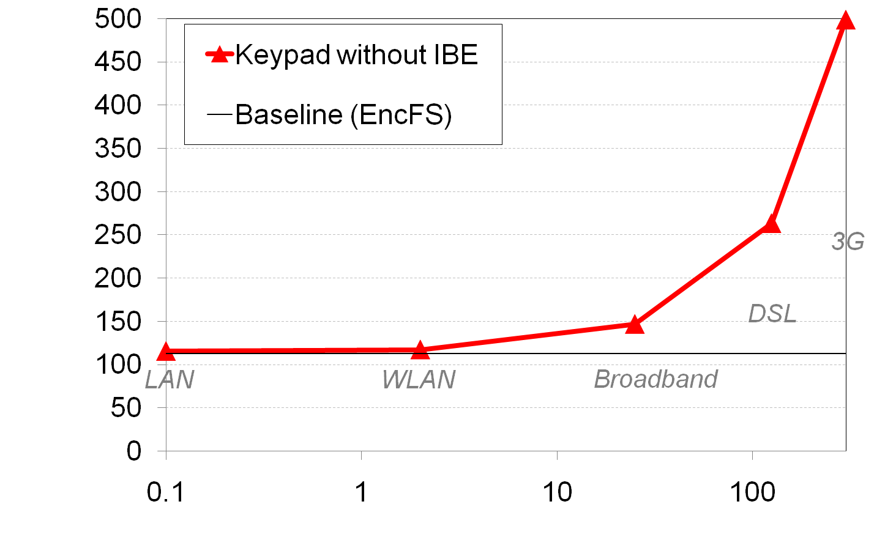
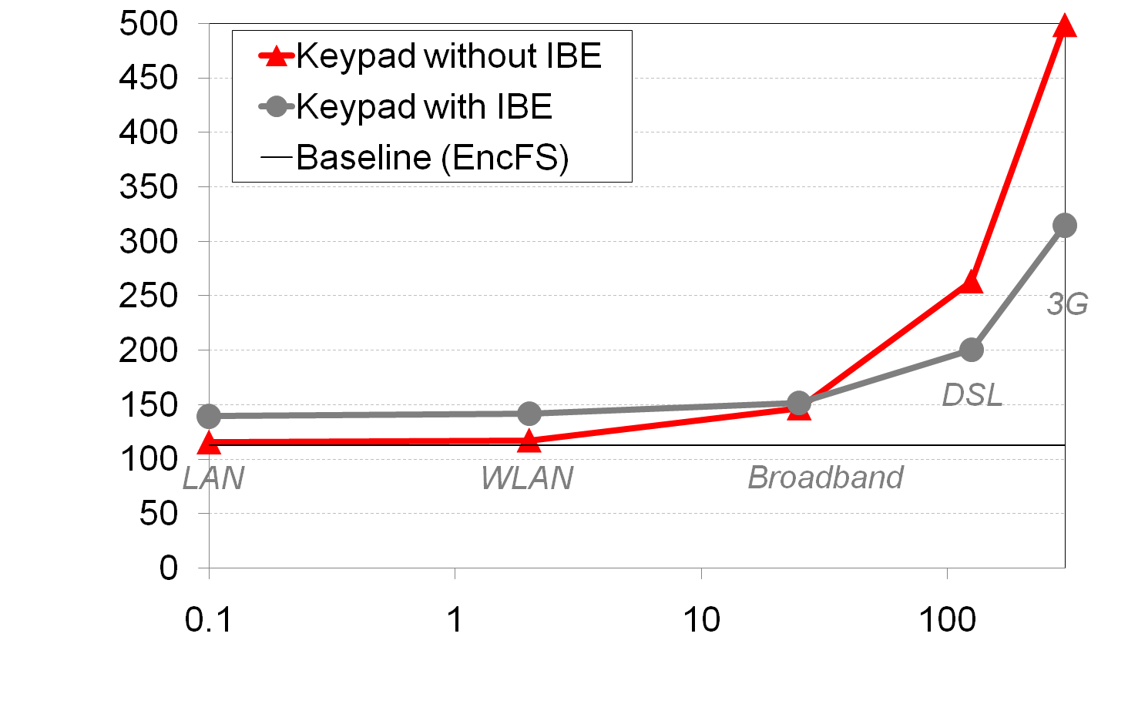
IBE’s Performance Impact
Enable IBE
Disable IBE
Apache Compilation Time (seconds)
Apache Compilation Time (seconds)
Keypad
300
300
Network RTT (ms) – logscale
Network RTT (ms) – logscale

Slide 22
So, Is Keypad Practical?
Application | Task | Time (seconds)
 |  | Baseline (EncFS) | Keypad
 |  |  | WiFi | 3G
OpenOffice Word Processor | Launch | 0.5 | 0.6 | 4.6
 | Save as | 1.4 | 1.4 | 2.0
 | Open | 1.7 | 1.8 | 2.1
Firefox | Launch | 3.7 | 3.8 | 8.8
 | Save a page | 0.7 | 0.7 | 1.3
 | Open tab | 0.2 | 0.2 | 0.2
Thunderbird | Launch | 1.3 | 1.3 | 3.1
 | Read email | 0.3 | 0.4 | 1.9
 | Quit | 0.2 | 0.2 | 0.2
Evince PDF Viewer | Launch | 0.1 | 0.1 | 0.1
 | Open document | 0.1 | 0.1 | 0.4
 | Quit | 0.0 | 0.0 | 0.0

Slide 23
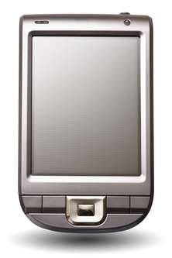
Challenge 2: Audited Disconnected Access
Keypad’s design relies on network connectivity for auditing!
Our observation: today’s users carry multiple devices
  E.g.: laptop, phone, iPad, Kindle
Paired-device Keypad extension uses one device to enable audited disconnected access on another device
audit server
keys,
filenames
hoard keys
File F
bluetooth
batch filenames and access logs
partial key & filename tables
partial access log

Slide 24
Paired-Device Implementation
We modified Keypad to support device pairing
  Simple Python daemon runs on an Android Nexus One phone
Bonus: device pairing can improve 3G/4G performance ☺
  Bluetooth is one order of magnitude faster than 3G
  We designed strong-semantics performance improvements
  44% improvement on 3G over the results we have seen before
hoard keys
audit server
keys, filenames
File F
3G
bluetooth
3G
batch filenames and access logs

Slide 25
Summary
Traditional encryption systems fail silently
Keypad enhances encrypted file systems with:
  Fine-grained file access auditing after theft
  Remote access control even in the absence of network
Our use of cryptography is unique
  Auditing instead of confidentiality

