Slide 1
Facilitating Communal Data Sharing in Public Clouds
Roxana Geambasu
Steve Gribble
Hank Levy
University of Washington

Slide 2
Outline
Vision: cloud as a platform for sharing code and data
Why now: favorable cloud technology trends
CloudViews: convenient, scalable, and efficient data sharing in public clouds

Slide 3
Outline
Vision: cloud as a platform for sharing code and data
Why now: favorable cloud technology trends
CloudViews: convenient, scalable, and efficient data sharing in public clouds

Slide 4

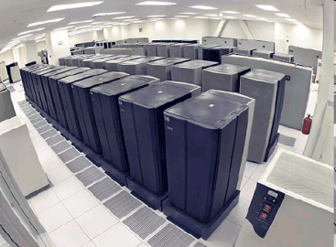
The Web’s Move to Public Clouds
Private datacenters
Public clouds
(AWS, AppEngine, Azure)
Web service
Web service
Web service
Web service
Web service
Web service
Web service
Web service
E.g.: SmugMug, Xignite,
Techout, JungleDisk

Slide 5
The Current Perspective
Top concerns have been to:
Facilitate transition of individual Web services
Isolate the Web services?
Private datacenters
Public cloud (e.g., AWS)
Web service
Web service
Web service
Web service
Web service
Web service
Web service
Web service

Slide 6


Isolation Leads To Stovepiping
Web services are siloed
  Each service implements the entire software stack
  Many functions are common
Building scalable services is hard even in the cloud
AWS
Flickr GUI
Picasa GUI
Tags
Comment
Tags
Comment
Search
Rating
Search
Rating
Social net.
...
Social net.
...

Slide 7


Our Perspective: Cloud as Sharing Platform
Tens of thousands of co-located Web services
  Most of the Web might be served from a few clouds
What if some services rented themselves to others?
AWS
Flickr GUI
Picasa GUI
Tags
Comment
Search
Rating
Social network

Slide 8
Our Vision
Efficient, scalable service composition should be a primary function in public clouds
Foresee a rich ecosystem of “utility services”
  Examples from today: S3, SQS, Map/Reduce; RightScale
Creating a large-scale service will be as easy as:
  pick utility services;
  write scripts to combine them; and
  add service-specific logic (e.g., GUI).
AWS

Slide 9
Supporting Composition in Public Clouds
Lots of challenges:
  Programming model
  Efficient and scalable inter-service communication
  Auditing computation (e.g., for billing)
  Diagnosing problems in service chains
  Service-level agreements
  ...
This talk addresses one vital type of composition: data-driven composition

Slide 10
Outline
Vision: cloud as a platform for sharing code and data
Why now: favorable cloud technology trends
CloudViews: convenient, scalable, and efficient data sharing in public clouds

Slide 11
Favorable Cloud Tech. Trends
Sharing was argued for in private-datacenter Web
  E.g., Web 2.0 mashups, service-oriented architecture
Two technology features make public clouds ideal for data sharing:
  A cheap, high-performance network
  A common database

Slide 12


1. The Free and Fast Network
Private datacenters
Public cloud (e.g., AWS)
WAN
Automatic photo tagging
Expensive, slow inter-service network
Free, high-speed parallel network
Opportunity: large-scale, low-delay data sharing for free

Slide 13


2. The Common Database
Private datacenters
Public cloud (e.g., AWS)
WAN
DB
DB
API
S3
Flickr
ALIPR
Each service must provide & manage APIs
Common DB can handle data sharing
Opportunity: convenient, effortless data sharing

Slide 14
Outline
Vision: cloud as a platform for sharing code and data
Why now: favorable cloud technology trends
CloudViews: convenient, scalable, and efficient data sharing in public clouds

Slide 15

Motivation
Today’s clouds not designed for this type of sharing
Inappropriate data sharing abstractions
  E.g., buckets in S3, column families in Bigtable
Limiting protection mechanisms
  E.g., ACL sizes in S3 are limited to 100
Resource allocation when sharing is involved
  Rely on data partitioning for performance isolation
What would the DB look like if designed for sharing?

Slide 16
CloudViews
Goal:
Leverage cloud trends to facilitate scalable, efficient, protected data sharing
Requirements:
Flexible and scalable sharing abstraction
  Must allow expressing of service APIs
Scalable protection mechanism
  10,000s services sharing data with each other
Fair resource allocation for queries on shared data

Slide 17
CloudViews Overview
Enhanced DB-style views for sharing
Capabilities for protection
Query admission control and QoS for resource allocation
Capability to “View of Public Photos”
View of Public Photos
View of Flickr's Data
View of ALIPR's Data
CloudViews
HBase

Slide 18
Conclusions
Today’s clouds focus on single services and isolation
Clouds should nurture large-scale data and code sharing
  Opens great opportunities for simplifying service creation
  Enables a rich ecosystem of “utility services” of the future
  Supported by technology trends
CloudViews: design cloud DB to take advantage of cloud technologies to support sharing
  Supports convenient, large-scale, efficient data sharing

Slide 19
Appendix

Slide 20
Related Work
Brantner, et.al., Building a Database on S3
  RDBMS atop S3 (transactions, paging, etc.)
  We’re borrow the “view” notion from RDBMS, but change it to support random APIs
Web 2.0 and service-oriented architecture
  Cloud environment is completely different
Relevant S3 features
  Query-string authentication
    No rights associated to the query string
  Requestor-pays buckets
    Only public sharing; buckets are physical containers

Slide 21
Open Questions
Data sharing challenges (CloudViews):
  Co-location of sharing services within the same cloud DC
  Query language (likely very limited subset of SQL)
  Scalability for protection, QE, resource allocation
  Performance isolation (service SLAs?)
  Scalable notifications mechanism (many services would love this)
Huge number of challenges for the general vision
  Listed on slide 9 and more…

Slide 22
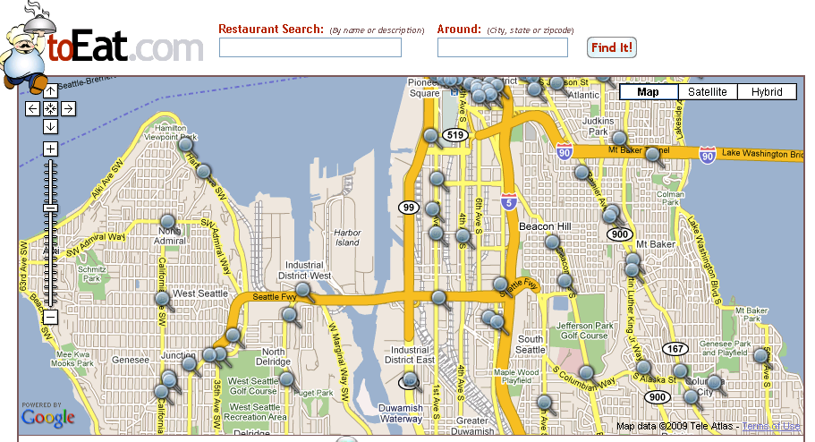


Background: Web Service Composition
Web service composition and mashups have existed for a long time (Web 2.0, SOA)
Client-side mashups:
  E.g., mapping mashups
Server-side mashups:
  E.g., Facebook apps,
  comparative shopping

