Slide 1
On-Demand
View Materialization and Indexing for Network Forensic Analysis
Roxana Geambasu¹, Tanya Bragin¹
Jaeyeon Jung², Magdalena Balazinska¹
¹ University of Washington ² Mazu Networks

Slide 2

Network Intrusion Detection System (NIDS)
Security
Alerts
(hostscan from IP X)
Network
flow records
NIDS
Router
flows
Flow
records
Enterprise Network
Forensic Queries
(find all flows to and from IP X over the past 6 hrs)
Historical
Flow
Database

Slide 3
Historical Flow Database
Requirements:
  High insert throughput (to keep up with incoming flows)
  Fast querying over historical flows (order of seconds)
NIDS vendors believe relational databases are
too general, not tuned for workload
Today NIDSs use custom flow database solutions
  Expensive to build, inflexible

Slide 4
Relational Databases (RDBMS)
Advantages
  Flexible and standard query language (SQL)
  Powerful query optimizer
  Support for indexes
Challenge
  Fast querying requires indexes
  Indexes are known to affect insert throughput

Slide 5
Goals
Determine when an “out-of-the-box” RDBMS can be used with an NIDS
Develop techniques to extend RDBMS’ ability to support both:
  High data insert rate
  Efficient forensic queries

Slide 6
Outline
Motivation and goals
Off-the-shelf RDBMS insert performance
On-demand view materialization and indexing (OVMI)
Related work and conclusions

Slide 7
Storing NIDS Flows in an RDBMS
Question: What flow rates can an off-the-shelf RDBMS support?
Experimental setup
  PostgreSQL database (off-the-shelf)
  Two real traces from Mazu Networks (NIDS vendor):
    “Normal Trace”: Oct-Nov 2006
      Stats: average flow rate: 10 flows/s, max flow rate: 4,011 flows/s
    “Code-Red Trace”: Apr 2003
      Activity from two Code Red hosts out of 389 hosts
      Stats: average flow rate: 27 flows/s, max flow rate: 571 flows/s

Slide 8
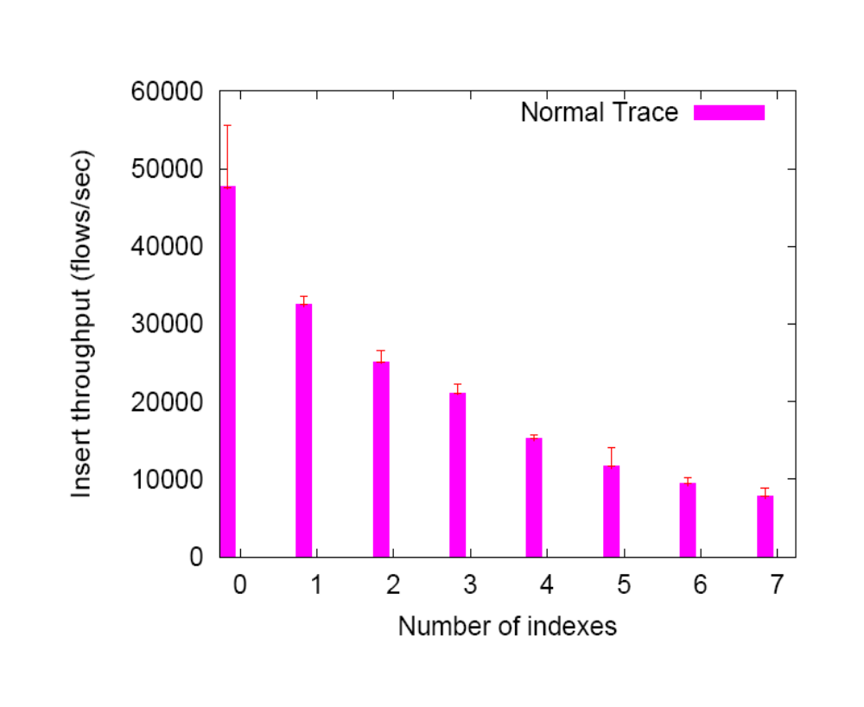
Database Bulk Insert Throughput

Slide 9
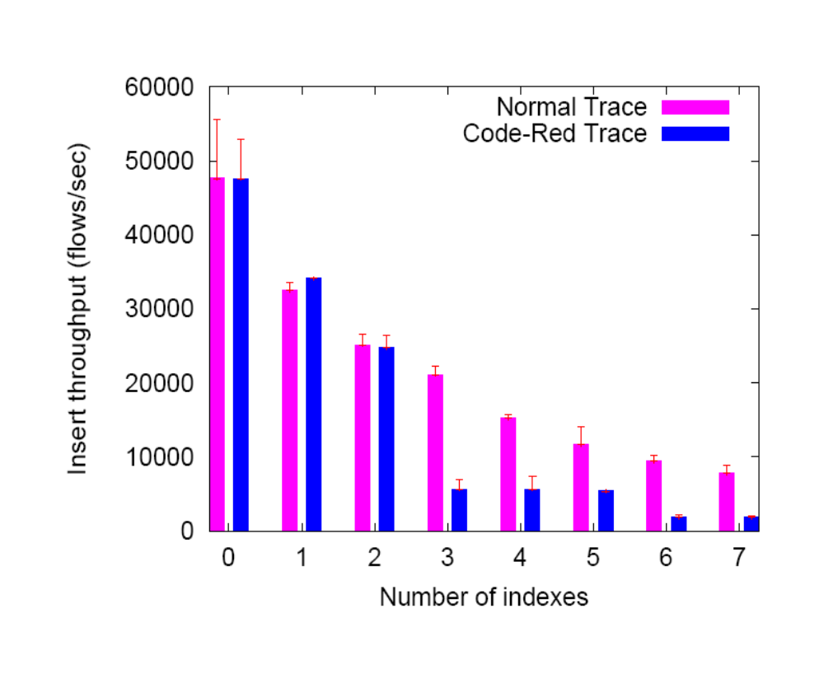
Database Bulk Insert Throughput
srv_ip

Slide 10
Forensic Queries
Without the right index, queries are slow
  Query: “Count all flows to or from an IP X over the last 1 day” (assuming 3,000 flows/s)
  Without the right indexes, takes about an hour
  With indexes on cli_ip and srv_ip, takes under a second
Wide variety of flow attributes
  Mazu flows have 20 attributes
  E.g.: time, client/server IP, client/server port, client-to-server packet counts, server-to-client packet count, etc.

Slide 11
Characteristics of Forensic Queries
Alert attributes partly determine relevant historical data
Queries typically look at small parts of the data
No need to index all data, all the time
Delay between alert time and time of first forensic query
Use delay to prepare relevant data

Slide 12
Outline
Motivation and goals
Off-the-shelf RDBMS insert performance
On-demand view materialization and indexing (OVMI)
Related work and conclusions

Slide 13


On-Demand View Materialization and Indexing (OVMI)
Administrator’s mailbox
Alert
(hostscan from IP X)
Router
NIDS
Alert
(hostscan from X)
Flow
records
Forensic
Queries
OVMI Engine
Prepare relevant data for upcoming queries
1. Materialize only relevant data
2. Index this data heavily
Historical
Flow
Database

Slide 14
Preparing Relevant Data
When Alert comes:
Materialize only data relevant to the Alert
    SELECT * INTO matview_Scan1 FROM Flows
    WHERE start_ts >= `now-T’ AND
    start_ts <= `now’ AND
    (cli_ip = X or srv_ip = X)
Index this materialized view
    CREATE INDEX iScan1_app
    ON matview_Scan1(app)

Slide 15
Evaluation of OVMI
Question: Can we prepare fast enough?
Experimental setup:
  Assume 3,000 flows/second
  Maintain full index on time
  Materialize 5% of a time window T

Slide 16
OVMI Evaluation Results
Materialize 5%
Create 3 indexes
Total time to prepare relevant data

Slide 17
OVMI Evaluation Results
 | 1 hour
Materialize 5% | 24 s
Create 3 indexes | 6 s
Total time to prepare relevant data | 30 s

Slide 18
OVMI Evaluation Results
 | 1 hour | 6 hours
Materialize 5% | 24 s | 6.5 min
Create 3 indexes | 6 s | 1.3 min
Total time to prepare relevant data | 30 s | 7.8 min

Slide 19
OVMI Evaluation Results
 | 1 hour | 6 hours | 1 day | 2 days
Materialize 5% | 24 s | 6.5 min | 58.4 min | 5.3 h
Create 3 indexes | 6 s | 1.3 min | 10.8 min | 13 min
Total time to prepare relevant data | 30 s | 7.8 min | 1.15 h | 5.5 h

Slide 20
OVMI Evaluation
OVMI prepares relevant 5% data of 1 hour in 30 s and 5% of 6 hours in 8 minutes
In general, preparation time depends on:
  window size
  average flow rate (so network size)
Therefore, we believe that OVMI is practical

Slide 21
Outline
Motivation and goals
Off-the-shelf RDBMS insert performance
On-demand view materialization and indexing (OVMI)
Related work and conclusions

Slide 22
Related Work
Intrusion detection systems (e.g., Netscout)
  Usually employ custom log-based storage solutions
Stream processing engines (e.g., Borealis, Gigascope)
  Do not support historical queries
Materialized views and caching query results
  We apply these techniques on-demand to enhance RDBMS’ support for NIDS
Warehousing solutions for historical queries

Slide 23
Conclusions
Relational databases can handle high input rates while maintaining a small number of indexes
Simple techniques can improve out-of-the-box RDBMS support for high insert rate and fast queries
OVMI avoids maintaining many full indexes
  Proactively prepare only relevant data of an alert for forensic queries
  Can prepare relatively large time windows for querying in minutes

Slide 24
Questions?

Slide 25
Appendix

Slide 26
Future Work
Inspect other commercial DB
  Oracle, DB2
OVMI is a first step in using RDBMSs in network monitoring applications
Explore other approaches
  Data partitioning
Archiving

Slide 27
Preparing 5% vs. 10% of a time window
 | 1 hour | 6 hours | 2 days
Prepare 5% | 30 s | 7.8 min | 5.5 h
Prepare 10% | 76.9 s | 12.5 min | 6.1 h

Slide 28
Query Partitioning
What if the admin queries data from outside the materialized view?
Split the query, e.g.: (view_mat_Alert1 is on the last 6 hours)
  The query:
    Q: SELECT * FROM Flows
  WHERE start_ts >= `now - 7’ AND srv_ip = X
  Is split into:
    Q1: SELECT * FROM view_mat_Alert1
  WHERE srv_ip = X
    Q2: SELECT * FROM Flows
  WHERE start_ts >= ‘now - 7’ AND
  start_ts <= ‘now - 6’ AND
  srv_ip = X

Slide 29
Performance of partitioned queries
Hours inside + Hours outside | Time
 | Results from Mat. View + Results from Flows | Unsplit query
5h + 1 h | 0.02 s + 21 s | 6.3 min
1 h + 5 h | 0.02 s + 4.8 min | 6.3 min

Slide 30
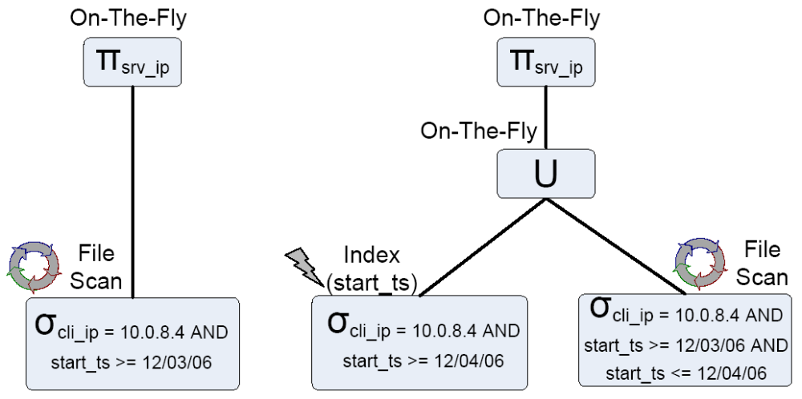
Query Partitioning
CREATE INDEX ON Flows(start_ts)
WHERE “start_ts” >= 12/04/06

Slide 31
Database Bulk Insert Throughput
1 – time
2 – cli_ip
3 – srv_ip
4 – protocol
5 – srv_port
6 – cli_port
7 -- application
srv_ip

