Slide 1
Comet: An Active
Distributed Key-Value Store
Roxana Geambasu
Amit Levy
Yoshi Kohno
Arvind Krishnamurthy
Hank Levy
University of Washington

Slide 2
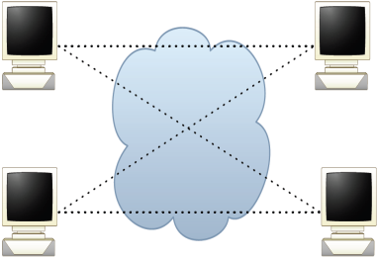
Distributed Key/Value Stores
A simple put/get interface
Great properties: scalability, availability, reliability
Increasingly popular both within data centers and in P2P
Data center
P2P
amazon.com
Vuze
LinkedIn
uTorrent
Facebook
Dynamo
Vuze DHT
Voldemort
uTorrent DHT
Cassandra

Slide 3

Distributed Key/Value Storage Services
Increasingly, key/value stores are shared by many apps
  Avoids per-app storage system deployment
However, building apps atop today’s stores is challenging
Data center
P2P
Photo Bucket
Altexa
Jungle Disk
Vuze App
One- Swarm
Vanish
Amazon S3
Vuze DHT

Slide 4
Challenge: Inflexible Key/Value Stores
Applications have different (even conflicting) needs:
  Availability, security, performance, functionality
But today’s key/value stores are one-size-fits-all
Motivating example: our Vanish experience
App 1
App 2
App 3
Key/value
store

Slide 5


Motivating Example: Vanish ^{[USENIX Security ‘09]}
Vanish is a self-destructing data system built on Vuze
Vuze problems for Vanish:
  Fixed 8-hour data timeout
  Overly aggressive replication, which hurts security
Changes were simple, but deploying them was difficult:
  Need Vuze engineer
  Long deployment cycle
  Hard to evaluate before deployment
Question:
How can a key/value store support many applications with different needs?
Vuze App
Vuze App
Vuze
Vuze
Vuze
Vuze
Vuze App
Vanish
Vanish
Vanish
Vanish
Vanish
Vanish
Vanish
Future app
Future app
Vuze DHT
Vuze DHT
Vuze DHT
Vuze DHT
Vuze DHT
Vuze DHT
Vuze DHT

Slide 6
Extensible Key/Value Stores
Allow apps to customize store’s functions
  Different data lifetimes
  Different numbers of replicas
  Different replication intervals
Allow apps to define new functions
  Tracking popularity: data item counts the number of reads
  Access logging: data item logs readers’ IPs
  Adapting to context: data item returns different values to different requestors

Slide 7
Design Philosophy
We want an extensible key/value store
But we want to keep it simple!
  Allow apps to inject tiny code fragments (10s of lines of code)
  Adding even a tiny amount of programmability into key/value stores can be extremely powerful
This paper shows how to build extensible P2P DHTs
  We leverage our DHT experience to drive our design

Slide 8
Outline
Motivation
Architecture
Applications
Conclusions

Slide 9

Comet
DHT that supports application-specific customizations
Applications store active objects instead of passive values
  Active objects contain small code snippets that control their behavior in the DHT
App 1
App 2
App 3
Comet
Active object
Comet node

Slide 10
Comet’s Goals
Flexibility
  Support a wide variety of small, lightweight customizations
Isolation and safety
  Limited knowledge, resource consumption, communication
Lightweight
  Low overhead for hosting nodes

Slide 11
Active Storage Objects (ASOs)
The ASO consists of data and code
  The data is the value
  The code is a set of handlers that are called on put/get
App 1
App 2
App 3
ASO
data
function onGet()
[…]
end
Comet
code

Slide 12
Simple ASO Example
Each replica keeps track of number of gets on an object
The effect is powerful:
  Difficult to track object popularity in today’s DHTs
  Trivial to do so in Comet without DHT modifications
aso.value = “Hello world!”
aso.getCount = 0
function onGet()
self.getCount = self.getCount + 1
return {self.value, self.getCount}
end
ASO
data
code

Slide 13

Comet Architecture
DHT Node
ASO₁
data
code
Comet
ASO Extension API
Active Runtime
External
Interaction
Sandbox Policies
Handler Invocation
Local Store
K₁
ASO₁
Traditional
DHT
K₂
ASO₂
Routing Substrate

Slide 14
The ASO Extension API
Applications | Customizations
Vanish | Replication
 | Timeout
 | One-time values
Adeona | Password access
 | Access logging
P2P File Sharing | Smart tracker
 | Recursive gets
P2P Twitter | Publish / subscribe
 | Hierarchical pub/sub
Measurement | Node lifetimes
 | Replica monitoring

Slide 15
The ASO Extension API
Intercept accesses | Periodic Tasks | Host Interaction | DHT Interaction
onPut(caller) | onTimer() | getSystemTime() | get(key, nodes)
onGet(caller) |  | getNodeIP() | put(key, data, nodes)
onUpdate(caller) |  | getNodeID() | lookup(key)
 |  | getASOKey()
 |  | deleteSelf()
Small yet powerful API for a wide variety of applications
  We built over a dozen application customizations
We have explicitly chosen not to support:
  Sending arbitrary messages on the Internet
  Doing I/O operations
  Customizing routing …

Slide 16
The ASO Sandbox
Limit ASO’s knowledge and access
  Use a standard language-based sandbox
  Make the sandbox as small as possible (<5,000 LOC)
    Start with tiny Lua language and remove unneeded functions
Limit ASO’s resource consumption
  Limit per-handler bytecode instructions and memory
  Rate-limit incoming and outgoing ASO requests
Restrict ASO’s DHT interaction
  Prevent traffic amplification and DDoS attacks
  ASOs can talk only to their neighbors, no recursive requests

Slide 17
Comet Prototype
We built Comet on top of Vuze and Lua
  We deployed experimental nodes on PlanetLab
In the future, we hope to deploy at a large scale
  Vuze engineer is particularly interested in Comet for debugging and experimentation purposes

Slide 18
Outline
Motivation
Architecture
Applications
Conclusions

Slide 19
Comet Applications
Applications | Customization | Lines of Code
Vanish | Security-enhanced replication | 41
 | Flexible timeout | 15
 | One-time values | 15
Adeona | Password-based access | 11
 | Access logging | 22
P2P File Sharing | Smart Bittorrent tracker | 43
 | Recursive gets* | 9
 | Publish/subscribe | 14
P2P Twitter
 | Hierarchical pub/sub* | 20
Measurement | DHT-internal node lifetimes | 41
 | Replica monitoring | 21
* Require signed ASOs (see paper)

Slide 20
Three Examples
Application-specific DHT customization
Context-aware storage object
Self-monitoring DHT

Slide 21
1. Application-Specific DHT Customization
Example: customize the replication scheme
We have implemented the Vanish-specific replication
  Code is 41 lines in Lua
function aso:selectReplicas(neighbors)
[...]
end
function aso:onTimer()
neighbors = comet.lookup()
replicas = self.selectReplicas(neighbors)
comet.put(self, replicas)
end

Slide 22
2. Context-Aware Storage Object
Traditional distributed trackers return a randomized subset of the nodes
Comet: a proximity-based distributed tracker
  Peers put their IPs and Vivaldi coordinates at torrentID
  On get, the ASO computes and returns the set of closest peers to the requestor
ASO has 37 lines of Lua code

Slide 23
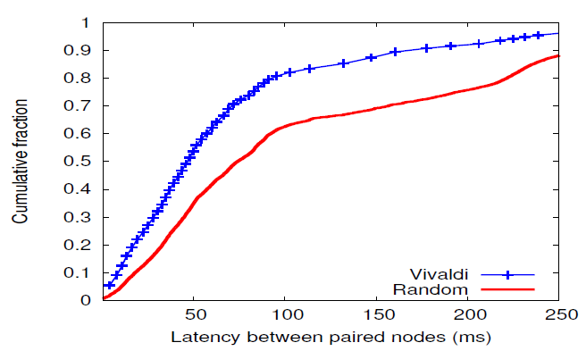
Proximity-Based Distributed Tracker
Comet tracker
Random tracker

Slide 24
3. Self-Monitoring DHT
Example: monitor a remote node’s neighbors
  Put a monitoring ASO that “pings” its neighbors periodically
Useful for internal measurements of DHTs
  Provides additional visibility over external measurement (e.g., NAT/firewall traversal)
  aso.neighbors = {}
  function aso:onTimer()
  neighbors = comet.lookup()
  self.neighbors[comet.systemTime()] = neighbors
  end

Slide 25
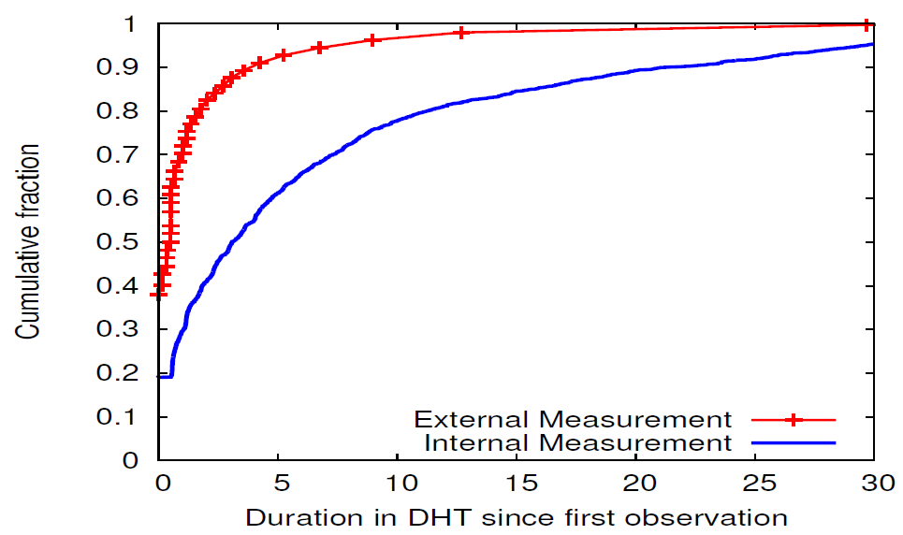
Example Measurement: Vuze Node Lifetimes
External measurement
Comet Internal measurement
Vuze Node Lifetime (hours)

Slide 26
Outline
Motivation
Architecture
Evaluation
Conclusions

Slide 27
Conclusions
Extensibility allows a shared storage system to support applications with different needs
Comet is an extensible DHT that allows per-application customizations
  Limited interfaces, language sandboxing, and resource and communication limits
  Opens DHTs to a new set of stronger applications
Extensibility is likely useful in data centers (e.g., S3):
  Assured delete
  Logging and forensics
  Storage location awareness
  Popularity

