Slide 1

Organizing and Sharing Distributed Web Objects with
Menagerie
Roxana Geambasu, Cherie Cheung, Alex Moshchuk,
Steve Gribble, Hank Levy
University of Washington

Slide 2


The transition onto the Web
Desktop
Web Services
Desktop applications Office productivity Email, news clients File sharing (Kazaa) | Software-as-a-service apps ThinkFree, Google Docs Web-based email, news Social networking sites
PC-based storage Ext3, NFS | Internet-based storage Amazon S3, iBackup

Slide 3


Desktop advantages
The user’s data is tightly integrated within a single FS
App
App
Users can:
Organize their files into folders
Process files using applications
Protectively share files with other users of the system
/
Trips
Work
France
Italy
File system
The FS provides functions to support these tasks
photos
spreadsheets
videos
… …

Slide 4





The Web lacks these advantages
Desktop
Web
Data is integrated
Data is scattered
/
Trips
Work
France
Italy
File system

Slide 5
Challenge 1: Organizing personal data
Desktop
Web
How to organize?
/
Trips
Work
Italy
Italy
France
Italy
Lots of tools for organization:
File managers, PIM systems

Slide 6
Challenge 2: Processing data
Desktop
Web
tar
grep
Archival service
Indexing service
Access via FS
How to access?
/
Trips
Work
Italy
France
Italy

Slide 7
Challenge 3: Sharing data protectively
Desktop
Web
Third-party service
Share & protect via FS
Protect
How to share?
/
Trips
Work
Italy
France
Italy

Slide 8
Overview
Three challenges:
  Organizing web objects into heterogeneous folders
  Processing heterogeneous folders
  Protected sharing of heterogeneous folders
Example application
Menagerie
Evaluation
Related work
Conclusions

Slide 9
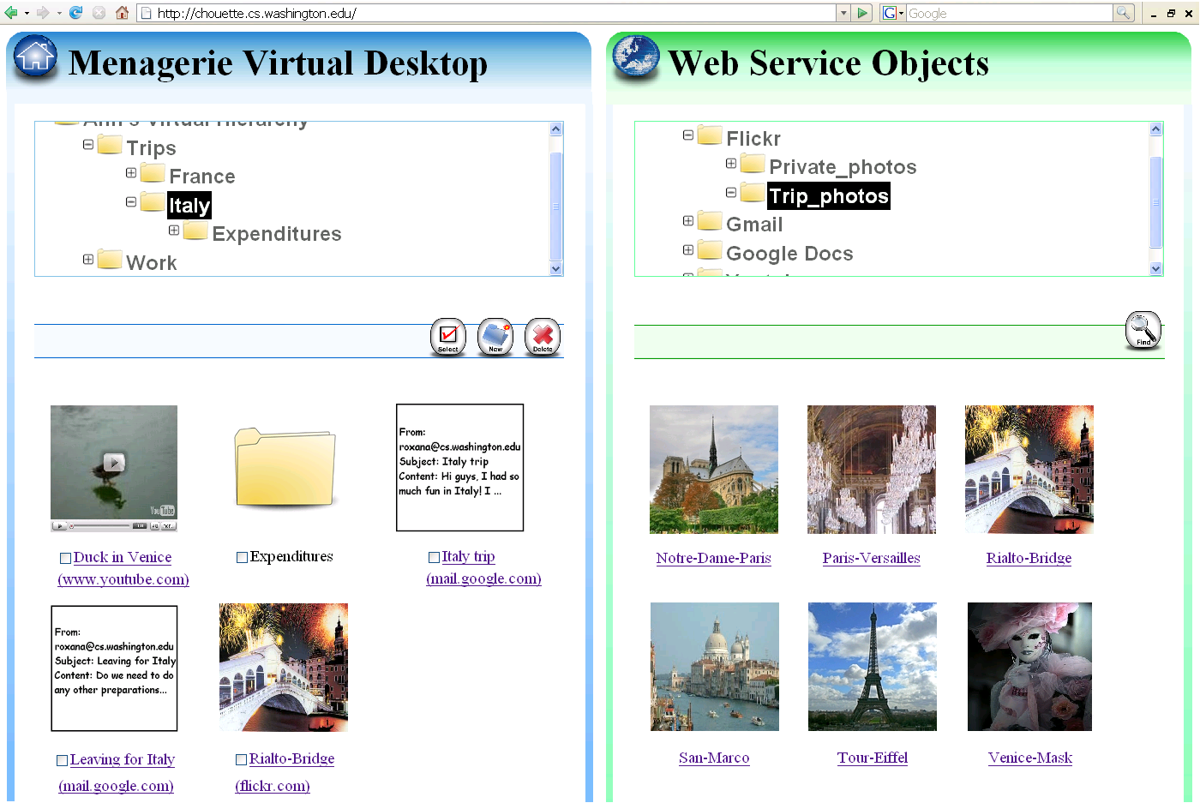



The Menagerie Web Object Manager
/
Trips
Work
France
Italy

Slide 10
The Menagerie Web Object Manager

Slide 11
The Menagerie Web Object Manager

Slide 12
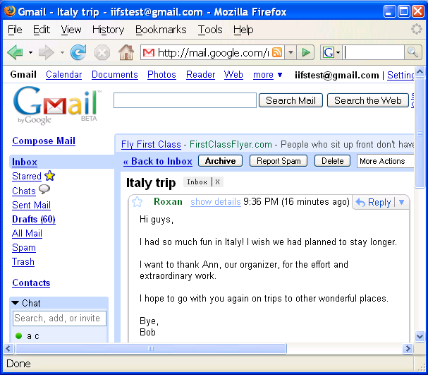
The Menagerie Web Object Manager

Slide 13
The Menagerie Web Object Manager – Sharing
Share
Sharing is deep

Slide 14
Overview
Three challenges:
  Organizing web objects into heterogeneous folders
  Processing heterogeneous folders
  Protected sharing of heterogeneous folders
Example application
Menagerie
Evaluation
Related work
Conclusions

Slide 15
Menagerie
Framework for building applications for personal Web-data management and sharing
Provides a set of unified infrastructure functions
  On the desktop, the FS provided these functions
Menagerie functions:
Common object naming
Common access to object content
Common fine-grained protection
These functions are motivated by the challenges identified in motivation

Slide 16


Menagerie architecture
The Menagerie Service Interface (MSI)
  Similar to OpenSocial, but for personal data organization
The Menagerie File System (MFS)
Application service
e.g., the Menagerie Web object manager
FS calls
MFS
MSI
MSI
MSI
MSI
MSI
MSI
Other service

Slide 17
The Menagerie prototype
Application service
MFS
Proxy
MSI
MSI
MSI
MSI
Proxy
Proxy
MSI
MSI
MSI
MSI
Proxy
MSI
MSI
Proxy

Slide 18
The Menagerie Service Interface (MSI)
Common service API
Contains operations for:
Common object naming
Common access to object content
Common fine-grained protection

Slide 19
1. Common object naming
Supports creation of heterogeneous folders
Italy

Slide 20

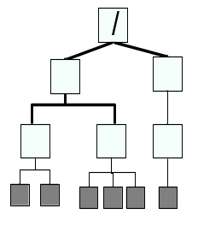
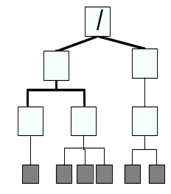
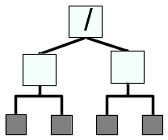
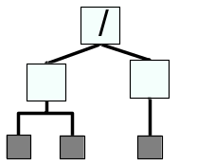
1. Common object naming
Supports creation of heterogeneous folders
Each service exports a hierarchical namespace of each user’s objects
MSI has operations for navigating and altering the namespace: ls(), mkdir()
Ann’s data
Charlie’s data
Ann’s data
Bob’s data
Labels
Albums
Threads
Photos
E-mails

Slide 21
2. Common access to object content
Supports processing of objects and collections
Archival service
Indexing service
How to access?
Italy

Slide 22
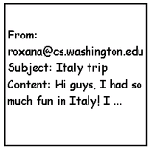


2. Common access to object content
Supports processing of objects and collections
Opaque object content operations
read(), write()
Embedded rendering
  Each service provides a summary HTML tag for each object
Email (HTML snippet)
Youtube (<object> tag)
Flickr (<img> thumbnail)

Slide 23
3. Common fine-grained protection
Supports protected sharing of heterogeneous folders
Third-party service
How to share?
Italy

Slide 24
3. Common fine-grained protection
Supports protected sharing of heterogeneous folders
To facilitate fine-grained sharing we use capabilities
A Menagerie capability is an unforgeable token
  Bundles together a globally unique object name & a set of access rights
  Provides the holder with authority to execute the specified actions on the named object
Sharing using capabilities is just like emailing URLs

Slide 25
3. Common fine-grained protection
Menagerie capabilities give services a choice:
  Allow direct access to web objects based on capabilities
  Require authentication in addition to the capability to provide access
Authentication allows services to track and control access to their objects
MSI protection functions:
create_capa(), revoke_capa()

Slide 26
Overview
Three challenges:
  Organizing web objects into heterogeneous folders
  Processing heterogeneous folders
  Protected sharing of heterogeneous folders
Example application
Menagerie
Evaluation
Related work
Conclusions

Slide 27
Easy to build apps atop Menagerie
Application | Description | LOC
Menagerie Web Object Manager | Service for organizing and sharing web objects of any type | 275 (php)
Web object Group Sharing | Service for sharing web objects of any type with a group (uses Gallery) | 167 (php)
Web-data backup | Back up heterogeneous collections of web objects (uses tar) | 10 (bash)
Contact synchronizer | Uses unison to synchronize contacts | 20 (bash)

Slide 28
Overview
Three challenges:
  Organizing web objects into heterogeneous folders
  Processing heterogeneous folders
  Protected sharing of heterogeneous folders
Example application
Menagerie
Evaluation
Related work
Conclusions

Slide 29
Related work
Common web service interfaces
  OpenSocial to support social networking apps [Google07]
→Menagerie is more general and it is designed for personal data object management and sharing apps
Web-data aggregation and clipping applications
  iGoogle, SecondBrain, Yahoo! Pipes, Backpack
  →Menagerie can serve as infrastructure for such applications
  →Most do not support fine-grained sharing
World Wide Web Without Walls (W5) [HotNets07]
  →Menagerie has similar vision, but adds concrete API and implementation
Using OS abstractions to address Web problems
  WebDAV[EuropeanConf99], Web file systems [TOCS98]

Slide 30
Conclusions
The shift from the desktop to the Web raises problems:
  data organization
  data processing
  protected sharing
A small set of common operations enable powerful, generic applications on Web objects and folders
  naming
  content access
  protection
Menagerie brings these functions onto the Web

Slide 31
Appendix

Slide 32
Menagerie vs. OpenSocial: Similarities
Facilitate applications by having services adhere to common API
  Adherence to OpenSocial gives us hope that Menagerie will be adopted
Similar concepts: uniform naming, uniform protection

Slide 33
Menagerie vs. OpenSocial: Differences
Deal with different kinds of data:
  Menagerie works with many types of personal data objects: photos, videos, word documents, spreadsheets, etc.
  OpenSocial designed for social networking data: friends, their activities
Designed for different types of applications:
  Menagerie: web-object management and fine-grained sharing
  OpenSocial: social networking apps and more coarse-grained sharing
Different protection mechanisms:
  OpenSocial: ACL-based sharing among friends
  Menagerie: Capability-based protection that facilitates fine-grained sharing

