Slide 1
RentAll web app for leaseS management
June 2021, Raluca Roxana Rosu

Slide 2
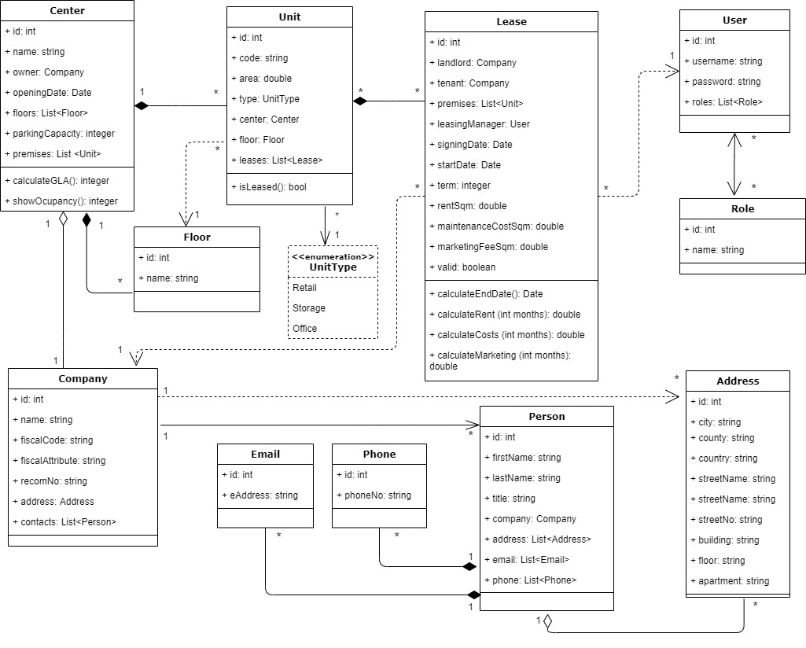
RENTALL
Uml class
diagram

Slide 3
RENTALL
Technology stack
BACK-END | FRONT-END
.NET 5 ASP.NET C# SQL Server Entity Framework | Angular HTML CSS Typescript

Slide 4
RENTALL
FUNCTIONALITY
LEASING DEPARTMENT | CENTER MANAGER
creates/edits/views lease agreements; gets fast info related to empty premises, average rent, gross leasable area; keeps track of the expiring leases. | views lease agreements; gets an overview of the leasing department’s activity; gets incomes and occupancy degree reports related to the shopping center.

Slide 5
DISCLAIMER
This document has been prepared by Amdaris for the sole use of the recipient. The information contained in this documentation is proprietary and confidential to Amdaris and should be kept confidential and not disclosed by the recipient to any other person unless such person has a need to know such information in order to evaluate the contents of this document.
Amdaris has prepared this document in good faith based on the information made available by the recipient to Amdaris. Amdaris reserves the right to make amendments and to correct any errors that are identified. This document is provided to the recipient subject to contract. Nothing in this document or in any related correspondence, discussions or other materials shall be construed as the basis of any contract or a representation which may be relied upon by the recipient unless agreed by Amdaris in the context of a legally binding agreement. No warranty, assurance or undertaking (express or implied) is or will be made, and no responsibility or liability is or will be accepted by Amdaris or any persons employed or engaged by Amdaris in relation to the adequacy, accuracy, completeness or reasonableness of the contents of this document, or of any other information (whether written or oral), notice or document supplied or otherwise made available to the receipt and, to the maximum extent permitted by applicable law, all and any such responsibility and liability is expressly disclaimed.
The following notice applies to this document and should be reproduced by the recipient on any copies which have been made in accordance with this notice.

