Slide 1
Chapter 1
An Introduction to
ASP.NET Programming

Slide 2
Objectives

Slide 3
Objectives (continued)
8. List the software components that you need on your own PC if you want to develop and run ASP.NET web applications in a standalone environment, including database applications.
9. Describe the class libraries and Common Language Runtime of the .NET Framework.
10. Distinguish between the aspx files and the code-behind files in an ASP.NET web application.

Slide 4
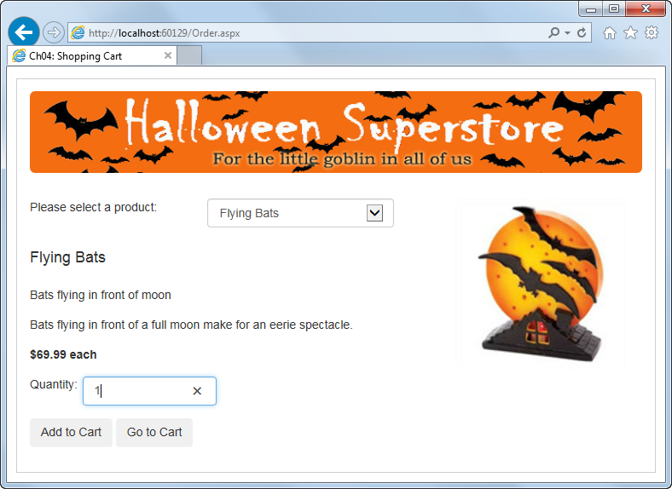
The Order page of a Shopping Cart application

Slide 5
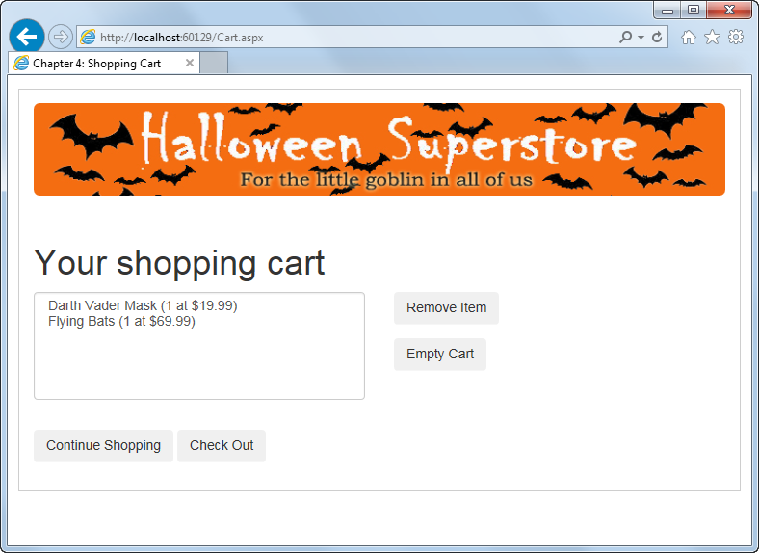
The Cart page of a Shopping Cart application

Slide 6
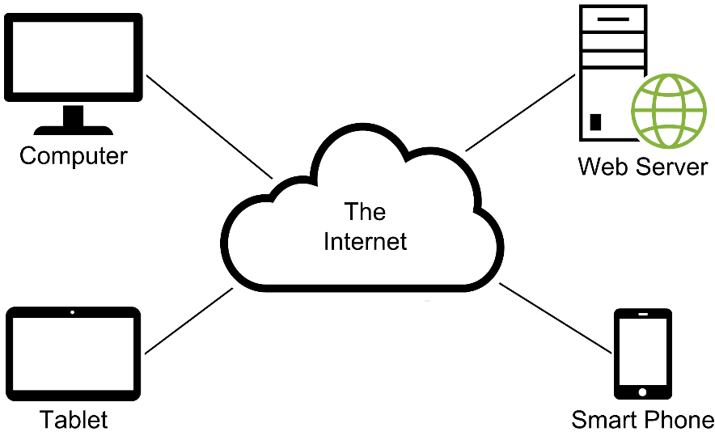
The components of a web application

Slide 7
The components of an HTTP URL

Slide 8
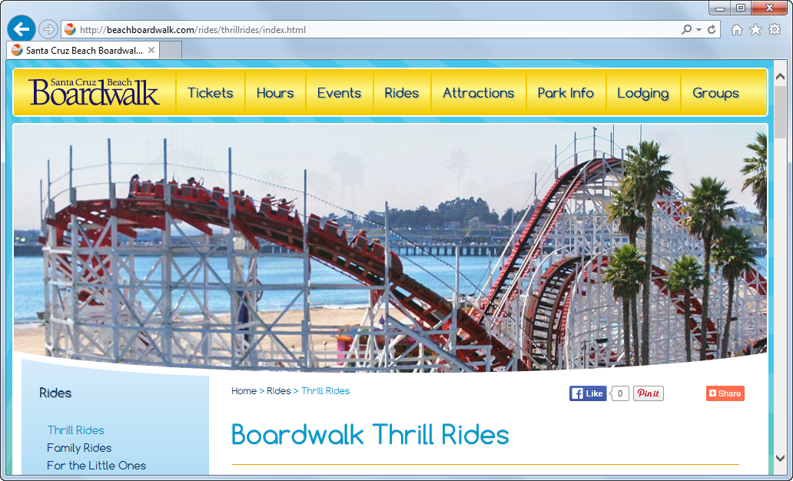
A static web page

Slide 9
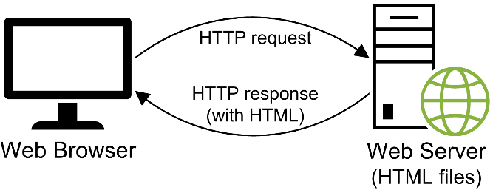
How a web server processes a static web page

Slide 10
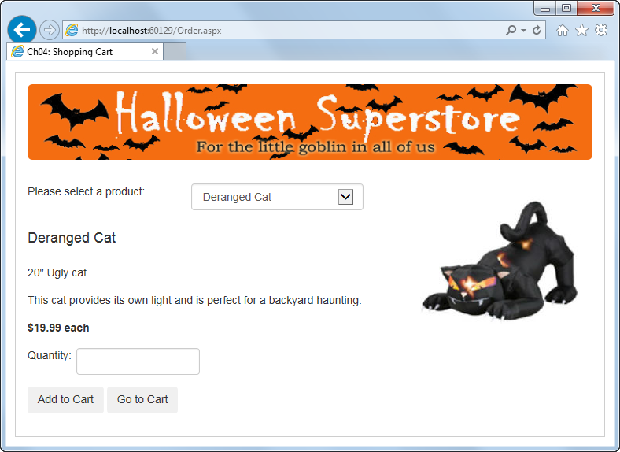
A dynamic web page

Slide 11
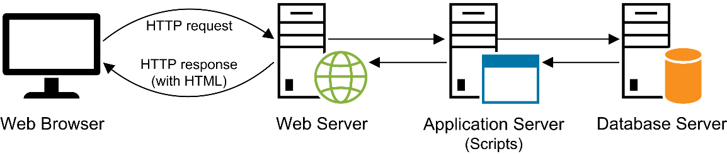
How a web server processes a dynamic web page

Slide 12
The two main ASP.NET technologies

Slide 13
The two main types of ASP.NET Web Forms projects

Slide 14
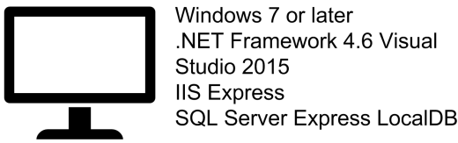
Standalone development

Slide 15
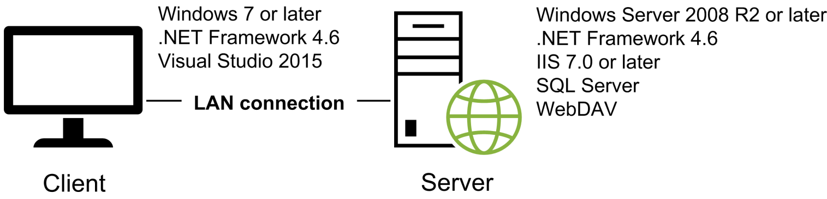
Intranet development

Slide 16
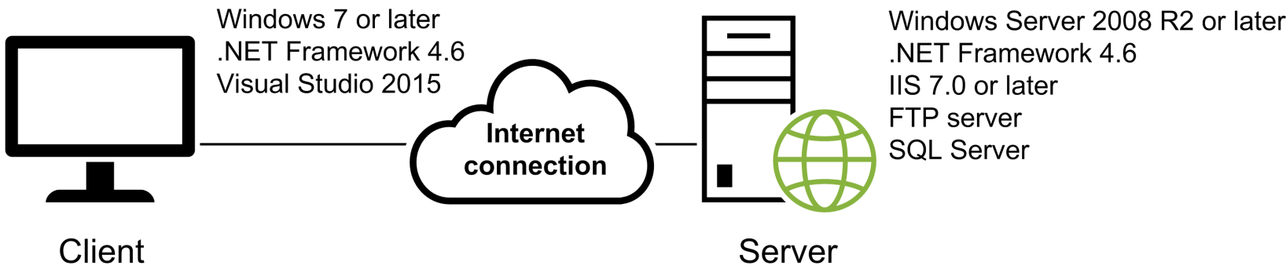
Internet development

Slide 17
The three editions of Visual Studio 2015

Slide 18
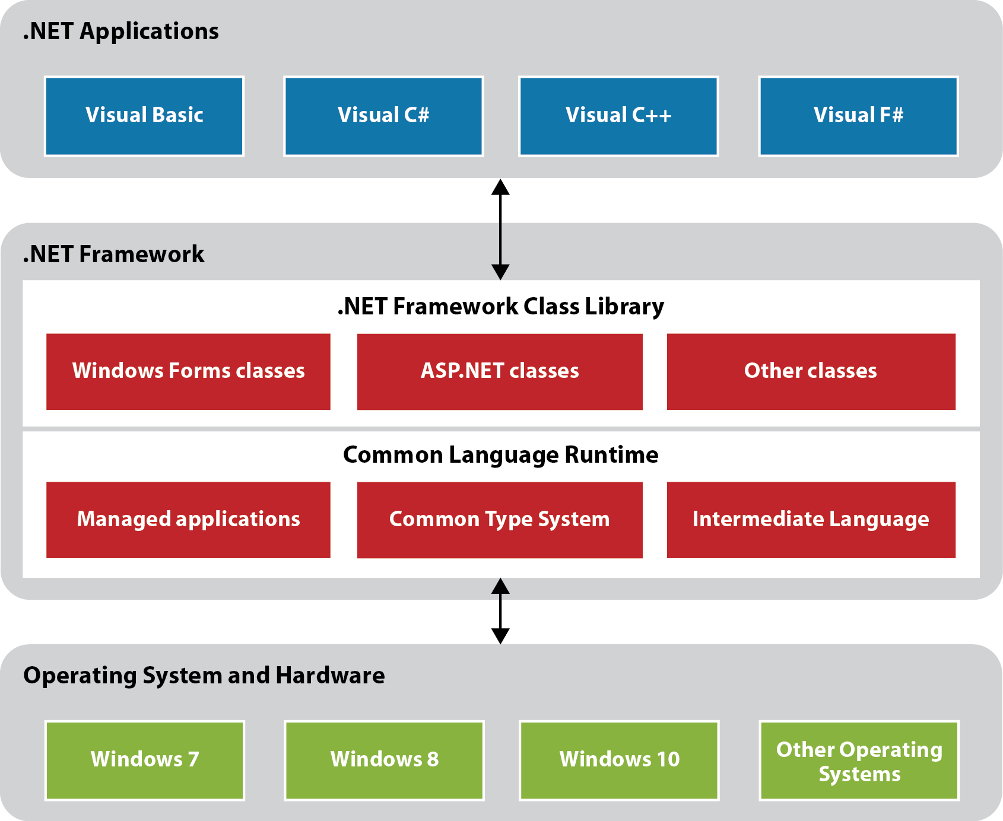
The .NET Framework

Slide 19
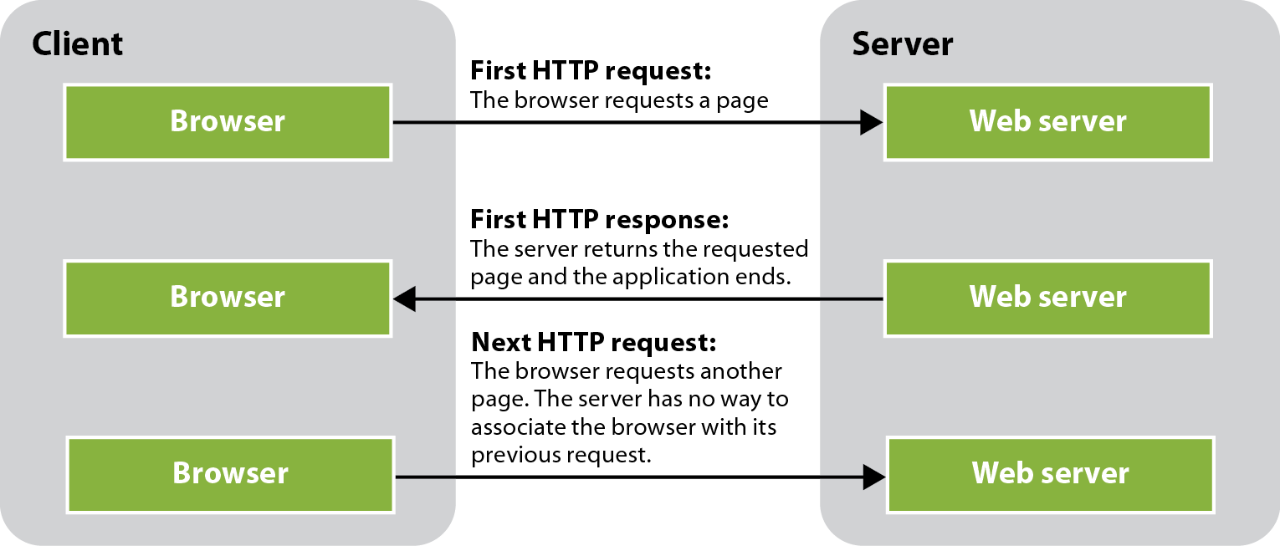
Why state is difficult to track in a web application

Slide 20
Five ASP.NET features for maintaining state

Slide 21
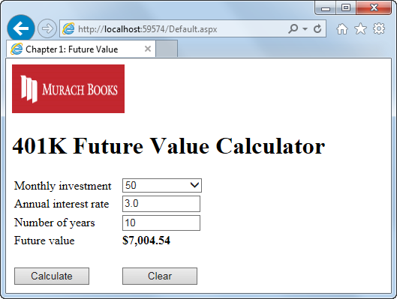
The Future Value application after the user clicks the Calculate button

Slide 22
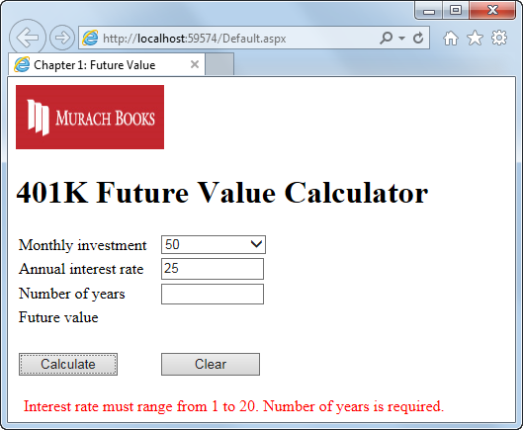
The Future Value application with error messages displayed

Slide 23
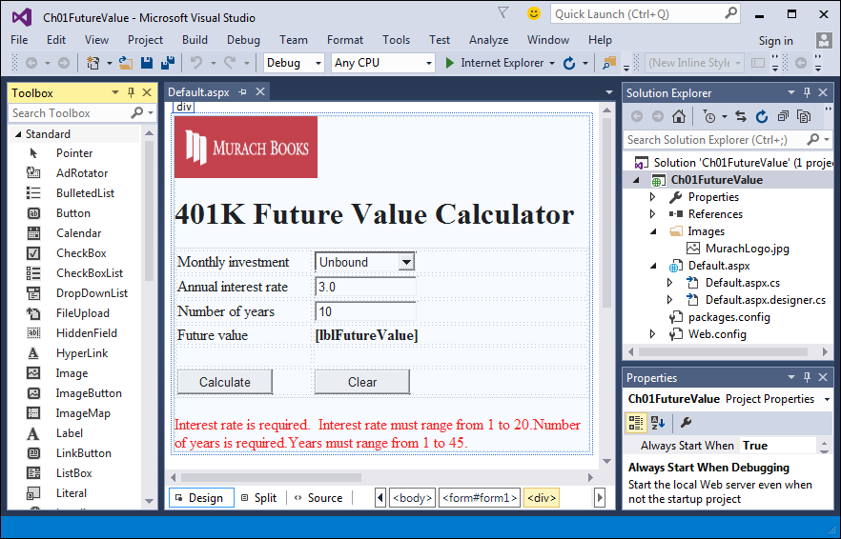
The Future Value form in Design view of Visual Studio 2015

Slide 24
Some of the files in the Future Value application

Slide 25
The aspx file for the Default form (Default.aspx)

Slide 26
The aspx file for the Default form (cont.)

Slide 27
The aspx file for the Default form (cont.)

Slide 28
The code-behind file for the Default form (Default.aspx.cs)

Slide 29
The code-behind file for the Default form (cont.)

Slide 30
The code-behind file for the Default form (cont.)

