Slide 2
Topics
Calculating a Running Total
Counting
Sentinels
Input Validation Loops
Nested Loops

Slide 3
Reading Assignment
Please read the following sections of the textbook:
  4.4 Calculating a Running Total
  4.5 Sentinels
  4.6 Input Validation Loops
  4.7 Nested Loops

Slide 4
Calculating a Running Total
Programs often need to calculate a total of a series of numbers
  Typically include two elements:
    A loop that reads each number in series
    An accumulator variable
  Known as program that keeps a running total: accumulates total and reads in series
  At end of loop, accumulator will reference the total

Slide 5
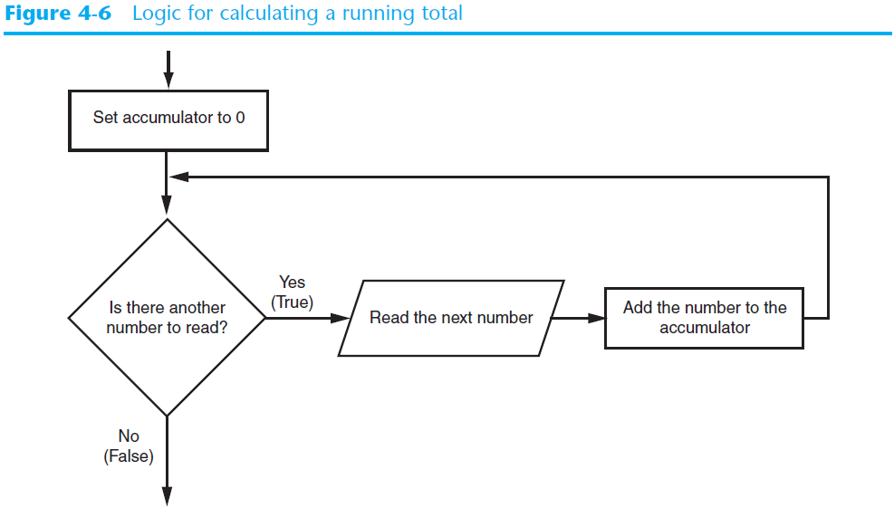
Calculating a Running Total (cont’d.)

Slide 6
Example 1
Write a program to calculate the sum of 5 numbers entered by the user.

Slide 7
Example 1: Algorithm
total = 0
Repeat 5 times
Input a number
total = total + number
3. Display total

Slide 8
Example 1: Python Code
total = 0.0
for i in range(5):
number = int(input('Enter a number: '))
total = total + number
print('The total is', total)

Slide 9
Example 2
Write a program to calculate the sum of all the numbers entered by the user. Every time after the user has entered a number, display the updated running total and then ask the user whether he wants to enter another number.

Slide 10
Example 2: Algorithm
total = 0
set keep_going to 'y'
while keep_going is 'y'
Input a number
total = total + number
Display total
Input keep_going

Slide 11
Example 2: Python Code
total = 0.0
keep_going = 'y'
while keep_going == 'y':
number = int(input('Enter a number: '))
total = total + number
print('The total so far: ', total)
keep_going = input('Do you want to enter another number? [Enter y for yes] ')
keep_going = keep_going.lower()

Slide 12
The Augmented Assignment Operators
In many assignment statements, the variable on the left side of the = operator also appears on the right side of the = operator
Augmented assignment operators: special set of operators designed for this type of job
  Shorthand operators

Slide 13
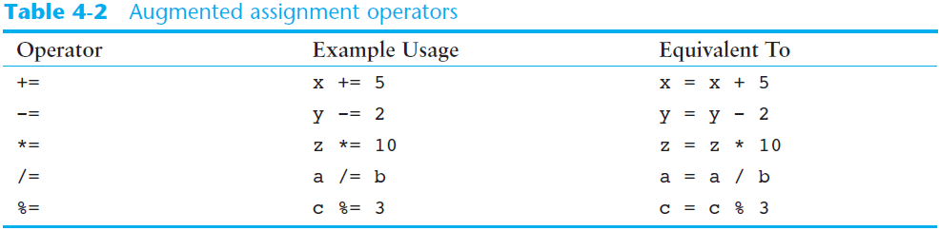
The Augmented Assignment Operators (cont’d.)

Slide 14
Example 1A: Python Code
total = 0.0
for i in range(5):
number = int(input('Enter a number: '))
total += number
print('The total is', total)

Slide 15
Example 2A: Python Code
total = 0.0
keep_going = 'y'
while keep_going == 'y':
number = int(input('Enter a number: '))
total += number
print('The total so far: ', total)
keep_going = input('Do you want to enter another number? [Enter y for yes] ')
keep_going = keep_going.lower()

Slide 16
Counting
Programs often need to count the number of input values that fulfill certain requirements
  Create a counter and initialize it to 0
  Use a loop to:
    read each input value
    If the input value satisfies the requirements, increase counter by 1
  Display the counter

Slide 17
Example 3
Write a program to read 5 scores from the user. Count number of scores that are 60 or above.

Slide 18
Example 3: Algorithm
count = 0
Repeat 5 times
Input a score
If score >= 60:
count = count + 1
3. Display count

Slide 19
Example 3: Python Code
count = 0
for i in range(5):
score = int(input('Enter a score: '))
if score >= 60:
count += 1
print('Scores 60 or above:', count)

Slide 20
Example 4
Write a program to count number of scores equal to or greater than 60. Every time after the user has entered a score, display the updated count and then ask the user whether he wants to enter another number.

Slide 21
Example 4: Algorithm
count = 0
set keep_going to 'y'
while keep_going is 'y'
Input a score
If score >= 60:
count = count + 1
Display count
Input keep_going

Slide 22
Example 4: Python Code
count = 0
keep_going = 'y'
while keep_going == 'y':
score = int(input('Enter a score: '))
if score >= 60:
count += 1
print('Number of scores 60 or above so far: ', count)
keep_going = input('Do you want to enter another number? [Enter y for yes] ')
keep_going = keep_going.lower()

Slide 23
Sentinels
Sentinel: special value that marks the end of a sequence of items
  When program reaches a sentinel, it knows that the end of the sequence of items was reached, and the loop terminates
  Must be distinctive enough so as not to be mistaken for a regular value in the sequence

Slide 24
Example 5
Salespeople in a company get a percentage of the amount of the sales for commission. Write a program to calculate commission for every salesperson in the company.
  We wrote a program for this problem last week
  Rewrite the program without asking user whether he wants to calculation another commission

Slide 25
Commission Program from Last Week
keep_going = 'y'
while keep_going == 'y':
sales = float(input('Enter the amount of sales: '))
comm_rate = float(input('Enter the commission rate: '))
commission = sales * comm_rate
print('The commission is $', commission)
keep_going = input('Do you want to calculate another commission (Enter y for yes): ')
keep_going = keep_going.lower()

Slide 26
Example 5: Algorithm
We are going to ask user to enter a sales amount of -1 when he does not want to calculate commission for another salesperson. -1 is used as a sentinel to tell the program that there is no more data to enter. There is no need to ask the user to enter ‘y’ if he wants to keep going.
See the algorithm on next slide

Slide 27
Example 5: Algorithm
Input amount of sales [or -1 to stop]
2. while sales is not -1
Input commission rate
commission = amount of sales * commission rate
display commission
Input next amount of sales [or -1 to stop]

Slide 28
Example 5: Python Code
sales = float(input('Enter the amount of sales [or -1 to stop]: '))
while sales != -1:
comm_rate = float(input('Enter the commission rate: '))
commission = sales * comm_rate
print('The commission is $', commission)
sales = float(input('Enter the amount of sales [or -1 to stop]: '))

Slide 29
Example 6
Write a program to calculate BTU needed for multiple rooms.
  We wrote a program for this problem last week
  Rewrite the program without asking user whether he wants to calculation BTU needed for another
  When the user has no more room to calculate, enter a room length of -1 as a sentinel to terminate the loop.

Slide 30
BTU Program from Last Week
anotherRoom = 'y'
while anotherRoom == 'y':
roomLength = float(input('Enter room length: '))
roomWidth = float(input('Enter room width: '))
roomHeight = float(input('Enter room height: '))
roomVolume = roomLength * roomWidth * roomHeight
btuNeeded = roomVolume * 3.5
print('BTU needed for this room:', btuNeeded)
anotherRoom = input('Calculate BTU for another room? [Enter y for yes] ')
anotherRoom = anotherRoom.lower()

Slide 31
Example 6: Algorithm
Input room length [or -1 to stop]
2. while room length is not -1
Input room width and height
Calculate room volume = length * width * height
Calculate BTU needed = room volume * 3.5
Display BTU needed
Input next room length [or -1 to stop]

Slide 32
Example 6: Python Code
roomLength = float(input('Enter room length [or -1 to stop]: '))
while roomLength != -1:
roomWidth = float(input('Enter room width: '))
roomHeight = float(input('Enter room height: '))
roomVolume = roomLength * roomWidth * roomHeight
btuNeeded = roomVolume * 3.5
print('BTU needed for this room:', btuNeeded)
roomLength = float(input('Enter room length [or -1 to stop]: '))

Slide 33

Input Validation Loops
Computer cannot tell the difference between good data and bad data
  If user provides bad input, program will produce bad output
  GIGO: garbage in, garbage out
  It is important to design program such that bad input is never accepted

Slide 34
Input Validation Loops (cont’d.)
Input validation: inspecting input before it is processed by the program
  If input is invalid, prompt user to enter correct data
  Commonly accomplished using a while loop which repeats as long as the input is bad
    If input is bad, display error message and receive another set of data
    If input is good, continue to process the input

Slide 35
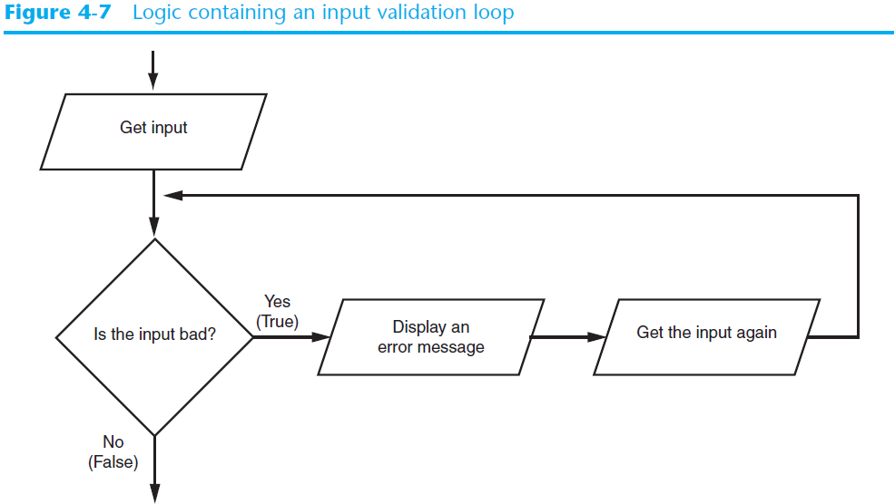
Input Validation Loops (cont’d.)

Slide 36
Example 7
Write a program to calculate sales tax. The tax rate is 0.07.
Write two versions of this program
  Example 7: no input validation on price
  Example 7A: make sure price >= 0

Slide 37
Example 7: Algorithm
Input price
2. Sales tax = price * 0.07
3. Display sales tax

Slide 38
Example 7: Python Code
price = float(input('Enter price: '))
salesTax = price * 0.07
print('Sales tax: ', salesTax)

Slide 39
Example 7A: Algorithm
Input price
While price < 0
  Display error message
  Input price
3. Sales tax = price * 0.07
4. Display sales tax

Slide 40
Example 7A: Python Code
price = float(input('Enter price: '))
while price < 0:
print('ERROR: price cannot be negative.')
price = float(input('Enter price: '))
salesTax = price * 0.07
print('Sales tax: ', salesTax)

Slide 41
Example 8
Write a program to calculate the average of two test scores. They cannot be lower than 0 or higher than 100.

Slide 42
Example 8: Algorithm
Input score 1
While score 1 < 0 or score 1 > 100
  Display error message
  Input score 1
3. Input score 2
4. While score 2 < 0 or score 2> 100
  Display error message
  Input score 2
average = (score 1 + score 2) / 2
Display average

Slide 43
Example 8: Python Code
score1 = float(input('Enter test 1 score: '))
while score1 < 0 or score1 > 100:
print('ERROR: test score must be in the range of 0 to 100.')
score1 = float(input('Enter test 1 score: '))
score2 = float(input('Enter test 2 score: '))
while score2 < 0 or score2 > 100:
print('ERROR: test score must be in the range of 0 to 100.')
score2 = float(input('Enter test 2 score: '))
average = (score1 + score2)/2
print('Average of the two scores: ', average)

Slide 44
Nested Loops
Nested loop: loop that is contained inside another loop
  Example: calculate the average of a few test scores for every student in a class
Key points about nested loops:
  Inner loop goes through all of its iterations for each iteration of outer loop
  Total number of iterations in nested loop: number_iterations_inner x
  number_iterations_outer

Slide 45
Example 9: Algorithm
Input number of students
Input number of tests
3. For every student
  total = 0
  for every test
  Input test score
  total = total + test score
  average = total / number of tests
  Display average

Slide 46
Example 9: Python Code
num_students = int(input('How many students do you have? '))
num_test_scores = int(input('How many test scores per student? '))
for student in range(num_students):
total = 0.0
print('Student number', student + 1)
print('---------------')
for test_num in range(num_test_scores):
print('Test number', test_num+1, end='')
score = float(input(': '))
total += score
average = total / num_test_scores
print('The average for student number', student + 1, 'is:', average)
print() # display a blank line

Slide 47
Summary
This chapter covered:
  Calculating a running total and augmented assignment operators
  Using a loop to count
  Use of sentinels to terminate loops
  Using a loop to validate input
  Nested loops

