Slide 2
Topics
Introduction to Functions
Defining and Calling a Function
Designing a Program to Use Functions
Local Variables
Passing Data to a Function

Slide 3
Reading Assignment
Please read the following sections of the textbook:
  5.1 Introduction to Functions
  5.2 Defining and Calling a Void function
  5.3 Designing a Program to Use Functions
  5.4 Local Variables
  5.5 Passing Arguments to Functions [Up to Program 5-7]

Slide 4
Functions
A group of statements with a name
Designed to perform a specific task
Using a function
  Calling a function: execute a function by including its name in a statement
  Example: Calling the float function:
    score = float(score)
  Other functions we have used: input function, print function, etc.

Slide 5
Built-in Functions vs. User- Defined Functions
float, input and print are known as built-in functions, because the code of these functions have been pre-written and included with the Python interpreter
We can also write our own functions

Slide 6
Writing Long Programs
Divide and conquer approach
  Divide a long program into functional parts
Modularized program: program wherein each task within the program is in its own function

Slide 7
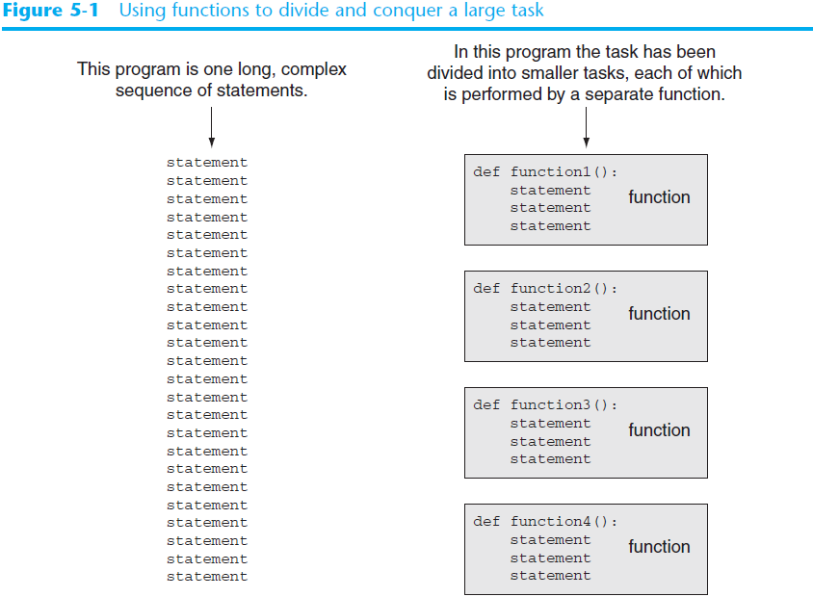

Slide 8
Example 1
Lunch combos in the cafeteria of a community college include an entrée and a beverage. Write a program for customers to enter their choices.

Slide 9
Example 1
[In One Sequence of Statements]
print('Entree:')
print('Enter 1 for fish and chips')
print('Enter 2 for burger and fries')
print('Enter 3 for fried chicken and smashed potato')
print('Enter 4 for barbecue pork')
entree = int(input('Please enter your choice: '))
if entree == 1:
print('You have chosen fish and chips')
elif entree == 2:
print('You have chosen burger and fries')
elif entree == 3:
print('You have chosen fried chicken and smashed potato')
elif entree == 4:
print('You have chosen barbecue pork')
print('Beverage:')
print('Enter 1 for iced tea')
print('Enter 2 for soda')
print('Enter 3 for coffee')
beverage = int(input('Please enter your choice: '))
if beverage == 1:
print('You have chosen iced tea')
elif beverage == 2:
print('You have chosen soda')
elif beverage == 3:
print('You have chosen coffee')

Slide 10
Example 1A
Two functions are defined:
  chooseEntree : handle choice of entrée
  chooseBeverage: handle choice of beverage
These two functions are used later in the program

Slide 11
Example 1A
[Writing and Using Functions]
def chooseEntree():
print('Entree:')
print('Enter 1 for fish and chips')
print('Enter 2 for burger and fries')
print('Enter 3 for fried chicken and smashed potato')
print('Enter 4 for barbecue pork')
entree = int(input('Please enter your choice: '))
if entree == 1:
print('You have chosen fish and chips')
elif entree == 2:
print('You have chosen burger and fries')
elif entree == 3:
print('You have chosen fried chicken and smashed potato')
elif entree == 4:
print('You have chosen barbecue pork')
# end of def chooseEntree
def chooseBeverage():
print('Beverage:')
print('Enter 1 for iced tea')
print('Enter 2 for soda')
print('Enter 3 for coffee')
beverage = int(input('Please enter your choice: '))
if beverage == 1:
print('You have chosen iced tea')
elif beverage == 2:
print('You have chosen soda')
elif beverage == 3:
print('You have chosen coffee')
# end of def chooseBeverage
chooseEntree() # use chooseEntree
chooseBeverage() # use choseBeverage

Slide 12
Example 1A
When the computer runs a program, it does not execute statements in a function until that function is called
This program consists of definitions of two functions plus these two statements:
chooseEntree() # call chooseEntree
chooseBeverage() # call chhoseBeverage

Slide 13
Example 1A
When the computer runs this program, the first statement it executes is:
chooseEntree() # call chooseEntree
Which tells the computer to execute the statements in chooseEntree
The second statement the computer executes:
chooseBeverage() # call chhoseBeverage
Which tells the computer to execute the statements in chooseBeverage

Slide 14
Benefits of Modularizing a Program with Functions
The benefits of using functions include:
  More organized code: easier to show logic
  Code reuse
    write the code once and call it multiple times
  Better testing and debugging
    Can test and debug each function individually
  Easier facilitation of teamwork
    Different team members can write different functions
    Faster development

Slide 15
Void Functions and Value-Returning Functions
A void function:
  Simply executes the statements it contains and then terminates.
    Examples: the two functions in Example 1A
A value-returning function:
  Executes the statements it contains, and then it returns a value back to the statement that called it.
    Examples: the input, int, and float functions

Slide 16
Defining and Calling a Function
Functions are given names
  Function naming rules:
    Cannot use key words as a function name
    Cannot contain spaces
    First character must be a letter or underscore
    All other characters must be a letter, number or underscore
    Uppercase and lowercase characters are distinct

Slide 17
Defining and Calling a Function (cont’d.)
Function name should be descriptive of the task carried out by the function
  Often includes a verb
Function definition: specifies what function does
  def function_name():
    statement
    statement

Slide 18
Defining and Calling a Function (cont’d.)
Function header: first line of function
  Includes keyword def and function name, followed by parentheses and colon
Block: set of statements that belong together as a group
  Example: the statements included in a function

Slide 19
Defining and Calling a Function (cont’d.)
Call a function to execute it
  When a function is called:
    Interpreter jumps to the function and executes statements in the block
    Interpreter jumps back to part of program that called the function
      Known as function return

Slide 20
Indentation in Python
Each block must be indented
  Lines in block must begin with the same number of spaces
    Use tabs or spaces to indent lines in a block, but not both as this can confuse the Python interpreter
    IDLE automatically indents the lines in a block
  Blank lines that appear in a block are ignored

Slide 21

Functions in Flowcharts
In a flowchart, function call shown as rectangle with vertical bars at each side
  Function name written in the symbol
  Typically draw separate flow chart for each function in the program
    End terminal symbol usually reads Return

Slide 22
Functions in Flowcharts
Start
chooseEntree()
chooseBeverage()
End

Slide 23
Functions in Flowcharts
chooseEntree()
Input entree
Display entree
return

Slide 24
Functions in Flowcharts
chooseBeverage()
Input beverage
Display beverage
Return

Slide 25
The main Function
It is a convention to define a function named main, which implements the mainline logic of the program
Calls other functions when they are needed
Usually defined at the beginning of the program so we can see the mainline logic of the program before we read the code of other functions

Slide 26
Structure of a Program that Has a Main Function
def main():
# statements of the main function here
# define other functions here
main() # call main function to execute

Slide 27
Example 1B
def main():
chooseEntree() # use chooseEntree
chooseBeverage() # use choseBeverage
# end of def main
def chooseEntree():
print('Entree:')
print('Enter 1 for fish and chips')
print('Enter 2 for burger and fries')
print('Enter 3 for fried chicken and smashed potato')
print('Enter 4 for barbecue pork')
entree = int(input('Please enter your choice: '))
if entree == 1:
print('You have chosen fish and chips')
elif entree == 2:
print('You have chosen burger and fries')
elif entree == 3:
print('You have chosen fried chicken and smashed potato')
elif entree == 4:
print('You have chosen barbecue pork')
# end of def chooseEntree
def chooseBeverage():
print('Beverage:')
print('Enter 1 for iced tea')
print('Enter 2 for soda')
print('Enter 3 for coffee')
beverage = int(input('Please enter your choice: '))
if beverage == 1:
print('You have chosen iced tea')
elif beverage == 2:
print('You have chosen soda')
elif beverage == 3:
print('You have chosen coffee')
# end of def chooseBeverage
main() # call main function

Slide 28
Example 2
The college transfer division of a community college has three departments: English, Math and Physics. They need a program to handle voice mail. First, the caller will be asked to choose a department. Then he will be asked to choose an instructor within the department. The caller can reach the secretary at any time.

Slide 29
Example 2
We wrote this program before without breaking up the code into functions. We are going to rewrite it.
Write a main function to implement the mainline logic
Write a separate function to handle each department

Slide 30
Example 2:
Algorithm for main function
Choose a department or the secretary
2. If (department choice is English)
call engDept to choose an instructor in English department
Else if (department choice is Math)
call mathDept to choose an instructor in Math department
Else If (department choice is Physics)
call phyDept to choose an instructor in Physics department
Else
call the secretary function

Slide 31
Example 2: Python Code [Part 1]
def main():
print('Welcome to the voice mail system of the college transfer division.')
print('Please enter 1 for English department')
print('Please enter 2 for Math department')
print('Please enter 3 for Physics department')
print('Please enter anything else to reach the secretary.')
deptChoice = input('Enter department choice: ')
if deptChoice == '1':
engDept()
elif deptChoice == '2':
mathDept()
elif deptChoice == '3':
phyDept()
else:
secretary()
# end of def main
def engDept():
print('You have reached the English department.')
print('Please enter 1 for Richard Cox')
print('Please enter 2 for James Miffin')
print('Please enter anything else to reach the secretary.')
instChoice = input('Enter instructor choice: ')
if instChoice == '1':
print('You have reached the voice mail of Richard Cox.')
elif instChoice == '2':
print('You have reached the voice mail of James Miffin.')
else:
secretary()
# end of def engDept
# continue on next slide

Slide 32
Example 2: Python Code [Part 2]
def mathDept():
print('You have reached the Math department.')
print('Please enter 1 for Susan Moore')
print('Please enter 2 for Christine Richon')
print('Please enter anything else to reach the secretary.')
instChoice = input('Enter instructor choice: ')
if instChoice == '1':
print('You have reached the voice mail of Susan Moore.')
elif instChoice == '2':
print('You have reached the voice mail of Christine Richon.')
else:
secretary()
# end of def mathDept
def phyDept():
print('You have reached the Physics department.')
print('Please enter 1 for Jeremy Davis')
print('Please enter anything else to reach the secretary.')
instChoice = input('Enter instructor choice: ')
if instChoice == '1':
print('You have reached the voice mail of Susan Moore.')
else:
secretary()
# end of def phyDept
def secretary():
print('You have reached the secretary of the division.')
# end of def secretary
main() # call main function

Slide 33
Example 2: Highlights
Logic is more clear than old version
  Tasks are distributed to several functions
  Mainline logic is shown in main function
Reuse the secretary function
  Code written once but called in multiple places
A called function can call other functions
  The secretary function is called in the main, engDept, mathDept and phyDept functions

Slide 34
Designing a Program to Use Functions
Top-down design: technique for breaking algorithm into functions
Hierarchy chart: depicts relationship between functions
  AKA structure chart
  Box for each function in the program, Lines connecting boxes illustrate the functions called by each function
  Does not show steps taken inside a function

Slide 35
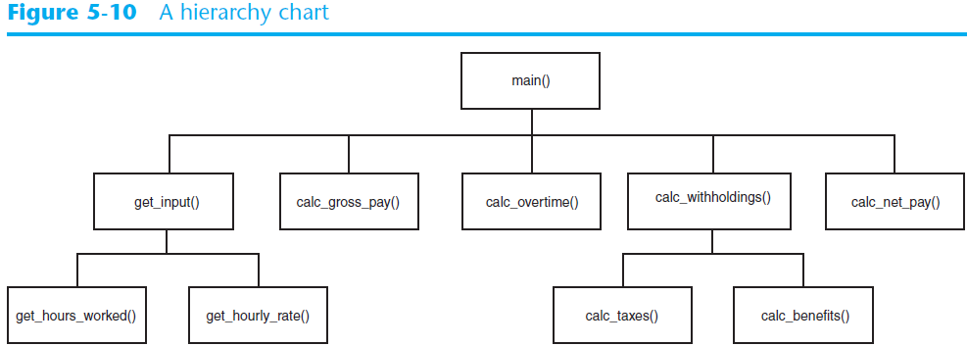
Designing a Program to Use Functions (cont’d.)

Slide 36
Scope of a Variable
Typically a variable is accessible only in part of a program
The part of a program in which a variable may be accessed is called its scope
The scope of a variable is determined by a set of rules

Slide 37
Scope of a Variable
A variable cannot be accessed before it is created
Example:
print('Your score is:', score) # score undefined
score = int(input('Enter your score: '))

Slide 38
Local Variables
Local variable: variable that is created inside the definition of a function
Example: gpa is a local variable defined in the get_gpa function
def get_gpa():
gpa = float(input('Enter GPA: '))
print(gpa)

Slide 39
Scope of Local Variables
A local variable is accessible only in the function in which it is created, starting from the point the variable is defined
It will be an error if another function tries to access it
See example on next slide

Slide 40
Example 3: Scope of Local Variables
def main():
name = input('Enter your name: ')
display_name()
# end of def main
def display_name():
print('Hello', name) # variable name inaccessible
# end of def display_name
main()

Slide 41
Scope of Local Variables
Different functions may have local variables with the same name. They are unrelated although they happen to have the same name.
  Each function does not see the other function’s local variables, so no confusion
  See next slide for an example

Slide 42
Example 4: Scope of Local Variables
def main():
texas()
california()
# end of def main
def texas():
birds = 5000
print('texas has', birds, 'birds.')
# end of def texas
def california():
birds = 8000
print('calofirnia has', birds, 'birds.')
# end of def calfornia
main()

Slide 43
Passing Data to a Function
Data can be passed to a function when the function is called.
Argument: piece of data that is sent into a function
  When calling the function, the argument is placed in parentheses following the function name
  Example: score is passed as argument to the print function:
  print(score)

Slide 44
Parameters
A function that receives data when it is called must have variables to store incoming data
Parameter variable: variable that is assigned the value of an argument when the function is called
  The parameter and the argument reference the same value
  General format:
  def function_name(parameter):

Slide 45
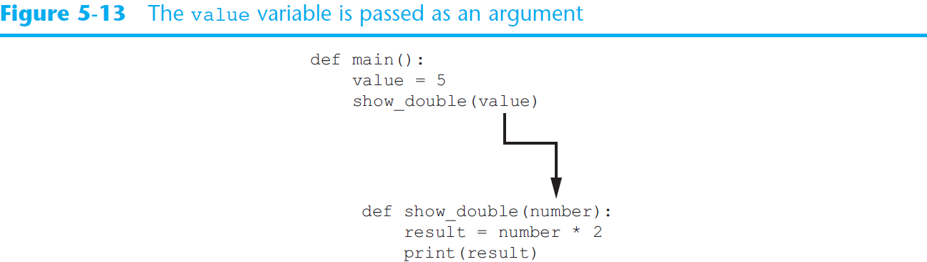
Passing Arguments to Functions (cont’d.)

Slide 46
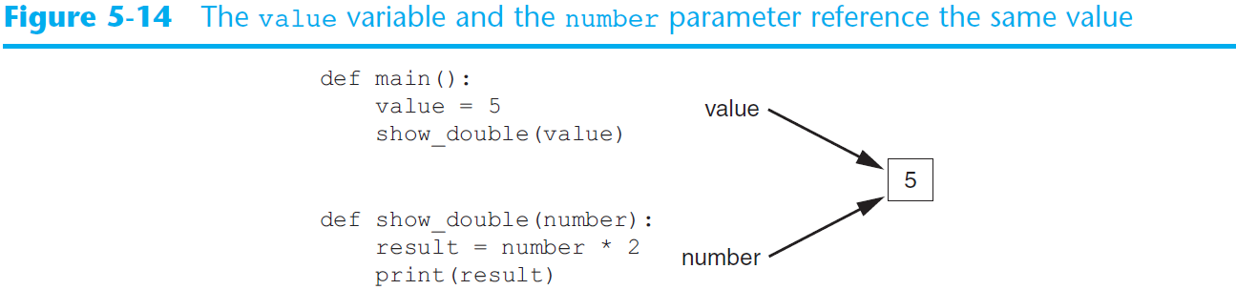
Passing Arguments to Functions (cont’d.)

Slide 47
Example 5
Write a program to convert cups to fluid ounces (1 cup = 8 ounces). Define an intro function to display an introduction. Also define a cups_to_ounces function to calculates ounces. Pass number of cups to this function as an argument.

Slide 48
Example 5
def main():
intro()
cups_needed = int(input('Enter the number of cups: '))
cups_to_ounces(cups_needed) # pass cups_needed
# end of def main
def intro():
print('This program converts measurements')
print('in cups to fluid ounces. For your')
print('reference the formula is:')
print('1 cup = 8 fluid ounces')
print()
# end of def intro
def cups_to_ounces(cups): # cups receives data
ounces = cups * 8
print('That converts to', ounces, 'ounces.')
# end of def cups_to_ounces
main()

Slide 49
Summary
This chapter covered:
  The advantages of using functions
  The syntax for defining and calling a function
  Methods for designing a program to use functions
  Use of local variables and their scope

