Slide 2
Topics
Writing Your Own Value-Returning Functions
Storing Functions in Modules

Slide 3
Reading Assignment
Please read the following sections of the textbook:
  5.8 Writing your Own Value-Returning Functions
  5.10 Storing Functions in Modules

Slide 4
Writing Your Own Value-Returning Functions
To write a value-returning function, you write statements you want the computer to execute and add a return statement at the end
  Format: return expression
    The value for expression will be returned to the part of the program that called the function
  The expression in the return statement can be a complex expression, such as a sum of two variables or the result of another value- returning function

Slide 5
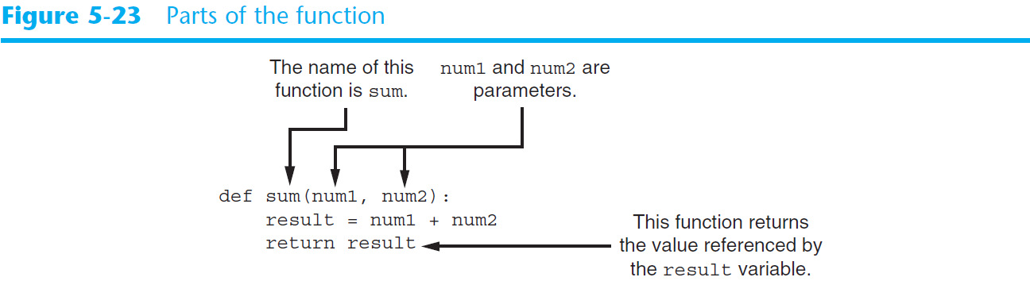
Writing Your Own Value-Returning Functions (cont’d.)

Slide 6

How to Use Value-Returning Functions
Value-returning function can be useful in specific situations
  Example: have function prompt user for input and return the user’s input
  Simplify mathematical expressions
  Complex calculations that need to be repeated throughout the program
Use the returned value
  Assign it to a variable or use as an argument in another function

Slide 7
Example 1
Write a program to calculate the sum of the user’s age and his best friend’s age. Define and use a sum function.

Slide 8
Example 1: Python code
def main():
first_age = int(input('Enter your age: '))
second_age = int(input("Enter your best friend's age: "))
total = sum(first_age, second_age)
print('Together you are', total, 'years old.')
# end of def main
def sum(num1, num2):
result = num1 + num2
return result
# end of def sum
main()

Slide 9
Using IPO Charts
IPO chart: describes the input, processing, and output of a function
  Tool for designing and documenting functions
  Typically laid out in columns
  Usually provide brief descriptions of input, processing, and output, without going into details
    Often includes enough information to be used instead of a flowchart

Slide 10
Example 2
Write a program to calculate a retail item’s sale price with a discount percentage of 20%. Define and use a get_regular_price function to get regular price from the user. Define and use a discount function to calculate the amount of the discount.

Slide 11
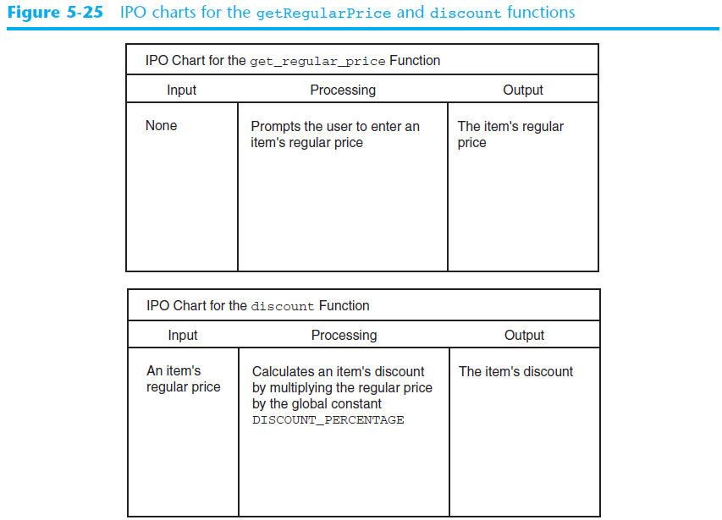
Using IPO Charts (cont’d.)

Slide 12
Example 2: Python code
DISCOUNT_PERCENTAGE = 0.20
def main():
reg_price = get_regular_price()
sale_price = reg_price - discount(reg_price)
print('The sale price is $', sale_price)
# end of def main
def get_regular_price():
price = float(input("Ehter the item's regular price: "))
return price
# end of def get_regular_price
def discount(price):
discount_amt = price * DISCOUNT_PERCENTAGE
return discount_amt
# end of def discount
main()

Slide 13
Example 3
Employees of a company work strictly on commission, which is calculated as follows:
  Sales less than $10,000: 10% commission
  Sales $10,000-14,999: 12% commission
  Sales $15,000-17,999 14% commission
  Sales $18,000-21,999: 16% commission
  Sales $22,000 or more: 18% commission
Employees are allowed to take up to $2000 in advance. Write a program to calculate an employee’s pay using this formula:

Slide 14
Example 3
pay = sales x commission rate – advanced pay
Define and use these three functions in the program:
  get_sales
  get_advanced_pay
  determine_comm_rate

Slide 15
Example 3: Python code [Part 1]
def main():
sales = get_sales()
advanced_pay = get_advanced_pay()
comm_rate = determine_comm_rate(sales)
pay = sales * comm_rate - advanced_pay
print('The pay is $', pay)
if pay < 0:
print('The salesperson must reimburse the company.')
# end of def main
def get_sales():
monthly_sales = float(input('Enter the monthly sales: '))
return monthly_sales
# end of get_sales
def get_advanced_pay():
print('Enter the amount of advanced pay or')
print('enter 0 if no advanced pay was given.')
advanced = float(input('Advanced pay: '))
return advanced
# end of get_advanced_pay
# continue on next slide

Slide 16
Example 3: Python code [Part 2]
def determine_comm_rate(sales):
if sales < 10000:
rate = 0.10
elif sales >= 10000 and sales < 15000:
rate = 0.12
elif sales >= 15000 and sales < 18000:
rate = 0.14
elif sales >= 18000 and sales < 22000:
rate = 0.16
else:
rate = 0.18
return rate
# end of determine_comm_rate
main()

Slide 17
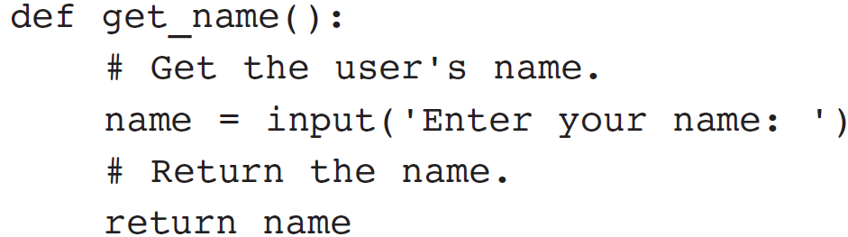
Returning Strings
You can write functions that return strings
For example:

Slide 18
Returning Boolean Values
Boolean function: returns either True or False
  Use to test a condition such as for decision and repetition structures
    Common calculations, such as whether a number is even, can be easily repeated by calling a function
  Use to simplify complex input validation code

Slide 19
Example 4
A company sells three models of printers:
  Model 100: $499
  Model 200: $549
  Model 300: $609
Write a program that asks the customer to choose a model. Display the choice and the price. Write a function to validate user’s choice of model.

Slide 20
Example 4: Python code
def main():
model = int(input('Enter model number [100/200/300]: '))
while is_invalid(model):
print('The valid model numbers are 100, 200 and 300.')
model = int(input('Enter model number [100/200/300]: '))
if model == 100:
print('Model 100 is chosen. Please pay $499')
elif model == 200:
print('Model 200 is chosen. Please pay $549')
elif model == 300:
print('Model 300 is chosen. Please pay $609')
# end of def main
def is_invalid(mod_num):
if mod_num != 100 and mod_num != 200 and mod_num != 300:
status = True
else:
status = False
return status
# end of def is_invalid
main()

Slide 21
Returning Multiple Values
In Python, a function can return multiple values
  Specified after the return statement separated by commas
    Format: return expression1,
    expression2, etc.
  When you call such a function in an assignment statement, you need a separate variable on the left side of the = operator to receive each returned value

Slide 22
Example 5
Write a program to get the first name and last name of the user. Define and use a get_name function to get the names.

Slide 23
Example 5: Python code
def main():
first_name, last_name = get_name()
print('Your name is', first_name, last_name)
# end of def main
def get_name():
first = input('Enter your first name: ')
last = input('Enter your last name: ')
return first, last
# end of def get_name
main()

Slide 24
Returning Multiple Values
Can we use two separate return statements to return two values?
The answer is no because a return statement actually terminates the execution of the whole function.

Slide 25
Example 5A: Will this work?
def main():
last_name, first_name = get_name()
print('Your name is', first_name, last_name)
# end of def main
def get_name():
first = input('Enter your first name: ')
last = input('Enter your last name: ')
return first
return last
# end of def get_name
main()

Slide 26
Returning Multiple Values
Example 5A does not work because the computer only executes the first return statement of the get_name function. Therefore, only the first name is returned.

Slide 27
Storing Functions in Modules
In large, complex programs, it is important to keep code organized
Modularization: grouping related functions in modules
  Makes program easier to understand, test, and maintain
  Make it easier to reuse code for multiple different programs
    Import the module containing the required function to each program that needs it

Slide 28
Storing Functions in Modules (cont’d.)
Module is a file that contains Python code
  Contains function definition but does not contain calls to the functions
    Importing programs will call the functions
Rules for module names:
  File name should end in .py
  Cannot be the same as a Python keyword
Import module using import statement

Slide 29
Example 6
Write a program to perform the following geometric calculations: the area of a circle, the circumference of a circle, the area of a rectangle, the perimeter of a rectangle. Write a function for each geometric calculation. Put functions about circle in a circle module. Put function about rectangle in a rectangle module.

Slide 30
Example 6: circle.py
import math
def area(radius):
return math.pi * radius**2
# end of def area
def circumference(radius):
return 2 * math.pi * radius
# end of def circumference

Slide 31
Example 6: rectangle.py
def area(width, length):
return width * length
# end of def area
def perimeter(width, length):
return 2 * (width + length)
# end of def perimeter

Slide 32
Example 6: geometry.py [Part 1]
import circle
import rectangle
AREA_CIRCLE_CHOICE = 1
CIRCUMFERENCE_CHOICE = 2
AREA_RECTANGLE_CHOICE = 3
PERIMETER_RECTANGLE_CHOICE = 4
QUIT_CHOICE = 5
def main():
display_menu()
choice = int(input('Enter your choice: '))
while choice != QUIT_CHOICE:
if choice == AREA_CIRCLE_CHOICE:
radius = float(input("Enter the circle's radius: "))
print('The area is', circle.area(radius))
elif choice == CIRCUMFERENCE_CHOICE:
radius = float(input("Enter the circle's radius: "))
print('The circumference is', circle.circumference(radius))
elif choice == AREA_RECTANGLE_CHOICE:
width = float(input("Enter the rectangle's width: "))
length = float(input("Enter the rectangle's lengthh: "))
print('The area is', rectangle.area(width, length))
elif choice == PERIMETER_RECTANGLE_CHOICE:
width = float(input("Enter the rectangle's width: "))
length = float(input("Enter the rectangle's lengthh: "))
print('The area is', rectangle.perimeter(width, length))
elif choice == PERIMETER_RECTANGLE_CHOICE:
width = float(input("Enter the rectangle's width: "))
length = float(input("Enter the rectangle's lengthh: "))
print('The area is', rectangle.perimeter(width, length))
else:
print('Error: invalid selection.')
display_menu()
choice = int(input('Enter your choice: '))
# end of def main

Slide 33
Example 6: geometry.py [Part 2]
def display_menu():
print('MENU')
print('1) Area of a circle')
print('2) Circumference of a circle')
print('3) Area of a rectangle')
print('4) Perimeter of a rectangle')
print('5) Quit')
# end of def display_menu
main()

Slide 34
Summary
This chapter covered:
  Global variables, global constants, and their advantages and disadvantages
  Value-returning functions, including:
    Writing value-returning functions
    Using value-returning functions
    Functions returning multiple values
  Using library functions and the import statement
  Modules, including the random and math modules

