Slide 2
Topics
Sequences
Introduction to Lists
List Slicing
Finding Items in Lists with the in Operator
List Methods and Useful Built-in Functions

Slide 3
Reading Assignment
Please read the following sections of the textbook:
  7.1 Sequences
  7.2 Introduction to Lists
  7.3 List Slicing
  7.4 Finding Items in Lists with the in Operator
  7.5 List Methods and Useful Built-in Functions [Skip Programs 7-4 and 7-6]

Slide 4
Sequences
Sequence: an object that contains multiple items of data
  The items are stored in sequence one after another
Python provides different types of sequences, including lists and tuples
  The difference between these is that a list is mutable and a tuple is immutable

Slide 5
Introduction to Lists
List: an object that contains multiple data items
  Element: An item in a list
  Format: list = [item1, item2, etc.]
  Can hold items of different types

Slide 6
Introduction to Lists
Creating a list of integers:
  even_numbers = [2, 4, 6, 8, 10]
Creating a list of strings:
  names = ['Molly', 'Steven', 'Will', 'Alicia', 'Adrina']
Creating a list holding different types:
  info = ['Alicia', 27, 1550.87]

Slide 7
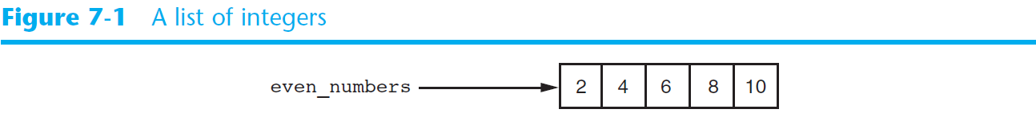
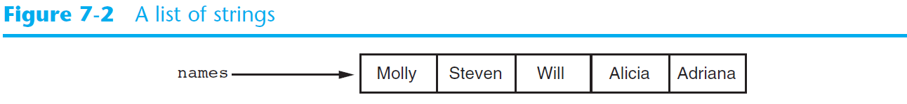
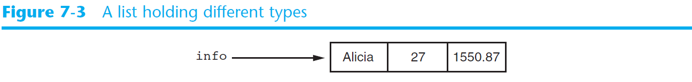
Introduction to Lists (cont’d.)

Slide 8
Printing an Entire List
We can use the print function to display an entire list
Example:
  even_numbers = [2, 4, 6, 8, 10]
  print(even_numbers)
Output:
  [2, 4, 6, 8, 10]

Slide 9
The list function
We can use the list function to convert certain types of objects to a list
Example:
  numbers = list(range(5))
is the same as:
  numbers = [0, 1, 2, 3, 4]
  Because range(5) generates the sequence 0, 1, 2, 3, 4

Slide 10

The Repetition Operator
Repetition operator: makes multiple copies of a list and joins them together
  The * symbol is a repetition operator when applied to a sequence and an integer
    Sequence is left operand, number is right
  General format: list * n

Slide 11
The Repetition Operator
Example:
  numbers = [0] * 5
creates the list [0, 0, 0, 0, 0]
Example:
  numbers = [1, 2, 3] * 3
creates the list [1, 2, 3, 1, 2, 3, 1, 2, 3]

Slide 12
Iterating over a List
You can iterate over a list using a for loop
  Format: for x in list:
  Example:
  numbers = [99, 100, 101, 102]
  for n in numbers:
  print(n)
  Displays 99, 100, 101 and 102

Slide 13
Indexing
Index: a number specifying the position of an element in a list
  Enables access to individual element in list
  Index of first element in the list is 0, second element is 1, and n’th element is n-1
  Negative indexes identify positions relative to the end of the list
    The index -1 identifies the last element, -2 identifies the next to last element, etc.

Slide 14
Indexing
Example:
  My_list = [10, 20, 30, 40]
  print(my_list[2])
  print(my_list[-4])
Displays
30
10

Slide 15
The len function
len function: returns the length of a sequence such as a list. Example:
  scores = [99, 75, 86, 92]
  num_scores = len(scores)
  print('Number of elements in the list:', num_scores)
  Output:
  Number of elements in the list: 4

Slide 16
Lists Are Mutable
Mutable sequence: the items in the sequence can be changed
  Lists are mutable, and so their elements can be changed
An expression such as
list[1] = new_value can be used to assign a new value to a list element

Slide 17
Lists Are Mutable
Example:
  scores = [99, 75, 86, 92]
  print(scores)
  scores[1] = 100
  print(scores)
  Output:
  [99, 75, 86, 92]
  [99, 100, 86, 92]

Slide 18
Concatenating Lists
Concatenate: join two things together
The + operator can be used to concatenate two lists
  Cannot concatenate a list with another data type, such as a number
The += augmented assignment operator can also be used to concatenate lists

Slide 19
Concatenating Lists
Example:
  list1 = [1, 2, 3, 4]
  list2 = [5, 6, 7, 8]
  list3 = list1 + list2
  print(list3)
  Output:
  [1, 2, 3, 4, 5, 6, 7, 8]

Slide 20
Concatenating Lists
Example:
  list1 = [1, 2, 3, 4]
  list2 = [5, 6, 7, 8]
  list1 += list2
  print(list1)
  Output:
  [1, 2, 3, 4, 5, 6, 7, 8]

Slide 21
List Slicing
Slice: a span of items that are taken from a sequence
  List slicing format: list[start : end]
  Span is a list containing copies of elements from start up to, but not including, end
    If start not specified, 0 is used for start index
    If end not specified, len(list) is used for end index
  Slicing expressions can include a step value and negative indexes relative to end of list

Slide 22
List Slicing
Example:
  list1 = ['A','B','C','D','E','F']
  list2 = list1[2:5]
  print(list2)
  Output:
  ['C', 'D', 'E']

Slide 23
List Slicing
Example:
  list1 = ['A','B','C','D','E','F']
  list2 = list1[:5]
  print(list2)
  Output:
  ['A', 'B', 'C', 'D', 'E']

Slide 24
List Slicing
Example:
  list1 = ['A','B','C','D','E','F']
  list2 = list1[2:]
  print(list2)
  Output:
  ['C', 'D', 'E', 'F']

Slide 25
List Slicing
  Slicing expressions can include negative indexes relative to end of list
Example:
  list1 = ['A','B','C','D','E','F']
  list2 = list1[-4:-2]
  print(list2)
  Output:
  ['C', 'D']

Slide 26
List Slicing
  Slicing expressions can include a step value
Example:
  list1 = ['A','B','C','D','E','F']
  list2 = list1[0:5:2]
  print(list2)
  Output:
  ['A', 'C', 'E']

Slide 27
Finding Items in Lists with the in Operator
You can use the in operator to determine whether an item is contained in a list
  General format: item in list
  Returns True if the item is in the list, or False if it is not in the list
Similarly you can use the not in operator to determine whether an item is not in a list

Slide 28
Example 1
Write a program to check whether a product code entered by the user is in the product list.

Slide 29
Example 1: Using in
def main():
prod_nums = ['V475', 'F987', 'Q143', 'R688']
search = input('Enter a product number: ')
if search in prod_nums:
print(search, 'was found in the list')
else:
print(search, 'was not found in the list')
# end of def main
main()

Slide 30
Example 1A: Using not in
def main():
prod_nums = ['V475', 'F987', 'Q143', 'R688']
search = input('Enter a product number: ')
if search not in prod_nums:
print(search, 'was not found in the list')
else:
print(search, 'was found in the list')
# end of def main
main()

Slide 31
List Methods and Useful Built-in Functions
append(item): used to add items to a list – item is appended to the end of the existing list
index(item): returns the index of the first element in the list containing item

Slide 32
List Methods and Useful Built-in Functions (cont’d.)
insert(index, item): used to insert item at position index in the list
sort(): used to sort the elements of the list in ascending order
remove(item): removes the first occurrence of item in the list
reverse(): reverses the order of the elements in the list

Slide 33
Example 2: The append Method
def main():
name_list = [] # create an empty list
again = 'y'
while again == 'y':
name = input('Enter a name: ')
name_list.append(name)
again = input('Do you want to add another name? [y/n]')
again = again.lower()
print()
print('Here are the names you entered.')
for name in name_list:
print(name)
# end of def main
main()

Slide 34
Example 3: The index Method
def main():
food = ['Pzza', 'Burgers', 'Chips']
print('Here are the items in the food list:')
print(food)
item = input('Which item should I change? ')
if item not in food:
print('That item was not found in the list')
else:
item_index = food.index(item)
new_item = input('Enter the new value: ')
food[item_index] = new_item
print('Here is the revised list:')
print(food)
# end of def main
main()

Slide 35
Example 4: The insert Method
def main():
names = ['James', 'Kathryn', 'Bill']
print('The list before the insert:')
print(names)
names.insert(0, 'Joe')
print('The list after the insert:')
print(names)
# end of def main
main()

Slide 36
Example 5: The sort Method
def main():
my_list = [9,1,0,2,8,6,7,4,5,3]
print('Original order:', my_list)
my_list.sort()
print('Sorted order:', my_list)
# end of def main
main()

Slide 37
Example 6: The remove Method
main():
food = ['Pzza', 'Burgers', 'Chips']
print('Here are the items in the food list:')
print(food)
item = input('Which item should I remove? ')
if item not in food:
print('That item was not found in the list')
else:
food.remove(item)
print('Here is the revised list:')
print(food)
# end of def main
main()

Slide 38
Example 7: The reverse Method
def main():
my_list = [1,2,3,4,5]
print('Original order:', my_list)
my_list.reverse()
print('Reversed:', my_list)
# end of def main
main()

Slide 39
List Methods and Useful Built-in Functions (cont’d.)
del statement: removes an element from a specific index in a list
  General format: del list[i]
min and max functions: built-in functions that returns the item that has the lowest or highest value in a sequence
  The sequence is passed as an argument

Slide 40
Example 8: The del Statement
def main():
my_list = [1,2,3,4,5]
print('Before deletion:', my_list)
del my_list[2]
print('After deletion:', my_list)
# end of def main
main()

Slide 41
Example 9: The min and max Functions
def main():
my_list = [5, 4, 3, 2, 50, 40, 30]
smallest = min(my_list)
largest = max(my_list)
print('The lowest value is', smallest)
print('The highest value is', largest)
# end of def main
main()

Slide 42
Summary
This chapter covered:
  Lists, including:
    Repetition and concatenation operators
    Indexing
    Techniques for processing lists
    Slicing lists
    List methods and built-in functions for lists

