Slide 2
Topics
Basic String Operations
String Slicing
Testing, Searching, and Manipulating Strings

Slide 3
Reading Assignment
Please read the following sections of the textbook:
  8.1 Basic String Operations
  8.2 String Slicing
  8.3 Testing, Searching and Manipulating Strings

Slide 4
Basic String Operations
Many types of programs perform operations on strings
In Python, many tools for examining and manipulating strings
  Strings are sequences, so many of the tools that work with sequences work with strings

Slide 5

Accessing the Individual Characters in a String
To access an individual character in a string:
  Use indexing
    Each character has an index specifying its position in the string, starting at 0
    Format: character = my_string[i]
  Use a for loop
    Format: for character in string:
    Useful when need to iterate over the whole string, such as to count the occurrences of a specific character

Slide 6
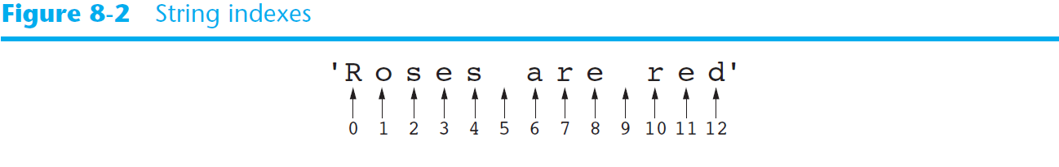
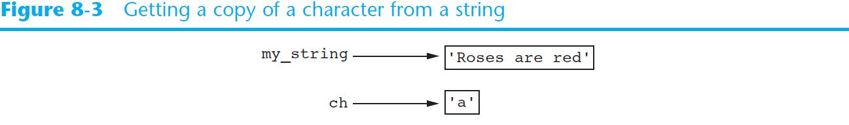
Accessing the Individual Characters in a String (cont’d.)
my_string = 'Roses are red'
ch = myString[6]

Slide 7
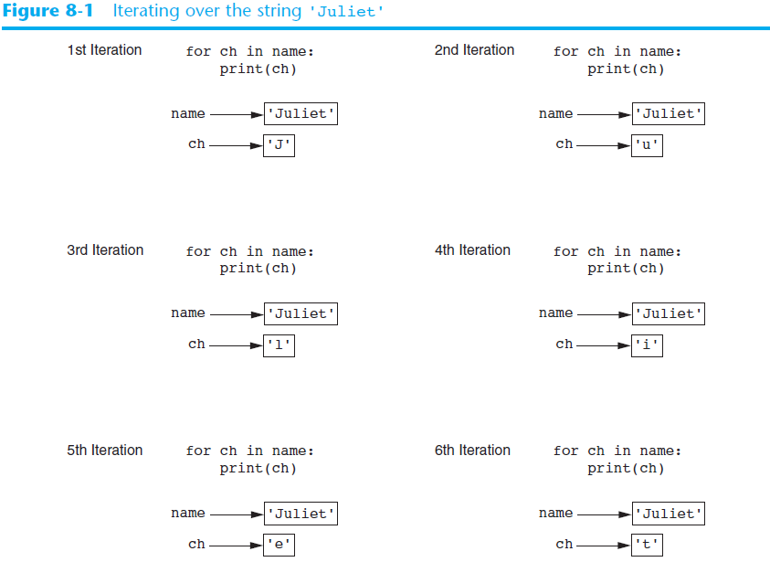

Slide 8
The len Function
The len function returns the number of characters in a string.
Example:
  city = 'Boston'
  size = len(city)
  size is 6 since there are 6 characters in 'Boston'

Slide 9
String Concatenation
Concatenation: appending one string to the end of another string
  Use the + operator to produce a string that is a combination of its operands
  The augmented assignment operator += can also be used to concatenate strings
    The operand on the left side of the += operator must be an existing variable

Slide 10
String Concatenation
Example :
  def main():
  message = 'Hello ' + 'world'
  print(message)
  main()
  Ouput:
  Hello world

Slide 11
String Concatenation
Example:
  def main():
  letters = 'abc'
  letters += 'def'
  print(letters)
  main()
  Ouput:
  abcdef

Slide 12
Strings Are Immutable
Strings are immutable
  Once they are created, they cannot be changed
  Cannot use an expression of the form
  string[index] = new_character
  Concatenation doesn’t actually change the existing string, but rather creates a new string and assigns the new string to the previously used variable

Slide 13
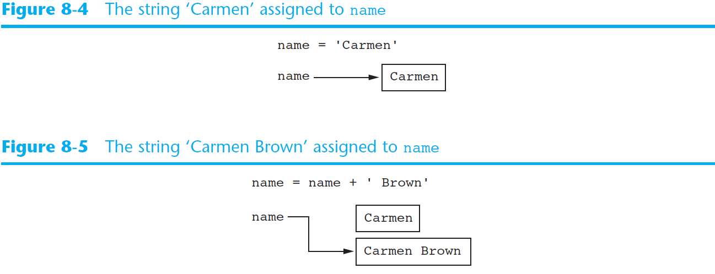
Strings Are Immutable (cont’d.)

Slide 14
String Slicing
Slice: span of items taken from a sequence, known as substring
  Slicing format: string[start : end]
    Expression will return a string containing a copy of the characters from start up to, but not including, end
    If start not specified, 0 is used for start index
    If end not specified, len(string) is used for end index
  Slicing expressions can include a step value and negative indexes relative to end of string

Slide 15
String Slicing
Example:
  def main():
  full_name = 'Patty Lynn Smith'
  middle_name = full_name[6:10]
  print(middle_name)
  main()
  Ouput:
  Lynn

Slide 16
String Slicing
Example:
  def main():
  full_name = 'Patty Lynn Smith'
  first_name = full_name[:5]
  print(first_name)
  main()
  Ouput:
  Patty

Slide 17
String Slicing
Example:
  def main():
  full_name = 'Patty Lynn Smith'
  last_name = full_name[11:]
  print(last_name)
  main()
  Ouput:
  Smith

Slide 18
String Slicing
Example:
  def main():
  full_name = 'Patty Lynn Smith'
  last_name = full_name[-5:]
  print(last_name)
  main()
  Ouput:
  Smith

Slide 19
String Slicing
Example:
  def main():
  letters = 'ABCDEFGHIJ'
  some_letters = letters[0:10:2]
  print(some_letters)
  main()
  Ouput:
  ACEGI

Slide 20
Example 1
System login names in a college are created by concatenating the first three letters of the first name, the first three letters of the last name and the last three characters of the student ID. Write a program to generate login names.

Slide 21
Example 1
def main():
first = input('Enter your first name: ')
last = input('Enter your last name: ')
idnumber = input('Enter your student ID number: ')
login_name = get_login_name(first, last, idnumber)
print('Your system login name is:', login_name)
# end of def main
def get_login_name(first, last, idnumber):
set1 = first[0:3]
set2 = last[0:3]
set3 = idnumber[-3:]
login_name = set1 + set2 + set3
return login_name
# end of def get_login_name
main()

Slide 22
Testing, Searching, and Manipulating Strings
You can use the in operator to determine whether one string is contained in another string
  General format: string1 in string2
    string1 and string2 can be string literals or variables referencing strings
Similarly you can use the not in operator to determine whether one string is not contained in another string

Slide 23
Using the in operator
Example:
  def main():
  text = 'Four score and seven years ago'
  if 'seven' in text:
  print('The string "seven" was found.')
  else:
  print('The string "seven" was not found.')
  main()

Slide 24
Using not in
Example:
  def main():
  text = 'Four score and seven years ago'
  if 'seven' not in text:
  print('The string "seven" was not found.')
  else:
  print('The string "seven" was found.')
  main()

Slide 25
String Methods
Strings in Python have many types of methods, divided into different types of operations
  General format: mystring.method(arguments)
Some methods test a string for specific characteristics
  Generally Boolean methods, that return True if a condition exists, and False otherwise

Slide 26
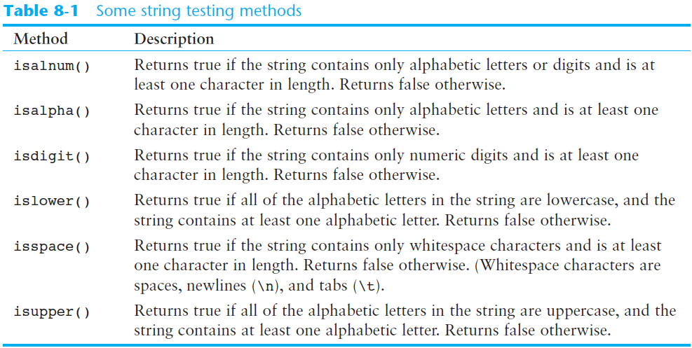
String Methods (cont’d.)

Slide 27
String Methods
Example:
  def main():
  string1 = '1200'
  if string1.isdigit():
  print(string1, 'contains only digits.')
  else:
  print(string1, 'contains characters other than digits.')
  main()

Slide 28
Example 2
Write a program to do the following:
Ask the user to enter a string
Use string methods listed in Table 8-1 to test the input string

Slide 29
Example 2
  def main():
  user_string = input('Enter a string: ')
  print('This is what I found about the strings: ')
  if user_string.isalnum():
  print('The string is alphanumeric.')
  if user_string.isdigit():
  print('The string contains only digits.')
  if user_string.isalpha():
  print('The string contains only alphabetic characters.')
  if user_string.isspace():
  print('The string contains only whitespace characters.')
  if user_string.islower():
  print('The letters in the string are all lowercase.')
  if user_string.isupper():
  print('The letters in the string are all uppercase.')
  # end of def main
  main()

Slide 30
String Methods (cont’d.)
Some methods return a copy of the string, to which modifications have been made
  Simulate strings as mutable objects
String comparisons are case-sensitive
  Uppercase characters are distinguished from lowercase characters
  lower and upper methods can be used for making case-insensitive string comparisons

Slide 31
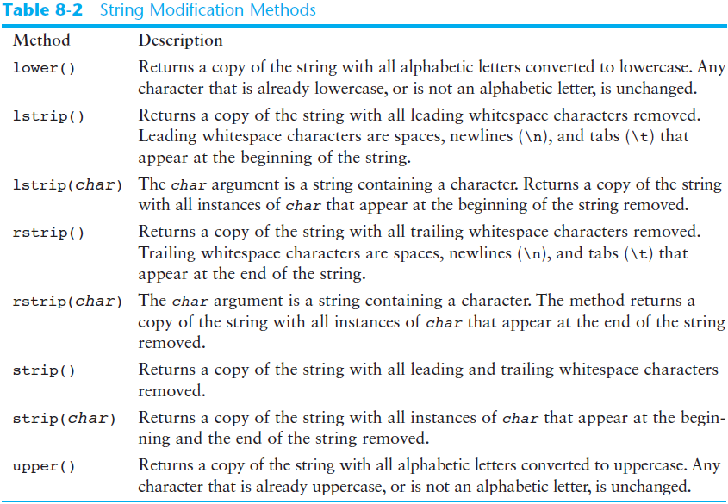
String Methods (cont’d.)

Slide 32
String Methods
Example:
  def main():
  user_string = ' ABCD '
  print('Before stripping spaces: ', user_string)
  user_string = user_string.strip()
  print('Before stripping spaces: ', user_string)
  main()

Slide 33
String Methods
Example:
  def main():
  user_string = '0001475'
  print('Before stripping spaces: ', user_string)
  user_string = user_string.lstrip('0')
  print('Before stripping spaces: ', user_string)
  main()

Slide 34
String Methods (cont’d.)
Programs commonly need to search for substrings
Several methods to accomplish this:
  endswith(substring): checks if the string ends with substring
    Returns True or False
  startswith(substring): checks if the string starts with substring
    Returns True or False

Slide 35
String Methods (cont’d.)
Several methods to accomplish this (cont’d):
  find(substring): searches for substring within the string
    Returns lowest index of the substring, or if the substring is not contained in the string, returns -1
  replace(substring, new_string):
    Returns a copy of the string where every occurrence of substring is replaced with new_string

Slide 36
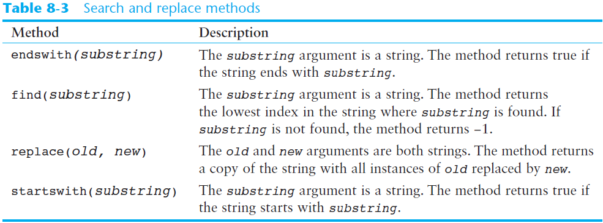
String Methods (cont’d.)

Slide 37
String Methods
Example:
  def main():
  filename = input('Enter the filename: ')
  if filename.endswith('.txt'):
  print('This is the name of a text file')
  elif filename.endswith('.doc'):
  print('This is the name of a word document')
  main()

Slide 38
Example 3
A computer system requires all passwords to fulfill the following requirements:
  Must not be shorter than 7 characters
  Must have at least 1 uppercase letter
  Must have at least 1 lowercase letter
  Must have at least 1 digit
Write a program that asks user to enter a password and check whether it is valid.

Slide 39
Example 3
def main():
password = input('Enter your password: ')
while not valid_password(password):
print('That password is not valid.')
password = input('Enter your password: ')
print('That is a valid password.')
# end of def main
def valid_password(password):
correct_length = False
has_uppercase = False
has_lowercase = False
has_digit = False
if len(password) >= 7:
correct_length = True
for ch in password:
if ch.isupper():
has_uppercase = True
if ch.islower():
has_lowercase = True
if ch.isdigit():
has_digit = True
if correct_length and has_uppercase and has_lowercase and has_digit:
is_valid = True
else:
is_valid = False
return is_valid
# end of def valid_password
main()

Slide 40
Example 4
Write a program to replace ‘-’ by ‘.’ in a course code. For example, change ‘CSC-121-8756’ to ‘CSC.121.8756’.

Slide 41
Example 4
def main():
course_code = input('Enter course code: ')
course_code = course_code.replace('-','.')
print("Course code with '-' replaced by '.':", course_code)
# end of def main
main()

Slide 42
The Repetition Operator
Repetition operator: makes multiple copies of a string and joins them together
  The * symbol is a repetition operator when applied to a string and an integer
    String is left operand; number is right
  General format: string_to_copy * n
  Variable references a new string which contains multiple copies of the original string

Slide 43
The Repetition Operator
Example:
  def main():
  string1 = 'Win'
  string2 = string1 * 3
  print(string2)
  main()

Slide 44
Splitting a String
split method: returns a list containing the words in the string
  By default, uses space as separator
  Can specify a different separator by passing it as an argument to the split method

Slide 45
Splitting a String
Example:
  def main():
  my_string = 'One two three four'
  word_list = my_string.split()
  print(word_list)
  main()
Output:
  ['One', 'two', 'three', 'four']

Slide 46
Splitting a String
Example:
  def main():
  date_string = '11/26/2014'
  date_list = date_string.split('/')
  print('Month:', date_list[0])
  print('Day:', date_list[1])
  print('Year:', date_list[2])
  main()

Slide 47
Splitting a String
Output:
  Month: 11
  Day: 26
  Year: 2014

Slide 48
Summary
This chapter covered:
  String operations, including:
    Methods for iterating over strings
    Repetition and concatenation operators
    Strings as immutable objects
    Slicing strings and testing strings
    String methods
    Splitting a string

