Slide 1
Style transfer from ineffective to effective arguments
Roxanne El Baff
*ACL 2023

Slide 2
Motivation

Slide 3
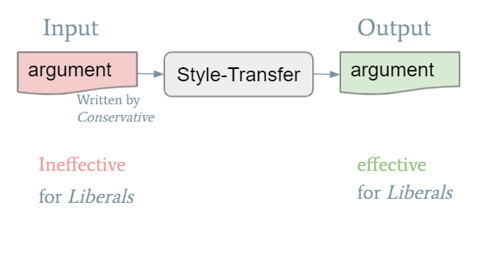
Motivation
We tackle the task of style-transfer between ineffective and effective arguments, where an ineffective argument is written by an author with ideology A and targeted at a reader with ideology B. (B = ㄱA)

Slide 4
Dataset

Slide 5
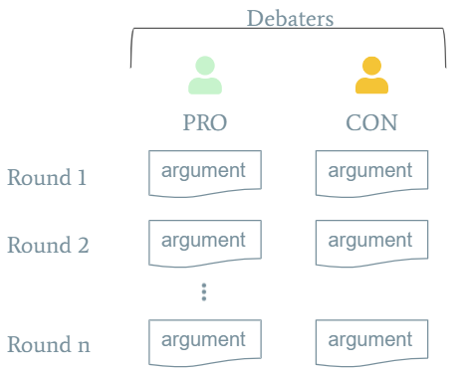
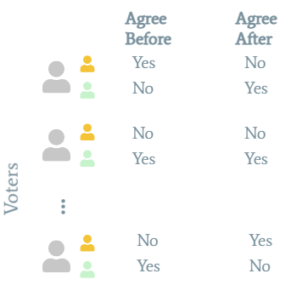
Dataset Overview
Liberal
Conservative

Slide 6
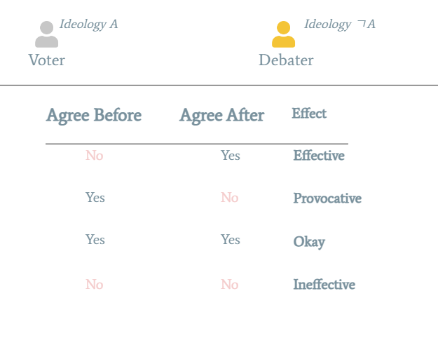
Dataset Overview

Slide 7

Dataset Defining Data Points
<argument>
<effect>

Slide 8
Dataset Defining Data Points
<argument>
<effect>
Majority votes for ideology X

Slide 9
Dataset Defining Data Points – which argument to use
Only the first debater‘s argument in debate
a
b
<argument>
<effect>
a
effective
b
ineffective

Slide 10
Dataset Defining Data Points – which argument to use
Only the last debater‘s argument in debate
<argument>
<effect>
a
effective
b
ineffective
a
b

Slide 11
Dataset Defining Data Points – which argument to use
First+last debater‘s argument in debate
a1
b1
<argument>
<effect>
a1+a2
effective
b1+b2
ineffective
a2
b2

Slide 12
Dataset Defining Data Points – which argument to use
last debater‘s argument in debate with the previous opposite argument
<argument>
<effect>
opp_a+a
effective
opp_b
opp_a
opp_b+b
ineffective
a
b

Slide 13
Dataset Defining Data Points – which argument to use
Each argument in the debate
<argument>
<effect>
a
effective
a
b
b
ineffective
c
effective
c
d
d
ineffective
e
f
e
effective
f
ineffective

Slide 14
Dataset Defining Data Points – which argument to use
Data distribution – check google sheet file

Slide 15
Style Features

Slide 16
Style Features
LIWC
NRC emotion
MPQA Arg
Empath (default)
Empath (ideology based)
Trained on Transformers
Emotion using the GoEmotion dataset
Emotion (Hartmann) using several datasets
Hedge
Typos
Toxicity
… searching for more

Slide 17
Style Features
LIWC
NRC emotion
MPQA Arg
Empath (default)
Empath (ideology based)
Trained on Transformers
Emotion using the GoEmotion dataset
Emotion (Hartmann) using several datasets
Hedge
Typos
Toxicity
… searching for more
Technical Details:
I was facing some performance issues so I moved from local pc to DLR Server
I am using spacy to build a pipeline:
I created a pipe for each feature predictor
For liberal, training data (46,792) the code is still running for more than 59 hours

Slide 18
Approach (suggestion)

Slide 19
Approach
Extract discriminative style features: s1, s2…sn
extract style features and define top n discriminative features between effective and ineffective arguments by:
running significance tests
PCA, or T-sne
training an (SVM) classifier for effective/ineffective arguments
We can try all three options and choose the one that suits us?

Slide 20
Delete Retrieve Generate
Tackles the task of text-attribute transfer: transforming a sentence to alter a specific attribute (e.g., sentiment) while preserving its attribute-independent content
Identify attribute markers that happens on 1 side (e.g. horrible)
Given a sentence, delete these attribute markers and consider the other words as content
Retrieve a sentence with similar content from the opposite corpus
Reconstruct by incorporating a neural generative model

Slide 21
Approach yang 2022
Select the top 3 discriminative features (Style A..C) between ineffective and effective for Ideology X
Mask ineffective arguments x_{a} --> z_{a}
For each style A..B
Calculate the style contribution of each word and mask the main contributors
Repeat this operation until style cannot be clearly distinguished from the masked sentence by the classifier.
Generate yang 2022
Approach 1
Mask (as above) effective arguments where we will have x_{b} --> z_{b}
Train a generator to transfer x_{b} --> z_{b}
Apply this generator on za
Approach 2
Use T5 to solve multitasks:
Classification task for Style A..C using filtered dataset: dataset with labels for effective arguments
LM task: fill the gap in ineffective arguments

Slide 22
Big Picture for ideology x
Zero-shot
Fine-Tuned w
effective args
Fine-Tuned w
ineffective args
Style Transfer
Approach 1
Style Transfer
Approach n
VS.
VS.
VS.
VS.

Slide 23
Using DistilGPT2
Fine tune 4 Distilgpt2 models using
Liberal effective dataset
Liberal ineffective dataset
Conservative effective dataset
Conservative ineffective dataset
Demo

