Slide 1

Data Cleaning and Data Visualization
With Correlation Heatmap using Pearson Algorithm
By: Roxanne Prajapati

Slide 2
Overview
GOAL : Clean and analyze a messy dataset
FOCUS: Relationship between Age, Salary, and Tenure
METHODS: Data cleaning, visualization, correlation, outlier detection
Notes:
In this activity,
I worked with a messy employee dataset.
The goal was to clean the data and analyze the relationship between age, salary, and tenure using visualization, correlation, and outlier detection.

Slide 3
Dataset Overview
Number records before cleaning: 10
Number of records after cleaning: 9
New columns:
Salary_NZD
Tenure_Years (derived from join date)
Age_Outlier (True/False)
Salary_NZD_Outliers (True/False)
Issues Found:
Missing Values
Text instead of numbers (e.g., “thirty-eight”)
Duplicate records
Inconsistent country codes
Salary values in different currencies (NZD and AUD)
Notes:
This slide provides an overview of the dataset.
The dataset originally contains 10 records, and after cleaning, it was reduced to 9 records due to the removal of duplicate entries.
Several new columns were created to support the analysis. These include Salary_NZD, which standardizes salary into a single currency, and Tenure_Years, which is calculated from the join date. I also added outlier flags for age and salary to help identify unusual values.
The dataset contains several data quality issues. These include missing values, text instead of numeric values, such as “thirty-eight”, duplicate records, and inconsistent country codes.
In addition, salary values were recorded in different currencies, specifically NZD and AUD, which required standardization to ensure a fair comparison.

Slide 4
Data Cleaning Process
Data Scrubbing
Fixed text values - numbers (e.g., “thirty-eight” to 38)
Removed duplicates
Fixed invalid date
Data Munging
Standardized country codes (AU to AUS)
Cleaned names and formats
Converted data types
Data Wrangling
Filled missing values using median
Created Tenure_Years
Detected outliers using IQR
Converted salary
Notes:
The data was cleaned in three steps. Data scrubbing converted text values into numbers, merged duplicate IDs, and fixed invalid dates. Data munging standardized formats like country codes and names. Data wrangling filled missing values, converted salary to NZD, created tenure, and added outlier detection using the IQR method.

Slide 5
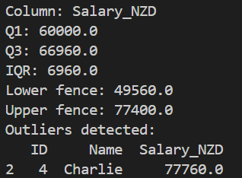
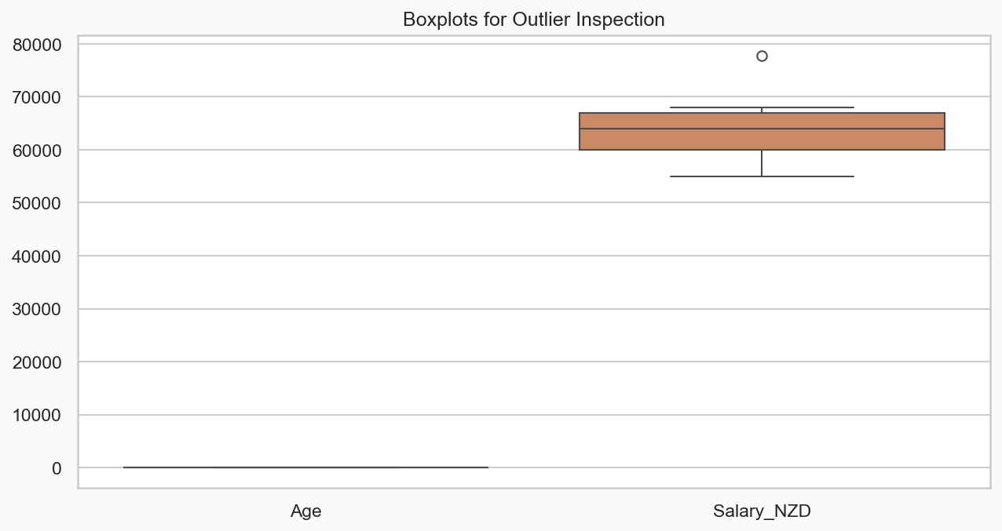
Outliers (IQR Method)
Charlie: $77,760 NZD
Slightly above upper fence detected as outlier after the currency conversion (AUD to NZD)
Notes:
This slide shows the outlier analysis using the IQR method. The upper fence is $77,400, and Charlie’s salary of $77,760 is slightly above this threshold, so it is detected as an outlier.
However, this outlier is not due to an unusually high salary, but rather the result of converting AUD to NZD. This shows that data transformations can affect outlier detection and should be interpreted carefully.

Slide 6
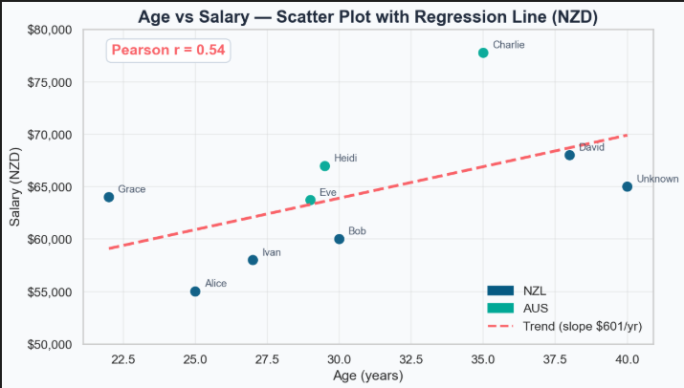
Key Findings
Age has a moderate positive relationship with salary (r = 0.54, $601/year)
Grace is an exception (+$2,720 above average)
Tenure has no impact (r = -0.12)
Notes:
Age has a moderate positive relationship with salary (r = 0.54) - There is a moderate positive correlation (r = 0.54) between age and salary (in NZD), indicating that older employees generally earn more. On average, salary increases by approximately $601 NZD per year of age, showing a clear upward trend, although the relationship is not very strong.
Grace (22) is an exception to the trend - Although younger employees usually earn less, Grace (22) earns $64,000 NZD, which is $2,720 above the average salary of employees aged 30 and under ($61,280 NZD). She earns more than several older employees, showing that salary is influenced by other factors.
Tenure has no meaningful relationship with salary (r = -0.12) - The correlation between tenure and salary is very weak and slightly negative (r = -0.12), meaning that years of service do not increase salary. In some cases, employees with longer tenure may even earn less than newer employees, suggesting that tenure is not a key factor in salary decisions..

Slide 7
Conclusion & takeaways
Real-world data is messy that’s why data cleaning and validation are important to avoid incorrect analysis
Small datasets can still provide meaningful insights when properly prepared and analyzed
Data transformations, such as currency conversion, can affect results and must be carefully interpreted
Notes:
In conclusion, this activity shows that real-world data is often messy, so proper cleaning is very important to avoid incorrect results.
Even with a small dataset, meaningful insights can still be obtained when the data is prepared properly.
However, transformations like currency conversion can affect the results, so they must be interpreted carefully

Slide 8
Thank you

