Slide 1
Fitness App User Clustering
Data cleaning and feature selection for unsupervised user segmentation
200
0
1
4
user records
missing values
invalid duration corrected
clustering features
Data cleaning process
Features used for clustering
Why these features?
Checked missing values: none found.
Checked duplicate rows and duplicate User_ID: none found.
Corrected data types for numeric and categorical columns.
Replaced one invalid negative session duration with the positive median session duration.
Age
Workouts_per_Week
Avg_Session_Duration_Min
Steps_per_Day
Excluded User_ID, Gender, Subscription_Type and Churned from model training.
They describe fitness behaviour and app engagement.
They are numeric, simple to standardize, and suitable for K-Means.
Subscription type and churn were kept for cluster interpretation only.
Notes:
The dataset contains 200 fitness app users. The cleaning step found no missing values or duplicates. One negative session duration was inconsistent, so it was replaced with the positive median. Four behavioural numeric features were selected for clustering.

Slide 2
Clustering Methodology
K-Means was applied after standardizing the selected features
Method used
Algorithm: K-Means clustering.
Scaling: StandardScaler was used so all features had equal influence.
Random state: 42 for repeatable results.
K was tested from 2 to 8 clusters.
Notes:
The features were standardized before K-Means to avoid steps per day dominating the model. Different k values were compared using elbow and silhouette methods. K equals 4 was selected because it had the highest silhouette score and produced easy-to-explain customer groups.

Slide 3
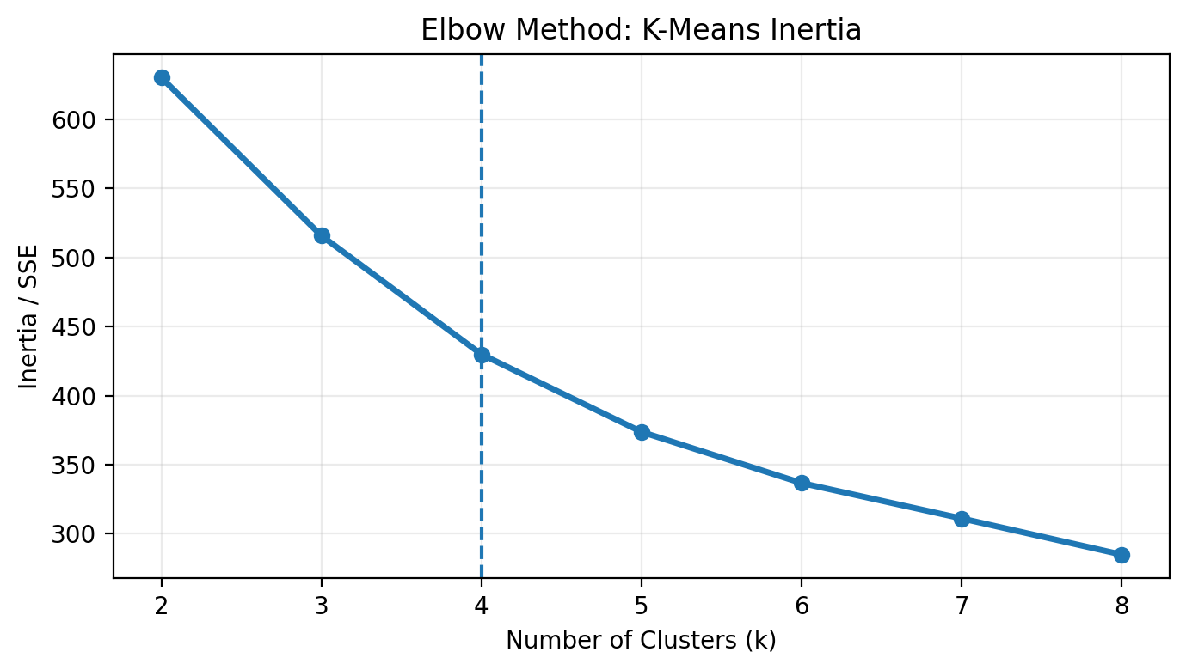
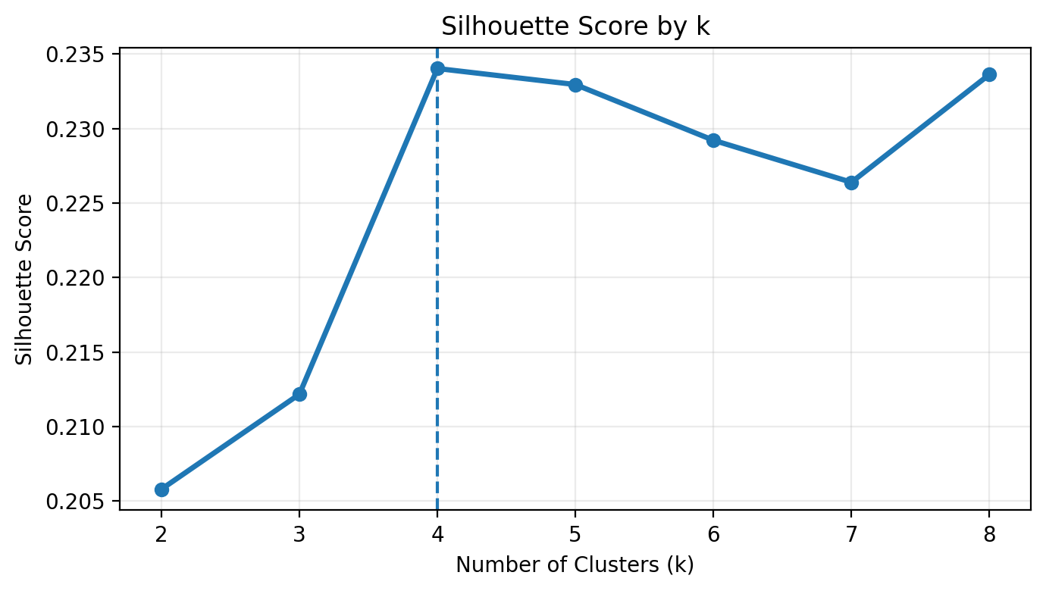
Clustering Methodology (contd.)
Optimal number of clusters: k = 4
• The silhouette score is highest at k = 4 among the tested values.
• The elbow curve also shows a steady improvement up to around 4 clusters before smaller gains.
• Four clusters provide a practical balance between model quality and easy business interpretation.
Fitness_App_User_Data.xlsx • Slide 2
Notes:
The features were standardized before K-Means to avoid steps per day dominating the model. Different k values were compared using elbow and silhouette methods. K equals 4 was selected because it had the highest silhouette score and produced easy-to-explain customer groups.

Slide 4
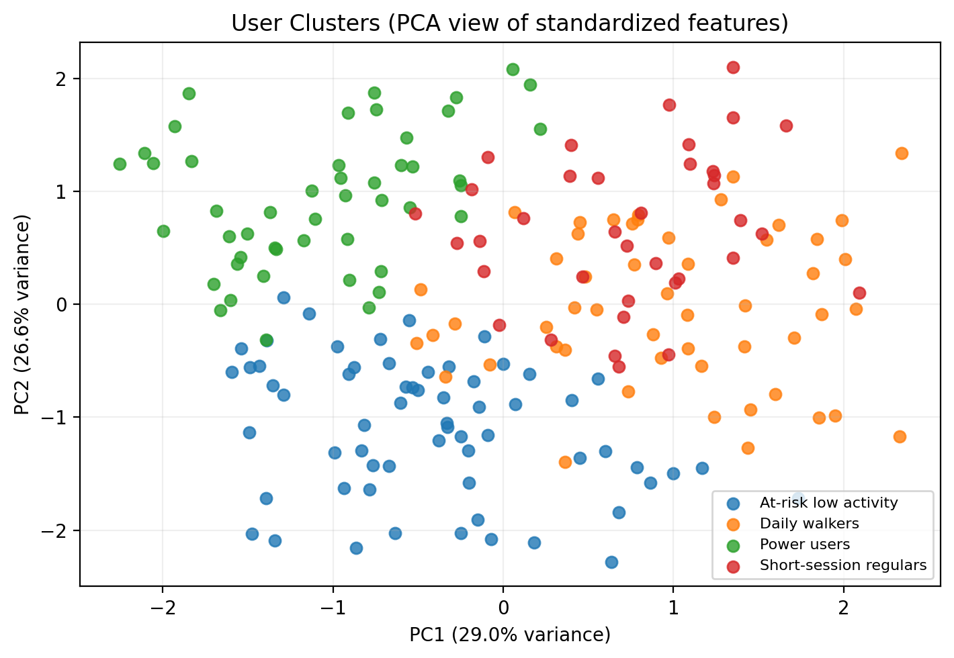
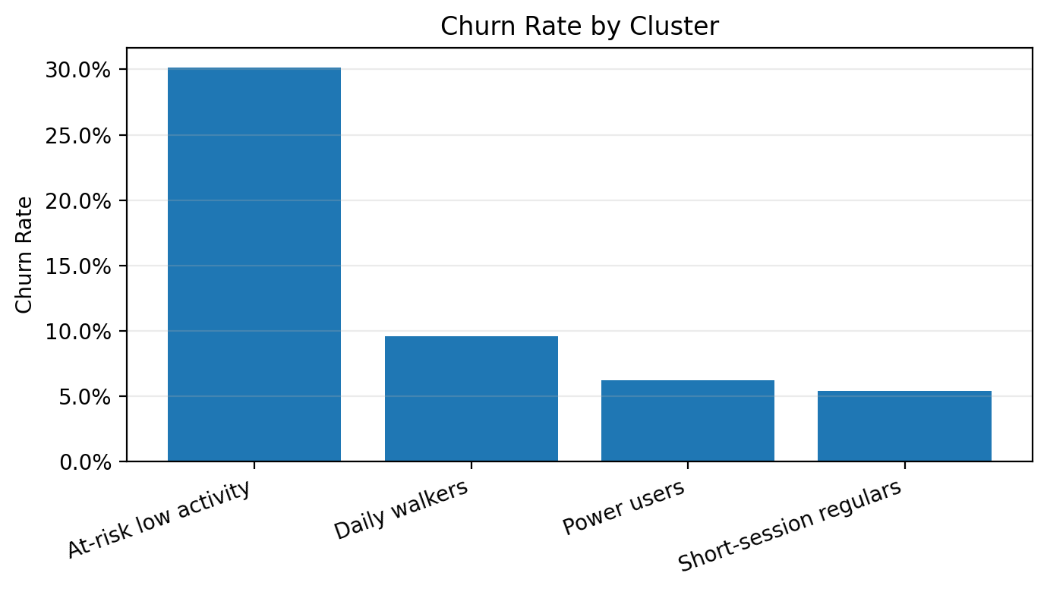
Key Findings and Insights
Four meaningful user segments were identified from activity patterns
Cluster
Users
Profile
Churn
At-risk low activity
63
Low steps, moderate sessions
30%
Daily walkers
52
High steps, few workouts
10%
Power users
48
High workouts + high steps
6%
Key Findings:
Short-session regulars
37
Frequent short workouts
5%
Four distinct user segments were identified.
Cluster 0 exhibited the highest churn rate (30%).
Clusters 2 and 3 demonstrated the strongest engagement levels.
Workout frequency and daily step count appear to be important indicators of user retention.
Highly engaged users are less likely to leave the platform.
Notes:
The strongest business insight is that the low-activity segment has the highest churn rate at around 30 percent. Power users and short-session regulars have much lower churn. The app could focus retention campaigns on low-activity users and offer different fitness journeys for walkers, power users, and short-session regulars.

