Slide 1
Week 11 – Activity 2
New Zealand Wellbeing Statistics
(2014–2018) | Time-Series Forecasting Project
Roxanne Peñaverde Prajapati
MSE803 – Data Analytics

Slide 2
Project Overview
Objective
Dataset
Forecasting Models
Forecast next year's wellbeing value
Compare five forecasting models
Evaluate prediction accuracy
Select the best-performing model
Source: Stats NZ – Wellbeing Time Series Explorer
Measure: Overall Life Satisfaction
Population: Total
Years: 2014, 2016, 2018
Linear Regression
XGBoost
ANN (Artificial Neural Network)
LSTM (Deep Learning)
ARIMA (Statistical)

Slide 3
Data Preparation & Processing
Load Dataset
Key Processing Steps
Extract Total Population
Loaded Excel dataset from Stats NZ Filtered Total Population records Removed blank values and corrected data types Interpolated missing years (2015, 2017) between survey points Created Time_Index feature (sequential integer) Created Lag_1 feature (previous year's wellbeing value) Split data into training (80%) and testing (20%) sets
Clean Data
Interpolate Missing Years
Feature Engineering
Train-Test Split
Forecasting Models
Model Evaluation
Next-Year Forecast

Slide 4
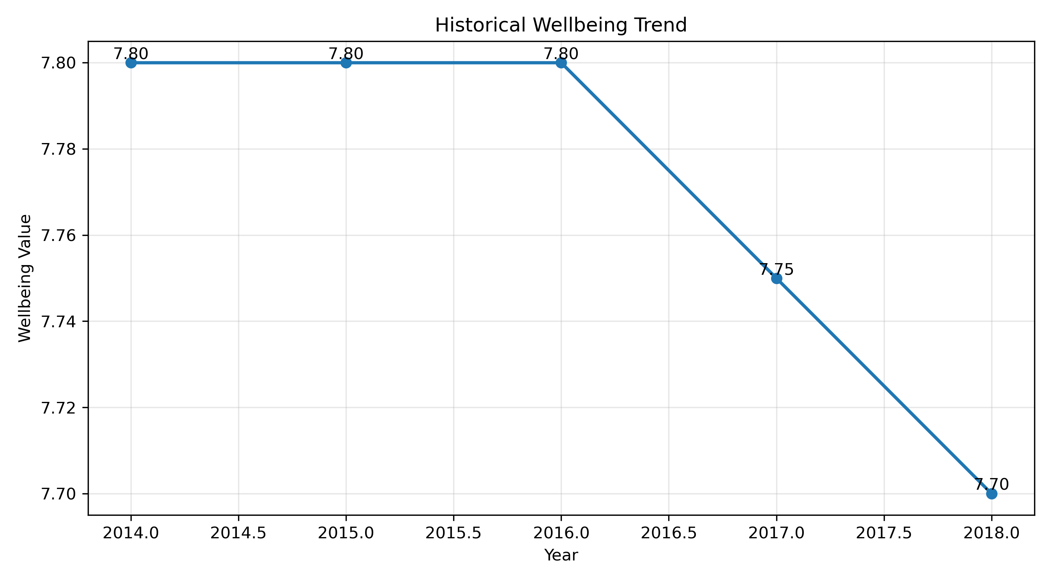
Historical Wellbeing Trend
What the graph shows
Wellbeing remained stable from 2014 to 2016
A slight decline occurred from 2016 to 2018
Overall life satisfaction changed only marginally
Why this matters
Reveals the historical trend before forecasting
Helps understand year-on-year changes
Provides context for model selection

Slide 5
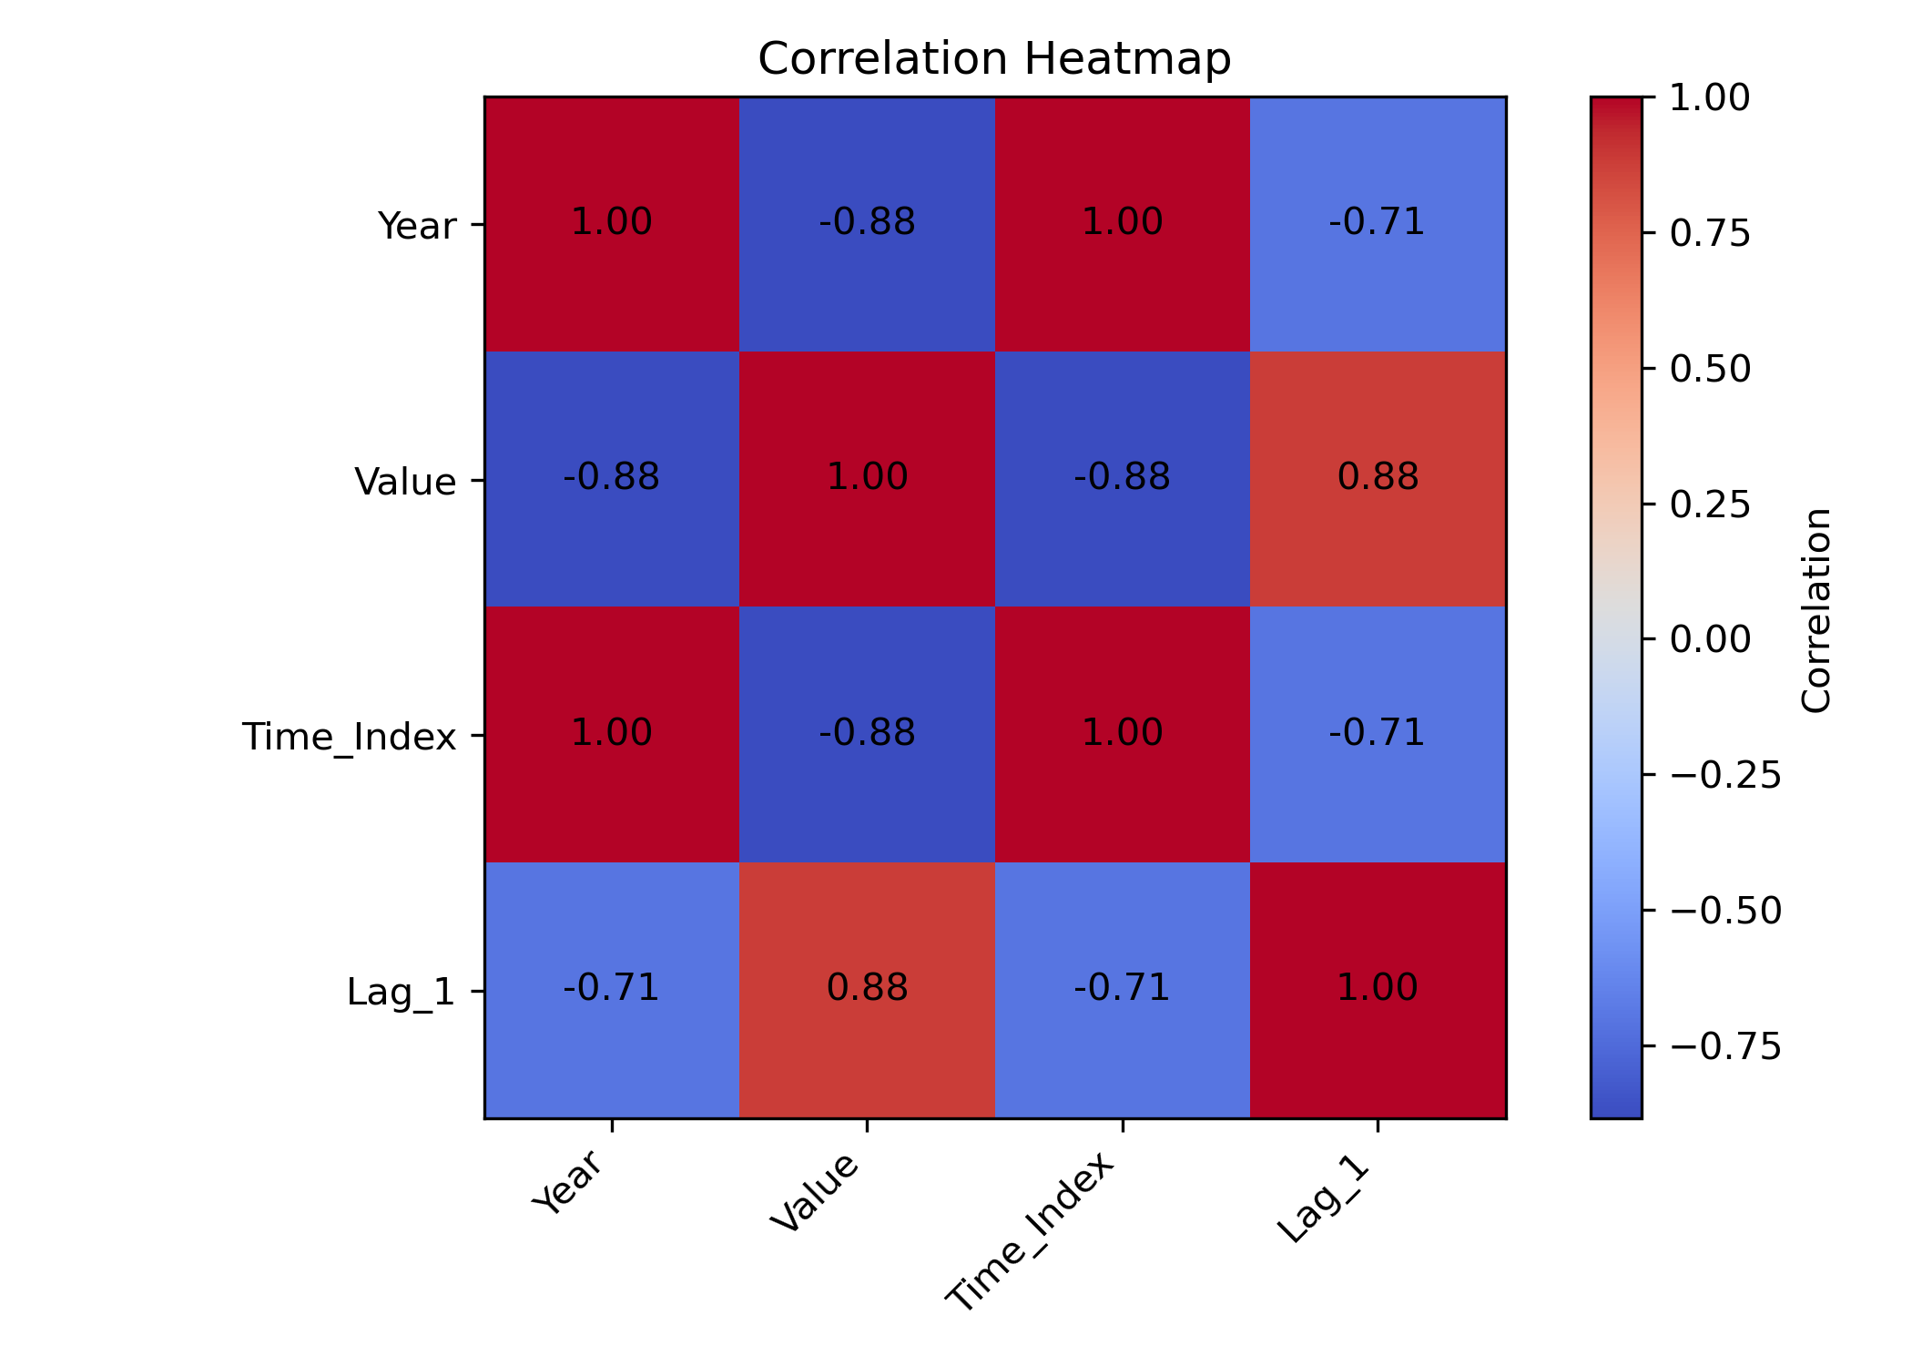
Correlation Analysis
What the heatmap shows
Year and Time_Index are perfectly correlated (+1.00)
Lag_1 has a strong positive relationship with wellbeing (+0.88)
Previous year's wellbeing predicts future wellbeing
Why this matters
Identifies relationships between all variables
Supports and validates feature engineering choices
Confirms Lag_1 as a useful forecasting predictor

Slide 6
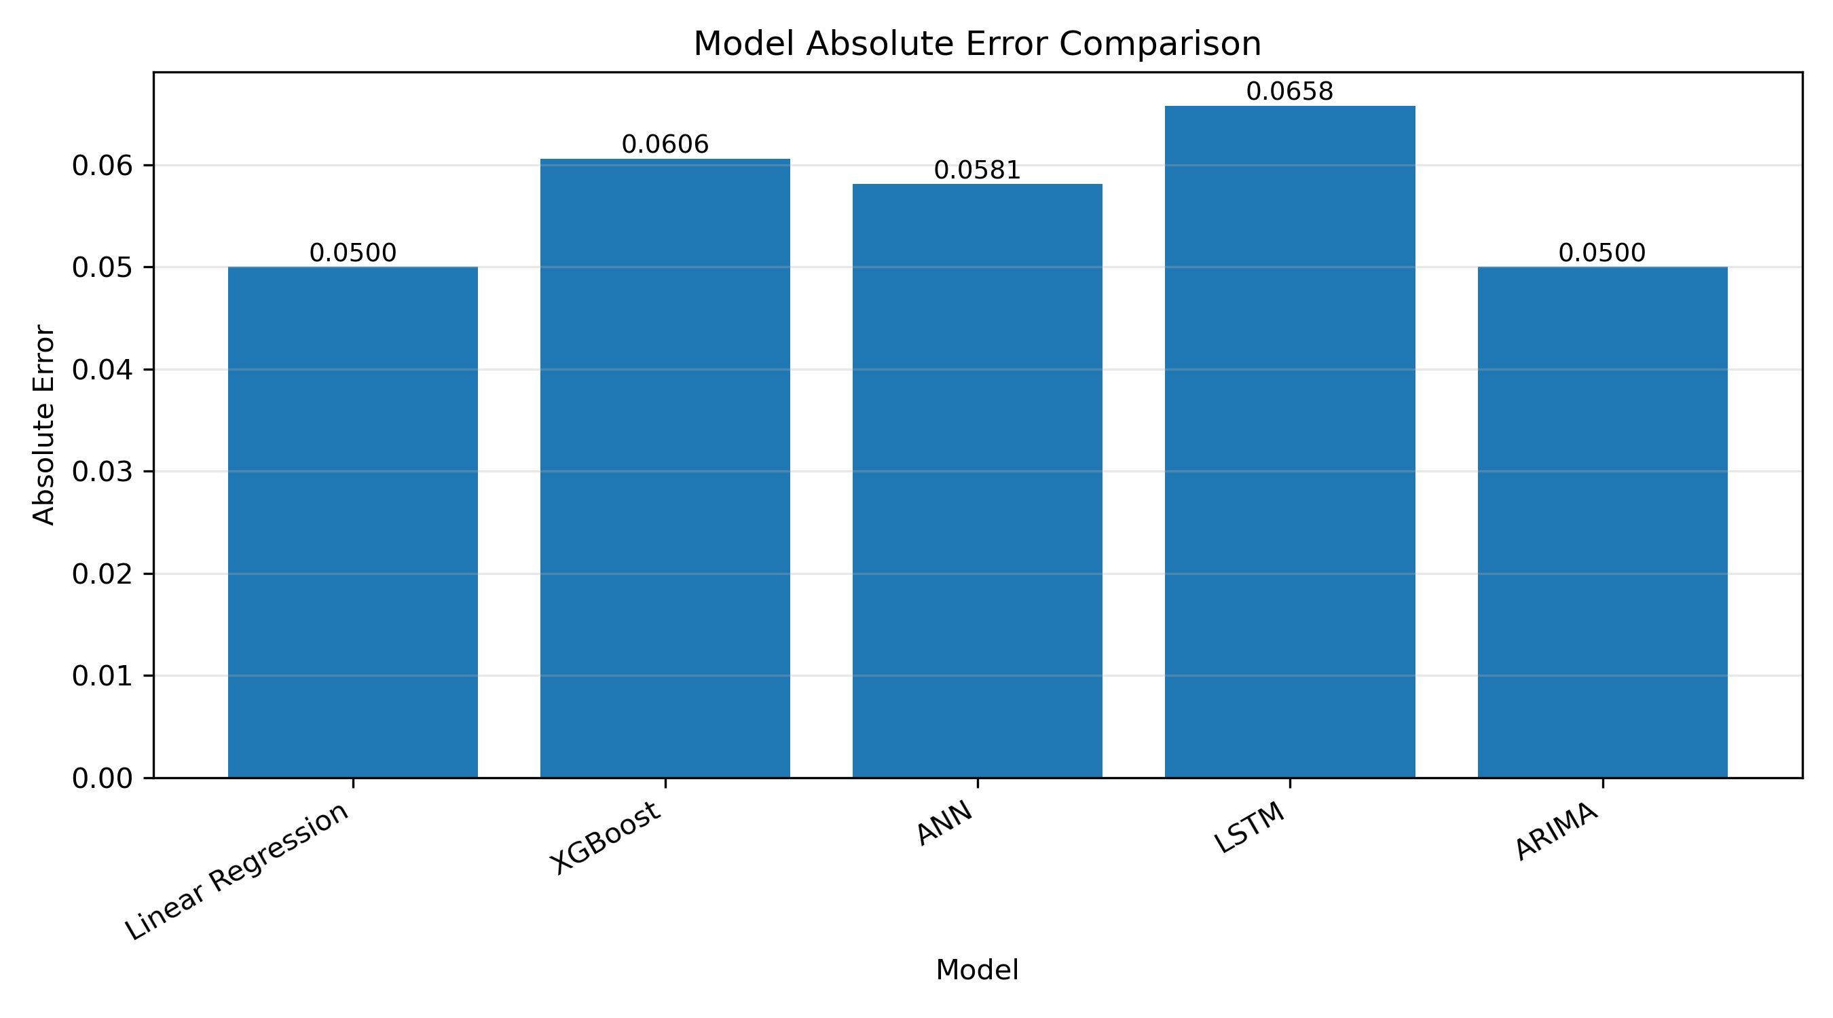
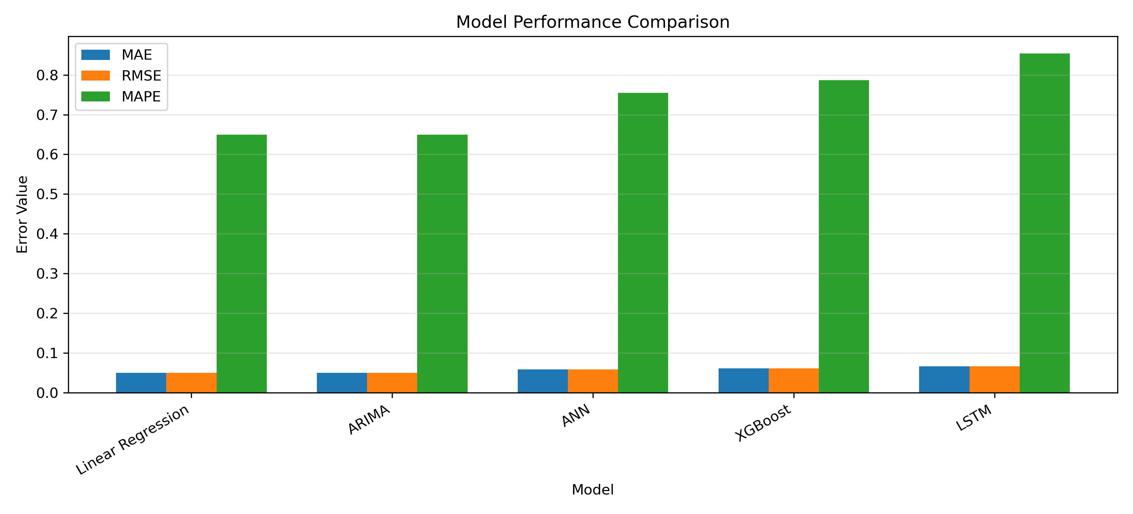
Model Performance
★ Linear Regression & ARIMA achieved the lowest error scores
★ Linear Regression & ARIMA achieved the lowest error — best performers for this dataset

Slide 7
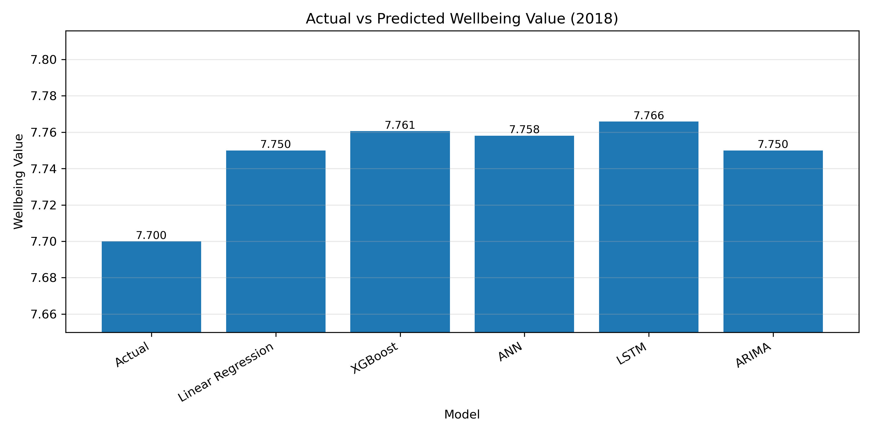
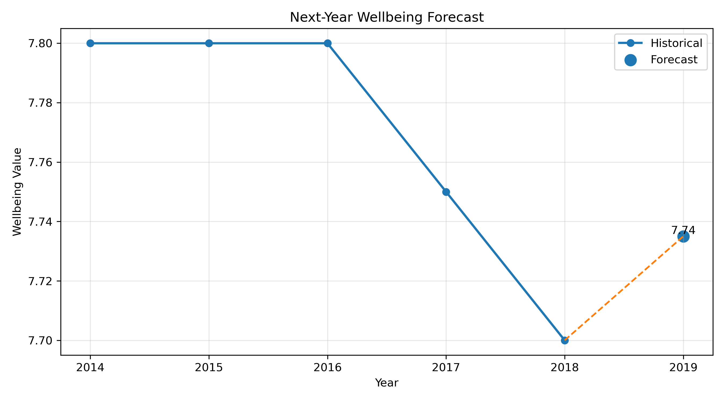
Forecast Results
1
2
3
All models predicted values close to the actual 2018 value of 7.70
Best model (Linear Regression) forecasts 7.74 for 2019
Wellbeing is expected to remain relatively stable in 2019

Slide 8
Key Findings
01
Stable Wellbeing Trend
Overall life satisfaction in New Zealand remained relatively stable between 2014 and 2018, showing only a modest decline from 7.80 to 7.70.
02
Simpler Models Outperformed Complex Ones
Linear Regression and ARIMA outperformed deep learning models such as ANN and LSTM. This outcome is expected when working with a small dataset that contains insufficient observations to train complex neural networks effectively.
03
Successful Forecasting Demonstrated
The forecasting process successfully predicted the next year's wellbeing value (7.74 for 2019), demonstrating how predictive analytics can support evidence-based future planning and decision-making.

