Slide 1
Crypbot
An In-Depth Overview of the Process and Techniques

Slide 2
Introduction to Trading Bots
Trading bots are automated software that buy and sell assets in the financial markets based on predefined strategies.
They can be used in stock trading, cryptocurrency trading, and other financial markets.

Slide 3
Project Overview
This project involves the development of a trading bot for the cryptocurrency market.
The bot was developed using various machine learning and deep learning models, along with time series analysis.

Slide 4
Data Source: Binance Testnet API
Binance Testnet API was used as the data source for this project.
The testnet environment allows developers to test their trading strategies without risking real money.

Slide 5
Understanding Binance Testnet
Binance Testnet mimics the live trading environment of Binance but uses virtual funds.
It's ideal for testing trading strategies and algorithms safely.

Slide 6
Data Parameters
Time Frame: 1 Minute
Time Horizon: From 1st January 2020 to the current time.
Currency: BTCUSDT (Bitcoin to USDT).

Slide 7
Data Preprocessing - Overview
Data preprocessing is a crucial step to ensure that the data is clean, consistent, and ready for analysis.
This step includes checking for missing data, filling gaps, and performing validation checks.

Slide 8
Handling Missing Data
Missing timesteps were identified and filled using linear interpolation.
Linear interpolation estimates missing values based on neighboring data points.

Slide 9
Validation Checks
Validation checks ensure data integrity:
Low should not be greater than High.
High should be greater than or equal to Open.
Close should not be greater than High.

Slide 10
Technical Indicators - Introduction
Technical indicators are mathematical calculations based on the price, volume, or open interest of a security.
They are used to forecast future price movements.

Slide 11
RSI (Relative Strength Index)
RSI measures the speed and change of price movements.
It oscillates between 0 and 100, with values above 70 indicating an overbought condition and below 30 indicating an oversold condition.

Slide 12
MACD (Moving Average Convergence Divergence)
MACD is a trend-following momentum indicator that shows the relationship between two moving averages of a security's price.
The MACD line is the difference between the 12-day and 26-day exponential moving averages (EMA).

Slide 13

MACD Signal Line
The MACD signal line is a 9-day EMA of the MACD line.
It is used to identify buy or sell signals based on crossovers with the MACD line.

Slide 14
MACD Histogram
The MACD histogram represents the difference between the MACD line and the MACD signal line.
Positive values indicate bullish momentum, while negative values indicate bearish momentum.

Slide 15
ADX (Average Directional Index)
ADX measures the strength of a trend.
Values above 25 indicate a strong trend, while values below 20 suggest a weak trend.

Slide 16
Average True Range (ATR)
ATR is a volatility indicator that measures the degree of price movement for a given period.
Higher ATR values indicate higher volatility, while lower values indicate lower volatility.

Slide 17
Bollinger band
popular tool among investors and traders, helps gauge the volatility of stocks and other securities to determine if they are over- or undervalued.
The center line is the stock price's 20-day simple moving average (SMA).
The upper and lower bands are set at a certain number of standard deviations, usually two, above and below the middle line.

Slide 18
Simple Moving Average (SMA)
SMA calculates the average price of a security over a specified number of periods.
It smooths out price data and helps identify trends.

Slide 19
Exponential Moving Average (EMA)
EMA is similar to SMA but gives more weight to recent price data.
It is more responsive to recent price changes.

Slide 20
Developing the Trading Strategy
The strategy combines multiple indicators (e.g., RSI, MACD, ADX) to generate buy/sell signals.
The goal is to maximize returns while minimizing risk.

Slide 21
Trading Strategy Rules
Entry: Buy when RSI < 30 and MACD crosses above the signal line.
Exit: Sell when RSI > 70 or MACD crosses below the signal line.
Stop Loss: Set at a predetermined ATR level to limit potential losses.

Slide 22
Implementing the Strategy in Python
The trading strategy was implemented in Python using the Pandas and TA-Lib libraries.
TA-Lib provides functions to calculate technical indicators, while Pandas handles data manipulation.

Slide 23
Backtesting the Strategy
The strategy was backtested on historical data to evaluate its performance.
Backtesting allows us to simulate the strategy's behavior over time.

Slide 24
Backtesting Results - Overview
The strategy's performance was evaluated based on several metrics:
- Net Profit
- Maximum Drawdown
- Win/Loss Ratio
- Sharpe Ratio

Slide 25
Net Profit and Drawdown
Net Profit: The total profit or loss from the strategy after all trades.
Drawdown: The maximum observed loss from a peak to a trough.

Slide 26
Win/Loss Ratio
Win/Loss Ratio: The ratio of profitable trades to losing trades.
A higher ratio indicates a more successful strategy.

Slide 27
Sharpe Ratio
Sharpe Ratio: A measure of the risk-adjusted return of the strategy.
Higher Sharpe ratios indicate better risk-adjusted returns.

Slide 28
Optimization of Strategy
The strategy was optimized by adjusting the indicator parameters to improve performance.
This involved testing different time periods and thresholds for RSI, MACD, and ADX.

Slide 29
Machine learning
Machine learning (ML) is a subset of artificial intelligence (AI) that uses algorithms and data to teach computers to learn without direct instruction.
There are multiple types of ML prominent are:
Supervised Learning
Unsupervised Learning
Semi Supervised learning
Federated learning

Slide 30
ML modeling
We were to predict next closing price to place the trades, so we have used Supervised learning.
Next Close price was predicted using previous open, high, low and close values.
If predicted close is greater than current close, the trade position will be long.
If predicted close is less than current close, the trade position will be short.

Slide 31
Models used
Yet to be added

Slide 32
Implementation on Binance Testnet
The optimized strategy was implemented on the Binance Testnet.
This allowed for real-time testing in a simulated environment.

Slide 33
Trade Execution Flow
The trade execution flow includes:
1. Fetching data and calculating indicators.
2. Opening trades based on signals.
3. Monitoring trades and based on signals and TP/SL.
4. Closing trades and recording results.

Slide 34
Trade Monitoring
After opening a trade, the bot continuously monitors the market.
If the indicators change, the bot may adjust the trade or close it.

Slide 35
Real-time Data Handling
The bot fetches real-time data from the Binance API.
Data handling involves processing incoming data and updating indicators.

Slide 36
Handling API Errors
The bot is equipped with error-handling routines to manage API errors.
Common issues include rate limits, connection errors, and unexpected responses.

Slide 37
Logging and Reporting
The bot logs all trade actions, errors, and performance metrics.
Logs are reviewed to assess performance and identify issues.

Slide 38
Performance Metrics
Key performance metrics include:
Consecutive wins/losses
Win/Loss Ratio
Maximum Drawdown

Slide 39
Real-time Testing Results
The bot was tested in real-time on the Binance Testnet.
Results showed a consistent performance with positive ROI.

Slide 40
Optimization and Future Work
Further optimizations include fine-tuning the strategy and improving risk management.
Future work may involve exploring additional indicators and AI techniques.

Slide 41
Conclusion
The trading bot successfully demonstrated the potential of algorithmic trading.
It highlights the importance of robust strategies, continuous monitoring, and optimization.

Slide 42
Questions
Thank you for your attention!
Any questions?

Slide 43
Simulation
A simulation was created that will run every hour to fetch data and generate signals.
These signals along with metadata will be saved in a database.
The information will be used to place trades and monitor the performance of individual models.

Slide 44
Integration
The information of individual models was displayed in a web app.
This webapp was developed using flask and rest APIs.

Slide 45
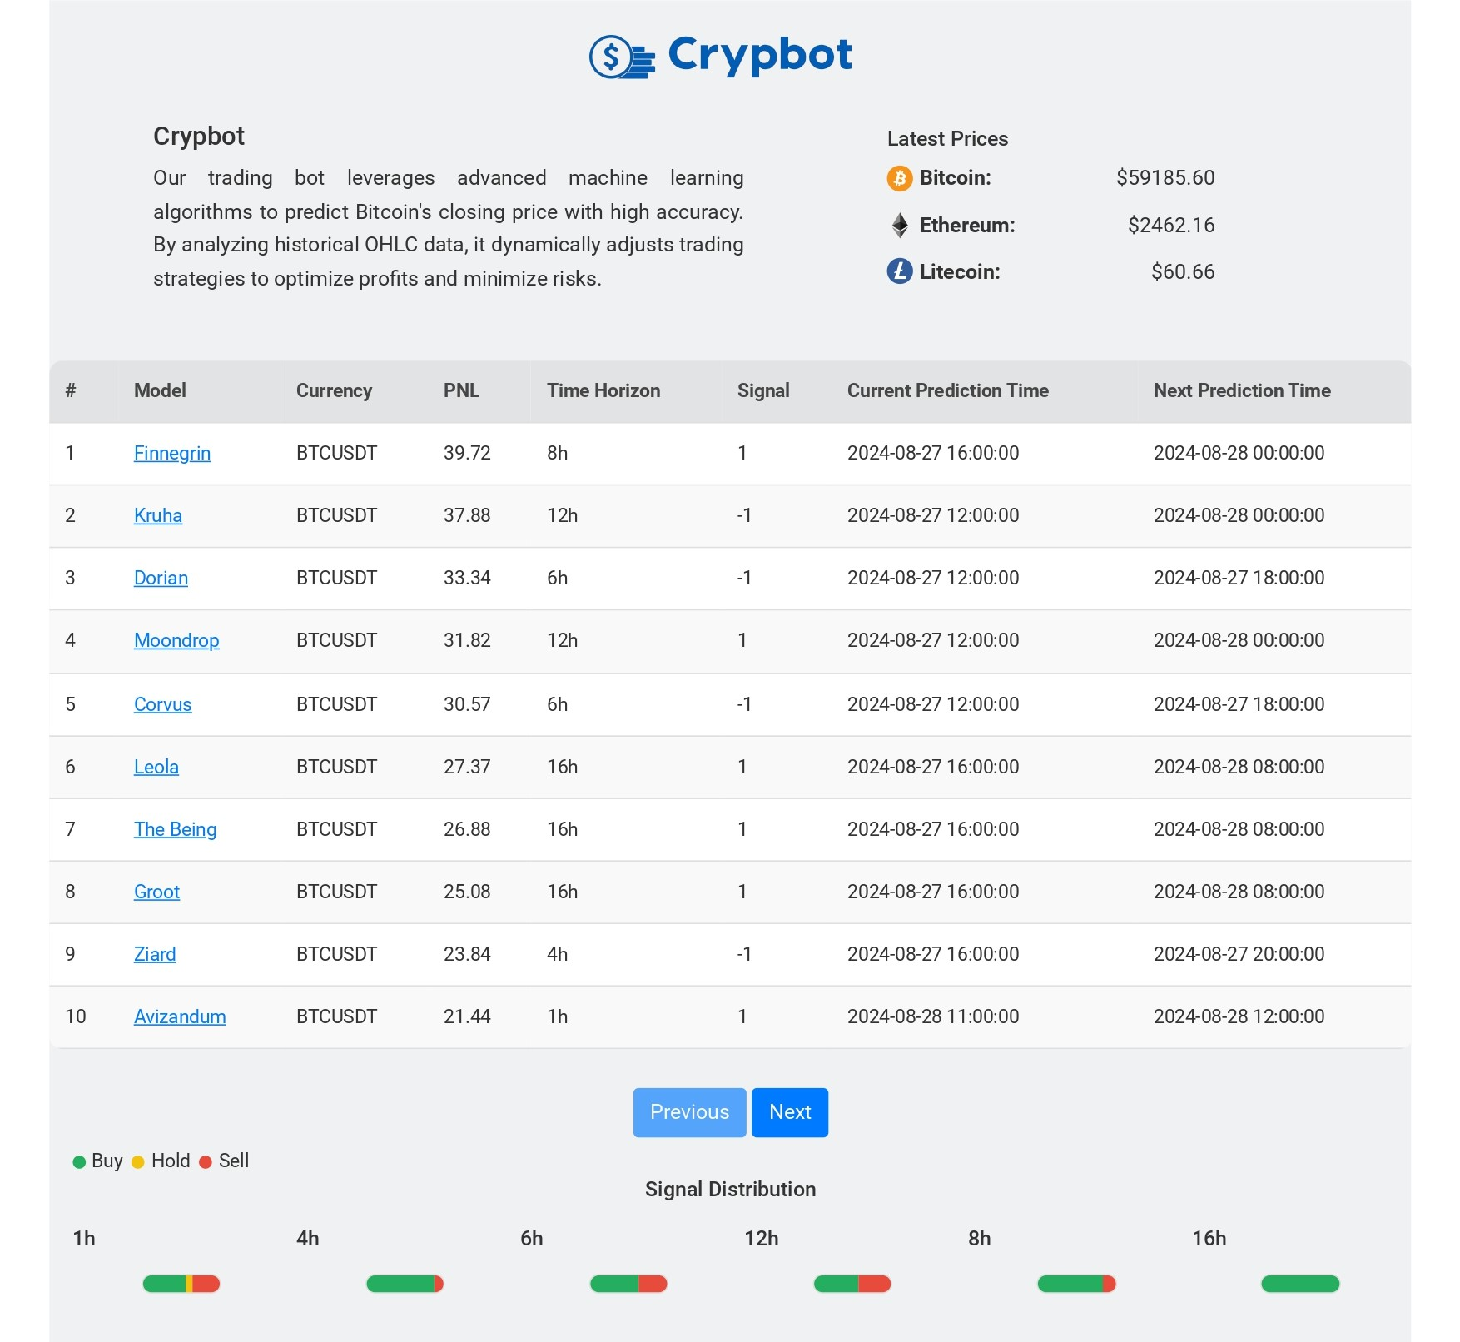
Frontend

Slide 46
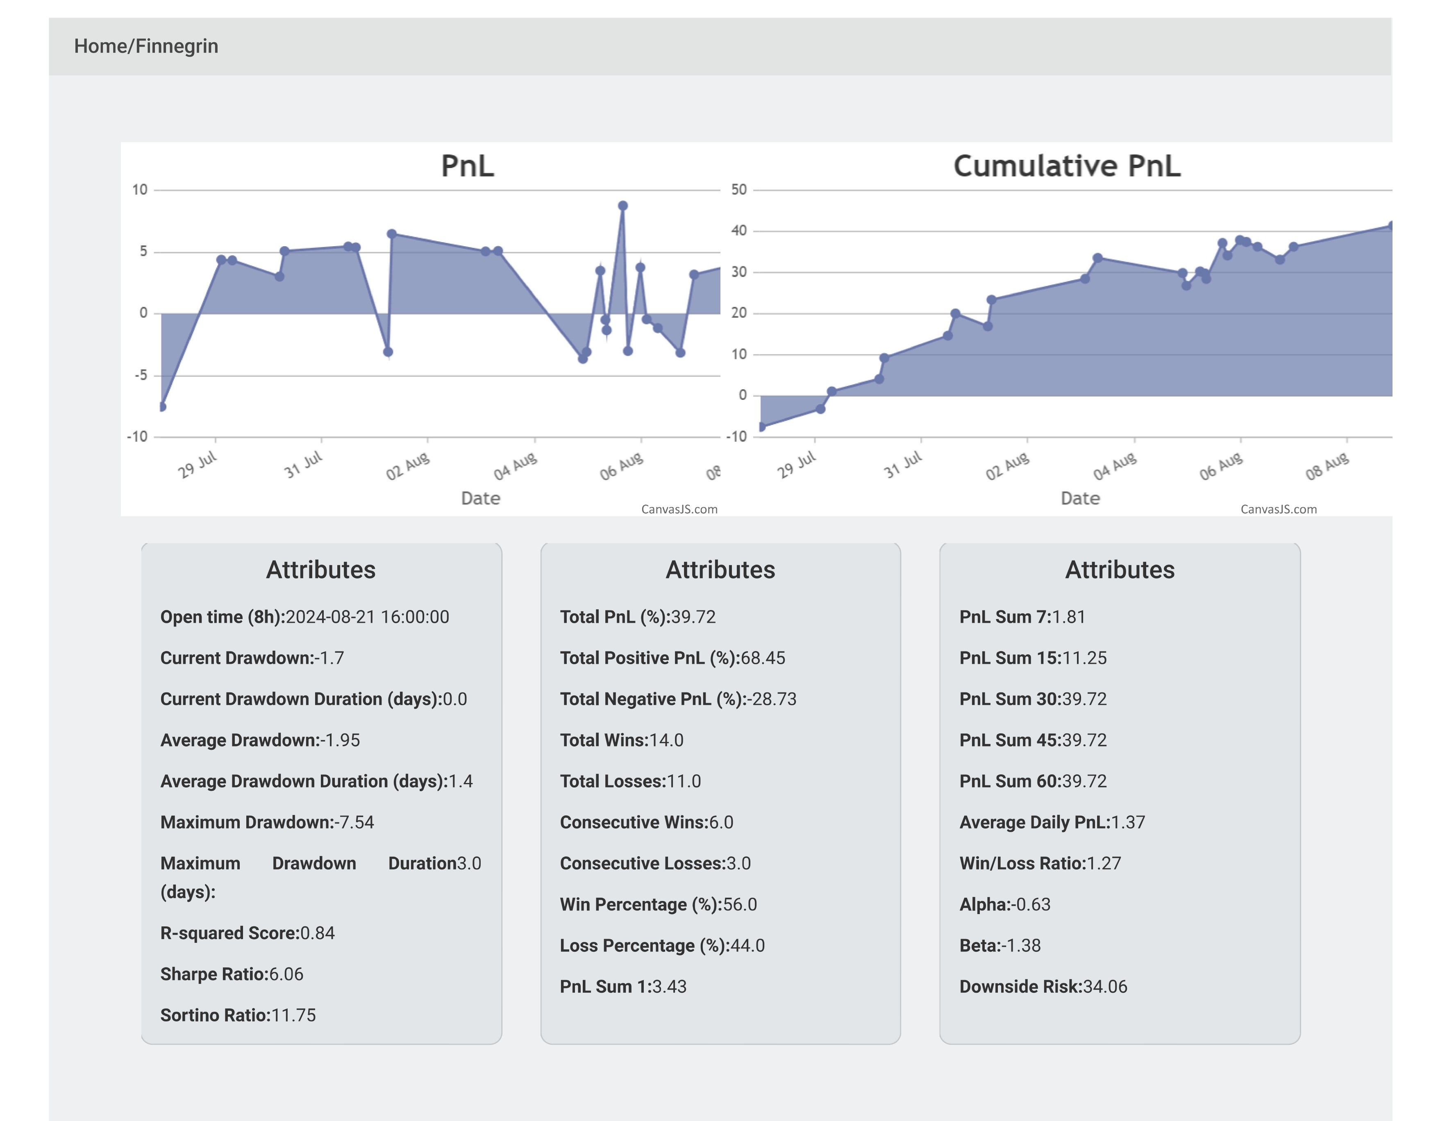
Stats of individual model

Slide 47
Appendix - Key Terminologies
ATR (Average True Range): A measure of market volatility.
PnL (Profit and Loss): A measure of the financial performance of a trade.
TP/SL (Take Profit/Stop Loss): Predefined levels to close a trade for profit or loss.

Slide 48
Appendix - References
Investopedia: Technical Indicators
Binance API Documentation
TA-Lib Documentation

Slide 49
Acknowledgments
Special thanks to the team, mentors, and resources that supported this project.
Gratitude to the open-source community for providing valuable tools and libraries.

