Slide 1


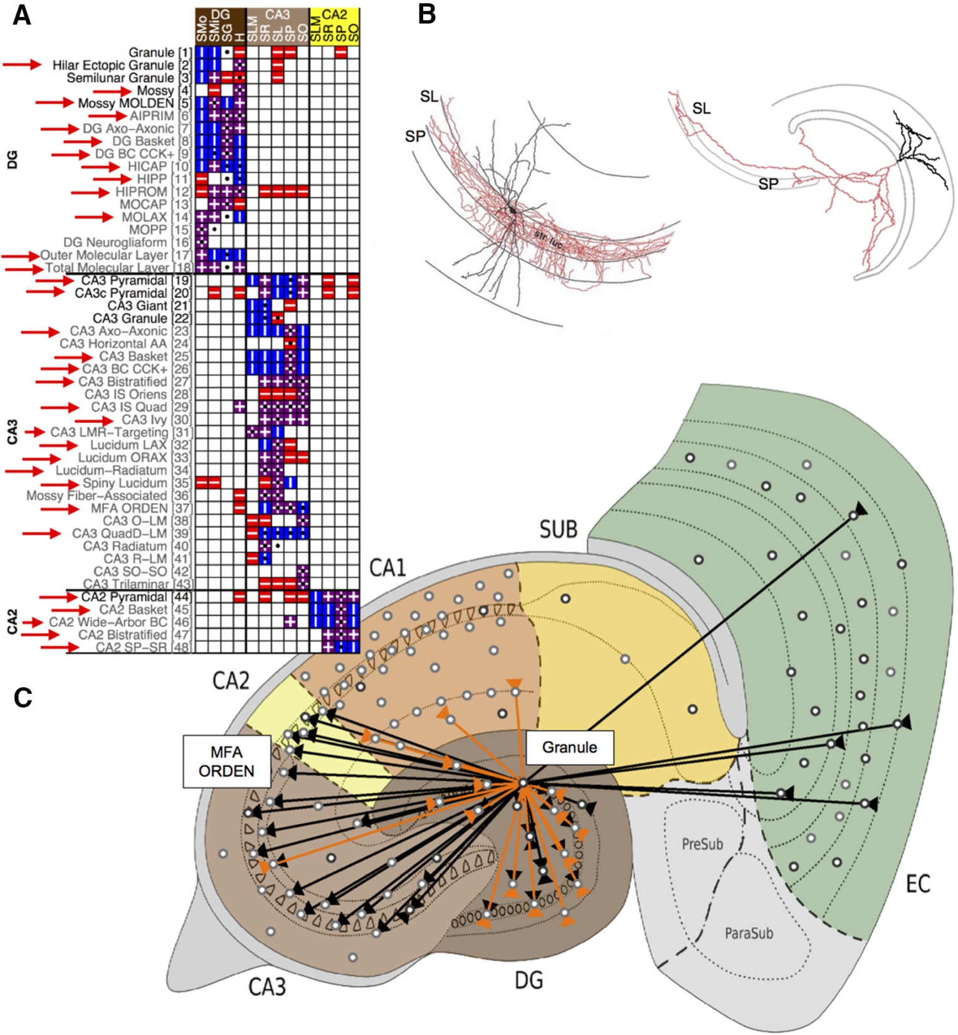
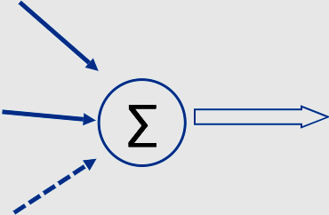

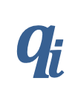
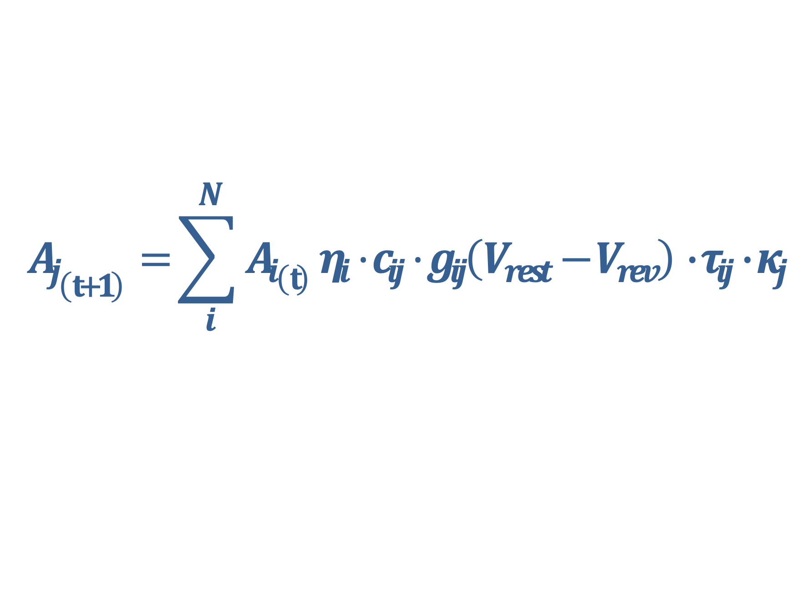
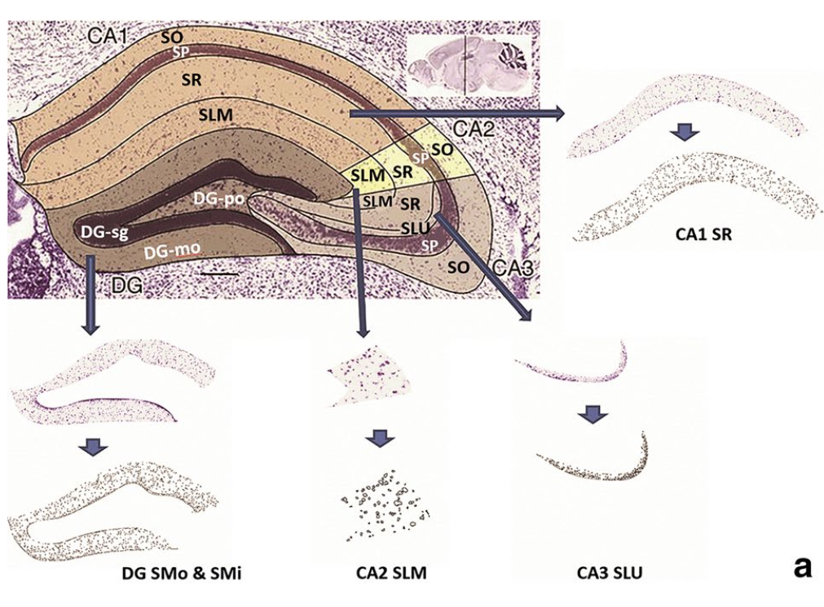
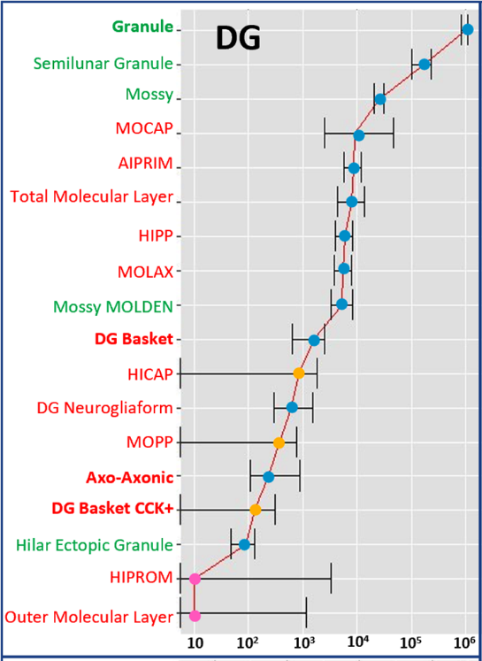
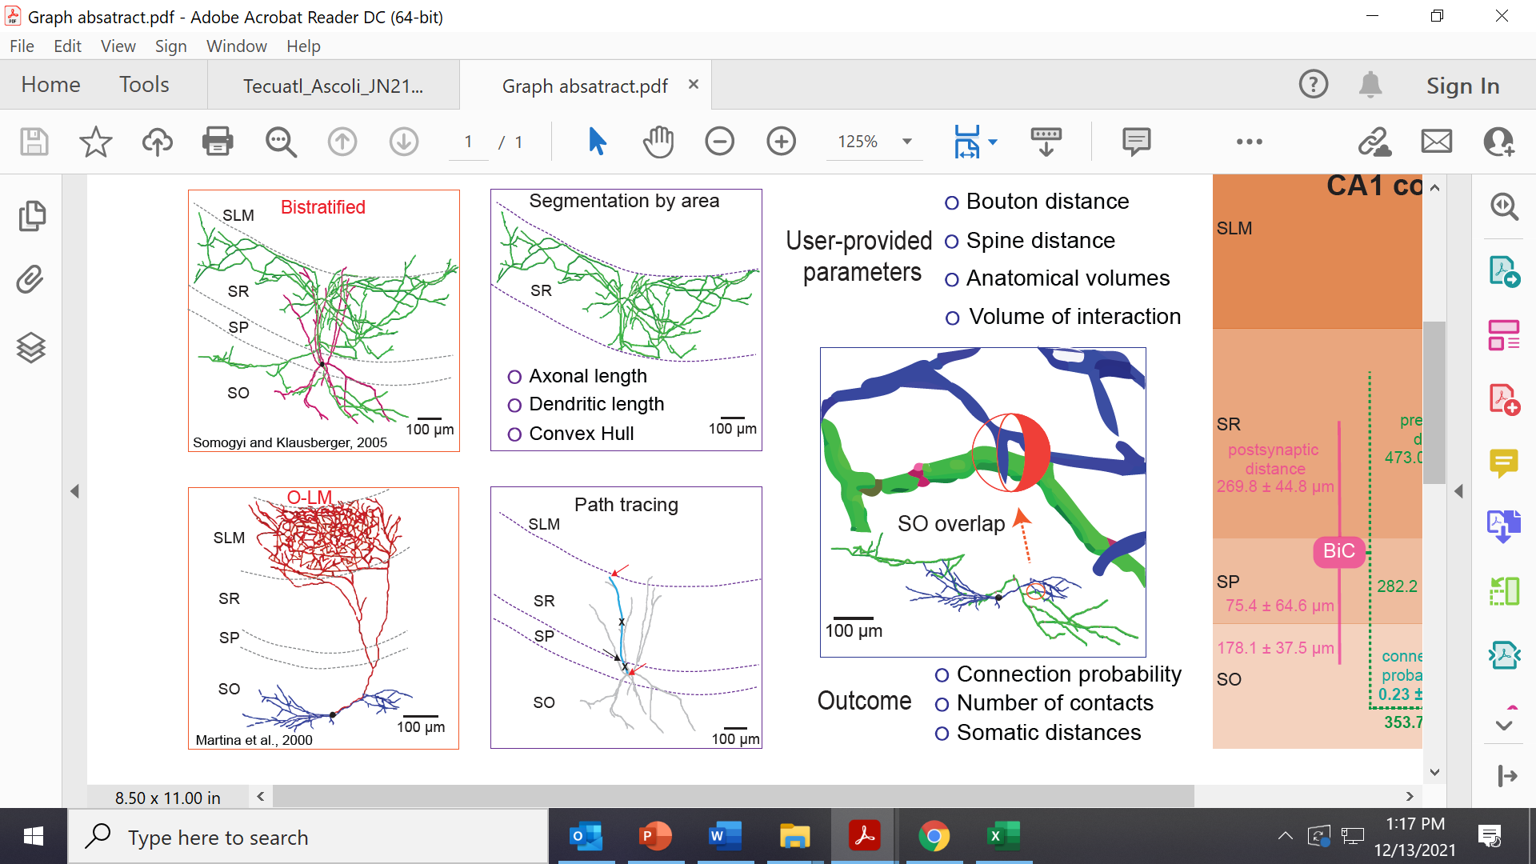
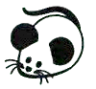
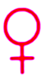
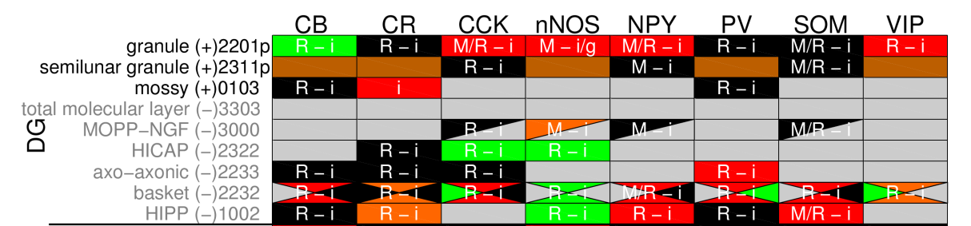
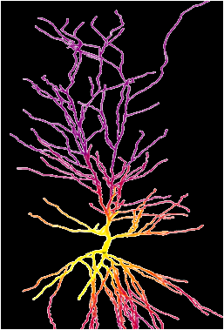
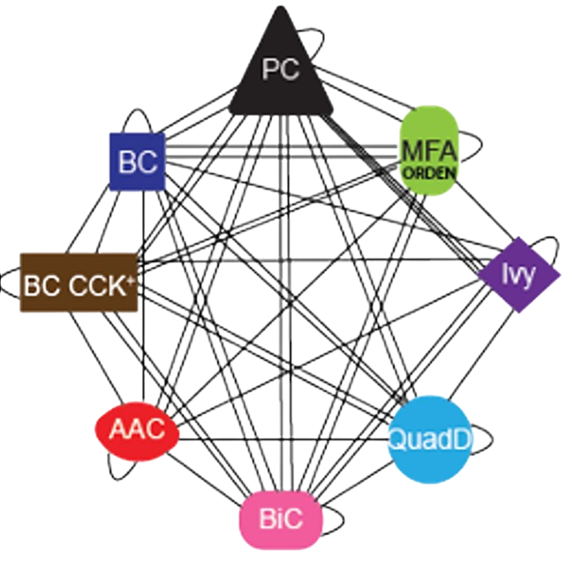

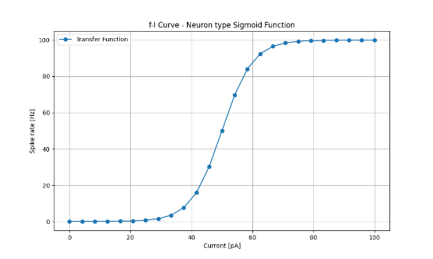
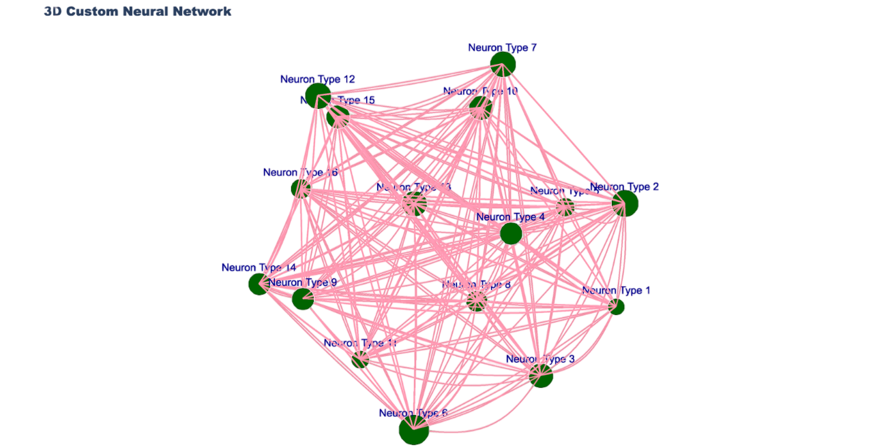
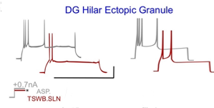
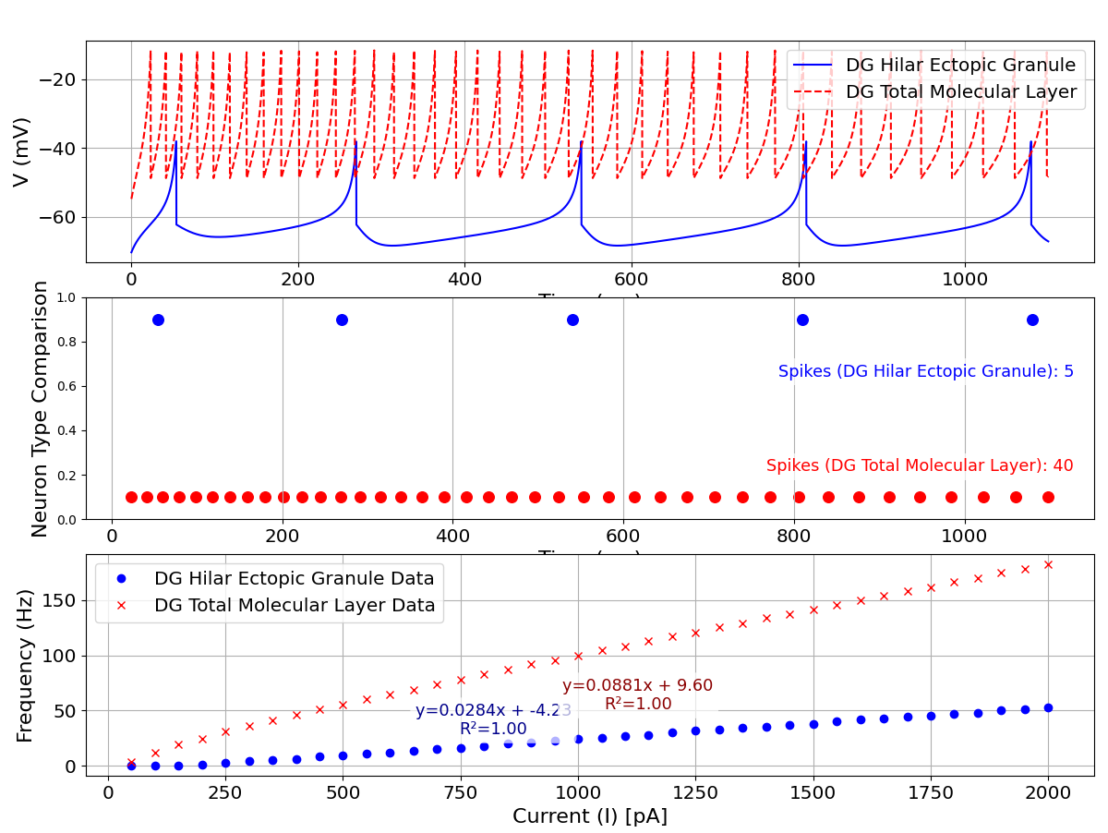
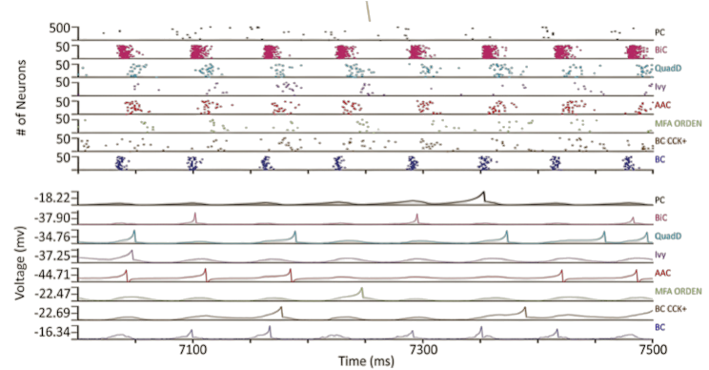
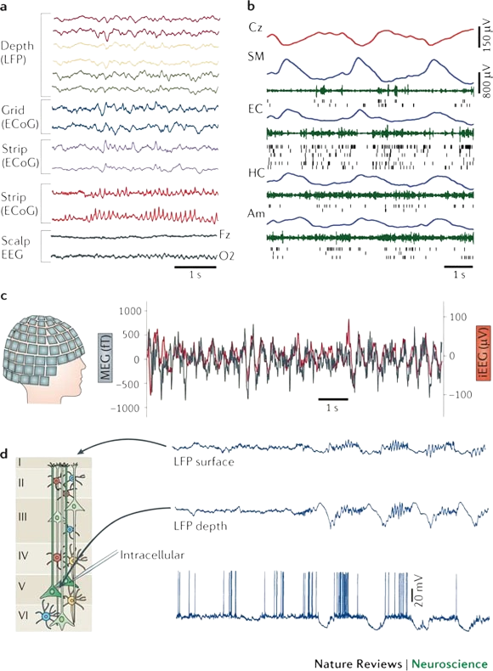
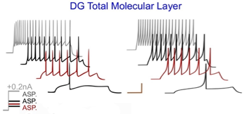
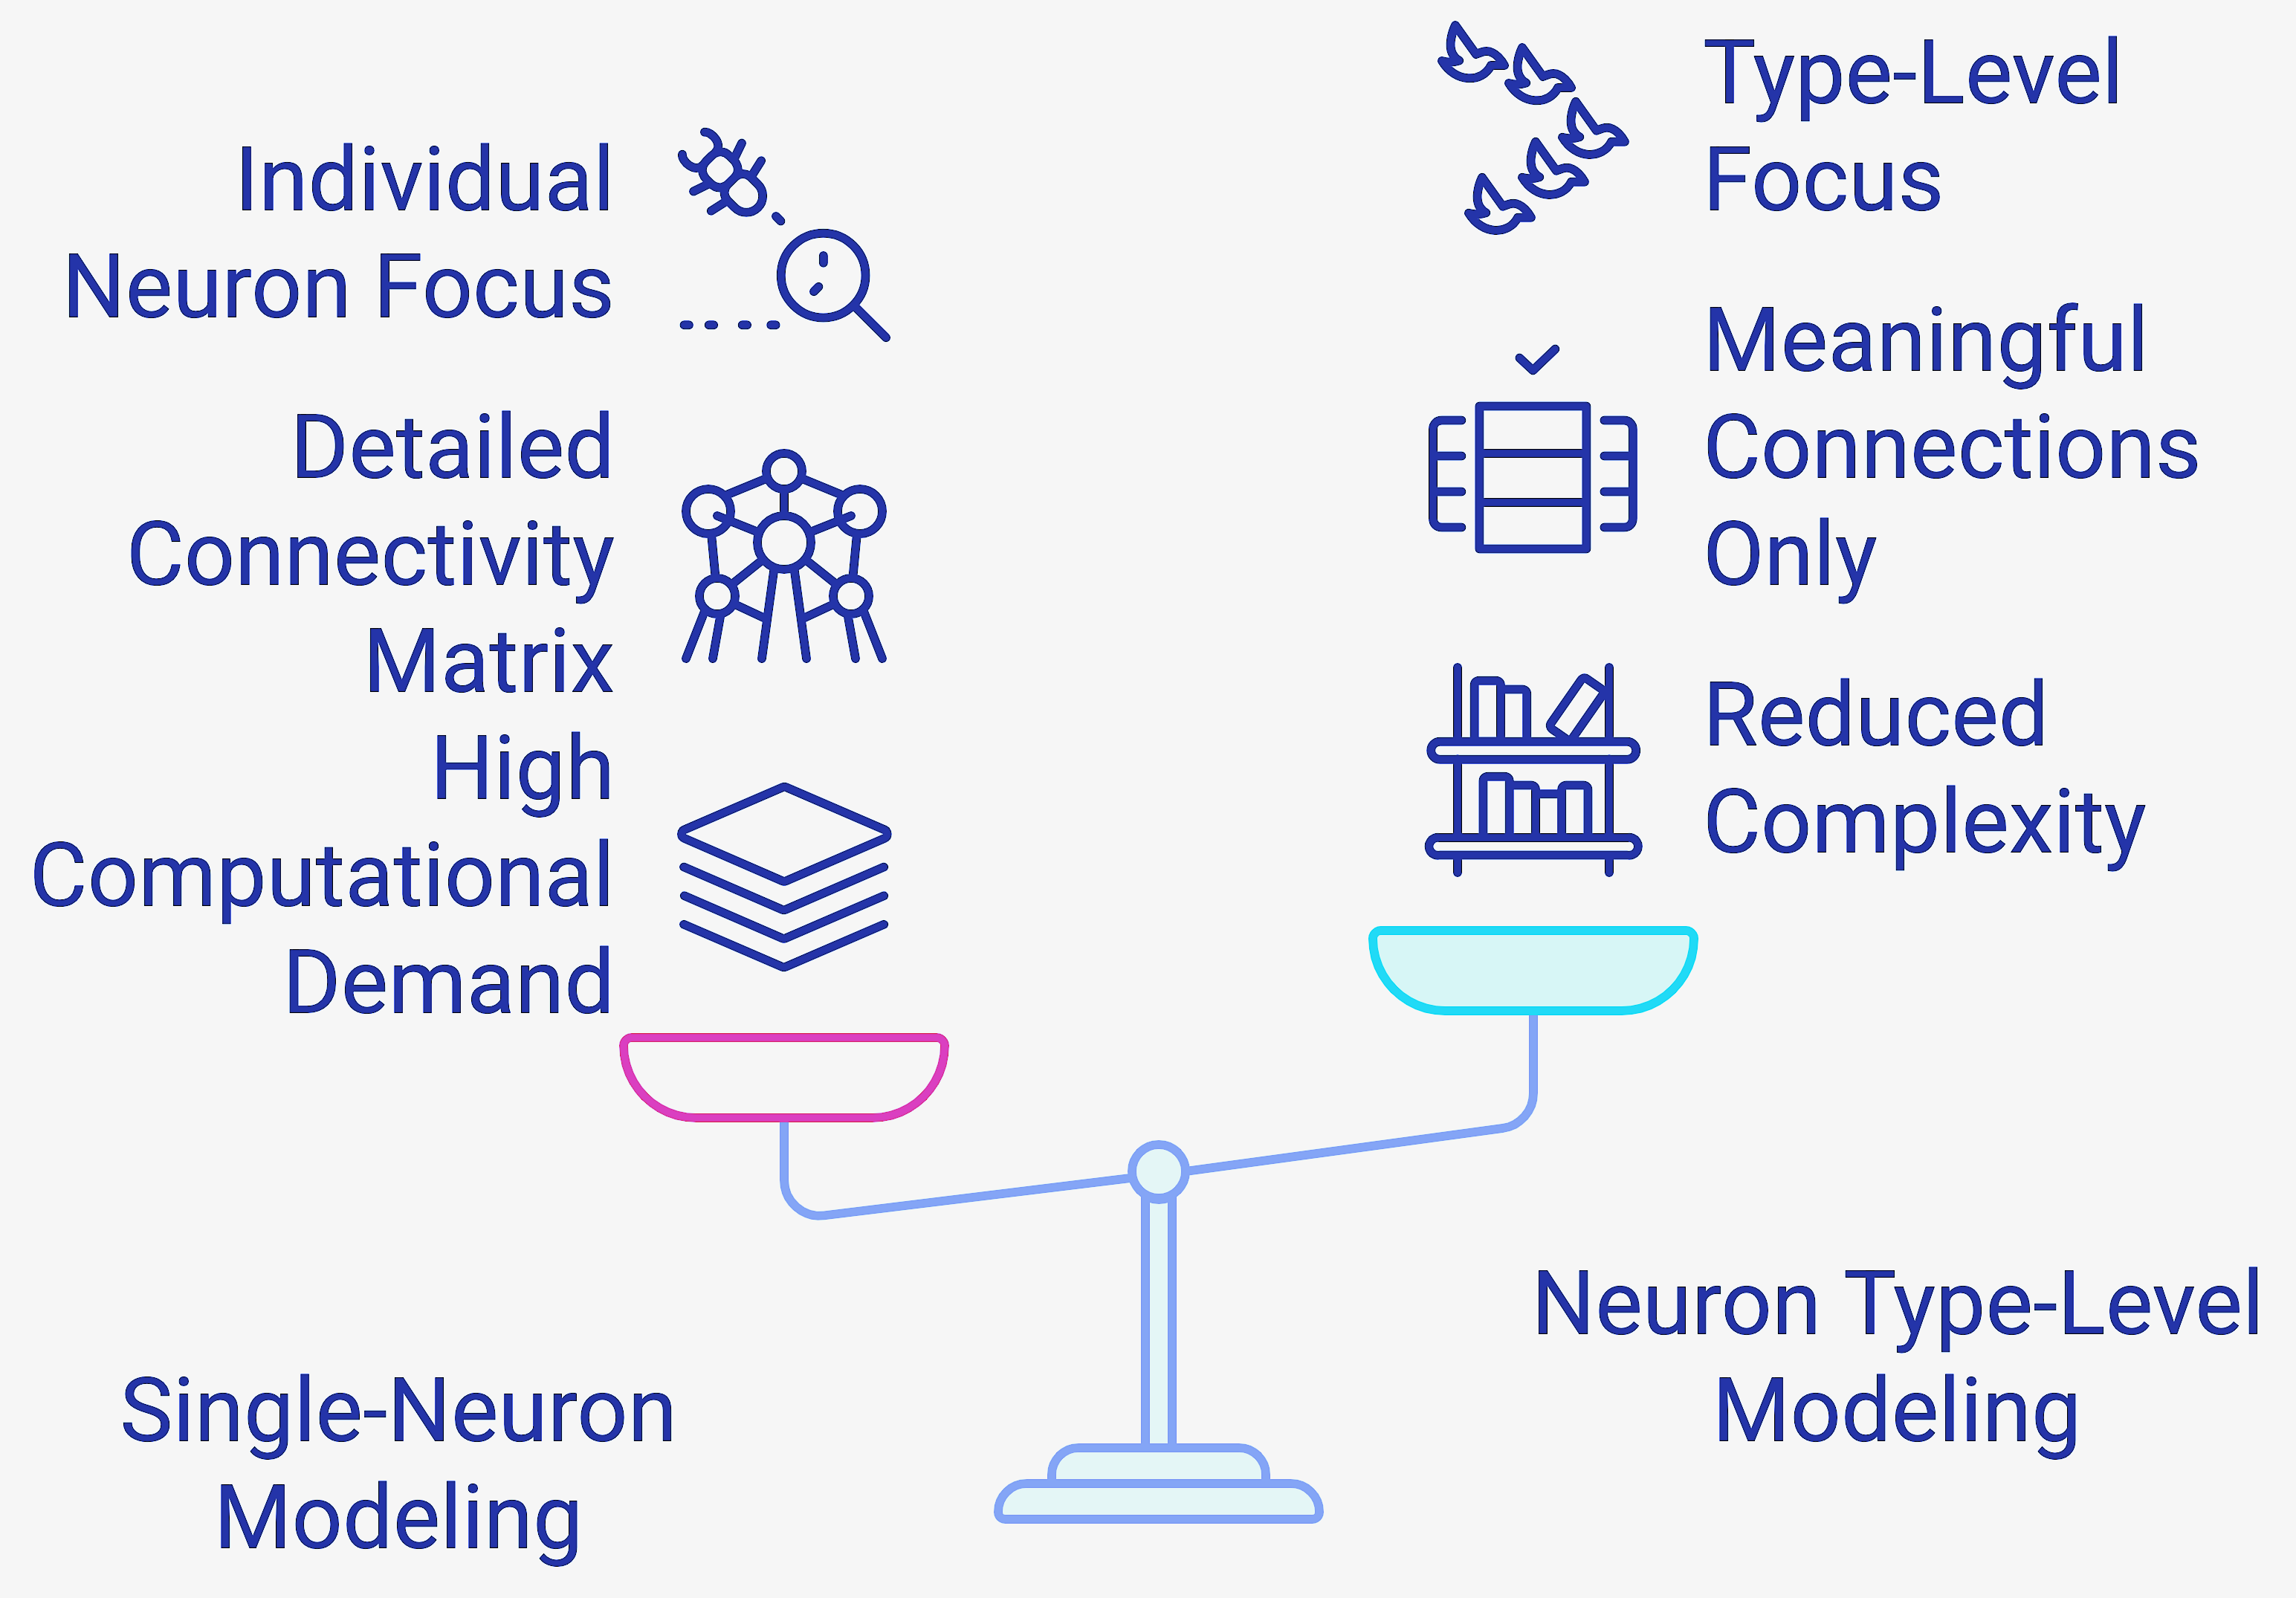
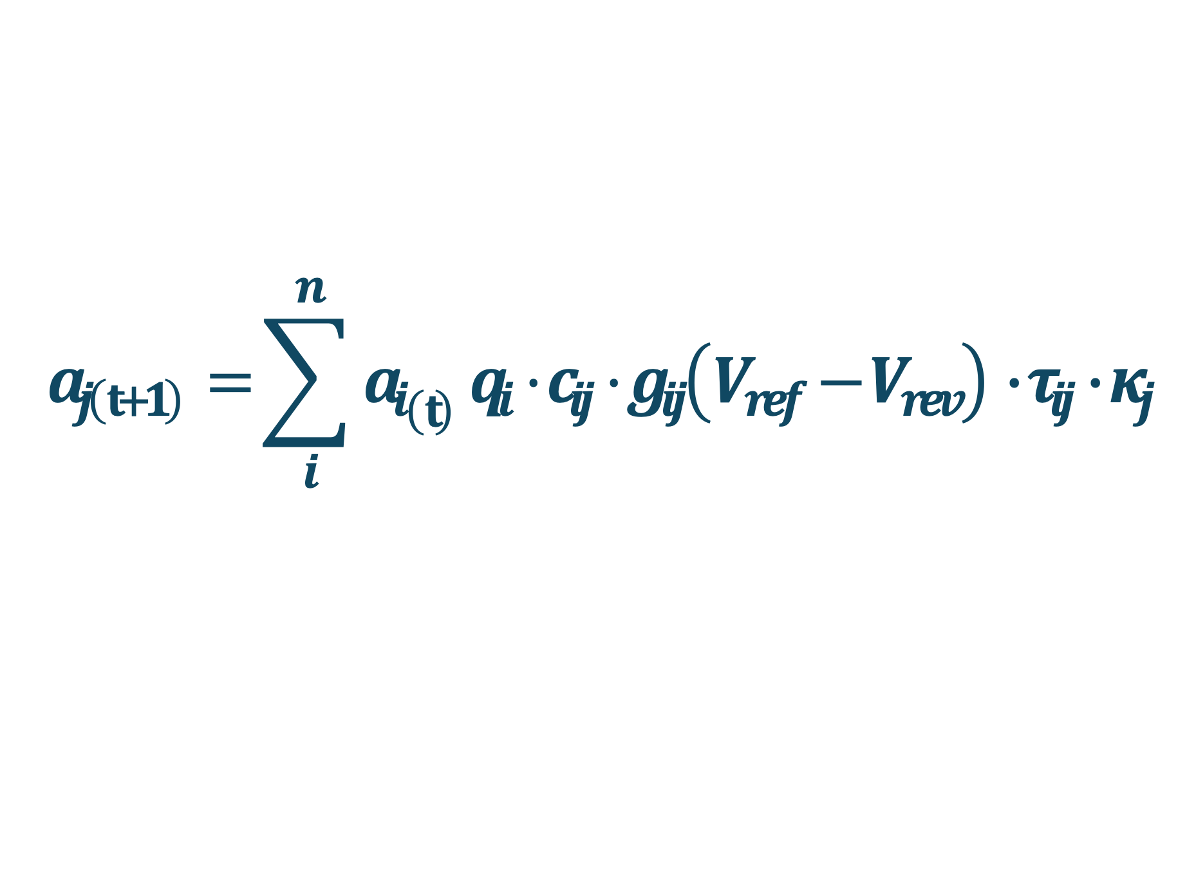



Data-Driven Functional Analysis of a
Mammalian Neuron Type Connectome
Jean Mimar Santa Cruz Yabarrena & Giorgio A. Ascoli
Center for Neural Informatics, Structures, & Plasticity (CN3), College of Engineering and Computing
George Mason University, Fairfax, VA, USA - ascoli@gmu.edu
Problem
Hippocampus Neuron Type Classification
The enormous complexity of and computational cost for simulating biological neural networks is a major challenge in computational neuroscience. Translating this complexity into data-driven simulations requires availability of suitable experimental data and modeling feasibility
MFA ORDEN
Hippocampome.org maps all known neuron types in the rodent hippocampal formation. V1.0 (2015) identified 122 neuron types with axons and dendrites distributed across 26 anatomical parcels
Objective
This work provides a computational framework founded on experimentally derived parameters to model hippocampal circuits at the crucial level of neuron types, enabling efficient simulations by reducing connectivity complexity without sacrificing biological accuracy
Pre-synaptic
1
2
3
Membrane electro-
physiology
4
5
Granule
Wheeler et al. eLife 2015 PMID26402459
Pos-synaptic
The resultant circuit consists of 38 excitatory and 84 inhibitory neuron types (nodes) interlinked by 3236 directional edges.
This comprehensive connectivity profile of the hippocampus and entorhinal cortex fosters insights on the functional operations at the computationally crucial level of neuron types
Synaptic Physiology
Synaptic Physiology
Connectivity
Transfer Function
Census
Inhibitory
V_{ref} =V_{thresh}
V_{ref} = V_{rest}
Excitatory
$$a_{j\left(t+1\right)}=\sum_{i}^{n}{{a_{i}}_{\left(t\right)}}q_{i}⋅c_{ij}⋅g_{ij}\left(V_{ref}−V_{rev}\right)∙τ_{ij}∙κ_{j}$$
Activity
$$\left[\begin{matrix}m_{11} & ⋯ & m_{1n} \\ ⋮ & ⋱ & ⋮ \\ m_{n1} & ⋯ & m_{nn}\end{matrix}\right]$$
Markov
Model
$$m_{ij}$$
Rees et al. 2016 PMID27896314
Pre-synaptic
Pos-synaptic
$$\left[A_{t+1}\right]= \left[A_{t}\right]\left[M_{ij}\right]$$
1
Census
2
Connectivity
3
Synaptic
Physiology
4
Simulated signal + Normalization
Attili et al. 2019 PMID31444616
Attili et al. 2020 PMID33343053
Tsodyks Pawelzik Markram
TPM Model
Synaptic Modeling Values
𝜏_{r} = 1457 ms
𝜏_{f} = 28.11 ms
𝜏_{d} = 4.39 ms
g = 1.606 nS
U = 0.2558
Age: 14 days
T = 22 °C
Vh = 60 mV
Transcriptomic profiling
Hamilton et al. 2017 10.1016/j.jpba.2017.03.062
Moradi et al. 2020 PMID31472001
Moradi et al. 2022 PMID35513471
Predictive features
Deep Learning
Tecuatl et al. 2021 PMID33361464
Probability of connection
Hamilton et al. 2017, PMID27747821
White et al. 2020, PMID31596053
Neuron types Hippocampome 1.0
Axonal-dendritic overlap
1200 articles
8000 excerpts
40k data entities
~90% of all
needed neuron type pairs characterized
Image acquisition, correction, & analysis of neuron distributions
Lit & DB mining
Neuron mapping & quantification
System of equations
Numerical optimization
Connectivity stoichiometry of all directional neuron pairs. Computational geometry also derives the distances along the axonal path (affecting signal failure and delay) the dendritic path (affecting signal attenuation and spread)
Izhikevich Model
5
Applications
Compartmental neuron models
Spike pattern phenotypes
Transfer Function
Type
Transient and/or steady-state present in the PATTERN
Delay (D)
Adapting Spiking (ASP)
Rapidly Adapting Spiking (RASP)
Non-Adapting Spiking (NASP)
Persistent Stuttering (PSTUT)
Persistent Slow-Wave Bursting (PSWB)
Evolutionary algorithm
𝜏_{m} Membrane
Eletrophysiology
Max FR Membrane
Eletrophysiology
Point-neuron model
Multi-compartment model
Window (spikes count) definition
Linear region
Graph-theoretic network analysis
Venkadesh et al. 2019 PMID31658260
Integrated information
Individual neuron
(Hodgkin-Huxley)
Izhikevich model
Quantitative Graph
Multi Scale Model
Real
Simulated
Number of spikes in 𝜏_{m} time
Neural Mass
k=2.9 a= 0.006 b= 6.17
d= 186 C= 483 Vr= -70.37
Vt= -55.22 Vpeak= -37.82 Vmin= -62.23
Spike simulation
a₁
9 parameters
a₂
a₃
a₄
a₅
a₆
Spiking Neural Network
k=0.92 a= 0.001 b= -3.12
d= 8 C= 236 Vr= -54.91
Vt= -41.69 Vpeak= -11.61 Vmin= -48.73
a₇
Neuron types channel
a₈
a₉
Topology
a₁₀
Time
a₁₁
Kopsick et al. 2023 PMID37663748
Sutton et al. 2024 PMID38892248
Kopsick et al. 2024 PMID39285088
a₁₂
Real-time population activity estimate
Linear transfer function
Individual neuron scale
The focus on neuron type circuit balances computational efficiency with biological realism, thereby offering new insights into mammalian functional connectomics
Real
Simulated
Linear approximation
≈ 10⁹nodes
≈ 10¹² edges
Core innovation
Hippocampome.org utilizes a dynamic system framework to quantify the neuron type-level input-output function. Modeling the neuron type behavior captures the essence of its computational role within the spiking neural network while reducing the overall complexity to a simpler transfer function. This can be further simplified into a linear Markov model for graph-theoretic network analyses or substituted with a more realistic compartmental Hodgkin-Huxley representation for multi-scale modeling
Neuron type scale
Markov model
≈ 100 nodes
≈ 2000 edges
5 key parameter sets

