Slide 1
Impact of local connectivity patterns on excitatory-inhibitory network dynamics
Shao, Y., Dahmen, D., Recanatesi, S., Shea-Brown, E., & Ostojic, S. (2025). PRX life, 3(2), 023008.
Final Presentation
Spring 2026 | BINF751
By R. Aniceto
Notes:
Hi, my name is Roxanne Aniceto a second year PhD student in the Bioinformatics & Computational Biology program. Today I'll talk about a 2025 paper by Shao et al titled “Impact of Local Connectivity Patterns on Excitatory-Inhibitory Network Dynamics that asks a pretty simple question: does it actually matter how neurons are wired together — not just how many connections there are, but the specific patterns?"

Slide 2
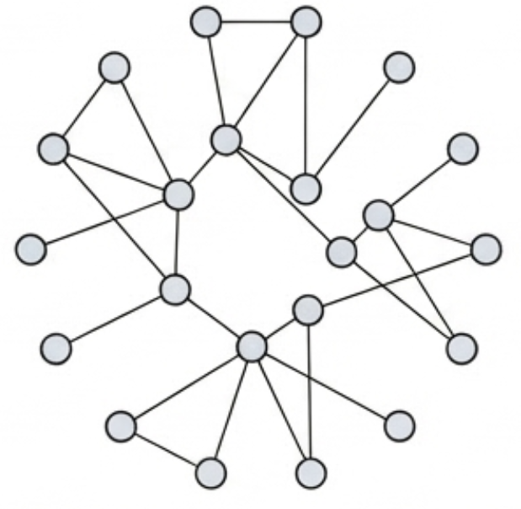
The Big Question(s)
The Old Assumption
Classic models assume neurons connect randomly, like strangers in a crowd
The Reality
Biological networks are sparse and neurons have ‘motifs’: cliques and secret handshakes
“How do these motifs respond to inputs and alter global stability?”
Notes:
"Classic models just assumed connections were random — like a crowd of strangers, any neuron could talk to any other with equal probability. But when you actually look at real brain data, that's not what you see. Neurons have preferred partners. They form these small repeating patterns — cliques, feedback loops — and the paper calls these motifs. So the question is: do these patterns change how the network behaves? And if so, how?"

Slide 3
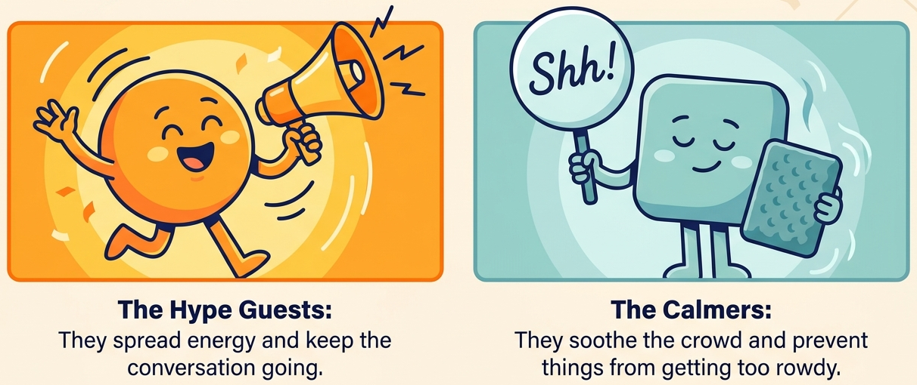
The System: E-I Networks (and a bit of math)
+ Excitatory (E) - Inhibitory (I)
Connectivity Matrix
$$J=J^{0}+ Z$$
$$J^{0}$$: sum of its mean, $$Z$$: the random bits
Steady-State Response: “r star”
$$r^{∗}={\left(I−J\right)}^{−1}I^{ext}$$
$$I$$: identity matrix, $$I^{ext}$$: external input, $${\left(I−J\right)}^{−1}=χ$$: response matrix
Notes:
"To answer that we need a model. The brain has two flavors of neurons — excitatory ones that fire each other up, and inhibitory ones that calm things down. Think of E neurons as the hype guests at a party and I neurons as whoever's trying to keep things from getting out of hand.
The connectivity is captured in J — one matrix that encodes all of those E and I interactions. We split it into J-naught, the mean structure, plus Z, the random deviations. This other equation is r-star — the steady-state. 's where the system naturally wants to live given its wiring and its inputs, and remains when everything is settled. Within it, we have The response matrix (I minus J) inverse that connects the external input through the internal connectivity to produce r-star.
."

Slide 4
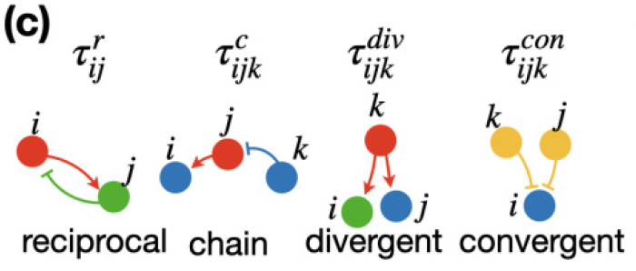
Pairwise Motifs - The Four Cliques
Shao et al (2025). Figure 1c
Chain
i →j→k
Reciprocal
i ↔ j
i and j talk back to each other
i talks to j, j talks to k
“The Telephone”
“The Gossip Group”
(Not analyzed in this paper)
Divergent
i← j →k
Convergent
i→ j ←k
j talks to both i + k
Both i + k talk to j
Notes:
"So we have E neurons that amplify and I neurons that suppress. The question is: what happens when those interactions aren't random — when specific pairs and triplets of neurons connect in repeating patterns?
The paper focuses on two motif types. Chains — i talks to j, j talks to k, a one-way relay. In an E-I network, a chain could be an E neuron exciting another E neuron which then drives an I neuron — or purely E-to-E, where excitation keeps passing forward and amplifying as it goes. That self-propagating quality is what makes chains powerful at the network level.
Reciprocals — i and j talk back to each other. In E-I terms this could be an E neuron exciting an I neuron which feeds back to suppress it — a classic feedback loop. Or two E neurons sustaining each other locally. The key is that the loop is closed between just those two neurons — the excitation doesn't travel anywhere new.
And here's something worth noting: in both cases, inhibitory neurons don't have an independent on-switch. They only activate when excitatory neurons drive them. Keep that in mind — it becomes important later.
The critical difference between chains and reciprocals comes down to how their influence scales with network size — but we'll come back to that once we see what they do to the eigenspectrum. For now: chains propagate, reciprocals contain. That distinction is the whole story

Slide 5
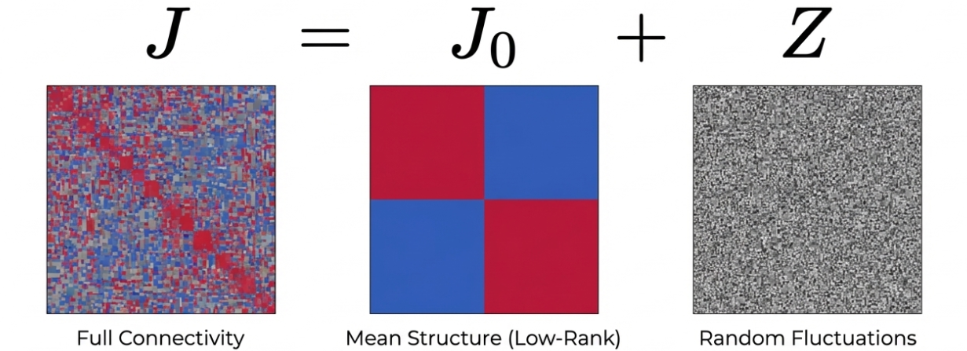
Deconstructing the Connectivity Matrix (J)
EE EI
IE II
Low-Rank Approximation = The Connectivity Cliff Notes
A few dominant patterns can be used to describe a majority of the system
Notes:
"The full matrix looks like noise — dense and impossible to read directly. But when you split it into J-naught and Z, a clean picture emerges.
J-naught is the mean structure — just the dominant patterns, approximated from the full matrix by keeping the most important directions and throwing away the rest. In the E-I case that gives you four blocks: E-E, E-I, I-E, I-I.
Z is everything left over. Every deviation from the mean.
The authors modeled Z as Gaussian with mean zero — which is biologically reasonable and mathematically convenient for what comes next.
J-naught alone captures most of the network's behavior. But Z still matters — in a specific and tractable way we're about to see."

Slide 6
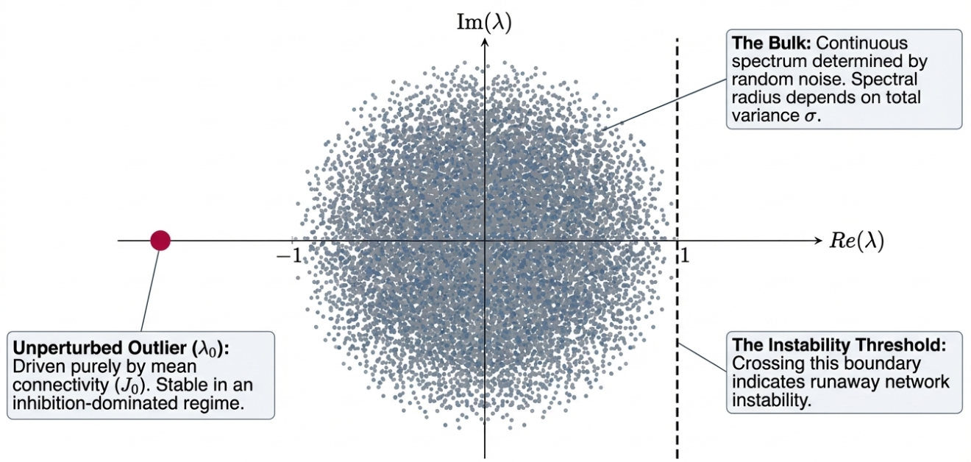
Eigenspectrum - Bulk vs. Outliers
Increase chain correlations, a new outlier appears
Increase reciprocal correlations, nudges existing negative $$λ_{0}$$ left
Notes:
"Okay so what you're looking at is the eigenspectrum of J, plotted in the complex plane. Every dot is an eigenvalue — a collective pattern of activity across the whole network. The horizontal axis tells you stability: negative real part means that pattern decays, positive means it grows. The vertical axis tells you whether and how fast it oscillates.
The big gray cloud is the bulk — dominated by Z, the random part. Because Z is Gaussian, we get a circular disk of eigenvalues. Its radius is set by how variable the random weights are.
The lone red dot to the left is λ₀ — the outlier driven by J-naught. It's sitting on the negative side because the network is inhibition-dominated — it's a stabilizing mode, pulling activity back toward rest.
The dashed line on the right at Re(λ) = 1 is the instability boundary. It comes directly from the response matrix — when J has an eigenvalue equal to 1, the inverse blows up and the network has no finite steady state. Cross that line and the network destabilizes.
Here's the key point: motifs don't move the bulk at all. They only move outliers. Chains push a brand new outlier λ₂ out toward that boundary, and that effect grows with N. Reciprocals nudge λ₀ further left into safety, independently of N.
The whole stability story comes down to where λ₂ lands. And to predict that, the authors build one clean matrix that captures everything — J-eff."

Slide 7
Meet Jeff, The Effective Matrix
Start with J
J = J⁰ + Z
Add ⟨Z²⟩ correction
Full connectivity matrix
Mean structure + noise
Motif structure emerges
J^{eff} = J⁰ + ⟨Z²⟩
Effective connectivity matrix
Deterministic | Predictive | Tractable
$$J^{eff}=J^{0}+\left\langle Z^{2}\right\rangle$$
decompose
Absorbs both mean structure J0 and motif corrections into one deterministic object
Predicts steady-state $$r^{∗}={\left(I−J^{eff}\right)}^{−1}I^{ext}$$
No simulation needed: one clean matrix inversion
Replaces the full noisy matrix
Predicts paradoxical responses
Captures how chain motifs structure drives counterintuitive inhibitory suppression
2nd order
Notes:
"So what is J-eff and why do we care?
Four steps on the left. Start with J, decompose into J-naught plus Z, take the second-order correction — the average of Z-squared, ⟨Z²⟩ — add it onto J-naught, and you get J-eff. It's deterministic, it has no randomness in it, and you can compute it directly.
The main payoff: J-eff lets you predict r-star without any simulation. Same response equation as before, but J is replaced by J-eff, which has already absorbed the mean structure and the motif corrections. Instead of running thousands of simulations and averaging, you just invert J-eff once. That's it.
It also predicts something classical models completely miss — the paradoxical response. More on that in a second.
For anyone working with empirical data: decompose your weight matrix, compute ⟨Z²⟩, build J-eff. That's the whole recipe.
But why does J-eff have that specific form? Because motifs leave a fingerprint in the statistics of Z — and ⟨Z²⟩ is exactly where that fingerprint shows up."

Slide 8
Where Motifs Live: From Z to Jeff
Average of Z-squared ⟨Z²⟩
Diagonals of ⟨Z²⟩
Chains encode here
new outlier λ₂
Reciprocals encode here
self-interaction terms · fixed · nudges λ₀
Independent of N
Scales with N
Off-diagonals of ⟨Z²⟩
Z averages out
⬆️ ⬇️ ⬆️ ⬇️ ⬆️ = 0
random wires cancel out
Motifs are outside the standard patterns of J⁰ ^{Deviations from the mean}
Chain motifs Global controllers
Reciprocal motifs Trapped in the bulk
1° order = average of values
square it
⟨Z²⟩ survives
correlated pairs don’t cancel
Motifs are encoded in ⟨Z²⟩,
not in Z itself
2° order = average of squared values
The Effective Matrix: $$J^{eff}=J^{0}+\left\langle Z^{2}\right\rangle$$
Notes:
"This slide traces the path from motif to matrix entry.
Both chain and reciprocal motifs live in Z — they're deviations from the mean, not part of J-naught. But Z on its own averages to zero. Individual weights go up and down and cancel out. First order: nothing.
But when you square Z, the sign disappears. Positive times positive, negative times negative — both positive. The correlated pairs — the ones that form motifs — stop cancelling and start accumulating. That's ⟨Z²⟩, and it carries the motif fingerprint that Z alone couldn't.
Chains go into the off-diagonal entries of ⟨Z²⟩ — those are the cross-neuron terms, connections between different neurons. Every new neuron you add creates more potential chain paths, so those entries grow with N. That's what pushes λ₂ out of the bulk.
Reciprocals go into the diagonal entries — a neuron's self-interaction mediated through its reciprocal partner. Fixed, doesn't grow with N. Nudges λ₀ left by a constant amount.
J-eff absorbs both. It's what the network effectively experiences — the one matrix you need to predict steady-state behavior without simulating every synapse.
So what does it actually predict that classical models miss?"

Slide 9
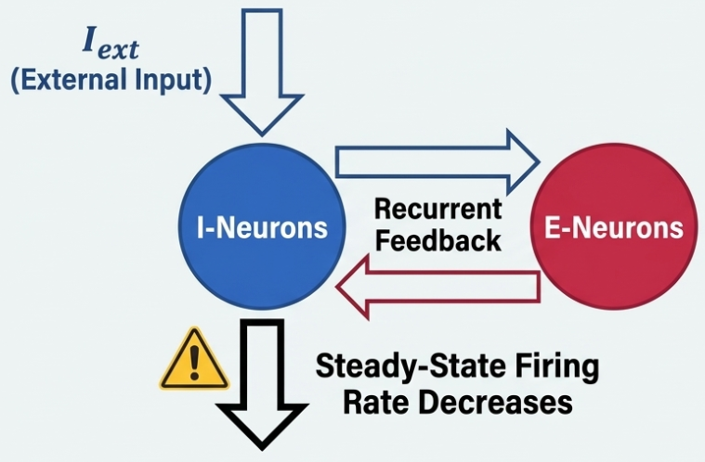
Paradoxical Response: More is Less
In networks with high chain motifs, telling the Brakes to work harder makes them shut down
More inhibition → less inhibition (sometimes)
Need these conditions:
Inhibition-stabilized networks (ISN)
Inhibition becomes load-bearing
Only E signals activate I neurons
Strong E-E Coupling
E neurons sustain each other, I tries to keep up
Excitation drops, Inhibition loses their drive
I need E neurons to be activated
I decrease in strong self-exciting networks
Notes:
"This is the most counterintuitive result in the paper. When chain motifs are strong enough — when λ₂ is pushing toward the instability boundary — the network enters a regime where stimulating inhibition harder actually reduces inhibitory activity. More inhibition leads to less inhibition.
Why? In an inhibition-stabilized network, I neurons have no independent drive — they only fire because E neurons are activating them. When you stimulate I harder, inhibition goes up, which suppresses E. But as E drops, I neurons lose their only drive source and follow E back down — below where they started.
Two things have to be true for this to happen: the network has to be inhibition-stabilized, and E-to-E coupling has to be strong — which is exactly what chain motifs create. So the paradoxical response isn't just a curiosity. It's a direct consequence of chain motifs pushing λ₂ toward the instability boundary. The eigenspectrum predicted it, and J-eff formalizes it." and it's been observed experimentally in both mouse and the human cortex."

Slide 10
Conclusion: Patterns Over Averages
Classic theory of independence violates correlations in connected motifs
Excitatory-inhibitory stability is governed by delicate feedback balance
Chain motifs dominate because their influence scales with network size
Low rank approximation: few outlier eigenmodes govern the response matrix
$$J^{eff}$$can predict the global steady-state and paradoxical responses
Magnitude alone does not determine population dynamics – sign structure balances all
Notes:
"So the takeaway is this. Classic random-network theory assumes independence — but motifs break that assumption and the consequences are real. Chains dominate at scale because their influence grows with N. A handful of outlier eigenmodes govern the whole network response. J-eff captures all of it in one deterministic matrix — predicting steady-state behavior and paradoxical responses that classical models miss entirely. The bottom line: structure matters more than averages. • Two networks with identical averages can behave completely differently — the wiring pattern is the hidden variable." • "Averages tell you the rules. Motifs tell you who breaks them — and that's what drives the dynamics."

Slide 11
My extension
Experimental data set – Hippocampome.org
Curated knowledge base of rodent circuitry
Uses available data to characterize cell-type
Neural-Mass Model:
census, connectivity probability, synaptic physiology, membrane electrophysiology, synapse decay time constant, transfer function gain
Notes:
"So the takeaway is this. Classic random-network theory assumes independence — but motifs break that assumption and the consequences are real. Chains dominate at scale because their influence grows with N. A handful of outlier eigenmodes govern the whole network response. J-eff captures all of it in one deterministic matrix — predicting steady-state behavior and paradoxical responses that classical models miss entirely. The bottom line: structure matters more than averages. • Two networks with identical averages can behave completely differently — the wiring pattern is the hidden variable." • "Averages tell you the rules. Motifs tell you who breaks them — and that's what drives the dynamics."

Slide 12
My extension – the dataset
Experimental data set – matrix M_ij
85 of 122 known cell types
Signed, weighted, directed connectivity matrix
Effective dynamical coupling matrix
Jacobian block matrix (EE, EI, IE, II)
Notes:
"So the takeaway is this. Classic random-network theory assumes independence — but motifs break that assumption and the consequences are real. Chains dominate at scale because their influence grows with N. A handful of outlier eigenmodes govern the whole network response. J-eff captures all of it in one deterministic matrix — predicting steady-state behavior and paradoxical responses that classical models miss entirely. The bottom line: structure matters more than averages. • Two networks with identical averages can behave completely differently — the wiring pattern is the hidden variable." • "Averages tell you the rules. Motifs tell you who breaks them — and that's what drives the dynamics."

Slide 13
Spectral Analysis
Full Network Spectral Radius = 1.00
Excitatory-only Spectral Radius = 1.032 (becomes unstable)
Notes:
"So the takeaway is this. Classic random-network theory assumes independence — but motifs break that assumption and the consequences are real. Chains dominate at scale because their influence grows with N. A handful of outlier eigenmodes govern the whole network response. J-eff captures all of it in one deterministic matrix — predicting steady-state behavior and paradoxical responses that classical models miss entirely. The bottom line: structure matters more than averages. • Two networks with identical averages can behave completely differently — the wiring pattern is the hidden variable." • "Averages tell you the rules. Motifs tell you who breaks them — and that's what drives the dynamics."

Slide 14
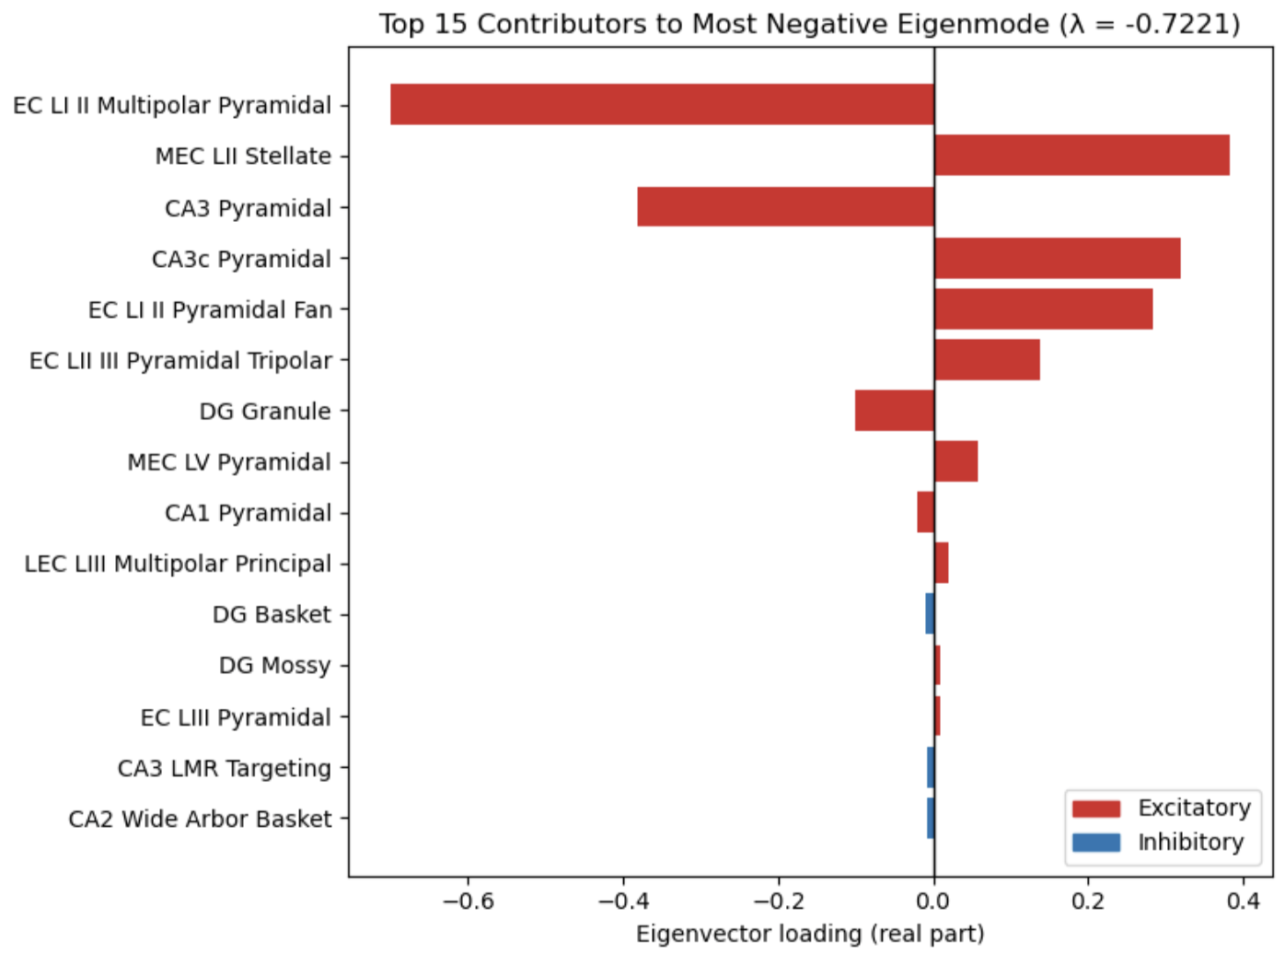
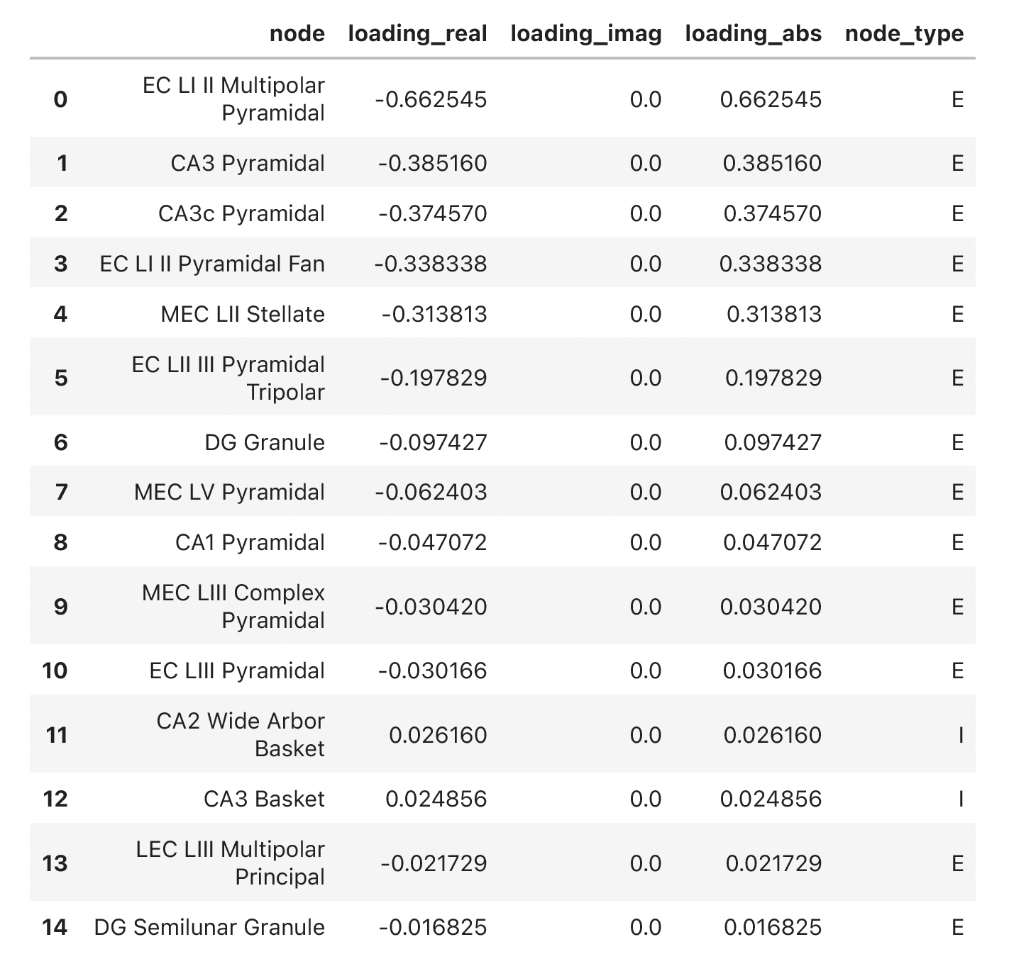
My extension
Notes:
"So the takeaway is this. Classic random-network theory assumes independence — but motifs break that assumption and the consequences are real. Chains dominate at scale because their influence grows with N. A handful of outlier eigenmodes govern the whole network response. J-eff captures all of it in one deterministic matrix — predicting steady-state behavior and paradoxical responses that classical models miss entirely. The bottom line: structure matters more than averages. • Two networks with identical averages can behave completely differently — the wiring pattern is the hidden variable." • "Averages tell you the rules. Motifs tell you who breaks them — and that's what drives the dynamics."

Slide 15
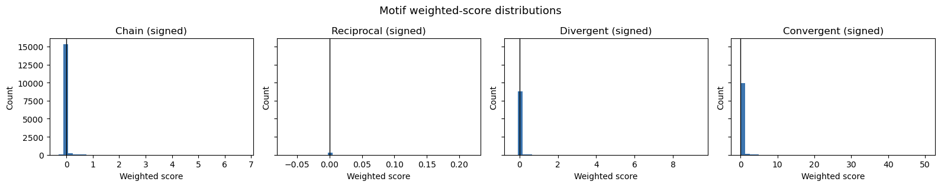
My extension
Notes:
"So the takeaway is this. Classic random-network theory assumes independence — but motifs break that assumption and the consequences are real. Chains dominate at scale because their influence grows with N. A handful of outlier eigenmodes govern the whole network response. J-eff captures all of it in one deterministic matrix — predicting steady-state behavior and paradoxical responses that classical models miss entirely. The bottom line: structure matters more than averages. • Two networks with identical averages can behave completely differently — the wiring pattern is the hidden variable." • "Averages tell you the rules. Motifs tell you who breaks them — and that's what drives the dynamics."

Slide 16
Conclusions & Future Steps (so far)
Unable to reconstruct the Trisynaptic Pathway (at least I can't interpret, given the information I have)
Perform a Schur decomposition -> feedforward relationships
Notes:
Thank you for your attention, I am able to take any questions

