Slide 1
DISSERTATION PROGRESS · ASCOLI LAB · GEORGE MASON UNIVERSITY
Wiring geometry and stability in the
hippocampal–entorhinal connectome
Six analyses on one 85-type Hippocampome coupling matrix — and the preprocessing that decides what any of them mean
01
02
03
04
05
06
E→E backbone
Inhibition
Motifs
GSN
Eigen / Schur
Jacobian
Roxanne Aniceto · Advisor: Dr. Giorgio Ascoli · 10 September 2026
Notes:
Six analysis stages on the same matrix. The through-line is that preprocessing choices — orientation, scale, and ordering — are not setup, they are load-bearing results.

Slide 2
THE QUESTION
A connectome is a matrix. Stability is a property of its geometry.
Eigenvalues describe where a linear system ends up. They say almost nothing about what it does first. In a directed, strongly non-normal network the two answers can point in opposite directions — asymptotically stable, and amplifying 27-fold on the way there.
Spectrum
Non-normal structure
The gap between them
Where the system settles. What eigenvalue analysis alone can tell you.
Everything before that. Transient gain, optimal perturbations, directional coupling.
Measurable, on real data, and the subject of this dissertation.
The working claim: specific wiring geometry — not overall E/I ratio, not degree distribution — governs how this circuit amplifies, stabilises, and disinhibits.
Notes:
Framing slide. The point of the whole project is the abscissa gap: spectral vs numerical.

Slide 3
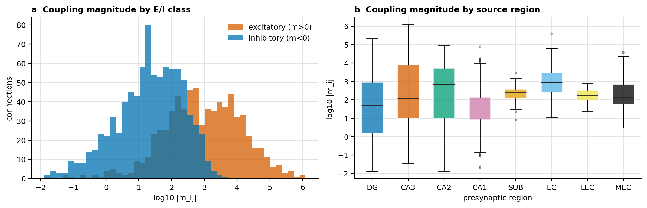
THE DATA
One matrix, built from Hippocampome v1.0
m_ij = q_i · c_ij · g_ij · (V_ref − V_rev) · τ_ij · κ_j working form: m_ij = w_ij · κ_j
85
1,570
0.220
71 / 85
neuron types
32 excitatory · 53 inhibitory
directed edges
1,641 netlist rows, 8 regions
off-diagonal density
422 reciprocal dyads
types with a non-zero
within-type diagonal
Asserted at load, so the pipeline fails loudly if the source data changes
m_ij = w_ij · κ_j exactly, with one κ_j per postsynaptic type · the sign of m_ij follows the presynaptic type’s E/I class for every edge — Dale’s law holds with no exceptions · no duplicate (pre, post) pairs
The diagonal is not autaptic. It is coupling between distinct cells of the same type — a stochastic-block-model diagonal. That distinction drives the twin-node unrolling in Stage 3 and the "self-connections are not the leak" rule in Stage 6.
Weight distributions: |m_ij| spans roughly eight orders of magnitude, which is why medians and log scales are used throughout.

Slide 4
OVERVIEW
Six stages, one matrix
1
E→E backbone
2
Inhibition
3
Motifs
Is the excitatory subnetwork feedforward? Seven path methods plus a feedback-arc ordering.
What does inhibition do to stability? Block fractures, Schur complements, ablations.
Which three-node patterns are structurally real? Census, unrolling, two null ensembles.
4
GSN
5
Eigen / Schur
6
Jacobian
Do local substructures predict global dynamics? Orbit counts into a graph network.
Where do the modes live and how do they couple? Schur cascade, propagation, greedy trees.
Restate it in continuous time and measure the transient. Abscissas, pseudospectra, Kreiss.
Stage 00 — Preprocessing runs underneath all six
Orientation decides causation. Scale decides whether the question is well-posed. Ordering decides what "feedforward" means.
Repositories: AscoliLab (EE_backbone, inhib_modulation, motif_analysis, tarjan_reorder, schur_decomp, jacobian_analysis, non-normal_matrices) and graph_subnetworks (GSN).

Slide 5
STAGE 00
00
Preprocessing is not setup. It is the result.
QUESTION
Does the pipeline compute what it claims to compute — on the matrix it claims to be holding?
METHOD
Three contracts, each checked in code rather than remembered: orientation (M[post, pre]), scale (spectral-radius normalisation), and ordering (shared permutations only).
FINDING
A transposed run is invisible to every structural diagnostic in the pipeline. It reads as a scientific result, not as a bug — which is exactly why it needs an assertion, not a convention.

Slide 6
STAGE 00 · ORIENTATION
00
The transpose: what the file is, and what the maths needs
On disk
In the analysis
Every mij_matrix.csv in the repository is M[pre, post] — rows are the source cell type, columns the target. That is how the netlist pivots, and it is the natural table to read a row as "what this cell sends".
Every function that reads M[i, j] as "the influence of j on i" needs M[post, pre]: x[t+1] = M x[t], dV/dt = A V, scipy.linalg.schur, numpy.linalg.eig, expm, controllability Gramians, NetworkX edge construction.
The rule: if a function interprets M[i, j] as the influence of cell j on cell i, it needs M[post, pre].
Rows are postsynaptic targets. Columns are presynaptic sources. Feedforward edges then land below the diagonal under a successful ordering.
Verified, not assumed. Reconstructing M[post, pre] from the 1,641-row netlist and differencing against the CSV gives residual 1.414 as stored and 3.0 × 10⁻¹⁸ transposed. mij_matrix.csv is presynaptic-rows / postsynaptic-columns, and the loader’s transpose is the right one.
Loaders that transpose for you
Loaders that hand back the raw frame
Functions with no loader in front of them
load_mij_data, load_source_receiver_matrix, load_inputs, prepare_schur_model, load_connectivity
load_mij_matrix (schur_core), load_connectivity_matrix, load_schur_blocks, load_matrix (EE backbone)
around sixty across six modules that assume M[post, pre] and cannot check it
docs/TRANSPOSE_WARNINGS.md §A, §F · tarjan_reorder/ORIENTATION_AUDIT.md · NOTEBOOK_REVIEW_vs_Borst_Leibold_2023.md Part D1

Slide 7
STAGE 00 · ORIENTATION
00
Orientation is checked, not remembered
E/I identity in this dataset comes from the sign of outgoing weights — so the block sign pattern is itself an orientation oracle. On these data the separation is total, which makes it a decisive test rather than a heuristic.
Block (source → receiver) | M[post, pre] — correct | M[pre, post] — flipped
E → E | 100% positive (n = 382) | 100% positive (n = 382)
E → I | 100% positive (n = 352) | 0% positive (n = 171)
I → E | 0% positive (n = 171) | 100% positive (n = 352)
I → I | 0% positive (n = 736) | 0% positive (n = 736)
The two off-diagonal blocks swap completely. There is no tolerance to tune, no netlist reconstruction, and no residual threshold — if E→I is not overwhelmingly positive and I→E overwhelmingly negative, the matrix is transposed.
assert_post_pre(M, classes) — runs at every loader boundary in jacobian_analysis
It costs microseconds and converts the convention from something to remember into something that fails loudly. It needs only the matrix and the class labels, so it also works on motif blocks, submatrices, and anything downstream that still carries E/I labels — where the netlist-residual test cannot reach.
Proposed repo-wide in docs/orientation_convention_proposal.md; implemented in jacobian_analysis/jacobian_core.py.

Slide 8
STAGE 00 · ORIENTATION
00
Where the transpose hides
Invisible defaults
Two functions, one name
One word apart
schur_decomp(m, transpose=True) expects [pre, post] and flips for you. Hand it an already-transposed matrix and it silently double-flips back. Every mode, loading and routing statement downstream reverses, with no error and no warning.
load_mij_matrix in schur_core_script.py returns the raw [pre, post] frame. load_mij_matrix in connectivity_methods.py returns a transposed, ρ-normalised J[post, pre]. Both are imported by name in notebooks.
normalized_J_receiver_by_sender.csv is [post, pre] — do not transpose. normalized_mij_sender_by_receiver.csv is [pre, post] — must transpose. Same directory, duplicated across five output folders.
What a flipped run actually looks like
Recurrency, order index, feedforward fraction and bandwidth are all identical — the reversed permutation is exactly as good. The only symptoms are a reversed cell order and the silent disappearance of the trisynaptic paths. Both read as a scientific result rather than as a bug.
Fixed: load_inputs() now records the selected orientation’s residual against the netlist and raises before analysis if they disagree beyond 1e-10. Asserting that one of the two orientations matched was not enough — it never asserted that the selected one was the match.
docs/TRANSPOSE_WARNINGS.md §B–§D · NOTEBOOK_REVIEW Part A2 [FIXED 2026-09-05]

Slide 9
STAGE 00 · NAMING
00
Two vocabularies, four identical strings
Sense | Notation | Means
Arrow / biological | E_to_I | E source → I receiver (rows I, columns E of a [post, pre] matrix)
Partition / algebraic | M[E, I] | M[E rows, I columns] = I source → E receiver
Both are internally consistent and no current output is wrong — but inhibitory_modulation.py can emit both in one notebook run. Cell 10 of notebook 02 prints a block column in the arrow sense while summarize_blocks prints a name column in the partition sense: adjacent tables, same four strings, opposite meanings.
Resolution: never write a bare EI again. Arrow names (E_to_I) for anything a human reads — dict keys, table values, plot labels. Bracket names (M[E,I]) for locals inside a formula. Bracket notation reads as row-then-column and cannot be mistaken for an arrow, so a mixed table becomes a visible mismatch rather than a silent one.
Orientation-sensitive settings that involve no .T at all
column_l1 normalises out-strength in M[post, pre] and in-strength in M[pre, post]. spectral_radius is transpose-invariant and is the safe default.
np.sum(axis=0) versus axis=1 silently swaps a source’s outgoing strength for a target’s incoming strength. Live in five modules.
infer_ei_from_signed_rows reads rows of the untransposed frame as outgoing. Hand it M[post, pre] and every E/I label inverts.
motif_analysis builds its motif ids from a [pre, post] matrix. Counts and eigenvalues survive; the id vocabulary does not — those tables do not join against tarjan_reorder or inhib_modulation without remapping.
docs/TRANSPOSE_WARNINGS.md §D–§E · docs/orientation_convention_proposal.md item 3

Slide 10
STAGE 00 · SCALE
00
Normalisation: five jobs, five different rules
Where | Transform | Why this one
Schur modes, propagation, linear systems | ρ(M) = 0.95 | matched and stable across with-self / no-self variants
Inhibitory stable-response analyses | ρ(M) = 0.85 | keeps resolvent, Neumann and Gramian calculations in range
Jacobian | ρ(W) = 0.95, applied to W and never to J | scaling J rescales the leak and silently changes τ
Neural-mass target for GSN | S = α·Mᵀ / ρ(Mᵀ), α = 0.9 | the linear map must be contractive or there is no fixed point
Orbit-count features | log1p, then z-score per feature | heavy-tailed counts; monotone, so injectivity is preserved
Coupling as a feature | sign(x) · log1p(|x|) | keeps Dale’s sign and puts E and I on one scale
Nothing here is analysable at native scale
Only spectral-radius normalisation is transpose-invariant
Raw ρ(M) = 26,213. The weight-normalisation scale in the E/I backbone notebook is ≈ 23,940, the 95th-percentile |w|. Spectral-radius normalisation changes absolute weight scale, so magnitudes are reported as normalised dynamics, not raw synaptic strength.
row_l1 and column_l1 swap meaning under transposition, and prepare_left_action_schur normalises before it transposes — harmless for spectral radius, meaning-changing for either L1 mode. Choosing ρ removes one whole class of orientation bug.
The counting analogue, from the motif work: a count answers what is there, a share answers what it is made of, and a ratio against a null answers what is surprising. Those routinely give opposite answers on the same data, so every result names the question first and the normalisation second.
schur_decomp/README.md · jacobian_analysis/README.md · graph_subnetworks/motif_protocol_briefing.md §5

Slide 11
STAGE 00 · ORDERING
00
Nine ways to order a matrix, and what each one optimises
Method | What it does | Objective it actually serves
Reverse Cuthill–McKee | symmetrises to abs(M) + abs(Mᵀ), then minimises bandwidth | compactness around the diagonal; direction deliberately discarded
Laplacian Fiedler | second eigenvector of the normalised Laplacian, same symmetrisation | spectral bisection; direction deliberately discarded
PageRank | ranks by incoming directed weight, sorted ascending | importance, not feedforwardness — yet best on recurrency here
Tarjan SCC condensation | condenses SCCs, then topologically sorts them | refuses to order within an SCC — a no-op on a single-component graph
Tarjan DFS finishing order | reverse depth-first finishing order, sources first | a position for every node, including nodes inside a cycle
Modified Tarjan | adjacent-swap descent on (N_upper, Σ|M′_ij|(j−i)) inside each SCC | upper-triangle count first, then weighted index length
Anatomical | fixed order from the known trisynaptic direction | the reference an inferred order should be checked against
Feedback-arc local search | best-insertion local search with iterated perturbation, multi-start | directly minimises backward edges or weight — NP-hard, so heuristic
Scrambled | random shared permutation | the null baseline every other row is scored against
Only shared permutations are meaningful
Two objectives, and here they are close to opposite
M′ = PᵀMP. Permuting rows independently of columns renames cells inconsistently, so it is not an ordering of the connectome at all. Under M[post, pre] a successful ordering puts feedforward edges strictly below the diagonal; upper-triangle mass is recurrency and the first subdiagonal is the serial chain.
Recurrency is the backward-edge count relative to a reference; order index is the fraction of entries on the first subdiagonal. Optimising one does not optimise the other, and the ranking of methods flips depending on which is being scored — which is why the two are never collapsed into a single rank.
tarjan_reorder/01, 02 · matrix_reordering_paper_analysis_script.py · Borst A, Leibold C (2023) J Neurosci 43(20):3599–3610, Figs. 5–7

Slide 12
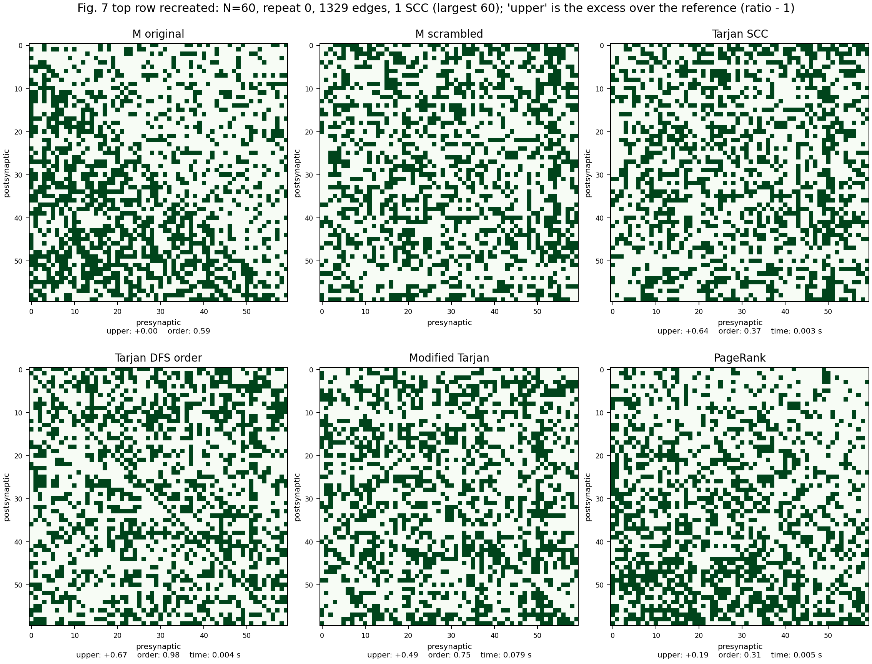
STAGE 00 · ORDERING
00
What those methods return on this matrix
Method (85-cell connectome) | Recurrency ratio | Order index
PageRank | 0.697 | 0.262
Modified Tarjan | 0.790 | 0.583
Laplacian Fiedler | 0.807 | 0.464
Anatomical | 0.830 | 0.714
Reverse Cuthill–McKee | 0.887 | 0.643
Tarjan DFS finishing order | 0.920 | 0.940
Original = Tarjan SCC condensation | 1.000 | 0.702
Figure 7 top row, recreated: the same realisation the summary curves measure.
"Tarjan" in Borst & Leibold is a depth-first search, not an SCC condensation. The 85-cell graph is a single SCC with alphabetical labels, so condensation returns the input order untouched — which is why Tarjan SCC and Original report byte-identical metrics.
A feedback-arc local search beats every implemented method: 445 backward edges (ratio 0.475) against PageRank’s 653, and 99.52% of |weight| placed below the diagonal against modified Tarjan’s 53.3%.
That reverses both null-test conclusions in notebook 01. With the optimiser, weighted feedforward reads z = +3.15 rather than "not unusual", and the backward-edge ratio goes the wrong way at z = +1.81. Twelve nulls, indicative only — redo at 100 before quoting.
The order index is saturated and should not be used as a discriminator: at density 0.220 a plain greedy walk finds a simple path through 81 of 85 cells, so ≥ 0.952 is available with no optimisation at all.
tarjan_reorder/NOTEBOOK_REVIEW_vs_Borst_Leibold_2023.md Parts D2, D3, D5 · optimal_orders.csv

Slide 13
STAGE 01
01
The excitatory backbone
QUESTION
Is the excitatory-to-excitatory subnetwork feedforward at the neuron-type level, and along which path does signal actually travel?
METHOD
Seven backbone constructions over the 32-node E→E graph — greedy, maximum spanning tree, branch-and-bound, bitmask/beam DP, two MILP formulations — plus a feedback-arc-minimising global ordering scored against a 2,000-draw permutation null.
FINDING
94.96% of positive E→E edge weight points forward under the recovered ordering, against a chance expectation near 50%. The subnetwork is close to feedforward despite being a single strongly connected component.

Slide 14
STAGE 01 · PATH METHODS
1
Seven ways to build a backbone, compared on the same graph
32 excitatory types, 355 positive directed E→E transitions, diagonal ignored. Six methods select a path from each seed; the seventh selects a global ordering and scores every edge rather than one walk.
Method | Mean path weight | Median | Mean length | Max
milp_subtour_elimination | 227,745 | 241,065 | 28.47 | 241,901
maximum_weight_asymmetric_hamiltonian_path | 204,189 | 222,249 | 31.00 | 223,059
branch_and_bound | 177,627 | 171,725 | 25.72 | 232,244
greedy_tree_path | 125,314 | 121,527 | 16.69 | 195,127
dynamic_programming (beam, width 5,000) | 109,772 | 105,454 | 4.47 | 150,350
maximum_spanning_tree | 95,745 | 109,051 | 5.47 | 114,610
Results above predate two solver fixes and are being regenerated
The branch-and-bound optimistic bound was not admissible and could prune the optimum. Scores rose after the fix; it is exact only when bb_status == "complete".
MILP optimality was read from pulp.LpStatus, which reports "Optimal" both when CBC proves optimality and when it stops on the time limit holding an incumbent. Optimality is now certified per seed from problem.sol_status.
The one negative benchmark gap — SUB CA1 Projecting Pyramidal — was an unproven incumbent, not evidence that the two MILP formulations answer different questions. The gap column now carries a gap_is_certified flag and raises if any method beats a proven optimum.
EE_backbone/ee_backbone_method_comparison.ipynb · docs/method_citations_and_verification.md

Slide 15
STAGE 01 · ORDERING
1
The excitatory subnetwork is close to feedforward
0.9496
0.486
< 0.005
forward-weight fraction under the
feedback-arc-minimising ordering
permutation null mean
(sd 0.124, n = 2,000)
empirical p
best of 2,000 random orders: 0.815
Quantity | Value
Strongly connected components | 1 (all 32 types)
Positive edges | 355
Forward / feedback edges under the ordering | 208 / 147
Forward / feedback edge weight | 748,421 / 39,719
Recurrence is carried by a small fraction of the weight
A single SCC means every type is reachable from every other. That is compatible with near-feedforward flow, because the return edges exist but carry roughly 5% of the weight.
The recovered order is anatomical, and nothing anatomical was supplied
It opens in superficial entorhinal layers, passes through CA3 and CA2 into CA1, and ends in subiculum and deep entorhinal layers — the expected direction of flow through the hippocampal formation. That fell out of maximising forward edge weight. The ordering is written to backbone_ordering.csv and consumed as the backbone coordinate by the E/I notebook.
EE_backbone/ee_backbone_ordering.py (feedback-arc ordering, Vahidi 2025) · ordering_metrics.csv, ordering_permutation_null.csv

Slide 16
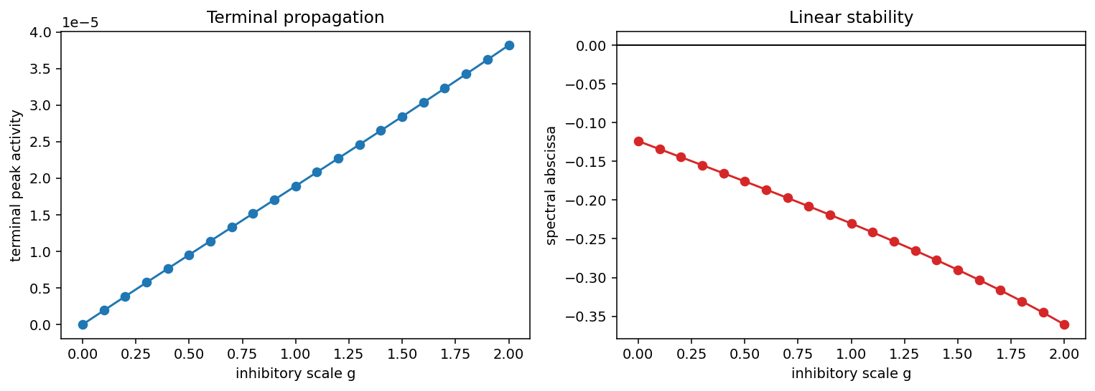
STAGE 01 · DYNAMICS
1
Inhibition along the backbone coordinate
−0.61
+27.20
285 / 578
spectral abscissa at g = 2 (−0.42 at g = 0)
stable at every gain tested
numerical abscissa
gap of ≈ 27.6 from the spectrum
feedforward / feedback
inhibitory edges vs the ordering
Inhibitory edge class | Mean |w| | Mean |displacement| | Median displacement
Feedforward (285 edges) | 0.00748 | 10.5 | +7
Feedback (578 edges) | 0.00444 | 21.8 | −13
Strong local feedforward inhibition alongside weak long-range feedback inhibition is consistent with the hippocampal–entorhinal microcircuit literature, and is checkable against it. The abscissa gap — not G_max alone — is the quantitative signature of non-normality, and it is what Stage 6 takes up in continuous time.
The placement null is negative, and that is reported as such
Observed terminal peak 0.10749 sits at the 22.4th percentile of a 500-draw null (empirical p = 0.226 / 0.776): inhibitory target placement is not distinguishable from chance on this statistic. Inference is by empirical p, not z — the null is skewed (−2.54), and at the previous N = 25 default the z spanned −0.2 to +34. The null preserves each source’s out-degree and weight multiset but not target in-degree, so it is a first-order placement null; a strength-preserving randomisation is the stronger comparison.
EE_backbone/ei_backbone_analysis.ipynb · Milisav et al. (2024) Nature Computational Science, on strength-preserving nulls.

Slide 17
STAGE 02
02
Inhibition and disinhibition
QUESTION
What does inhibition actually do to this network’s stability — and is it the direct inhibitory edges that matter, or the chains through them?
METHOD
Coarse block fractures (EE / EI / IE / II / self), the inhibitory Schur complement with a Neumann-depth expansion, motif enrichment against a degree-preserving null, and node-, edge- and motif-level ablations, all run in matched with-self and no-self variants.
FINDING
E→E carries the excitatory growth mode; cross-E/I coupling is stabilising. Inhibitory feedback pulls the effective excitatory dynamics back to target from either starting point, and the enriched motif is a disinhibitory chain, not a direct inhibitory edge.

Slide 18
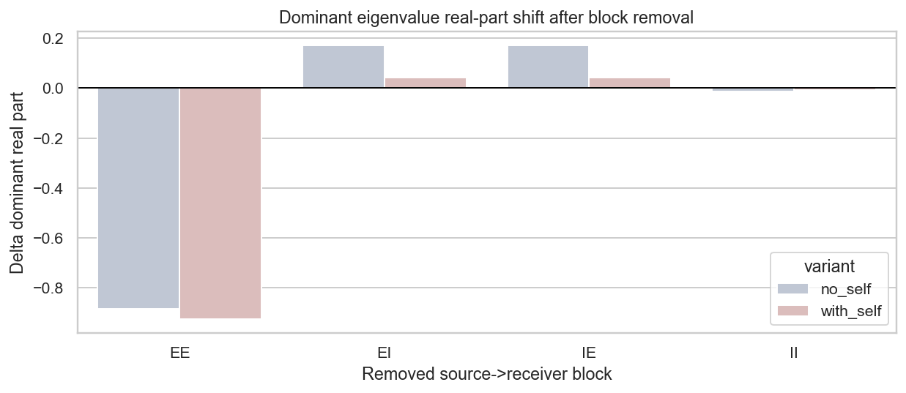
STAGE 02 · BLOCK FRACTURES
2
Which block carries the instability
Both variants normalised to a dominant real eigenvalue of 0.85, then one block removed at a time.
Block removed | with_self | no_self | Reading
E → E | 0.85 → 0.063 | 0.85 → 0.099 | carries essentially the whole excitatory growth mode
I → I | 0.85 → 0.844 | 0.85 → 0.838 | nearly inert at the level of the dominant eigenvalue
Cross E/I (E→I and I→E) | 0.85 → 0.886 | 0.85 → 0.996 | removal destabilises — the cross terms are stabilising
The paradox worth stating to a committee
The E→I block carries almost all of the matrix norm, and yet inhibitory feedback shows up in the spectrum as weak. Massive E→I weight with a very light I→E return produces small inhibitory feedback eigenvalues — the influence is real but it is transient and directional, not spectral.
That is the same geometry Stage 6 measures directly as an abscissa gap. It is also why block removal, not eigenvalue inspection, is the diagnostic that separates these blocks.
inhib_modulation/notebooks/02_inhibitory_modulation_analysis.ipynb · schur_decomp/07_inhibitory_modulation.ipynb

Slide 19
STAGE 02 · SCHUR COMPLEMENT
2
Inhibitory feedback returns excitation to target
M_eff_E = M[E,E] + M[E,I] · (I − M[I,I])⁻¹ · M[I,E] — partition notation: M[E,I] is I source onto E receiver
Variant | ρ(M[E,E]) — excitatory block alone | ρ(M_eff_E) — after inhibitory feedback
with_self | 0.886 | 0.850
no_self | 0.996 | 0.850
From either starting point — a mildly supercritical excitatory block with self-connections, or one sitting at the edge of instability without them — the effective excitatory dynamics land on the same target. Inhibition is not trimming a little off the top; it is what sets the operating point.
Why the Neumann expansion earns its place
Matched-variant discipline
Expanding (I − M[I,I])⁻¹ = Σ M[I,I]ᵏ makes the inhibitory chain depth explicit and interpretable:
k = 0 direct inhibition, E ← I
k = 1 disinhibition, E ← I ← I
k ≥ 2 longer inhibitory relays
The retained order is selected per variant by an explicit model-selection rule rather than fixed in advance, so chain depth is a reported result and not an assumption.
with_self and no_self are normalised independently before comparison. That isolates the effect of removing the diagonal, but it means every with/without statement is about matched normalised dynamics — not about raw diagonal mass.
Stated as an interpretation caution in the project README rather than left for a reader to infer, because the no-self variant systematically looks more dramatic on every downstream measure precisely because normalisation redistributes influence into off-diagonal pathways.
schur_decomp/README.md §5 · inhibitory_schur_modulation_script.py (schur_effective_E, neumann_ii_model_selection)

Slide 20
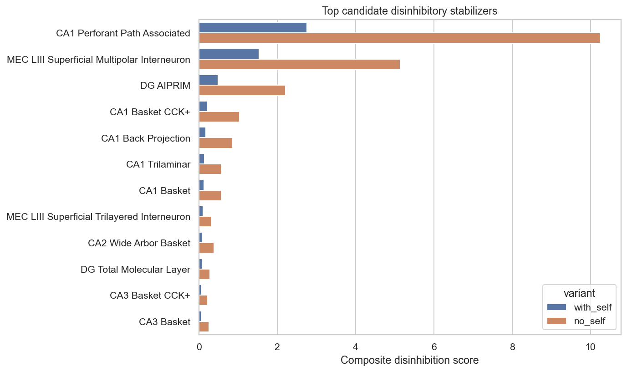
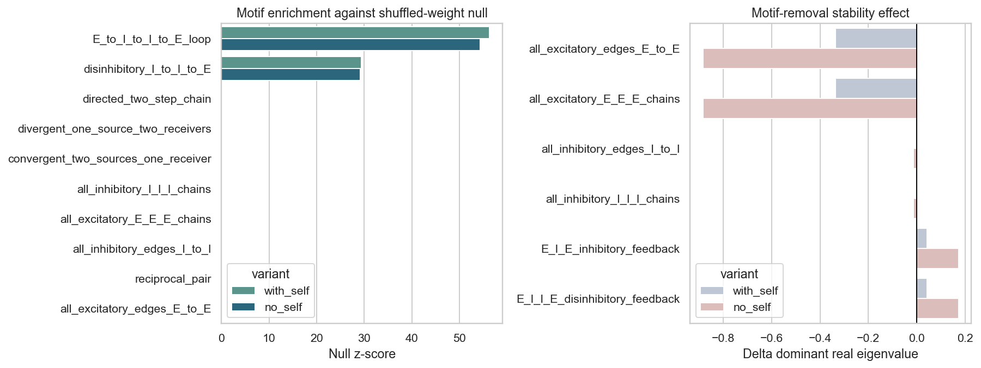
STAGE 02 · DISINHIBITION
2
The enriched motif is a chain, not an edge
Motif class | z, with self-connections | z, no self-connections
E → I → I → E loop | 51.96 | 51.60
Disinhibitory I → I → E | 27.53 | 28.03
Top disinhibitory sources
CA1 Perforant Path Associated
MEC LIII Superficial Multipolar Interneuron
DG AIPRIM
Enrichment is stable across variants and the source ranking barely moves, which is the strongest evidence in this stage that the effect is structural rather than a normalisation artefact. The reading: disinhibitory relays are the mechanism by which inhibition sets the excitatory operating point, and the same cells appear as the top-loading contributors to the leading Schur modes in Stage 5.
inhib_modulation/outputs/02_inhibitory_modulation_analysis/ · top_disinhibitory_sources_by_variant.csv, motif_enrichment_by_variant.csv

Slide 21
STAGE 03
03
Motif enumeration and analysis
QUESTION
Which three-node patterns are actually over-represented once degree and reciprocity are held fixed — and where do they sit anatomically?
METHOD
The 13 Davis–Holland–Leinhardt directed triad classes, validated against Rees et al. (2016); twin-node unrolling of the within-type diagonal; exact orbit counting by lookup table; two null ensembles, one classical and one conservative.
FINDING
The connectome is strongly transitive and cycle-averse. The fully reciprocal triangle is enriched 7.7× (z = +62) while the open reciprocal class 201 is suppressed to 0.11× — reciprocity clusters into closed triangles rather than spreading into chains.

Slide 22
STAGE 03 · VOCABULARY
3
Thirteen classes, and what to do with the diagonal
The vocabulary is the 13 connected DHL triad classes. Validated against Rees et al. (2016) — same Hippocampome data, 122 types: their superpatterns A–M map exactly onto the 13 classes (A=021U, B=021C, C=021D, D=111D, E=030T, F=111U, G=030C, H=120D, I=201, J=120C, K=120U, L=210, M=300), and their data-independent combinatorics reproduce exactly — 86 connected + 18 disconnected E/I patterns, F→8 variants, G→4 variants.
The diagonal is not autaptic, so it cannot simply be dropped. Triads are defined over three distinct nodes: a self-loop contributes nothing to a census, and the within-type structure of 71 of 85 types would vanish silently.
Unrolling: split each self-connected type into two exchangeable instances joined by a reciprocal dyad carrying the within-type weight in both directions. Each twin inherits the type’s full external connectivity. Result: 156 instances, 5,562 edges, zero self-loops.
Orbit counting by a 64-pattern lookup table over all node triples, not VF2 subgraph isomorphism search. Every 3-node subset carries one of 64 directed adjacency patterns; a precomputed table gives its class and each position’s orbit. Exact, no automorphism correction, 0.4 s instead of 30 s, validated against networkx.triadic_census on all 13 classes.
A bug the rewrite retired
VF2’s subgraph_isomorphisms_iter emits one mapping per automorphism, so raw orbit counts were inflated by |Aut| — 6× for class 300, 3× for 030C, 2× for several others. The vertex-disambiguation figure δ is invariant under that rescaling, so it never moved, but the orbit-frequency chart was distorted until the counts were divided per column and cross-checked against nx.triadic_census. The lookup-table implementation removes the failure mode rather than correcting for it.
graph_subnetworks/gsn_connectome.py · Rees et al. (2016) eNeuro 3(6) ENEURO.0205-16.2016 · Davis & Leinhardt (1972); Holland & Leinhardt (1970)

Slide 23
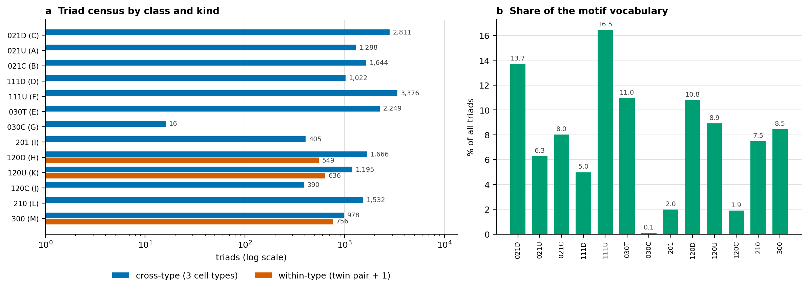
STAGE 03 · COUNTING
3
Which denominator, and why it changes the answer
The instance graph multiply-counts: a triple of three twinned types appears 2³ = 8 times with an identical pattern. That is correct for the model — each instance genuinely occupies those orbits — and wrong for description, because it weights twinned triples eightfold for a reason that is our construction, not biology. For counting, every triad is reduced to the multiset of cell types it involves.
Level | Triads
Connected triads on the instance graph | 119,342
Distinct cell-type triads, cross-type (3 distinct types) | 18,572
Distinct cell-type triads, within-type (twin pair + 1) | 1,941
Total distinct cell-type triads | 20,513
The check that this is right
The deduplicated cross-type census equals the triad census of the 85-node type graph exactly, class by class. The 1,941 within-type triads are the residue a type-graph census cannot see at all — there, they are self-loops.
Vocabulary composition
Four classes carry more than half of it: 111U 16.5%, 021D 13.7%, 030T 11.0%, 120D 10.8%. The pure 3-cycle 030C is nearly absent — 16 triads, 0.08%.
Unrolling adds structure constrained to three classes, because the third cell must treat both twins identically: 120U (636), 120D (549), 300 (756).
graph_subnetworks/motif_characterization.ipynb · motif_tables/triad_census.csv, within_type_triads.csv

Slide 24
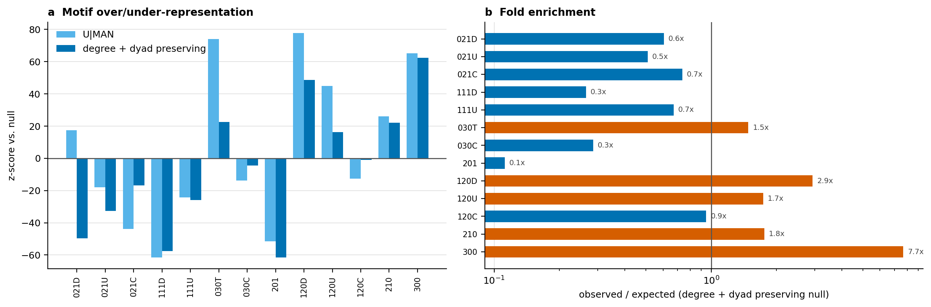
STAGE 03 · SIGNIFICANCE
3
Two nulls, and one that would have lied
Class | Observed | Expected | Fold | z
300 fully reciprocal triangle | 978 | 127 | 7.7× | +62
120D | 1,666 | 568 | 2.9× | +49
030T feed-forward | 2,249 | 1,516 | 1.5× | +23
201 | 405 | 3,617 | 0.11× | −62
111D | 1,022 | 3,857 | 0.27× | −58
networkx.directed_edge_swap is not usable here
It preserves degrees but destroys about 60% of the 422 mutual dyads. As a null it would report enormous, entirely spurious enrichment for every reciprocal motif.
U|MAN — the classical triad-census null. The counts of mutual, asymmetric and null dyads are held fixed; degrees are free.
Degree- and dyad-preserving rewiring — every type’s in-degree, out-degree and the M/A/N dyad counts are all held fixed. Swaps are applied separately to mutual dyads and asymmetric edges and rejected if one would convert into the other. What survives this is genuine three-node structure.
Both a z-score and a fold change are reported for every class, because they answer different questions: z says how far the observation sits from the null spread and grows with ensemble precision, fold change is the effect size. The cyclic class 030C shows the gap — z = −4.5 sounds decisive, but the counts are 16 observed against 56 expected.
Reading: reciprocity clusters into closed triangles rather than spreading into open chains. Raw counts would have said the opposite, because the most common class is the most common for degree reasons.
graph_subnetworks/motif_tables/motif_significance.csv · 400 null samples

Slide 25
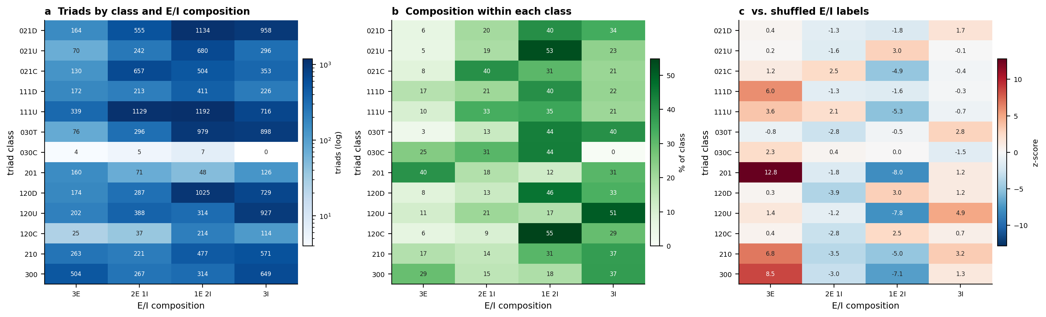
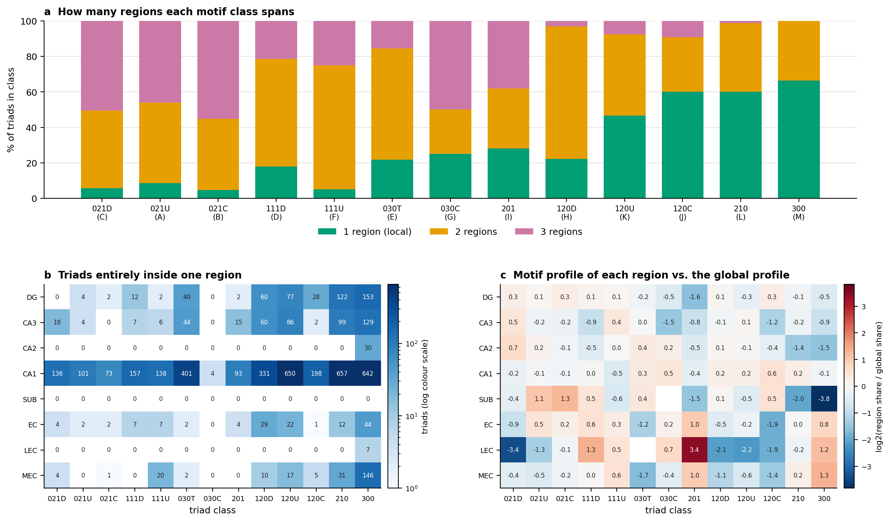
STAGE 03 · GEOGRAPHY AND COMPOSITION
3
Where the motifs are, and who is in them
24.2%
66%
85 / 86
of triads sit entirely
inside one region
of class 300 triads are
single-region — reciprocity is local
Dale-consistent coloured
patterns that actually occur
Open two-edge classes are the cross-region ones — 021C, 111U and 021D each span two or three regions more than 94% of the time. Long-range structure here is made of two-edge motifs, not triangles.
E/I composition is 1E2I 35.6%, 3I 32.0%, 2E1I 21.3%, 3E 11.1% — close to what the 32E / 53I inventory alone predicts. Reporting that composition on its own would be true and uninformative.
Placement is what the inventory does not predict. Hold the graph fixed and permute E/I labels over cell types — rewiring instead would change topology and labelling at once, and the two effects could not be separated. All-excitatory triads are then specifically over-represented in the reciprocal classes: 201 z = +13, 300 z = +9, 210 z = +7, 111D z = +6. The recurrent excitatory core is structural.
The single absent coloured pattern is the purely inhibitory 3-cycle I1 → I2 → I3 → I1. E/I colouring adds no vertex disambiguation: δ stays at 0.9529, and the four tied type pairs are ones Hippocampome separates on molecular markers rather than connectivity.
Every descriptive count here is on the binary adjacency; coupling magnitude enters only the weight-distribution figure. A weighted motif analysis is a separate question and is not claimed.
graph_subnetworks/motif_tables/region_motif_enrichment.csv, ei_composition_per_class.csv, coloured_pattern_vocabulary.csv

Slide 26
STAGE 04
04
Graph substructure networks
QUESTION
Do local subgraph counts carry information about a global dynamical observable that message passing alone cannot reach?
METHOD
Bouritsas et al. (2022): append triad-orbit counts to node and edge features so the network exceeds 1-WL expressivity. Target is the steady state of a linear neural-mass model under unit DG Granule drive; transductive node regression, splits drawn over cell types, ten repeats.
FINDING
GSN-e reaches R² = 0.57 against 0.21 for a first-order MLP and 0.22 for a plain MPNN — but Spearman is flat at ≈ 0.72 across every model. The gain is in calibration, not in ranking, and reporting either metric alone would misstate it.

Slide 27
STAGE 04 · DESIGN
4
Mapping the paper onto a connectome
Substructure family H
δ = 0.9529
The 13 directed triad classes. 30 vertex-orbit features feed GSN-v; 30 edge-orbit features feed GSN-e.
vertex disambiguation — 81 of 85 orbit signatures are distinct
The four ties are CA1 Basket / CA1 Basket CCK+, CA1 Bistratified / CA1 Ivy, CA3 Basket / CA3 Basket CCK+, and MEC LIII Superficial Multipolar / Trilayered — types Hippocampome separates on molecular markers, not connectivity. The tie is a property of the data, not a failure of the features.
Target
A global function of the whole coupling matrix — the steady state under a unit DG Granule drive. Chosen deliberately so a shallow message-passing network cannot reach it locally.
Splits
Monotone transforms cost nothing
Over cell types, never over node instances. Twins are exchangeable and carry identical features by construction, so an instance-level split would put a type’s twin in train and its partner in test and the model would score by memorising.
Orbit counts go in as log1p then standardised per feature. Because log1p is strictly monotone and applied elementwise, distinct count vectors stay distinct — the injectivity that Theorem 3.3 relies on is preserved. The normalisation buys optimiser conditioning and costs nothing theoretically.
Coupling enters as sign(x)·log1p(|x|), which keeps Dale’s sign and puts E and I on one scale across eight orders of magnitude.
Baselines
MLP on first-order features, the same MLP with orbit counts appended, and a plain MPNN — so the orbit contribution is separable from the message-passing contribution.
Bouritsas G, Frasca F, Zafeiriou S, Bronstein MM (2022) IEEE TPAMI 45(1):657–668 · graph_subnetworks/GSN_connectome_workflow.ipynb

Slide 28
STAGE 04 · RESULTS
4
Orbit counts help — in calibration, not in ranking
Model | Test R² (mean ± sd, 10 splits) | Spearman
MLP — first-order features only | 0.21 ± 0.53 | 0.71
MLP — first-order + orbit counts | 0.44 ± 0.42 | 0.74
MPNN | 0.22 ± 0.94 | 0.73
GSN-v (vertex orbits) | 0.44 ± 0.29 | 0.72
GSN-e (edge orbits) | 0.57 ± 0.23 | 0.73
Two metrics, deliberately
R² is calibration; Spearman is ranking. Reporting R² alone would overstate the result. Reporting Spearman alone would erase it. Both are in the table because they disagree, and the disagreement is the finding: orbit counts sharpen the magnitude of the prediction while every model already orders the types about equally well.
Orbit counts help both with and without message passing, and GSN-e ≥ GSN-v as Theorem 3.3 predicts. The ordering of the five models is stable across splits even though individual R² values are not.
Caveats that belong on the same slide as the numbers
The edge attribute already carries m_ij, which is most of what determines the dynamics — so the headroom for purely structural features is smaller here than in the paper’s unweighted benchmarks. Setting edge_attr to a constant is the cleaner test of topological expressivity and is the next experiment to run.
The spectral normalisation α = 0.9 is a modelling choice, not a calibration: it makes the linear map contractive, and it is not derived from membrane time constants. Conclusions about the ordering of types under the neural-mass target are more defensible than conclusions about magnitudes.
R² variance is real, not decoration. One fold holds roughly 17 types and a single outlier moves it considerably — which is why the MPNN’s ± 0.94 is reported rather than smoothed.
graph_subnetworks/GSN_connectome_workflow.ipynb · deterministic given the notebook seeds

Slide 29
STAGE 05
05
Eigen and Schur decomposition
QUESTION
Where do the network’s modes live, how do they couple, and what does removing the within-type diagonal do to any of it?
METHOD
Complex Schur decomposition A = Q T Q* of the oriented, spectral-radius-normalised state matrix; modal seeding and propagation; greedy top-contributor trees per mode; matched with-self / no-self comparison across all ten notebooks.
FINDING
Removing self-connections nearly triples non-normality (5,870 → 18,320) while preserving the dominant modal direction (overlap 0.901). The influence does not disappear — normalisation redistributes it into off-diagonal pathways.

Slide 30
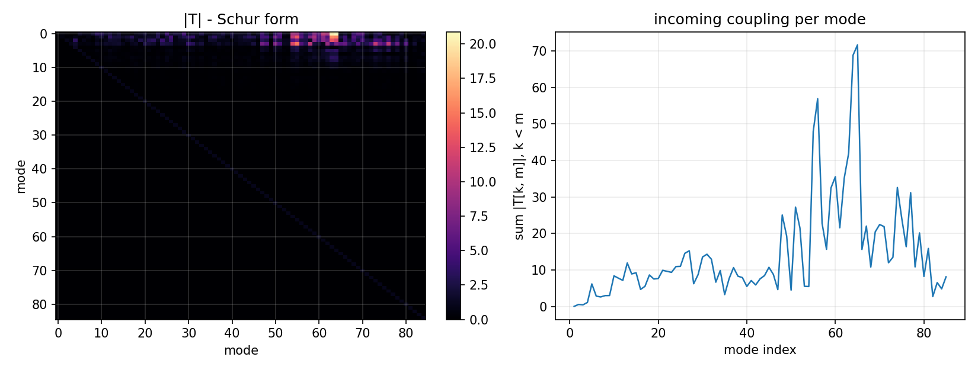
STAGE 05 · METHOD
5
Why Schur and not eigendecomposition
A = Q T Q* Q unitary, T upper-triangular — the diagonal is the spectrum, the upper triangle is mode-to-mode coupling.
This matrix is directed and strongly non-normal. Eigenvalues alone do not describe transient amplification or directional coupling, and the eigenvector basis is badly conditioned — condition number 9.9 × 10⁴, so modes are not separately excitable and cannot be treated as independent channels.
Q is unitary, so Schur coordinates are numerically stable where the modal basis is not, and the triangular structure keeps the cascade visible instead of collapsing it into a diagonal.
Direction convention: in p = Q*x we have ṗ_m = Σ_n T[m,n] p_n, so a non-zero T[m,n] with n > m means mode n drives mode m. The cascade runs high index to low index.
Borst & Leibold want R lower-triangular so the lower triangle reads as forward flow; scipy returns upper-triangular. Converting is a basis reversal — J = I[::−1], R = J T Jᵀ, Z = Q Jᵀ — not a transpose. Transposing would change the operator.
Open item, flagged not fixed
Notebook 03 labels this coupling backwards — schur_upper_coupling_out_abs is read as flow into later modes when it is flow in from them. It affects labels and prose, not the invariant rankings.
What survives a wrong transpose, and what does not
Invariant: spectral radius and every eigenvalue, the Schur off-diagonal norm and departure ratio, resolvent gain and condition number at z = 1 — so the headline motif rankings hold either way. Not invariant: every cell-attributed quantity — node Schur participation, dominant Schur node, and the entire signed-overlap operator in notebook 04, which is built from signed loadings. That is the part to verify rather than assume.
schur_decomp/01–06 · Goldman MS (2009) Neuron 61:621–634, the feedforward-in-transformed-coordinates result Eq. 10 builds on.

Slide 31
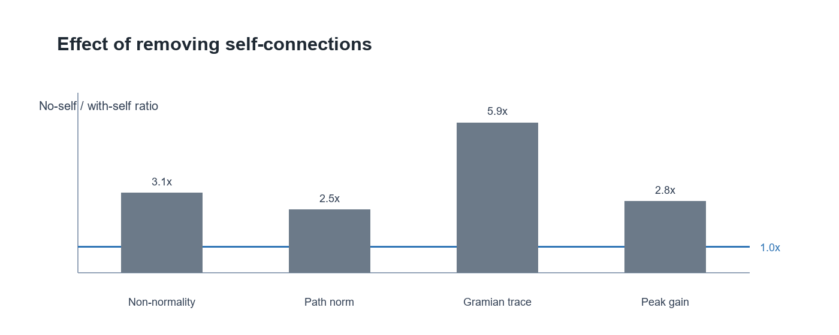
STAGE 05 · RESULTS
5
Matched normalised dynamics, with and without the diagonal
Variant | Raw ρ | Achieved ρ | ‖M‖_F | Non-normality | Signal at t = 10
with_self | 26,213.13 | 0.95 | 77.18 | 5,869.90 | 17.35
no_self | 14,837.87 | 0.95 | 136.35 | 18,319.83 | 39.48
Dominant vector overlap between variants is 0.901 — the dominant modal direction is broadly preserved when self-connections are removed.
Regional dominance: CA1 dominates 26 of 85 Schur modes, CA3 and DG 15 each, MEC 12. High-loading cells are predominantly inhibitory — CA1-dominant modes average 25.46 high-loading inhibitory cells, CA3 modes 27.67, DG modes 26.20.
Greedy top-contributor trees average 4.26 edges and 2.74 connected components per mode: many modal contributor sets are not explained by a single connected source tree. Leading modes are dominated by the same inhibitory cells that top the disinhibition ranking in Stage 2 — MEC LIII Superficial Multipolar, DG AIPRIM, CA1 Trilaminar.
Linear-systems companion, no_self vs with_self after matched normalisation: cumulative path ‖·‖_F 323.87 vs 131.96, Gramian trace 56,246 vs 9,547, Gramian condition 42,740 vs 5,767, peak gain 193.43 vs 69.39, both peaking at frequency 0.01.
How to read the no-self column
The two variants are normalised independently, so this is not a raw-diagonal-mass comparison. The consistent pattern — higher non-normality, stronger propagation, larger gain and larger Gramian trace without the diagonal — is a structural consequence of normalisation redistributing influence into off-diagonal pathways, and should be stated that way rather than as "self-connections suppress propagation".
schur_decomp/02, 04, 05, 08, 10 · outputs/schur_modes, schur_mode_greedy_trees, network_linear_systems

Slide 32
STAGE 06
06
Continuous time and non-normal structure
QUESTION
The matrix was built as a discrete Markov operator but used to talk about continuous-time dynamics. Does the conclusion survive being restated correctly?
METHOD
τ dx/dt = −x + W x, so J = (−I + W)/τ with W the same oriented, normalised M[post, pre]. Spectral, numerical and pseudospectral abscissas; transient envelope; Kreiss bound; Henrici departure; a normal surrogate as control.
FINDING
Asymptotically stable at α = −0.05, and amplifying a worst-case perturbation 27-fold before it decays. The normal surrogate carrying the same eigenvalues amplifies exactly 1.0×, so the amplification is structure, not spectrum.

Slide 33
STAGE 06 · FRAMING
6
Restating the operator in continuous time
The mismatch, stated for reviewers rather than left implicit
M was constructed as a discrete operator — x[t+1] = M x[t], stable iff ρ(M) < 1 — and then used to discuss continuous-time circuit dynamics, where stability is max Re λ < 0. Those are different boundaries: a disk and a half-plane.
τ dx_i/dt = −x_i + Σ_j W_ij x_j J = (−I + W) / τ stable iff max Re λ < 0
Quantity | Definition | Question it answers
Spectral abscissa | α(J) = max Re λ | How fast does it settle, eventually?
Numerical abscissa | ω(J) = λ_max((J + Jᵀ)/2) | How fast can it grow at t = 0?
Pseudospectral abscissa | α_ε(J) | How far can a perturbation of size ε push it?
These three coincide for a normal matrix. The gap between them is transient amplification, and it is invisible to eigenvalue analysis alone. Given that this network is strongly non-normal, that gap is the point of the project — and the continuous formulation also makes questions expressible that the discrete one cannot state cleanly: the optimal-perturbation SVD of exp(Jt), the Kreiss lower bound, the inhibitory gain at which α(J) crosses zero, and the ISN test comparing J_EE against full J.
Three conventions carried into this stage
Normalise W, never J — scaling J rescales the leak and silently changes τ. · Ablations are not renormalised by default: a cut changes the network’s gain, and renormalising afterwards scales that change away; notebook 04 runs the sweep both ways. · Self-connections are autapses, not the leak. The −I term lives in J and is never removed by a no_self variant.
jacobian_analysis/README.md · jacobian_core.py

Slide 34
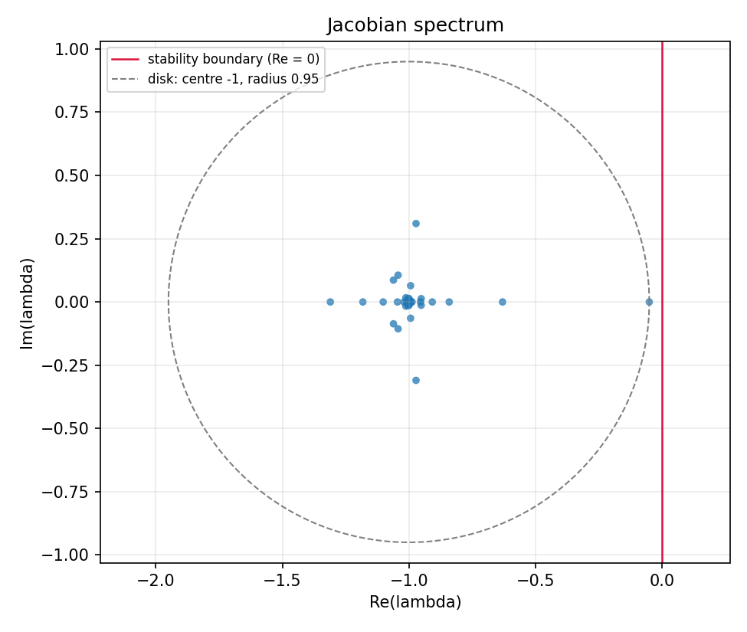
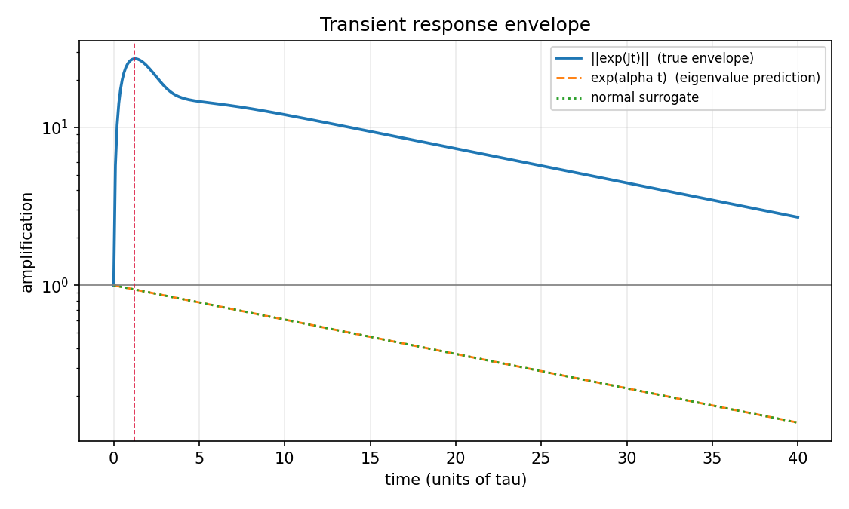
STAGE 06 · DIAGNOSTICS
6
Stable, and amplifying 27-fold on the way there
At ρ(W) = 0.95, τ = 1, leak = 1.
Quantity | Value | Reading
Spectral abscissa α(J) | −0.0500 | stable; slowest mode decays with time constant 20 τ
Numerical abscissa ω(J) | 29.58 | growth rate at t = 0 is strongly positive
Abscissa gap | 29.63 | the entire gap is non-normal transient structure
Peak amplification | 27.11× at t = 1.2 τ | worst-case transient gain
Kreiss lower bound | 18.47 at ε = 0.05 | amplification guaranteed without simulating
Henrici departure | 77.17 (99.3% of ‖J‖_F) | almost all of the matrix norm is non-normal
Eigenvector condition number | 9.9 × 10⁴ | the modal basis is nowhere near orthogonal
The control that makes this a claim
A normal surrogate — a diagonal matrix carrying exactly the same eigenvalues — has peak amplification of exactly 1.0.
So the 27-fold gain is attributable to non-normal structure and not to the spectrum. A purely spectral reading predicts monotone decay at rate 0.05 and is wrong about the entire first few τ of the response.
Stiffness: λ_J = μ − 1 for each eigenvalue μ of W, so the per-mode effective time constant is τ/(1 − μ). Re(μ) spans [−0.310, 0.950], giving effective time constants from 0.76 τ to 20 τ, with 44 of 85 modes faster than τ — a 26-fold spread. Read those as a description of the spectrum, not as measurable relaxation times: with an eigenvector condition number of 9.9 × 10⁴ the eigendirections are not separately excitable, and with ω(J) = +29.6 a worst-case state grows rather than relaxing at any of these rates.
jacobian_analysis/01_jacobian_construction.ipynb · Trefethen & Embree (2005) Spectra and Pseudospectra · Dayan & Abbott, Theoretical Neuroscience ch. 7

Slide 35
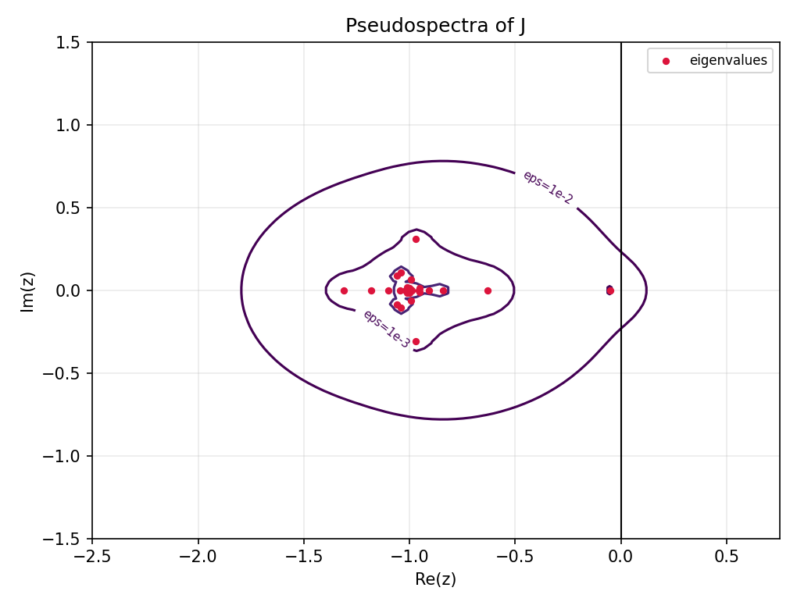
STAGE 06 · STRUCTURE
6
Where the amplification lives — and one number not to misread
Block (source → target) | ‖·‖_F at ρ(W) = 0.95
E → I | 77.02
E → E | 4.91
I → I | 0.40
I → E | 0.084
ρ(J) = 1.31 is not instability
The spectral radius measures distance from the origin, and in continuous time the origin means nothing: the stability boundary is the imaginary axis, and |λ| = √(Re² + Im²) mixes decay rate with oscillation frequency.
λ_J = λ_W − 1, so the spectrum of J is the spectrum of W — a cloud of radius 0.95 — translated to centre −1. The eigenvalue attaining ρ(J) is λ = −1.3103, the most negative one; measured from the correct centre, max |λ_J + 1| = 0.95 exactly. ρ(J) is a speed statistic, not a stability one.
Nearly all of the matrix norm sits in one off-diagonal block with a very weak return path — the canonical feedforward geometry that produces non-normal amplification, and the same asymmetry that made cross-E/I removal destabilising in Stage 2. Notebooks 04 and 05 are where that reading gets tested rather than assumed.
The two criteria are the same operator
(I + J) − W = 0 to machine precision, so the discrete M analysed in Stage 5 is the forward-Euler propagator of this Jacobian at dt = τ. The discrete criterion ρ(M) < 1 is the Euler-step condition |1 + dt·λ| < 1 — a disk of radius 1/dt centred at −1/dt; the continuous criterion is the half-plane. Both are satisfied.
Worth stating in the dissertation: the largest stable Euler step here is 1.53 τ, so dt = τ sits inside the stability region with about 50% margin. Had the fastest mode been roughly twice as fast, the discrete analysis would have been an unstable discretisation of a stable system — an artefact of the time step rather than a property of the circuit. The exact propagator gives ρ(exp(Jτ)) = 0.9512 against 0.95 for Euler.
jacobian_analysis/01_jacobian_construction.ipynb, block baseline and Euler-equivalence sections

Slide 36
SYNTHESIS
What is settled, and what is still open
Settled
Open
Orientation, empirically, for this dataset: netlist residual 3.0 × 10⁻¹⁸ transposed against 1.414 as stored, and the loader now raises if a supplied netlist disagrees with the selected orientation.
The discrete and continuous readings are the same operator, and the Euler step sits inside the stability region with roughly 50% margin.
Non-normality is not marginal: 99.3% of ‖J‖_F is departure from normality, and a normal surrogate with the same spectrum amplifies exactly 1.0×.
The connectome is transitive and cycle-averse against a degree- and dyad-preserving null, and the recurrent excitatory core is a placement effect rather than an inventory effect.
Inhibitory feedback returns the effective excitatory dynamics to target from either variant, and the enriched motif class is a disinhibitory chain.
Both null-test conclusions in the ordering notebook reverse under a real feedback-arc optimiser. Twelve nulls so far; redo at 100 before any of it is quoted.
The EE-backbone path-weight tables predate the branch-and-bound and MILP solver fixes and need regeneration.
The motif Schur coupling direction is labelled backwards in notebook 03, and the motif-block orientation is asserted rather than verified against the w_ij metadata columns.
The E/I backbone placement null is first-order — out-degree and weight multiset preserved, target in-degree free. A strength-preserving randomisation is the stronger comparison.
motif_analysis motif ids are built in [pre, post] and do not join against the tarjan_reorder or inhib_modulation motif tables without remapping.
The order index is saturated at this density and should be dropped as a headline discriminator or reported against a density-matched baseline.
Open items are tracked in tarjan_reorder/NOTEBOOK_REVIEW_vs_Borst_Leibold_2023.md and docs/TRANSPOSE_WARNINGS.md.

Slide 37
NEXT
Where the work goes from here
1
Close the ordering null
2
Finish the Jacobian suite
Replace modified Tarjan with the feedback-arc optimiser inside ordering_null_test and re-run at the full 100 nulls. This is the highest-value scientific fix outstanding.
Notebooks 02–06: optimal perturbations from the SVD of exp(Jt), ablations against block-preserving nulls, the inhibitory gain at which α(J) crosses zero, and the ISN test comparing J_EE against full J.
3
Left eigenvectors, Eq. 9
4
Constant edge_attr GSN run
The input-gain decomposition is the substantive gap and the one closest to the dissertation question — it is where the non-normality argument becomes an input-output claim rather than a matrix property.
Strip m_ij from the edge attribute so the orbit features are tested on topology alone. The cleanest expressivity test available on this data.
5
Population level → motif level
6
Promote the orientation guard
Move the effects from population-level coupling to motif-level, then generalise the pipeline to C. elegans, the Drosophila hemibrain, and the Allen Mouse Connectivity Atlas.
Move assert_post_pre and the orientation audit into a repo-level common/orientation.py, so orientation is a property of the file rather than of anyone’s memory.
Dissertation framing: non-normal linear algebra applied to empirically reconstructed hippocampal–entorhinal connectomes.

Slide 38
SOURCES
References and primary code
Literature
Code and data
Borst A, Leibold C (2023) Connecting Connectomes to Physiology. J Neurosci 43(20):3599–3610.
Bouritsas G, Frasca F, Zafeiriou S, Bronstein MM (2022) Improving graph neural network expressivity via subgraph isomorphism counting. IEEE TPAMI 45(1):657–668.
Rees CL, Wheeler DW, Hamilton DJ, White CM, Komendantov AO, Ascoli GA (2016) eNeuro 3(6):ENEURO.0205-16.2016.
Davis JA, Leinhardt S (1972); Holland PW, Leinhardt S (1970) — the 13 triad classes and the U|MAN null.
Trefethen LN, Embree M (2005) Spectra and Pseudospectra. Princeton.
Goldman MS (2009) Neuron 61:621–634 · Dayan P, Abbott LF, Theoretical Neuroscience ch. 7.
Hennequin et al. (2012, 2014) · Murphy & Miller (2009) · Milisav et al. (2024) Nat Comput Sci.
Tarjan RE (1972) · Cuthill E, McKee J (1969) · Page L et al. (1999).
AscoliLab/docs — TRANSPOSE_WARNINGS.md, matrix_orientation_inventory.md, orientation_convention_proposal.md
AscoliLab/EE_backbone — ee_backbone_analysis.py, ee_backbone_ordering.py, ei_backbone_analysis_helpers.py
AscoliLab/inhib_modulation — notebooks 01–03, inhibitory_modulation.py
AscoliLab/motif_analysis — triad_utils.py, motif Schur and signed-overlap scripts
AscoliLab/tarjan_reorder — notebooks 01–04, ORIENTATION_AUDIT.md, NOTEBOOK_REVIEW_vs_Borst_Leibold_2023.md
AscoliLab/schur_decomp — notebooks 01–10, schur_core_script.py and four analysis modules
AscoliLab/jacobian_analysis — jacobian_core.py, notebooks 01–06
graph_subnetworks — gsn_connectome.py, GSN_connectome_workflow.ipynb, motif_characterization.ipynb
Data: mij_netlist.csv (1,641 rows) → mij_matrix.csv (85 × 85, stored [pre, post])
Roxanne Aniceto · Ascoli Lab, Krasnow Institute · George Mason University · 10 September 2026

