Slide 1
WeatherWise
Real-Time Weather Forecast Dashboard
By : Aditya Kumar & Ashif Rahman

Slide 2
> Problem & Solution <
Problems:
Fragmented weather information
Cluttered interfaces with ads
Poor data visualization
Outdated designs
Solution:
Clean, fast, beautiful dashboard
Real-time data + interactive charts
Modern glassmorphism UI
Ad-free experience

Slide 3
> Key Features <
Core Features:
Dual Location - GPS + city search
Interactive Charts - Temperature & humidity
Modern UI - Glassmorphism + Dracula theme
Real-Time - Auto-refresh every 15 min
️ Unit Toggle - Celsius ↔ Fahrenheit
Smart Cache - 10-min cache, faster loads

Slide 4
> Technology Stack <
Frontend:
HTML5, CSS3, JavaScript (ES6)
Chart.js, Material Icons
Backend:
Python 3.13, Flask 3.0
Flask-CORS, Requests

Slide 5
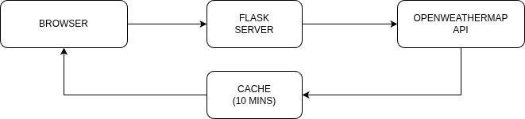
> Technology Stack <
External:
OpenWeatherMap API v2.5
Architecture:

Slide 6
> Data Flow <
Process:
User searches city
Flask checks cache (10 min)
If fresh → return cached data
If stale → call OpenWeatherMap API
Store in cache
Return to browser
Display with charts
Benefits:
Fast response times
Reduced API usage
Better user experience

Slide 7
> UI & Design <
Design Principles:
Glassmorphism - Frosted glass effect
Dark Theme - Dracula color palette
Responsive - Desktop, tablet, mobile
Animations - Smooth transitions
Color Palette:
Purple #bd93f9, Pink #ff79c6, Cyan #8be9fd
Orange #ffb86c, Yellow #f1fa8c, Dark #282a36

Slide 8
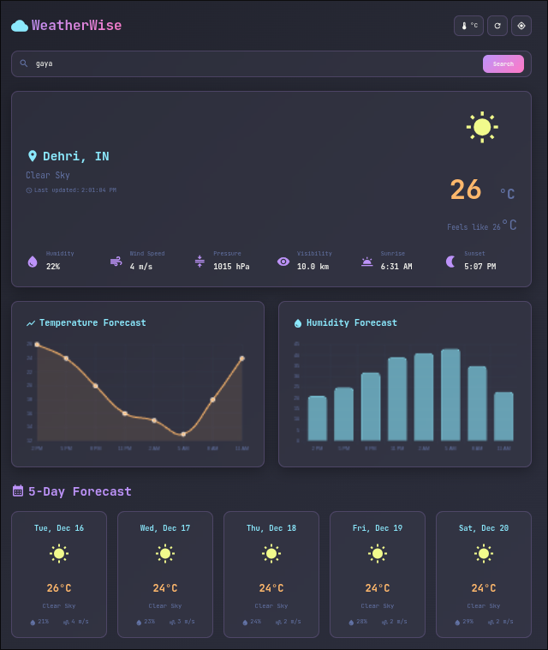
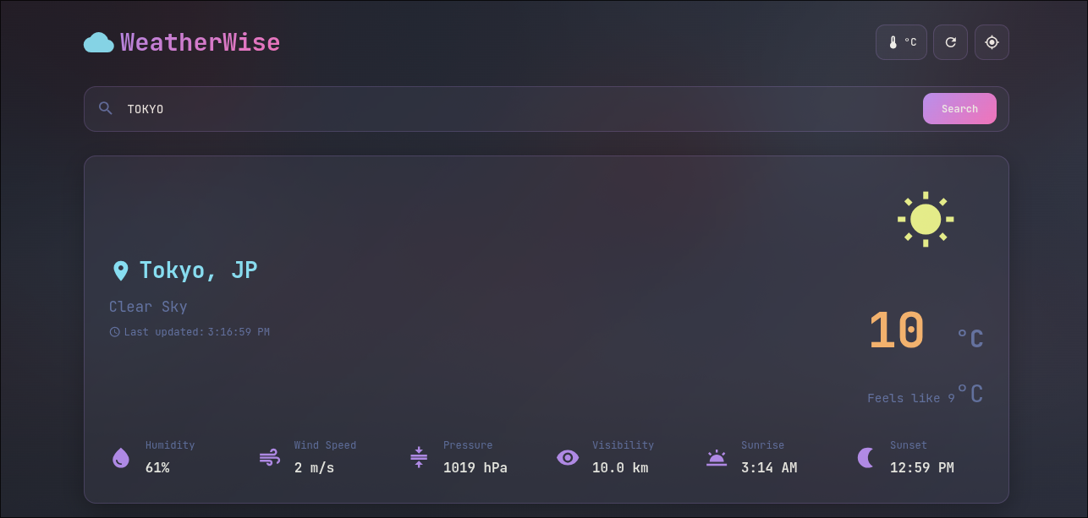
> UI & Design <
Screenshots:

Slide 9
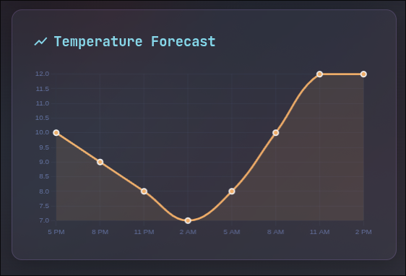
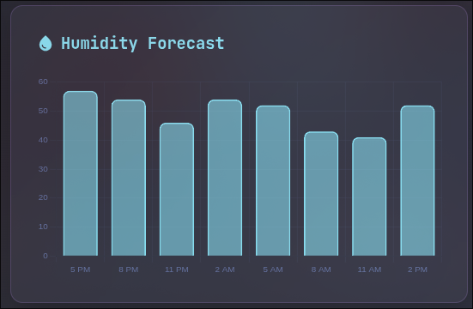
> UI & Design <
Screenshots:

Slide 10
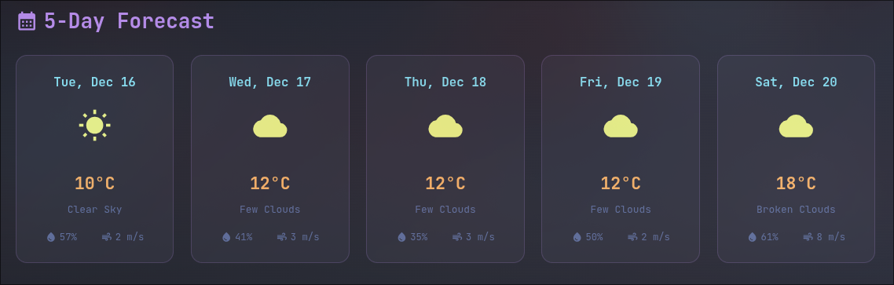
> UI & Design <
Screenshots:

Slide 11
> Feature Deep Dive <
Location:
Auto GPS detection
Manual city search
Remembers last location
Current Weather:
Temperature + feels-like
Humidity, wind, pressure
Visibility, sunrise/sunset

Slide 12
> Feature Deep Dive <
Forecast:
5-day predictions
Noon-time snapshots
Weather icons + details
Charts:
24-hour temperature trend
Humidity bar chart
Interactive tooltips

Slide 13
> Technical Highlights <
Optimizations:
Caching - 10-min cache → 83% fewer API calls
Retry Logic - 3 attempts → 99.5% uptime
Parallel Calls - Promise.all → 50% faster loads
LocalStorage - Saves preferences → personalized UX
# Cache system
cache = {'data': weather, 'timestamp': now}
# Retry logic
for attempt in range(3):
try: return fetch_data()
except: continue

Slide 14
> Conclusion <
Achievements:
Full-stack web app
Real-time API integration
Modern UI/UX
Responsive design
Open-source (GPL-3.0)
Links:
GitHub: github.com/roxxadiiii/WeatherWise
License: GPL-3.0

Slide 15

> Resources <
GeistMono Nerd font
MapleMono Nerd font
Mononoki Nerd font
Dracula colorscheme
LLM for debugging and formatting
Github for managing code
OnlyOffice for making ppt
Scan for code

