Slide 1

Scheduling Jobs to Minimize Energy
Samir Khuller
Joint work with Jessica Chang and Hal Gabow

Slide 2
Procrastination Pays: Scheduling Jobs in Batches
Samir Khuller
Joint work with Jessica Chang and Hal Gabow
PROJECT PARTICIPANTS: A. Deshpande, A. Kayyoor, K. Mukherjee, B. Saha

Slide 3

Simple Batch Scheduling Problem
Given a collection of N unit jobs, with release times and deadlines (integers), time is slotted.
Machine can be active or inactive. In an active time slot we can schedule ≤B jobs.
Minimize number of “active” slots.
N=9
B=3

Slide 4
Simple Scheduling Problem
Given a collection of N unit jobs, with release times and deadlines (integers), time is slotted.
In an active time slot we can schedule ≤B jobs.
Minimize number of “active” slots.
N=9
B=3
A
A
A
A
FOUR ACTIVE SLOTS

Slide 5



Energy Scheduling
CPU
CPU
CPU
STORAGE 1
STORAGE 2
STORAGE 3
Notes:
Motivation/context

Slide 7
An Example
[A]
[B]
[C]
[B,C]
[A]
A
B
B
C
A
C
CPU
CPU
CPU
STORAGE 1
STORAGE 2
STORAGE 3
Notes:
Motivation/context

Slide 8
An Example
[A]
[B]
[C]
[B,C]
[A]
S1
A
B
B
C
A
C
STORAGE 1
STORAGE 2
STORAGE 3
Notes:
Motivation/context

Slide 9
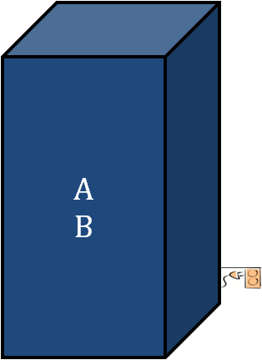
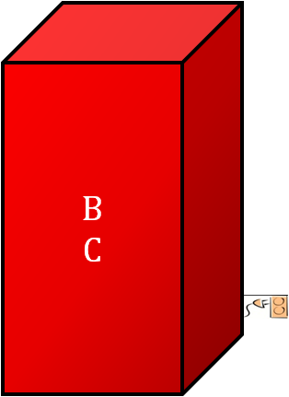
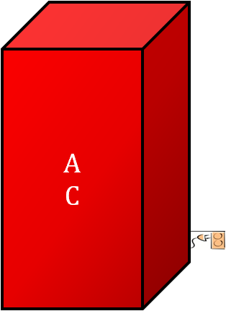
An Example
[A]
[B]
[C]
[B,C]
[A]
COST 3 →
S1
S2
S3
STORAGE 1
STORAGE 2
STORAGE 3
Notes:
Motivation/context

Slide 10
An Example
[A]
[B]
[C]
[B,C]
[A]
S2
B
C
A
B
A
C
STORAGE 1
STORAGE 2
STORAGE 3
Notes:
Motivation/context

Slide 11
An Example
[A]
[B]
[C]
[B,C]
[A]
COST 2 →
S2
S3
A
B
B
C
STORAGE 1
STORAGE 2
STORAGE 3
Notes:
Motivation/context

Slide 12


Storage Scheduling Model
Model Components
processor
  Capacity B
memory banks M₁, …, M_{m}
jobs 1, …, n
  l_{i} job length
  S_{i} pages needed
  T_{i} feasible times
Job set J:
l₁: 2; S₁ = {A,D}
l₂:1; S₂ = {C,D}
…
…
STORAGE
SYSTEM
CPU
M₁
M₂
…
M_{m}

Slide 13
Model: Feasibility and Cost
for each job i,
  l_{i} work units
  S_{i} µ data in “on” banks
Job set J:
l₁: 2; S₁ = {A,D}
l₂:1; S₂ = {C,D}
…
…
cost
  E(S) = ∑_{j} f(j)
  f(j) = total time bank j is “on”
STORAGE
SYSTEM
CPU
M₁
M₂
…
M_{m}

Slide 14
General Problem seems difficult…
We focus on a special case with one memory bank, and even that leads to an interesting scheduling problem with a new objective function.
Van of capacity P, need to fetch people from the airport (Batch Scheduling).
[R. Kleinberg] Communication in large systems (bunch messages into a single packet).

Slide 15
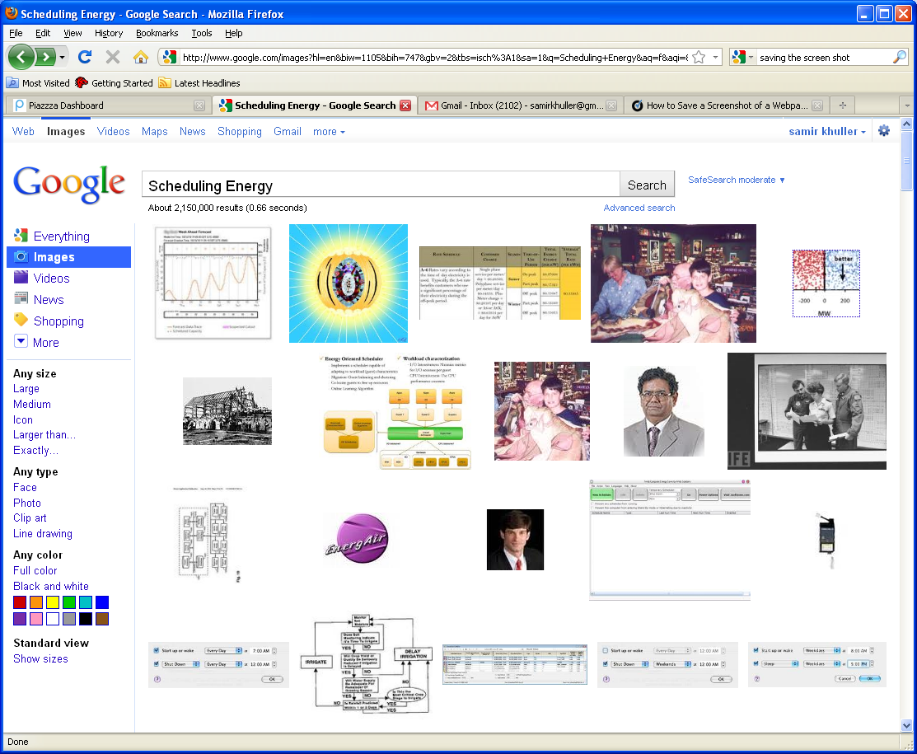
“Scheduling Energy”
FROM GOOGLE IMAGES

Slide 16
Large systems using many memory banks that can be turned on and off depending on the needs.
We can process P queries in each time unit, and queries have a window of time in which they should be run.
[R. Kleinberg] Communication in large systems (bunch messages into a single packet).

Slide 17
View through Flows
Each job is a node in J, and each time slot is a node in T.
Edge from j to t indicates that we can schedule job j at time t.
Pick a small set of nodes in T and create edges of capacity B to t.
The max flow should have value N (# jobs).
2
2
2
J
T
B=2

Slide 18
A more general model
Each job can be done in only a subset of time slots (not necessarily one interval).
Each job may have some non-unit (integral) processing requirement, but pre-emption is allowed.

Slide 19
Prior Related Work
Dynamic Programming based algorithm for the one window case with high polynomial complexity [Even, Levi, Rawitz, Schieber, Shahar, Sviridenko 2008] by developing an algorithm for interval-stabbing with capacities for the stabbers.
Scheduling Job in batches – however we wish to minimize number of batches, rather than max completion time or tardiness [Ikura,Gimple 1986] and other followup work [Condotta, Knust, Shakhlevich 2010].

Slide 20
Our Results
SINGLE WINDOW
An O(n logn) algorithm for one window with unit jobs (any B).
Polynomial DP solution for one window with unit jobs with arbitrary release times and deadlines, when time is not slotted (any B).
Pre-emptive version for non-unit jobs is NP-hard if we cannot change the processor that runs the job.
Problem with unit jobs is NP-hard for B ≥3.
Polynomial solution for B=2 and unit jobs. Extends for non-unit processing time (with pre-emption) and a given budget for number of active time slots if instance is schedulable, o.w NP-hard.
Consider pre-emptive scheduling when a slot is partially active, and develop a fast combinatorial algorithm.
Prove an relationship between optimal pre-emptive and non-preemptive schedules for B=2. This ratio is at least ¾.
MULTIPLE WINDOWS

Slide 21
Minimizing Busy Time
[Flammini, Monaco, Moscardelli, Shachnai, Shalom, Tamir, Zaks 2009] consider the problem of minimizing total busy time of (interval) jobs of arbitrary length that have to be packed into groups of “width” ≤P.
Packing logs into cartons of a fixed width.
Carton has to fit all its logs.
Minimize total length of cartons

Slide 22
[FMMSSTZ09]
Interval packing is NP-hard (follows by a reduction from Winkler and Zhang (2000).
Develop a greedy 4-approximation.
Improved approx. bounds for other special cases.

Slide 23
Main Ideas
Lower bound (1) OPT ≥ Total Size/P
Lower bound (2) OPT ≥ Span of Jobs
Order jobs in DECREASING length
First Fit: Pack interval in first bin, creating sets of jobs J(1), J(2)….
Lemma: Busy(J(i)) ≤ 3 Size(J(i-1))/P
Charge busy time of all bins except first…

Slide 24
Minimizing Busy Time
[Khandekar, Schieber, Shachnai, Tamir 2010] consider a generalization of the previous work when the intervals can be moved around within a window and the “width” of a job is between 1 and P.
PRESENT A 5 APPROX. + MOLDABLE JOBS

Slide 25
Minimizing Busy Time
Assume P= ∞, solve the problem (DP!).
Reduce this to the case of intervals.
Partition jobs into TWO classes – narrow and wide.
Wide jobs have width ≥P/4 and the wastage is a factor of 4.
Narrow jobs are packed greedily (as before).
Consider many special cases as well.

Slide 26
Classical Scheduling
Two Proc. Scheduling with prec. constraints
With integer release times and deadline [Garey, Johnson 76, 77]
Extensions when time is not slotted [Wu, Jaffar 02]
Scheduling jobs in clusters [Baptiste 06] and improvements [Baptiste, Chrobak, Durr 07]
Extensions by [Demaine et al 2007]
SCHEDULING UNIT JOBS TO MINIMIZE STARTUP ENERGY

Slide 27
Scheduling Unit Jobs
B=1 [Garey, Johnson, Simons, Tarjan 81]
Any B [Simons, Warmuth 89]
Above results in a non-slotted model – mainly for checking feasibility.

Slide 28
Back to our (basic) problem
Schedule N unit jobs with release times and deadlines, using the smallest number of active slots.
At most B jobs in an active slot, each job has a release time and deadline.

Slide 29
Lazy Algorithm
Order jobs by deadline d₁≤d₂≤ …≤d_{N}
If we have N_{i} jobs of deadline d_{i} then allocate ┌ N_{i} /P┐slots.
In addition we may choose “filler” jobs with future deadlines, using EDF.
KEY: we don’t change the set of scheduled jobs, but may re-assign jobs to slots.

Slide 30
A
A
A
P=2
In fact, we can schedule jobs in EDF order once we know the active slots.
Filler jobs with later deadlines can be chosen using EDF.

Slide 31
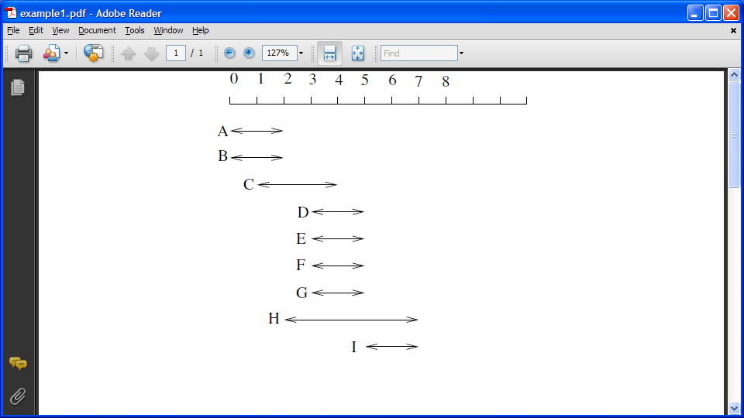

Slide 32
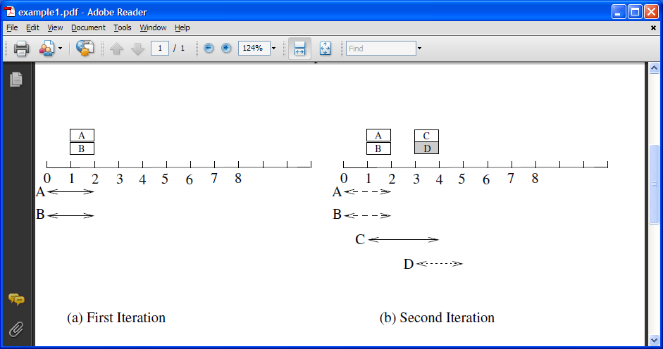
P=2

Slide 33
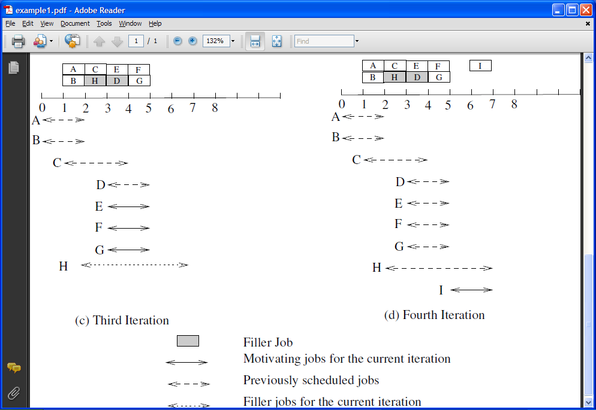

Slide 34
Pre-processing Step: Process overloaded time slots
B=3
Scan intervals from right to left, and reduce deadlines of excess jobs in overloaded slots (>B jobs with that deadline).
When choosing jobs, subtract one from deadlines of jobs with earlier release times.

Slide 35
Algorithm Lazy Activation
Order jobs in non-decreasing deadline order and scan jobs left to right.
Let Si be jobs with (common) deadline di.
Schedule jobs that have not been scheduled until now, as late as possible.
Use empty space to schedule (filler) jobs with later deadlines (based on EDF).

Slide 36
Example for Lazy Activation
Given a collection of N unit jobs, with release times and deadlines (integers).
In an active time slot we can schedule ≤B jobs.
Minimize number of “active” slots.
B=3
A
A
A
A
FOUR ACTIVE SLOTS

Slide 37
Proof of Optimality
Let I’ be the modified instance
Claim: OPT(I) = OPT(I’)
Pf: A solution for I’ is clearly feasible for I.
To show: a feasible solution for I is also feasible for I’.
}
P-1
x
y
r_{x}≤ r_{y}

Slide 38
OPT(I’) uses deadline slots
X
B
t
Pick an optimal solution with the least number of non-deadline slots.
Let t be the rightmost non-deadline slot.
Merge B and X and retain the P jobs with earliest deadlines, repeat pushing to the right.

Slide 39
Optimality of Lazy Algorithm
Consider the earliest deadline d_{1.}
Wlog we schedule the jobs with that deadline at the deadline.
Filler jobs are chosen based on EDF, an easy exchange argument justifies this choice.

Slide 40
Jobs have multiple windows
EACH JOB HAS A SET OF FEASIBLE SLOTS
N elements
M sets
Problem is NP-hard for P=3.
Reduction from 3 EXACT COVER.
Solution with N/3 sets corresponds to N/3 active slots that can do all N jobs.

Slide 41
Polynomial Alg. For B=2
Need to assign all jobs to slots.
Each slot has one or two jobs.
Minimize the number of slots with non-zero degree.
A
B
C
JOBS
TIME SLOTS

Slide 42
Max Degree Subgraph
Given a graph G=(V,E) and upper bound on degree constraints, find a max cardinality subgraph satisfying degree constraints.
Reducible to Matching

Slide 43
Polynomial Alg. For B=2
D(v)≤1
D(v)≤2
ADD SELF_LOOPS
A
B
C
JOBS
TIME SLOTS
FIND A MAX DEGREE CONSTRAINED SUBGRAPH HERE
|DCS| = |J|+|T-A|

Slide 44
Need to be a bit careful!
D(v)≤1
D(v)≤2
A
B
C
JOBS
TIME SLOTS
MAY NOT SCHEDULE ALL JOBS
FIND A DEGREE CONSTRAINED SUBGRAPH HERE
|DCS| = |J|+|T-A|

Slide 45
Remove self loops and find M*
A
B
C
FIND A MAX DEGREE CONSTRAINED SUBGRAPH
BY IMPROVING THIS INITIAL SOLUTION (RE-INSERT
SELF LOOPS)!

Slide 46
Remove self loops and find M*
MATCHED NODES
REMAIN MATCHED!
A
B
C
FIND A MAX DEGREE CONSTRAINED SUBGRAPH
(PUT SELF LOOPS BACK IN)
BY IMPROVING THIS INITIAL SOLUTION!

Slide 47
Extensions to Non-Unit Case
We can still find a pre-emptive schedule, provided all jobs can be satisfied – each job j has some length l(j).
If all jobs cannot be satisfied, the problem of satisfying the largest number of jobs becomes NP-hard.
In addition, we may have a FIXED budget for active slots; previous method extends.

Slide 48
Pre-emptive Scheduling of Unit Jobs
Time slots can be partially active or inactive.
Can reduce 2 slots to 1.5 active slots.
Ratio of pre-emptive to non-preemptive schedule cost is at least ¾.
Proof very involved, uses a conversion of the optimal non-pre-emptive schedule to a pre-emptive (fractional) schedule.
B=2

Slide 49
Original Motivation
[A]
[B]
[C]
[B,C]
[A]
A
B
B
C
A
C
CPU
CPU
CPU
STORAGE 1
STORAGE 2
STORAGE 3
Notes:
Motivation/context

Slide 50
Conclusions
For B=2, general windows, matching is needed! Take a graph G, and for each pair of adjacent nodes create a common slot when they can be scheduled. A perfect matching corresponds to an optimal schedule.
General B – O(log n) approximation using set cover.
Online Versions?
Improved algorithms for minimizing busy time?

Slide 51
THANKS TO OLA SVENSSON!

Slide 52
